Slide 1
21CSC303J – SOFTWARE ENGINEERING AND PROJECT MANAGEMENT
SRM RESEARCH HUB
Ponnuri Aniruddha (RA2112704010015)
Vamshi Gadde (RA2112704010017)
Y Shabanya Kishore (RA2112704010018)
Guide:
Dr.A.Shanthini

Slide 2

Project Description
The Research Paper Repository is a web-based platform designed to facilitate the management and access of research papers. It provides users with the ability to explore and contribute to a curated collection of academic publications, with a focus on papers published by SRM Institute of Science and Technology (SRMIST) researchers. The platform aims to streamline the process of discovering, sharing, and collaborating on research within the academic community.
‹#›

Slide 3
BUSINESS CASE TEMPLATE
TITLE / ROLE : SRM RESEARCH HUB
ABOUT THE PROJECT
● Current academic research papers are scattered across various sources, making it difficult for researchers to discover and access relevant publications.
● SRM Institute of Science and Technology (SRMIST) research papers may not receive adequate exposure beyond traditional academic circles, hindering their impact and recognition.
● Existing methods for sharing and collaborating on research papers are often cumbersome and lack user-friendly features, leading to inefficiencies in knowledge dissemination and collaboration.
● Researchers require a secure and intuitive platform to access, contribute, and collaborate on research papers while ensuring data privacy and integrity.
● By providing a centralized repository for research papers, the project aims to facilitate collaboration among researchers, students, and academic professionals, fostering innovation and knowledge exchange within the academic community.

Slide 4
BUSINESS CASE TEMPLATE
THE HISTORY
● Academic research papers from SRM Institute of Science and Technology (SRMIST) are scattered across various sources including academic journals, conference proceedings, and institutional repositories.
● Researchers, students, and academic professionals struggle to discover and access relevant SRMIST research papers due to the lack of a centralized platform.
● Existing methods for sharing and collaborating on research papers are often inefficient and fragmented, leading to challenges in knowledge dissemination and collaboration.
● SRMIST research papers may not receive adequate visibility and recognition beyond traditional academic circles, limiting their impact and contribution to the broader research community.

Slide 5
BUSINESS CASE TEMPLATE
LIMITATIONS
● Limited access to research papers: The project's success may be hindered if there are restrictions or limitations on accessing SRM Institute of Science and Technology (SRMIST) research papers from official sources.
● Technical challenges: Complexities in integrating with SRMIST's official website or obtaining data from various websites may pose technical hurdles to the project's development and functionality.

Slide 6
BUSINESS CASE TEMPLATE
APPROACH
Research and Analysis:
● Conduct research on existing academic repositories and collaboration platforms.
● Analyze user requirements and preferences within the SRM Institute of Science and Technology (SRMIST) community.
● Investigate technical feasibility and compatibility with SRMIST's official website and data sources.
Data Integration:
● Establish connections with SRMIST's official website or data sources to fetch research paper metadata.
● Develop scripts to retrieve and parse data from external sources. `
● Implement a data cleansing process to ensure that the data conforms to the database structure.
Database Management:
● Design and implement a scalable database for storing user information, research papers, and metadata.
● Optimize database queries and indexing for efficient data retrieval and storage.

Slide 7
BUSINESS CASE TEMPLATE
BENEFITS
● Centralized repository for research papers enhances accessibility and visibility of SRM Institute of Science and Technology (SRMIST) publications.
● Facilitates collaboration and knowledge sharing among researchers, students, and academic professionals within the institution.
● Streamlines the process of discovering, accessing, and citing relevant research papers, thereby fostering academic excellence and innovation.
● Enhances the reputation and recognition of SRMIST as a hub for cutting-edge research and scholarly contributions.
● Encourages interdisciplinary collaboration and cross-departmental engagement by providing a platform for interdisciplinary research exploration.

Slide 8
STAKEHOLDERS
Stakeholder Name | Activity/ Area /Phase | Interest | Influence | Priority (High/ Medium/ Low)
Researchers | Access to latest research papers | High | Low | Medium
Students | Access to educational resources | High | High | High
Faculty Members | Research dissemination and collaboration | High | High | High
External Researchers | Access to SRMIST research papers | High | Low | Low

Slide 9
WATERFALL METHODOLOGY
Well-defined Requirements: If the requirements for the SRM Research Hub are clear from the outset, with little expectation of change, the Waterfall model allows for a systematic progression through the stages of development.
Sequential Phases: The Waterfall model sequential nature – with distinct phases for requirements gathering, design, implementation, verification, and maintenance – ensures that each phase can be completed and reviewed for quality before moving on to the next.
Documentation and Rigor: This model emphasizes rigorous documentation and adherence to initial plans, which can be beneficial for aligning with institutional policies and maintaining clarity of purpose throughout the project lifecycle.
Stakeholder Communications: It can be easier to communicate progress to stakeholders with a Waterfall approach because the project is divided into distinct stages with concrete deliverables at the end of each phase.
Resource Planning: The Waterfall model allows for more predictable resource allocation and scheduling since each phase is planned in detail at the start of the project.

Slide 10
REQUIREMENTS
System requirements
Hardware
Server infrastructure capable of hosting web services, managing databases, and storing sensitive data.
Scalable storage solutions can handle increasing volumes of research papers and user data.
Software:
Web server software and a database management system (such as MySQL or PostgreSQL).
Frameworks and libraries designed for web application development
Compatibility:
Compatibility with a variety of research paper file formats (for example, PDF and DOCX).

Slide 11
REQUIREMENTS
Functional requirements:
User Authentication and Authorization:
Users should be able to register for accounts with a valid email address and password.
Registered users should be able to log in to the website securely.
The system should enforce password strength requirements and provide options for password recovery and account management.
Different user roles (e.g., regular user, administrator) should have different levels of access permissions.
Research Paper Discovery and Search:
Users should be able to browse and search for research papers by title, authors, publication date, keywords, and categories.
The search functionality should support advanced filtering options to refine search results.
Users should be able to view detailed information about each research paper, including abstracts, authors, publication details, and related metadata.

Slide 12
REQUIREMENTS
Functional requirements:
Research Paper Upload and Submission:
Registered users should have the ability to upload research papers to the platform.
The upload process should include fields for entering metadata such as title, authors, abstract, keywords, and publication date.
The system should validate uploaded papers to ensure they meet specified file format and size requirements.
Uploaded papers should undergo review by administrators before being made publicly accessible.
Administrative Tools:
Administrators should have access to tools for managing user accounts, reviewing uploaded papers, and moderating user interactions.
The system should provide administrative dashboards and reporting tools for monitoring platform usage and performance.

Slide 13
REQUIREMENTS
Non-functional requirements:
Usability:
The website should have a clean and intuitive user interface, with consistent navigation and layout across pages.
Content should be organized logically, with clear labels and descriptive headings to aid user comprehension.
The website should be responsive and mobile-friendly, adapting to different screen sizes and devices
Reliability:
The system should be reliable and resilient, with mechanisms in place to detect and recover from failures automatically.
Error handling and logging should be implemented to track system errors and provide useful feedback to users and administrators.
Backup and recovery procedures should be documented and tested regularly to ensure data integrity and availability.

Slide 14
Effort and Cost Estimation
Activity Description | Sub-Task | Sub-Task Description | Effort (in hours) | Cost in INR
Design the user screen | E1R1A1T1 (Effort-Requirement-Activity-Task) | Designing the User Login page | 5 | 10,000
 | E1R1A1T2 | Designing the Home Page | 7 | 10,000
 | E1R1A1T3 | Designing the student dashboard | 8 | 10,000
 | E1R1A1T4 | Designing the teacher dashboard | 8 | 10,000
 | E1R1A1T5 | Designing the Back End | 10 | 24,000
Identify Data Source for displaying units of Energy Consumption |  | Go through Interface contract (Application Data Exchange) documents | 5 | 10,000
 |  | Document | 3 | 6,0000
 |  | Software testing | 8 | 16,000
Effort (hr) | Cost (INR)
1 | 5,000

Slide 15
Infrastructure/Resource Cost
Infrastructure Requirement | Qty | Cost per qty | Cost per item
IR1 | PC’s | 4 | 70,000
IR2 | Wi-Fi | 1 | 4,000
 | Hosting Server | 1 | 6,000
 | Backup Server | 1 | 6,000
 | Tie-Up with all Department | NA | NA

Slide 16
Maintenance and Support Cost
Category | Details | Qty | Cost per qty per annum | Cost per item
People | Network, System, Middleware and DB admin Developer , Support Consultant | 3 | 2,000,000 | 60,00,000
License | Operating System Database Middleware IDE | 10 | 10000 | 1,00,000
Infrastructures | Server, Storage and Network | 20 | 20000 | 4,00,000

Slide 17
Identification Team members
Name | Role | Responsibilities
vamshi,Aniruddha,Shabanya | Key Business User (Product Owner) | Provide clear business and user requirements
vamshi,aniruddha | Project Manager | Manage the project
shabanya | Business Analyst | Discuss and Document Requirements
aniruddha | Technical Lead | Design the end-to-end architecture
vamshi | UX Designer | Design the user experience
vamshi | Frontend Developer | Develop user interface
aniruddha | Backend Developer | Design, Develop and Unit Test Services/API/DB
shabanya | Cloud Architect | Design the cost effective, highly available and scalable architecture
shabanya | Cloud Operations | Provision required Services
vamshi | Tester | Define Test Cases and Perform Testing

Slide 18
Responsibility Assignment Matrix
RACI Matrix | Team Members
 | Vamshi (Designer) | Aniruddha (Developer) | Shabanya (Project Manager & BA)
User Requirement Documentation | - | C/I | A
Advertisement | C | C | R
Development | C | R | I
Website Design | R | A | I
Testing / Deployment | - | A | C
Bug Fixes | A | R | I
Update & Upgrade | - | C | A
A | Accountable
R | Responsible
C | Consult
I | Inform

Slide 19
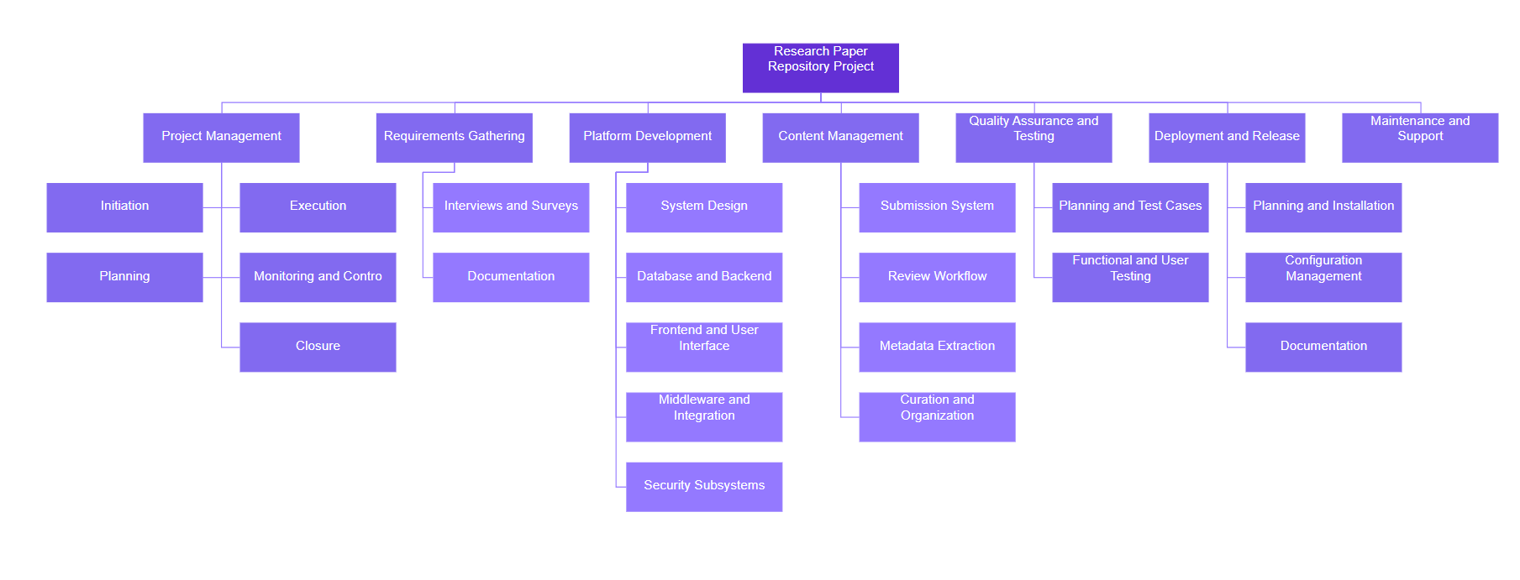
WBS

Slide 20
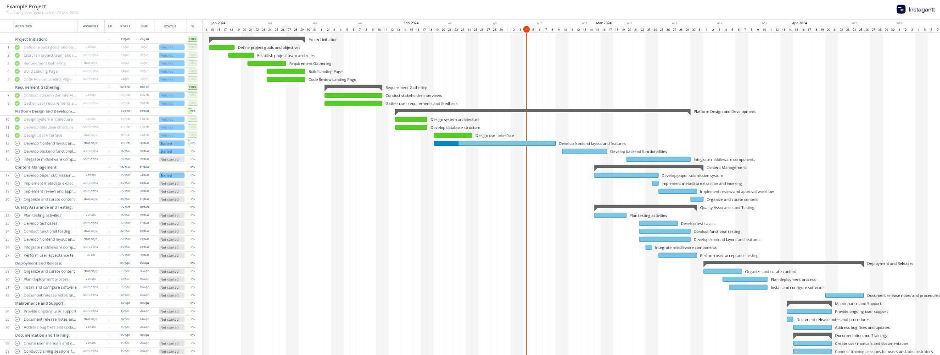
GANTT CHART

Slide 21
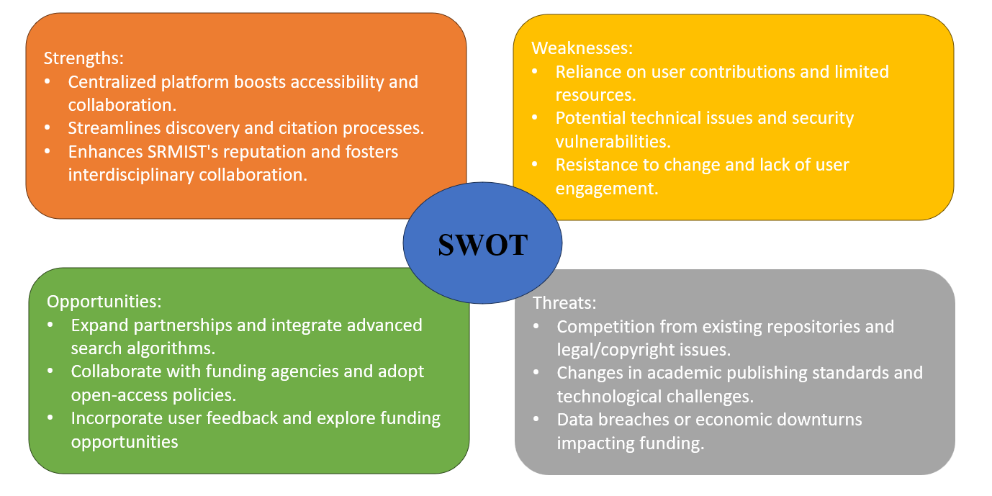
SWOT

Slide 22
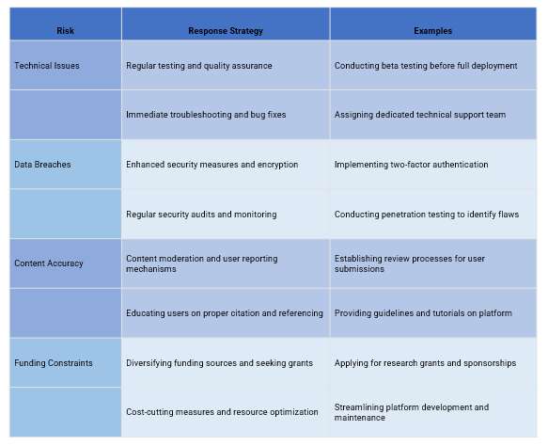
RMMM

Slide 23
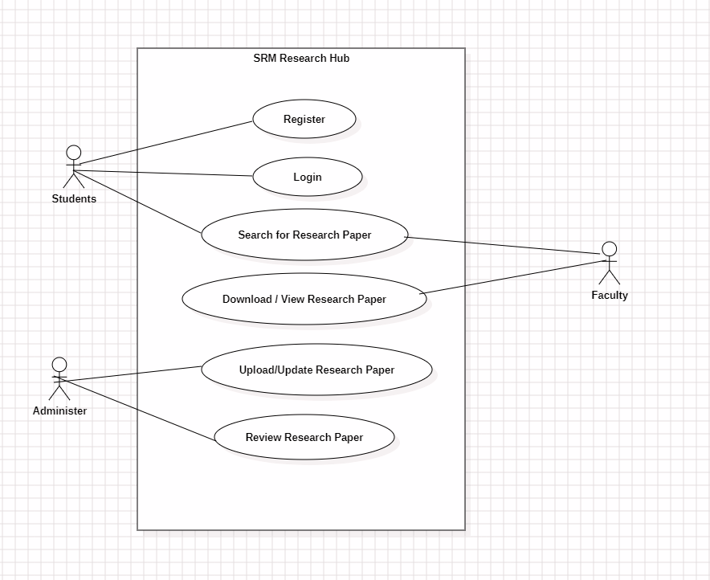
USE CASE DIAGRAM

Slide 24
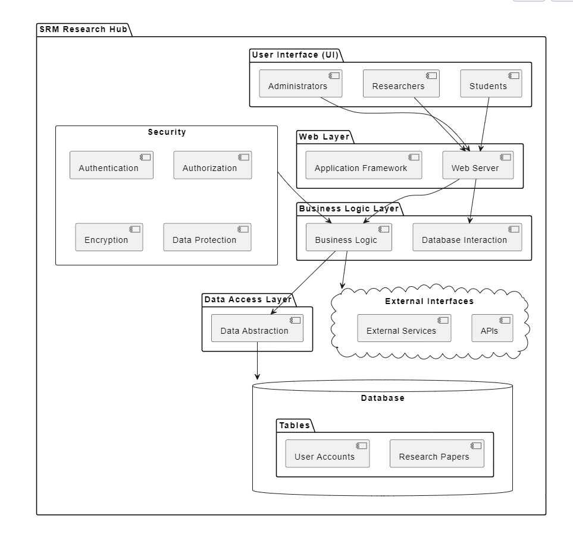
SYSTEM ARCHITECTURE

Slide 25
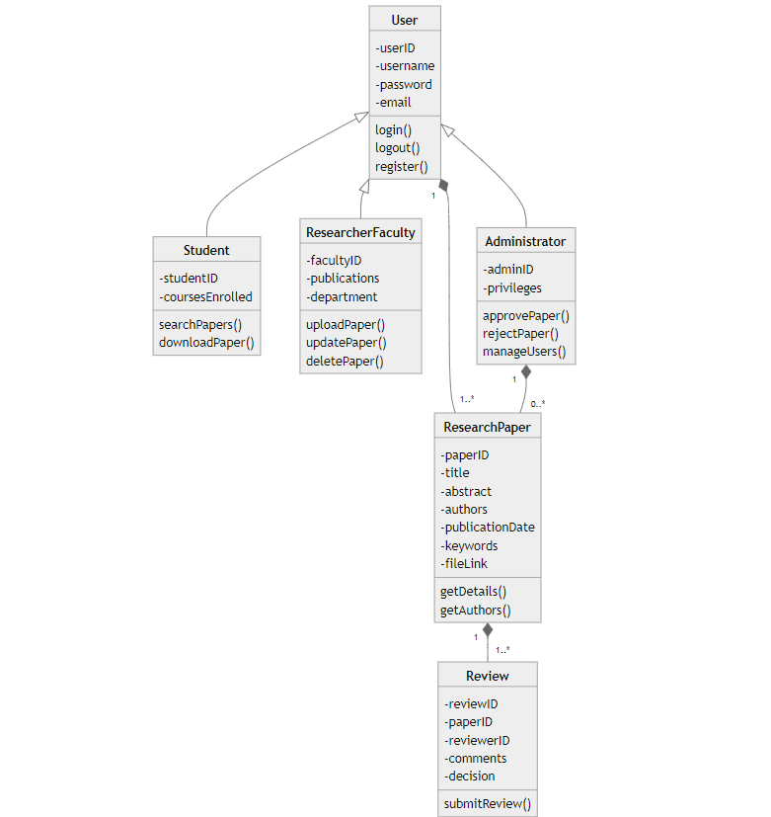
CLASS DIAGRAM

Slide 26
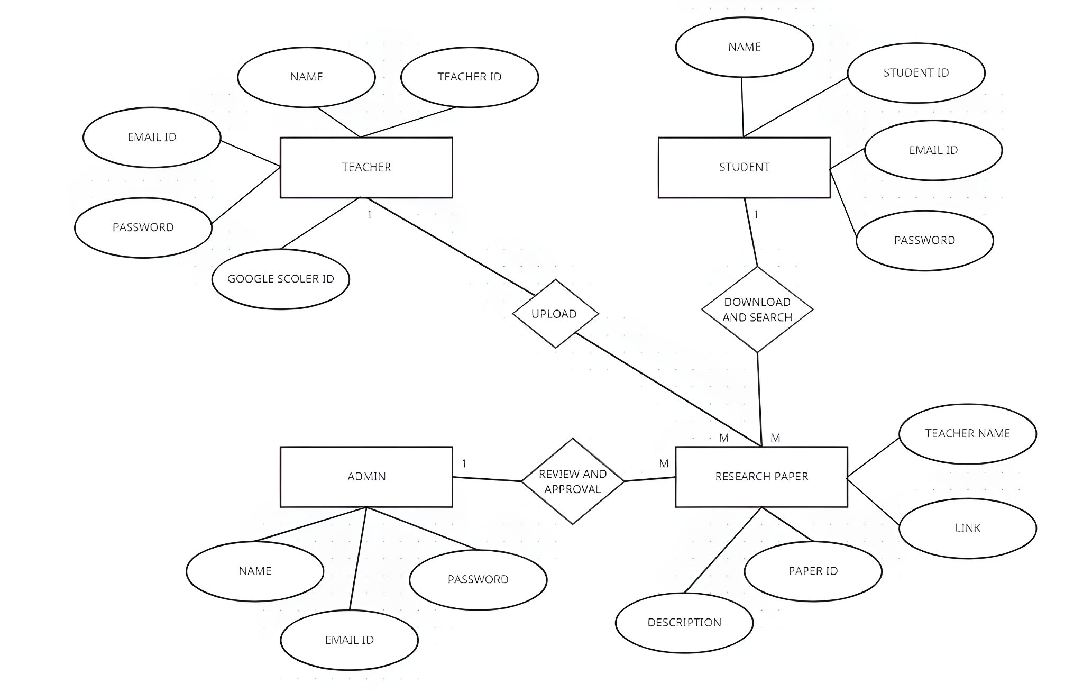
ER DIAGRAM

Slide 27
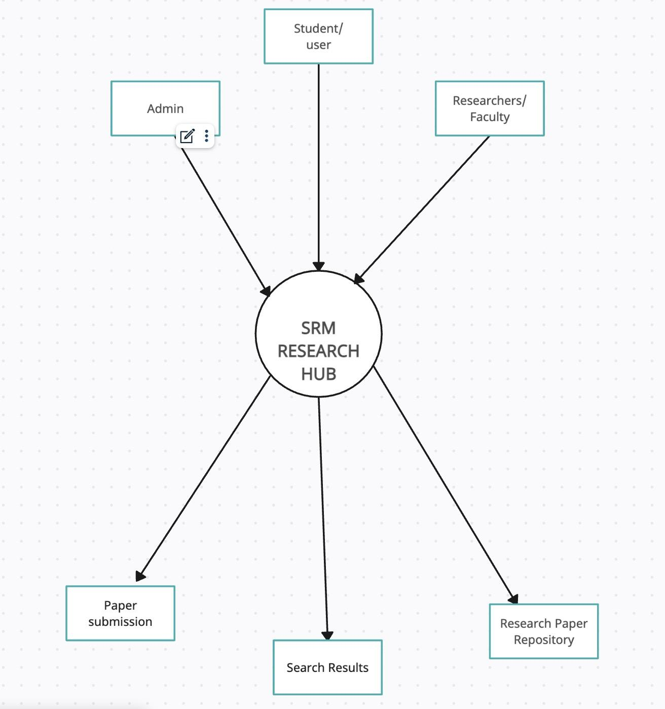
Data Flow Diagram Level - 0

Slide 28
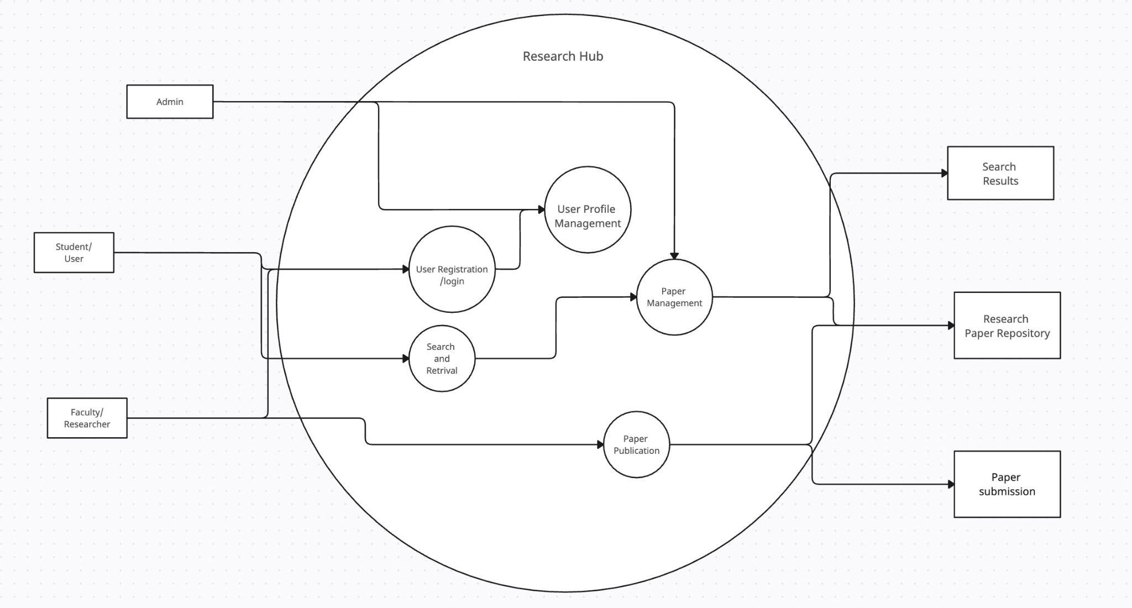
Data Flow Diagram Level - 1

Slide 29
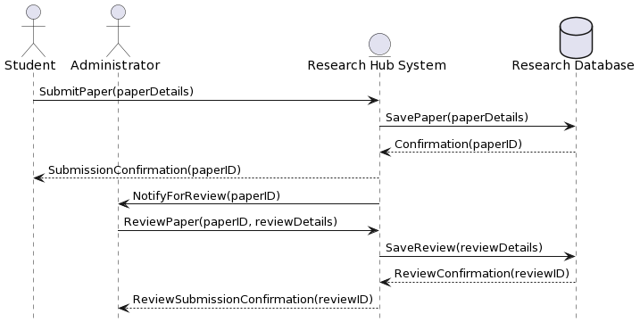
SEQUENCE DIAGRAM

Slide 30
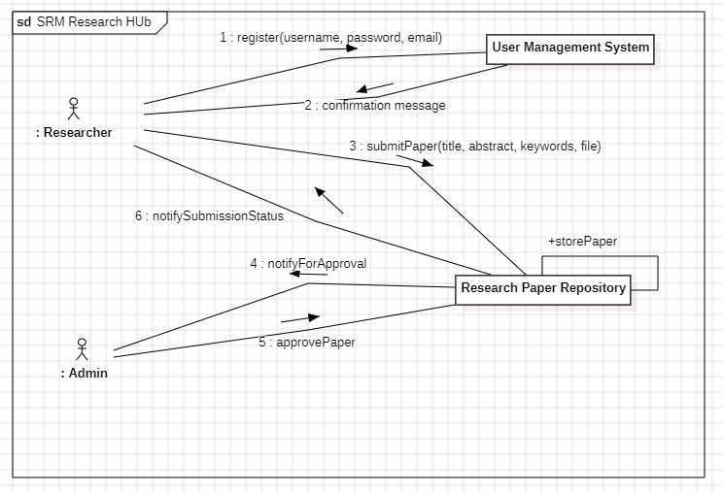
COLLABORATION DIAGRAM

Slide 31
Testing Framework/User Interface
Functional Testing:
All application modules will be covered, with a focus on core functionalities like user registration, login, research paper management (upload, download, edit, delete), search and filtering, user profiles, and integration with SRMIST sources.
Automation will cover critical functionalities and regression testing of core user flows.
Manual testing will address specific test cases and edge cases that are less suitable for automation.

Slide 32
Testing Framework/User Interface
Non-Functional Testing:
Performance testing will assess response times, load capacity, and scalability under varying user loads.
Usability testing will involve user feedback to evaluate the interface's intuitiveness, learnability, and overall user experience.
Security testing will ensure data security, role-based access control, and protection against vulnerabilities.

Slide 33
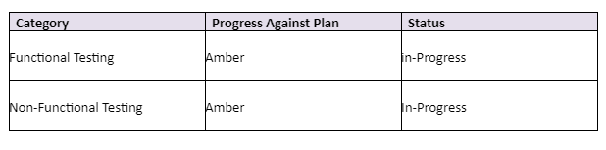
Testing Progress

Slide 34
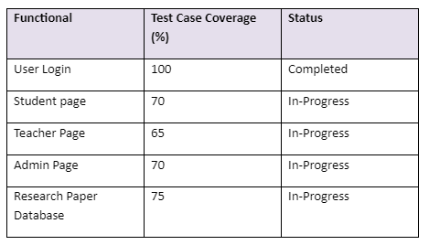
Functional Testing

Slide 35
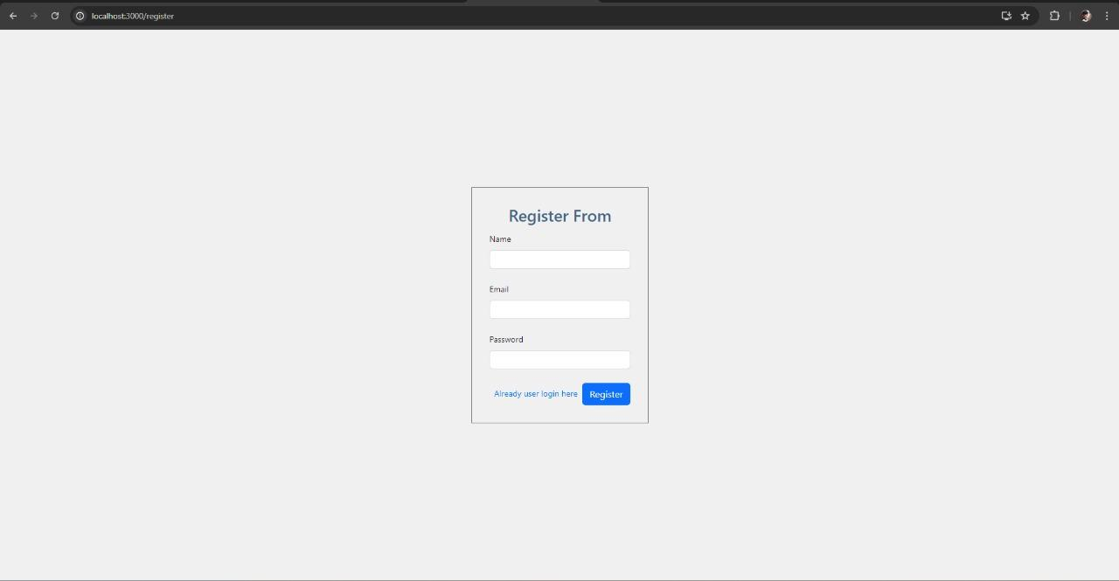
User Registration

Slide 36
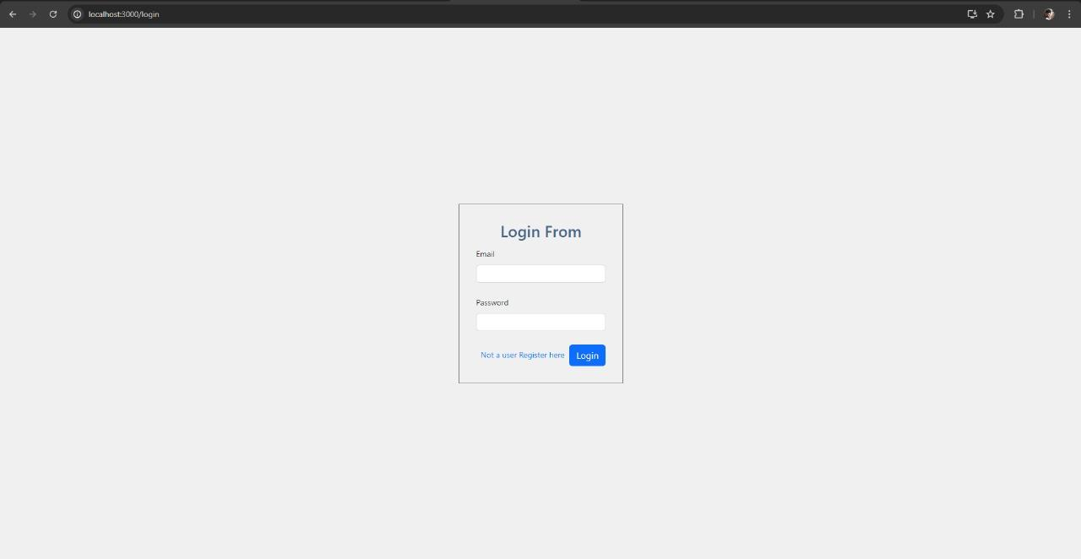
User Login

Slide 37
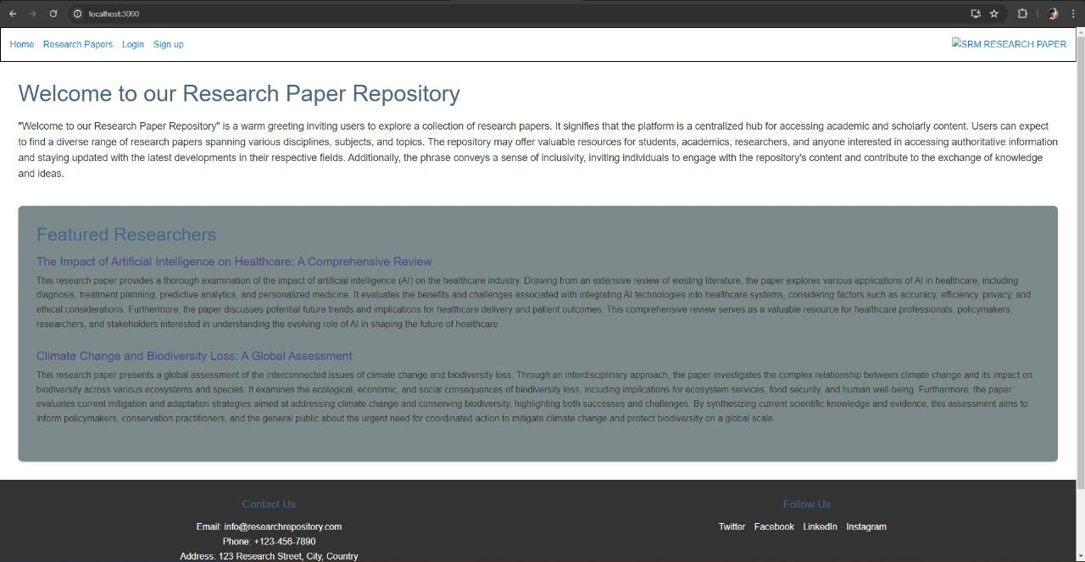
Home Page(Landing Page)

Slide 38
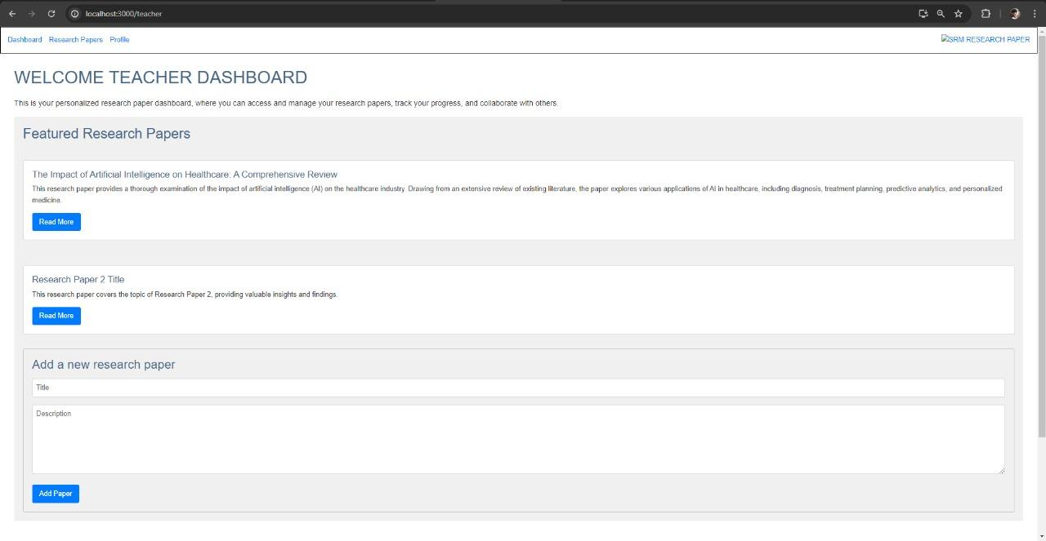
Teacher dashboard

Slide 39
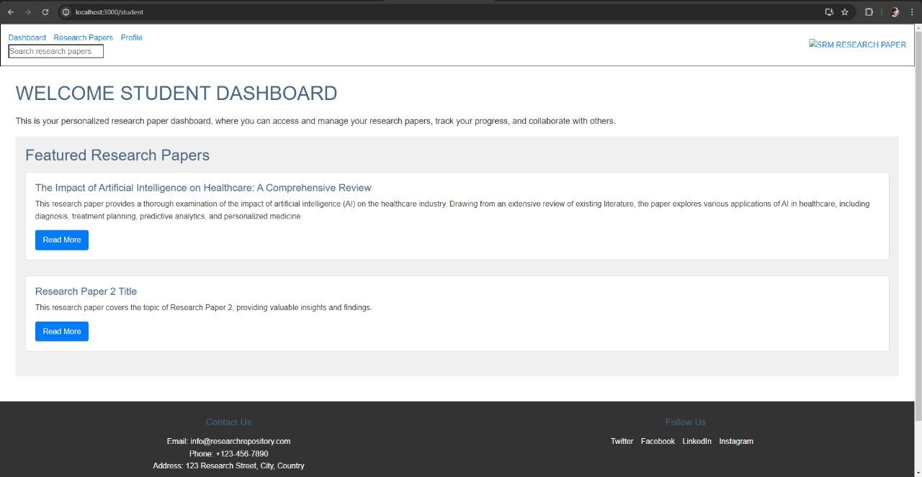
Student Dashboard

Slide 40
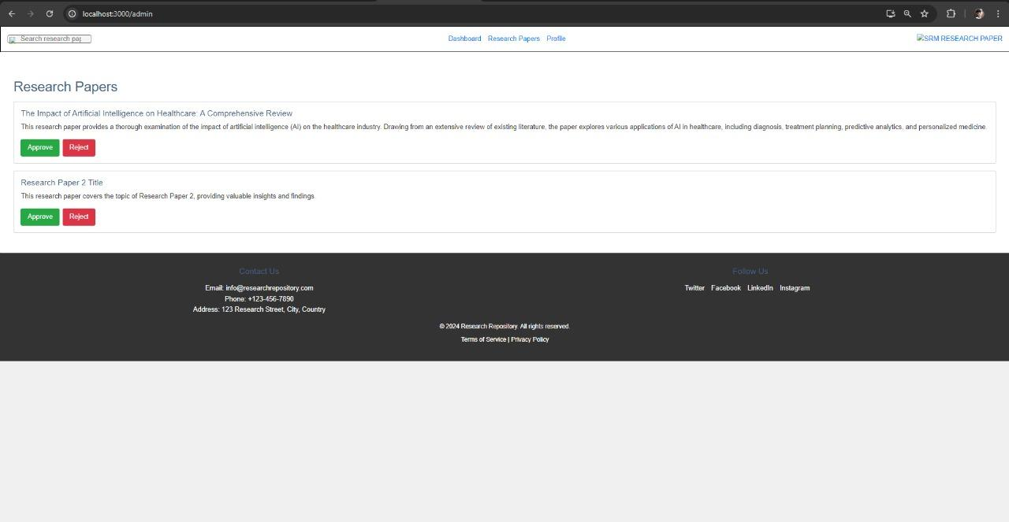
Admin Dashboard

Slide 41
REFERENCES
Boosting Java Application Development with Eclipse: This book, available as of December 2020, offers a comprehensive guide on using Eclipse for Java application development, covering aspects like configuring servers, automatic code generation, and exception handling, which could be particularly useful for backend development aspects of your project.
Analysis and Classification of Requirements Specification for Web Application Development: A study from July 2020 that provides a model for classifying stakeholders' requirements in web application development. This could be instrumental in ensuring that your project meets the needs of its intended users and stakeholders effectively.
Web Application Development Based on Gamification Technique: This thesis from July 2020 explores using gamification techniques in web application development to enhance learning achievement and motivation. This approach could be useful if your project aims to engage users in an educational context or to increase user interaction and retention.
Leukemia Decision Support Web Application Development Process: A poster from April 2020 detailing the development process of a web application aimed at aiding medical decision-making. This resource could provide insights into designing web applications for specialized fields and ensuring user needs are met effectively.
Research and Analysis of the Front-end Frameworks and Libraries in E-Business Development: This paper discusses the design and development of web-based platforms for conducting online research, highlighting the importance of scalable architecture and the use of REST API for component communication, which could be applicable to your project's design.
Each of these papers provides a unique perspective that could be applied to different aspects of your project, from technical implementation to user engagement strategies. Exploring these resources could offer valuable insights and methodologies to enhance the development and success of your web application.

