Slide 1
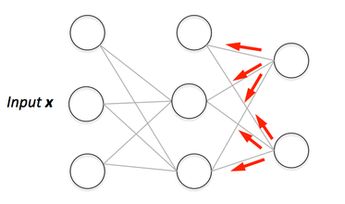
Backpropagation
https://hmkcode.com/ai/backpropagation-step-by-step/

Slide 2
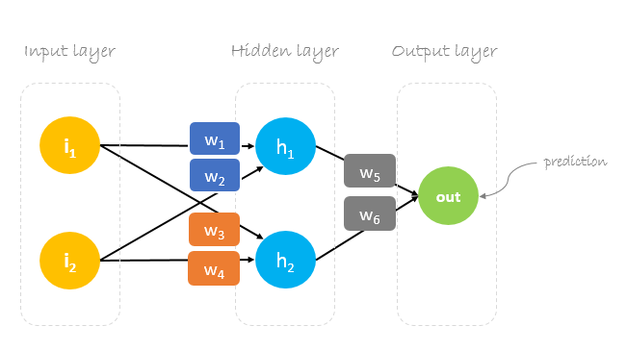
Backpropagation

Slide 3
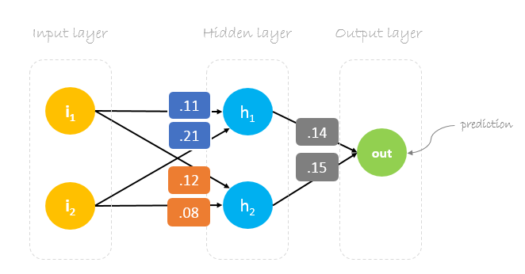
Backpropagation

Slide 4
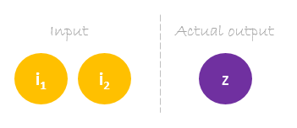
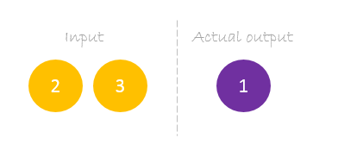
Backpropagation

Slide 5
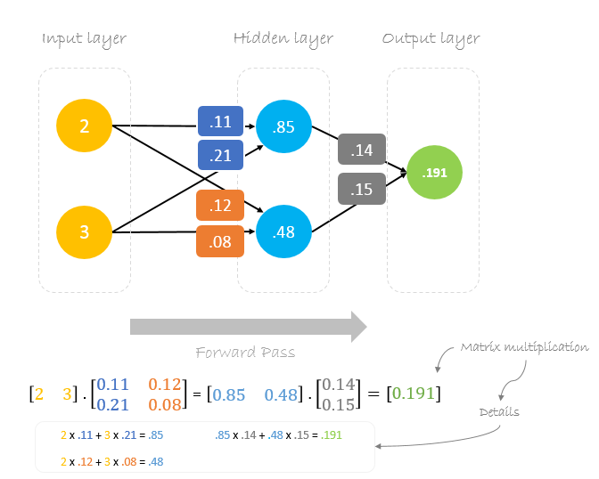
Backpropagation

Slide 6
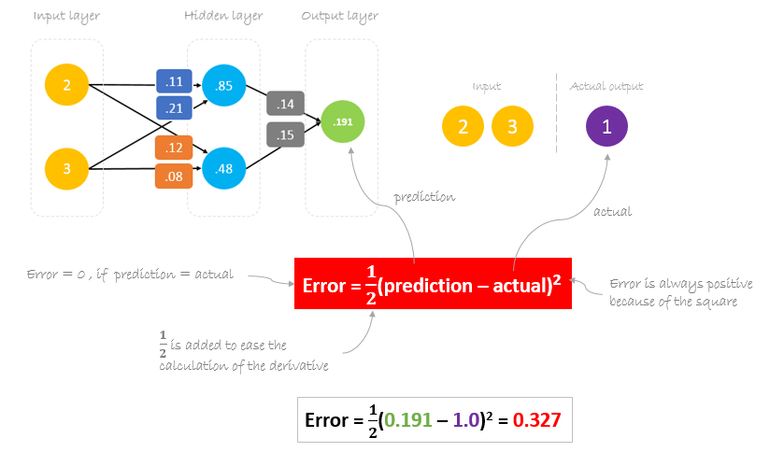
Calculating Error

Slide 7
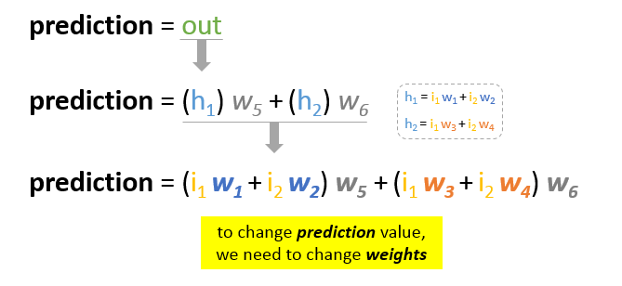
Reducing Error

Slide 8
Backpropagation
Backpropagation, short for “backward propagation of errors”, is a mechanism used to update the weights using gradient descent. It calculates the gradient of the error function with respect to the neural network’s weights. The calculation proceeds backwards through the network.
Gradient descent is an iterative optimization algorithm for finding the minimum of a function; in our case we want to minimize the error function. To find a local minimum of a function using gradient descent, one takes steps proportional to the negative of the gradient of the function at the current point.

Slide 9
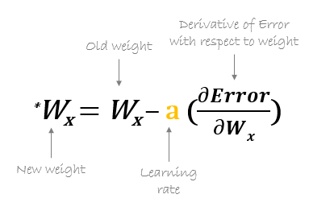

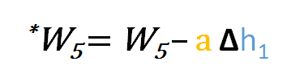
Backpropagation

Slide 10
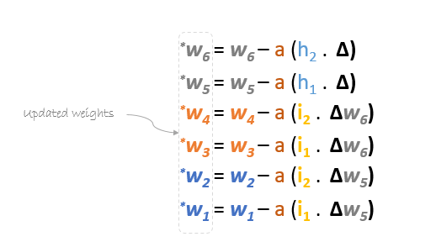
Backpropagation

Slide 11
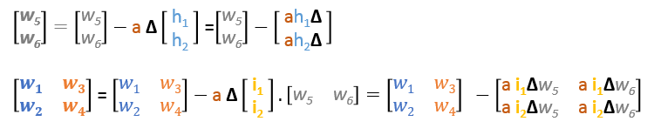
Backpropagation
Formulas in Matrices

Slide 12
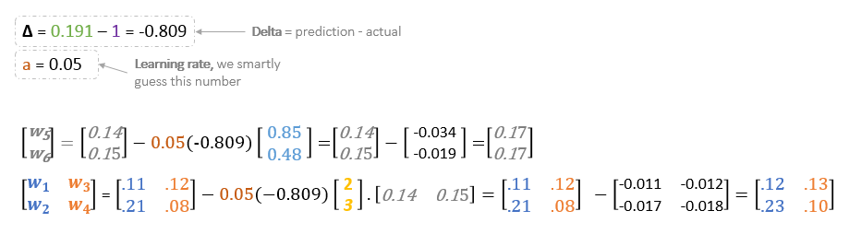
Backpropagation
Backward Pass

Slide 13
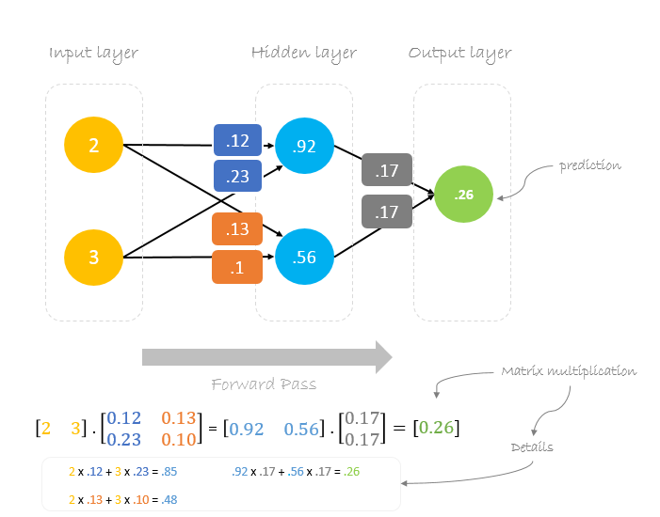

Slide 14
Backpropagation
We can notice that the prediction 0.26 is a little bit closer to actual output than the previously predicted one 0.191. We can repeat the same process of backward and forward pass until error is close or equal to zero.

