Slide 1
Gradient Based Learning

Slide 2
Gradient-Based Learning
Largest difference between simple ML Models and neural networks are nonlinearity of a neural network causes most interesting loss functions to become non-convex. This means that neural networks are usually trained by using iterative, gradient-based optimizers that merely drive the cost function to a very low value, rather than exact linear equation solvers used to train linear regression models or the convex optimization algorithms used for logistic regression or SVMs.

Slide 3
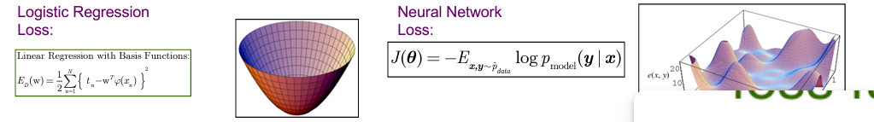
Loss: Standard ML vs NN
Use iterative gradient-based optimizers that merely drives cost to low value, rather than •Exact linear equation solvers used for linear regression or •convex optimization algorithms used for logistic regression or SVMs

Slide 4
Optimization
We need to use the loss to train our network such that it performs better.
A lower loss means our model is going to perform better.
The process of minimizing any mathematical expression is called optimization.
Notes:
https://www.kdnuggets.com/2020/12/optimization-algorithms-neural-networks.html

Slide 5
Optimizers
Optimizers are algorithms or methods used to change the attributes of the neural network such as weights and learning rate to reduce the losses. Optimizers are used to solve optimization problems by minimizing the function.

Slide 6
Types of Optimizers
Gradient Descent
Stochastic Gradient Descent (SGD)
Mini Batch Stochastic Gradient Descent (MB-SGD)
SGD with momentum
Adaptive Gradient (AdaGrad)
RMSprop
Adam

Slide 7
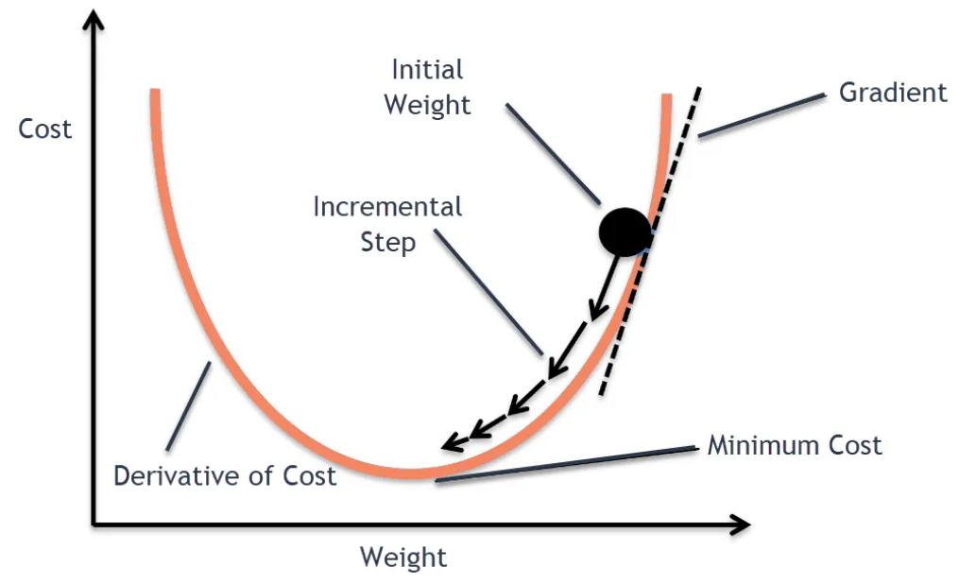
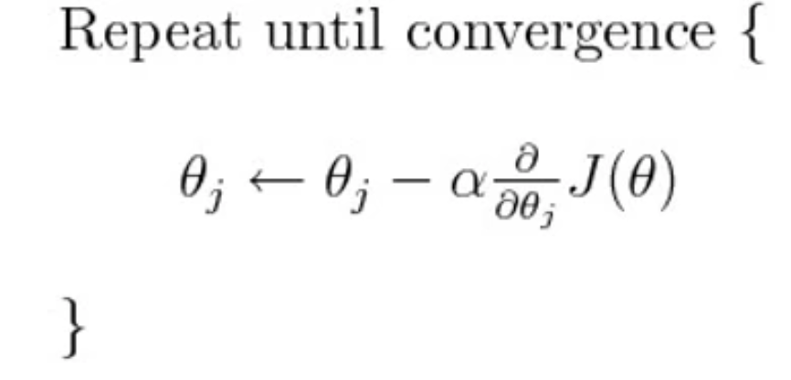
Gradient Descent

Slide 8
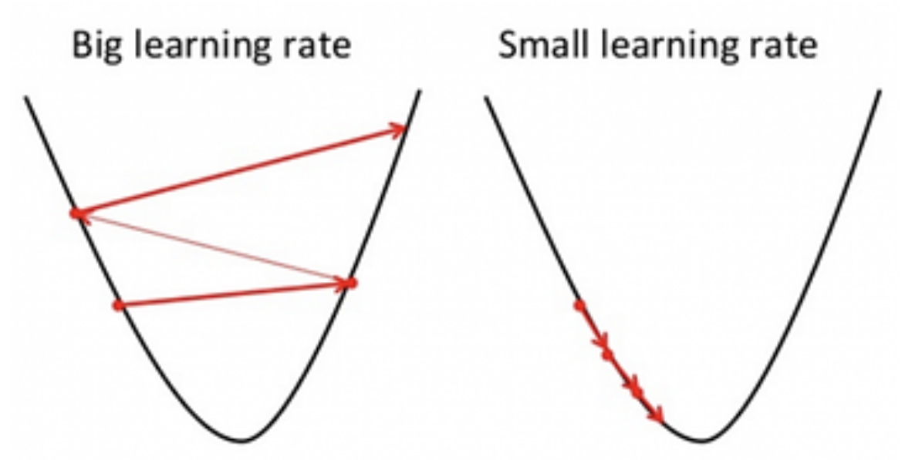
Gradient Descent – Learning Rate

Slide 9
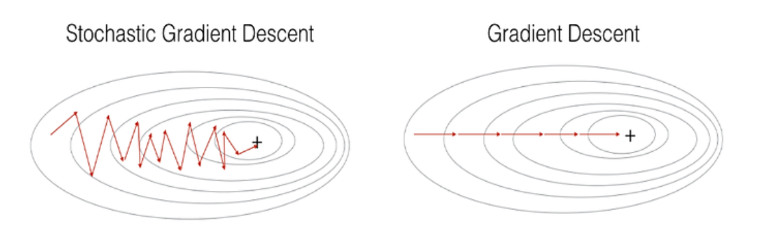
Stochastic Gradient Descent (SGD)
Considering One input at a time

Slide 10
GD and SGD
Batch Size:
Gradient Descent (GD): In gradient descent, the entire dataset is used to compute the gradient of the cost function with respect to the parameters in a single iteration. This means that the entire dataset is processed in one go.
Stochastic Gradient Descent (SGD): In stochastic gradient descent, only a single randomly chosen data point is used to compute the gradient in each iteration.

Slide 11
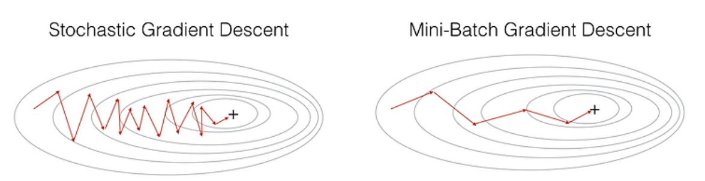
Mini Batch Stochastic Gradient Descent (MB-SGD)
MB-SGD algorithm takes a batch of points or subset of points from the dataset to compute derivate.

Slide 12
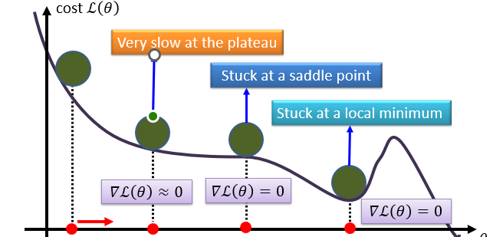
SGD with Momentum

Slide 13
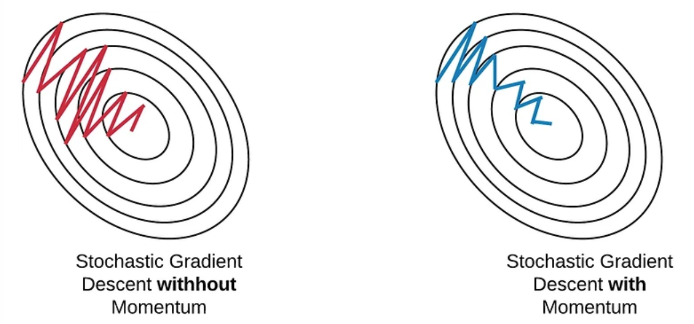
SGD with Momentum
Denoise derivative using exponential weighting average that is to give more weightage to recent updates compared to the previous update.

Slide 14
Adaptive Gradient Descent (AdaGrad)
For all the previously discussed algorithms the learning rate remains constant. So the key idea of AdaGrad is to have an adaptive learning rate for each of the weights.
It performs smaller updates for parameters associated with frequently occurring features, and larger updates for parameters associated with infrequently occurring features.

Slide 15
RMSprop
RMSProp (Root Mean Squared Propagation) is an adaptive learning rate optimization algorithm.

Slide 16
Adagrad Vs. RMSProp
Adaptive Learning Rates:
Adagrad: Adagrad adapts the learning rates for each parameter based on the historical gradient information. It maintains a separate learning rate for each parameter, and the learning rates are inversely proportional to the square root of the sum of squared gradients for each parameter. This means that parameters with larger gradients receive smaller learning rates, and vice versa.
RMSprop: RMSprop (Root Mean Square Propagation) also adapts learning rates based on the historical gradient information but uses a moving average of squared gradients. The purpose of this moving average is to give less weight to recent squared gradients and more weight to historical ones. It addresses one drawback of Adagrad by using a decaying average of past squared gradients, which prevents the learning rates from becoming too small too quickly.

Slide 17
Adaptive Moment Estimation (Adam)
It combines ideas from both momentum-based methods and adaptive learning rate methods to achieve efficient and effective optimization.

Slide 18
Adam Vs. RMSprop
Adam: Adam adapts the learning rates for each parameter based on both the first and second moments of the gradients. It maintains separate adaptive learning rates for each parameter, incorporating both momentum and adaptive learning rates.
RMSprop: RMSprop also adjusts the learning rates for each parameter. It uses a moving average of squared gradients to adaptively scale the learning rates. However, RMSprop does not incorporate momentum.

