Slide 1
WATER POLLUTION AND ITS MANAGEMENT UNIT IV 18CEO405T
Dr. S. Karuppasamy
Department of Civil Engineering
SRMIST

Slide 2
ROLE OF POLLUTION CONTROL BOARD
Classifying water of the central/state
Laying down, modifying or annulling effluent standards for (a) sewage/trade effluents (b) the quality of receiving water resulting from discharge of effluents
Laying down standards of treatment of sewage/trade effluents to be discharges into a stream.
Evolving economical and reliable methods of treatment of sewage/trade effluents, methods of utilization in agriculture, and efficient methods of disposal on land in certain cases;
Reviewing the disposal system of sewage effluents, works and plants for sewage treatment or in connection with the grant of any consent;
Making, varying or revoking any order (i) for prevention, control or abatement of discharge of waste into streams or wells (ii) requiring any person concerned to construct new systems for the disposal of sewage/trade effluents or to modify, alter or control water pollution.
Advising the government(Central/State) with respect to the location of an industry whose operation is likely to result in water pollution.

Slide 3
ROLE OF POLLUTION CONTROL BOARD
The Water Act prohibits any person from knowingly causing or permitting the entry of
(i) any poisonous, noxious or polluting matter, directly or indirectly, into any stream or well or water or on land
any other matter into any stream which may tend, either directly or in combination with similar matters, to impede the proper flow of the water of the stream in a manner leading or likely to a substantial aggravation of pollution due to other causes or of its consequences.
CPCB/SPCB is responsible for determining whether the matter is poisonous, noxious or polluting or any other matter.

Slide 4
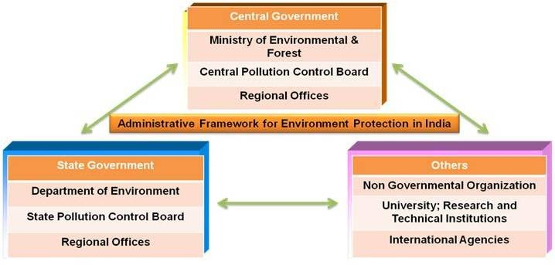
HIERARCHY - POLLUTION CONTROL BOARD

Slide 5
POWER OF POLLUTION CONTROL BOARD
The central pollution control board is vested with the following powers:
The Central Pollution Control Board (CPCB) is empowered by section 18 of the Water ( Prevention and Control of Pollution) Act, 1974 to give directions to the state pollution Control boards.
The CPCB has powers to perform any on the functions of the state pollution SPCB (State Pollution Control Board) in case of non-compliance of any directions given by the CPCB.
The CPCB is empowered to issue directions under section 33A of Water Act, 1974 to direct the closure, prohibition or regulation of any industry, operation or process or the stoppage or regulation of supply of electricity, water or any other service.

Slide 6
POWER OF STATE POLLUTION CONTROL BOARD
The SPCB has the following powers conferred on it by the Water (Prevention and Control of Pollution) Act, 1974:
Power to obtain information (section 20)
Power to take samples of effluents for analysis (section 21)
Power of any entry and inspection
Power to impose restrictions on new outlets and new discharges
Power to refuse or withdraw consent for the establishment of any industry, etc ( section 27)
Power to carry out emergency operations in case of pollution of stream or well (section 32)
Power to make applications to the courts for restraining apprehend pollution of water in streams or wells.
Power to give directions

Slide 7
THE WATER CESS ACT, 1977
The act came in existence on December 7, 1977. It provides for the levy and collection of a cess on water consumed by persons carrying certain industries and by local authorities, with the view to augment the resources of the Central and State Boards for prevention and control of water pollution.
The Act extends to the whole of India except the State of Jammu and Kashmir. It is consisted of 17 sections. The salient features of the Act are as follows.
1. There shall be levied and collected a cess calculated on the basis of the water consumed. The cess shall be payable by
(a) Every person carrying on any specified industry
(b) Every local authority
Schedules I and II of this Act give the list of specified industries and rates at which the cess is to levied respectively.
Affixing meters for measuring water quantity used and the furnishing of returns for water use by the industry and local authority.

Slide 8
THE WATER CESS ACT, 1977
3. The proceeds of the cess levied shall first be credited to the consolidated fund of India and Central Government to pay Central and State Boards from time to time, from this proceed.
Provision of penalty not exceeding the amount of cess in arrears, for non-payment of cess within the specified time. False return filing shall attract the penalty of imprisonment up to six months.
The Central Government may make rules for carrying out the purposes of this Act.

Slide 9
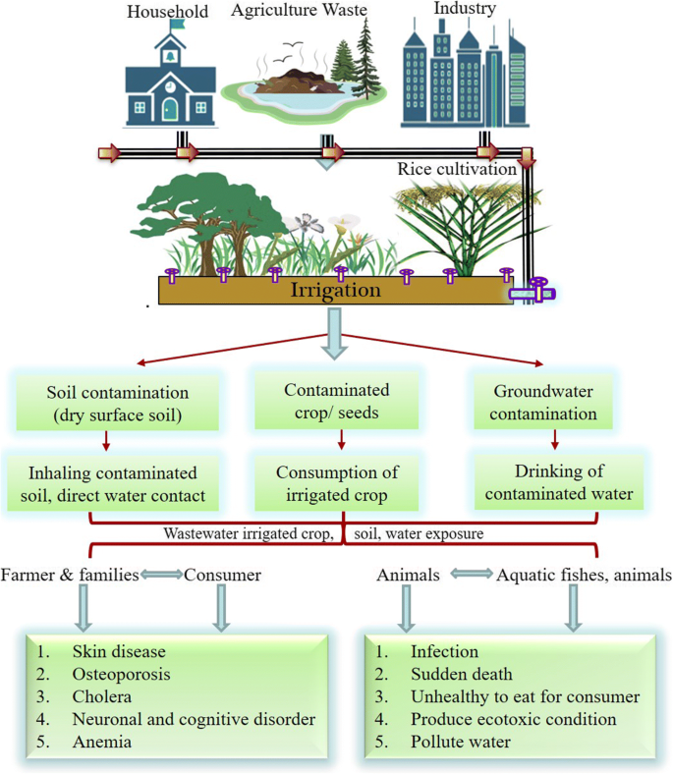
IRRIGATIONAL APPROACH IN WASTEWATER CONSERVATION

Slide 10
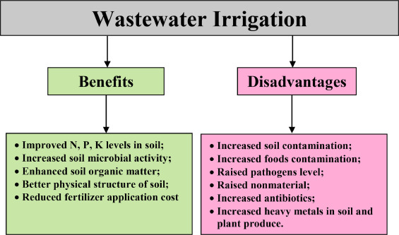
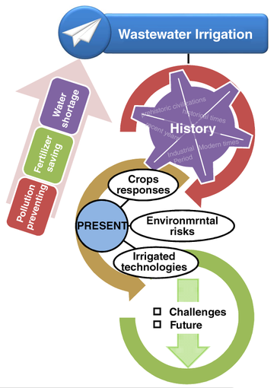
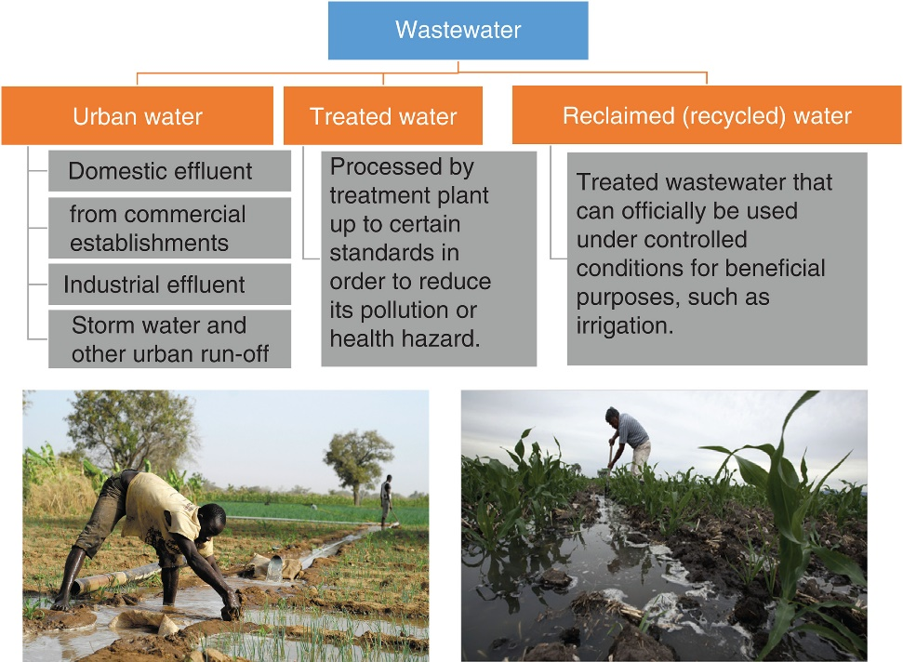
IRRIGATIONAL APPROACH IN WASTEWATER CONSERVATION

Slide 11
LEGAL ACTION AGAINST DEFAULTER/POLLUTER
The command and control approach towards water pollution is evident from the permit system under the Water Act.
Consent of the CPCB/SPCB is required to establish any industry, operation or process, or any treatment and disposal system etc., which is likely to discharge sewage/trade effluent into a stream or well or on land, to use any new altered outlet or new sewage discharge.
Contravention of these two provisions is punishable with imprisonment for a term between 18 months and six years as well as fine.

Slide 12
LEGAL ACTION AGAINST DEFAULTER/POLLUTER
CPCB/SPCB has been granted certain powers to prevent and control water pollution
It can undertake certain emergency measures to remove and dispose the polluting matter, or to remedy or mitigate pollution caused by the polluting matter or issue orders immediately restraining or prohibiting the polluting activity.
It can apply to the courts to restrain apprehended water pollution in streams and wells. The court may direct a potential polluter to desist from causing pollution or direct a potential polluter to desist from causing pollution or direct an actual polluter to remove the polluting matter.
In case of non-compliance with the latter direction, the CPCB/SPCB may be authorized by the court to undertake the removal, disposal and recover the expenses from the polluter.
It can direct closure, prohibit or regulation of any industry, operation or process, or to stop or regulate supply of water, electricity or any other service.

Slide 13
MANAGEMENT STRATEGY USED FOR WATER CONSERVATION
Comprehensive approach to water resource management
1. Reduce overall use
2. Reducing water waste
3. Recycling used water for other purposes
Water consumption:
Modify agricultural water practices to minimize evaporation and seepage
Industrial recycling and reuse of water on-site
Making water conservation part of daily life.

Slide 14
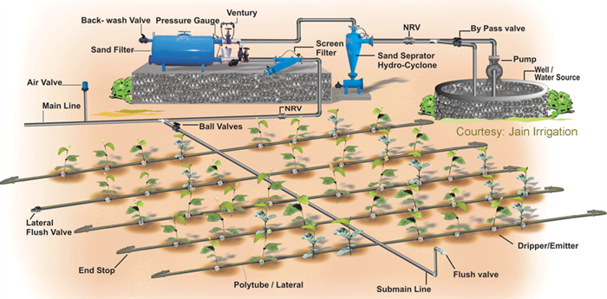
MANAGEMENT STRATEGY USED FOR WATER CONSERVATION
Water conservation refers to reducing usage of water and recycling of waste water for different purposes such as cleaning, manufacturing and agricultural irrigation.
Water conservation includes the policies, strategies and activities to manage fresh water as a sustainable resource to protect the water environment and to meet current and future human demand.

Slide 15
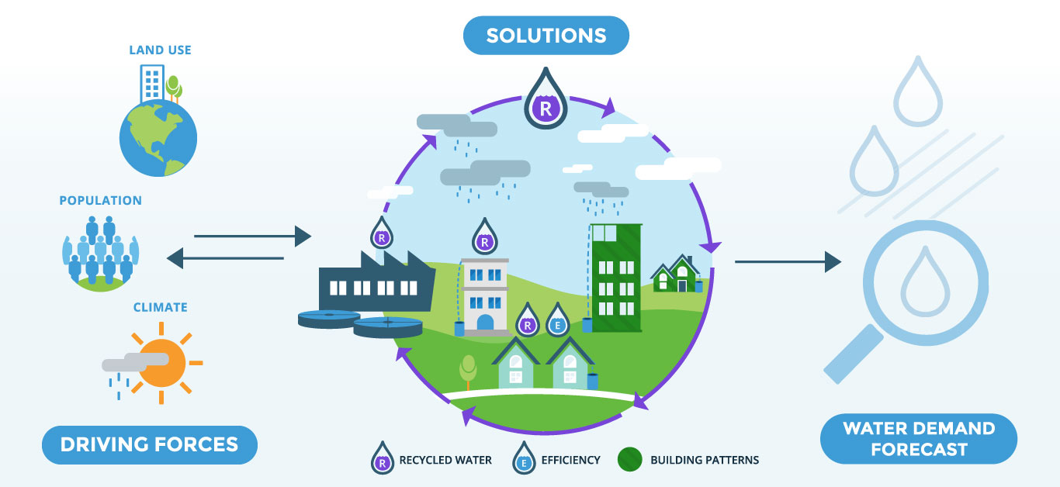
MANAGEMENT STRATEGY USED FOR WATER CONSERVATION

Slide 16
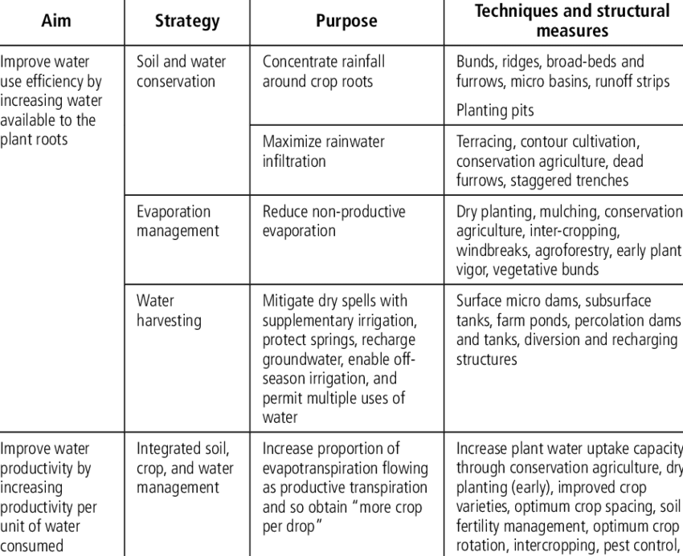
MANAGEMENT STRATEGY USED FOR WATER CONSERVATION

Slide 17
MANAGEMENT STRATEGY USED FOR WATER CONSERVATION
Identify conservation goals
Develop a water-use profile and forecast
Evaluate planned facilities
Identify and evaluate conservation measures
Identify and assess conservation incentives
Analyse benefits and costs
Select conservation measures and incentives
Prepare and implement the conservation plan
Integrate conservation and supply plans, modify forecasts
Monitor, evaluate, and revise program as needed.

Slide 18
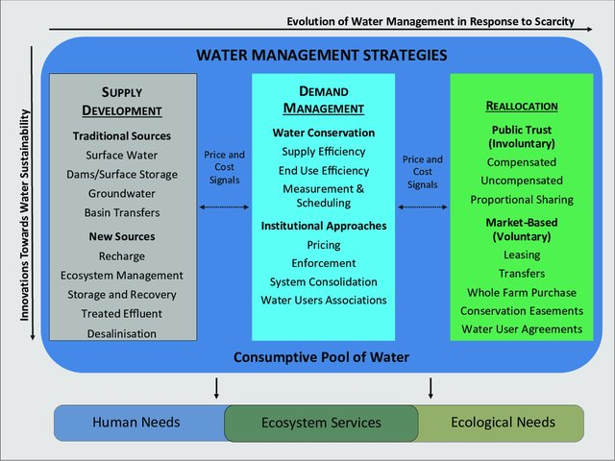
MANAGEMENT STRATEGY USED FOR WATER CONSERVATION

Slide 19
MANAGEMENT STRATEGY USED FOR WATER CONSERVATION
Reduce water demand
Improve operational efficiency
Increase water supply
Management strategy used for water conservation
Improve water supply
Promote resource stewardship

Slide 20
MANAGEMENT STRATEGY USED FOR WATER CONSERVATION
1. Reduce water demand:
Agricultural water use efficiency: Agricultural water use efficiency involves improvements in technologies and management of agricultural water that result in water supply, water quality, and environmental benefits. Efficiency improvements can include on-farm irrigation equipment, crop and farm water management, and water supplier distribution systems.
Urban water use efficiency:
Urban water use efficiency involves technological or behavioural improvements in indoor and outdoor residential, commercial, industrial, and institutional water use that lower demand, lower per capita water use, and result in benefits to water supply, water quality, and the environment.

Slide 21
MANAGEMENT STRATEGY USED FOR WATER CONSERVATION
2. Improve operational efficiency:
Conveyance: Conveyance provides for the movement of water. Specific objectives of natural and managed water conveyance activities include flood management, consumptive and non-consumptive environmental uses, water quality improvement, recreation, operational flexibility, and urban and agricultural water deliveries. Infrastructure includes natural watercourses as well as constructed facilities like canals, pipelines and related structures including pumping plants, diversion structures, distribution systems, and fish screens. Groundwater aquifers are also used to convey water.
System re-operation:
System re-operation means changing existing operation and management procedures for such water facilities as dams and canals to meet multiple beneficial uses. System re-operation may improve the efficiency of existing uses, or it may increase the emphasis of one use over another. In some cases, physical modifications to the facilities may be needed to expand the re-operation capability.

Slide 22
MANAGEMENT STRATEGY USED FOR WATER CONSERVATION
2. Improve operational efficiency:
Water transfer:
A water transfer is defined in the California Water Code as a temporary or long-term change in the point of diversion, place of use, or purpose of use due to a transfer or exchange of water or water rights. A more general definition is that water transfers are a voluntary change in the way water is usually distributed among water users in response to water scarcity. Transfers can be from one party with extra water in one year to another who is water-short that year.

Slide 23
MANAGEMENT STRATEGY USED FOR WATER CONSERVATION
2. Increase water supply
Conjunctive Management and Groundwater storage
Conjunctive management is the coordinated operation of surface water storage and use, groundwater storage and use, and the necessary conveyance facilities. Conjunctive management allows surface water and groundwater to be managed in an efficient manner by taking advantage of the ability of surface to capture and temporarily store storm water and the ability of aquifers to serve as long term-storage.
Desalination – Brackish/ Seawater
Desalination is a water treatment process for the removal of salt from water for beneficial use. Desalination is used on brackish (low-salinity) water as well as seawater. In California, the principal method for desalination is reverse osmosis. This process can be used to remove salt as well as specific contaminants in water such as trihalomethane precursors, volatile organic carbons, nitrates, and pathogens.

Slide 24
MANAGEMENT STRATEGY USED FOR WATER CONSERVATION
2. Increase water supply
Precipitation enhancement
Precipitation enhancement, commonly called “cloud seeding,” artificially stimulates clouds to produce more rainfall or snowfall than they would naturally. Cloud seeding injects special substances into the clouds that enable snowflakes and raindrops to form more easily.
Re-cyled municipal water
Water recycling, also known as reclamation or reuse, is an umbrella term encompassing the process of treating wastewater, storing, distributing, and using the recycled water.
Surface storage Regional/Local
Surface storage is the use of reservoirs to collect water for later release and use. Surface reservoirs can be formed by building dams across active streams or by building off-stream reservoirs where the majority of the water is diverted into storage from a nearby water source.

Slide 25
MANAGEMENT STRATEGY USED FOR WATER CONSERVATION
2. Improve water quality
Drinking water Treatment and distribution
Drinking water treatment includes physical, biological, and chemical processes to make water suitable for potable use. Distribution includes the storage, pumping, and pipe systems to protect and deliver the water to customers.
Groundwater/Aquifer remediation
Groundwater remediation involves extracting contaminated groundwater from the aquifer, treating it, and discharging it to a water course or using it for some purpose. It is also possible to inject the treated water back into the aquifer.
Contaminated groundwater can result from a multitude of sources, both naturally occurring and anthropogenic. Examples of naturally occurring contaminants include heavy metals, high TDS, and high salinity from specific geologic formations or conditions.
Groundwater can also be contaminated from anthropogenic sources with organic constituents, inorganic constituents, and radioactive constituents from many point and non-point sources. These anthropogenic sources include industrial sites, mining operations, leaking tanks and pipelines, landfills, impoundments, dairies, agricultural and storm runoff, and septic systems.

Slide 26
MANAGEMENT STRATEGY USED FOR WATER CONSERVATION
2. Improve water quality
Matching quality to use
Matching water quality to water use is a management strategy that recognizes that not all water uses require the same quality water. One common measure of water quality is its suitability for an intended use, and a water quality constituent is often only considered a contaminant when that constituent adversely affects the intended use of the water.
High quality water sources can be used for drinking and industrial purposes that benefit from higher quality water, and lesser quality water can be adequate for some uses, such as irrigation. Further, some new water supplies, such as recycled water, can be treated to a wide range of purities that can be matched to different uses.
Pollution prevention
Pollution prevention can improve water quality for all beneficial uses by protecting water at its source, reducing the need and cost for other water management and treatment options.
By preventing pollution throughout a watershed, water supplies can be used, and re-used, for a broader number and types of downstream water uses. Improving water quality by protecting source water is consistent with a watershed management approach to water resources problems.

Slide 27
MANAGEMENT STRATEGY USED FOR WATER CONSERVATION
2. Improve water quality
Urban Run-off management
Urban runoff management is a broad series of activities to manage both storm water and dry weather runoff. Dry weather runoff occurs when, for example, excess landscape irrigation water flows to the storm drain. Urban runoff management is linked to several other resource strategies including pollution prevention, land use management, watershed management, water use efficiency, recycled water, protecting recharge areas, and conjunctive management (combined use of surface and ground water systems to optimize resource use and minimize adverse effects of using a single source).

Slide 28
MANAGEMENT STRATEGY USED FOR WATER CONSERVATION
2. Promote resource stewardship
Agricultural land stewardship
Agricultural lands stewardship broadly means conserving natural resources and protecting the environment by land managers whose stewardship practices conserve and improve land for food, fiber, watershed functions, soil, air, energy, plant and animal and other conservation purposes.
It also protects open space and the traditional characteristics of rural communities. Further, it helps landowners maintain their farms and ranches rather than being forced to sell their land because of pressure from urban development.

Slide 29
MANAGEMENT STRATEGY USED FOR WATER CONSERVATION
2. Promote resource stewardship
Economic incentives:
Economic incentives are financial assistance and pricing policies intended to influence water management. For example, economic incentives can influence the amount of use, time of use, wastewater volume, and source of supply.
Economic incentives include low-interest loans, grants, and water pricing rates. Free services, rebates, and the use of tax revenues to partially fund water services also have a direct effect on the prices paid by the water users.
Governmental financial assistance can provide incentives for resource plans by regional and local agencies. Also, government financial assistance can help water agencies make subsidies available to their water users for a specific purpose.

Slide 30
MANAGEMENT STRATEGY USED FOR WATER CONSERVATION
2. Promote resource stewardship
Ecosystem restoration:
Ecosystem restoration can include changing the flows in streams and rivers, restoring fish and wildlife habitat, controlling waste discharge into streams, rivers, lakes or reservoirs, or removing barriers in streams and rivers so salmon and steelhead can spawn.
Ecosystem restoration improves the condition of our modified natural landscapes and biotic communities to provide for the sustainability and for the use and enjoyment of these ecosystems by current and future generations.

Slide 31
MANAGEMENT STRATEGY USED FOR WATER CONSERVATION
2. Promote resource stewardship
Flood plain management:
Floodplain management reduces risks to life and property and benefits natural resources. Floodplain management accepts periodic flooding and generally is a preferred alternative to keeping rivers in their channels and off floodplains.
Seasonal inundation of floodplains provides essential habitat for hundreds of species of plants and animals, many of them dependent on periodic floods. There are also benefits to the economy, agriculture, and society to keeping rivers and their floodplains connected, including water quality improvements and groundwater recharge.
Floodplain management also entails limiting the amount and type of development in a floodplain.

Slide 32
MANAGEMENT STRATEGY USED FOR WATER CONSERVATION
2. Promote resource stewardship
Recharge area protection:
Recharge area protection includes keeping groundwater recharge areas from being paved over or otherwise developed and guarding the recharge areas so they do not become contaminated.
Protection of recharge areas, whether natural or man-made, is necessary if the quantity and quality of groundwater in the aquifer are to be maintained. Existing and potential recharge areas must be protected so that they remain functional and they are not contaminated with chemical or microbial constituents.
Urban landuse management
Effective urban land use management consists of planning for the housing and economic development needs of a growing population while providing for the efficient use of water and other resources.
The way in which we use land – the type of use and the level of intensity – has a direct relationship to water supply and quality.

Slide 33
MANAGEMENT STRATEGY USED FOR WATER CONSERVATION
2. Promote resource stewardship
Water dependent recreation:
Water-dependent recreation includes a wide variety of outdoor activities that can be divided into two (2) categories.
The first category includes fishing, boating, swimming, and rafting, which occur on lakes, reservoirs, and rivers.
The second category includes recreation that is enhanced by water features but does not require actual use of the water, such as wildlife viewing, picnicking, camping, and hiking.

Slide 34
MANAGEMENT STRATEGY USED FOR WATER CONSERVATION
2. Promote resource stewardship
Watershed management:
Watershed management is the process of evaluating, planning, managing, restoring, and organizing land and other resource use within an area of land that has a single common drainage point.
Watershed management tries to provide sustainable human benefits, while maintaining a sustainable ecosystem. Watershed management assumes that a prerequisite for any project is the sustained ability for the watershed to maintain the functions and processes that support the native ecology of the watershed. This does not imply that a goal is to return to an undisturbed condition.
Instead it implies an integration of human needs and environmental needs that allow the watershed to sustain ecological integrity over time while providing for sustainable community needs. It is recognized that watersheds are dynamic and the precise makeup of plants, animals, and other characteristics will change over time.

Slide 35
INDUSTRIAL APPROACH IN WATER CONSERVATION
Reason to conserve water:
1. Reduced costs—water costs account for 1–2 percent of a business’ overhead. Saving water can help reduce overhead costs.
2. Increase in future water prices—water prices are set to rise above inflation. Saving water now will reduce costs in the future.
3. Production efficiency—using water efficiently will make additional water available for future production.
4. Tax benefits—many government agencies and water utilities provide rebates, grants, and tax relief to encourage water conservation. Tax benefits keep money where it belongs, in your pocket.

Slide 36
INDUSTRIAL APPROACH IN WATER CONSERVATION
Industrial approach in water conservation:
Water is a vital component of many industrial operations, and is utilized for a wide range of purposes in industrial processes. With an increasing requirement for water as a result of a reduction in the available water resources, it is becoming increasingly necessary to implement water conservation measures in industrial processes so as to guarantee sustainable industrial development.
In recent years, there has been considerable development of systematic methods to minimize the use of freshwater and the production of wastewater by industry in response to increasingly stringent environmental regulations, economic driving forces and public concern over the quality of the environment.
The process integration approach is one method that is often used to implement water recycling: in this approach, a flow of recycled water is used in an operation that produces a high level of contaminant.

Slide 37
INDUSTRIAL APPROACH IN WATER CONSERVATION
Industrial approach in water conservation:
Two main groups of methods are used for the systematic design of water-recovery networks: rigorous graphical targeting approaches and mathematical-based optimization techniques.
A systematic approach to designing optimal water recycling in an industrial plant comprises two main tasks. The first task is to define the maximum amount of recycling that is possible, and the second task is to design alternative recycling networks that will allow the operations to meet the water recycling target.

Slide 38
INDUSTRIAL APPROACH IN WATER CONSERVATION
Industrial approach in water conservation:
Nearest-neighbor principle to design minimum freshwater networks for fixed contaminant load problems and fixed flow rate problems.
The minimum water target using the water cascade analysis (WCA) technique, which is a numerical alternative to the graphical water targeting technique and can quickly yield an accurate estimate of the minimum water target, the pinch-point locations, and the water allocation target for maximum water recovery.

Slide 39
GROUNDWATER MANAGEMENT
Groundwater management involves planning, implementation, and operation necessary to provide safe and reliable groundwater supplies. This necessitates groundwater management at a basin scale.
Groundwater management objectives typically focus on aquifer yield, recharge, and water quality (i.e., groundwater quantity and quality) as well as on socio-economic, legal, and political factors. After the proper evaluation of available water resources in a basin and the preparation of alternative management plans, action decisions can be made by suitable government or public agencies.

Slide 40
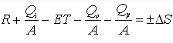
GROUNDWATER MANAGEMENT
Basic concepts of groundwater management:
To manage a groundwater basin, a proper knowledge of the quantity of water that can be developed is a prerequisite. Determination of available water within a basin requires the evaluation of the elements constituting the water cycle. Therefore, the most fundamental approach to groundwater management is based on water balances within a groundwater basin. The water balance equation (or hydrologic budget) for a groundwater basin can be written as:
Where, R = recharge to groundwater [L/T], Q_{i} = surface-water inflow into groundwater storage in the basin [L³/T], A = area of the basin [L²], ET = loss of groundwater due to evapotranspiration [L/T], Q_{o} = groundwater outflow from the basin (groundwater outflow into surface water) [L³/T], Q_{p} = total groundwater pumping from the basin [L³/T], and ΔS = change of groundwater storage in the basin [L/T]. The values of these parameters are considered over a specific period of time for which the groundwater balance is sought.

Slide 41
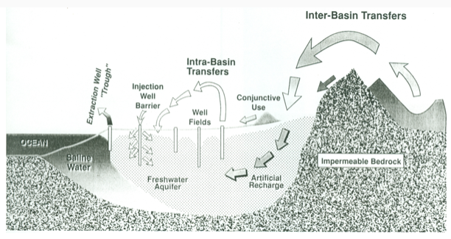
GROUNDWATER MANAGEMENT
Salient features of groundwater management:
A well-organized plan is essential to any groundwater management program, because it relates all necessary tasks, resources and time. During the preparation of a groundwater management plan, the knowledge of possible management techniques plays an important role, among other information.
Groundwater management techniques such as ‘conjunctive use of surface water and groundwater’, ‘artificial recharge of groundwater and seawater barriers’, ‘interbasin transfer of water’, ‘intrabasin transfer of water’, ‘indirect recharge through avoidance of pumping’, and ‘control well fields’

Slide 42
GROUNDWATER MANAGEMENT
Conjunctive use of groundwater and surface water:
Conjunctive use of surface water and groundwater is a management technique designed to maximize the use of available water resources.
The major objectives of conjunctive use technique are:
(i) to maximize net benefits,
(ii) to increase reliability of supply,
(iii) to enhance overall efficiency of a water system, and
(iv) to minimize the degradation of ecosystems/environment.
It requires a coordinated operation plan for both surface water and groundwater designed to meet demands while ensuring maximum water conservation.
Conjunctive use plans vary from percolation of natural stream flows to complex programs involving inter and intrabasin water transfers, with facilities for recharge, extraction, and distribution.
Some important benefits of conjunctive use are:
(i) reduced surface-water storage facilities,
(ii) water conservation,
(iii) smaller surface-water networks, and
(iv) less evaporation loss.

Slide 43
GROUNDWATER MANAGEMENT
Artificial recharge of groundwater and seawater barriers:
Storing surface water into underground formations as groundwater for future use is an established practice in a conjunctive-use program.
Groundwater recharge is accomplished by inducing percolation of surface water, thereby replenishing underlying aquifers.
When pumping near coastal areas creates depressions in groundwater levels, seawater migrates into the inland and contaminates underlying freshwater aquifers.
Protection of coastal aquifers against seawater intrusion requires some kind of seawater barriers such as a ridge of ‘protective groundwater elevations’ constructed through the use of a line of injection wells (recharge wells) along the seashore or a ‘pumping trough’ to intercept intruding seawater.

Slide 44
GROUNDWATER MANAGEMENT
Interbasin transfer of water:
In many areas of the world, low precipitation rates, coupled with limited natural surface-water supplies necessitate the import of water from far distances. For example, the California aqueducts bring water hundreds of miles from the areas where surface water is abundant to the southern semi-arid region.
This water is either consumed directly or stored in groundwater reservoirs for later recovery. This transfer of water can be done on a seasonal basis, and if sufficient surface-water supplies are available, it can change the dynamics of water utilization.
Generally, the water management technique, ‘interbasin transfer of water’ involves huge expenses and raises serious environmental issues. Therefore, proper planning and analysis are essential prior to the adoption of this water management technique.

Slide 45
GROUNDWATER MANAGEMENT
Intrabasin transfer of water:
Complex geologic conditions exist in most groundwater development areas. For example, it may be possible to overdraft one area while excessively recharging another, and still not exceed the safe-yield values predicted by regional groundwater budget calculations.
Therefore, a detailed basin investigation and analysis is necessary to delineate the areas of excess or deficiency and effectively design optimum pumping, distribution, and recharge programs. This management technique is usually less expensive and more environment friendly (i.e., reduced environmental impact) than the ‘interbasin transfer of water.

Slide 46
GROUNDWATER MANAGEMENT
Indirect recharge through avoidance of pumping:
This is one of the innovative groundwater management techniques, which makes use of an indirect method of recharge. This technique encourages or requires groundwater users to purchase imported water instead of pumping groundwater.
In fact, this is equivalent to recharging the basin by the quantity of water not pumped. Such water management programs are made effective by keeping the costs of imported water supplies equal to or less than the pumping costs. They are implemented periodically by groundwater basin managers to regulate groundwater levels.

Slide 47
GROUNDWATER MANAGEMENT
Control well fields:
Another technique used to conserve groundwater is through the use of ‘control well fields’. Control well fields are strategically placed to produce interference effects for the control of hydraulic gradients and induce desirable groundwater-flow directions.
Control well fields typically control outflow from basins or restrain contaminant plumes. Well head protection (WHP) strategy used in many developed countries is one example of groundwater management by using the technique of control well fields.
Besides the above-mentioned groundwater management techniques, the specialized techniques like Soil-Aquifer Treatment (SAT) and River Bank Filtration (RBF) are also promising techniques, among others, for managing water-quality problems at a basin or sub-basin scale.

Slide 48
GROUNDWATER MANAGEMENT
Artificial recharge of groundwater:
In order to augment the natural supply of groundwater, people artificially recharge groundwater basins.
Artificial recharge can be defined as “augmenting the natural movement of surface water into underground formations by some method of construction, by spreading of water, or by artificially changing natural conditions.
Various methods have been developed for artificial recharge, including water spreading, recharging through pits and wells, and pumping to induce recharge from surface water bodies such as rivers and lakes.
The choice of a particular recharge method depends on several factors such as local topography, geologic and soil conditions, amount of water to be recharged, and the ultimate use of water. Under special circumstances, the value of land, water quality, or climate can be important factors in the selection of recharge methods.

Slide 49
GROUNDWATER MANAGEMENT
Artificial recharge of groundwater:
(1) Maintain or augment the natural groundwater as an economic resource.
(2) Coordinate operation of surface and groundwater reservoirs.
(3) Combat adverse conditions such as progressive lowering of groundwater levels, unfavourable salt balance, or saline water intrusion.
(4) Provide subsurface storage for locally available surplus surface water or imported surface water.
(5) Minimize or prevent land subsidence.
(6) Provide a localized subsurface distribution system for established wells.
(7) Provide on-site treatment and storage for the reclaimed wastewater for subsequent reuse.
(8) Conserve or extract energy in the form of hot or cold water.

Slide 50
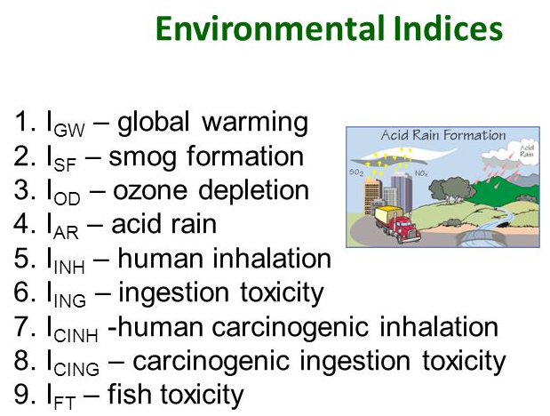
ENVIRONMENTAL INDICATORS
Environmental indicators: Describe the behaviour of separate components of the environment (.g., air quality, water pollution, etc.,)
Environmental indicators quantify and simplify information on environmental issues in order to make this information useable and publicly known.
Environmental indicators most frequently represent a change in condition over a period of time or geographic area.
Indicators that compare conditions over time (e.g trend analysis) are useful to illustrate factors such as extreme events, seasonal changes, and responses to management actions.

Slide 51
ENVIRONMENTAL INDICATORS
Environmental indicator helps to provide an insight into the state of the environment or human health.
Indicators are developed based on quantitative measurements or statistics of environmental condition that are tracked over time.
Environmental indicators can be developed and used at a wide variety of geographic scales, from local to regional to national levels.
By monitoring the environment using indicators, any government can better share meaningful environmental information with the public, and help ensure that high-quality environmental decisions are made by government and the public.

Slide 52
ENVIRONMENTAL INDICATORS
Environmental indicators should be considered as a subset of sustainable development indicators which are meant to track the overall sustainability of a society with respect to its environmental, social and economic integrity and health.
Environmental indicators are used by governments, non-government organizations, community groups and research institution to understand the trends in the environment.

Slide 53
ENVIRONMENTAL INDICATORS
An environmental index is the combination of multiple sources of information about an environmental system from potentially varying attributes of that system (e.g. in stream processes, ecological processes, species richness, vegetation, etc.,)
Environmental indices are typically developed to provide an overall snapshot of some feature of the environment system but they are also used to compare similar environmental systems.
Construction of an environmental index requires careful consideration of several important aspects of the individual environmental indicators.

Slide 54
ENVIRONMENTAL INDICATORS
Steps involved in construction of environmental indices:
Defining a theoretical framework for supporting indicator selection
Data preparation
Standardization of the potentially disparate indicators so that they can easily be combined into an index.
Weighting and aggregation of the individual indicators
Robustness and sensitivity of the decisions made in constructing and environmental index.

Slide 55
TYPES OF ENVIRONMENTAL INDICATORS
Indicators used to assess ecosystem health fall under one of three categories
1. Physical
2. Chemical
3. Biological
Physical and Chemical indicators are measures of the physical and chemical components of the ecosystem, whereas biological indicators refer to organisms, species, or communities whose characteristics show the presence of specific environmental conditions.
Air pollution indicators
Biodiversity indicators
Ecosystem integrity
Sustainable use
Climate indicators
Energy indicators
Water indicators

Slide 56
TYPES OF ENVIRONMENTAL INDICATORS
Air pollution indicators:
Ammonia emission, Heavy metal emissions
Biodiversity indicators:
Species of national interest
Species diversity
Ecosystem integrity
Marine Trophic Index of seas
Nutrients in transitional, coastal and marine waters
Sustainable use:
Forest: growing stock
Agriculture: Nitrogen balance
Climate indicators
Production and consumption of ozone depleting substances
Greenhouse gas emission trends
Energy indicators
Renewable primary energy consumption
Progress on energy efficiency
Water indicators
Use of freshwater resources
Nutrients in freshwater

Slide 57
WATER QULAITY INDEX
Assessment of water quality can be a complex process undertaking multiple parameters capable of causing various stresses on overall water quality.
To evaluate water quality from a large number of samples, each containing concentrations for many parameters is difficult.
Traditional approaches to assessing water quality are based on the comparison of experimentally determined parameter values with the existing guidelines.
Hence, water quality indices are such approaches which minimises the data volume to a great extent and simplifies the expression of water quality status.
Water quality index can be evaluated on the basis of various physical, chemical and bacteriological parameters. Numerous water quality indices have been formulated all over the world which can easily judge out the overall water quality within a particular area promptly and efficiently.
US National Sanitation Foundation Water Quality Index (NSFWQI), Canadian Council of Ministers of the Environment Water Quality Index (CCMEWQI), British Columbia Water Quality Index (BCWQI), and Oregon Water Quality Index (OWQI)

Slide 58
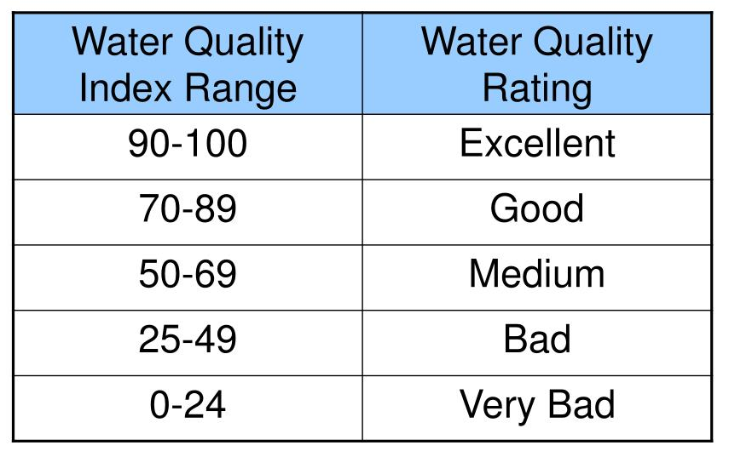
WATER QULAITY INDEX
Role of Water Quality Index (WQI)
WQI numerically summarizes the information from multiple water quality parameters into a single value.
The single value can be used to compare data from several sites and also used to analyse the trends over a single site.
Water quality Interpretation:

Slide 59
BASIC PROCEDURES FOR WQI DEVELOPMENT
1. Variable selection
2. Variables transformation with the use of statistical techniques. Thus brings all the parameters into same scale and units.
3. Assigning weights. In general experts opinion is considered for assigning the weights.
4. Generate cumulative index
5. Assessment and water quality classification

Slide 60
TYPES OF WATER QUALITY INDEX
1. National Sanitation Foundation Water Quality Index (NSFWQI) :
2. Oregon Water Quality Index ( OWQI):
3. British Columbia Water Quality Index (BCWQI)
4. Canadian Council of Ministers of the Environment (CCME) Water quality Index
5. Recreational Water Quality Index
6. Water Quality Index

Slide 61

TYPES OF WATER QUALITY INDEX
1. National Sanitation Foundation Water Quality Index (NSFWQI) :
Brown et al. developed a water quality index paying great rigor in selecting parameters, developing a common scale, and assigning weights for which elaborate Delphic exercises were performed. This effort was supported by the National Sanitation Foundation (NSF) and that is why also referred as NSFWQI.

Slide 62

TYPES OF WATER QUALITY INDEX
Oregon Water Quality Index (OWQI):
OWQI expresses water quality by integrating measurements of eight water quality variables. The Oregon Water Quality Index, developed by the Oregon Department of Environmental Quality (ODEQ) in the late 1970s and updated several times since then is another frequently used WQI in public domain. OWQI was updated in 1995 by refining the original sub-indice, adding temperature and total phosphorus sub-indice, and improving the aggregation calculation.
Where, SIi= Sub-index of each parameters, Wi= Weighting factor, n= Number of sub-indices.

Slide 63

TYPES OF WATER QUALITY INDEX
British Columbia Water Quality Index:
British Columbia water quality index was developed by the Canadian Ministry of Environment in 1995 as increasing index to evaluate water quality. This index is similar to Canadian Council of Ministers of the Environment Water Quality Index (CCMEWQI) where water quality parameters are measured and their violation is determined by comparison with a predefined limit (discussed in section vi below). It provides possibility to make a classification on the basis of all existing measurement parameters.
The number 1.453 was selected to give assurance to the scale index number from zero to 100.It is important to note that repeated samplings and increasing stations increase the accuracy of British Columbia index.

Slide 64
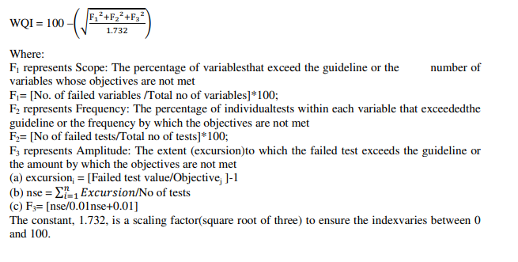
TYPES OF WATER QUALITY INDEX
Canadian Council of Ministers of Environment Water Quality Index (CCMEWQI):
The Canadian Council of Ministers of the Environment(CCME) has developed a Water Quality Index (WQI) to simplify the reporting of complex and technical water quality data.
The CCME WQI is a science-based communication tool that tests multi-variable water quality data against specified water quality benchmarks determined by the user.

Slide 65
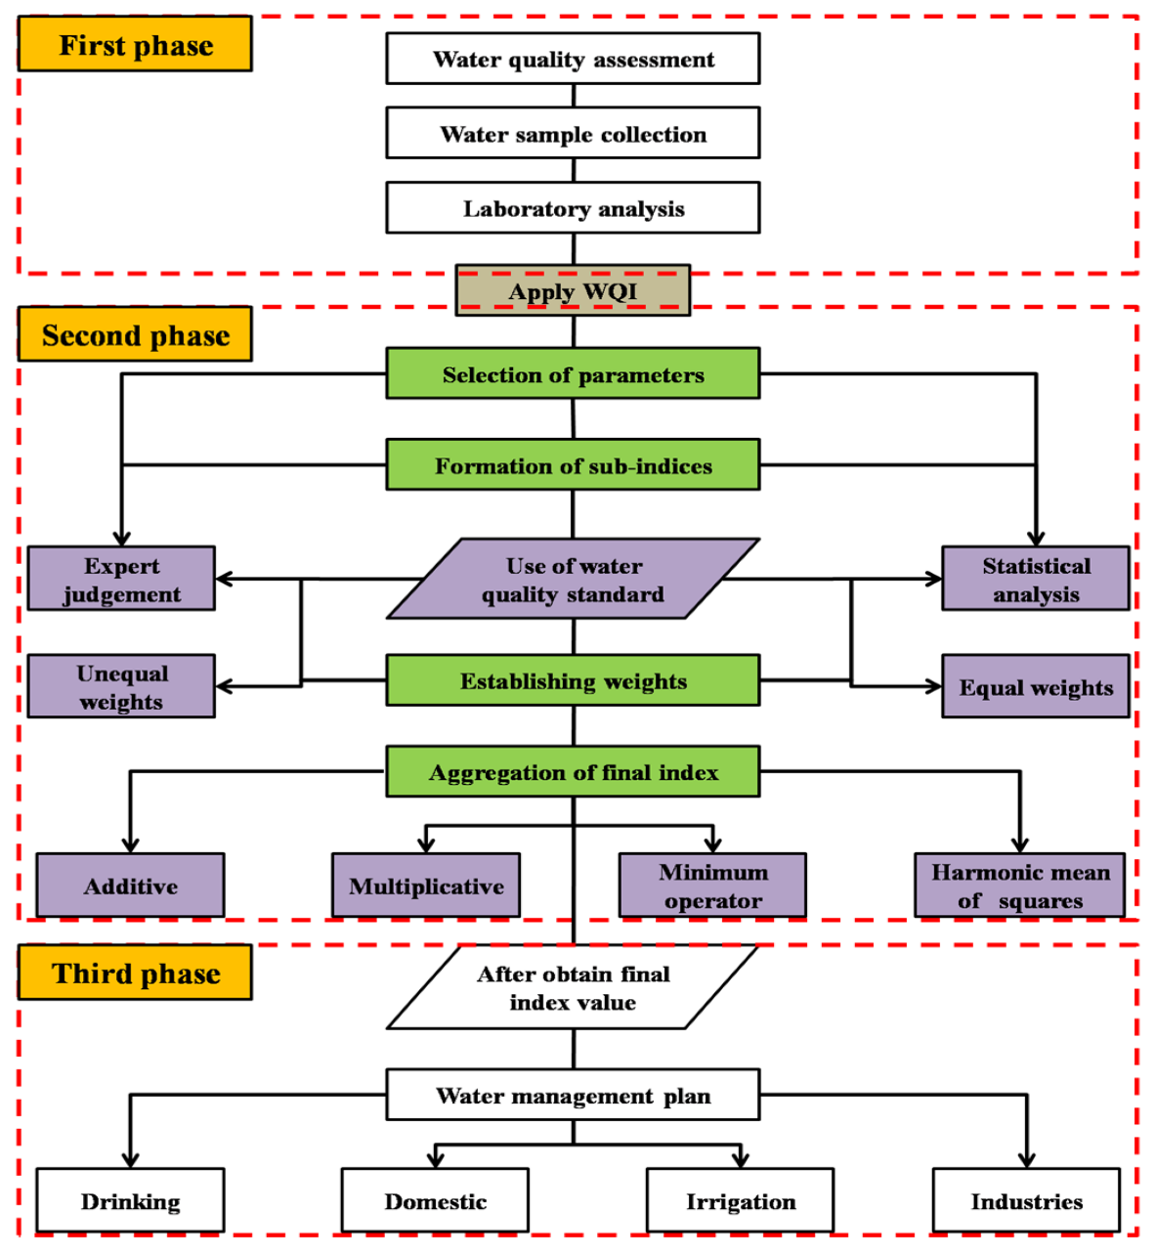
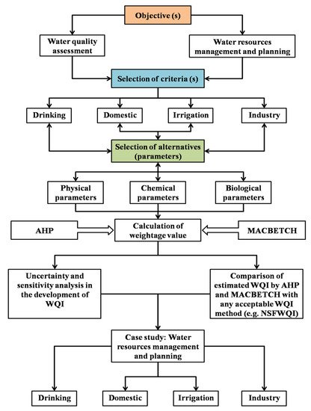
WATER QULAITY ASSESSMENT

Slide 66
PUBLIC PARTICIPATION IN WATER MANAGEMENT
Water Quality at Home
Use Environmentally Friendly Cleaning Products
Use Household Water Wisely
Use Household Energy Wisely
Compost Your Lawn Clippings, Yard Debris, and Food Wastes
Recycle and Reuse Household Goods instead of Throwing Them in the Trash
Be Mindful of Your Use of Pesticides, Herbicides, and Fertilizers in Home Landscaping
Educate and Involve Your Children, and Set a Good Example

Slide 67
PUBLIC PARTICIPATION ON WATER CONSERVATION
Awareness on water conservation
Maintain and improve quality of water
Collection and treatment of waste water effluents
Pollution check
Encourage natural regeneration of vegetation and supplementing with artificial regeneration
Sustainable water utilisation
Minimise domestic water consumption
Recycling of waste water
Improved irrigation methods

Slide 68
PUBLIC PARTICIPATION ON WATER CONSERVATION
Rain water harvesting
Roof top rainwater harvesting
Revival of traditional water harvesting structures
Micro-catchment water harvesting
Recharge structures for wells and bore wells
Strategies to support water conservation
Some of the strategies that can support water conservation activities and tackle the water scarcity problem include:
Instead of waiting for somebody else to start conserving, let us, as an individual, take the first step towards conserving water
There are a lot of ways that we can conserve water at our home, industries and agricultural fields.
Wasting water has become a significant environmental problem, both at consumer and industrial levels.

Slide 69
PUBLIC PARTICIPATION IN WATER MANAGEMENT
Public Involvement
Public participation can contribute to planning by providing:
Incorporation of community values
Formulation of better plans
Assurance of reasonable costs
Public acceptance and support
Resolution of controversies over the plan.

Slide 70
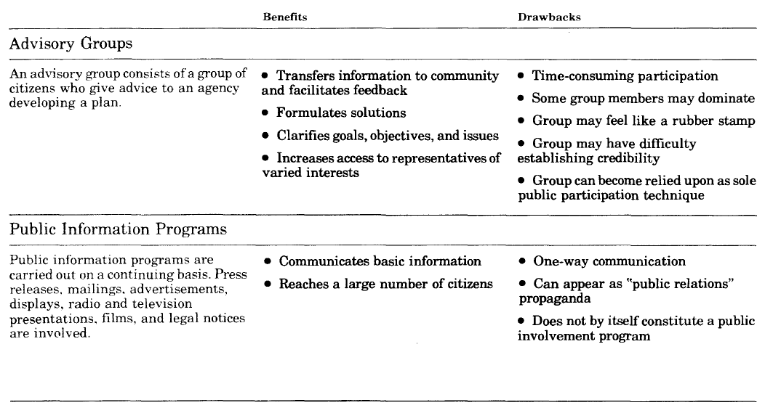
PUBLIC PARTICIPATION TECHNIQUES

Slide 71
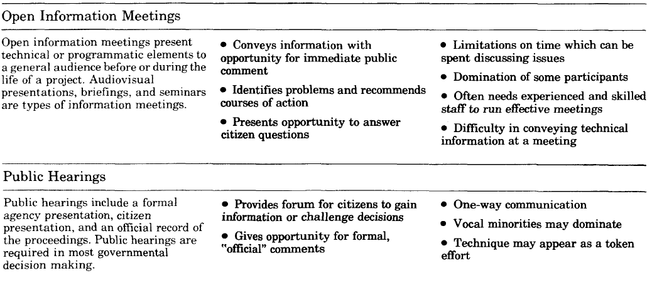
PUBLIC PARTICIPATION TECHNIQUES

Slide 72
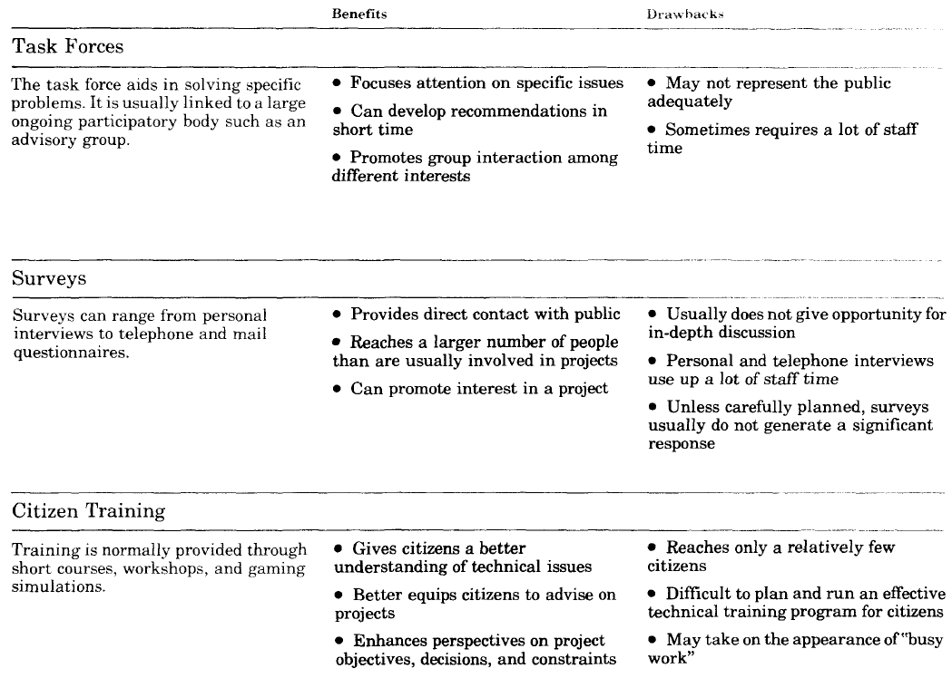
PUBLIC PARTICIPATION TECHNIQUES

Slide 73
AWARENESS OF DOMESTIC USAGE FOR CONSERVATION OF WATER
The aim of raising public awareness for water issues is to engage the public in topics such as:
water conservation; hygienic water use; or preservation of ecosystems.
Other issues are the development of self-regulating water institutions, increasing the willingness to pay or contribute to water services; awareness for planning for emergencies; and strengthening political will.
Ideally, public awareness is not a one-way communication, but an interaction of many active stakeholders, who influence each other and provide social control by mutually reinforcing agreed sets of values.
Awareness can be raised through a variety of channels which should be coordinated in a bigger communications strategy.
Those channels include water campaigns, engaging with environmental NGOs and community groups, making information available to the general public through inventories, for example, and providing information to the public through product labelling etc.

Slide 74
AWARENESS OF DOMESTIC USAGE FOR CONSERVATION OF WATER
Product labelling or environmental certification is a useful tool for raising awareness.
“Blue” and “green” labels have been used in water saving devices and eco-friendly products and services
They have encouraged changes in consumption patterns and triggered industries to adopt new standards in often essentially traditional markets like plumbing fixtures or water conveyance

Slide 75
PUBLIC WATER CONSERVATION CAMPAIGNS
Public water conservation campaigns raise awareness in all levels of society about the importance of saving water to cope with its scarcity and ensure sustainability.
The aim is to change citizen attitudes and behaviour to improve water use efficiency.
This is done through education and awareness campaigns on the socioeconomic and environmental benefits of water conservation and different conservation methods.
Communication means include traditional and social media, as well as direct communication such as workshops, presentations, stakeholder dialogues, etc.
Other means such as economic incentives can also be employed
Source: https://www.ctc-n.org/technologies/public-water-conservation-campaigns

Slide 76
PUBLIC WATER CONSERVATION CAMPAIGNS
Campaigns can use a number of communication methods:
Direct use of conventional media (printed media, TV, radio) and/or non-conventional media (messages on water bills, games, transport tickets, comic books, etc.), through the visual and performing arts;
Organization of large events and/or endorsement by celebrities (generating media attention);
Use of existing networks (religious networks, social movements, NGO networks, business associations);
Use of logos (e.g. a water drop) to give identity to the campaign.

Slide 77
PUBLIC WATER CONSERVATION CAMPAIGNS
Public water conservation campaigns implementation
Preparation and execution of public awareness campaigns requires a multidisciplinary team, including water experts, building and construction experts, and social marketing, communication and outreach and education professionals.
A thorough analysis of local public water systems and consumer habits is typically undertaken (often using household surveys) to identify potential water savings and primary targets for consumer behaviour patterns.
This includes identification of main target groups for awareness campaigns, for example local water utility companies, households, workplaces, large businesses, etc.
Campaigns can also establish water conservation goals to facilitate tracking of progress and achievement of objectives.
Critical components of planning and executing a campaign include communication protocols and materials organization and production, and establishment of partnerships with media, schools, local NGOs, etc. for effective dissemination.
Source: https://www.ctc-n.org/technologies/public-water-conservation-campaigns

Slide 78
ENVIRONMENTAL BENEFITS OF PUBLIC WATER CONSERVATION CAMPAIGNS
Reduces end water-use, in turn reducing pressures on water utilities, local freshwater sources and the environment.
Requires less energy for abstraction, transport and treatment, mitigating greenhouse gas emissions.
Socioeconomic Benefits
Reduces water costs for utilities and end users.
Source: https://www.ctc-n.org/technologies/public-water-conservation-campaigns

Slide 79
OPPORTUNITIES AND BARRIERS OF PUBLIC WATER CONSERVATION CAMPAIGNS
Opportunities
Better understanding of water conservation is likely to promote greater sustainable behaviour amongst citizens
Inclusive approach encourages stakeholders and organizations to engage and work together
Results in climate resilience: adaptation and mitigation benefits, such as water source protection, water use reduction and mitigation of greenhouse gasses
Relatively low cost-technology with wide reach

Slide 80
OPPORTUNITIES AND BARRIERS OF PUBLIC WATER CONSERVATION CAMPAIGNS
Barriers
Certain conservation techniques such as water recycling need associated education on correct use to ensure safety and minimizing health threats from potential contamination
Success can be impeded due to public scepticism and lack of understanding about the impacts of personal water-use on overall supplies
Success often relies on individual behaviour on private properties, which can be difficult to monitor and measure, revealing only changes in combined impacts
Source: https://www.ctc-n.org/technologies/public-water-conservation-campaigns

