Slide 1





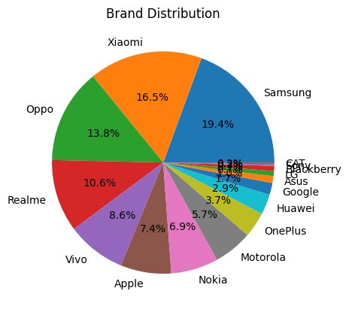




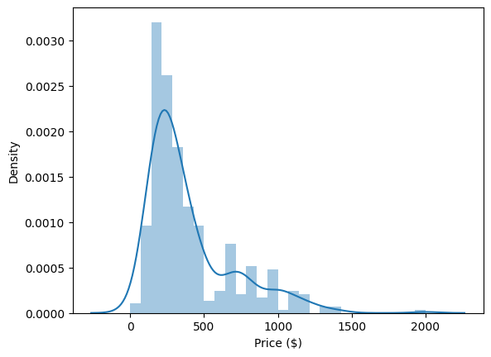
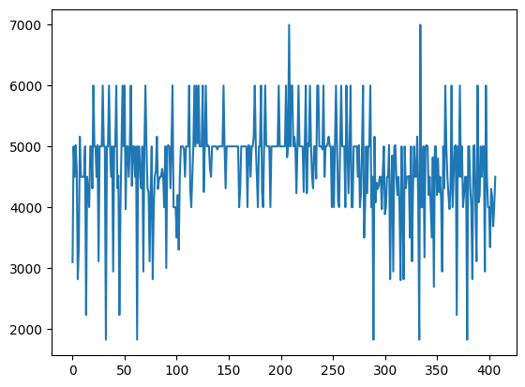
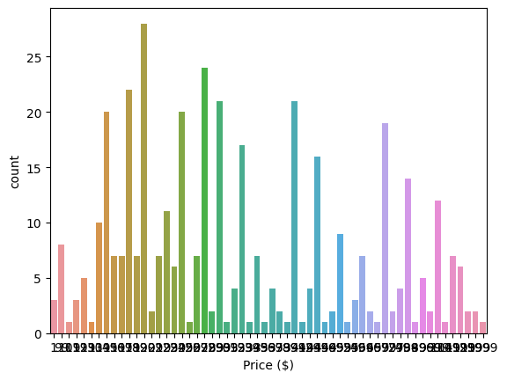
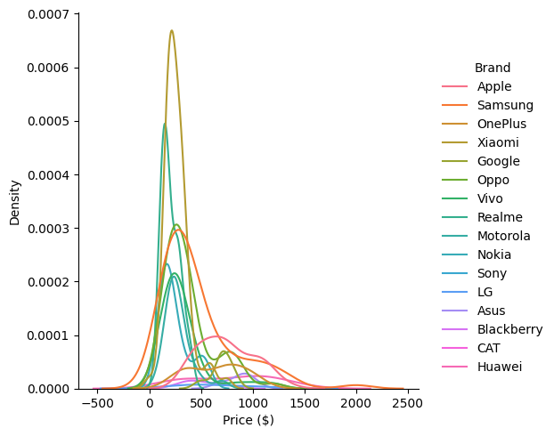
Understanding the Influence of Specifications on Mobile Phone Prices
In the dynamic market of mobile phones, understanding the relationship between specifications and pricing is crucial for both manufacturers seeking to design competitive products and consumers aiming to make informed purchasing decisions. The problem at hand is to analyze a dataset containing information about various mobile phone specifications, including Storage, RAM, Camera, Screen Size, and Battery Capacity, and their corresponding retail prices. The objective is to uncover the influence of these specifications on mobile phone prices and provide actionable insights.
The analysis showcases the symbiotic relationship between specifications and pricing within the dynamic mobile phone landscape. It charts a course for strategic product design, competitive pricing strategies, and informed consumer choices. As the industry continues its evolution, these insights will remain a compass guiding effective decision-making for manufacturers and buyers, fostering a responsive market that caters to the evolving needs of both stakeholders.
The primary objective of this analysis is to determine the extent to which each specification influences the price of a mobile phone. By quantifying the impact of specifications on pricing, we seek to provide insights that can guide manufacturers in product development and assist consumers in making informed purchasing decisions.
By the end of this analysis, we anticipate identifying key specifications that significantly influence mobile phone prices. The analysis will reveal whether certain specifications command premium pricing or play a more subdued role in price determination. Insights gained will aid manufacturers in strategic decision-making and guide consumers in selecting devices that align with their preferences and budgets. This analysis holds significance for manufacturers seeking to optimize product features and pricing strategies. Additionally, consumers can benefit from understanding the value proposition associated with various specifications at different price points. Ultimately, this analysis contributes to a deeper understanding of the mobile phone market dynamics, empowering stakeholders to navigate the choices available in the market effectively.

