Slide 1
Routing Protocols I

Slide 2
Routing
Recall: There are two parts to routing IP packets:
1. How to pass a packet from an input interface to the output interface of a router (packet forwarding) ?
2. How to find and setup a route ?
Packet forwarding is done differently in datagram and virtual-circuit packet networks
Route calculation is done in a similar fashion

Slide 3
Routing Algorithms
Objective of routing algorithms is to calculate `good’ routes
Routing algorithms for both datagrams and virtual circuits should satisfy:
  - Correctness - Simplicity
  - Simplicity - Robustness
  - Stability - Fairness
  - Optimality
Impossible to satisfy everything at the same time
© Jörg Liebeherr, 1998,1999

Slide 4
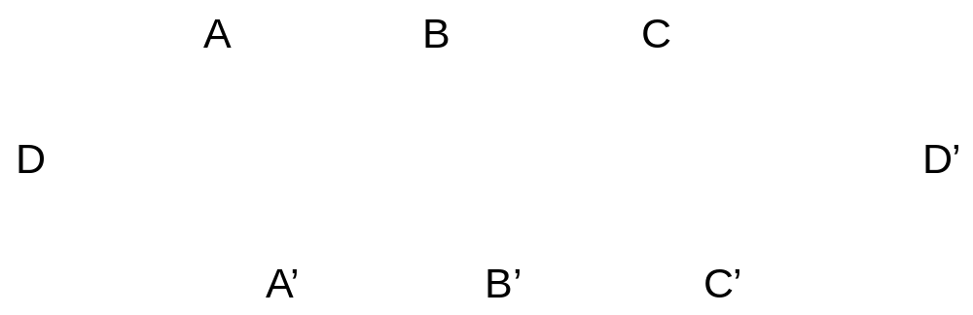
Fairness vs. maximum throughput
Example: Assume that stations A, B, C wants to send to A’, B’, and C’, each at 5 Mb/s
Assume the capacity of the network links is 10 Mb/s.

Slide 5
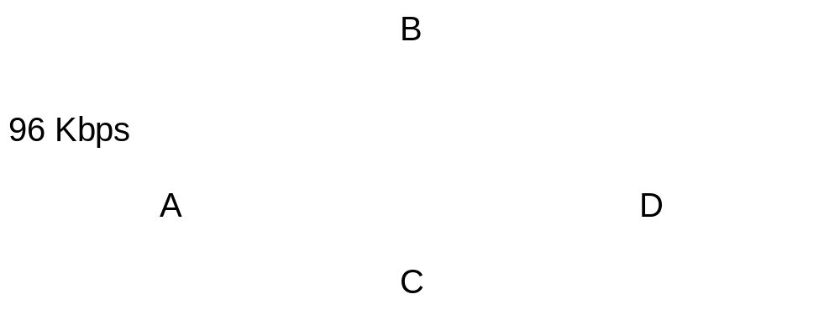
Stability vs. optimal delay
Example: Optimize delay by sending all packets over link with the least traffic.
  Update the routing decision every 10 sec

Slide 6
Elements of Routing Algorithms
Optimization Criteria:
  - Number of Hops - “Cost”
  - Delay - Throughput
Decision Time:
  Once per session (VCs)
  Once per packet (datagram)
Decision Place:
  Each node (distributed routing)
  Central node (centralized routing)
  Sending node (source routing)

Slide 7
Shortest-Path Routing
Routing algorithms generally use a shortest path algorithm to calculate the route with the least cost
Three components:
1. Measurement Component
    Nodes (routers) measure the current characteristics such as delay, throughput, and “cost”
  2. Protocol
    Nodes disseminate the measured information to other nodes
3. Calculation
    Nodes run a least-cost routing algorithm to recalculate their routes

Slide 8
Goal of Shortest Path Routing
Goal: Given a network were each link between two nodes i and j is assigned a cost. Find the path with the least cost between nodes i and j.
Parameters:
  d_{ij} cost of link between node i and node j;
d_{ij} = ∞, if nodes i and j are not connected;
d_{ii} = 0
N set of nodes

Slide 9
Approaches to Shortest Path Routing
There are two basic approaches to least-cost routing in a communication network
There are two basic approaches to shortest-path routing:
1. Link State Routing
2. Distance Vector Routing

Slide 10
Approaches to Shortest Path Routing
1. Link State Routing
  Each node knows the distance to its neighbors
  The distance information (=link state) is broadcast to all nodes in the network
  Each node calculates the routing tables independently
2. Distance Vector Routing
  Each node knows the distance (=cost) to its directly connected neighbors
  A node sends a list to its neighbors with the current distances to all nodes
  If all nodes update their distances, the routing tables eventually converge

Slide 11
Distance Vector Routing

Slide 12
Distance Vector
Each node maintains two tables:
  Distance Table: Cost to each node via each outgoing link
  Routing Table: Minimum cost to each node and next hop node
Nodes exchange messages that contain information on the cost of a route
Reception of messages triggers recalculation of routing table

Slide 13
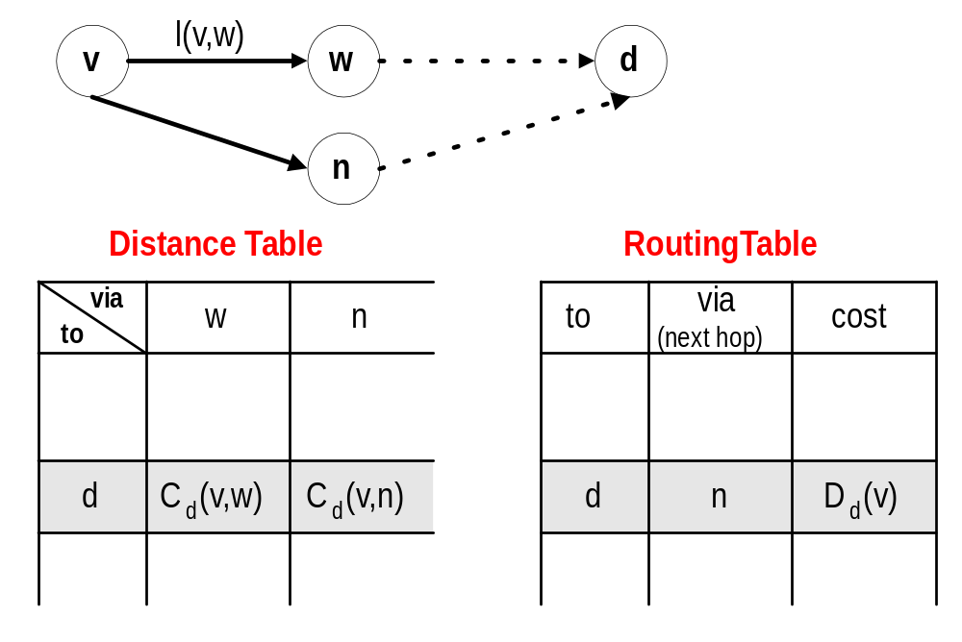
Distance Vector Algorithm: Tables
Note: In the figure,
C_{d}(v,w)<C_{d}(v,n) and, therefore,
D_{d}(v) = C_{d}(v,n)
l (v,w) cost of link (w,v)
C _{d}(v,w) cost from v to d via w
D_{d}(v) minimum cost from v to d

Slide 14
Messages
Nodes exchange messages to their neighbors.
If node v sends a messages to node x of the form,
[m , D_{m} (v)], this means
“I can go to node m with minimum cost D_{m} (v)”
[m , D_{m} (v)]
v
x
This message is only of interest to neighbors of v

Slide 15
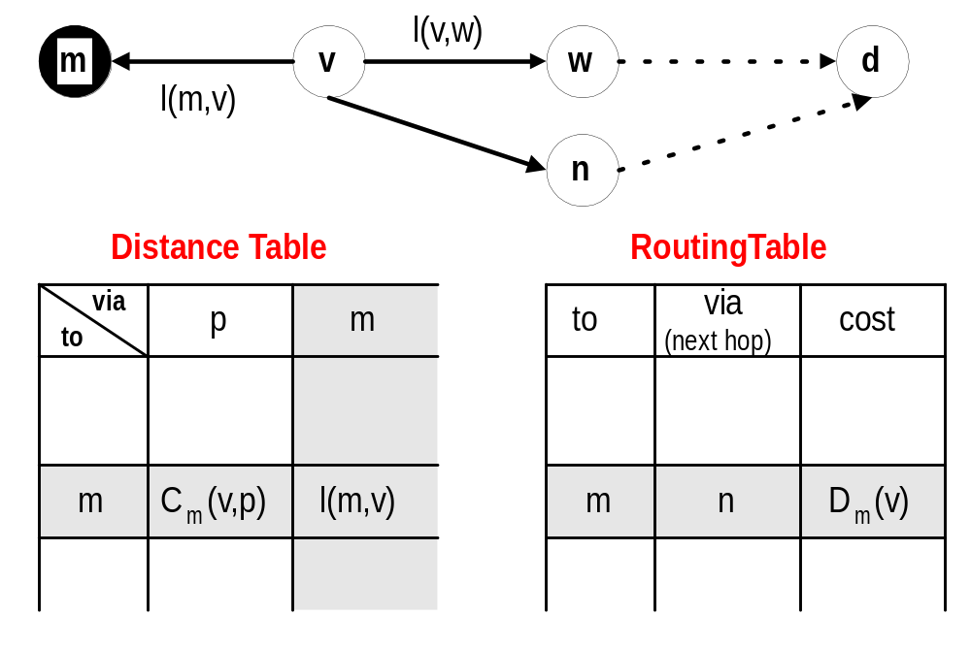
New link with cost l(m,v) comes up
New
row
New
column

Slide 16
New link with cost l(m,v) comes up
Operations at node v
1. Add new row in distance and routing table, and new column to distance table
2. Recalculate distance table under consideration of l(m,v)
3. Compute min_{w} C_{m}(v,w):
(a) If no changes to previous value of min_{w} C_{m}(v,w):
Do nothing
(b) If C_{m}(v, m) = min_{w} C_{m}(v,w) D_{m}(v)=C_{m}(v,m) change entry in m-th row of routing table to (m, , D_{m}(v)) and send message [m, D_{m}(v)] to all neighbors
3. Also: Since v is a neighbor of m, v sends the contents of its routing table to m: [a, D_{a}(v)], [b, D_{b}(v)], ...., [z, D_{z}(v)]

Slide 17
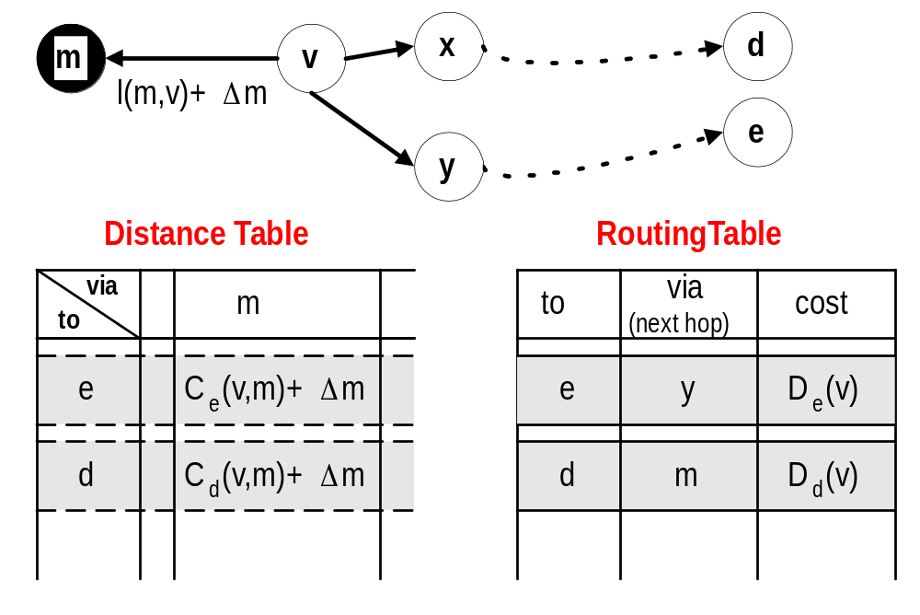
Cost of link changes by Δm

Slide 18
Cost of link changes by Δm
Operations at node v
1. Entries in m-th column of distance table are changed by Δ (if link goes down: Δ = ∞).
2. For all destinations d:
Compute min_{w} C_{m}(v,w):
(a) If no changes to previous value of min_{w} C_{m}(v,w):
Do nothing
(b) If C_{m}(v, m) = min_{w} C_{m}(v,w)
Change entry in d-th row of routing table to (m,C_{d}(v, m)), and send messages [d, C_{d}(v, m)] to all neighbors

Slide 19
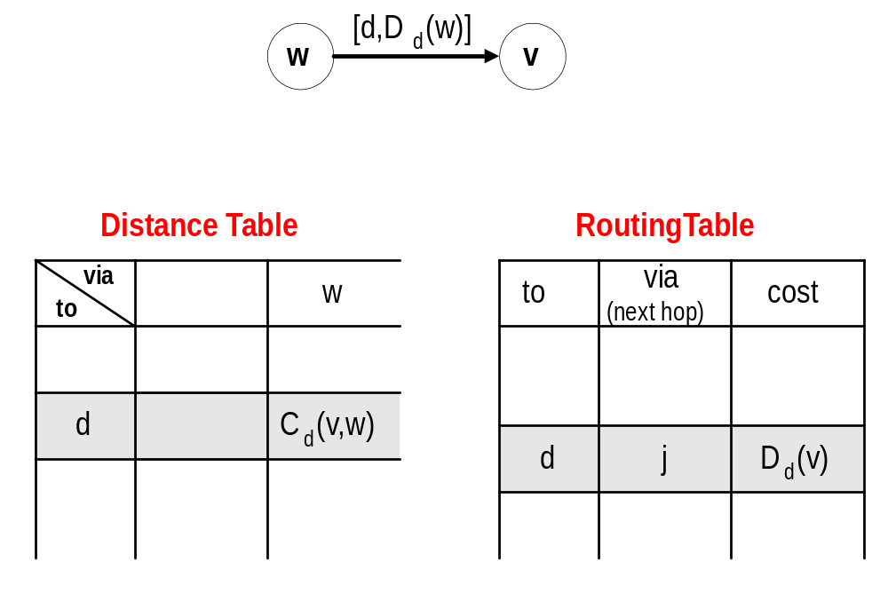
Node v receives a message [d, D_{d}(w)]

Slide 20
Node v receives a message [d, D_{d}(w)]
Operations at node v
1. If d = v then ignore the message
2. If d ≠ v then
  C_{d}(v, w) = D_{d}(w) + l (w,v)
  Compute min_{x} C_{d}(v,x) :
  If no changes, then do nothing
  If C_{d}(v,w)=minx C_{d}(v,x), then
  change entry in d-th row of routing table to (d, C_{d}(v, w)) and send message [d, C_{d}(v,w)] to all neighbors.

Slide 21
Example
Assume that Node 1 comes up at time t=0
Show how the entries for destination 1 are updated at all other nodes
5
2
3
3
5
2
1
2
1
6
3
1
4
5
2
1

Slide 22
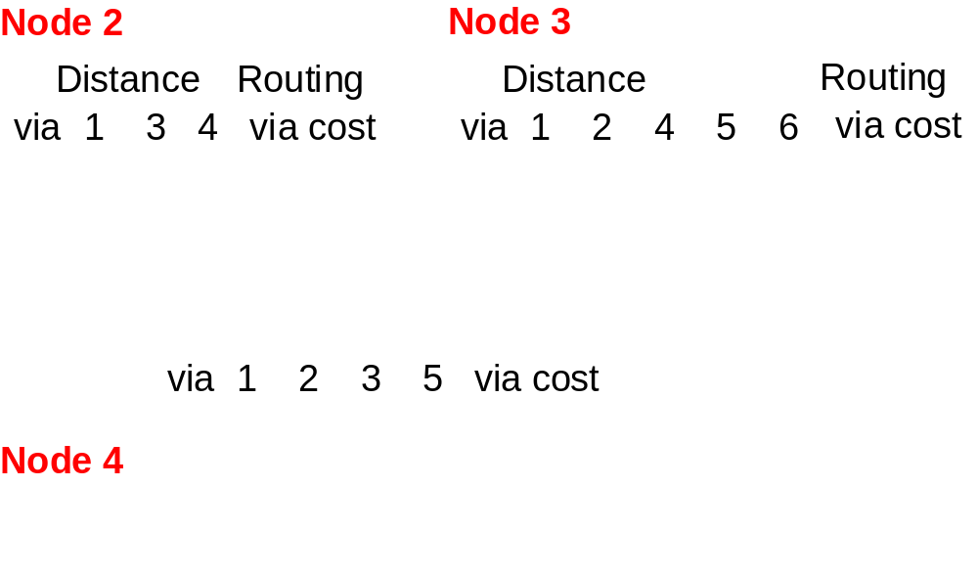
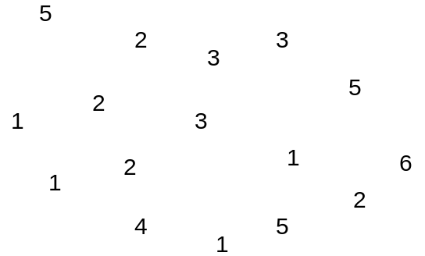

Example
Node 6
Distance
Routing
Distance
Routing
via
3 4 6
via cost
via
5 6
via cost
Node 5

Slide 23
Discussion of Distance Vector Routing
Entries of routing tables can change while a packet is being transmitted. This can lead to a single datagram visiting the same node more than once (Looping)
If the period for updating the routing tables is too short, routing table entries are changed before convergence (from the previous updates) is achieved
Example: The ARPANET used a Distance Vector algorithm with an update period of <1 sec. Due to the instability of routing, the ARPANET switched in 1979 to a link state routing algorithm

Slide 24
Characteristics of Distance Vector Routing
Periodic Updates: Updates to the routing tables are sent at the end of a certain time period. A typical value is 90 seconds.
Triggered Updates: If a metric changes on a link, a router immediately sends out an update without waiting for the end of the update period.
Full Routing Table Update: Most distance vector routing protocol send their neighbors the entire routing table (not only entries which change).
Route invalidation timers: Routing table entries are invalid if they are not refreshed. A typical value is to invalidate an entry if no update is received after 3-6 update periods.

Slide 25
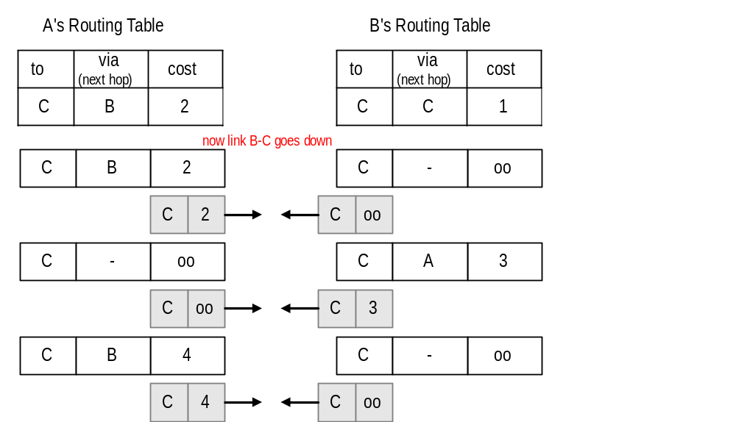
The Count-to-Infinity Problem
A
1
B
1
C

Slide 26
Count-to-Infinity
The reason for the count-to-infinity problem is that each node only has a “next-hop-view”
For example, in the first step, A did not realize that its route (with cost 2) to C went through node B
How can the Count-to-Infinity problem be solved?

Slide 27
Count-to-Infinity
The reason for the count-to-infinity problem is that each node only has a “next-hop-view”
For example, in the first step, A did not realize that its route (with cost 2) to C went through node B
How can the Count-to-Infinity problem be solved?
Solution 1: Always advertise the entire path in an update message (Path vectors)
      If routing tables are large, the routing messages require substantial bandwidth
      BGP uses this solution

Slide 28
Count-to-Infinity
The reason for the count-to-infinity problem is that each node only has a “next-hop-view”
For example, in the first step, A did not realize that its route (with cost 2) to C went through node B
How can the Count-to-Infinity problem be solved?
Solution 2: Never advertise the cost to a neighbor if this neighbor is the next hop on the current path (Split Horizon)
      Example: A would not send the first routing update to B, since B is the next hop on A’s current route to C
      Split Horizon does not solve count-to-infinity in all cases!

Slide 29
Link State Routing

Slide 30

Distance Vector vs. Link State Routing
With distance vector routing, each node has information only about the next hop:
    Node A: to reach F go to B
    Node B: to reach F go to D
    Node D: to reach F go to E
    Node E: go directly to F
Distance vector routing makes
poor routing decisions if
directions are not completely
correct
(e.g., because a node is down).
If parts of the directions incorrect, the routing may be incorrect until the routing algorithms has re-converged.
A
B
C
D
E
F

Slide 31
Distance Vector vs. Link State Routing
In link state routing, each node has a complete map of the topology
If a node fails, each
node can calculate
the new route
Difficulty: All nodes need to
have a consistent view of the
network
A
B
C
A
B
C
A
B
C
D
E
F
D
E
F
D
E
F
A
B
C
D
E
F
A
B
C
A
B
C
A
B
C
D
E
F
D
E
F
D
E
F

Slide 32
Link State Routing
Each node must
  discover its neighbors
  measure the delay (=cost) to its neighbors
  broadcast a packet with this information to all other nodes
  compute the shortest paths to every other router
The broadcast can be accomplished by flooding
The shortest paths can be computer with Dijkstra’s algorithm

Slide 33
Link State Routing: Basic princples
  1. Each router establishes a relationship (“adjacency”) with its neighbors
  2.Each router generates link state advertisements (LSAs) which are distributed to all routers
      LSA = (link id, state of the link, cost, neighbors of the link)
  3. Each router maintains a database of all received LSAs (topological database or link state database), which describes the network has a graph with weighted edges
  4. Each router uses its link state database to run a shortest path algorithm (Dijikstra’s algorithm) to produce the shortest path to each network

Slide 34
Link State Routing: Properties
Each node requires complete topology information
Link state information must be flooded to all nodes
Guaranteed to converge

Slide 35
Operation of a Link State Routing protocol
IP Routing
Table
Received
LSAs
Link State
Database
Dijkstra’s
Algorithm
LSAs are flooded
to other interfaces

Slide 36
Dijkstra’s Shortest Path Algorithm for a Graph
Input: Graph (N,E) with
N the set of nodes and E ⊆ N × N the set of edges
d_{vw} link cost (d_{vw} = infinity if (v,w) ∉ E, d_{vv} = 0)
s source node.
Output: D_{n} cost of the least-cost path from node s to node n
M = {s};
for each n ∉ M
D_{n} = d_{sn};
while (M ≠ all nodes) do
Find w ∉ M for which D_{w} = min{D_{j} ; j ∉ M};
Add w to M;
for each n ∉ M
D_{n} = min_{w} [ D_{n}, D_{w} + d_{wn} ];
Update route;
enddo

Slide 37
Example Network
5
2
3
3
5
2
1
2
1
6
3
1
4
5
2
1

Slide 38
Example
Example: Calculate the shortest paths for node 1.
Iteration M D₁ D₂ D₃ D₄ D₅ D₆
Init

Slide 39
Example
Result is a routing tree:
... which results in a routing table (of node 1):

