Slide 1
ROUTING ON THE INTERNET
COSC 6590

Slide 2
Routing Protocols
routers receive and forward packets
make decisions based on knowledge of topology and traffic/delay conditions
use dynamic routing algorithm
distinguish between:
  routing information - about topology & delays
  routing algorithm - that makes routing decisions based on information
Notes:
The routers in an internet are responsible for receiving and forwarding packets through the interconnected set of networks. Each router makes routing decision based on knowledge of the topology and traffic/delay conditions of the internet. In more complex internets, a degree of dynamic cooperation is needed among the routers. In particular, the router must avoid portions of the network that have failed and should avoid portions of the network that are congested. To make such dynamic routing decisions, routers exchange routing information using a special routing protocol for that purpose. Information is needed about the status of the internet, in terms of which networks can be reached by which routes, and the delay characteristics of various routes. In considering the routing function, it is important to distinguish two concepts:
• Routing information: Information about the topology and delays of the internet
• Routing algorithm: The algorithm used to make a routing decision for a particular datagram, based on current routing information

Slide 3
Performance Criteria
used for selection of route
simplest is “minimum hop”
can be generalized as “least cost”
Notes:
The selection of a route is generally based on some performance criterion. The simplest criterion is to choose the minimum-hop route (one that passes through the least number of nodes) through the network. This is an easily measured criterion and should minimize the consumption of network resources. A generalization of the minimum-hop criterion is least-cost routing. In this case, a cost is associated with each link, and, for any pair of attached stations, the route through the network that accumulates the least cost is sought. In either the minimum-hop or least-cost approach, the algorithm for determining the optimum route for any pair of stations is relatively straightforward, and the processing time would be about the same for either computation. Because the least-cost criterion is more flexible, this is more common than the minimum-hop criterion. Several least-cost routing algorithms are in common use. These are described in Stallings DCC8e Section 12.3

Slide 4
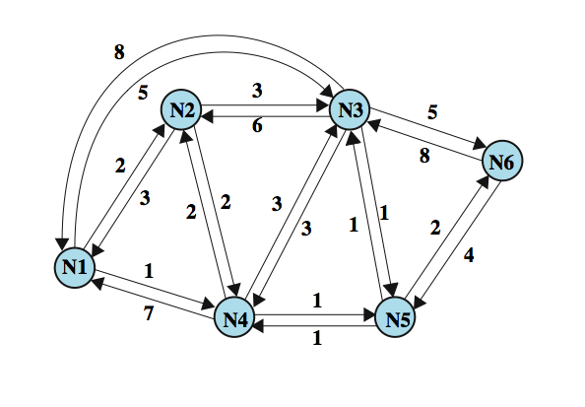
Example Packet Switched Network
Notes:
Stallings DCC8e Figure 12.1 illustrates a network in which the two arrowed lines between a pair of nodes represent a link between these nodes, and the corresponding numbers represent the current link cost in each direction. The shortest path (fewest hops) from node 1 to node 6 is 1-3-6 (cost = 5 + 5 = 10), but the least-cost path is 1-4-5-6 (cost = 1 + 1 + 2 = 4). Costs are assigned to links to support one or more design objectives. For example, the cost could be inversely related to the data rate (i.e., the higher the data rate on a link, the lower the assigned cost of the link) or the current queuing delay on the link. In the first case, the least-cost route should provide the highest throughput. In the second case, the least-cost route should minimize delay.

Slide 5
Autonomous Systems (AS)
is a group of routers and networks managed by single organization
which exchange information via a common routing protocol
form a connected network
  at least one path between any pair of nodes
  except in times of failure
Notes:
An autonomous system (AS) exhibits the following characteristics:
1. An AS is a set of routers and networks managed by a single organization.
2. An AS consists of a group of routers exchanging information via a common routing protocol.
3. Except in times of failure, an AS is connected (in a graph-theoretic sense); that is, there is a path between any pair of nodes.

Slide 6
Interior and Exterior Router Protocols
interior router protocol (IRP)
  passes routing information between routers within AS
  can be tailored to specific applications
  needs detailed model of network to function
may have more than one AS in internet
  routing algorithms & tables may differ between them
routers need info on networks outside own AS
use an exterior router protocol (ERP) for this
  supports summary information on AS reachability
Notes:
A shared routing protocol, which we shall refer to as an interior router protocol (IRP), passes routing information between routers within an AS. The protocol used within the AS does not need to be implemented outside of the system. This flexibility allows IRPs to be custom tailored to specific applications and requirements.
It is likely that an internet will be constructed of more than one AS. In this case, the routing algorithms and information in routing tables used by routers in different ASs may differ. Buts, the routers in one AS need at least a minimal level of information concerning networks outside the system that can be reached. We refer to the protocol used to pass routing information between routers in different ASs as an exterior router protocol (ERP).
We can expect that an ERP will need to pass less information than an IRP, for the following reason. If a datagram is to be transferred from a host in one AS to a host in another AS, a router in the first system need only determine the target AS and devise a route to get into that target system. Once the datagram enters the target AS, the routers within that system can cooperate to deliver the datagram; the ERP is not concerned with, and does not know about, the details of the route followed within the target AS.

Slide 7
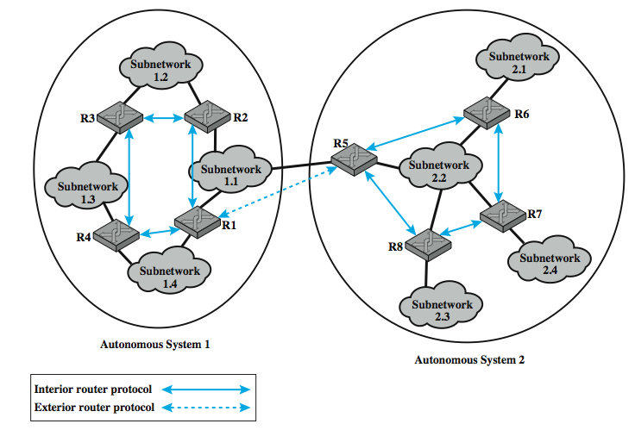
Application of IRP and ERP
Notes:
Illustrate the use of an interior router protocol (IRP) vs an exterior router protocol (ERP) in this example. Here, all of the LANs at a site, such as an office complex or campus, could be linked by routers to form an AS. This system might be linked through a wide area network to other ASs. The situation is illustrated in Stallings DCC8e Figure 19.5.

Slide 8
Approaches to Routing –
Distance-vector
each node (router or host) exchange information with neighboring nodes
first generation routing algorithm for ARPANET
  eg. used by Routing Information Protocol (RIP)
each node maintains vector of link costs for each directly attached network and distance and next-hop vectors for each destination
requires transmission of much info by routers
  distance vector & estimated path costs
changes take long time to propagate
Notes:
Internet routing protocols employ one of three approaches to gathering and using routing information: distance-vector routing, link-state routing, and path-vector routing.
Distance-vector routing requires that each node (router or host that implements the routing protocol) exchange information with its neighboring nodes. Two nodes are said to be neighbors if they are both directly connected to the same network. This approach is that used in the first generation routing algorithm for ARPANET, as described in Section 12.2. For this purpose, each node maintains a vector of link costs for each directly attached network and distance and next-hop vectors for each destination. The relatively simple Routing Information Protocol (RIP) uses this approach.
Distance-vector routing requires the transmission of a considerable amount of information by each router. Each router must send a distance vector to all of its neighbors, and that vector contains the estimated path cost to all networks in the configuration. Furthermore, when there is a significant change in a link cost or when a link is unavailable, it may take a considerable amount of time for this information to propagate through the internet.

Slide 9
Approaches to Routing –
Link-state
designed to overcome drawbacks of distance-vector
each router determines link cost on each interface
advertises set of link costs to all other routers in topology
if link costs change, router advertises new values
each router constructs topology of entire configuration
  can calculate shortest path to each dest
  use to construct routing table with first hop to each dest
do not use distributed routing algorithm, but any suitable alg to determine shortest paths, eg. Dijkstra's algorithm
Open Shortest Path First (OSPF) is a link-state protocol
Notes:
Link-state routing is designed to overcome the drawbacks of distance-vector routing. When a router is initialized, it determines the link cost on each of its network interfaces. The router then advertises this set of link costs to all other routers in the internet topology, not just neighboring routers. From then on, the router monitors its link costs. Whenever there is a significant change (a link cost increases or decreases substantially, a new link is created, an existing link becomes unavailable), the router again advertises its set of link costs to all other routers in the configuration.
Because each router receives the link costs of all routers in the configuration, each router can construct the topology of the entire configuration and then calculate the shortest path to each destination network. Having done this, the router can construct its routing table, listing the first hop to each destination. Because the router has a representation of the entire network, it does not use a distributed version of a routing algorithm, as is done in distance-vector routing. Rather, the router can use any routing algorithm to determine the shortest paths. In practice, Dijkstra's algorithm is used. The open shortest path first (OSPF) protocol is an example of a routing protocol that uses link-state routing. The second generation routing algorithm for ARPANET also uses this approach.

Slide 10
What Exterior Routing Protocols are not
link-state and distance-vector not effective for exterior router protocol
distance-vector
  assumes routers share common distance metric
  but different ASs may have different priorities & needs
  but have no info on AS’s visited along route
link-state
  different ASs may use different metrics and have different restrictions
  flooding of link state information to all routers unmanageable
Notes:
Both link-state and distance-vector approaches have been used for interior router protocols. Neither approach is effective for an exterior router protocol.
In a distance-vector routing protocol, each router advertises to its neighbors a vector listing each network it can reach, together with a distance metric associated with the path to that network. This distance-vector protocol assumes that all routers share a common distance metric with which to judge router preferences. This may not be the case among different ASs. A given AS may have different priorities from other ASs and may have restrictions that prohibit the use of certain other AS. A distance-vector algorithm gives no information about the ASs that will be visited along a route.
In a link-state routing protocol, each router advertises its link metrics to all other routers. Each router builds up a picture of the complete topology of the configuration and then performs a routing calculation. Different ASs may use different metrics and have different restrictions. Although the link-state protocol does allow a router to build up a picture of the entire topology, the metrics used may vary from one AS to another, making it impossible to perform a consistent routing algorithm. The flooding of link state information to all routers implementing an exterior router protocol across multiple ASs may be unmanageable.

Slide 11
Exterior Router Protocols –
Path-vector
alternative path-vector routing protocol
  provides info about which networks can be reached by a given router and ASs crossed to get there
  does not include distance or cost estimate
  hence dispenses with concept of routing metrics
have list of all ASs visited on a route
enables router to perform policy routing
  eg. avoid path to avoid transiting particular AS
  eg. link speed, capacity, tendency to become congested, and overall quality of operation, security
  eg. minimizing number of transit ASs
Notes:
An alternative, known as path-vector routing, is to dispense with routing metrics and simply provide information about which networks can be reached by a given router and the ASs that must be crossed to get there. The approach differs from a distance-vector algorithm in two respects: First, the path-vector approach does not include a distance or cost estimate. Second, each block of routing information lists all of the ASs visited in order to reach the destination network by this route.
Because a path vector lists the ASs that a datagram must traverse if it follows this route, the path information enables a router to perform policy routing. That is, a router may decide to avoid a particular path in order to avoid transiting a particular AS. For example, information that is confidential may be limited to certain kinds of ASs. Or a router may have information about the performance or quality of the portion of the internet that is included in an AS that leads the router to avoid that AS. Examples of performance or quality metrics include link speed, capacity, tendency to become congested, and overall quality of operation. Another criterion that could be used is minimizing the number of transit ASs.

Slide 12
Border Gateway Protocol (BGP)
developed for use with TCP/IP internets
is preferred EGP of the Internet
uses messages sent over TCP connection
current version is BGP-4 (RFC1771)
functional procedures
  neighbor acquisition - when agree to exchange info
  neighbor reachability - to maintain relationship
  network reachability - to update database of routes
Notes:
The Border Gateway Protocol (BGP) was developed for use in conjunction with internets that employ the TCP/IP suite, although the concepts are applicable to any internet. BGP has become the preferred exterior router protocol for the Internet. BGP was designed to allow routers, called gateways in the standard, in different autonomous systems (ASs) to cooperate in the exchange of routing information. The protocol operates in terms of messages, which are sent over TCP connections. The current version of BGP is known as BGP-4 (RFC 1771).
Three functional procedures are involved in BGP First it is necessary to perform neighbor acquisition, which occurs when two neighboring routers in different autonomous systems agree to exchange routing information regularly. A formal acquisition procedure is needed because one of the routers may not wish to participate. To perform neighbor acquisition, two routers send Open messages to each other after a TCP connection is established. If each router accepts the request, it returns a Keepalive message in response.
Once a neighbor relationship is established, the neighbor reachability procedure is used to maintain the relationship. For this purpose, the two routers periodically issue Keepalive messages to each other.
The final procedure is network reachability. Each router maintains a database of the networks that it can reach and the preferred route for reaching each network. When a change is made to this database, the router issues an Update message that is broadcast to all other routers implementing BGP.

Slide 13
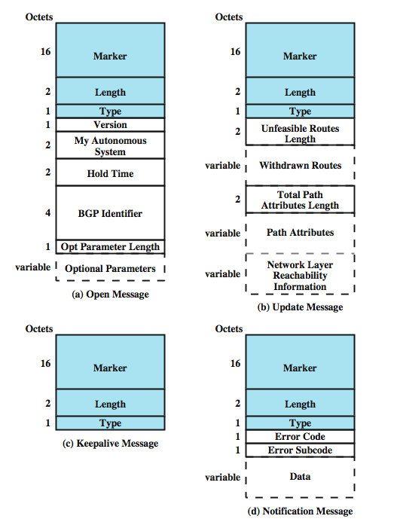
BGP Messages
Open
Update
Keep alive
Notification
Notes:
The repertoire of messages is summarized in Stallings DCC8e Table 19.2:
Open - to open a neighbor relationship with another router
Update - to (1) transmit information about a single route and/or (2) list multiple routes to be withdrawn.
Keepalive - to (1) acknowledge an Open message and (2) periodically confirm the neighbor relationship.
Notification - is sent when an error condition is detected.
Stallings DCC8e Figure 19.6 illustrates the formats of all of the BGP messages. Each message begins with a 19-octet header containing three fields, as indicated by the shaded portion of each message in the figure:
• Marker: Reserved for authentication. The sender may insert a value in this field that would be used as part of an authentication mechanism to enable the recipient to verify the identity of the sender.
• Length: Length of message in octets.
Type: Type of message: Open, Update, Notification, Keepalive.

Slide 14
Message Types -
Open & KeepAlive
router makes TCP connection to neighbor
Open message
  sent by connection initiator
  includes proposed hold time
  receiver uses minimum of own/sent hold time
  max time between Keepalive and/or Update
Keep Alive message
  To tell other routers that this router is still here
Notes:
To acquire a neighbor, a router first opens a TCP connection to the neighbor router of interest. It then sends an Open message. This message identifies the AS to which the sender belongs and provides the IP address of the router. It also includes a Hold Time parameter, which indicates the number of seconds that the sender proposes for the value of the Hold Timer. If the recipient is prepared to open a neighbor relationship, it calculates a value of Hold Timer that is the minimum of its Hold Time and the Hold Time in the Open message. This calculated value is the maximum number of seconds that may elapse between the receipt of successive Keepalive and/or Update messages by the sender.
The Keepalive message consists simply of the header. Each router issues these messages to each of its peers often enough to prevent the Hold Timer from expiring.

Slide 15
Message Types - Update
Update message conveys two info types:
  Info about single routes through internet
  List of routes being withdrawn
info on a route uses 3 fields:
  Network Layer Reachability Information (NLRI)
  Total Path Attributes Length
  Path Attributes
withdraw route identified by dest IP address
Notes:
The Update message communicates two types of information: Information about a single route through the internet, which may be added to the database of any recipient router, and a list of routes previously advertised by this router that are being withdrawn.
An Update message may contain one or both types of information. Information about a single route through the network involves three fields: the Network Layer Reachability Information (NLRI) field, the Total Path Attributes Length field, and the Path Attributes field. The NLRI field consists of a list of identifiers of networks that can be reached by this route. Each network is identified by its IP address, which is actually a portion of a full IP address. Recall that an IP address is a 32-bit quantity of the form {network, host}. The left-hand or prefix portion of this quantity identifies a particular network. The Path Attributes field contains a list of attributes that apply to this particular route.
The second type of update information is the withdrawal of one or more routes. In this case, the route is identified by the IP address of the destination network.

Slide 16
Message Types – Update (2)
Origin - IGP or EGP
AS_Path - list of AS traversed
Next_hop - IP address of border router
Multi_Exit_Disc - info on routers internal to AS
Local_pref - inform routers in AS of route pref
Atomic_Aggregate, Aggregator - implement route aggregation to reduce amount of info
Notes:
The defined attributes used in the Path Attributes field are:
• Origin: Indicates whether this information was generated by an interior router protocol (e.g., OSPF) or an exterior router protocol (in particular, BGP).
• AS_Path: A list of the ASs that are traversed for this route.
• Next_Hop: The IP address of the border router that should be used as the next hop to the destinations listed in the NLRI field.
• Multi_Exit_Disc: Used to communicate some information about routes internal to an AS. This is described later in this section.
• Local_Pref: Used by a router to inform other routers within the same AS of its degree of preference for a particular route. It has no significance to routers in other ASs.
• Atomic_Aggregate, Aggregator: These two fields implement the concept of route aggregation. In essence, an internet and its corresponding address space can be organized hierarchically (i.e., as a tree). In this case, network addresses are structured in two or more parts. All of the networks of a given subtree share a common partial internet address. Using this common partial address, the amount of information that must be communicated in NLRI can be significantly reduced.

Slide 17
AS_Path and Next_Hop Use
AS_Path
  used to implement routing policies
    eg. to avoid a particular AS, security, performance, quality, number of AS crossed
Next_Hop
  only a few routers implement BGP
  responsible for informing outside routers of routes to other networks in AS
Notes:
The AS_Path attribute actually serves two purposes. Because it lists the ASs that a datagram must traverse if it follows this route, the AS_Path information enables a router to implement routing policies. That is, a router may decide to avoid a particular path to avoid transiting a particular AS. For example, information that is confidential may be limited to certain kinds of ASs. Or a router may have information about the performance or quality of the portion of the internet that is included in an AS that leads the router to avoid that AS. Examples of performance or quality metrics include link speed, capacity, tendency to become congested, and overall quality of operation. Another criterion that could be used is minimizing the number of transit ASs.
Typically, most of the routers in an autonomous system will not implement BGP. Only a few routers will be assigned responsibility for communicating with routers in other autonomous systems. The Next_Hop attribute is used to convey the identity of the next hop border router, independent of whether it implements BGP (though it must use an IRP to relay this info to a BGP router in its AS).

Slide 18
Notification Message
sent when some error condition detected:
Message header error
Open message error
Update message error
Hold time expired
Finite state machine error
Cease
Notes:
The Notification Message is sent when an error condition is detected. The following errors may be reported:
• Message header error: Includes authentication and syntax errors.
• Open message error: Includes syntax errors and options not recognized in an Open message. This message can also be used to indicate that a proposed Hold Time in an Open message is unacceptable.
• Update message error: Includes syntax and validity errors in an Update message.
• Hold timer expired: If the sending router has not received successive Keepalive and/or Update and/or Notification messages within the Hold Time period, then this error is communicated and the connection is closed.
• Finite state machine error: Includes any procedural error.
• Cease: Used by a router to close a connection with another router in the absence of any other error.

Slide 19
BGP Routing Information Exchange
within AS a router builds topology picture using IGP
router issues Update message to other routers outside AS using BGP
these routers exchange info with other routers in other AS
  AS_Path field used to prevent loops
routers must then decide best routes
Notes:
The essence of BGP is the exchange of routing information among participating routers in multiple ASs. This process can be quite complex. In what follows, we provide a simplified overview. To begin, a router that implements BGP will also implement an internal routing protocol such as OSPF. This is used to exchange routing information with other routers within the AS, to build up a picture of the topology of the networks and routers in AS, and to construct a routing table. Next, the router can issue an Update message to its neighbors that informs them that all of the networks listed in NLRI are reachable via this router, and that the only autonomous system traversed is it’s AS. In turn these routers can forward the information just received in a new Update message to its neighbors. They must now decide if this route is its preferred route to the networks listed. It may have knowledge of an alternate route to some or all of these networks that it prefers for reasons of performance or some other policy metric. In this fashion, routing update information is propagated through the larger internet, consisting of a number of interconnected autonomous systems. The AS_Path field is used to assure that such messages do not circulate indefinitely: if an Update message is received by a router in an AS that is included in the AS_Path field, that router will not forward the update information to other routers.
Routers within the same AS, called internal neighbors, may exchange BGP information. In this case, the sending router does not add the identifier of the common AS to the AS_Path field. When a router has selected a preferred route to an external destination, it transmits this route to all of its internal neighbors.

Slide 20
Open Shortest Path First (RFC2328)
IGP of Internet
replaced Routing Information Protocol (RIP)
uses Link State Routing Algorithm
  each router keeps list of state of local links to network
  transmits update state info
  little traffic as messages are small and not sent often
uses least cost based on user cost metric
topology stored as directed graph
  vertices or nodes (router, transit or stub network)
  edges (between routers or router to network)
Notes:
The OSPF protocol (RFC 2328) is now widely used as the interior router protocol in TCP/IP networks. OSPF computes a route through the internet that incurs the least cost based on a user-configurable metric of cost. The user can configure the cost to express a function of delay, data rate, dollar cost, or other factors. OSPF is able to equalize loads over multiple equal-cost paths.
Each router maintains a database that reflects the known topology of the autonomous system of which it is a part. The topology is expressed as a directed graph. The graph consists of: Vertices, or nodes (router, transit or stub networks); and edges (directly connected routers, router to network).

Slide 21
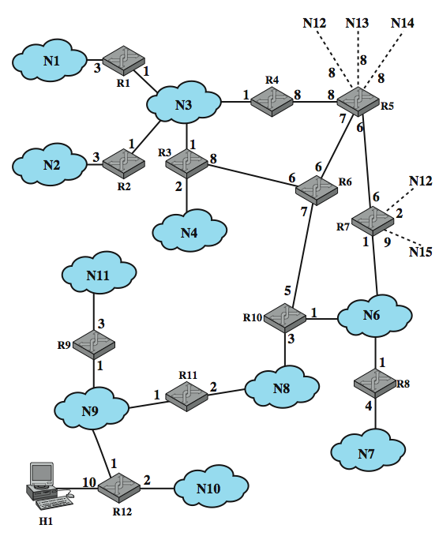
Example OSPF AS
Notes:
Stallings DCC8e Figure 19.7, based on one in RFC 2328, shows an example of an autonomous system.

Slide 22
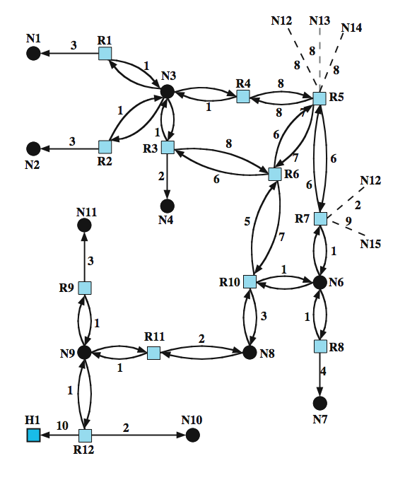
Directed
Graph of AS
Notes:
Stallings DCC8e Figure 19.8 is the resulting directed graph, mapped using:
• Two routers joined by a point-to-point link are represented in the graph as being directly connected by a pair of edges, one in each direction (e.g., routers 6 and 10).
• When multiple routers are attached to a network (such as a LAN or packet-switching network), the directed graph shows all routers bidirectionally connected to the network vertex (e.g., routers 1, 2, 3, and 4 all connect to network 3).
• If a single router is attached to a network, the network will appear in the graph as a stub connection (e.g., network 7).
• An end system, called a host, can be directly connected to a router, in which case it is depicted in the corresponding graph (e.g., host 1).
• If a router is connected to other autonomous systems, then the path cost to each network in the other system must be obtained by some exterior router protocol (ERP). Each such network is represented on the graph by a stub and an edge to the router with the known path cost (e.g., networks 12 through 15).
A cost is associated with the output side of each router interface. This cost is configurable by the system administrator. Arcs on the graph are labeled with the cost of the corresponding router output interface. Arcs having no labeled cost have a cost of 0. Note that arcs leading from networks to routers always have a cost of 0.

Slide 23
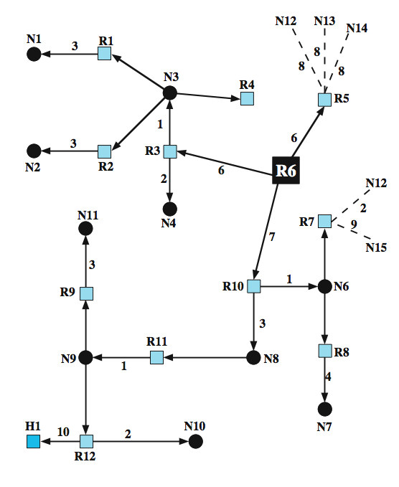
SPF Tree for Router 6
Notes:
A database corresponding to the directed graph is maintained by each router. It is pieced together from link state messages from other routers in the internet. Using Dijkstra's algorithm (see Stallings DCC8e Section 12.3), a router calculates the least-cost path to all destination networks. The result for router 6 of Figure 19.7 is shown as a tree in Stallings DCC8e Figure 19.9, with R6 as the root of the tree. The tree gives the entire route to any destination network or host. However, only the next hop to the destination is used in the forwarding process. The resulting routing table for router 6 is shown in Stallings DCC8e Table 19.3. The table includes entries for routers advertising external routes (routers 5 and 7). For external networks whose identity is known, entries are also provided.

Slide 24
Least Cost Algorithms
basis for routing decisions
  can minimize hop with each link cost 1
  or have link value inversely proportional to capacity
defines cost of path between two nodes as sum of costs of links traversed
  in network of nodes connected by bi-directional links
  where each link has a cost in each direction
for each pair of nodes, find path with least cost
  link costs in different directions may be different
alternatives: Dijkstra or Bellman-Ford algorithms
Notes:
Virtually all packet-switching networks and all internets base their routing decision on some form of least-cost criterion. If the criterion is to minimize the number of hops, each link has a value of 1. More typically, the link value is inversely proportional to the link capacity, proportional to the current load on the link, or some combination. In any case, these link or hop costs are used as input to a least-cost routing algorithm, which can be simply stated as:
“Given a network of nodes connected by bidirectional links, where each link has a cost associated with it in each direction, define the cost of a path between two nodes as the sum of the costs of the links traversed. For each pair of nodes, find a path with the least cost.”
Note that the cost of a link may differ in its two directions. This would be true, for example, if the cost of a link equaled the length of the queue of packets awaiting transmission from each of the two nodes on the link.
Most least-cost routing algorithms in use in packet-switching networks and internets are variations of one of two common algorithms, known as Dijkstra's algorithm and the Bellman-Ford algorithm. This section provides a summary of these two algorithms.

Slide 25
Dijkstra’s Algorithm
finds shortest paths from given source node s to all other nodes
by developing paths in order of increasing path length
algorithm runs in stages (next slide)
  each time adding node with next shortest path
algorithm terminates when all nodes processed by algorithm (in set T)
Notes:
Dijkstra's algorithm [DIJK59] can be stated as: Find the shortest paths from a given source node to all other nodes by developing the paths in order of increasing path length. The algorithm proceeds in stages. By the kth stage, the shortest paths to the k nodes closest to (least cost away from) the source node have been determined; these nodes are in a set T. At stage (k + 1), the node not in T that has the shortest path from the source node is added to T. As each node is added to T, its path from the source is defined.

Slide 26
Dijkstra’s Algorithm Method
Step 1 [Initialization]
  T = {s} Set of nodes so far incorporated
  L(n) = w(s, n) for n ≠ s
  initial path costs to neighboring nodes are simply link costs
Step 2 [Get Next Node]
  find neighboring node not in T with least-cost path from s
  incorporate node into T
  also incorporate the edge that is incident on that node and a node in T that contributes to the path
Step 3 [Update Least-Cost Paths]
  L(n) = min[L(n), L(x) + w(x, n)] for all n ∉ T
  f latter term is minimum, path from s to n is path from s to x concatenated with edge from x to n
Notes:
Dijkstra's Algorithm has three steps; steps 2 and 3 are repeated until T = N. That is, steps 2 and 3 are repeated until final paths have been assigned to all nodes in the network. Itcan be formally described as shown above, given the following definitions:
N = set of nodes in the network
s = source node
T = set of nodes so far incorporated by the algorithm
w(i, j) = link cost from node i to node j; w(i, i) = 0; w(i, j) = ∞ if two nodes not directly connected; w(i, j) ≥ 0 if two nodes are directly connected
L(n) = cost of the least-cost path from node s to node n that is currently known to the algorithm; at termination, this is the cost of the least-cost path in the graph from s to n.
The algorithm terminates when all nodes have been added to T. At termination, the value L(x) associated with each node x is the cost (length) of the least-cost path from s to x. In addition, T defines the least-cost path from s to each other node. One iteration of steps 2 and 3 adds one new node to T and defines the least-cost path from s to that node. That path passes only through nodes that are in T. To see this, consider the following line of reasoning. After k iterations, there are k nodes in T, and the least-cost path from s to each of these nodes has been defined. Now consider all possible paths from s to nodes not in T. Among those paths, there is one of least cost that passes exclusively through nodes in T (see Problem 12.4), ending with a direct link from some node in T to a node not in T. This node is added to T and the associated path is defined as the least-cost path for that node.

Slide 27
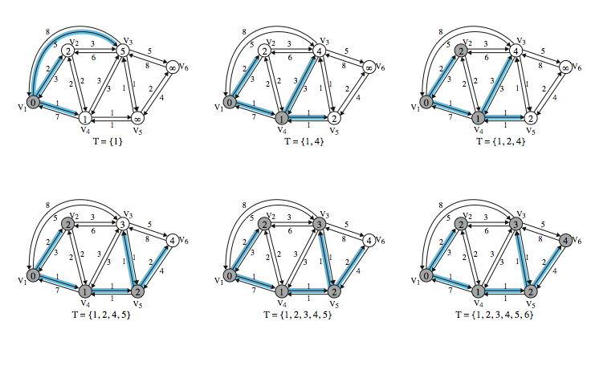
Dijkstra’s Algorithm Example
Notes:
Stallings DCC8e Table 12.2a (next slide) and Figure 12.9 show the result of applying this algorithm to the graph of Figure 12.1, using source node s = 1. The shaded edges define the spanning tree for the graph. The values in each circle are the current estimates of L(x) for each node x. A node is shaded when it is added to T. Note that at each step the path to each node plus the total cost of that path is generated. After the final iteration, the least-cost path to each node and the cost of that path have been developed. The same procedure can be used with node 2 as source node, and so on.

Slide 28
Dijkstra’s Algorithm Example
Iter | T | L(2) | Path | L(3) | Path | L(4) | Path | L(5) | Path | L(6) | Path
1 | {1} | 2 | 1–2 | 5 | 1-3 | 1 | 1–4 | ∞ | - | ∞ | -
2 | {1,4} | 2 | 1–2 | 4 | 1-4-3 | 1 | 1–4 | 2 | 1-4–5 | ∞ | -
3 | {1, 2, 4} | 2 | 1–2 | 4 | 1-4-3 | 1 | 1–4 | 2 | 1-4–5 | ∞ | -
4 | {1, 2, 4, 5} | 2 | 1–2 | 3 | 1-4-5–3 | 1 | 1–4 | 2 | 1-4–5 | 4 | 1-4-5–6
5 | {1, 2, 3, 4, 5} | 2 | 1–2 | 3 | 1-4-5–3 | 1 | 1–4 | 2 | 1-4–5 | 4 | 1-4-5–6
6 | {1, 2, 3, 4, 5, 6} | 2 | 1-2 | 3 | 1-4-5-3 | 1 | 1-4 | 2 | 1-4–5 | 4 | 1-4-5-6
Notes:
Stallings DCC8e Table 12.2a shows the result of applying this algorithm as shown in Figure 12.9 (previous slide).

Slide 29
Reference
Data & Computer Communications by William Stallings

