Slide 1
Routing - I
Important concepts: link state based routing, distance vector based routing

Slide 2
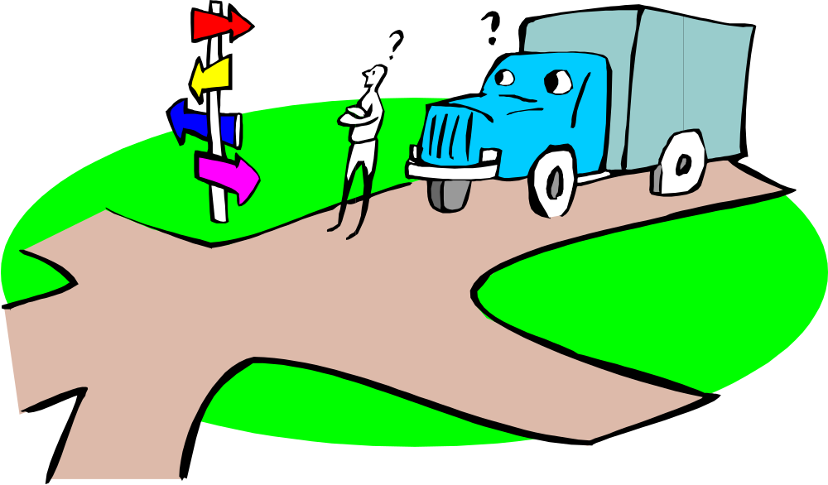
In the middle of Intersection …

Slide 3
Two Strategies …
Strategy One:
  You have a map, which gives you a complete picture of where you are, and possible routes, distances to get to destination X
Strategy Two:
  You don’t have a map, all you know is the road signs telling you the distance from here, i.e., where you are, to next adjacent town
  Also suppose you ask around, from the people from the neighbor town, you know (according to them) how far it is from here to the destination

Slide 4
Routing
Routing protocol
Goal: determine “good” path
(sequence of routers) thru
network from source to dest.
5
B
3
C
2
5
A
2
1
F
Graph abstraction for routing algorithms:
graph nodes are routers
graph edges are physical links
  link cost: delay, $ cost, or congestion level
3
1
2
D
E
1
“good” path:
  typically means minimum cost path
  other def’s possible

Slide 5
Routing Algorithm Classification
Global or decentralized information?
Global:
all routers have complete topology, link cost info
“link state” algorithms
Decentralized:
router knows physically-connected neighbors, link costs to neighbors
iterative process of computation, exchange of info with neighbors
“distance vector” algorithms
Static or dynamic?
Static:
routes change slowly over time
Dynamic:
routes change more quickly
  periodic update
  in response to link cost changes

Slide 6
A Link State Routing Algorithm
Dijkstra’s algorithm
net topology, link costs known to all nodes
  accomplished via “link state broadcast”
  all nodes have same info
computes least cost paths from one node (‘source”) to all other nodes
  gives routing table for that node
iterative: after k iterations, know least cost path to k dest.’s
Notation:
c(i,j): link cost from node i to j. cost infinite if not direct neighbors
D(v): current value of cost of path from source to dest. V
p(v): predecessor node along path from source to v, that is next v
N: set of nodes whose least cost path definitively known

Slide 7
Dijkstra’s Algorithm
1 Initialization:
2 N = {A}
3 for all nodes v
4 if v adjacent to A
5 then D(v) = c(A,v)
6 else D(v) = infty
7
8 Loop
9 find w not in N such that D(w) is a minimum
10 add w to N
11 update D(v) for all v adjacent to w and not in N:
12 D(v) = min( D(v), D(w) + c(w,v) )
13 /* new cost to v is either old cost to v or known
14 shortest path cost to w plus cost from w to v */
15 until all nodes in N

Slide 8
Dijkstra’s Algorithm: An Example
Step
0
1
2
3
4
5
start N
A
AD
ADE
ADEB
ADEBC
ADEBCF
D(B),p(B)
2,A
2,A
2,A
D(C),p(C)
5,A
4,D
3,E
3,E
D(D),p(D)
1,A
D(E),p(E)
infinity
2,D
D(F),p(F)
infinity
infinity
4,E
4,E
4,E
5
B
3
C
2
5
A
2
1
F
3
1
2
D
E
1

Slide 9
Dijkstra’s Algorithm: Discussion
Algorithm complexity: n nodes
each iteration: need to check all nodes, w, not in N
n*(n+1)/2 comparisons: O(n**2)
more efficient implementations possible: O(nlogn)
Oscillations possible:
e.g., link cost = amount of carried traffic
1
A
A
A
A
1+e
2+e
0
0
2+e
2+e
0
D
0
0
B
D
B
D
B
D
B
1+e
1
0
0
1+e
1
0
e
0
0
1
1+e
0
e
C
C
C
C
1
1
e
… recompute
routing
… recompute
… recompute
initially

Slide 10
Distance Vector Algorithm Overview
Each router starts with a distance table consisting of the value “0” for itself and the value “infinity” for every other destination
Each router will transmit its distance vector to each of its neighbors whenever the information changes (as well as when a link to a neighbor first comes up)
Each router saves the most recently received distance vector from each of its neighbors, and calculate its own distance vector, based on minimizing the cost to each destination

Slide 11
Distance Vector Algorithm
iterative:
continues until no nodes exchange info.
self-terminating: no “signal” to stop
asynchronous:
nodes need not exchange info/iterate in lock step!
distributed:
each node communicates only with directly-attached neighbors
Distance Table data structure
each node has its own
row for each possible destination
column for each directly-attached neighbor to node
example: in node X, for dest. Y via neighbor Z:
distance from X to
Y, via Z as next hop
X
=
D (Y,Z)
Z
=
c(X,Z) + min {D (Y,w)}
w

Slide 12
Distance Table: An Example
1
cost to destination via
B
C
E
7
D ()
A
B
C
D
A
1
7
6
4
B
14
8
9
11
D
5
5
4
2
A
8
2
1
E
D
2
E
D
D (C,D)
=
c(E,D) + min {D (C,w)}
destination
w
=
2+2 = 4
E
D
D (A,D)
=
c(E,D) + min {D (A,w)}
w
=
2+3 = 5
loop!
E
B
D (A,B)
=
c(E,B) + min {D (A,w)}
w
=
8+6 = 14
loop!

Slide 13
Distance Table Gives Routing Table
cost to destination via
E
Outgoing link
to use, cost
D ()
A
B
C
D
A
1
7
6
4
B
14
8
9
11
D
5
5
4
2
A
B
C
D
A,1
D,5
D,4
D,4
destination
destination
Distance table
Routing table

Slide 14
Distance Routing: Overview
Iterative, asynchronous: each local iteration caused by:
local link cost change
message from neighbor: its least cost path change from neighbor
Distributed:
each node notifies neighbors only when its least cost path to any destination changes
  neighbors then notify their neighbors if necessary
Each node:
wait for (change in local link cost of msg from neighbor)
recompute distance table
if least cost path to any dest has changed, notify neighbors

Slide 15
Distance Vector Algorithm
At all nodes, X:
1 Initialization:
2 for all adjacent nodes v:
3 D (*,v) = infty /* the * operator means "for all rows" */
4 D (v,v) = c(X,v)
5 for all destinations, y
6 send min D (y,w) to each neighbor /* w over all X's neighbors */
X
X
X
w

Slide 16
Distance Vector Algorithm: Cont’d
8 loop
9 wait (until I see a link cost change to neighbor V
10 or until I receive update from neighbor V)
11
12 if (c(X,V) changes by d)
13 /* change cost to all dest's via neighbor v by d */
14 /* note: d could be positive or negative */
15 for all destinations y: D (y,V) = D (y,V) + d
16
17 else if (update received from V wrt destination Y)
18 /* shortest path from V to some Y has changed */
19 /* V has sent a new value for its min DV(Y,w) */
20 /* call this received new value is "newval" */
21 for the single destination y: D (Y,V) = c(X,V) + newval
22
23 if we have a new min D (Y,w)for any destination Y
24 send new value of min D (Y,w) to all neighbors
25
26 forever
X
X
w
X
X
w
X
w

Slide 17
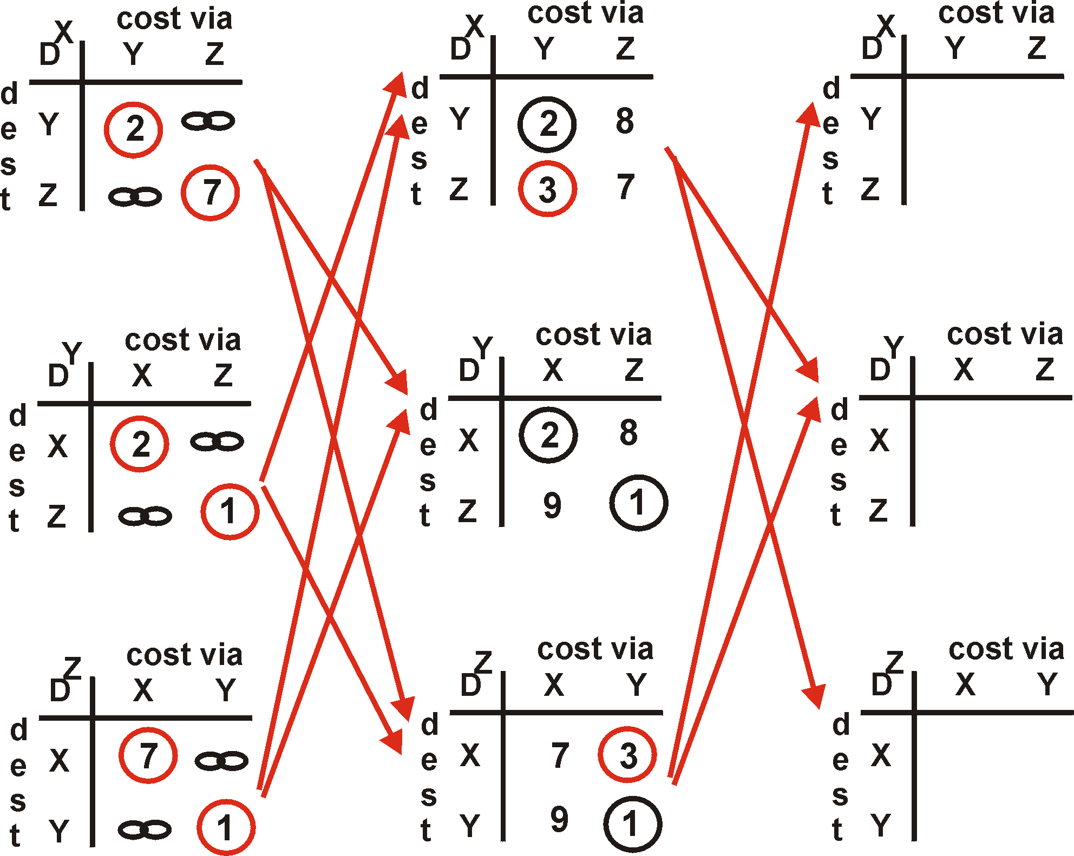
Distance Vector Algorithm: Example
Y
2
1
X
Z
7

Slide 18
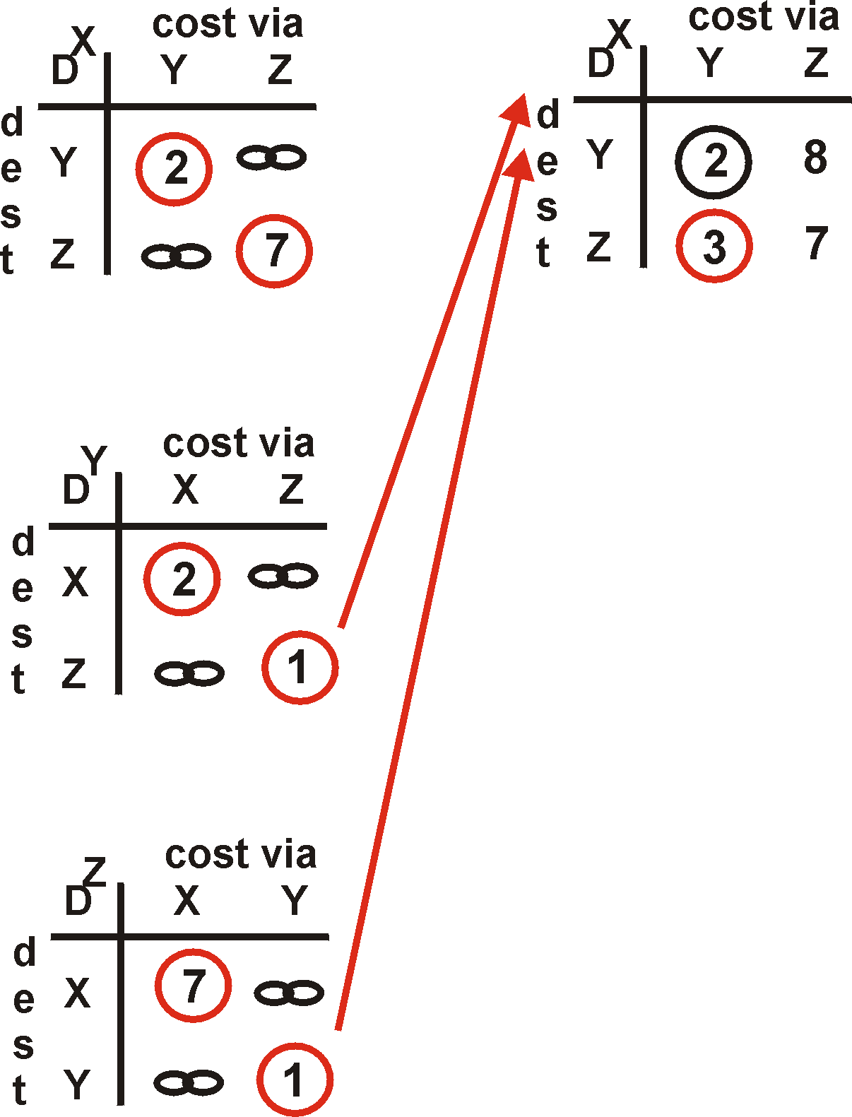
Distance Vector Algorithm: Example
Y
2
1
X
Z
X
Z
7
D (Y,Z)
=
c(X,Z) + min {D (Y,w)}
w
=
7+1 = 8
X
Y
D (Z,Y)
=
c(X,Y) + min {D (Z,w)}
w
=
2+1 = 3

Slide 19
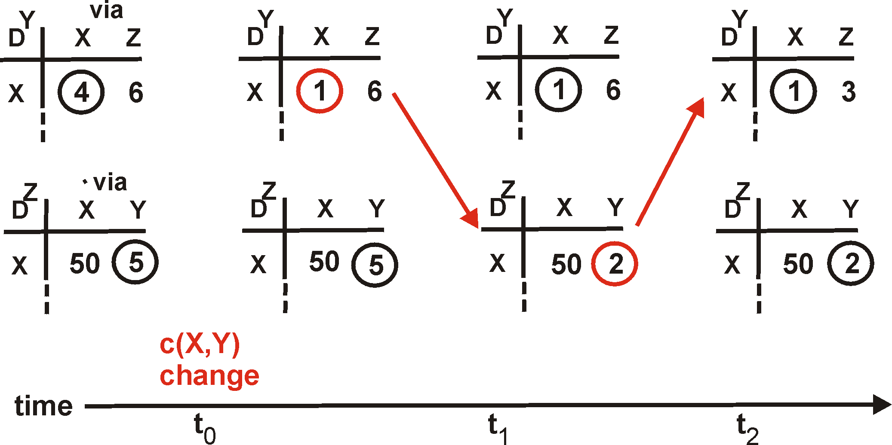
Distance Vector Algorithm: Link Cost Changes
Link cost changes:
node detects local link cost change
updates distance table (line 15)
if cost change in least cost path, notify neighbors (lines 23,24)
1
Y
4
1
X
Z
50
algorithm
terminates
“good
news
travels
fast”

Slide 20
Count to infinity: Another Example
A
B
C
1
1

Slide 21
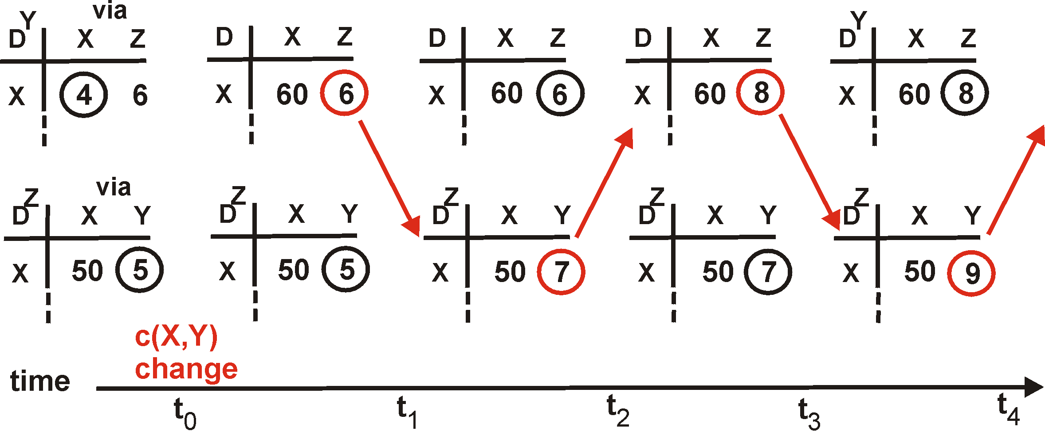
Distance Vector: Link Cost Changes
Link cost changes:
good news travels fast
bad news travels slow - “count to infinity” problem!
60
Y
4
1
X
Z
50
algorithm
continues
on!

Slide 22
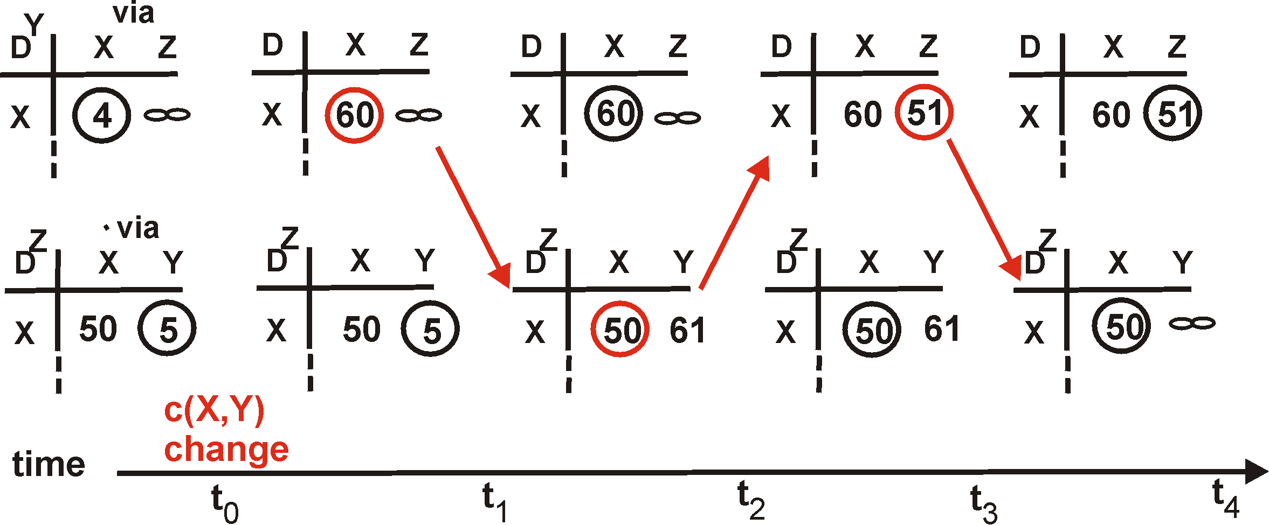
Distance Vector: Position Reverse
If Z routes through Y to get to X :
Z tells Y its (Z’s) distance to X is infinite (so Y won’t route to X via Z)
will this completely solve count to infinity problem?
60
Y
4
1
X
Z
50
algorithm
terminates

Slide 23
Comparison of LS and DV Algorithm
Message complexity
LS: with n nodes, E links, O(nE) msgs sent each
DV: exchange between neighbors only
  convergence time varies
Speed of Convergence
LS: O(n**2) algorithm requires O(nE) msgs
  may have oscillations
DV: convergence time varies
  may be routing loops
  count-to-infinity problem
Robustness: what happens if router malfunctions?
LS:
  node can advertise incorrect link cost
  each node computes only its own table
DV:
  DV node can advertise incorrect path cost
  each node’s table used by others
    error propagate thru network

Slide 24
Summary
LS and DV are representative
There are other type of routing algorithms, especially in circuit switching world, e.g., hot potato algorithm
Most of the internet routing protocols (think OSPF, BGP etc.) are based on these fundamental algorithms we introduced just now

