Slide 1
Artificial Neural Networks

Slide 2
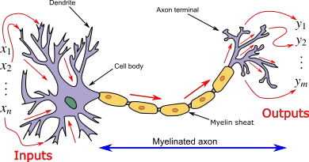
Neurons

Slide 3
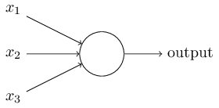

The Perceptron
w1
w2 w3
(x1 * w1) + (x2 * w2) + (x3 * w3) >=threshold ((x1 * w1) + (x2 * w2) + (x3 * w3)) + bias > 0

Slide 4
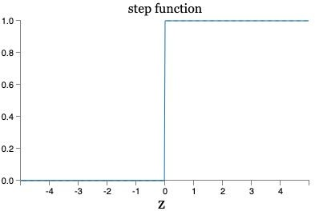
Activation function

Slide 5
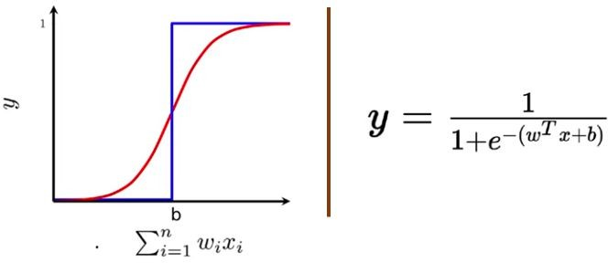
Activation function - Sigmoid
Sum of weights times inputs, plus bias

Slide 6
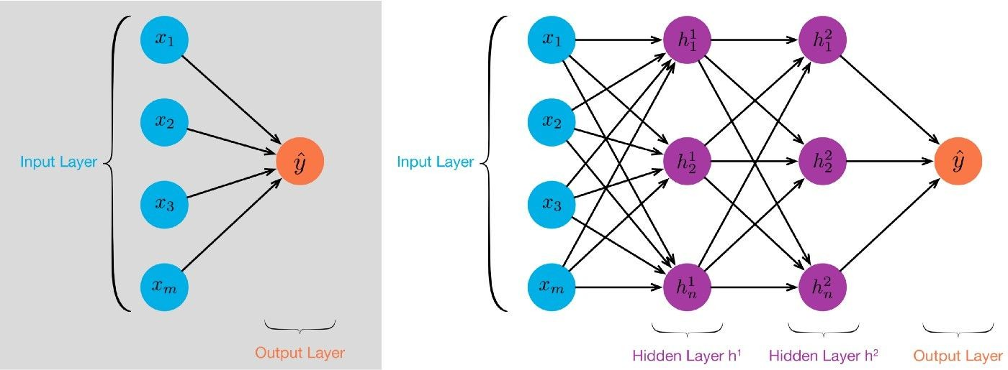
Neural networks - Structure

Slide 7

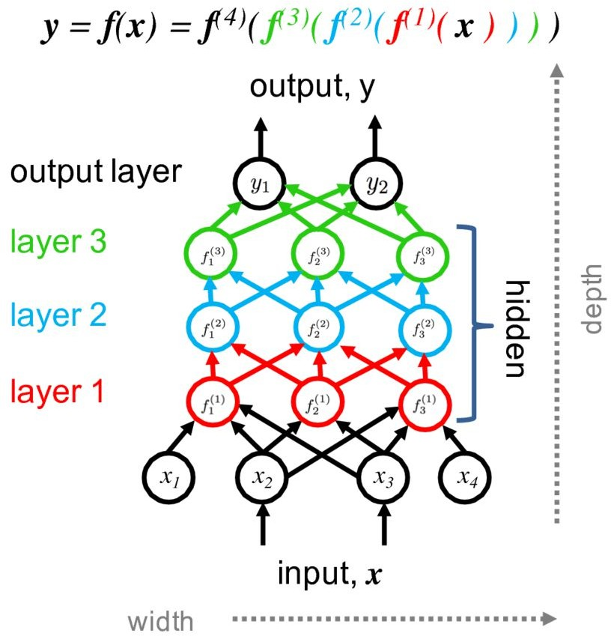
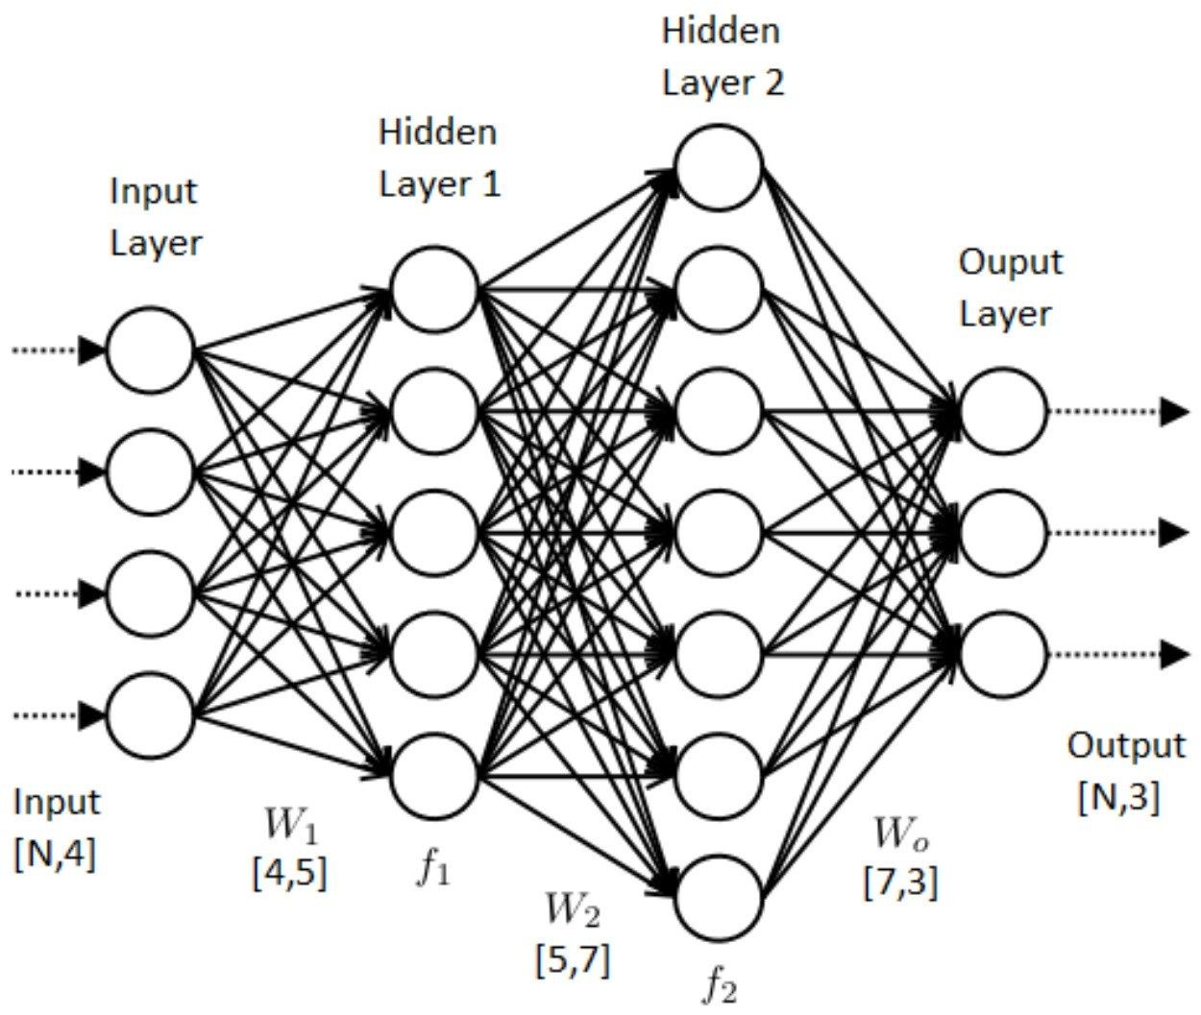
Neural networks?

Slide 8
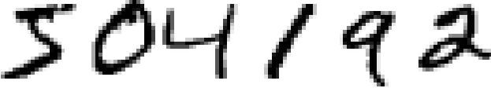
Recognising handwritten numbers

Slide 9
how does it work?
Start with random numbers for all weights and biases.
Train the network with training examples
Assess how well it did by comparing actual output and desired using a cost function (or loss function) to compute the error.
Try and reduce this error by tuning the weights and biases in the network

Slide 10
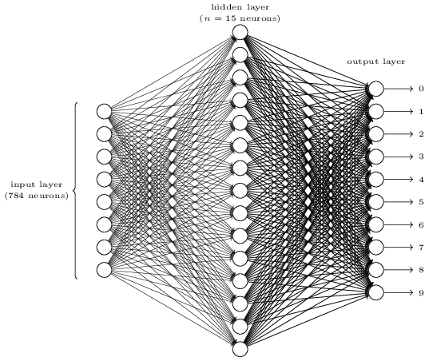
Cost function - outputs
Training a network to recognise a 6
Desired 0
0
0
0
0
0
1
0
0
0
0

Slide 11
Cost function - outputs
Training a network to recognise a 6
Desired | Actual | |Difference|
0 | 0.3 | 0.3
0 | 0 | 0
0 | 0.5 | 0.5
0 | 0.2 | 0.2
0 | 0 | 0
0 | 0.1 | 0.1
1 | 0.3 | 0.7
0 | 0 | 0
0 | 0 | 0
0 | 0.9 | 0.9
0 | 0.8 | 0.8

Slide 12

Cost function
Training a network
Desired Actual
|Difference|
weights
biases
Number of training inputs

Slide 13
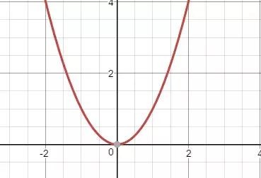
How to minimise a function?

Slide 14
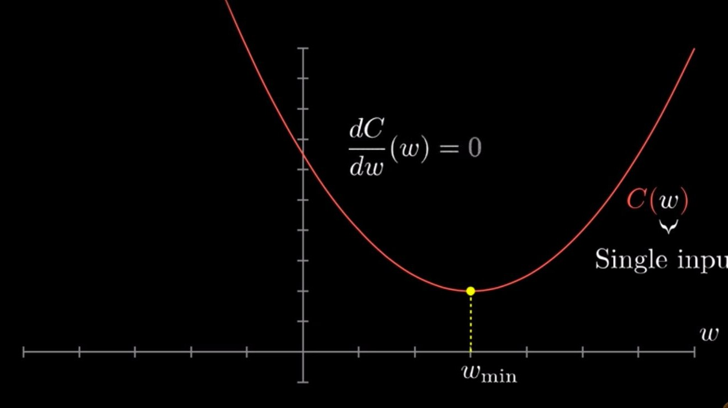

Slide 15
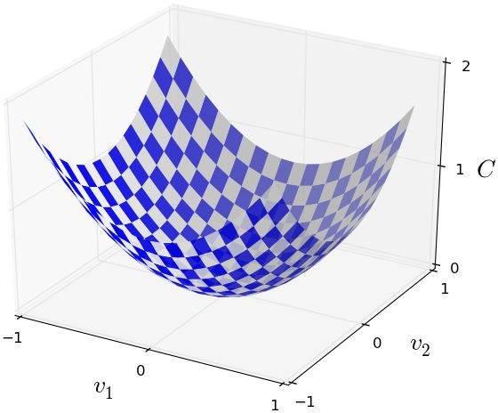

How to minimise a function? C(w1,w2)
Two variables = 3D graph
3+ variables = ??? puny human brain. But that’s fine, we can use the derivative.
Use partial differentiation to understand derivative of a function with multiple inputs
w2
w1

