Slide 1
Activation Functions

Slide 2
What is an activation function and why use them?
The activation function decides whether a neuron should be activated or not by calculating the weighted sum and further adding bias to it. The purpose of the activation function is to introduce non-linearity into the output of a neuron.

Slide 3
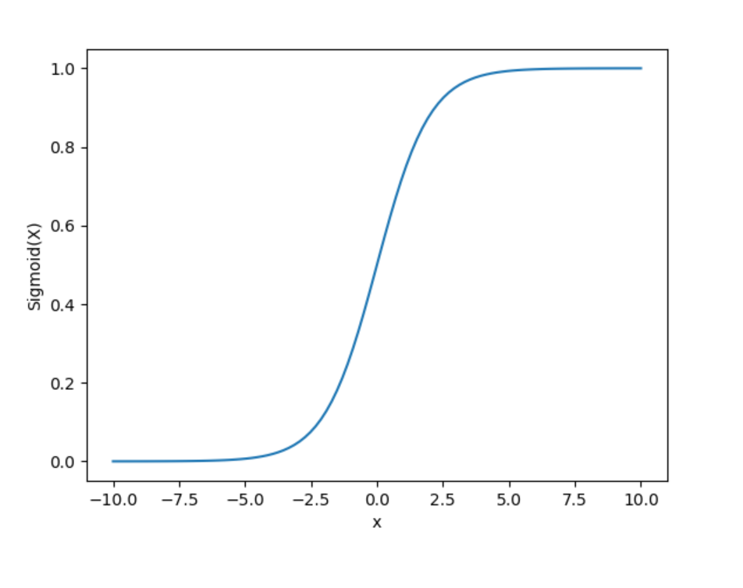
Sigmoid Function
It is a function which is plotted as ‘S’ shaped graph.
Equation : A = 1/(1 + e^{-x})
Nature : Non-linear. Notice that X values lies between -2 to 2, Y values are very steep. This means, small changes in x would also bring about large changes in the value of Y.
Value Range : 0 to 1
Uses : Usually used in output layer of a binary classification, where result is either 0 or 1, as value for sigmoid function lies between 0 and 1 only so, result can be predicted easily to be 1 if value is greater than 0.5 and 0 otherwise.

Slide 4
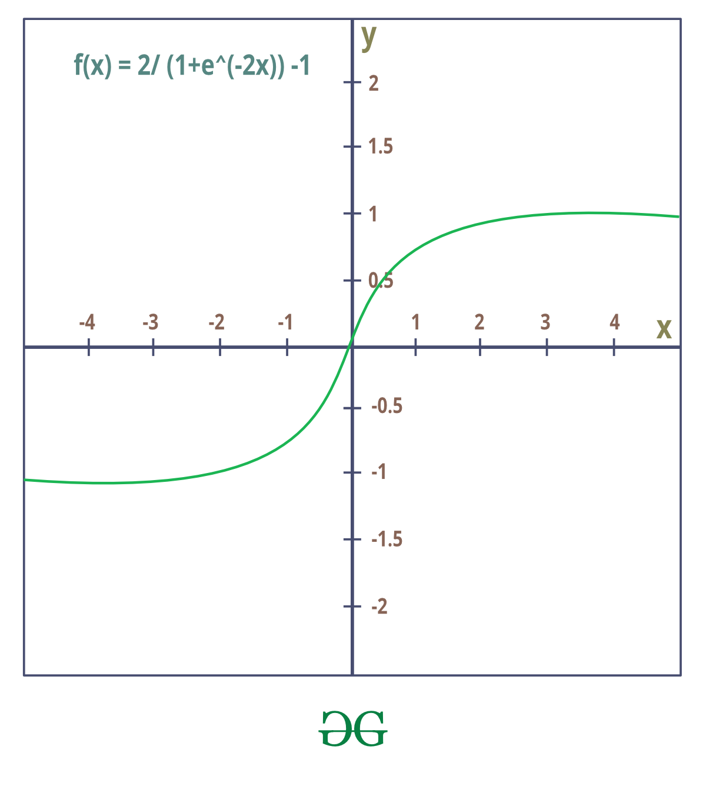
Tanh Function
The activation that works almost always better than sigmoid function is Tanh function also known as Tangent Hyperbolic function. It’s actually mathematically shifted version of the sigmoid function. Both are similar and can be derived from each other.
Equation :- f(x) = tanh(x) = 2/(1 + e-2x) – 1 OR tanh(x) = 2 * sigmoid(2x) – 1
Value Range :- -1 to +1
Nature :- non-linear
Uses :- Usually used in hidden layers of a neural network as it’s values lies between -1 to 1 hence the mean for the hidden layer comes out be 0 or very close to it, hence helps in centering the data by bringing mean close to 0. This makes learning for the next layer much easier.

Slide 5
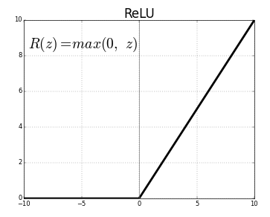
RELU Function
It Stands for Rectified linear unit. It is the most widely used activation function. Chiefly implemented in hidden layers of Neural network.
Equation :- A(x) = max(0,x). It gives an output x if x is positive and 0 otherwise.
Value Range :- [0, inf)
Nature :- non-linear, which means we can easily backpropagate the errors and have multiple layers of neurons being activated by the ReLU function.
Uses :- ReLu is less computationally expensive than tanh and sigmoid because it involves simpler mathematical operations. At a time only a few neurons are activated making the network sparse making it efficient and easy for computation.

Slide 6
Softmax Function
The softmax function is also a type of sigmoid function but is handy when we are trying to handle multi- class classification problems.

