Slide 1
Machine Learning

Slide 2
Agenda
Data Representation
Feature Extraction
Machine Learning Problems
Regression
Classification
Clustering
Machine Learning Algorithms
Gradient Descent
KNN
Neural Networks
K-means

Slide 3
Data Representation
Critical first step in many learning problems
How to represent real world objects or concepts
– Extract numerical information (features) from them

Slide 4
Feature Extraction
Suppose we want to:
Cluster houses
Predict home values
Classify houses
Need to represent houses as collection of features

Slide 5
Feature Extraction
Bedrooms (count)
Size (square feet)
Lot size (acres)
Age (years)
Distance to landmark (miles)

Slide 6
Feature Space
House | Size | Age | Lot Size | # BR
1 | 1400 | 15 | 0.5 | 2
2 | 800 | 4 | 0.25 | 1
3 | 2300 | 35 | 0.2 | 4
4 | 1700 | 8 | 0.5 | 2
…
Age (years)
Size (square feet)

Slide 7

Feature Extraction
Suppose we want to:
Find similar regions in an image
Called image segmentation
Primitive for higher level learning
Cluster pixels
Image from https://flic.kr/p/ahLKUz

Slide 8
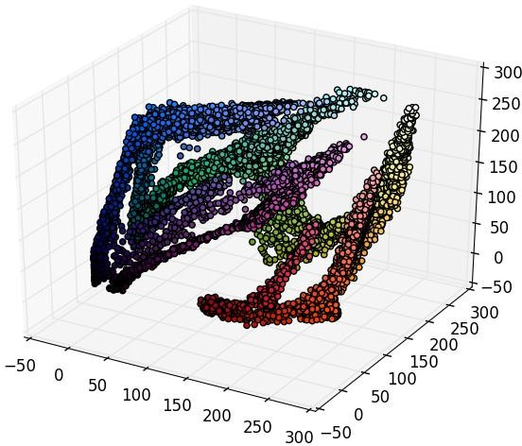
Feature Extraction
Blue
Green
Red

Slide 9
Data Representation Recap
Feature selection is critical
Some preprocessing usually required
Scale features
Reduce dimensionality (e.g., PCA)
Once we have data in features space, we can apply ML algorithms

Slide 10
Machine Learning Problems
Regression
Fit model (e.g., function) to existing data
Several input variables, one response (e.g., output) variable
Predict stock prices, home values, etc.
Classification
Place items into one of N bins/classes
Document / Text classification (e.g., spam vs. not spam, positive tweet vs. negative tweet, etc.)
Clustering
Group common items (e.g., documents, tweets, images, people) together
Product recommendation

Slide 11
Regression
Select features
Embed data in feature space
Value
House size (sqft)

Slide 12
Regression
Select features
Embed data in feature space
Predict house values
Value
House size (sqft)

Slide 13
Regression
Select features
Embed data in feature space
Predict house values
Run regression algorithm
Value
House size (sqft)

Slide 14
Regression
Select features
Embed data in feature space
Predict house values
Run regression algorithm
Predict values
Value
House size (sqft)

Slide 15
Machine Learning Problems
Regression
Fit model (e.g., function) to existing data
Several input variables, one response (e.g., output) variable
Predict stock prices, home values, etc.
Classification
Place items into one of N bins/classes
Document / Text classification (e.g., spam vs. not spam, positive tweet vs. negative tweet, etc.)
Clustering
Group common items (e.g., documents, tweets, images, people) together
Product recommendation

Slide 16
Classification
Sentiment classification
Face detection
Medial diagnosis
Spam detection

Slide 17
Classification
Select features
Embed data in feature space
Feature B
Feature A

Slide 18
Classification 2D Example
Select features
Embed data in feature space
Label data
– E.g., spam vs. not spam
Feature B
Feature A

Slide 19
Classification 2D Example
Select features
Embed data in feature space
Label data
– E.g., spam vs. not spam
Classify new observations
?
Feature B
?
?
?
Feature A

Slide 20
Machine Learning Problems
Regression
Fit model (e.g., function) to existing data
Several input variables, one response (e.g., output) variable
Predict stock prices, home values, etc.
Classification
Place items into one of N bins/classes
Document / Text classification (e.g., spam vs. not spam, positive tweet vs. negative tweet, etc.)
Clustering
Group common items (e.g., documents, tweets, images, people) together
Product recommendation

Slide 21
Clustering
Group common items
– documents, tweets, images, people
Customer segmentation

Slide 22
Clustering
Select features
Embed data in feature space
Feature B
Feature A

Slide 23
Clustering
Select features
Embed data in feature space
Apply clustering algorithm
Feature B
Feature A

Slide 24
Clustering
Select features
Embed data in feature space
Apply clustering algorithm
Can be used to classify new observations
Feature B
?
?
?
Feature A

Slide 25
Clustering
Select features
Embed data in feature space
Apply clustering algorithm
Can be used to classify new observations
Many other applications
Feature B
Feature A

Slide 26
Algorithms
Regression
Gradient Descent
Classification
K-Nearest Neighbors
Neural Networks
Clustering
K-means

Slide 27
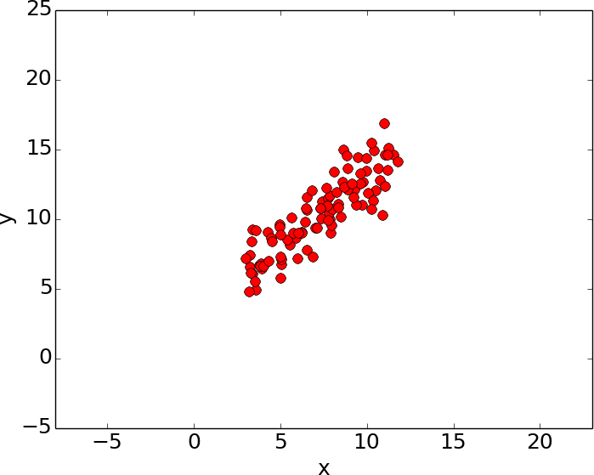
Gradient Descent for Linear Regression

Slide 28
Gradient Descent for Linear Regression

Slide 29
Regression Example
y = mx + c

Slide 30
Regression Example
Need to score candidate lines (m,c) pairs
Choose the best one

Slide 31
Regression Example - Error

Slide 32
Regression Example - Error

Slide 33
Regression Example - Error

Slide 34
Regression Example - Error
y = mx + c
N
(y −(mx +c))
error =
∑
i=1
2
i
i
Compute Gradient
Search for solution

Slide 35

Linear Regression

Slide 36
Minimize the Cost Function

Slide 37
Gradient Descent
Gradient Descent is an optimization algorithm used to find the values of a function's parameters (m,c) that minimize a cost function as far as possible.
Demo: Gradient Descent Workedout.xlsx

Slide 38
Overfitting
Suppose we want to find the price of a house. We trained the model and model is giving 99% accuracy score on training data.
And then we test the model performance on test data and we get the accuracy score=50%.
Why this much difference? The reason is that the model is overfitted and that's why its performing good on training data and bad on testing data.

Slide 39
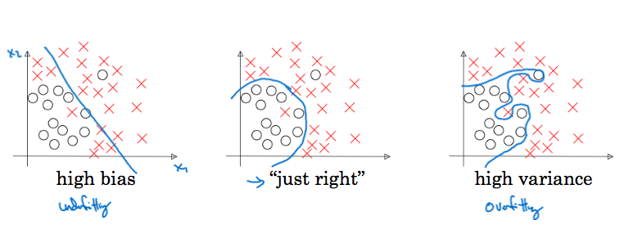
Bias and Variance

Slide 40
How Does Overfitting can be handled in Machine Learning?
So how can you avoid this happening? By using a technique called cross-validation. This helps limit the amount of data the machine learning algorithm has access to, reducing the chance of Overfitting.

Slide 41
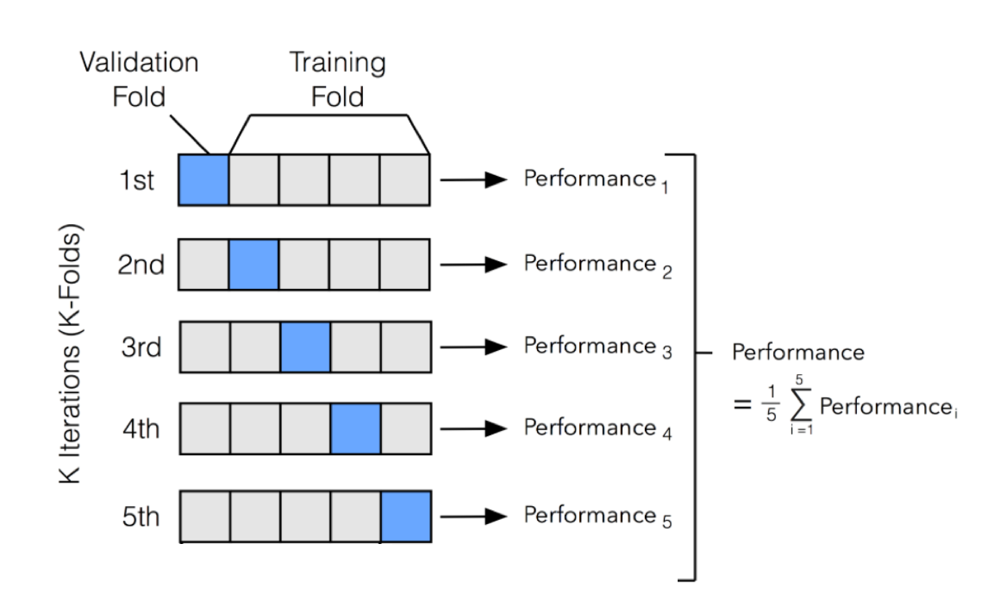
Testing – Cross Validation

Slide 42
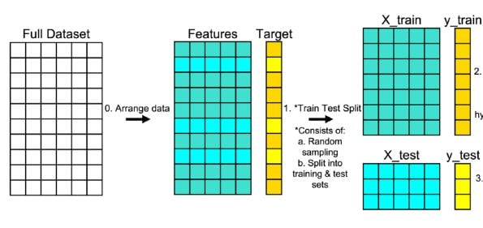
Split the Dataset

