Slide 1
HORMONES
Dr. B. Usha

Slide 2
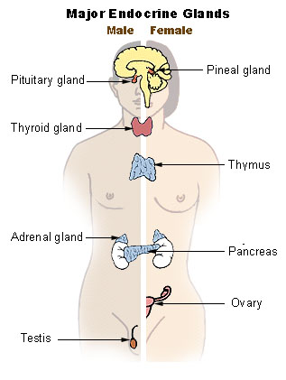
Endocrine System
The endocrine system includes the endocrine (inside) glands and their hormones
The function of the endocrine system is to secrete hormones into the bloodstream
Hormone: A Chemical messenger which targets a specific group of cells, in order to cause that group of cells do some activity or stop doing an activity.

Slide 3
Endocrine and Exocrine System
Exocrine glands release their secretions into ducts, or tubes
Liver→ Bile released into the gallbladder, then through a duct into the small intestine
Pancreas→ releases pancreatic juice into the small intestine via a duct
Endocrine Glands are called ductless glands
Release hormones directly into the bloodstream
Blood transports hormones throughout the body
Each hormone acts on only a certain kind of tissue called its target tissue

Slide 4
Pituitary gland
Pituitary gland is a round organ about the size of a pea (~1 cm in diameter), located behind the bridge of the nose at the base of the brain
Secretes 9 different hormones, which affect many different areas of the body, including:
Growth
Blood pressure
Regulation of Pregnancy
Breast milk production
Reproductive hormones- LH, FSH
Melanocyte-stimulating hormone
Water regulation in the body (kidneys) (ADH)
Temperature regulation

Slide 5
THYROID GLAND AND THYROXINE HORMONE
Located in the neck
Releases hormone thyroxine
Function is to regulate rates of metabolism in the body
Essential for normal physical and mental development
Over secretion of thyroxin: hperthyroidism
Results in nervousness and weight loss
Under secretion of thyroxin: hypothyroidism
Results in cretinism (mental retardation, small size) in children

Slide 6
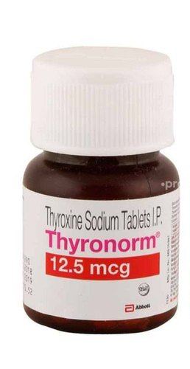
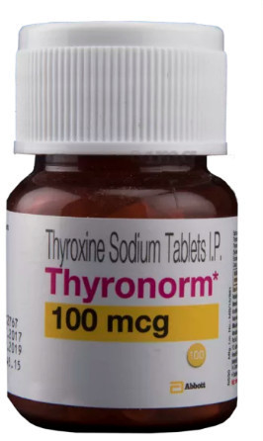
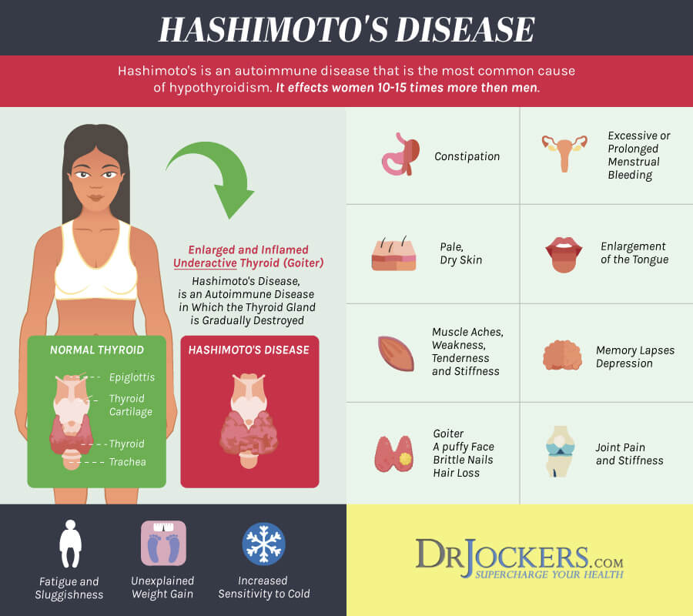
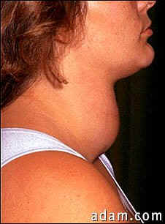
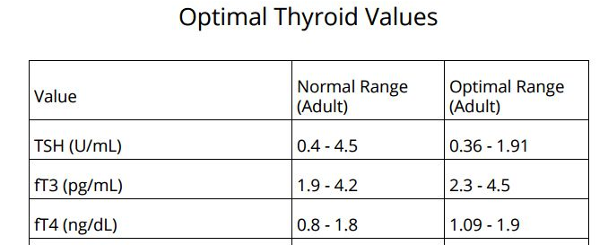
HYPOTHYROIDISM

Slide 7
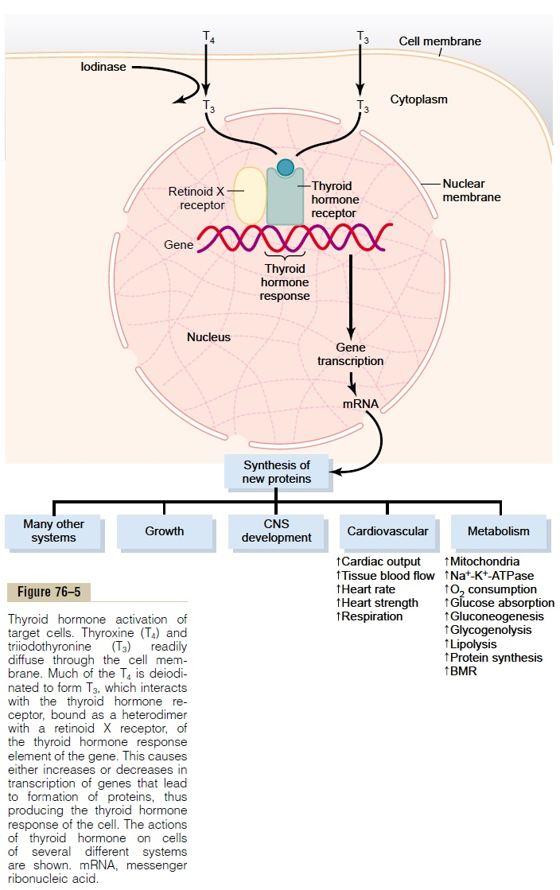

Slide 8
Adrenal Glands (Kidney Hats)
Located at the top of each kidney
Hormones released are cortisone and adrenaline (flight/fight hormone)
Function of cortisone is to regulate carbohydrate, protein and fat metabolism
promotes conversion of fats and proteins to glucose
Function of adrenaline is to raise blood sugar levels and increases heartbeat and breathing rates under panic or freight conditions

Slide 9
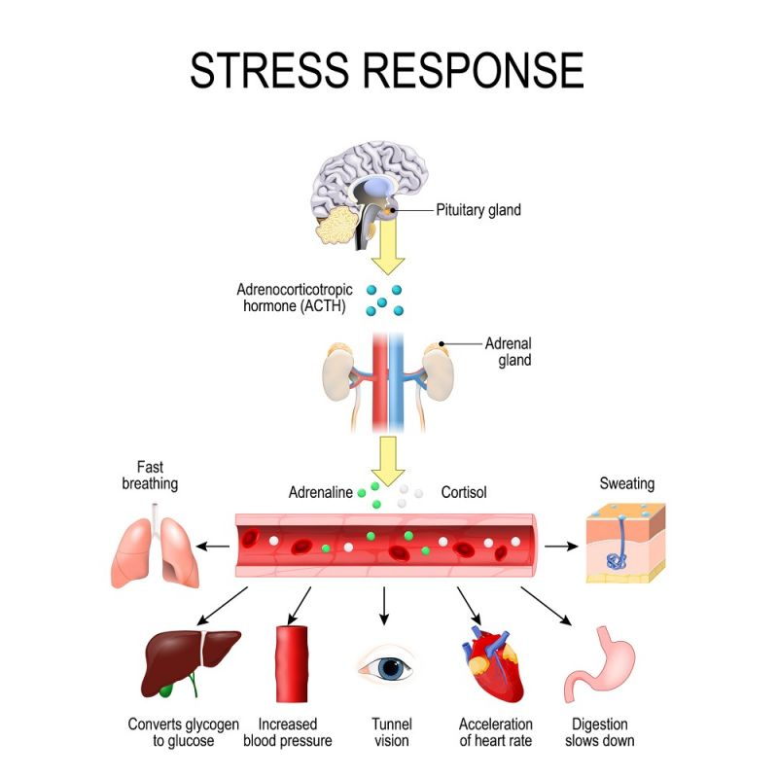
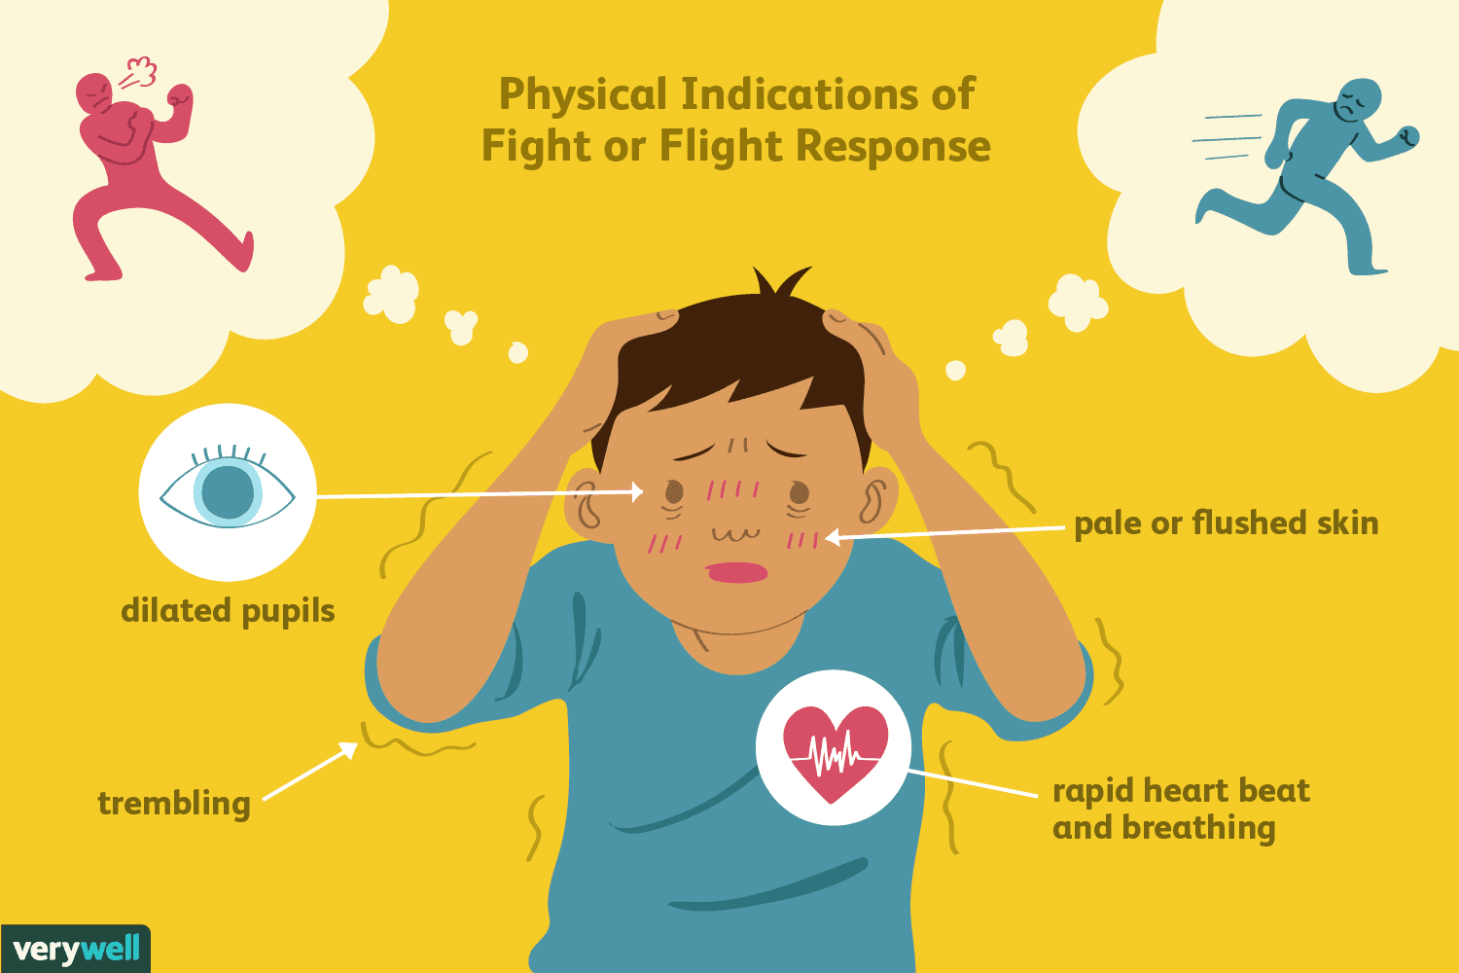

Slide 10
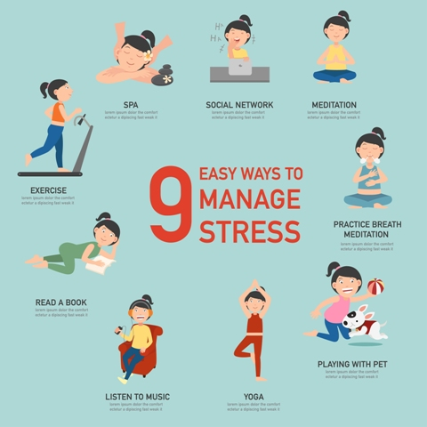
MODE OF GOODNESS
happy soul
healthy body
not materialistic
being with like minded people
healthy food
healthy thoughts
Let go attitude
MODE OF PASSION
into money making in a good way
not egoistic
not jealous
not selfish
not giving importance to health
MODE OF IGNORANCE
same as mode of passion
only money-minded

Slide 11
Islet of Langerhans
Located on the pancreas
Hormones secreted are insulin and glucagon
Insulin stimulates glucose uptake by cells
Glucagon promotes conversion of glycogen stored in the liver (animal-based carbohydrate) to glucose

Slide 12
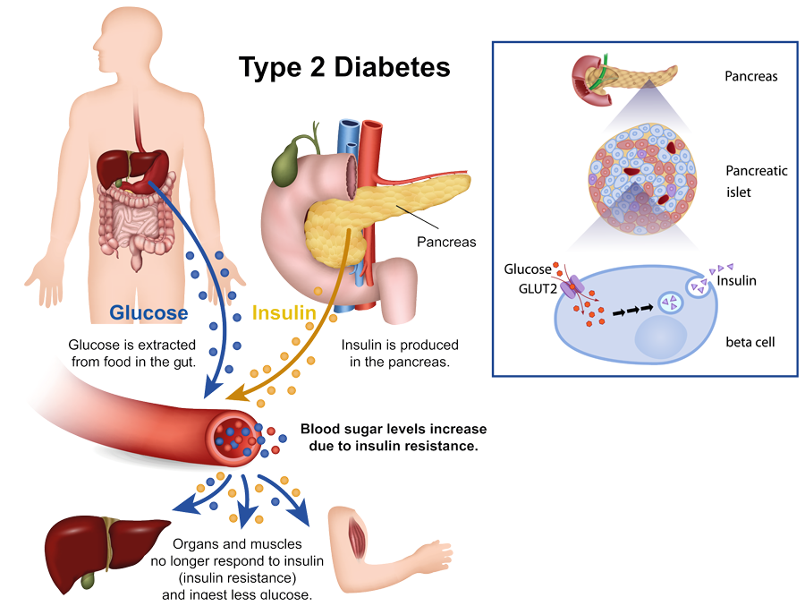
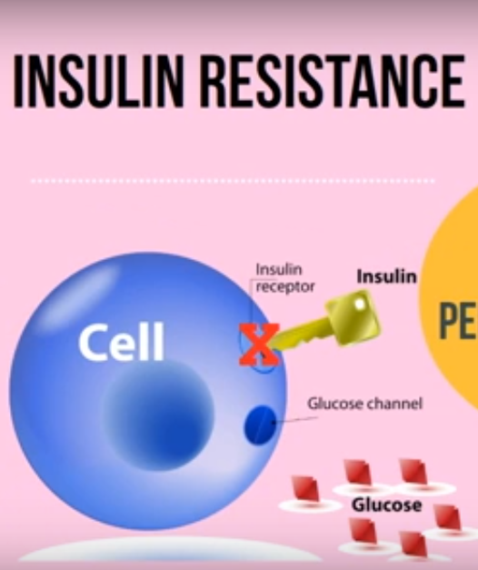
Diabetes mellitus and Insulin resistance

Slide 13
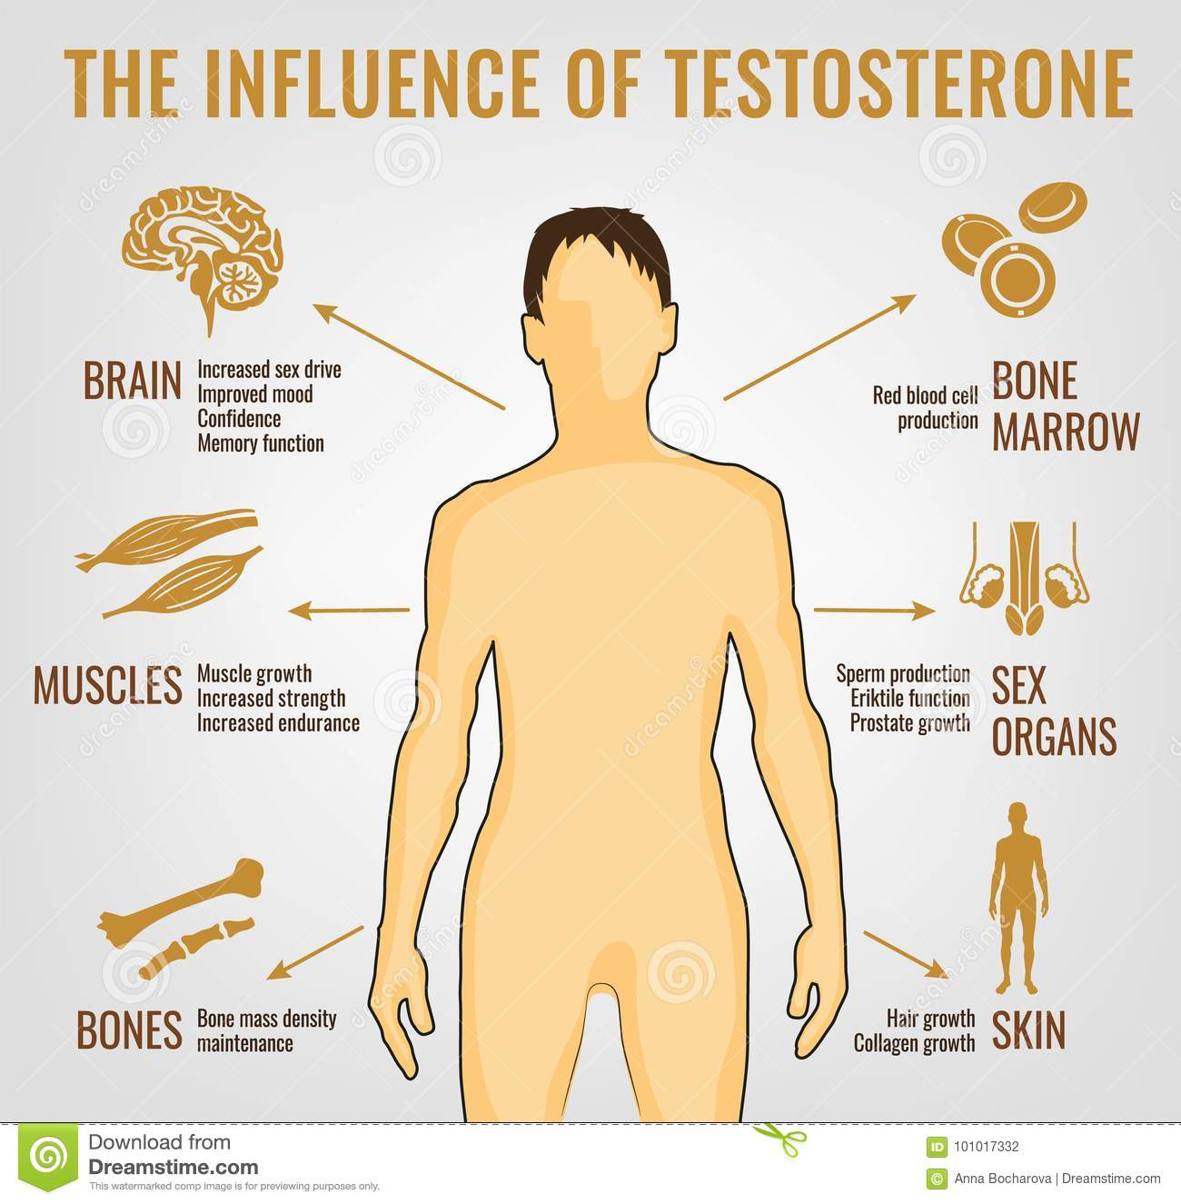
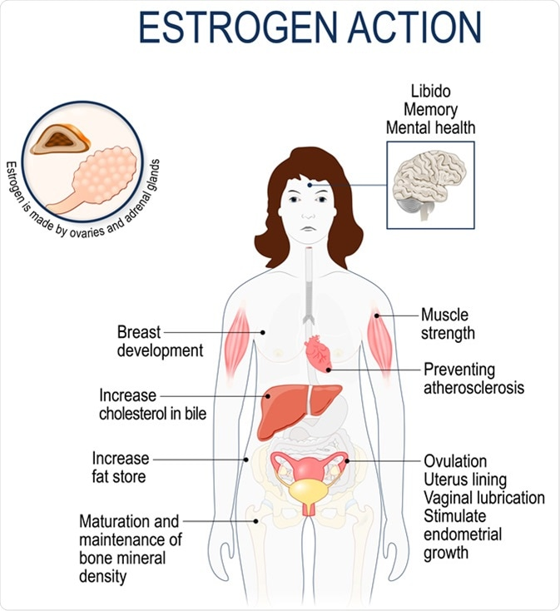
Reproductive hormones
Ovaries
Estrogen
Progesterone
Testis
Testosterone

Slide 14
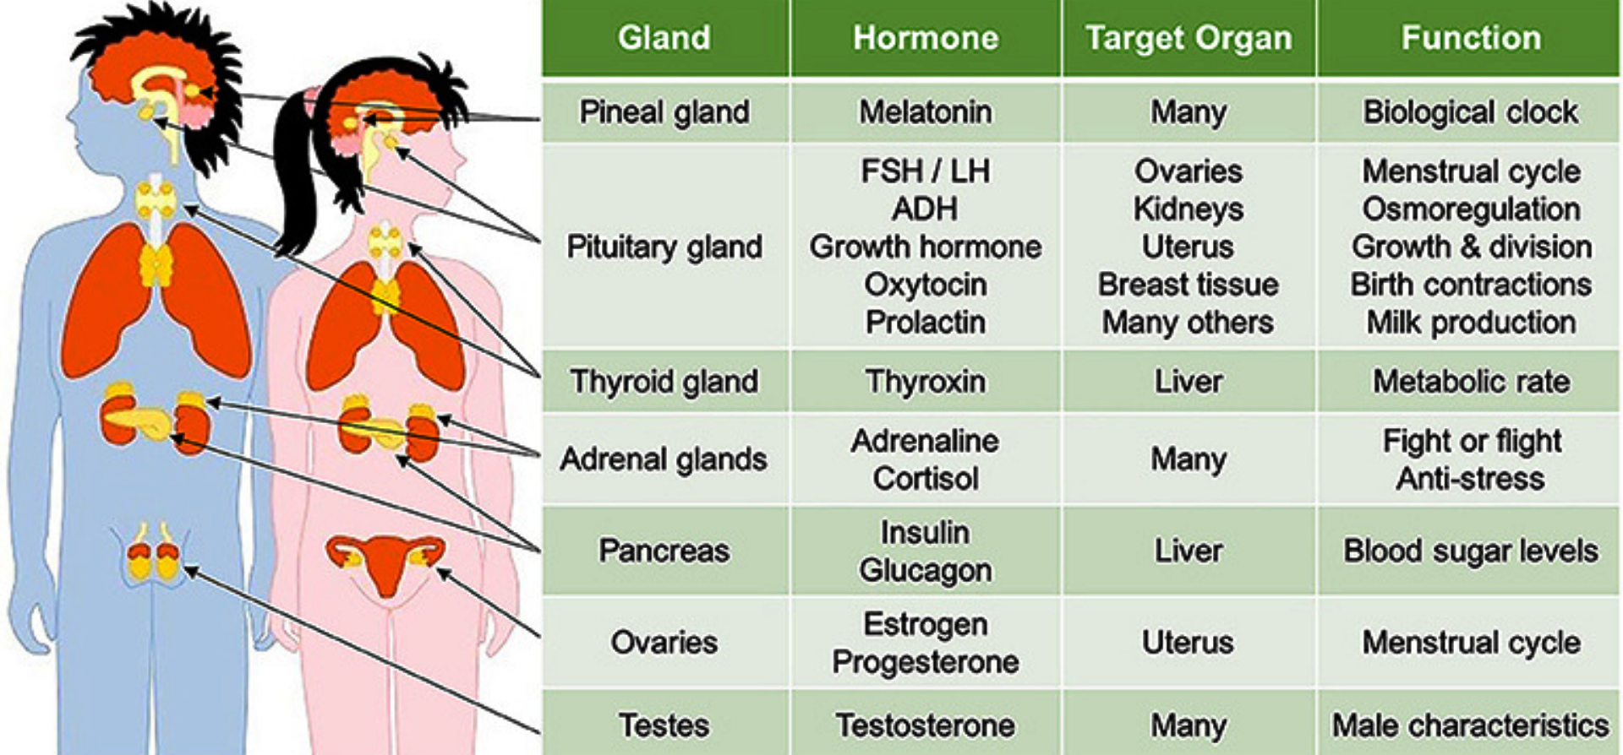
Summary

Slide 15
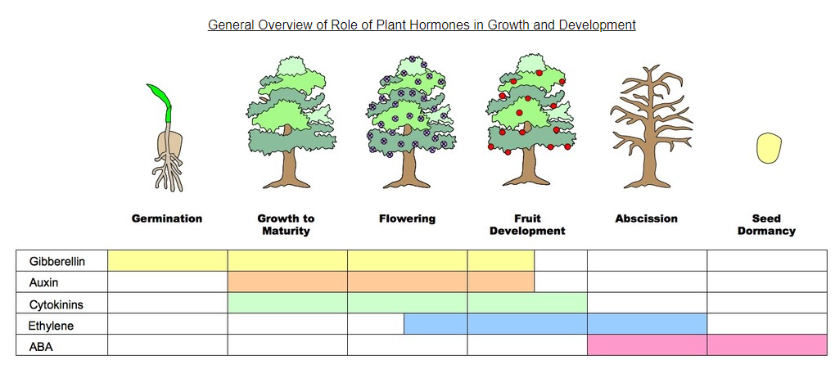
Plant hormones

Slide 16
Self assessment- Match
Gland/Organ | Hormone and Function
Pineal | GH, LH, FSH, controls growth and reproduction
Pituitary | Insulin, controls blood sugar level
Thyroid | Adrenaline and cortisol, controls stress response
Pancreas | Estrogen, controls embryo development
Ovary | Melatonin, circadian rhythm
Testis | Thyroxine, controls metabolism
Adrenal | Testosterone, control male characteristics

Slide 17
Thank you

