Slide 1
DEFINITIONS

Slide 2
Why Technical Definitions ?
Describe and define new products and services
Introduce new information to reader in clear and effective ways
Allow experts and specialists to communicate with a more generalized audience
Increase reader understanding
Elaborate on technical terms
Improperly defined terms can have a negative impact

Slide 3
Definition:
A definition is a statement that explains the meaning of the term (a word, phrase, or other set of symbols) or a type of thing.
The action or process of stating the meaning of a word or word group

Slide 4
Example:
For you, if I defined the steel as boron-doped high-austenite steel that undergoes a martensitic transformation in a crash, that would probably mean nothing
High-austenite steel is relatively ductile; its manufacturing process includes cold rolling, annealing, and quenching; and car manufacturers use high-austenite steel in crumple zones because this steel gets harder and stiffer under pressure, thus protecting drivers.

Slide 5
Types
There are three types of definitions commonly used in technical writing:
Parenthetical definitions
Sentence definitions
Extended definitions

Slide 6
Parenthetical definitions
Parenthetical definitions are words that quickly explain a term and are included within the same sentence as the word being defined. These informal definitions can be a synonym or a short phrase. The definition will be placed in parentheses immediately following the word being defined.
Ex: For example, you might write, 'Our company should invest in creating sinistral (left-side) office to meet the growing market demand.

Slide 7
Sentence definitions
Sentence definitions are an explanation of a word using one sentence. These are more formal explanations than parenthetical definitions. Sentence definitions follow a similar form, which includes:
The term being defined
The class to which the word belongs
The feature that distinguish the term from other words

Slide 8
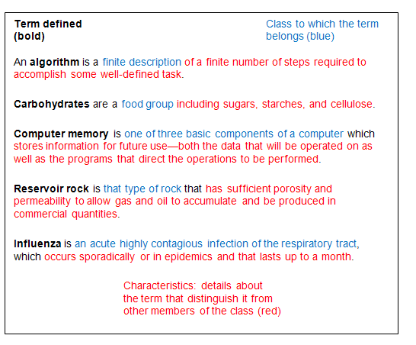

Slide 9
Extended definition:
-When a term needs to be explained in great detail and precision,
-Extended definition provides more information besides talking about the category and the use or function.
-Some objects or concepts require more than a one-sentence definition. An extended definition might require a paragraph or even several pages to fully define a complex concept or object.

Slide 10
What to include in extended definition
Etymology: Explaining origin of the word itself
History: If relevant and helpful for explaining the term, discussing the history of the term/its use/controversies associated with it
Cause and Effect: Discussing how the situation came about and what effects it may have
Description: Listing and defining the component parts
Principles of Operation: Discussing how topic in question functions, including any special materials or conditions required; "how it works"
Classification: Showing how the topic fits into a larger category
Contrast/Negation: Showing how the topic differs from others in the same class
Comparison: Explaining how the topic is similar to others in the same category or class
Analogy: Explaining by comparing two dissimilar topics, where the second is familiar to the audience
Examples: Anecdotes or instances of this term from the real world
Illustrations: Visual aids

Slide 11
1.Single Sentence Definition is a short definition, which is essential for technical writing. It can be written as:
Column A |  | Column B |  | Column C
Thing to be defined | = | What is it / group to which the thing belongs | + | Specific details that separate it from other things in its group
Examples:
Technology | is | the application of scientific knowledge | to | Practical purpose
Laboratory | is | a place | to | Conduct experiments
Transformer | is | an electrical equipment | to | Change(to step up or step down) the voltage of current
Calculator | is | an electronic device | for | Carrying out arithmetic operations

Slide 12
Examples (Cont.)
Scanner: Scanner is an electronic device which analyses an image and then captures an processes it so that it can be saved to a file on a computer.
Airbag : Airbag is a safety device which will cause an air filled pillow to prevent one from hitting the dashboard.
Road roller: Road roller is a mechanical device with heavy wide smooth rollers used in road making to make the surface smooth.
Turbine: Turbine is an engine or motor in which the pressure of liquid or a gas turns a wheel, usually to produce energy.

Slide 13
includes the basic parts of a formal definition-class and characteristics, as well as additional information that may include description, examples, classification, comparison, explanation or other details.
2.Extended Definitions
Examples:
Global warming is the rise in the average temperature of Earth's atmosphere and oceans. It is primarily caused by increasing concentrations of greenhouse gases produced by human activities such as burning of fossil fuels and deforestation.

Slide 14
Examples (Cont.)
Laser Technology
Laser Technology is a kind of modern technology using sophisticated equipment, involving high cost, designed and operated by highly skilled professionals, used in various areas, particularly in the medical field to diagnose, operate and provide laser treatment for complicated and serious diseases.
Appropriate Technology
Appropriate Technology is a kind of technology that makes use of available resources . It is otherwise called as low cost technology. For example, gobar gas is produced using the local resource cow dung that is easily available. In practice, this technology uses the simplest form of technology to achieve the intended purpose in a suitable location. Appropriate Technology is not only employed in rural areas but is also gaining momentum in urban areas.

Slide 15
Exercise
Single sentence definitions:
Engineering
Kerf
Cloud computing
Data Science
Algorithm.
Data Analytics.
Data mining.
Big Data.
Artificial intelligence (AI)
Machine Learning.
Deep learning.

Slide 16
Exercise
Cloud
Software
Domain
Virtual Private Network (VPN)
IP Address
botnet
Block cipher
Firewall
Bug
Behaviour monitoring

Slide 17
Exercise
Define the following terms in a sentence each:
Engineering
Ballast
Seismograph
Machine code
Word Processor
Give extended definitions for the following phrases:
Artificial Intelligence
Virtual Reality
Bluetooth
Junk Food
Cloning

Slide 18
Bio Engineering terms
Bioengineering
Biomaterial
Hydrogel
Haptic technology
Microfluidics

Slide 19
Thank You

