Slide 1
Plagiarism

Slide 2
What Is Plagiarism?
Use of another’s work without giving credit
“Intentionally or knowingly representing the words, ideas, or work of another as one’s own in any academic exercise” (CSUN 2010-2012 Catalog, Appendix E)California State university Northridge code of Conduct

Slide 3

Discussion Question
Why should we be concerned about it?

Slide 4
Because…
If you plagiarize, you are cheating yourself.
  You don’t learn to write out your thoughts in your own words, and you don’t get specific feedback geared to your individual needs and skills.
  Plagiarizing a paper is like sending a friend to basketball practice for you – you’ll never get the benefit of the practice yourself.
Plagiarism is dishonest because it misrepresents the work of another as your own.
Plagiarism devalues others' original work.
  Submitting another writer's work as yours is taking an unfair advantage over students who do their own work.

Slide 5
Because…
It is wrong to take or use property (an author's work) without giving the owner the value or credit due.
Copyright violations can result in fines or legal damages.
Plagiarism violates the CSUN Code of Conduct and can result in suspension or expulsion.
CSUN's reputation affects the value of your degree; student dishonesty hurts CSUN’s standing and can make your degree worth less.

Slide 6
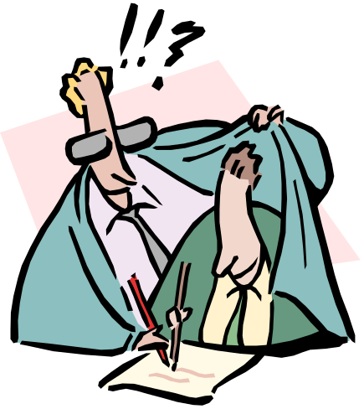
Discussion Questions
Why do people plagiarize?
What can we do to prevent it?

Slide 7
How to prevent?
Understand Plagiarism
Properly Quote and Paraphrase
Properly Cite Sources
Check Your Work for Possible Plagiarism
Practice

Slide 8
Types of Plagiarism
Intentional plagiarism:
deliberate copying or use of another’s work without credit.
Unintentional plagiarism can result from:
    not knowing citation standards
    (e.g., “I thought the Internet was free!”)
    sloppy research and poor note-taking habits, or
    careless “copying and pasting” of electronic sources.
Both types are subject to disciplinary
action

Slide 9
Types cont…
Direct plagiarism is the word-for-word transcription of a section of someone else’s work
Self-plagiarism occurs when a student submits his or her own previous work, or mixes parts of previous works, without permission
Mosaic Plagiarism occurs when a student borrows phrases from a source without using quotation marks, or finds synonyms for the author’s language while keeping to the same general structure and meaning of the original. Sometimes called “patch writing”
Accidental plagiarism occurs when a person neglects to cite their sources, or misquotes their sources, or unintentionally paraphrases a source by using similar words, groups of words, and/or sentence structure without attribution.

Slide 10

The Spectrum of Offenses
Possibly Unintentional
Plagiarism
Deliberate
Plagiarism
Using a source too closely when paraphrasing
Building on someone’s ideas without citation
Copying from another source without citing (on purpose or by accident)
Hiring someone to write your paper
Buying, stealing, or borrowing a paper

Slide 11

Avoiding Plagiarism
Manage your time
Keep track of your sources
Distinguish your ideas from the ideas in other sources
Be careful when working with others
Think of the consequences

Slide 12
Proper Citation
Know what to cite
  Keep track of original sources
  Be careful of “cut and paste” online research
  There are “no freebies”
  Beware of “common knowledge”
Know how to cite
  Provide enough information so we can find the original source
  Use an accepted standard such as APA or MLA
  Use your own words and ideas
  If you repeat another’s exact words, you must use quotation marks and cite the source.
  Avoid using others’ work with minor cosmetic changes.

Slide 13
Proper Citation – cont’d
Know when to cite
  Direct quotations
  Paraphrased ideas
  Facts or information that isn’t common knowledge
  When in doubt, you must cite

Slide 14

Plagiarism in Teams
Team Assignments
  All members of the team are responsible for accuracy and honesty of team work
  Keep track of your own research and contributions to the team
  Proofread for each other
  Read the paper before it is submitted
Study Groups
  When working together on individual assignments, hand in your own words/answers
  Don’t give others your written answers. You can discuss how you got your solutions

Slide 15
Academic Dishonesty

Slide 16
Types of Academic Dishonesty
Cheating
  “Intentionally using or attempting to use unauthorized materials, information, or study aids in any academic exercise”
Fabrication
  “Intentional falsification or invention of any information or citation in an academic exercise”
Facilitating academic dishonesty
  “Intentionally or knowingly helping or attempting to help another to commit an act of academic dishonesty”
Plagiarism

Slide 17
Tools for checking Plagiarism
self-plagiarism checker
plagiarisma
plagscan
plagtracker
copyleaks
quetext pro account free
unicheck

