Slide 1
18CSC202J - OBJECT ORIENTED DESIGN AND PROGRAMMING Session 7 Topic : UML Class Diagram, its components, Class Diagram relations and Multiplicity

Slide 2
Overview of UML Diagrams
Behavioral
: behavioral features of a system / business process
Activity
State machine
Use case
Interaction
Structural
: element of spec. irrespective of time
Class
Component
Deployment
Object
Composite structure
Package
Interaction
: emphasize object interaction
Communication(collaberation)
Sequence
Interaction overview
Timing

Slide 3

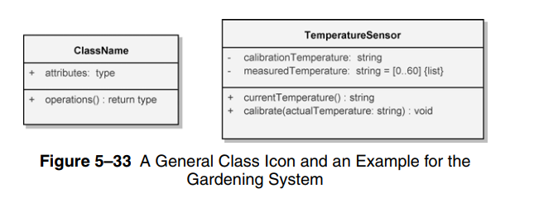
UML Class diagram :
The UML Class diagram is a graphical notation used to construct and visualize object oriented systems.
A class diagram describes the structure of a system such as Classes and their attributes , operations (or methods) and the relationships among objects.
A class diagram is used to show the existence of classes and their relationships in the logical view of a system.

Slide 4
Basic components of a class diagram
The standard class diagram is composed of three sections:
Upper section: Contains the name of the class. This section is always required, to know whether it represents the classifier or an object.
Middle section: Contains the attributes of the class. Use this section to describe the qualities of the class. This is only required when describing a specific instance of a class.
Bottom section: Includes class operations (methods). Displayed in list format, each operation takes up its own line. The operations describe how a class interacts with data.

Slide 5
RULES TO BE FOLLOWED:
Class name must be unique to its enclosing namespace.
The class name begins in uppercase and the space between multiple words is omitted.
The first letter of the attribute and operation names is lowercase with subsequent words starting in uppercase and spaces are omitted.
Since the class is the namespace for its attributes and operations an attribute name must be unambiguous in the context of the class.

Slide 6
Attribute specification format:
visibility attributeName : Type [multiplicity] = DefaultValue {property string}
Operation specification format:
visibility operationName (parameterName : Type) : ReturnType {property string}
VISIBILITY
Public (+) Visible to any element that can see the class.
Protected (#) Visible to other elements within the class and to subclasses .
Private (-) Visible to other elements within the class .
Package (~) Visible to elements within the same package.

Slide 7
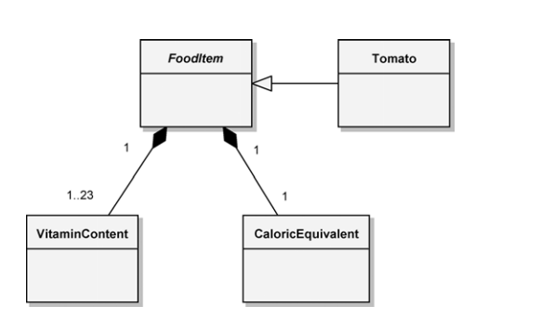
Abstract class
An abstract class is one for which no instances may be created.
Because such classes are so important to engineering good class inheritance trees, there is a special way to designate an abstract class.

Slide 8
To denote that an operation is abstract, we simply italicize the operation name; this means that this operation may be implemented differently by all instances of its subclasses.
In the Hydroponics Gardening System, we have food items that have a specific vitamin content and caloric equivalent, but there is not a type of food called “food item.”
Hence, the FoodItem class is abstract.
Above fig also shows the subclass Tomato, which represents a concrete (instantiable) food item grown in the greenhouse.

Slide 9
Class Relationships
The essential connections among classes include
Association
Generalization
Aggregation
Composition
Association :
The association icon connects two classes and denotes a semantic connection.
Associations are often labeled with noun phrases, such as Analyzes, denoting the nature of the relationship.
A class may have an association to itself (called a reflexive association), such as the collaboration among instances of the PlanAnalyst class.

Slide 10
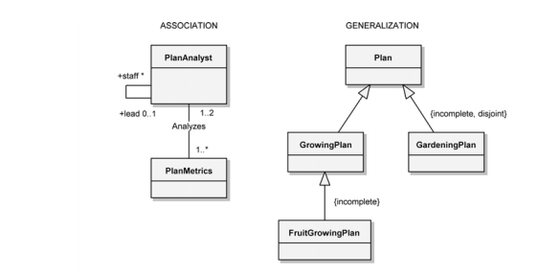

Slide 11
A class may have an association to itself (called a reflexive association), such as the collaboration among instances of the PlanAnalyst class.
The use of both the association end names and the association name is to provide clarity.
It is also possible to have more than one association between the same pair of classes.
Associations may be further adorned with their multiplicity, using the following syntax:
1 Exactly one
* Unlimited number (zero or more)
0..* Zero or more
1..* One or more
0..1 Zero or one
3..7 Specified range (from three through seven, inclusive)

Slide 12
.
GENERALIZATION
The generalization icon denotes a generalization/specialization relationship and appears as an association with a closed arrowhead.
The GrowingPlan class in Figure is the superclass and its subclass is the FruitGrowingPlan
AGGREGATION
Aggregation, as manifested in the “part of ” relationship, is a constrained form of the more general association relationship.

Slide 13
It appears as an association with an unfilled diamond at the end denoting the aggregate (the whole).
The class at the other end denotes the class whose instances are part of the aggregate object.
Reflexive and cyclic aggregation is possible.
In figure, an individual EnvironmentalController class has the Light, Heater, and Cooler classes as its parts.
The multiplicity of * (zero or more) at the aggregate end of the relationship further highlights this lack of physical containment.
COMPOSITION
Composition implies that the construction and destruction of these parts occurs as a consequence of the construction and destruction of the aggregate.

Slide 14
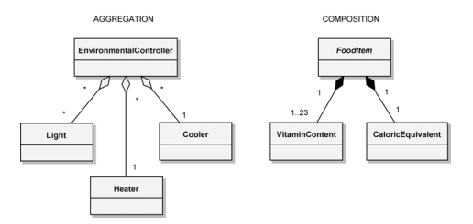
The icons described thus far constitute the essential elements of all class diagrams.
Collectively, they provide the developer with a notation sufficient to describe the fundamentals of a system’s class structure.

Slide 15
Classes
A class is a description of a set of
objects that share the same attributes,
operations, relationships, and semantics.
Graphically, a class is rendered as a
rectangle, usually including its name,
attributes, and operations in separate,
designated compartments.
ClassName
attributes
operations

Slide 16
Class Names
ClassName
The name of the class is the only required tag in the graphical representation of a class. It always appears in the top-most compartment.
attributes
operations

Slide 17
Class Attributes
Person
name : String
address : Address
birthdate : Date
ssn : Id
An attribute is a named property of a
class that describes the object being modeled.
In the class diagram, attributes appear in
the second compartment just below the
name-compartment.

Slide 18
Class Attributes (Cont’d)
Attributes are usually listed in the form:
attributeName : Type
A derived attribute is one that can be
computed from other attributes, but
doesn’t actually exist. For example,
a Person’s age can be computed from
his birth date. A derived attribute is
designated by a preceding ‘/’ as in:
/ age : Date
Person
name : String
address : Address
birthdate : Date
/ age : Date
ssn : Id

Slide 19
Class Attributes (Cont’d)
Person
+ name : String
# address : Address
# birthdate : Date
/ age : Date
- ssn : Id
Attributes can be:
+ public
# protected
- private
/ derived

Slide 20
Class Operations
Person
name : String
address : Address
birthdate : Date
ssn : Id
eat
sleep
work
play
Operations describe the class behavior
and appear in the third compartment.

Slide 21
Class Operations (Cont’d)
PhoneBook
newEntry (n : Name, a : Address, p : PhoneNumber, d : Description)
getPhone ( n : Name, a : Address) : PhoneNumber
You can specify an operation by stating its signature: listing the name, type, and default value of all parameters, and, in the case of functions, a return type.

Slide 22
Depicting Classes
When drawing a class, you needn’t show attributes and operation in every diagram.
Person
Person
Person
name : String
birthdate : Date
ssn : Id
Person
name
address
birthdate
eat()
sleep()
work()
play()
Person
eat
play

Slide 23
Class Responsibilities
A class may also include its responsibilities in a class diagram.
A responsibility is a contract or obligation of a class to perform a particular service.
SmokeAlarm
Responsibilities
-- sound alert and notify guard station
when smoke is detected.
-- indicate battery state

Slide 24
Relationships
In UML, object interconnections (logical or physical), are
modeled as relationships.
There are three kinds of relationships in UML:
dependencies
generalizations
associations

Slide 25
Dependency Relationships
A dependency indicates a semantic relationship between two or
more elements. The dependency from CourseSchedule to Course exists because Course is used in both the add and remove operations of CourseSchedule.
CourseSchedule
Course
add(c : Course)
remove(c : Course)

Slide 26
Generalization Relationships
Person
A generalization connects a subclass
to its superclass. It denotes an
inheritance of attributes and behavior
from the superclass to the subclass and
indicates a specialization in the subclass
of the more general superclass.
Student

Slide 27
Generalization Relationships (Cont’d)
UML permits a class to inherit from multiple superclasses, although some programming languages (e.g., Java) do not permit multiple inheritance.
Student
Employee
TeachingAssistant

Slide 28
Association Relationships
If two classes in a model need to communicate with each other, there must be link between them.
An association denotes that link.
Student
Instructor

Slide 29
Association Relationships (Cont’d)
We can indicate the multiplicity of an association by adding multiplicity adornments to the line denoting the association.
The example indicates that a Student has one or more Instructors:
Student
Instructor
1..*

Slide 30
Association Relationships (Cont’d)
The example indicates that every Instructor has one or more Students:
Student
Instructor
1..*

Slide 31
Association Relationships (Cont’d)
We can also indicate the behavior of an object in an association (i.e., the role of an object) using rolenames.
teaches
learns from
Student
Instructor
1..*
1..*

Slide 32
Association Relationships (Cont’d)
We can also name the association.
membership
Student
Team
1..*
1..*

Slide 33
Association Relationships (Cont’d)
We can specify dual associations.
member of
Student
Team
1..*
1..*
1
president of
1..*

Slide 34
Association Relationships (Cont’d)
We can constrain the association relationship by defining the navigability of the association. Here, a Router object requests services from a DNS object by sending messages to (invoking the operations of) the server. The direction of the association indicates that the server has no knowledge of the Router.
Router
DomainNameServer

Slide 35
Association Relationships (Cont’d)
Associations can also be objects themselves, called link classes or an association classes.
Registration
modelNumber
serialNumber
warrentyCode
Product
Warranty

Slide 36
Association Relationships (Cont’d)
A class can have a self association.
next
LinkedListNode
previous

Slide 37
Association Relationships (Cont’d)
We can model objects that contain other objects by way of special associations called aggregations and compositions.
An aggregation specifies a whole-part relationship between an aggregate (a whole) and a constituent part, where the part can exist independently from the aggregate. Aggregations are denoted by a hollow-diamond adornment on the association.
Car
Engine
Transmission

Slide 38
Association Relationships (Cont’d)
A composition indicates a strong ownership and coincident lifetime of parts by the whole (i.e., they live and die as a whole). Compositions are denoted by a filled-diamond adornment on the association.
Window
Scrollbar
1
1
Titlebar
1
1
Menu
1
1 .. *

Slide 39
Interfaces
An interface is a named set of operations that specifies the behavior of objects without showing their inner structure. It can be rendered in the model by a one- or two-compartment rectangle, with the stereotype <<interface>> above the interface name.
<<interface>>
ControlPanel

Slide 40
Multiplicity
One-to-one
2. One-to-many
3. Many-to-many
One-to-one relationship
For example, in retail telemarketing operations, we would find
a one-to-one relationship between the class Sale and the class
CreditCardTransaction.
Many-to-many relationship
For example, each instance of the class Customer might initiate
a transaction with several instances of the class SalesPerson,

