Slide 1
Hydrogels

Slide 2
Overview
Definition
Classification
Uses
Preparation
Example-PEG
Important Properties
Drug Delivery
Biological scaffold

Slide 3
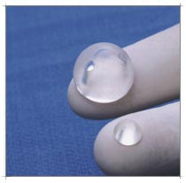
What is a Hydrogel?
Water swollen ploymeric structures crosslinked together.
  Cross-links produced through:
    Chemical reaction to form covalent bonds
    Entanglement of polymers
    Hydrogen bonding and van der Walls forces

Slide 4
Classification of Hydrogels
Homopolymer
Copolymer
Multipolymer
Interpenetrating
  A polymeric network is allowed to swell in another monomer.

Slide 5
Classification of Hydrogels
Neutral
Anionic
Cationic
Ampholytic

Slide 6
Uses
Biomaterial, coatings for medical devices, contact lenses
  Biologically compatible
Drug delivery
  Degradable, swelling properties
Many other biological applications
  Develop human tissues
Food- Jello

Slide 7
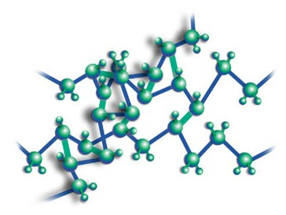
How they’re made.
Can cross link polymers via:
  Heat
  Pressure
  Chemical reaction
  Photopolymeriziation
    Use light UV, visible
  Radiation
    Electron beams
    Gama rays
    X-rays

Slide 8

How they’re made.
Radical chain reaction used to form cross links
Crosslinkers
  Acrylate, double bond forms radical

Slide 9
Polyethylene Glycol (PEG)
Properties
  Clear, viscous, odorless, miscible in water, non-toxic
Uses
  Wound dressing, soft tissue replacement, drug delivery.
  Laxatives, Skin Creams, Lubricants, Food Additive, Twinkies?

Slide 10
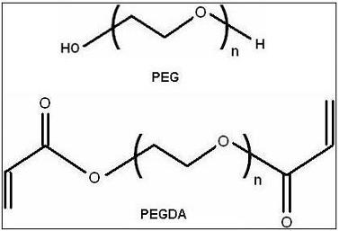
Polyethylene Glycol (PEG)

Slide 11
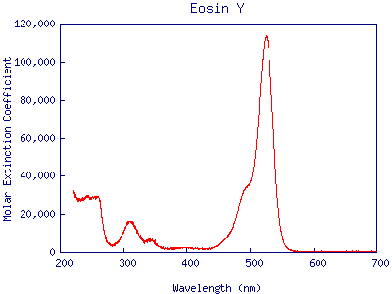
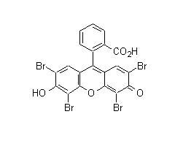
Eosin Y
One Part of a Two Part Photoinitiator System
Maximum Adsorption at 514 nm (visible)
Passes Free Radical to Triethanolamine
Taken from OLMC.Ogi.edu

Slide 12
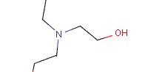
Triethanolamine
Accepts Free Radical from Eosin Y
Combines with macromer to begin polymerization reaction

Slide 13
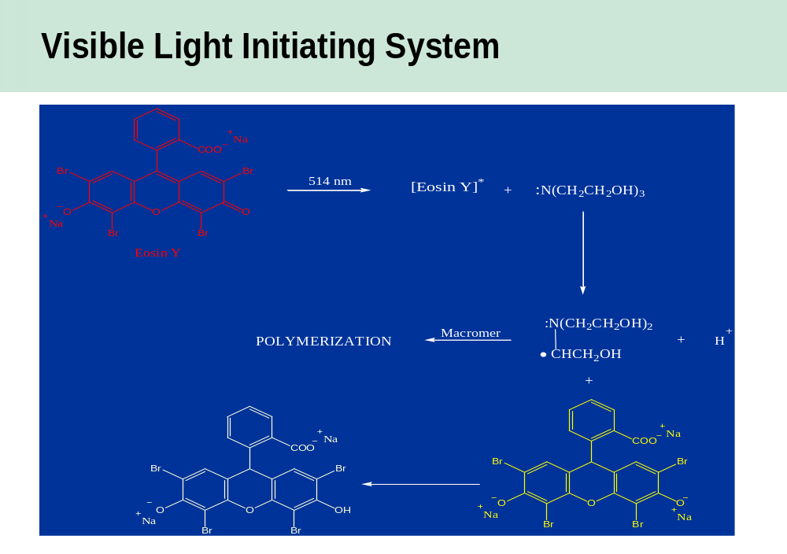

Slide 14
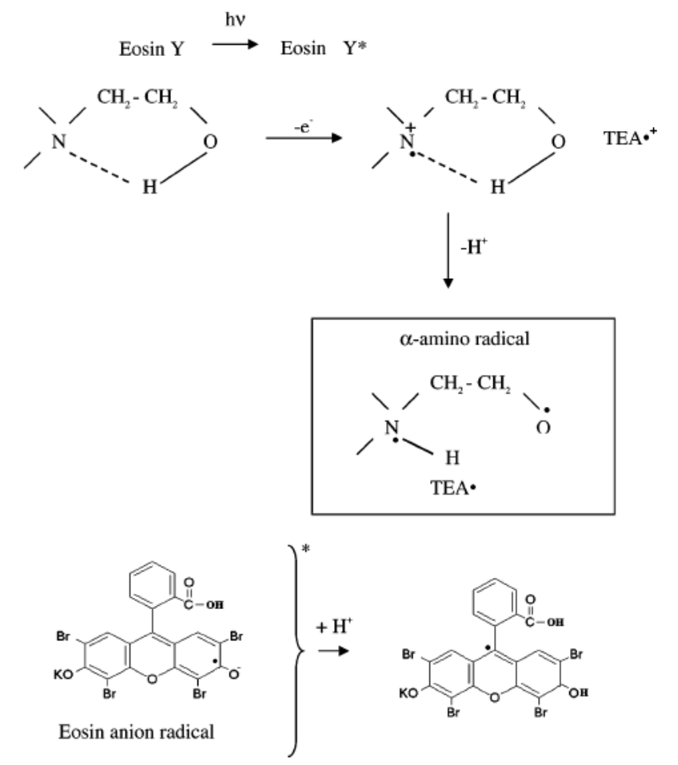
A closer look
Eosin exited to triplet stage
Electron transfer from TEA to excited Eosin
  Eosin anion radical
  TEA cation radical
Proton loss from TEA cation radical
  Produces alpha-amino radical
  Proton goes to Eosin anion radical
    Neutral eosin radical

Slide 15
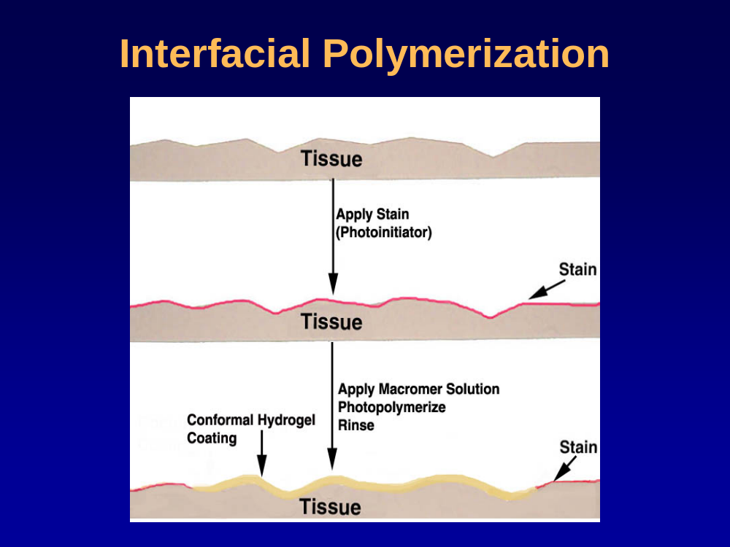

Slide 16
Variations in the method
Increase light energy?
Light intensity
Timing
  Variation in timing can lead to varried thicknesses

Slide 17
Benefits of using this method
Advantages in biological applications, no harmful light (UV, x-ray, other radiation).
  encapsulation of cells and proteins
  Drug screening
  Biosensing applications
Strong bonding to the substrate
  hydrated for more than 18 months without suffering delamination from the substrate surface

Slide 18
Important Properties
Swelling
  Solute diffusion
  Surface properties and mobility
  Optical properties
  Mechanical properties

Slide 19
Important Properties
pH sensitive hydrogels
  pH responsive hydrogels contain acidic or basic pendent groups
  In appropriate media these groups ionize forming charges on the gel
    Increases swelling forces due to localization of charges on the pendent group
    Mesh size can change significantly with little change in pH

Slide 20
Important Properties
Temperature sensitive hydrogels
  Exhibit lower critical solution temperatures (LCST), temperature at which at which a polymer is soluble
    Above this temperature the hydrogel is hydrophobic and does not significantly swell in water.

Slide 21
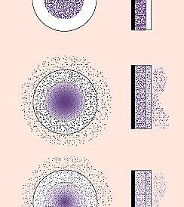
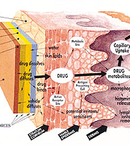
Drug Delivery

Slide 22
Drug Delivery
A dry hydrogel contains a water soluble drug
Drug is immobile in the hydrogel matrix and begins to diffuse out when the hydrogel begins to swell with water.
  Depends on two processes:
    Water migration inward
    Drug diffusion outward

Slide 23
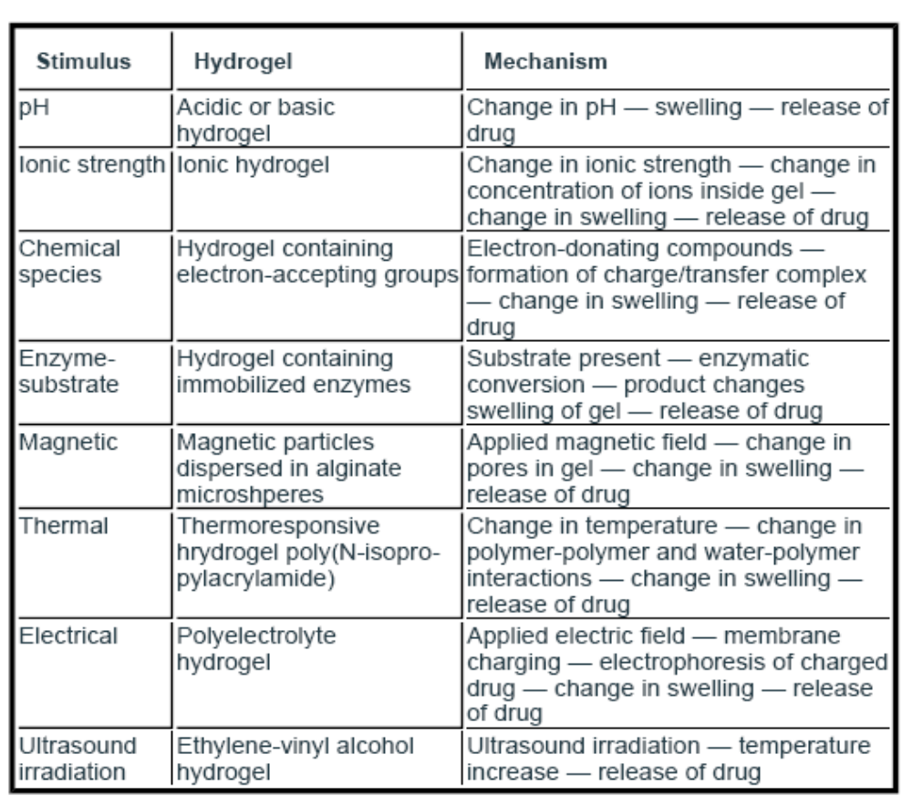
Drug Delivery

Slide 24
Biological scaffold
Osteoprogenitor cells are cultured hydrogel scaffold to produce osteoblasts
Great for protein management, proteins need to remain moist.
Can even be use to grow human tissue

Slide 25
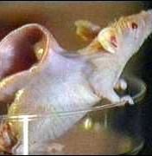
Biological scaffolds in tissue engineering
scaffold made from 99% polyglycolic acid and 1% polylactic acid
  Same material used in dissolving surgical stitches
Fibers woven into a loose mesh that was 97% air (not water)
  room for cells to grow into
Scaffold formed into shape of ear
  Seeded with cartilage cells from donor
Use “Nude Mouse”

