Slide 1

18CSC202J - OBJECT ORIENTED DESIGN AND PROGRAMMING
Session 12
Topic : UML use case Diagram, use case, Scenario, Use case Diagram objects and relations

Slide 2
USECASE DIAGRAM
Use case diagrams give us that capability.
Use case diagrams are used to depict the context of the system to be built and the functionality provided by that system.
They depict who (or what) interacts with the system. They show what the outside world wants the system to do.

Slide 3
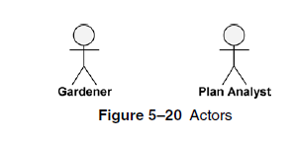
NOTATIONS
Actors are entities that interface with the system.
They can be people or other systems.
Actors, which are external to the system they are using, are depicted as stylized stick figures.

Slide 4
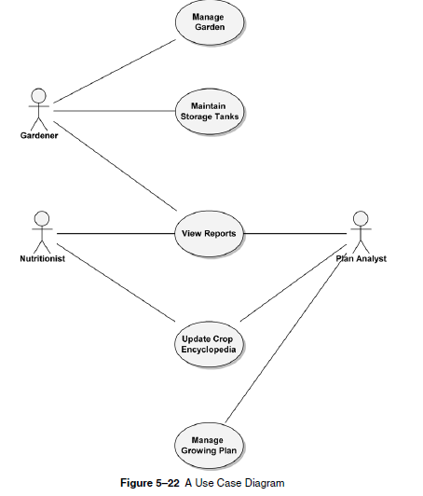

Slide 5
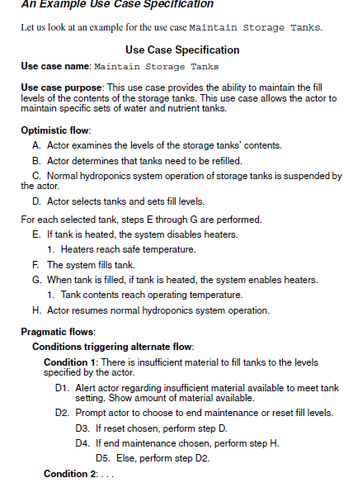

Slide 6
Relationship
Two relationships used primarily for organizing use case models are both powerful
«include» relationship
«extend» relationship

Slide 7
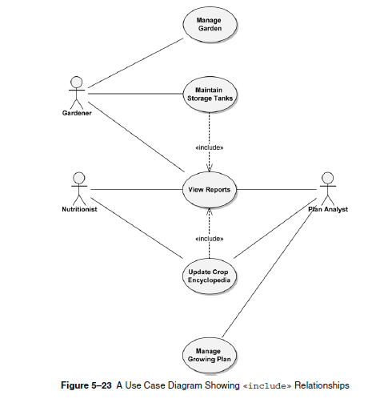

Slide 8
«include» relationship
In our hydroponics example, we have an Update Crop Encyclopedia use case.
During analysis, we determine that the Nutritionist actor using that use case will have to see what is in the crop encyclopedia prior to updating it.
This is why the Nutritionist can invoke the View Reports use case.
The same is true for the Gardener actor whenever invoking Maintain StorageTanks.

Slide 9
Neither actor should be executing the use cases blindly. Therefore, the View Report use case is a common functionality that both other use cases need.
This can be depicted on the use case model via an «include» relationship, as shown in Figure.
This diagram states, for example, that the Update Crop Encyclopedia usecase includes the View Reports use case.
This means that View Reports must be executed when Update Crop Encyclopedia is executed.
UpdateCrop Encyclopedia would not be considered complete without View Reports.

Slide 10
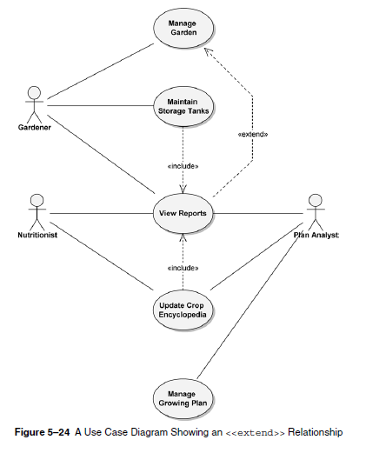
«extend» Relationships

Slide 11
While developing your use cases, you may find that certain activities might be performed as part of the use case but are not mandatory for that use case to run successfully.
In our example, as the Gardener actor executes the Manage Garden use case, he or she may want to look at some reports.
This could be done by using the View Reports use case.
However, View Reports is not required when Manage Garden is run. Manage Garden is complete in and of itself. So, we modify the use case diagram to indicate that the View Reports use case extends the Manage Garden use case.

Slide 12
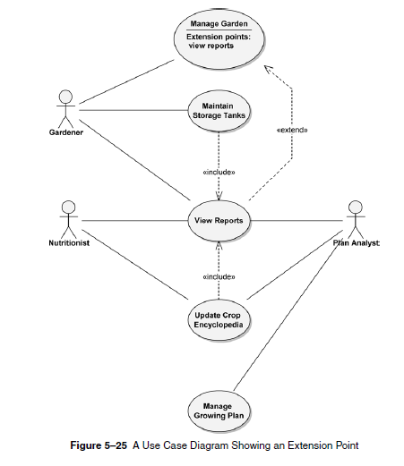
Where an extending use case is executed, it is indicated in the use case specification as an extension point.
The extension point specifies where, in the flow of the including use case, the extending use case is to be executed.

Slide 13
