Slide 1
Session-2

Slide 2
Topics covered
I/O Operation
Data types
Variable
Static
Constant
Pointer
Type conversion

Slide 3
I/O Operation
C++ I/O operation occurs in streams, which involve transfer of information into byte
It’s a sequences of bytes
Stream involved in two ways
It is the source as well as the destination of data
C++ programs input data and output data from a stream.
Streams are related with a physical device such as the monitor or with a file stored on the secondary memory.
In a text stream, the sequence of characters is divided into lines, with each line being terminated.
With a new-line character (\n) . On the other hand, a binary stream contains data values using their memory representation.

Slide 4
Stream in C
Text Stream
Binary Stream

Slide 5
Cascading of Input or Output Operators
<< operator –It can use multiple times in the same line.
Its called Cascading
Cout ,Cin can cascaded
For example
cout<<“\n Enter the Marks”;
cin>> ComputerNetworks>>OODP;

Slide 6
Reading and Writing Characters and Strings
char marks;
cin.get(marks);//The value for marks is read
OR
marks=cin.get();//A character is read and assigned to marks
string empname;
cin.getline(empname,20);
Cout<<“\n Welcome ,”<<empname;

Slide 7
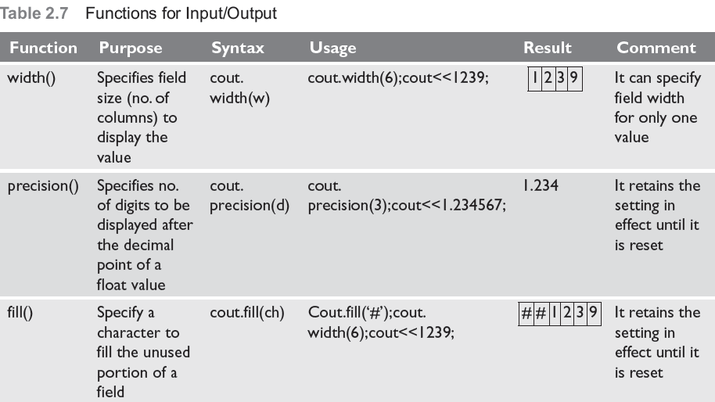
Formatted Input and Output Operations
Formatted I/O
I/O class function and flages
Manipulators
#include<iostream.h>
#define PI 3.14159
main()
{
cout.precision(3);
cout.width(10);
cout.fill(‘*’);
cout<<PI;
Output
*****3.142

Slide 8
Formatting with flags
The setf() is a member function of the ios class that is used to set flags for formatting output.
syntax -cout.setf(flag, bit-field)
Here, flag defined in the ios class specifies how the output should be formatted and bit-field is a constant (defined in ios ) that identifies the group to which the formatting flag belongs to.
There are two types of setf()—one that takes both flag and bit-fields and the other that takes only the flag .

Slide 9
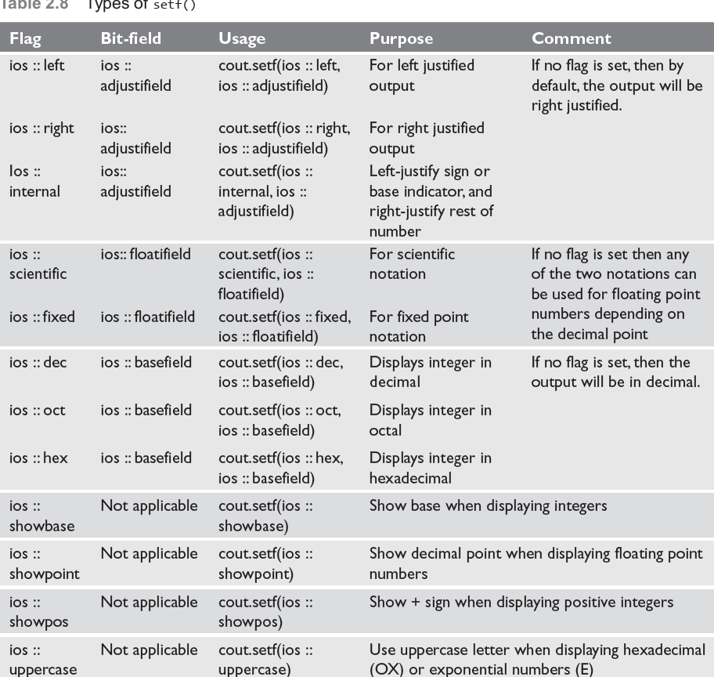

Slide 10
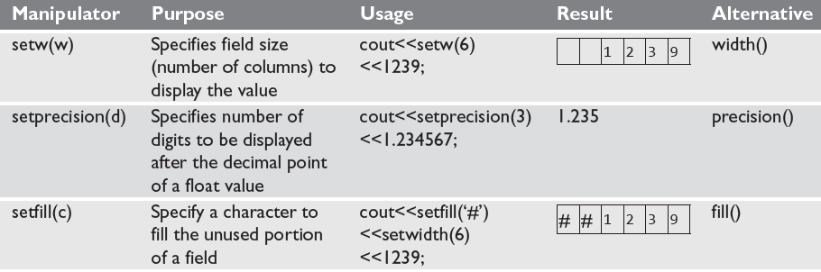
Formatting Output Using Manipulators
C++ has a header file iomanip.h that contains certain manipulators to format the output

Slide 11
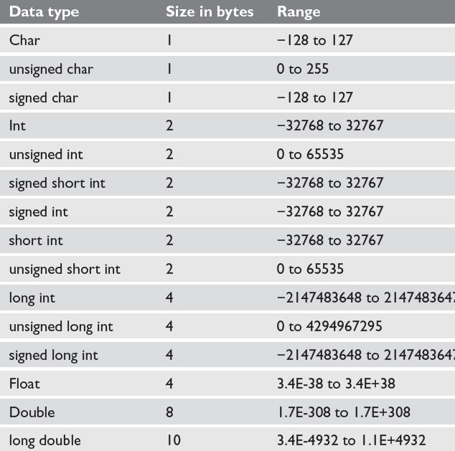
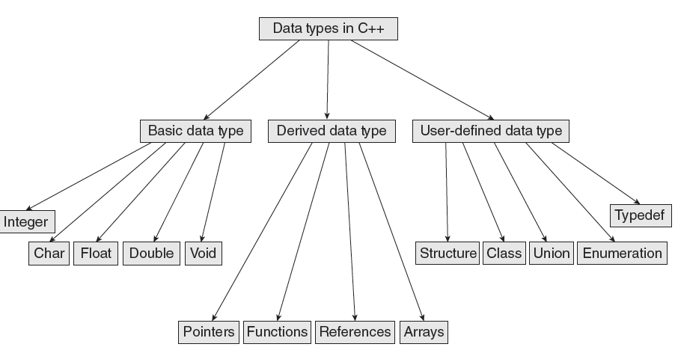
Data Types in C++

Slide 12

Variables
A variable is the content of a memory location that stores a certain value. A variable is identified or denoted by a variable name. The variable name is a sequence of one or more letters, digits or underscore, for example: character_
Rules for defining variable name:
A variable name can have one or more letters or digits or underscore for example character_.
White space, punctuation symbols or other characters are not permitted to denote variable name.
A variable name must begin with a letter.
Variable names cannot be keywords or any reserved words of the C++ programming language.
Data C++ is a case-sensitive language. Variable names written in capital letters differ from variable names with the same name but written in small letters.
01
Local Variables
03
Instance variables
02
Static Variables
04
Final Variables

Slide 13
Variables
Local Variables
Instance Variables
Static Variables
Constant Variables
Local variable: These are the variables which are declared within the method of a class.
Example:
public class Car {
public:
void display(int m){ // Method
int model=m; // Created a local variable model
cout<<model;
}
Instance variable: These are the variables which are declared in a class but outside a method, constructor or any block.
Example:
public class Car {
private: String color;
// Created an instance variable color
Car(String c)
{
color=c;
}}
Static variables: Static variables are also called as class variables. These variables have only one copy that is shared by all the different objects in a class.
Example:
public class Car {
public static int tyres;
// Created a class variable void init(){
tyres=4;
} }
Constant is something that doesn't change. In C language and C++ we use the keyword const to make program elements constant.
Example:
const int i = 10;
void f(const int i)
class Test
{
const int i;
};

Slide 14
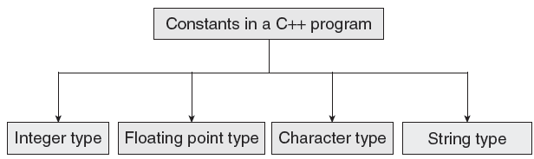
CONSTANTS
Constants are identifiers whose value does not change. While variables can change their value at any time, constants can never change their value.
Constants are used to define fixed values such as Pi or the charge on an electron so that their value does not get changed in the program even by mistake.
A constant is an explicit data value specified by the programmer.
The value of the constant is known to the compiler at the compile time.

Slide 15
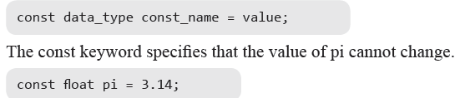

Declaring Constants
Rule 1 Constant names are usually written in capital letters to visually distinguish them from other variable names which are normally written in lower case characters.
Rule 2 No blank spaces are permitted in between the # symbol and define keyword.
Rule 3 Blank space must be used between #define and constant name and between constant name and constant value.
Rule 4 #define is a preprocessor compiler directive and not a statement. Therefore, it does not end with a semi-colon.

Slide 16
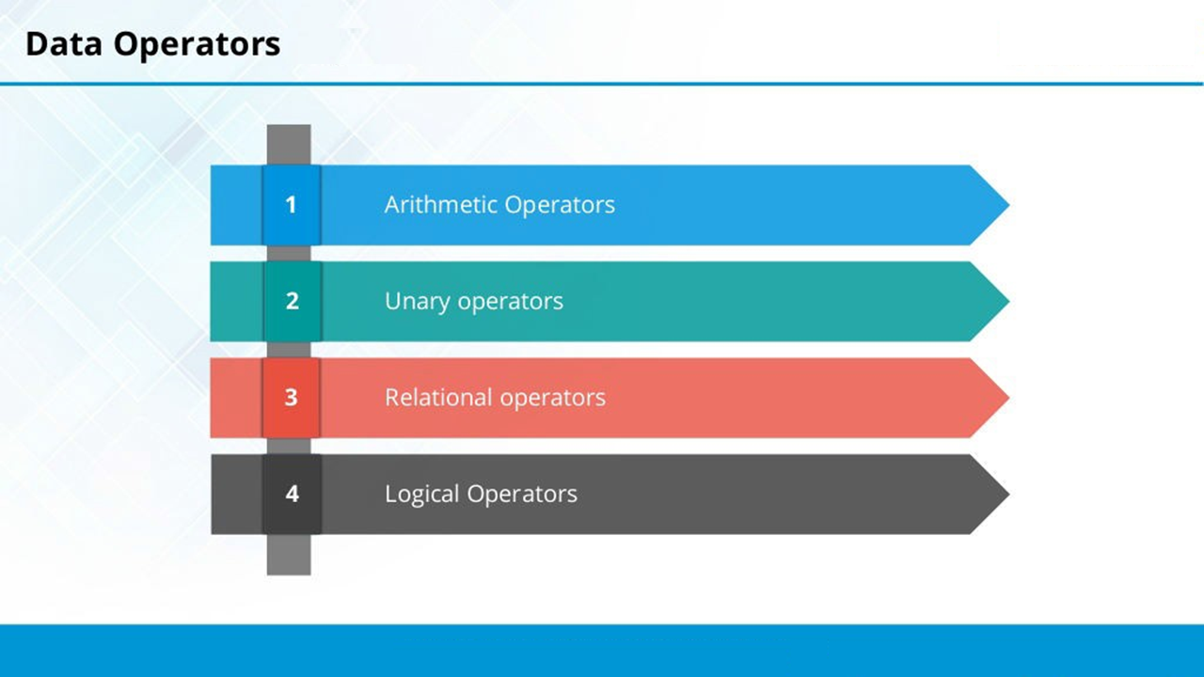

Slide 17
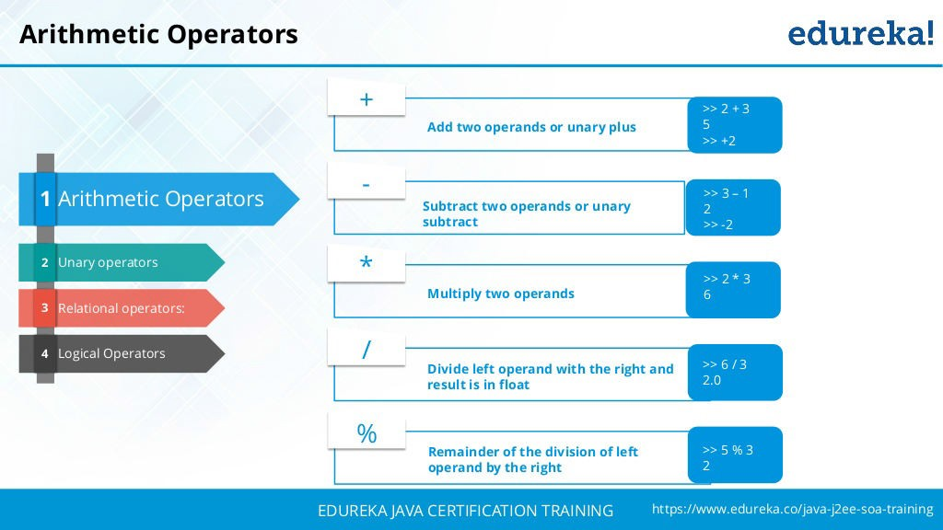

Slide 18
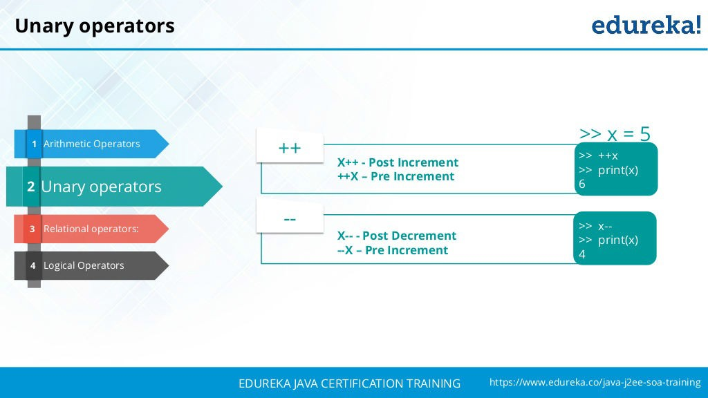

Slide 19
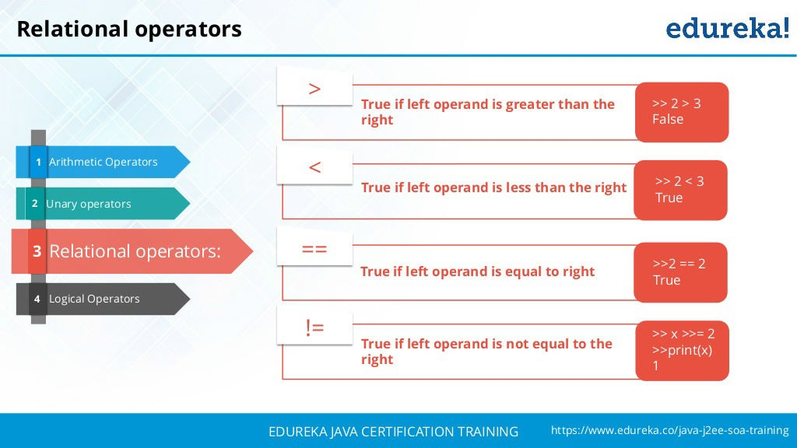

Slide 20
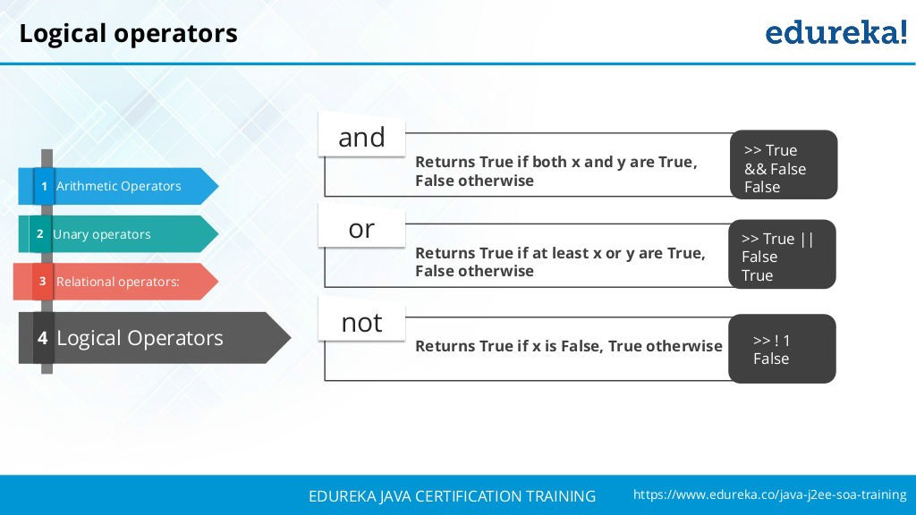

Slide 21

Special Operators
Scope resolution operator
In C, the global version of a variable cannot be accessed from within the inner block. C++ resolves this problem by using scope resolution operator (::), because this operator allows access to the global version of a variable.
1
New Operator
The new operator denotes a request for memory allocation on the Heap. If sufficient memory is available, new operator initializes the memory and returns the address of the newly allocated and initialized memory to the pointer variable.
2
Delete Operator
3
Since it is programmer’s responsibility to deallocate dynamically allocated memory, programmers are provided delete operator by C++ language.
Member Operator
4
C++ permits us to define a class containing various types of data & functions as members. To access a member using a pointer in the object & a pointer to the member.

Slide 22
Operator Precedence
Rank | Operators | Associativity
1 | ++, --, +, -, !(logical complement) ,~(bitwise complement) ,(cast) | Right
2 | *(mul) , /(div), %(mod) | Left
3 | + , - (Binary) | Left
4 | >> , <<, >>> (Shift operator) | Left
5 | >, <, >=,<= | Left
6 | ==, != | Left
7 | & (Bitwise and) | Left
8 | ^ ( XOR) | Left
9 | | (Bitwise OR) | Left
10 | && (Logical and) | Left
11 | || (Logical OR) | Left
12 | Conditional | Right
13 | Shorthand Assignment | Right

Slide 23
Pointers
Pointer is variable in C++
It holds the address of another variable
Syntax data_type *pointer_variable;
Example int *p,sum;
Assignment
integer type pointer can hold the address of another int variable
To assign the address of variable to pointer-ampersand symbol (&)
p=&sum;

Slide 24
How to use it
P=&sum;//assign address of another variable
cout<<&sum; //to print the address of variable
cout<<p;//print the value of variable
Example of pointer
#include<iostream.h>
using namespace std;
int main()
{ int *p,sum=10;
p=&sum;
cout<<“Address of sum:”<<&sum<<endl;
cout<<“Address of sum:”<<p<<endl;
cou<<“Address of p:”<<&p<<endl;
cout<<“Value of sum”<<*p;
}
Output:
Address of sum : 0X77712
Address of sum: 0x77712
Address of p: 0x77717
Value of sum: 10

Slide 25
Pointers and Arrays
assigning the address of array to pointer don’t use ampersand sign(&)
#include <iostream>
using namespace std;
int main(){
//Pointer declaration
int *p;
//Array declaration
int arr[]={1, 2, 3, 4, 5, 6};
//Assignment
p = arr;
for(int i=0; i<6;i++){
cout<<*p<<endl;
//++ moves the pointer to next int position
p++;
}
return 0;
}
OUTPUT:
0
1
2
3
4
5
6

Slide 26
This Pointers
this pointer hold the adderss of current object
int num;
This->num=num;

Slide 27
Function using pointers
#include<iostream>
using namespace std;
void swap(int *a ,int *b );
//Call By Reference
int main()
{
int p,q;
cout<<"\nEnter Two Number You Want To Swap \n";
cin>>p>>q;
swap(&p,&q);
cout<<"\nAfter Swapping Numbers Are Given below\n\n";
cout<<p<<" "<<q<<" \n";
return 0;
}
void swap(int *a,int *b)
{
int c;
c=*a;
*a=*b;
*b=c;
}
Output:
Enter Two Number You Want to Swap
10 20
After Swapping Numbers Are Given below
20 10

Slide 28
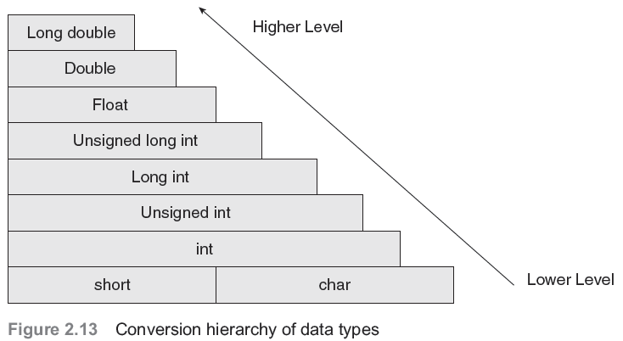
Type conversion and type casting
Type conversion or typecasting of variables refers to changing a variable of one data type into another. While type conversion is done implicitly, casting has to be done explicitly by the programmer.

Slide 29
Type Casting
Type casting an arithmetic expression tells the compiler to represent the value of the expression in a certain format.
It is done when the value of a higher data type has to be converted into the value of a lower data type.
However, this cast is under the programmer’s control and not under the compiler’s control. The general syntax for type casting is destination_variable_name=destination_data_ty--pe(source_variable_name);
float sal=10000.00;
int income;
Income=int(sal);

