Slide 1
CONSTRUCTORS
TYPES OF CONSTRUCTORS

Slide 2
CONSTRUCTORS
A constructor is a special member function whose task is to initialize the data members of an objects of its class.
It is special because it has same name as its class name.
It invokes automatically whenever a new object of its associated class is created.
It is called constructor because it constructs the initial values of data members and build your programmatic object.

Slide 3
CONSTRUCTORS
It is very common for some part of an object to require initialization before it can be used.
Suppose you are working on 100's of objects and the default value of a particular data member is needed to be zero.
Initialising all objects manually will be very tedious job.
Instead, you can define a constructor function which initialises that data member to zero. Then all you have to do is declare object and constructor will initialise object automatically

Slide 4
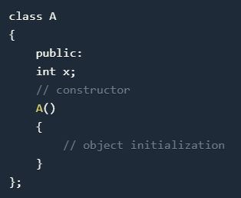
CONSTRUCTORS
While defining a contructor you must remember that the name of constructor will be same as the name of the class, and contructors will never have a return type.

Slide 5
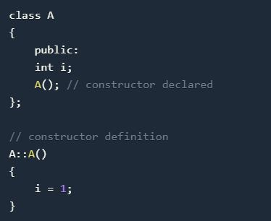
CONSTRUCTORS
Constructors can be defined either inside the class definition or outside class definition using class name and scope resolution :: operator.

Slide 6
CONSTRUCTOR CHARACTERS
They must be declared in the public scope.
They are invoked automatically when the objects are created.
They do not have return types, not even void and they cannot return values.
They cannot be inherited, though a derived class can call the base class constructor.
Like other C++ functions, Constructors can have default arguments.

Slide 7
CONSTRUCTOR CHARACTERS
Constructors cannot be virtual.
We can not refer to their addresses.
An object with a constructor (or destructor) can not be used as a member of a union.
They make ‘implicit calls’ to the operators new and delete when memory allocation is required.

Slide 8
CONSTRUCTOR TYPES
Constructors are of three types:
Default Constructor
Parametrized Constructor
Copy Constructor

Slide 9
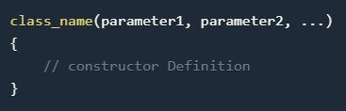
DEFAULT CONSTRUCTOR
Default constructor is the constructor which doesn't take any argument. It has no parameter.
Syntax :

Slide 10
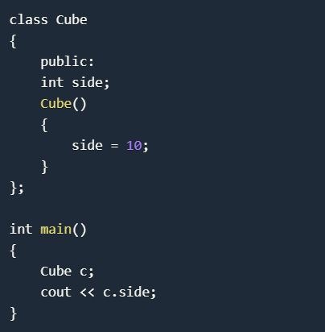
DEFAULT CONSTRUCTOR
Example
Output : 10

Slide 11
DEFAULT CONSTRUCTOR
As soon as the object is created the constructor is called which initializes its data members.
A default constructor is so important for initialization of object members, that even if we do not define a constructor explicitly, the compiler will provide a default constructor implicitly.

Slide 12
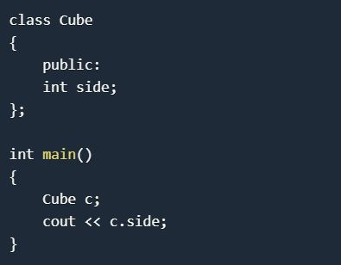
DEFAULT CONSTRUCTOR
Output: 0 or any random value
In this case, default constructor provided by the compiler will be called which will initialize the object data members to default value, that will be 0 or any random integer value in this case.

Slide 13
PARAMETERIZED CONSTRUCTOR
These are the constructors with parameter.
Using this Constructor you can provide different values to data members of different objects, by passing the appropriate values as argument.

Slide 14
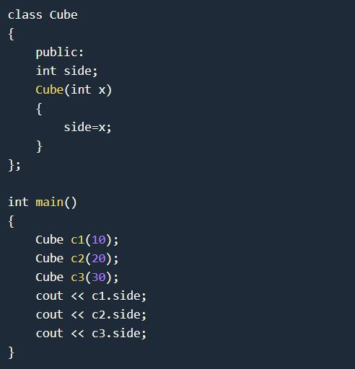
PARAMETERIZED CONSTRUCTOR
OUTPUT
10
20
30

Slide 15
PARAMETERIZED CONSTRUCTOR
By using parameterized constructor in above case, we have initialized 3 objects with user defined values. We can have any number of parameters in a constructor.

Slide 16
COPY CONSTRUCTOR
These are special type of Constructors which takes an object as argument, and is used to copy values of data members of one object into other object.

Slide 17
COPY CONSTRUCTOR
These are special type of Constructors which takes an object as argument, and is used to copy values of data members of one object into other object.
It is usually of the form X (X&), where X is the class name. The compiler provides a default Copy Constructor to all the classes.

Slide 18
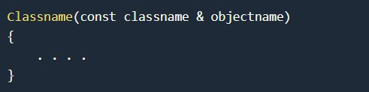
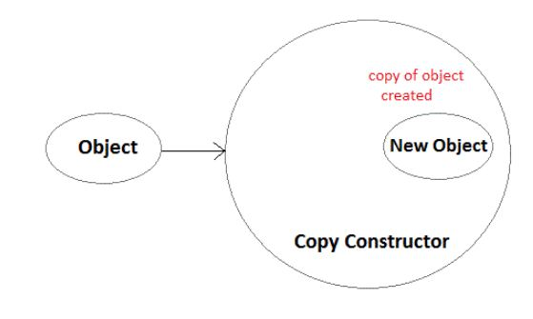
COPY CONSTRUCTOR
As it is used to create an object, hence it is called a constructor. And, it creates a new object, which is exact copy of the existing copy, hence it is called copy constructor.

Slide 19
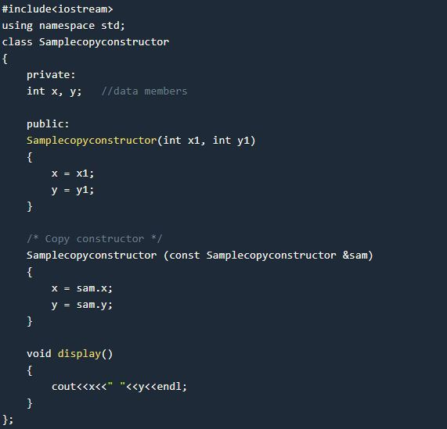
COPY CONSTRUCTOR

Slide 20
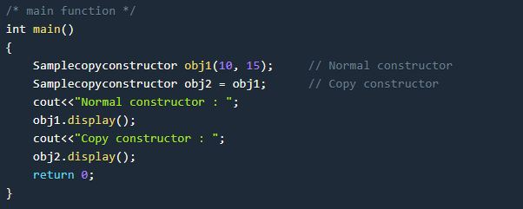
COPY CONSTRUCTOR
Output :
Normal constructor : 10 15
Copy constructor : 10 15

Slide 21
STATIC CONSTRUCTOR
C++ doesn’t have static constructors but you can emulate them using a static instance of a nested class.
class has_static_constructor {
friend class constructor;
struct constructor {
constructor() { /* do some constructing here … */ }
};
static constructor cons;
};
// C++ needs to define static members externally.
has_static_constructor::constructor has_static_constructor::cons;

