Slide 1


Slide 2

UML Specifies a number of interaction diagrams to model dynamic aspects of the system
Dynamic aspects of the system
  Messages moving among objects/classes
  Flow of control among objects
  Sequences of events

Slide 3

Interaction Diagrams - Set of objects or roles and the messages that can be passed among them.
  Sequence Diagrams - emphasize time ordering
  Communication Diagrams - emphasize structural ordering
State Diagrams
  State machine consisting of states, transitions, events and activities of an object
Activity & Swimlane Diagrams
  Emphasize and show flow of control among objects

Slide 4

Describe the flow of messages, events, actions between objects
Show concurrent processes and activations
Show time sequences that are not easily depicted in other diagrams
Typically used during analysis and design to document and understand the logical flow of your system
Emphasis on time ordering!

Slide 5

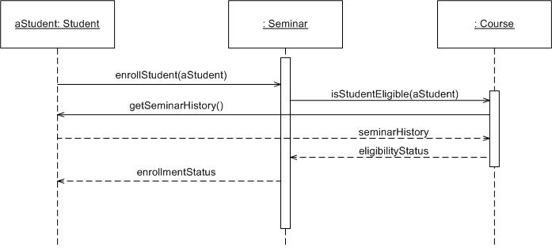

Slide 6

Time Increasing -->
All lines should be horizontal to indicate instantaneous actions. Additionally if ActivityA happens before ActivityB, ActivityA must be above activity A
Lower = Later!

Slide 7

:Student
:Registration System
Time=A
GetDetails()
Time=B
What does this mean?
Do you typically care?

Slide 8

Objects: aStudent is a specific instance of the Student class
Generic (unnamed)
objects
Generic (unnamed)
objects of class type Seminar
and Course
Specific
Instance of an
Object

Slide 9
execution
lifeline

Slide 10
Method call
Return value

Slide 11
c : Client
o : ODBCProxy
create()
: Transaction
setActions(a, b, c)
setValues(a, 3, 4)
setValues(b, c, 7)
(committed)
destroy()
create()
destroy()
Synchronous message
Asynchronous message
Coming up: Components: Guards
Return message

Slide 12

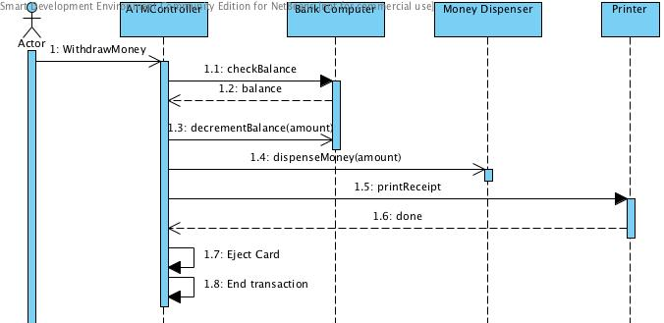
There are problems here… what are they?
Synchronous message
Asynchronous message
Return message

Slide 13

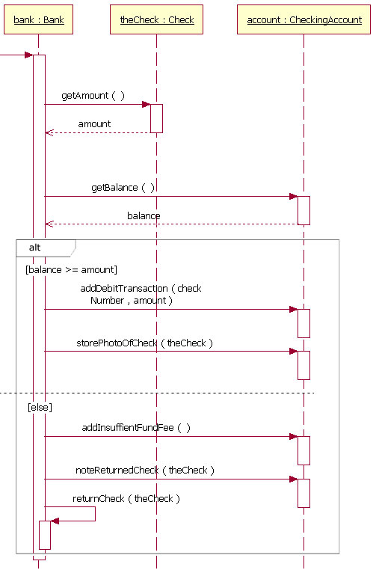
Coming up: Components: option

Slide 14

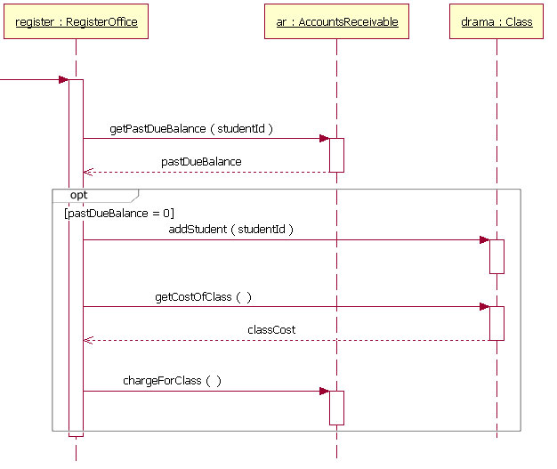
Coming up: Components: loop

Slide 15

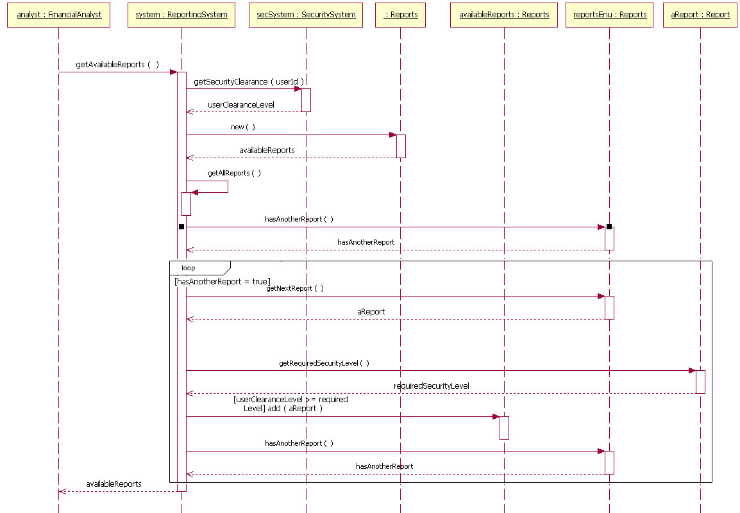
Coming up: In class exercise

Slide 16

Rarely use options,loops,alt/else
  These constructs complicate a diagram and make them hard to read/interpret.
  Frequently it is better to create multiple simple diagrams
Create sequence diagrams for use cases when it helps clarify and visualize a complex flow
Remember: the goal of UML is communication and understanding

Slide 17

Draw a sequence diagram for:
  Getting on a flight. Start at home, check in at the counter, go through security, and end up at the gate. (If you have time during the exercise, get yourself to your seat.)
    You may get searched in security

Slide 18

