Slide 1
Introduction to Python
Basics of Python Programming Language
Day 1 | Duration: 2 Hours

Slide 2
The Zen of Python
“Simple is better than complex.”
- The Zen of Python (by Tim Peters)
Simple
Code Readability
Clean Syntax
Ease of writing
Shorter Code
Less LOC
print(‘Hello, World!’)

Slide 3
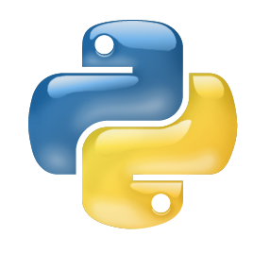
Terminal Objectives
To know the basic features of Python.
To learn how to work with Python Interpreter.
To learn what are the different datatypes of Python.
To know how Python handles the variables.
To learn how to use conditional statements & loops.
To learn how to write scripts using Python.

Slide 4
Why Python?
Beginner Friendliness
Easy to Learn
Flexible
Stability
Easy to Maintain
Portable
Community
5th Largest StackOverflow Community
4th Most-Used Language at GitHub
Career
Google
Dropbox
Quora
Instagram etc.
Future
4th Most Popular Programming Language out of 100

Slide 5
Topics to Cover
Features & Applications of Python
Using Python Interpreter
Variable & Datatypes
Conditional Statement
Loops
Write a Python Script

Slide 6
Features & Applications of Python

Slide 7
Features & Applications of Python
Easy to Learn
Simple & Clean Syntax
Python is Interpreted
High-Level & Interactive (Shell)
Object-Oriented
Free & Open Source
Portable & Embeddable
Extensive Libraries
Python
Scripting Language & Automations
Web Development
GUI Programs
Database Programming
Advanced Scientific Computing
Big Data Analysis
Machine Learning
Image Processing
Network Based Application
Text & Natural Language Processing

Slide 8
Using Python Interpreter

Slide 9
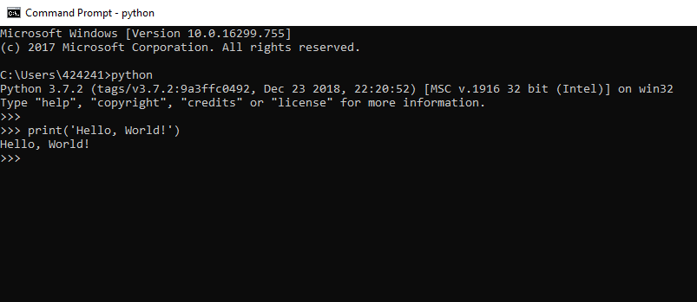
Using Python Interpreter
Open via Windows command prompt:
Open Windows command prompt, type ‘python’ & press Enter.

Slide 10
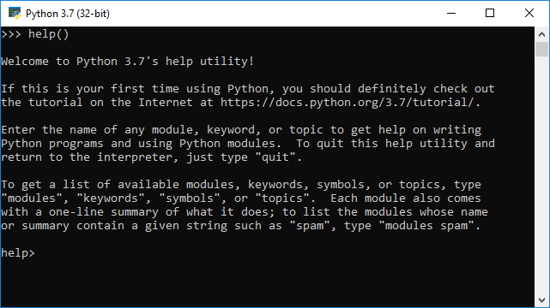
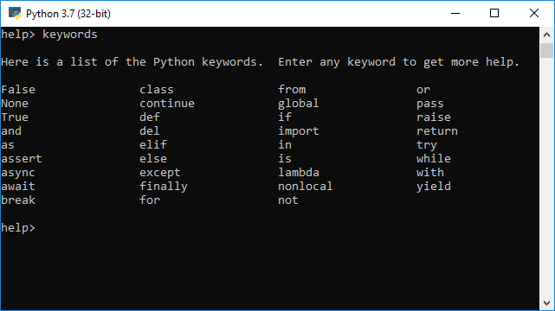
Using Python Interpreter
Launch the ‘help’ utility within Shell.

Slide 11
Variable & Datatypes

Slide 12
Variables & Datatypes
Variables are named locations in memory. In Python, all variables contain references (memory addresses, sometimes called pointers) to objects held elsewhere in memory. Everything in Python is an object.
In Python you do not need to declare variables before using them, interpreter automatically detects the type of the variable by the data it contains (Dynamic Typing).

Slide 13
Identifiers
All identifiers must start with letter or underscore, you cannot use digits & they are case sensitive.
Identifiers can contain letters, digits and underscores only.
Identifiers can be of any length.
Identifier cannot be a keyword (keywords are reserved words that Python uses for special purpose).
Example: my_var_1, my_Var, varSalary2 etc.

Slide 14
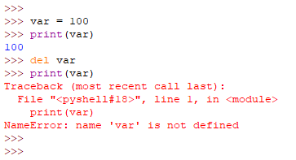
Variable & Datatypes
Deleting a variable:
The del statement deletes the variable from memory and de-allocates the space associated to it.
Addressing a variable that is no longer in memory, will generate an error.

Slide 15




Variable & Datatypes
In Python, a variable may be assigned a value of one type and then later re-assigned a value of a different type.
100
x
100
y
500
“Hi”

Slide 16
Variable & Datatypes
Python has 7 categories of built-in types
String
Numeric
Sequence
Set
Dictionary
Boolean
Binary (out of scope for this class)

Slide 17
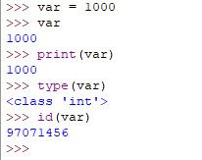
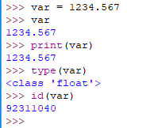
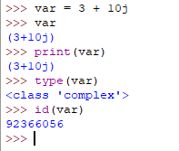
Numeric Types
Numbers
Integer
Float
Complex Number

Slide 18
Boolean
The bool type can hold the values True and False
All values can be converted to bools.
The only values that are False are False, None (no reference), 0, and empty Strings or collections.

Slide 19
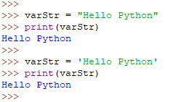
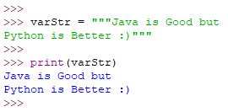
Strings
Strings in Python are identified as a contiguous set of characters represented in the quotation marks. Python allows for either pairs of single or double quotes.

Slide 20
Strings
Subsets of strings can be taken using the slice operator ([ ], [ : ], & [::]) with indexes starting at 0 in the beginning of the string and working their way from -1 at the end.
Left to right →
0
1
2
3
4
5
P
Y
T
H
O
N
-6
-5
-4
-3
-2
-1
← Right to left

Slide 21
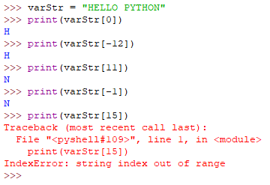
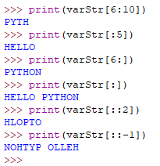
Strings
0
1
2
3
4
5
6
7
8
9
10
11
H
E
L
L
O
P
Y
T
H
O
N
-12
-11
-10
-9
-8
-7
-6
-5
-4
-3
-2
-1
varStr = “HELLO PYTHON”
Slice syntax:
string[start:end:increment]
Increment is by default 1.

Slide 22




Strings
More String Operations
Operator | Description | Example
‘+’ | Concatenates two strings.
‘*’ | Repeats the string for a given number.
‘in’ (‘not in’) | Returns True (false) if LHS substring is present inside the RHS string.
‘%sym’ | Formatting by format-symbols (%s, %d, %c, %f, %o, %h etc.).

Slide 23
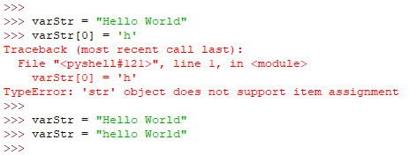
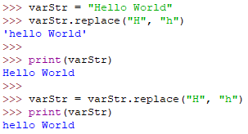
Strings
Strings are Immutable. This means, once a string object is created the element values cannot be updated or modified.

Slide 24
String Methods
Reference the Python string methods at https://www.w3schools.com/python/python_strings.asp
Using appropriate strings to test the behavior of String operations and methods, code the following challenges. I’ll ask for progress and go over them as you go through them.

Slide 25
String Challenges
Using two string variables referencing strings of your choosing (you don’t need to use the same two strings for each part:
Determine if one of the strings is contained in the other.
Determine if the reverse of one of the strings is contained in the other
Determine if the two strings start with the same letter
Determine if the two strings are the same, regardless of case.
Create a numeric variable. Concatenate the two strings together with the number in between them. (eg: “Dog”, ”Cat”, and 4 -> “Dog4Cat”)

Slide 26
Sequences
Python has three sequence types:
List
Tuple
Range

Slide 27
Ranges
A range is a sequence of numbers generated by the range function. See
https://pynative.com/python-range-function/
It is primarily used for creating a range of values to iterate over in a loop.

Slide 28
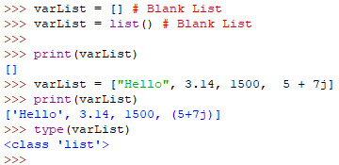
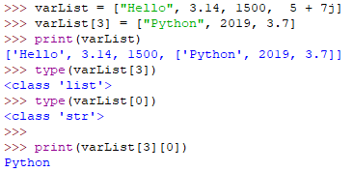
Lists
List is sequence of heterogeneous values, referenced by index.
List is mutable, meaning we can modify the elements’ values anytime.
Python does not have a simpler array primitive type.
Literal lists are entered and displayed as values in [ ]s

Slide 29
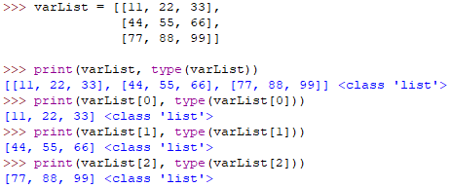
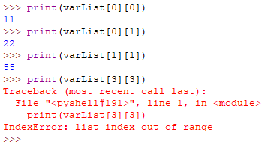
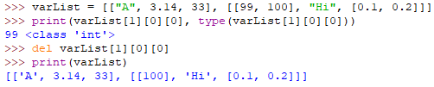
Variable & Datatypes
We can have nested lists (list inside list), to implement 2D/3D list or of any dimension.
Column Indexes
 | 0 | 1 | 2
0 | 11 | 22 | 33
1 | 44 | 55 | 66
2 | 77 | 88 | 99
Row Indexes

Slide 30
Variable & Datatypes
Python includes built-in methods that can be used to manipulate List. We can display them using dir(obj) function.
The ‘+’, ‘*’ & ‘in’ operators also works on List in similar way as String.
Splicing of list can also be done like String using [ : ] notation.
List methods can be found at https://www.w3schools.com/python/python_lists.asp

Slide 31
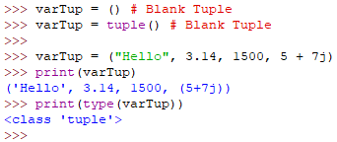
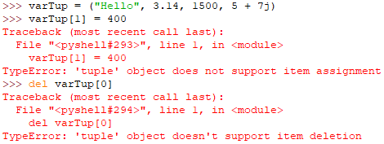
Tuples
Tuple is sequence of heterogeneous values, referenced by index.
Tuple is immutable (unlike List), means we cannot modify the elements’ value.
Literal tuples are created and displayed as values in ( )s

Slide 32
Tuples
Using Tuples is similar to using Lists, with the exception of operations that modify the data in the sequence. See https://www.w3schools.com/python/python_tuples.asp

Slide 33
Tuples
There are few places where Tuples are used behind the scene by Python itself.
During simultaneous assignment of variable.
During returning multiple values from Function.
When variable length arguments are passed to a Function.
As individual key-value pairs in a Dictionary.

Slide 34
Sets
The Set is a collection which:
Is unordered
Is unindexed
Contains unique values
Contains values which cannot be changed
Can have values added to it and removed from it.
It’s literal representation for creation and display is values contained in { }s

Slide 35
FrozenSet
A FrozenSet differs from a set in that
It cannot have values added or removed
It can only be created by passing an iterable object(sequence, dict, or set) into the frozenset() function.

Slide 36
Sets
As with sequences, Set has methods that can be called on it.
https://www.w3schools.com/python/python_sets.asp

Slide 37
Dictionaries
Dictionary (dict) is an unordered collection of items.
A Dictionary has a (key: value) pair.
Dictionaries are optimized to retrieve values when the key is known.
Like sets, dicts use { }s for literals, only with key: value pairs rather than just values.
dicts did this first. Sets came in with Python 3
{} is an empty dict, not an empty set
Example: somedict – {”cheetah”: “fast”, ”grades”: [12, 15, 10], “passing”: True}

Slide 38
Variable & Datatypes
Python includes built-in methods that can be used to work with Dictionary. We can display them using dir(obj) function.
The ‘in’ operators also works on Dictionary but on Key set not on Value set.
As with a set, the order of items in a dictionary is unpredictable.
somedict[key] = value either inserts a new key:value pair or changes the value for an existing key
Methods and examples at https://www.w3schools.com/python/python_dictionaries.asp

Slide 39
Conversion/Constructor methods
All types have a constructor, which is their name as a method (int(), str(), dict(), bool(), list(), complex(), etc).
With no argument, they will create an empty, 0-value, or False instance of the type.
With an argument they will cast the argument into their own type, if possible. Python is very liberal with this possibility.

Slide 40
Conditional Statement

Slide 41
Conditional Statement
Decision making is required when we want to execute a code only if a certain condition is satisfied.
The if…elif…else statement is used in Python for decision making.
Python uses indentation for blocks.
The indentation level of lines of code determines how statements are grouped together.
Syntax:
if <condition>:
<code in if block>
elif <condition>:
<code in elif block>
else:
<code in else block>
val = 10
if (val < 50):
print('Less than 50!')
elif (val >= 50 and val < 75):
print('With in 50 to 75!')
else:
print('More than 75!')

Slide 42
Conditional Statement
We can nest ifs inside of ifs, elifs, and elses. We need elif for clean syntax because this can’t be done without indentation, as it can in c-derived languages.
if cond1:
else:
if cond2:
else:
if cond3:
else:

Slide 43
Loops

Slide 44
Loops
Python provides two different loops ‘for’ & ‘while’.
The for loop in Python is used to iterate over a sequence (List, Tuple, String, Dictionary) or other iterable objects. Iterating over a sequence is called traversal.
Syntax:
for Iterating-Variable in Sequence:
<Body of for>

Slide 45
Loops
The while loop in Python is used to iterate over a block of code as long as the test expression is true.
The test expression is checked first. The body of the loop is entered only if the test expression is True. This process continues until the test expression is False.
Syntax:
while Test-Expression:
<Body of while>

Slide 46
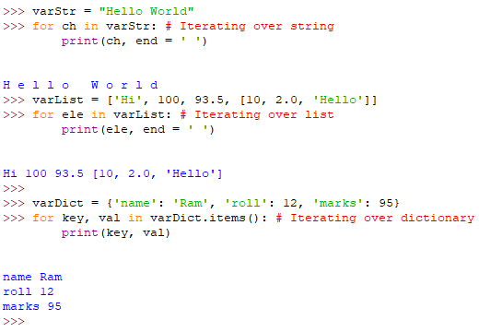
Loops
For each item in sequence
The ‘for’ loop execution flow:
Last item?
Yes
Next item
Or
continue
No
Body of for
break
Exit Loop

Slide 47
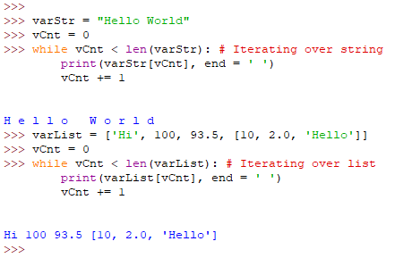
Loops
Start
The ‘while’ loop execution flow:
Test
the condition
False
Next iteration
Or
continue
True
Body of while
break
Exit Loop

Slide 48
Challenge
Put a multi-word string into a variable(e.g. “All good things must end”). Use material from strings, sequences, and loops to
print out all of the words in the opposite order. (e.g. “end must things good All”)
print out all of the words backwards, but in the original order (e.g. “llA doog sgniht tsum dne”)
If you have time, you can think of different ways of solving the problem or ensure that the words output as a single string rather than a list of words.

Slide 49
Write a Python Script

Slide 50
Write a Python Script
First of all we have to use an editor (or IDE) for your development. The write down the Python codes inside a new file and save the file with .py extension in your project directory.
Python uses .py as the extension for the script files.
To execute the script, open the windows command prompt, change directory to the directory where the script file is saved (or use the full path), use ‘python’ give a blank space and mention the name of the script-file. Press enter.
Syntax: python <script-file> 
Example: python D:\myproject\hello.py 

Slide 51
Write a Python Script
When we execute a Python script, Python interpreter will first compile the code and create a bytecode before it starts the execution of the program.
Execution of a Python program means execution of the bytecode on the Python Virtual Machine (PVM).
Every time a Python script is executed, bytecode is created. If a Python script is imported as a module, the bytecode will be stored in the corresponding .pyc file.
Source Code
(.py)
Byte Code
(.pyc)
Execution
(PVM)

Slide 52
Thank you
Indranil Paul (424241)
Python Developer
Banking & Financial Services | WMC Account

