Slide 1
Introduction to Python
Basics of Python Programming Language
Day 5 | Duration: 2 Hours

Slide 2
The Zen of Python
“Simple is better than complex. Complex is better than complicated.”
- The Zen of Python (by Tim Peters)
Collect Data
Process Data
Connect Database
Update Table
Close Connection

Slide 3

Terminal Objectives
To learn how to connect to database (MySQL & SQLite) using Python.
We will learn to create Database. Compare syntax with other Database packages.
To learn how to execute SQL queries to perform database transactions like DDL (CREATE) & DML (SELECT, UPDATE, INSERT, DELETE) etc. in Python.
To learn how to write a program in Python to deal with Database.

Slide 4
Why to use Database?
Benefits
Processing queries and object management
Controlling redundancy and data inconsistency
Efficient memory management and indexing
Concurrency control and transaction management
Data security
Integrated data

Slide 5
Topics to Cover
Database Programming using Python
Connect to a Database
Create Database
Create Table
Select Record
Insert Record
Update Record
Delete Record

Slide 6
Database Programming using Python

Slide 7
Database Programming using Python
In many programming languages, the developer needs to take care of the open and closed connections of the database, to avoid further exceptions and errors. But in Python, these things are taken care of.
Python supports relational database systems.
Python database APIs are compatible with various databases, so it is very easy to migrate and port database application interfaces.

Slide 8
Database Programming using Python
Python Database API supports a wide range of databases.
Python
MySQL
Oracle
MS SQL Server
PostgreSQL
Informix
SQLite
Sybase
MongoDB
MySQL
mysql-connector
Oracle
cx_oracle
MongoDB
pymongo
SQLite
sqlite3

Slide 9
Database Programming using Python
DB-API (SQL-API) for Python
Python DB-API is independent of any database engine, which enables you to write Python scripts to access any database engine.
DB API implementation for MySQL is MySQLdb, mysql-connector.
For PostgreSQL, it supports psycopg, PyGresQL & pyPgSQL.
For Oracle dc_oracle2 and cx_oracle are very famous.
For MongoDB its PyMongo.
Pydb2 is the DB-API implementation for DB2 & for SQLite its sqlite3.
Python’s DB-API consists of connection objects, cursor objects, standard exceptions and some other module contents.

Slide 10
Database Programming using Python
Connection objects create a connection with the database and these are further used for different transactions. These connection objects are also used as representatives of the database session.
Cursor is one of the powerful features of SQL. These are objects that are responsible for submitting various SQL statements to a database server.
Exception handling is very easy in the Python DB-API module. We can place warnings and error handling messages in the programs.
Python DB-API has various options to handle this, like Warning, InterfaceError, DatabaseError, IntegrityError, InternalError, NotSupportedError, ProgrammingError & OperationalError.

Slide 11
Database Programming using Python
Warning
If there is any warning generated during SQL execution
DatabaseError
Any transaction failure or connectivity error
InterfaceError
IntegrityError
Specially for type mismatch, wrong query syntax
InternalError
If we try to enter duplicate records in the database
NotSupportedError
Some unexpected thing like disconnection, access issue
ProgrammingError
Some operation that is not supported by the API
OperationalError
If there are any programming errors like duplicate database creations
If there are any operation errors like no databases selected

Slide 12
Database Programming using Python
SQLite is a simple database system, which saves its data in regular data files or even in the internal memory of the computer, i.e. the RAM.
It was developed for embedded applications, like Mozilla-Firefox (Bookmarks), Symbian OS or Android.
SQLITE is “quite” fast, even though it uses a simple file. it can be used for large databases as well. If you want to use SQLite, you have to import the module sqlite3.

Slide 13

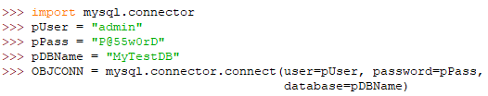

Database Programming using Python
Connect to a SQLite Database: sqlite3.connect(<database>)
Connecting to SQLite
Connecting to MySQL
Connecting to Oracle

Slide 14
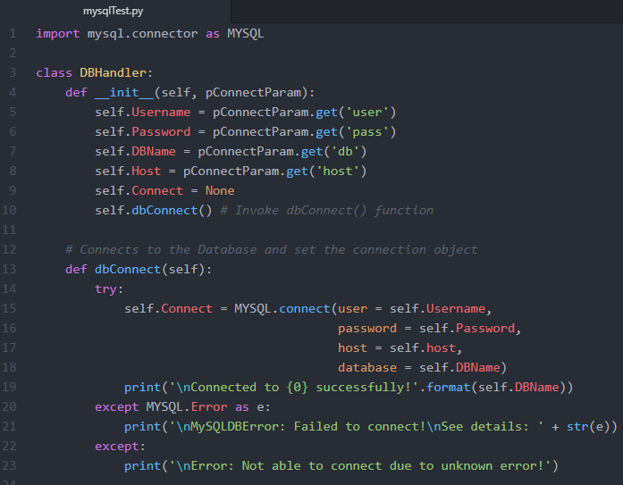
Database Programming using Python
The connect() function creates a connection to the MySQL server and returns a MySQLConnection object.
The __init__() function of our DBHandler class initializes the connection parameters.
The dbConnect() function connects to the database and set the self.Connect attribute with the connection object.

Slide 15
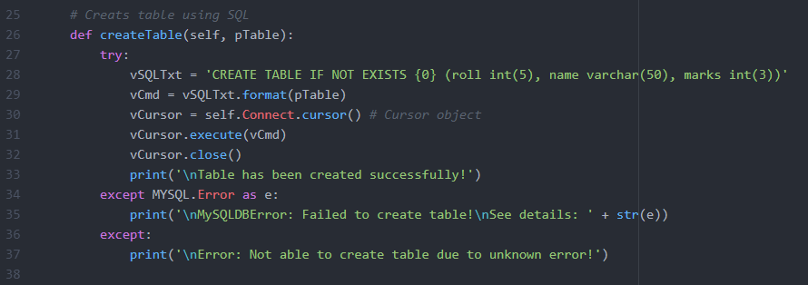
Database Programming using Python
The createTable() function creates a table (the table name is sent as argument) in the database using Create Table SQL.
The cursor() returns a cursor object (MySQLCursor object) which has an execute() method to execute SQL commands.

Slide 16
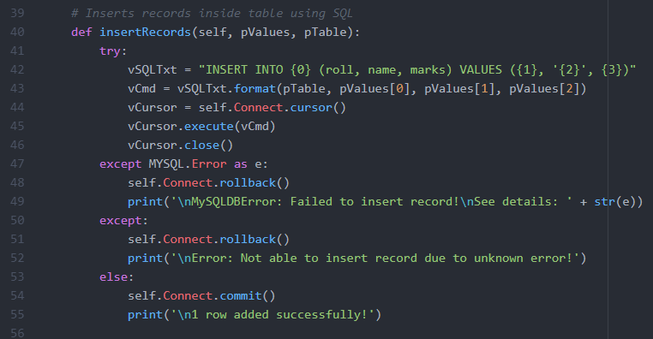
Database Programming using Python
The insertTable() function formats an insert query using parameters sent as argument.
Then the execute() method to execute SQL commands (an insert query).
If there is any error then rollback() else commit() is called to do a rollback or commit respectively

Slide 17
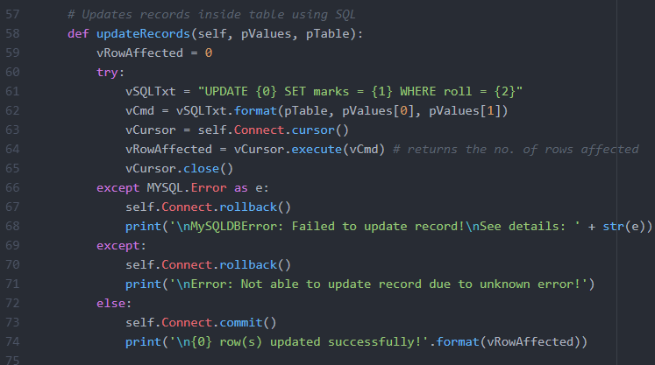
Database Programming using Python
The updateTable() function formats an update query using parameters sent as argument.
Then the execute() method to execute SQL commands (an update query).
The execute() function also returns the number of rows affected.

Slide 18
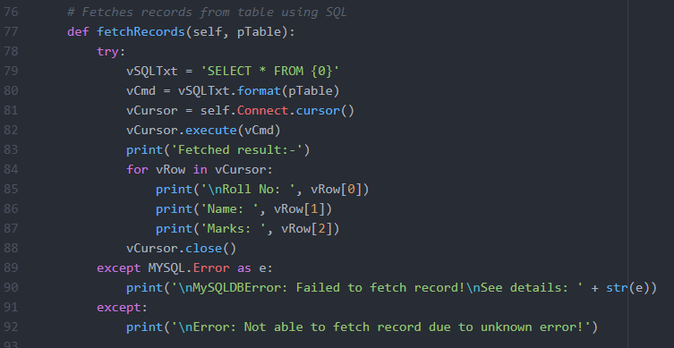
Database Programming using Python
The fetchRecords() function formats a select query using parameters sent as argument.
Then the execute() method to execute SQL commands (an update query).
Use loops to iterate over cursor object.

Slide 19
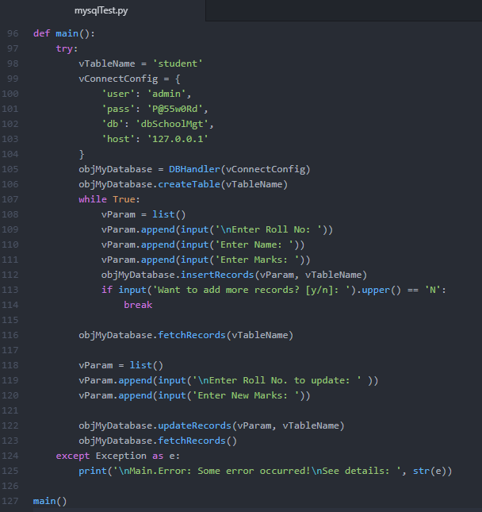
Database Programming using Python
The main() function has created an object of our dbHandler class and invoked the methods using obj.<method> notation and passed the required parameters.

Slide 20
Activities
Write a program to store employee id (AUTO INCREMENT), name, salary, design, project in a database table. During inserting, generate a random password for him/her and store it along with other fields. Display the records in console and also keep functionality to save the displayed result into a file (user choice). Make good formatting to print the data inside the file. Keep functionality to pick records from a formatted file for bulk insert. For delete query remove the record and generate a single log file for all deleted records.

Slide 21
Summary
Python has its own DB-API to support the database programming.
We can use Python to deal with all the major DBMS packages.
We will get separate modules for each DBMS and we can install them as external library and import them in our script.
The connect() function helps to connects to the database and returns a connection-object.
The connection-object.cursor() returns a cursor which has an execute() function to execute SQL queries.

Slide 22
Check on learning
We have learnt how to connect to database (MySQL & SQLite) using Python.
We also learnt to create Database & Table.
We can now execute SQL queries to perform database transactions like SELECT, UPDATE, INSERT, DELETE etc. in Python.
We have learnt how to write a complete program in Python to deal with Database.

Slide 23
Links
https://www.sqlite.org/docs.html
https://dev.mysql.com/doc/connector-python/en/

Slide 24

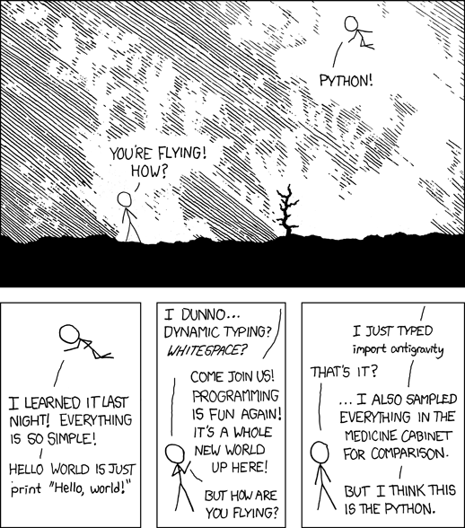
Hello, World! This is.. S
It is the extensive library of Python that make programming easier. Agree?

Slide 25
Thank you
Indranil Paul (424241)
Python Developer
Banking & Financial Services | WMC Account

