Slide 1
Introduction to Python
Basics of Python Programming Language
Day 3 | Duration: 2 Hours

Slide 2
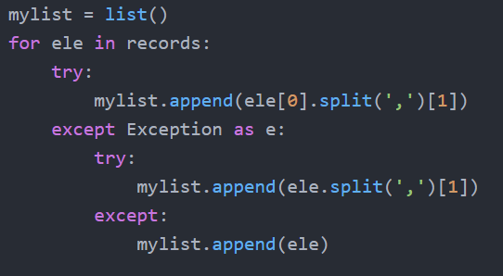
The Zen of Python
“Errors should never pass silently, unless explicitly silenced.”
- The Zen of Python (by Tim Peters)

Slide 3

Terminal Objectives
To learn how to write multi-threading programs using Python.
To learn how to send emails from Python script using SMTP.
To learn how to parse an XML document, modify the content, add new element and generate new XML.
To learn how to handle JSON using Python.

Slide 4
Why this is for?
Multi-Threading programming solves the purpose to run functions simultaneously. So we can design our application in such a way so that the functions those who are not depended on each other can run on threads in parallel.
Email sending from script is very useful. We can use this facility to send confirmation mails, approval mails, or else error-report, crash-report.
XML & JSON parsing techniques is required to handle the XML docs or JSON (from API) to fetch/modify data from within it.

Slide 5
Topics to Cover
Multi-Threading Programming using Python
Email Sending using Python
Parsing XML using Python
Handling JSON using Python

Slide 6
Multi-Threading Programming using Python

Slide 7
Multi-Threading Programming using Python
In computing, a process is an instance of a computer program that is being executed.
A thread is an entity within a process that can be scheduled for execution. Also, it is the smallest unit of processing.
A thread is a sequence of such instructions within a program that can be executed independently of other code.
For simplicity, you can assume that a thread is simply a subset of a process.
In a simple, single-core CPU, it is achieved using frequent switching between threads. This is called context switching. Context switching takes place so frequently that all the threads appear to be running simultaneously (this is termed as multitasking).

Slide 8
Multi-Threading Programming using Python
Multiple threads can exist within one process.
Each thread contains its own register set & local variables (stored in stack).
All thread of a process share global variables (stored in heap) & the code.
Code
Data
Files
Code
Data
Files
Register
Stack
Register
Register
Register
Stack
Stack
Stack
Time
Thread
Threads
Thread#1
Thread#2
Single Threaded Process
Multi-Threaded Process
Process

Slide 9
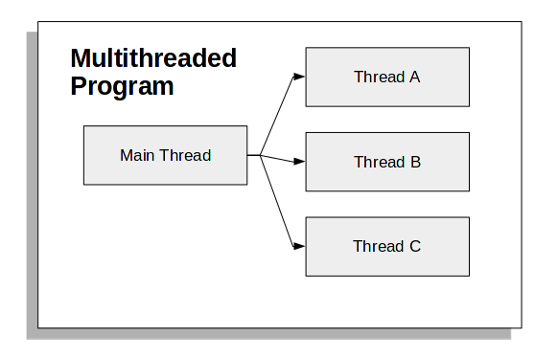
Multi-Threading Programming using Python
In Python, the threading module provides a very simple and intuitive API for spawning multiple threads in a program.
The main thread will be the program itself and the threads that are created inside the program will be the child thread of it.
The main thread should wait for the child threads to execute completely, otherwise after main thread is completed with its execution, the child threads will become orphan threads, and will be remove from the system by the OS.

Slide 10
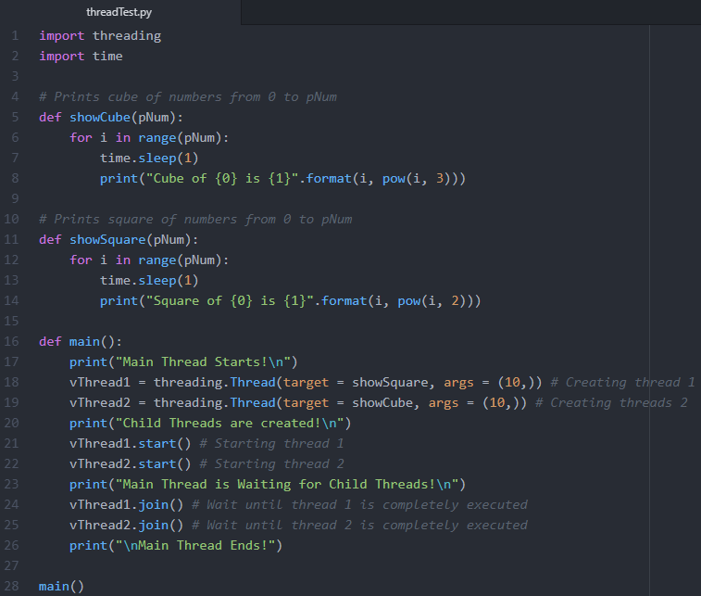
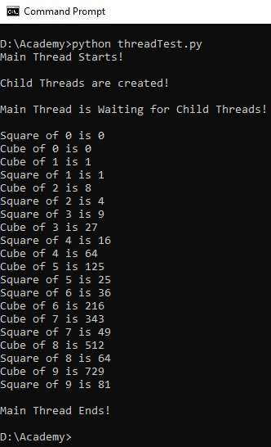
Multi-Threading Programming using Python https://www.geeksforgeeks.org/multithreading-python-set-1/
Main Program
Start #1
Start #2
Idle
Stop #1
Stop #2
Main Program is complete

Slide 11
Email Sending using Python

Slide 12
Email Sending using Python
Python comes with the built-in smtplib module for sending emails using the Simple Mail Transfer Protocol (SMTP).
The smtplib uses the RFC 821 protocol for SMTP.
The primary requirement is a mail server.
We can use mail server localhost or the one which is provided by gmail (smtp.gmail.com:587). For last one you need a google account, and you have to set your security settings.
Turn the Allow less secure apps to ON.
Note: This can make your google account vulnerable to other applications.

Slide 13

Email Sending using Python
You can test the email functionality by running a local SMTP debugging server, using the smptd module that comes pre-installed with Python.
Rather than sending emails to the specified address, it discards them and prints their content to the console.
Running a local debugging server means we don’t need to deal with encryption of messages or to log in to an email server.
Note: Ctrl + c to stop

Slide 14
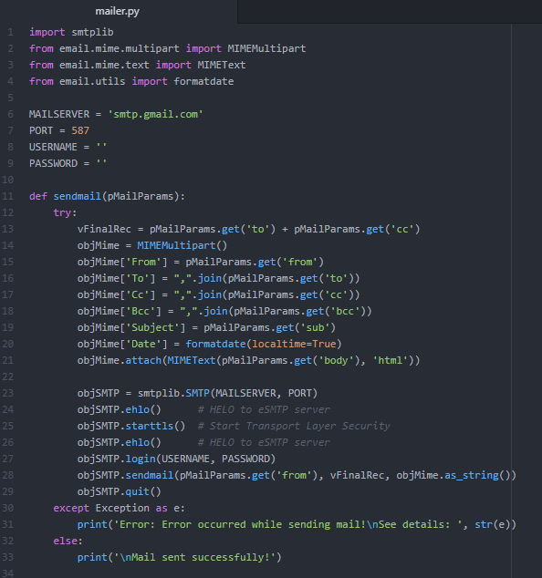
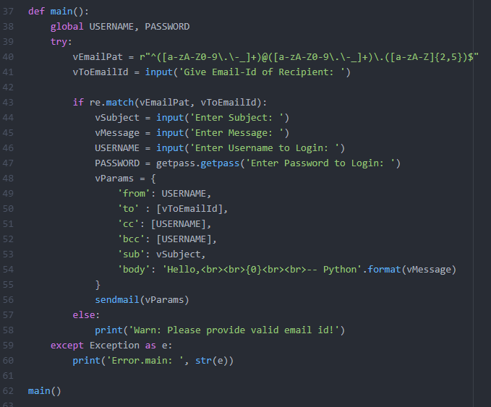
Email Sending using Python
Note: You need admin privilege in you system to run this program, otherwise [WinError 10013] error will occur.

Slide 15
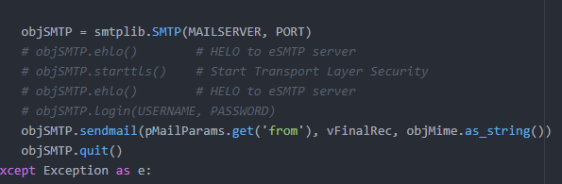
Email Sending using Python
To identify yourself to the server, .helo() (SMTP) or .ehlo() (ESMTP) should be called after creating an .SMTP() object, and again after .starttls().
This function is implicitly called by .starttls() and .sendmail().
Comment out the section in the code for encryption of messages or to log in to an email server.
Change HOST & PORT to
‘localhost’ & 1025 (where
the SMTP dev server is
running).

Slide 16
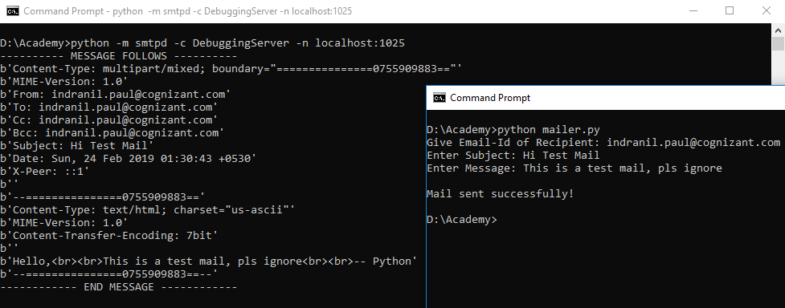
Email Sending using Python
The advantage of this utility is that, we tested our code but no mail was sent to the recipient. The mail sent from the script was discarded and the output is shown here.
The output is nothing but the complete email message.

Slide 17
Parsing XML using Python

Slide 18
Parsing XML using Python
XML (EXtensible Markup Language) is a portable, open source language that allows programmers to develop applications that can be read by other applications, regardless of operating system and/or developmental language.
XML is a markup language much like HTML. This is recommended by the World Wide Web Consortium and available as an open standard.
XML is extremely useful for keeping track of small to medium amounts of data without requiring a SQL-based backbone.
It is mainly used in webpages, where the data has a specific structure and is understood dynamically by the XML framework.
XML creates a tree-like structure that is easy to interpret and supports a hierarchy.

Slide 19
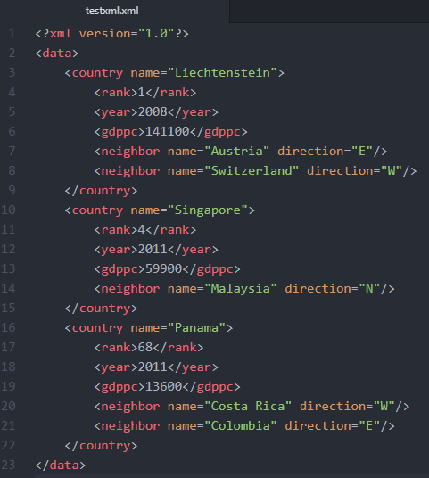
Parsing XML using Python
Whenever a page follows XML, it is called an XML document.
XML documents have sections, called elements, defined by a beginning and an ending tag. A tag is a markup construct that begins with < and ends with >. The characters between the start-tag and end-tag, if there are any, are the element’s content. Elements can contain markup, including other elements, which are called ‘child elements’.
The top-level element is called the root, which contains all other elements.
Attributes are name–value pair that exist within a start-tag or empty-element tag. An XML attribute can only have a single value and each attribute can appear at most once on each element.
XML Document

Slide 20
Parsing XML using Python
The XML tree structure makes navigation, modification, and removal relatively simple programmatically. Python has a built in library, ElementTree, that has functions to read and manipulate XMLs.
import xml.etree.ElementTree as ET
tree = ET.parse(<XML Document>)
root = tree.getroot()
root = ET.fromstring(<XMLInStringFormat>)

Slide 21
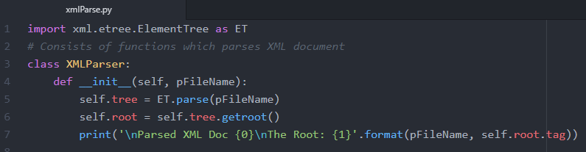
Parsing XML using Python
We have our own class XMLParser, which is having some functions to traverse, modify, search etc. Below is the __init__() which accepts the XML Document as argument (pFileName).
The ET.parse(pFileName) sets the self.tree & self.root attributes.

Slide 22
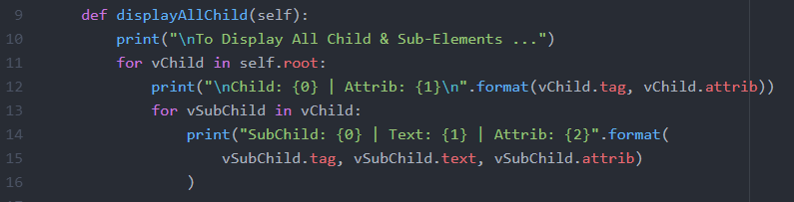
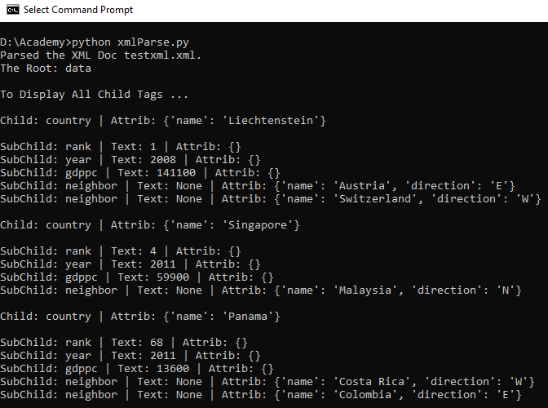
Parsing XML using Python
The displayAllChild() function will traverse through the self.root attribute and displays all the elements & sub-elements along with the tag, attribute & text.
We have used the for loop to perform this operation.

Slide 23
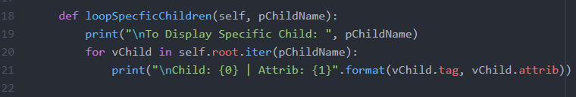

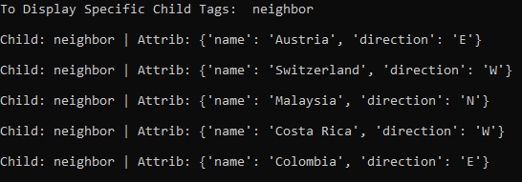
Parsing XML using Python
The root.iter() function creates a tree iterator with the current element. The iterator iterates over this element and all elements below it.
During calling the function loopSpecificChildren() we have passed ‘neighbor’ as the name of the sub-element to be iterated over.

Slide 24
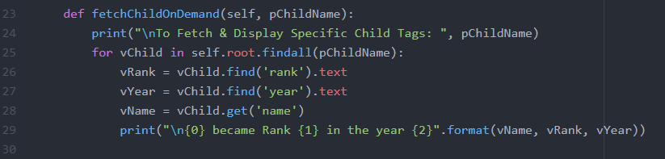

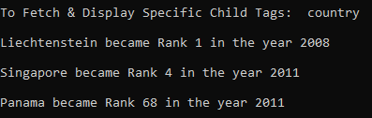
Parsing XML using Python
Find specific element & attribute’s value over a given child name:
root.findall(): Finds only elements with a tag which are direct children of the current element.
root.find(): Finds only the first child with a particular tag.
root.get(): Accesses the element’s attributes.

Slide 25
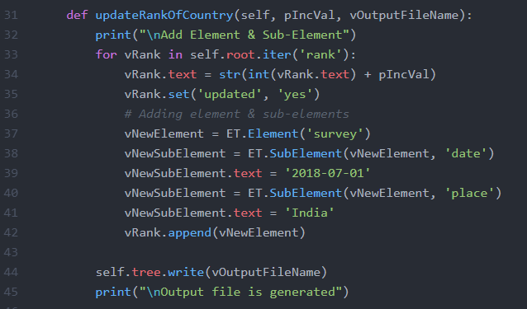

Parsing XML using Python
Modify an XML Document:
tree.write(): Writes the element tree to a file, as XML.
ele.set(): adding and modifying attributes.
ET.Element(): Creates an element object.
ET.SubElement(): Creates a sub-element for a given element.
ele.append(): Adds the element to the end of this element’s internal list of sub-elements.
ele.remove(): Removes sub-element from the given element.

Slide 26
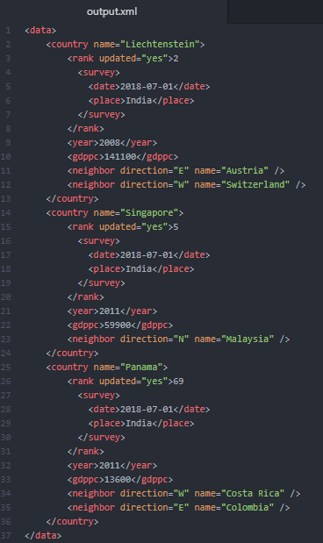
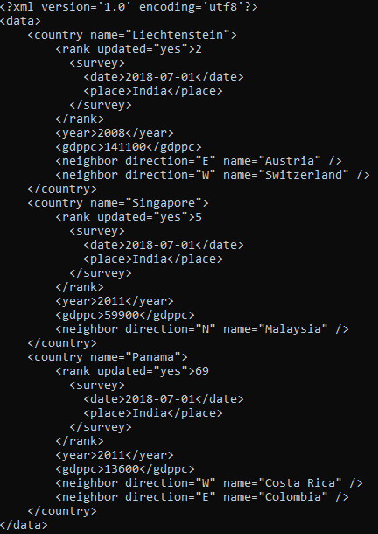

Parsing XML using Python
Here is the output.xml generated.
We can also display the content of a XML file in console using print statement.

Slide 27
Handling JSON using Python

Slide 28
Handling JSON using Python
JSON (stands for “JavaScript Object Notation”) is a text-based format which facilitates data interchange between diverse applications.
Its simplicity and flexibility has led to widespread usage, especially in preference to earlier XML-based formats.
The most common JSON entity that you will encounter is an object: a set of key-value.

Slide 29
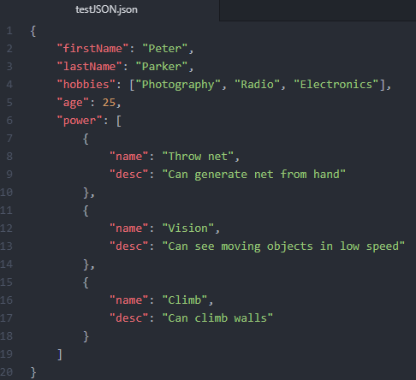
Handling JSON using Python
Python comes with a built-in package called json for encoding and decoding JSON data.
The process of encoding JSON is usually called serialization.
Deserialization is the reverse process of decoding data that has been stored or delivered in the JSON standard.
A JSON file

Slide 30
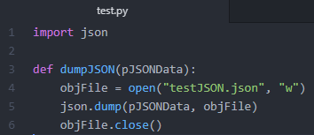
Handling JSON using Python
Serialization Example:
That dump() takes two positional arguments: (1) the data object to be serialized, and (2) the file-like object to which the bytes will be written.
testJSON.json

Slide 31
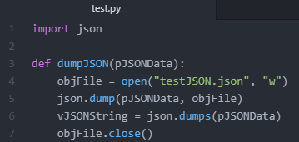
Handling JSON using Python
Serialization Example:
That dump() takes two positional arguments: (1) the data object to be serialized, and (2) the file-like object to which the bytes will be written.
Serialized JSON can also be stored in our program, you could write it to a native Python str object, that is done by dumps().
The dumps() takes one argument and returns the JSON in string format.

Slide 32
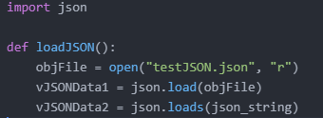
Handling JSON using Python
Deserialization Example:
In the json library, you’ll find load() and loads() for turning JSON encoded data into Python objects.
We can use request module to fetch JSON from the API and store into a file and a variable.
import requests
response = requests.get(<URL>)
json = response.json()

Slide 33
Activities
Write a email sending module to send notification about the exceptions/errors to development team.
Write a Multi-Threaded program to execute two functions one will parse the supplied XML document to find each ‘country’ element along with its sub-elements and put in separate XML files (name the file countryname.xml), and another function will read the parse the same file and generate a paragraph (multiline string) as Tag|Attributes|Text\n and put in a separate text file (countryname.txt).
Take input from user and build a employee detail JSON empid, fname, lname, sal, dob, doj, projname. Store JSON in a (.json) file. Write another function to convert the supplied XML doc to a compatible JSON file.

Slide 34
Summary
Multi-Threading programming solves the purpose to run functions simultaneously. The threading module helps to spawn threads in Python.
The join() function make the main thread wait for the child threads to complete.
The smtplib module is required to send emails from Python script, which uses the SMTP.
We can test (debug) our emails using smtpd module, without sending emails.
The xml.etree.ElementTree module provides the functions to parse, modify XML documents.
The json module provides the functions to deal with JSON data.

Slide 35
Check on learning
We have learnt how to write multi-threading programs using Python.
We also have learnt how to send emails from Python script using SMTP (smtplib).
We can test (debug) our emails using smtpd module, without sending emails.
We learnt how to parse an XML document, modify the content, add new element & generate new XML.
We also learnt how to handle JSON using Python.

Slide 36
Links
https://docs.python.org/3/library/threading.html
https://docs.python.org/3/library/smtplib.html
https://docs.python.org/3/library/xml.etree.elementtree.html
https://docs.python.org/3/library/json.html

Slide 37

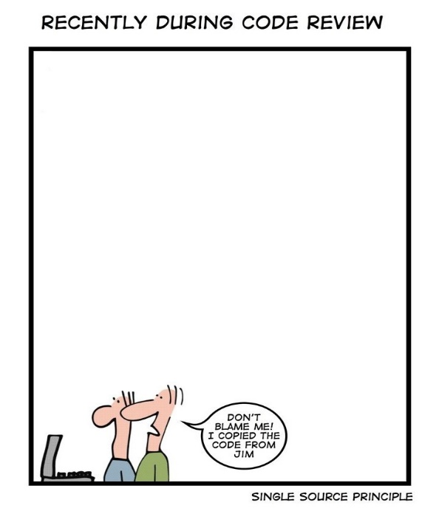
Hello, World! This is.. S
Are you still copying? Let us write functions… put them into modules… build our own package, make version control & reuse the effort.

Slide 38
Thank you
Indranil Paul (424241)
Python Developer
Banking & Financial Services | WMC Account

