Slide 1
Statistics

Slide 2
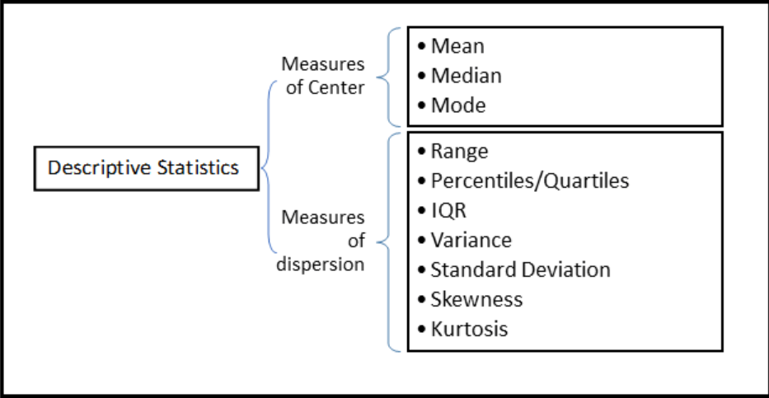
Descriptive Statistics

Slide 3
statistics
1.Types of statistics -1.Descriptive 2.Interferential.
2. Measure of Central Tendency – 1.Mean 2.Median 3. Mode
3.Sample is small subset of Population.
4.Measures of Dispersion- 1.Variance 2.Standard Deviation
5.Alternative formula for variance -
=Avg (sum of squares of numbers) – square(Mean) ie. E(x^2) –square(E(x)) .
6.Random Variable(X) – It is a function that maps random process into a number.
7.Types of R.V -1.Discrete 2.Continous –Exact Quantity.
8.Continous random variable – Probability Distribution Function.

Slide 4
Binomial Distribution.
1.The binomial distribution determines the probability of observing a specified number of successful outcomes in a specified number of trials.
2. Expected value- E(X) =Sum(X* P(X)) =Arithmetic Mean .
3.Expected value (formula 2) – E(x) =n*P // n=Trials,P=Probability of Success//
4.If n tends to infinity Binomial turns to poisson distribution.
5.Eg. Fair dice thrown ,coin is tossed.

Slide 5
Poisson Distribution
The Poisson distribution is the discrete probability distribution of the number of events occurring in a given time period, given the average number of times the event occurs over that time period.
It is used when no. of trials are large.
Eg.no. of cars passing per hour ,no. of customers visiting hotel.
P(x)= exp(-l)*(l^k)/(k!) (l=Lambda=Expected value)

Slide 6
Normal distribution
P(x) = (o.3989/D)* exp(-0.5 * (m^2))
Where m= (x- mean) / D // D= Standard deviation // -(1)
It is used to approximate the Binomial Disribution.
Eg. Distribution of weight ,height etc.
CDF
Z-scores - How many standard Deviation away from Mean.
Z= m (from (1))(Independent of Distribution type)
Empirical Rule- 68-95-99.7 corresponding to first ,second and third standard deviation respectively.
Note -For standard normal distribution mean=0,std. dev.=1.

Slide 7
Central limit Theorem
An essential component of the Central Limit Theorem is that the average of your sample means will be the population mean.
Positive Skew Distribution – If long tail of curve is going in positive x direction known as Positive Skew Distribution .Mean is on rightmost side of peak of distribution.
Negative Skew Distribution – If long tail of curve is going in positive x direction known as Negative Skew Distribution . Mean is on leftmost side of peak of distribution.
Kurtosis – Ratio of 4th moment to square moment in statistics. It gives idea about how pointed peak of Distribution is.

Slide 8
Measure of SKEWNESS
Pearson’s Coefficient of Skewness = (Mean –Mode)/(standard deviation).
-VE Sign indicated it is negatively skewed and Vice versae.
Variance of sample mean =Variance of Population /sample size.(also known as
Standard error of mean)

Slide 9
Bernoulli Distribution
Mean =n*p //P= Probability of success.//
Variance= n(p)(1-p).
A Bernouilli distribution is a discrete probability distribution for a Bernouilli trial — a random experiment that has only two outcomes (usually called a “Success” or a “Failure”).
Applications-
Coin tosses: record how many coins land heads up and how many land tails up.
Births: how many boys are born and how many girls are born each day.
Rolling Dice: the probability of a roll of two die resulting in a double six.

Slide 10
Hypothesis Testing and p-values
A small p (≤ 0.05), reject the null hypothesis. This is strong evidence that the null hypothesis is invalid.
A large p (> 0.05) means the alternate hypothesis is weak, so you do not reject the null.

Slide 11
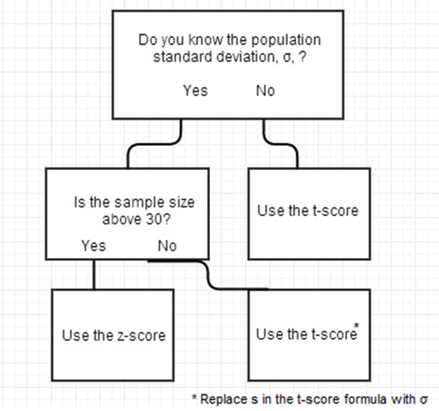
Z vs T statistics

Slide 12
Type I ERROR
It is better to increase confidence interval upto 95-99 % to avoid Type I error.
WE have to reject null hypothesis though it is true because of Type one error.
Y= 7.43*x^3+3.61*x+ 5*log(x)+2.235

Slide 13
PROPERTIES
.If X and Y are two random variables which are completely independent
and z=x+y and A=x-y
1.E(z)= E(x)+E(y) and E(A)=E(x) –E(y)
2.var(z) = var(x)+var(y) and var(A)= var(x)+ var(y)

Slide 14
R^2 – Measure of fit
R^2 = 1- sum(((y –yn)/(y –mean(y)))
R^2 when tends to 1 implies good fit.

Slide 15
Covariance and regression line
Cov(x,y) =E(xy) – E(x)*E(y)
Ie.m =cov(x,y)/cov(x,x) for y= mx+b

Slide 16
CHI-SQUARE DISTIBUTION
What is a Chi Square Test?
There are two types of chi-square tests. Both use the chi-square statistic and distribution for different purposes:
A chi-square goodness of fit test determines if a sample data matches a population. For more details on this type, see: Goodness of Fit Test.
A chi-square test for independence compares two variables in a contingency table to see if they are related. In a more general sense, it tests to see whether distributions of categorical variables differ from each another.
A very small chi square test statistic means that your observed data fits your expected data extremely well. In other words, there is a relationship.
A very large chi square test statistic means that the data does not fit very well. In other words, there isn’t a relationship.

Slide 17
Continued….
Chi-square = sum( (observed-expected value)^2)/expected value)
Note If you have n datapoints then degress of freedom =n-1
If chi-square is greater than critical value then our fit is not good.
In case of tabular data, degress of freedom = (r-1)*(c-1)
From alpha level and degrees of frredom we determine the critical chi square value.

Slide 18
Correlation
Correlation(X,Y)= Covariance(X,Y)/sqrt(variance(X)*variance(Y))
-1<=Correlation(X,Y)<=1 ie.Normalized version of Covariance

Slide 19
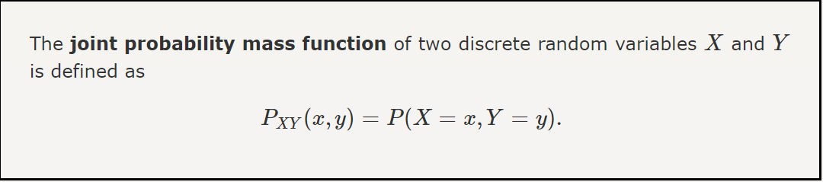
Joint distributions

Slide 20
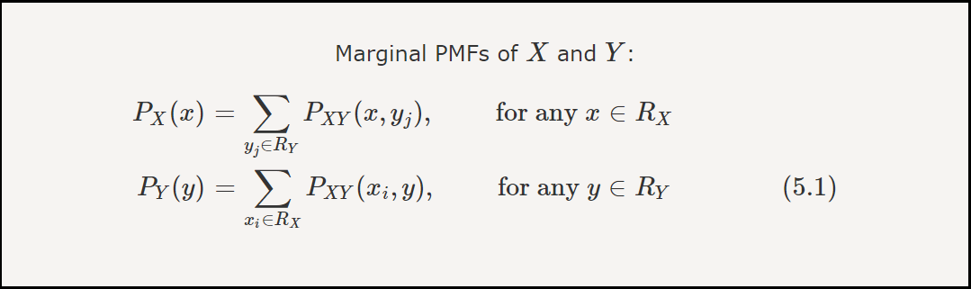
Marginal distributions

Slide 21
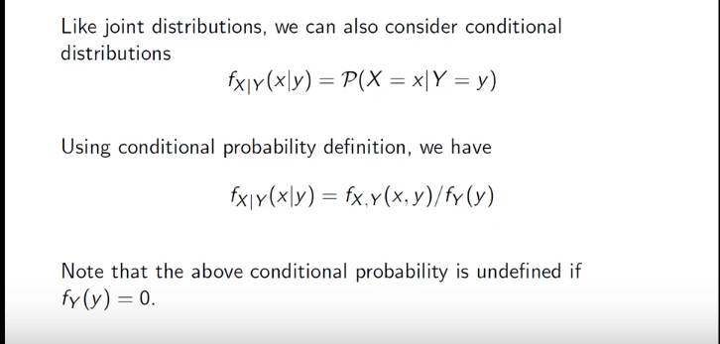
Conditional distributions

Slide 22
Geometric DISTRIBUTION
The geometric distribution represents the number of failures before you get a success in a series of Bernoulli trials. This discrete probability distribution is represented by the probability density function:
f(x) = (1 − p)x − 1p
E(X) =1/p
Var(X)= 1-p/p^2

Slide 23
Uniform distribution
E(x)= (a+b)/2 #[a,b] –Range for uniform distribution
VAR(X)= (a-b)^2/12

