Slide 1
collected data and key-observations (in all graphs, vert. axes values are in mm)
Parts:
Car bonnet
GE blade
Composite mold
Fender
No. of Perturbations: (total 67 cases/data)
traj 1: 13
traj 2,3 : 4
traj 4: 5
traj 5: 5
traj 6: 5
traj 7: 5
traj 8: 5
traj 9: 5
traj 10: 5
traj 11: 5
Trajectories on each part
Car bonnet : (4 trajectories)
traj 1 (placement 1), traj 2 to 4(placement 2)
2. GE blade: (3 trajectories)
traj 5 to 7
Composite mold: (3 trajectories)
traj 8 to 10
4. Fender: (3 trajectories)
traj 11 to 13

Slide 2
comparing effects of weights
(mean(x)_max(y) = (x/100)*mean_d_error + (y/100)*max_d_error
(Error function for optimization)

Slide 3
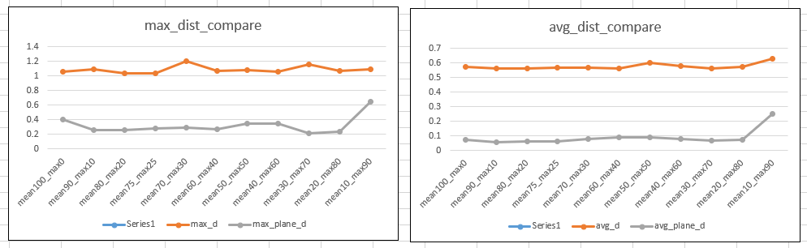
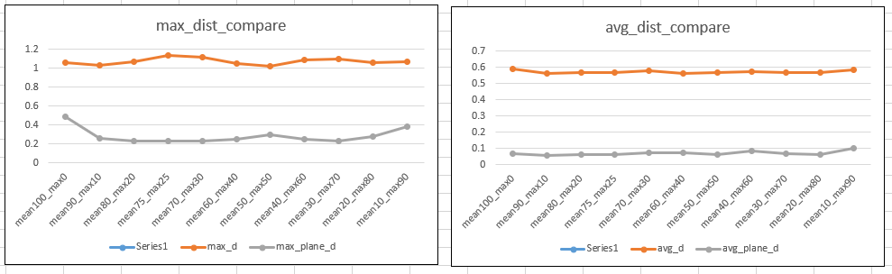
Car bonnet_placement1
Case1: comparing effects of weights
Case3: comparing effects of weights

Slide 4
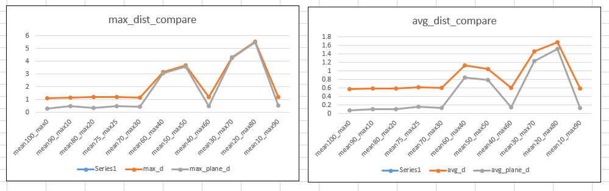
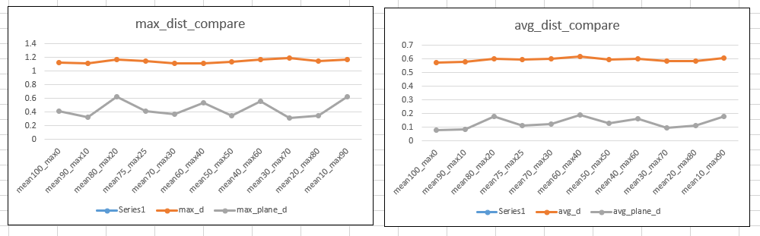
Car bonnet_placement2
Case14: comparing effects of weights
Case18: comparing effects of weights

Slide 5
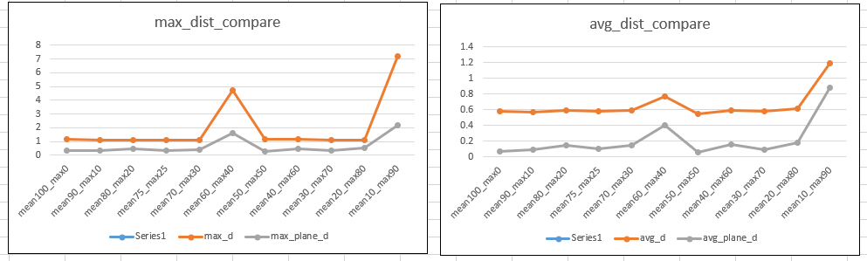
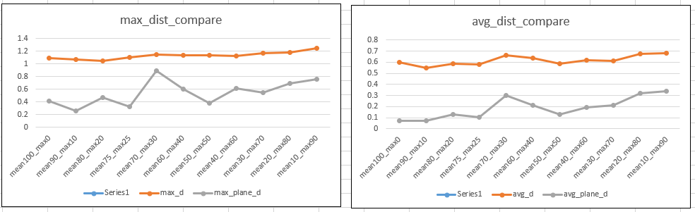
GE blade
Case23: comparing effects of weights
Case30: comparing effects of weights

Slide 6
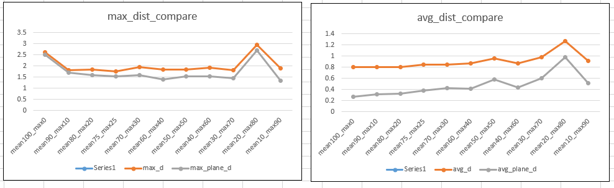
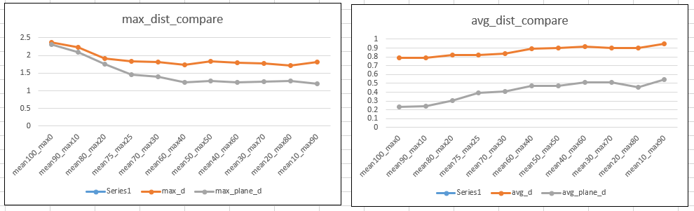
Composite_mold
Case38: comparing effects of weights
Case50: comparing effects of weights

Slide 7
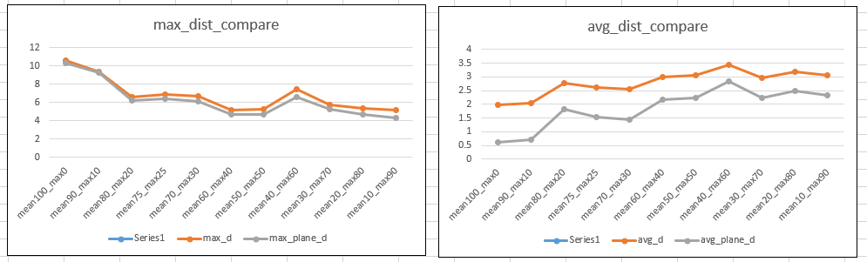
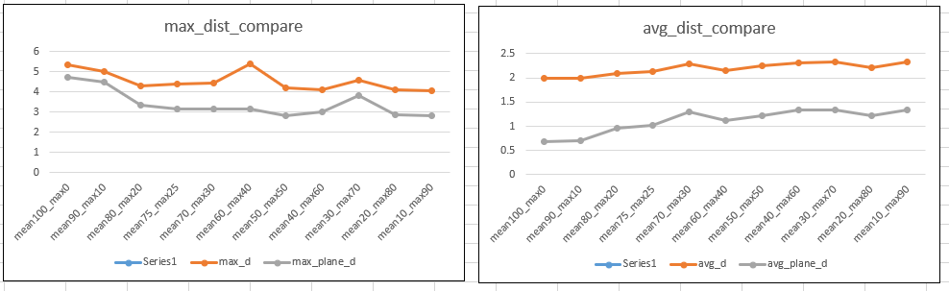
fender
Case53: comparing effects of weights
Case61: comparing effects of weights

Slide 8
Repeatability Check

Slide 9
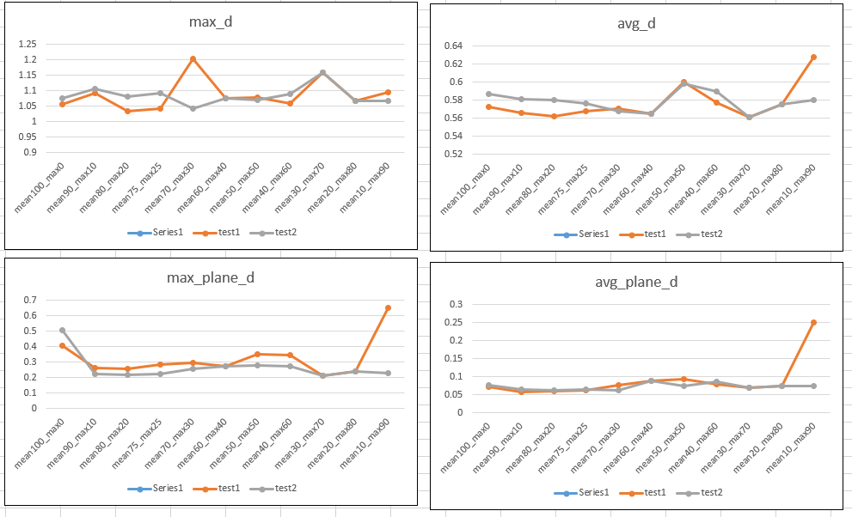
Car_bonnet – case1

Slide 10
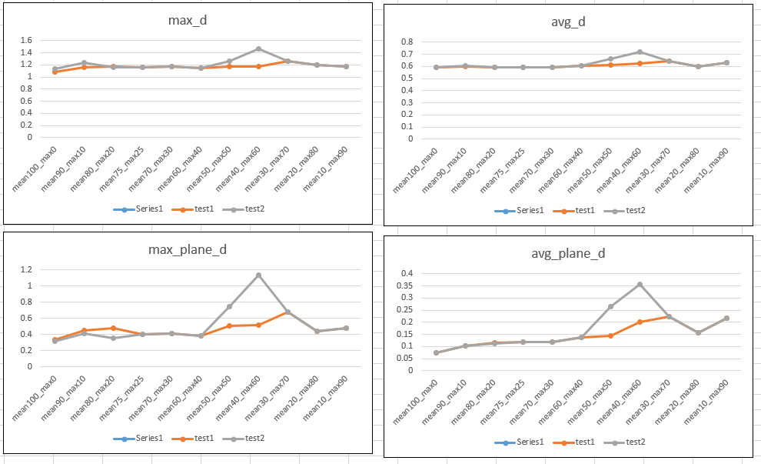
Car_bonnet – case15

Slide 11
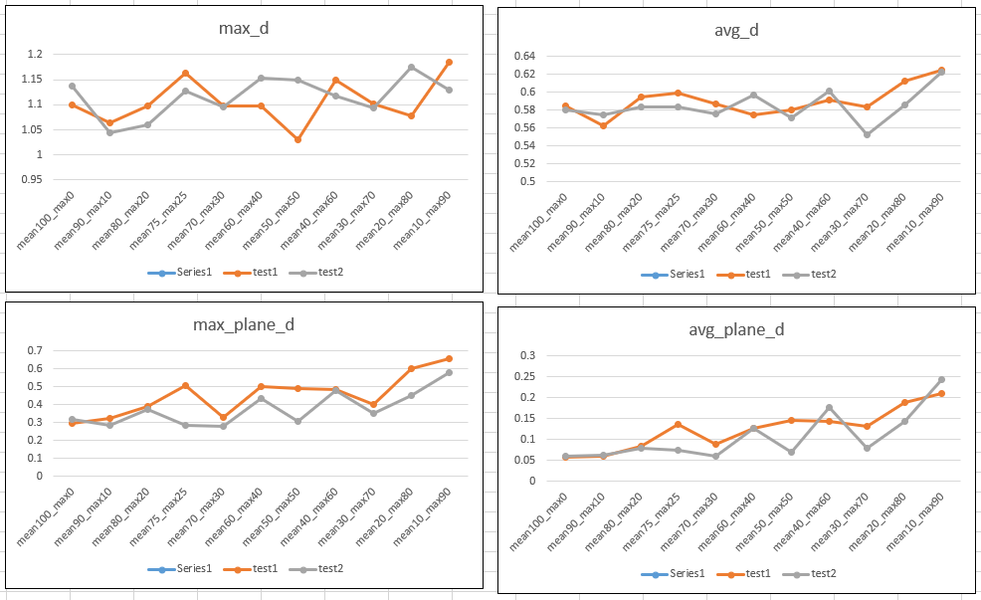
GE_blade – case 25

Slide 12
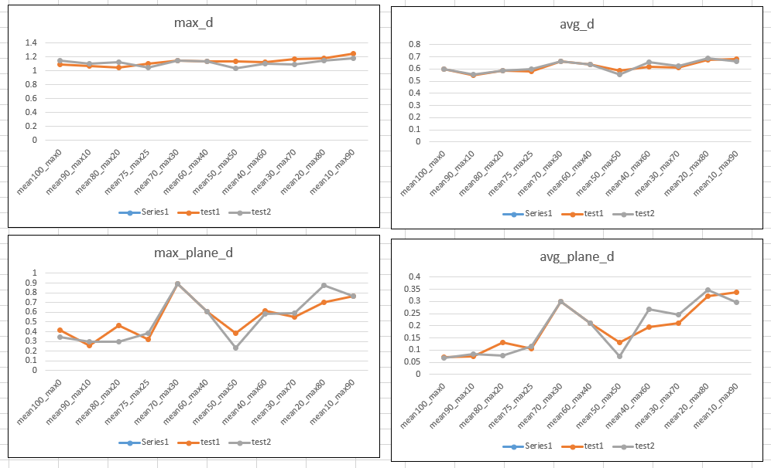
GE_blade – case 30

Slide 13
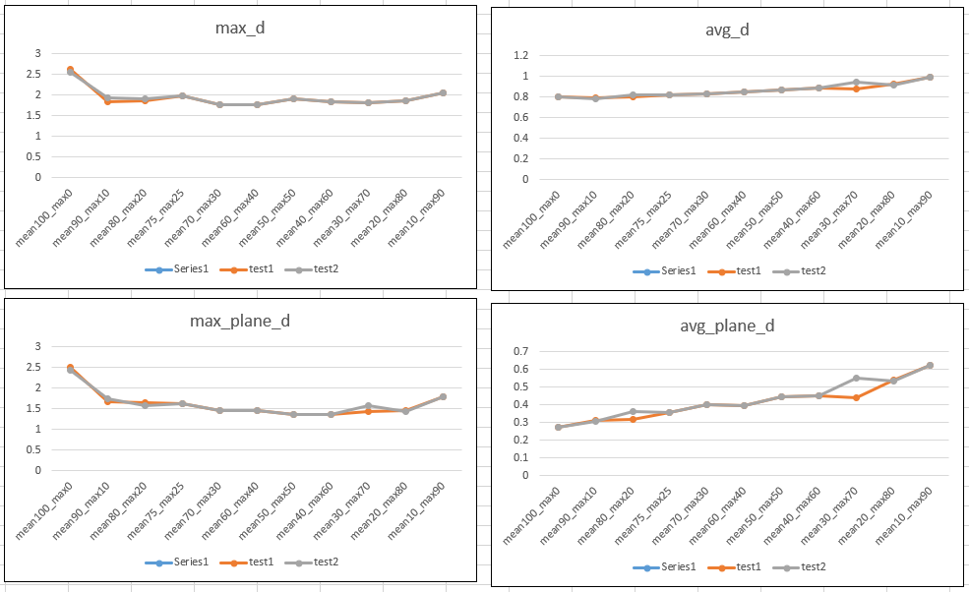
Composite_mold – case 40

Slide 14
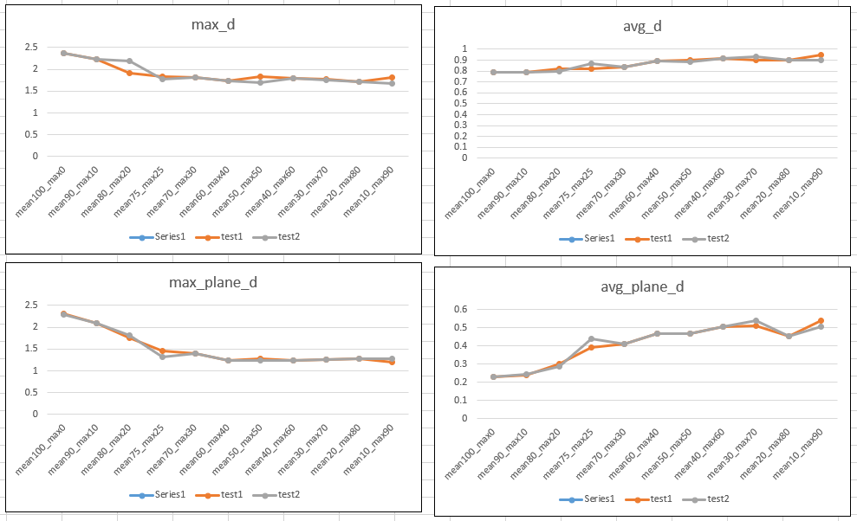
Composite_mold – case 50

Slide 15
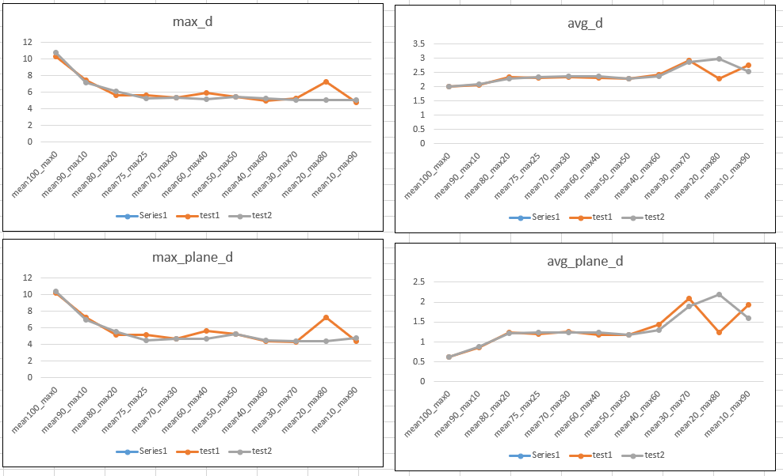
Fender – case 55

Slide 16
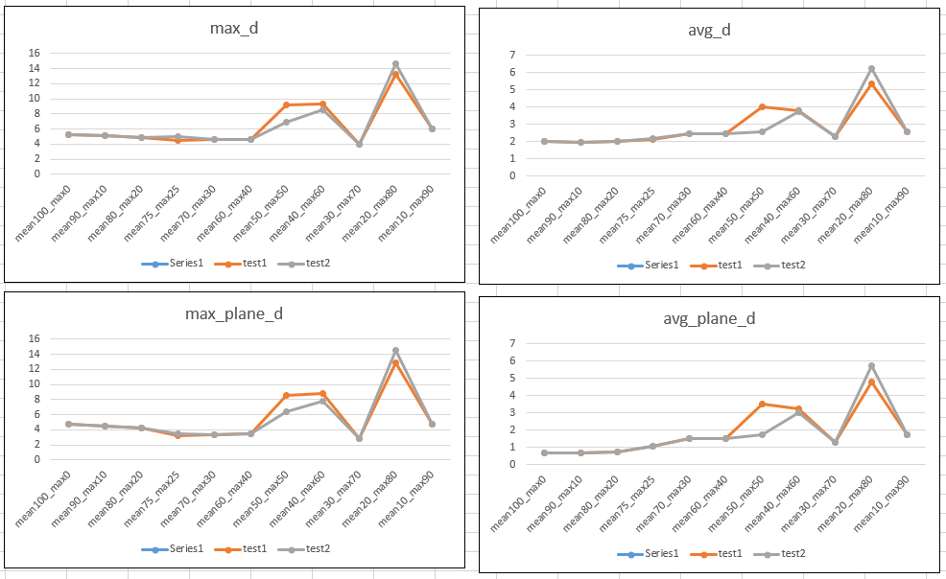
Fender – case 60

Slide 17










Repeatability Check –
Difference between 2 Transformation Matrices taken under same error function and same trajectory.
Car bonnet-case 1
100avg+0max
90avg+10max
80avg+20max
70avg+30max
60avg+40max
50avg+50max
40avg+60max
30avg+70max
20avg+80max
10avg+90max

Slide 18










Repeatability Check – Transformation Matrix
GE blade-case 25
100avg+0max
90avg+10max
80avg+20max
70avg+30max
60avg+40max
50avg+50max
40avg+60max
30avg+70max
20avg+80max
10avg+90max

Slide 19







Repeatability Check – Transformation Matrix
Composite mold-case 40
100avg+0max
90avg+10max
80avg+20max
70avg+30max
60avg+40max
50avg+50max
40avg+60max
30avg+70max
20avg+80max
10avg+90max

Slide 20










Repeatability Check – Transformation Matrix
fender-case 55
100avg+0max
90avg+10max
80avg+20max
70avg+30max
60avg+40max
50avg+50max
40avg+60max
30avg+70max
20avg+80max
10avg+90max

Slide 21
Reduction in error function

Slide 22
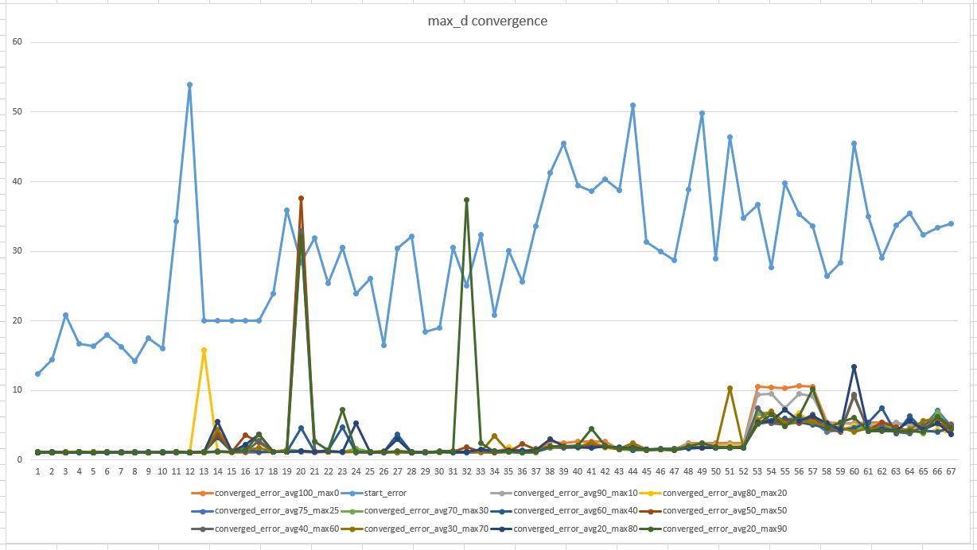

Slide 23
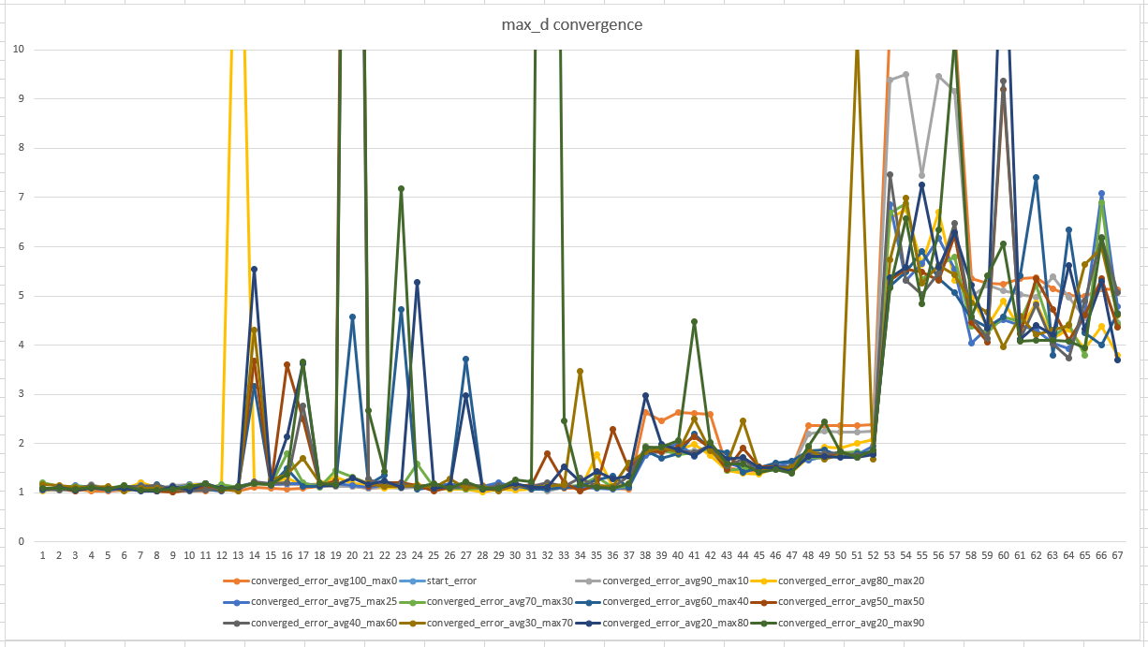

Slide 24
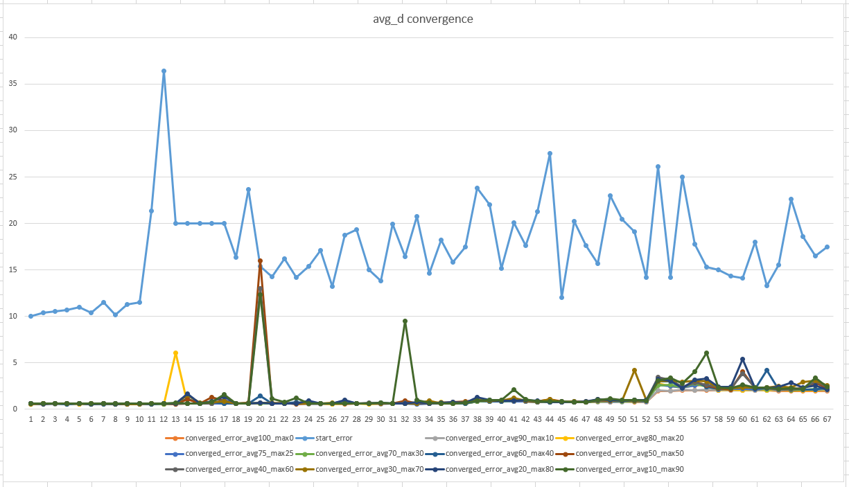

Slide 25
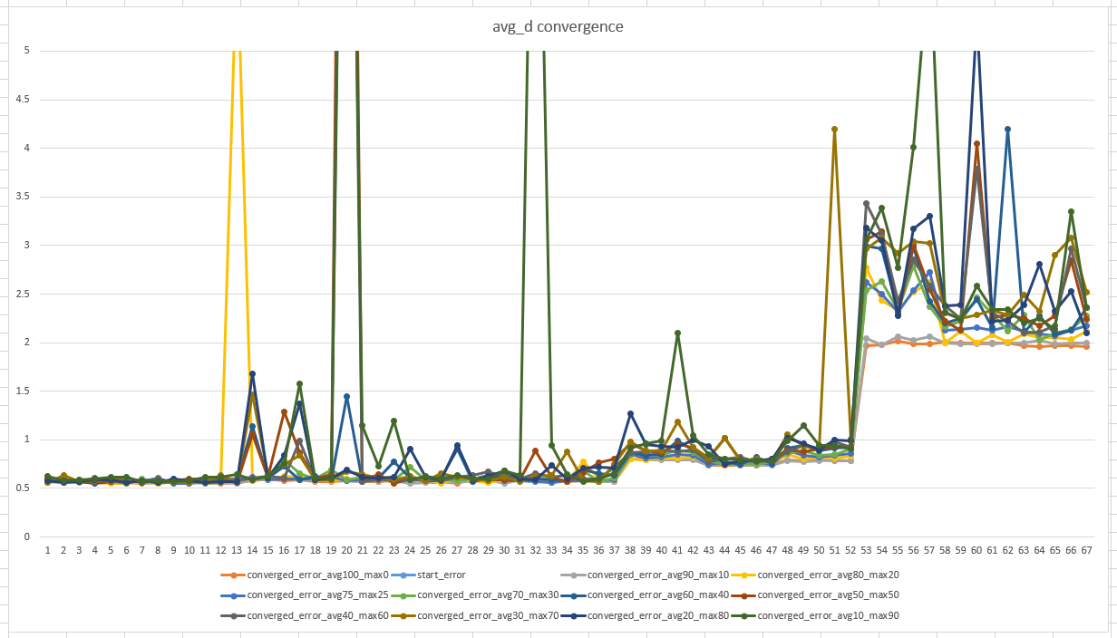

Slide 26
Error convergence distribution for all parts
(avg75_max25 case)

Slide 27
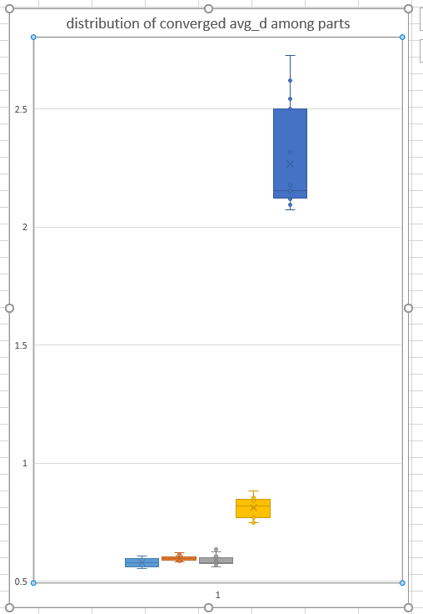
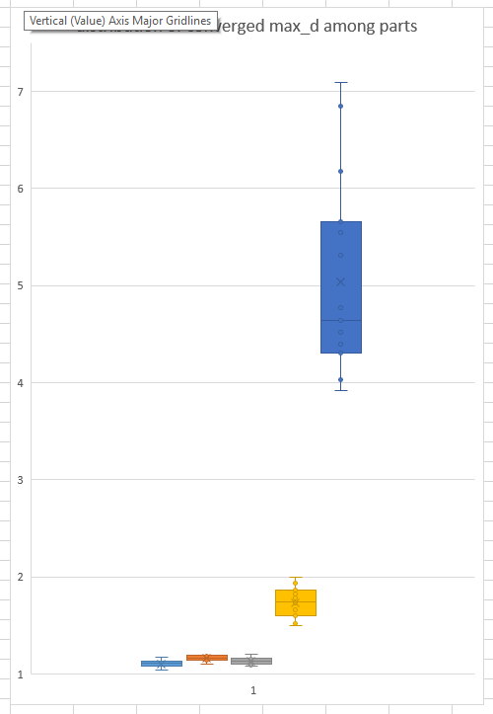

Slide 28
key-observations
Plane_d significantly reduced as compared to normal d
Change in avg_d (plane_d vs d) is more than change in max_d
In car bonnet…change in max_d is also more
In fender and composite_mold distance change is not that great
Repeatability check
Converged errors are almost same at all places (all max, avg, max_plane, avg_plane)
In some cases, when weight on max is high, errors are slightly deviating
In transformations, many of translations are repeatable under 1mm
In some case, specially towards high weight on max_d side, matrix is not that repeatable.
Reduction in error value (comparing max and avg distance)
Almost all errors (both avg and max dist) started with value more than 10-15 mm (some cases even more than 30 mm )
For all reading max_d converged to around 1 mm (except fender which is around 5 mm)
For all reading avg_d converged to around 0.5 mm (except fender which is arounf 2 mm)
Reading from avg70_max30 is good for max_d
Readings from hight weight on avg and low weight on max are better for avg_d
Converge of error is nice…except fender

