Slide 1
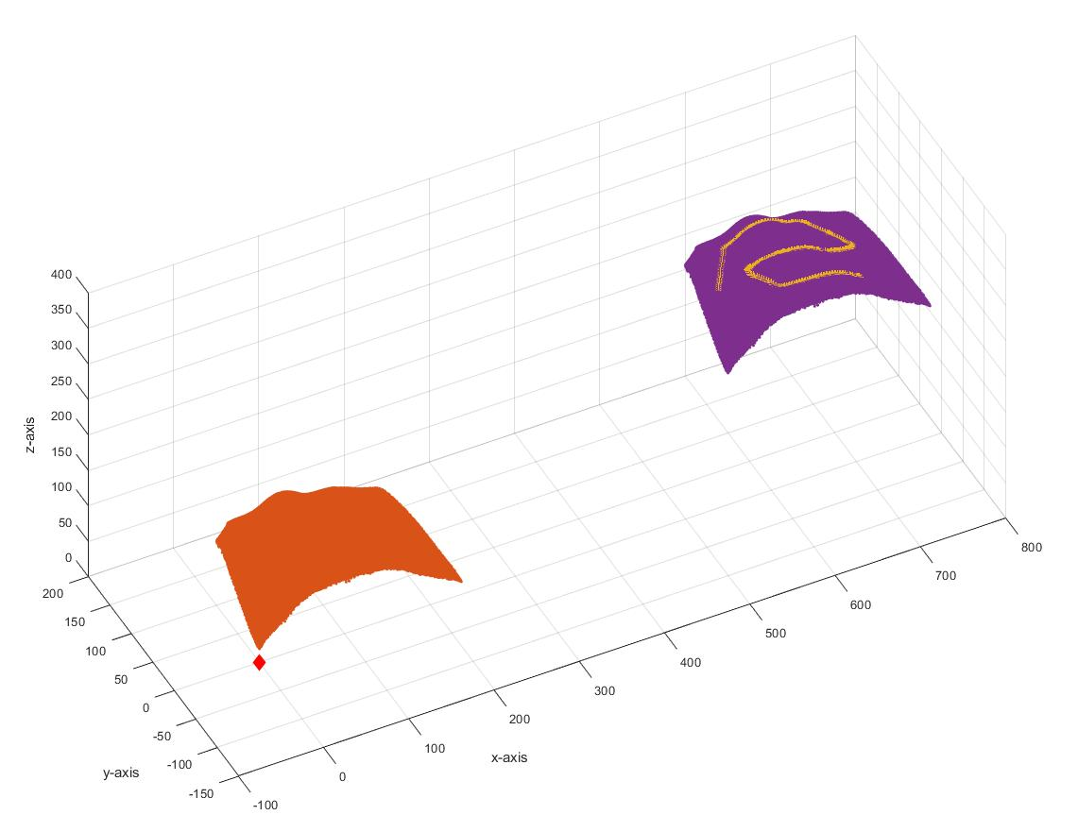
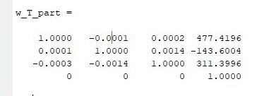
True Transformation
Error max_dist: 1.0059mm
Error mean_dist: 0.6221 mm

Slide 2
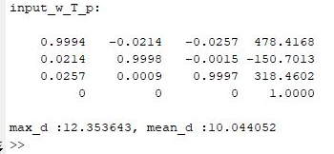
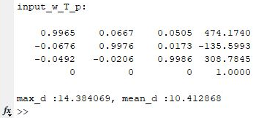
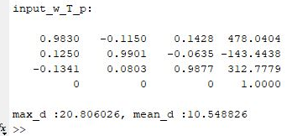
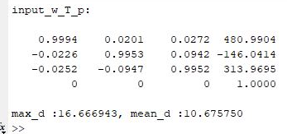
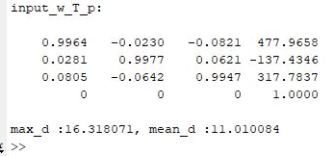
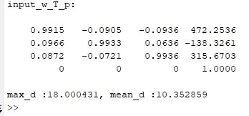
Perturbing true transformation to get start points for icp (10 cases)

Slide 3
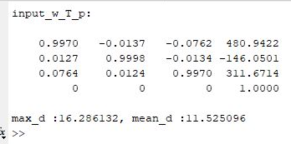
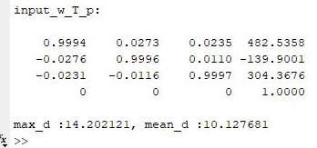
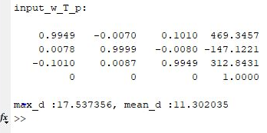
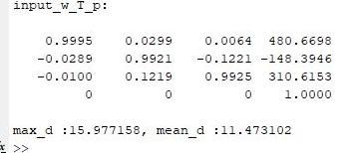
Perturbing true transformation to get start points for icp (10 cases)

Slide 4
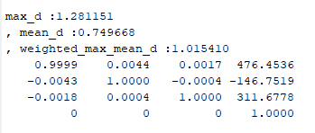
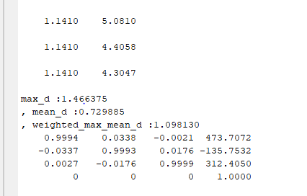
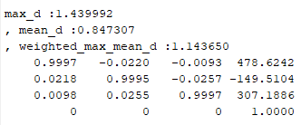
CASE 1
Final transformation after applying icp
Error: (1*max_d + 1*mean_d)/2
(stopping criteria: max running time = 2 min)
True Transformation
Error max_dist: 1.0059mm
Error mean_dist: 0.6221 mm
Input transformation
Solution 1: Final Transformation
Solution 2: Final Transformation
Solution 3: Final Transformation

Slide 5
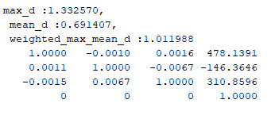
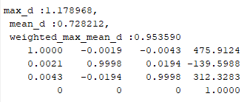
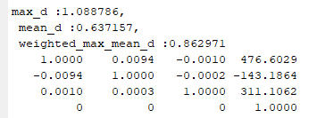
CASE 2
Final transformation after applying icp
Error: (1*max_d + 1*mean_d)/2
(stopping criteria: max running time = 2 min)
True Transformation
Error max_dist: 1.0059mm
Error mean_dist: 0.6221 mm
Input transformation
Solution 1: Final Transformation
Solution 2: Final Transformation
Solution 3: Final Transformation

Slide 6
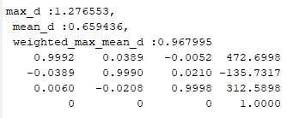
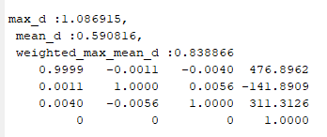
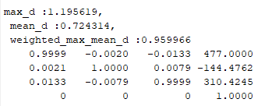
CASE 3
Final transformation after applying icp
Error: (1*max_d + 1*mean_d)/2
(stopping criteria: max running time = 2 min)
True Transformation
Error max_dist: 1.0059mm
Error mean_dist: 0.6221 mm
Input transformation
Solution 1: Final Transformation
Solution 2: Final Transformation
Solution 3: Final Transformation

Slide 7
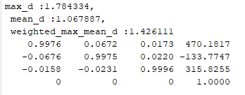
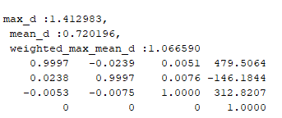
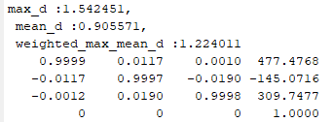
CASE 4
Final transformation after applying icp
Error: (1*max_d + 1*mean_d)/2
(stopping criteria: max running time = 2 min)
True Transformation
Error max_dist: 1.0059mm
Error mean_dist: 0.6221 mm
Input transformation
Solution 1: Final Transformation
Solution 2: Final Transformation
Solution 3: Final Transformation

Slide 8
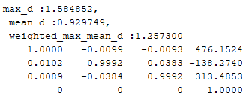
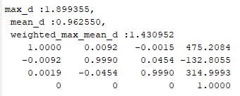
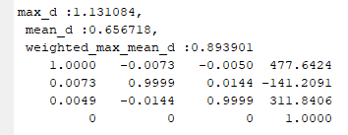
CASE 5
Final transformation after applying icp
Error: (1*max_d + 1*mean_d)/2
(stopping criteria: max running time = 2 min)
True Transformation
Error max_dist: 1.0059mm
Error mean_dist: 0.6221 mm
Input transformation
Solution 1: Final Transformation
Solution 2: Final Transformation
Solution 3: Final Transformation

Slide 9
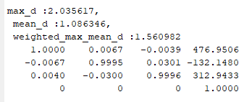
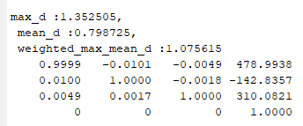
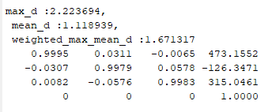
CASE 6
Final transformation after applying icp
Error: (1*max_d + 1*mean_d)/2
(stopping criteria: max running time = 2 min)
True Transformation
Error max_dist: 1.0059mm
Error mean_dist: 0.6221 mm
Input transformation
Solution 1: Final Transformation
Solution 2: Final Transformation
Solution 3: Final Transformation

Slide 10
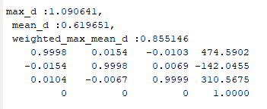
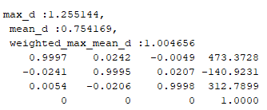
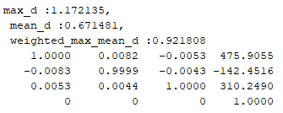
CASE 7
Final transformation after applying icp
Error: (1*max_d + 1*mean_d)/2
(stopping criteria: max running time = 2 min)
True Transformation
Error max_dist: 1.0059mm
Error mean_dist: 0.6221 mm
Input transformation
Solution 1: Final Transformation
Solution 2: Final Transformation
Solution 3: Final Transformation

Slide 11
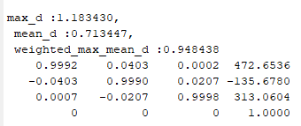
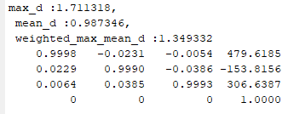
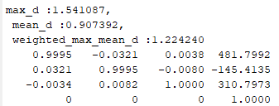
CASE 8
Final transformation after applying icp
Error: (1*max_d + 1*mean_d)/2
(stopping criteria: max running time = 2 min)
True Transformation
Error max_dist: 1.0059mm
Error mean_dist: 0.6221 mm
Input transformation
Solution 1: Final Transformation
Solution 2: Final Transformation
Solution 3: Final Transformation

Slide 12
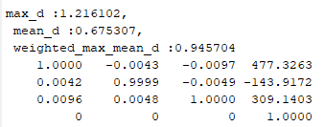
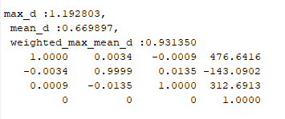
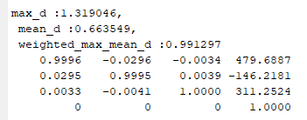
CASE 9
Final transformation after applying icp
Error: (1*max_d + 1*mean_d)/2
(stopping criteria: max running time = 2 min)
True Transformation
Error max_dist: 1.0059mm
Error mean_dist: 0.6221 mm
Input transformation
Solution 1: Final Transformation
Solution 2: Final Transformation
Solution 3: Final Transformation

Slide 13
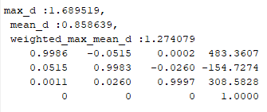
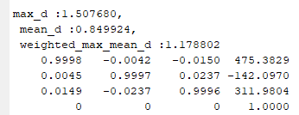
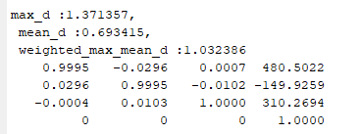
CASE 10
Final transformation after applying icp
Error: (1*max_d + 1*mean_d)/2
(stopping criteria: max running time = 2 min)
True Transformation
Error max_dist: 1.0059mm
Error mean_dist: 0.6221 mm
Input transformation
Solution 1: Final Transformation
Solution 2: Final Transformation
Solution 3: Final Transformation

Slide 14
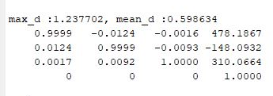
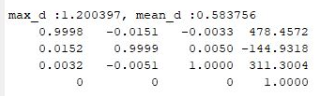
CASE 1
Final transformation after applying icp
Error: mean_d
(stopping criteria: Error<0.6mm or
max running time = 2 min)
True Transformation
Error max_dist: 1.0059mm
Error mean_dist: 0.6221 mm
Input transformation
Solution 1: Final Transformation
Solution 2: Final Transformation

Slide 15
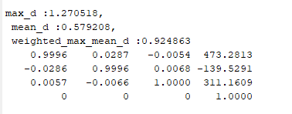
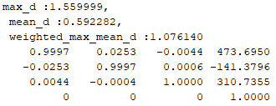
CASE 2
Final transformation after applying icp
Error: mean_d
(stopping criteria: Error<0.6mm or
max running time = 2 min)
True Transformation
Error max_dist: 1.0059mm
Error mean_dist: 0.6221 mm
Input transformation
Solution 1: Final Transformation
Solution 2: Final Transformation

Slide 16
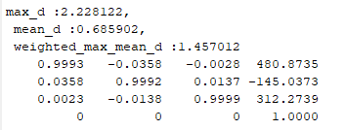
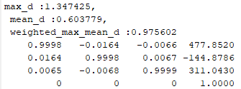
CASE 3
Final transformation after applying icp
Error: mean_d
(stopping criteria: Error<0.6mm or
max running time = 2 min)
True Transformation
Error max_dist: 1.0059mm
Error mean_dist: 0.6221 mm
Input transformation
Solution 1: Final Transformation
Solution 2: Final Transformation

Slide 17
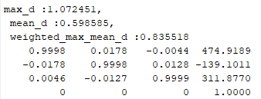
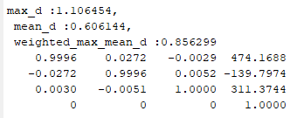
CASE 4
Final transformation after applying icp
Error: mean_d
(stopping criteria: Error<0.6mm or
max running time = 2 min)
True Transformation
Error max_dist: 1.0059mm
Error mean_dist: 0.6221 mm
Input transformation
Solution 1: Final Transformation
Solution 2: Final Transformation

Slide 18


CASE 5
Final transformation after applying icp
Error: mean_d
(stopping criteria: Error<0.6mm or
max running time = 2 min)
True Transformation
Error max_dist: 1.0059mm
Error mean_dist: 0.6221 mm
Input transformation
Solution 1: Final Transformation
Solution 2: Final Transformation

Slide 19


CASE 6
Final transformation after applying icp
Error: mean_d
(stopping criteria: Error<0.6mm or
max running time = 2 min)
True Transformation
Error max_dist: 1.0059mm
Error mean_dist: 0.6221 mm
Input transformation
Solution 1: Final Transformation
Solution 2: Final Transformation

Slide 20


CASE 7
Final transformation after applying icp
Error: mean_d
(stopping criteria: Error<0.6mm or
max running time = 2 min)
True Transformation
Error max_dist: 1.0059mm
Error mean_dist: 0.6221 mm
Input transformation
Solution 1: Final Transformation
Solution 2: Final Transformation

Slide 21


CASE 8
Final transformation after applying icp
Error: mean_d
(stopping criteria: Error<0.6mm or
max running time = 2 min)
True Transformation
Error max_dist: 1.0059mm
Error mean_dist: 0.6221 mm
Input transformation
Solution 1: Final Transformation
Solution 2: Final Transformation

Slide 22


CASE 9
Final transformation after applying icp
Error: mean_d
(stopping criteria: Error<0.6mm or
max running time = 2 min)
True Transformation
Error max_dist: 1.0059mm
Error mean_dist: 0.6221 mm
Input transformation
Solution 1: Final Transformation
Solution 2: Final Transformation

Slide 23


CASE 10
Final transformation after applying icp
Error: mean_d
(stopping criteria: Error<0.6mm or
max running time = 2 min)
True Transformation
Error max_dist: 1.0059mm
Error mean_dist: 0.6221 mm
Input transformation
Solution 1: Final Transformation
Solution 2: Final Transformation

