Slide 1

Implementation of ICP Variants
Pavan Ram Piratla
Janani Venkateswaran

Slide 2
Outline
Introduction
Comparison
Individual ICP stages
Parameters for comparison
Issues
Conclusion
Results

Slide 3
Introduction
Implementation and comparison
Original ICP algorithm
Modified variant (more efficient)
Algorithm modified in a couple of stages

Slide 4
Comparison
Besl and McKay [92] method for registering 3D shapes
Based on iteratively finding the nearest point to a given point on a model
Variation based on a comparison paper by Rusinkiewicz and Levoy [ 2001]

Slide 5
Stages
Point selection
Point matching
Weighting
Outlier removal
Error metric
Error minimization

Slide 6
Parameters
Random sampling of points on the surface
Most computationally expensive step: finding the closest point
n points : single point query complexity of O(n).
m samples: Complexity is O(mn)
The closest-point can be calculated with more efficiency by using other data structures like a kd tree or by caching

Slide 7
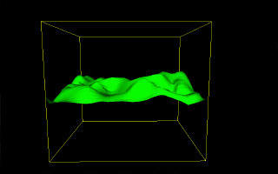
Octree
Efficient version:
Simplified implementation of an Octree
An octree works by subdividing the space into cubes

Slide 8
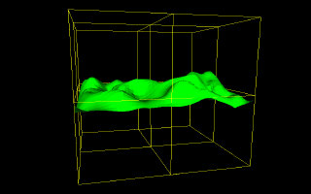
Octree
Root node: Subdivided into 8 parts

Slide 9
Implementation
Using the octree, we can prune large areas without needing to consider them at all
When the cube we consider has no triangles, we disregard that section of the octree
Complexity is reduced drastically: the octree has a constant lookup time

Slide 10
Point-to-point matching
We perform closest-point matching by using a point-to-point metric
The ICP algorithm requires preprocessing to generate an octree
The 1D representation accumulates information
Much faster than the initial ICP algorithm using octree

Slide 11
More Parameters
Weighting: Does not substantially affect performance
Rejection of outliers: Decreases speed and performance
Error metric: We use the l₂ distance as the error metric
Minimize the ε value at each iteration
Terminating condition: RMS residual error

Slide 12
Alternate issues
Speed increase using closest-point caching
If the termination threshold is small, caching significantly improves performance
Fastest surface point computation can be used

Slide 13
Advantages and disadvantages
Works much faster
Less computation
Requires preprocessing for the octree
Trade-off is worth it

Slide 14
Results
Ran the iterations on the Stanford bunny
Used the simplified octree to find the closest point efficiently
Randomly sampled points on it
Iterations converge quickly
Results will be displayed at the end of the presentation

Slide 15
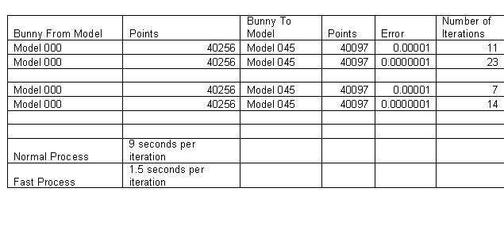

Slide 16
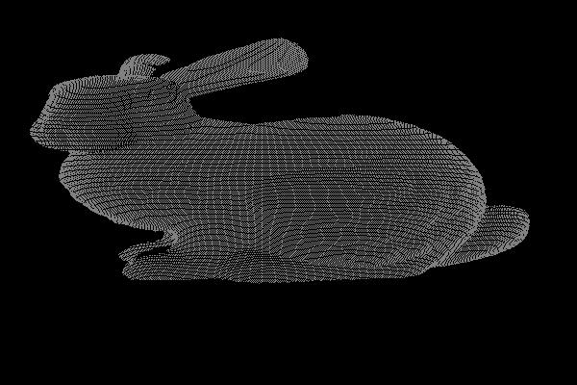
Bunny Model 000

Slide 17
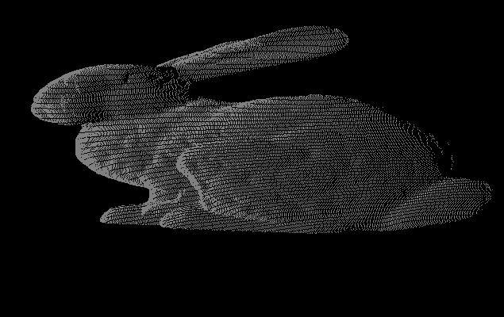
Bunny Model 045

Slide 18
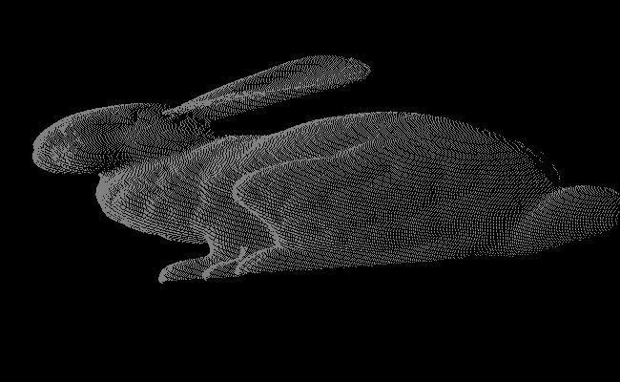
Bunny Model 0045

Slide 19
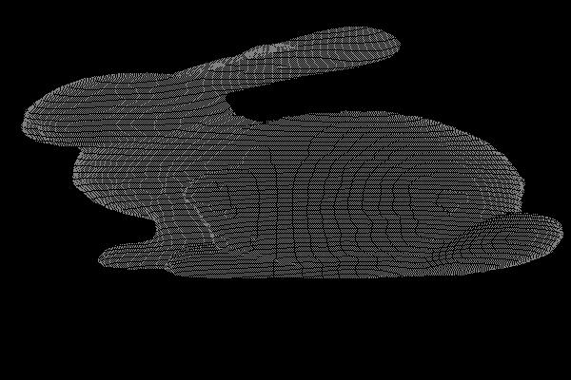
Bunny Model 0045 Fast

Slide 20
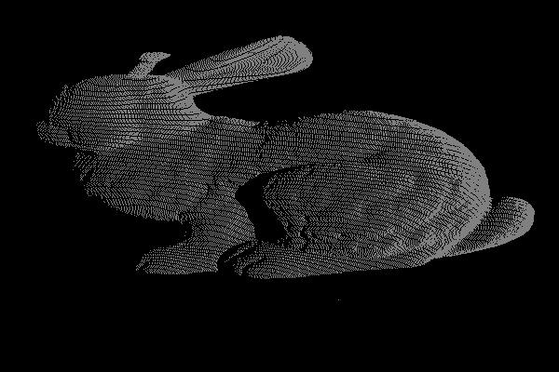
Bunny Model 4500

Slide 21
Conclusion
Compared the two algorithms
The efficiency in finding the closest point
Results show the iteration convergence and the lower computation required to perform it

Slide 22
References
Fast and Accurate Shape-based registration: David A. Simon
http://www.ri.cmu.edu/pub_files/pub1/simon_david_1996_1/simon_david_1996_1.pdf
The Stanford 3D scanning repository
http://graphics.stanford.edu/data/3Dscanrep/
http://www.gametutorials.com/Tutorials/OpenGL/Octree.htm

Slide 23
THANK YOU!

