Slide 1
CSE 554
Lecture 5: Alignment
Fall 2011

Slide 2
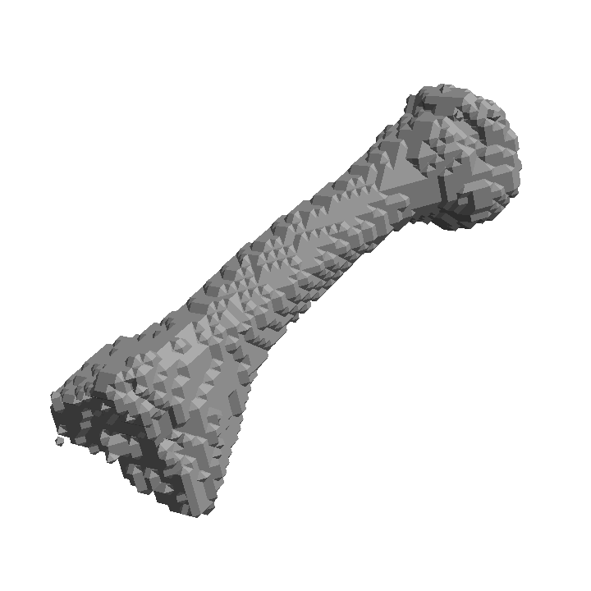
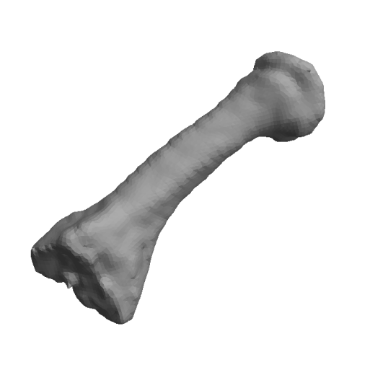
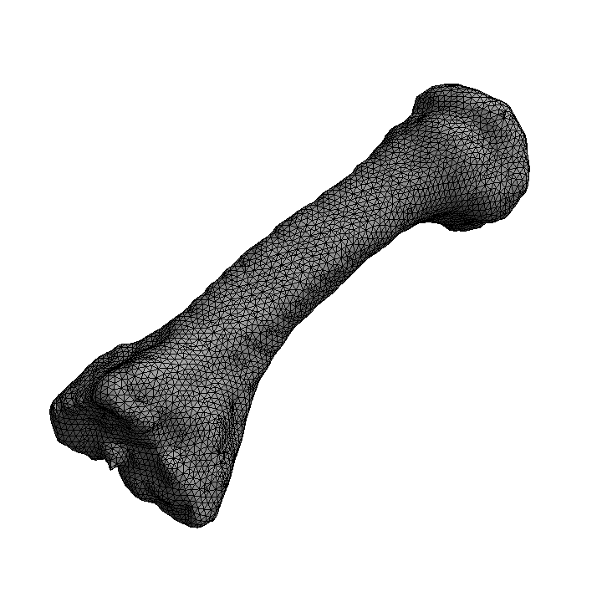
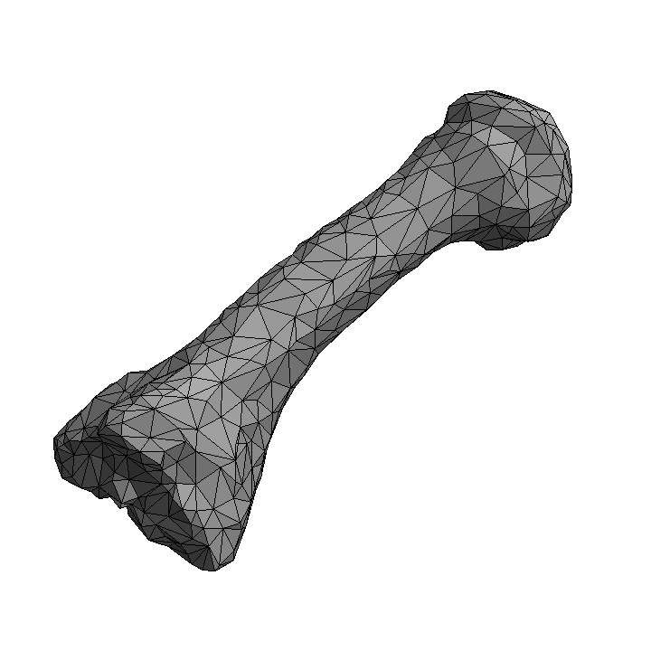
Review
Fairing (smoothing)
  Relocating vertices to achieve a smoother appearance
  Method: centroid averaging
Simplification
  Reducing vertex count
  Method: edge collapsing

Slide 3
Simplification (2D)
The algorithm
  Step 1: For each edge, compute the best vertex location to replace that edge, and the QEM at that location.
    Store that location (called minimizer) and its QEM with the edge.

Slide 4
Simplification (2D)
The algorithm
  Step 1: For each edge, compute the best vertex location to replace that edge, and the QEM at that location.
    Store that location (called minimizer) and its QEM with the edge.
  Step 2: Pick the edge with the lowest QEM and collapse it to its minimizer.
    Update the minimizers and QEMs of the re-connected edges.

Slide 5
Simplification (2D)
The algorithm
  Step 1: For each edge, compute the best vertex location to replace that edge, and the QEM at that location.
    Store that location (called minimizer) and its QEM with the edge.
  Step 2: Pick the edge with the lowest QEM and collapse it to its minimizer.
    Update the minimizers and QEMs of the re-connected edges.

Slide 6
Simplification (2D)
The algorithm
  Step 1: For each edge, compute the best vertex location to replace that edge, and the QEM at that location.
    Store that location (called minimizer) and its QEM with the edge.
  Step 2: Pick the edge with the lowest QEM and collapse it to its minimizer.
    Update the minimizers and QEMs of the re-connected edges.
  Step 3: Repeat step 2, until a desired number of vertices is left.

Slide 7
Simplification (2D)
The algorithm
  Step 1: For each edge, compute the best vertex location to replace that edge, and the QEM at that location.
    Store that location (called minimizer) and its QEM with the edge.
  Step 2: Pick the edge with the lowest QEM and collapse it to its minimizer.
    Update the minimizers and QEMs of the re-connected edges.
  Step 3: Repeat step 2, until a desired number of vertices is left.

Slide 8

Simplification (2D)
Step 1: Computing minimizer and QEM on an edge
  Consider supporting lines of this edge and adjacent edges
  Compute and store at the edge:
    The minimizing location p
    QEM of p
    QEM coefficients (a, b, c)
Stored at the edge:

Slide 9



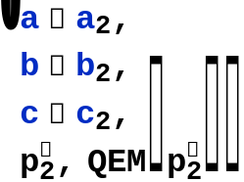


Simplification (2D)
Step 2: Collapsing an edge
  Remove the edge and its vertices
  Re-connect two neighbor edges to the minimizer of the removed edge
  For each re-connected edge:
    Increment its coefficients by that of the removed edge
      The coefficients are additive!
    Re-compute its minimizer and QEM
Collapse
: new minimizer locations computed from the updated coefficients

Slide 10
Review
Fairing (smoothing)
  Relocating vertices to achieve a smoother appearance
  Method: centroid averaging
Simplification
  Reducing vertex count
  Method: edge collapsing

Slide 11
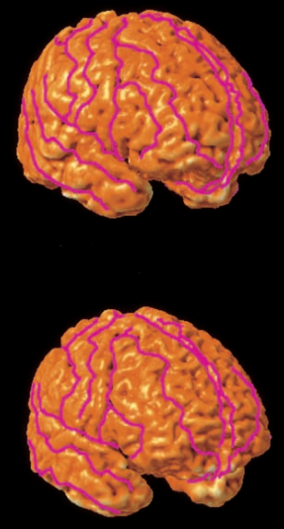
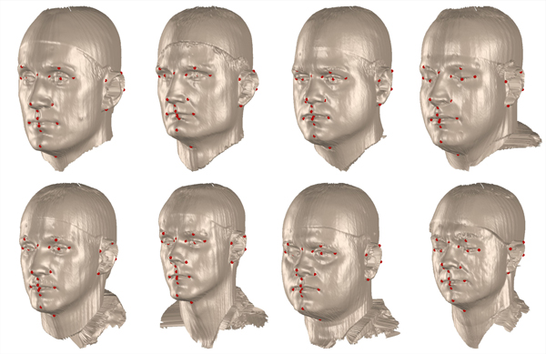
Registration
Fitting one model to match the shape of another
  Automated annotation
  Tracking and motion analysis
  Shape and data comparison
Courtesy: Sowell et al.
Courtesy: Schneider and Eisert

Slide 12
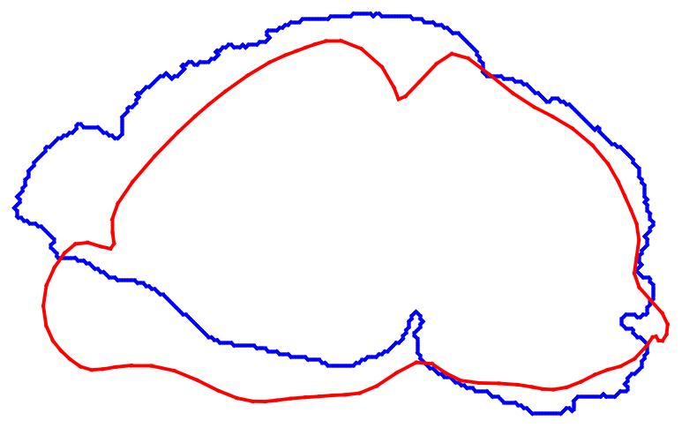
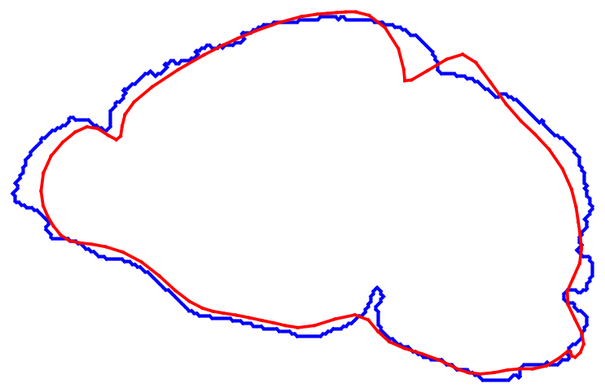
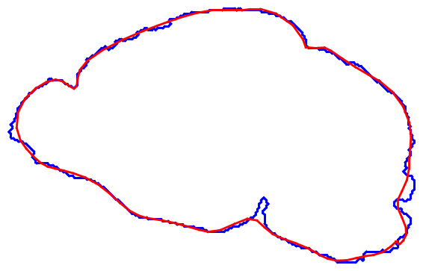
Registration
Challenges: global and local shape differences
  Imaging causes global shifts and tilts
    Requires alignment
  The shape of the organ or tissue differs in subjects and evolve over time
    Requires deformation
Brain outlines of two mice
After alignment
After deformation

Slide 13
Alignment
Registration by translation or rotation
  The structure stays “rigid” under these two transformations
    Also called isometric transformations (distance-preserving)
  Accounts for shifts and tilts in imaging
Before alignment
After alignment

Slide 14

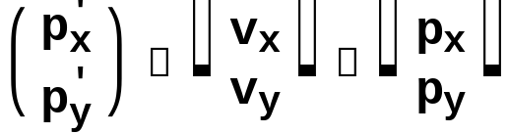

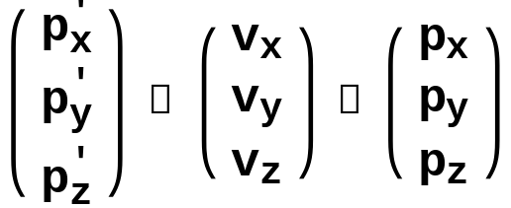
Transformation Math
Translation
  Vector addition:
  2D:
  3D:

Slide 15

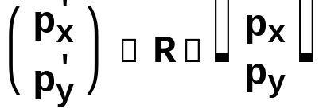


Transformation Math
Rotation
  Matrix product:
  2D:
    Rotate around the origin!
    To rotate around another point q:
y
x

Slide 16
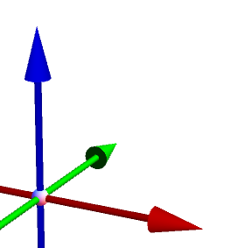
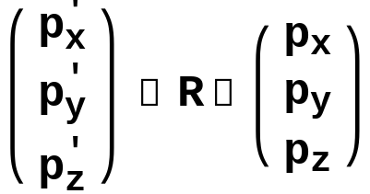
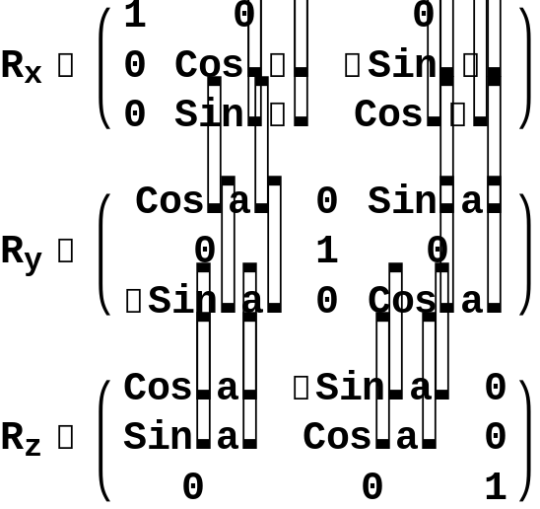
Transformation Math
Rotation
  Matrix product:
  3D:
z
y
Around X axis:
x
Around Y axis:
Around Z axis:

Slide 17

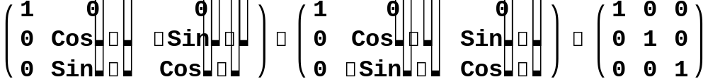

Transformation Math
Properties of a rotational matrix
  Orthonormal (orthogonal and normal):
    Examples:
    Easy to invert:
  Any orthonormal matrix represents a rotation

Slide 18



Transformation Math
Properties of a rotational matrix
  The rotation angle can be obtained from the trace of the matrix
    Trace: sum of diagonal entries
    2D:
    3D:
      α is the angle of rotation around the rotation axes
      True for rotation around any axes (not just X,Y,Z)
  The larger the trace, the smaller the rotation angle

Slide 19

Transformation Math
Eigenvectors and eigenvalues
  Let M be a square matrix, v is an eigenvector and λ is an eigenvalue if:
    Intuitively, if M represents a transformation, an eigenvector is invariant (up to scale) under the transformation.
  There are at most m distinct eigenvalues for a m by m matrix
  Any scalar multiples of an eigenvector is also an eigenvector (with the same eigenvalue).

Slide 20
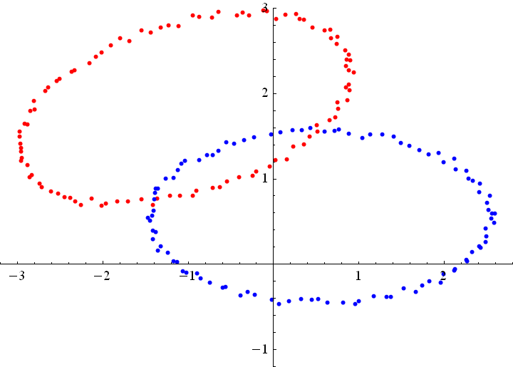
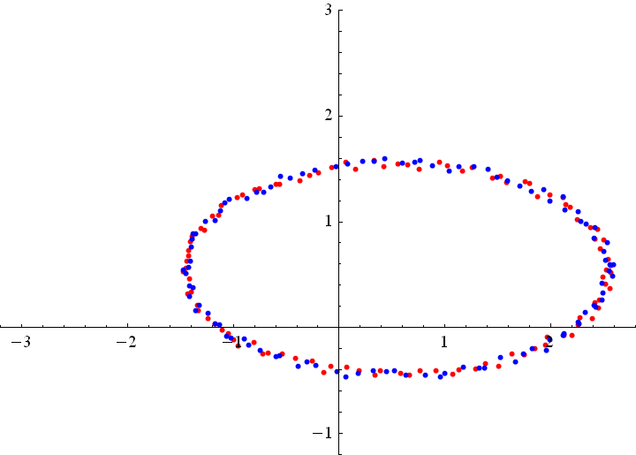
Alignment
Input: two models represented as point sets
  Source and target
Output: locations of the translated and rotated source points
Source
Target

Slide 21
Alignment
Method 1: Principal component analysis (PCA)
  Aligning principal directions
Method 2: Singular value decomposition (SVD)
  Optimal alignment given prior knowledge of correspondence
Method 3: Iterative closest point (ICP)
  An iterative SVD algorithm that computes correspondences as it goes

Slide 22
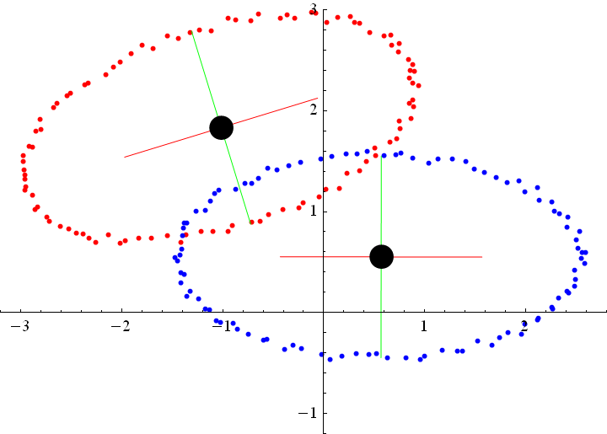
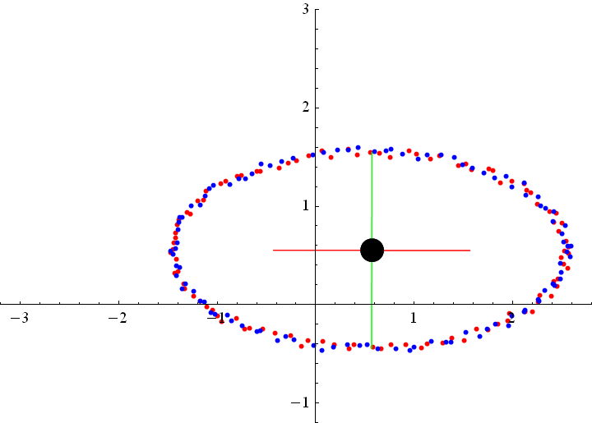
Method 1: PCA
Compute a shape-aware coordinate system for each model
  Origin: Centroid of all points
  Axes: Directions in which the model varies most or least
Transform the source to align its origin/axes with the target

Slide 23
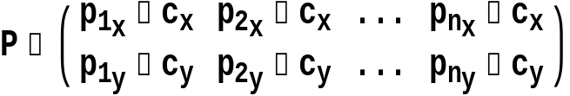
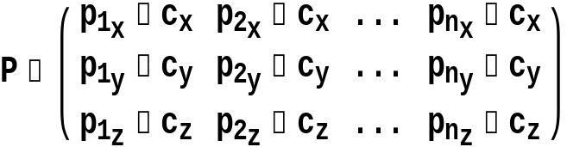

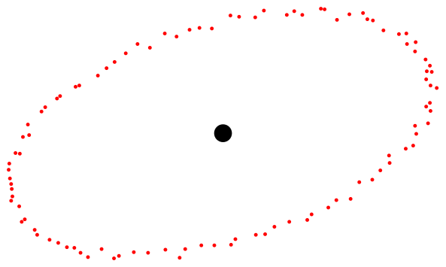

Method 1: PCA
Computing axes: Principal Component Analysis (PCA)
  Consider a set of points p₁,…,p_{n} with centroid location c
    Let P be a matrix whose i-th column is vector p_{i} – c
      2D (2 by n):
      3D (3 by n):
    Build the covariance matrix:
      2D: a 2 by 2 matrix
      3D: a 3 by 3 matrix

Slide 24
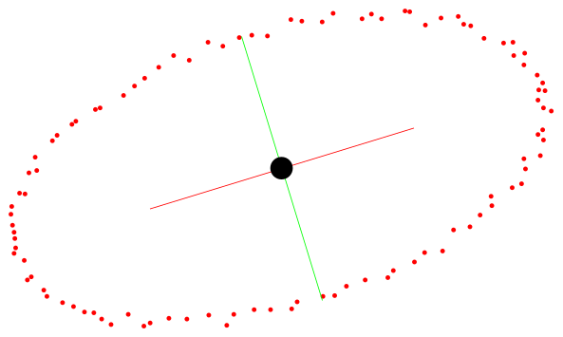
Method 1: PCA
Computing axes: Principal Component Analysis (PCA)
  Eigenvectors of M represent principal directions of shape variation
    The eigenvectors form orthogonal axes (2 vectors in 2D; 3 vectors in 3D)
      Note they are “un-signed”: lacking an orientation.
  Eigenvalues indicate amount of variation along each eigenvector
    Eigenvector with largest (smallest) eigenvalue is the direction where the model shape varies the most (least)
Eigenvector with the smallest eigenvalue
Eigenvector with the largest eigenvalue

Slide 25




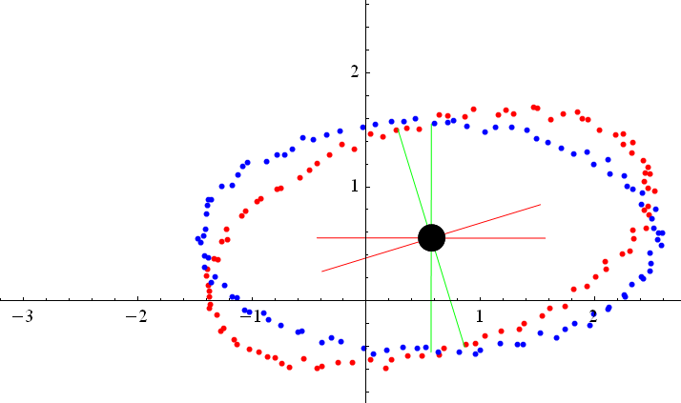



Method 1: PCA
PCA-based alignment
  Let c_{S},c_{T} be centroids of source and target.
  First, translate source to align c_{S} with c_{T}:
  Next, find rotation R that aligns two sets of PCA axes, and rotate source around c_{T}:
  Combined:

Slide 26


Method 1: PCA
Rotational alignment of two sets of oriented axes
  Let A, B be two matrices whose columns are two sets of oriented axes
    The axes are orthogonal and normalized
  We wish to compute a rotation matrix R such that:
  Notice that A and B are orthonormal, so we have:

Slide 27
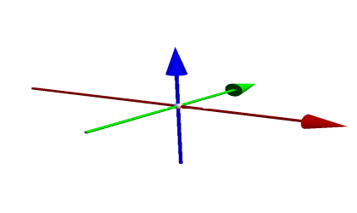
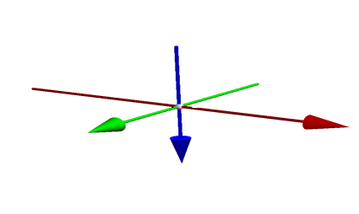
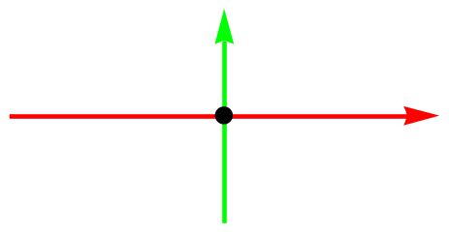
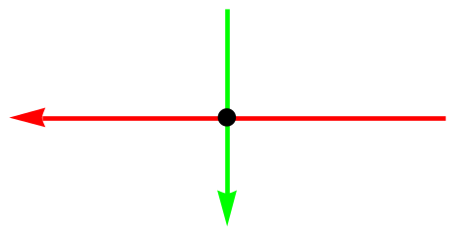
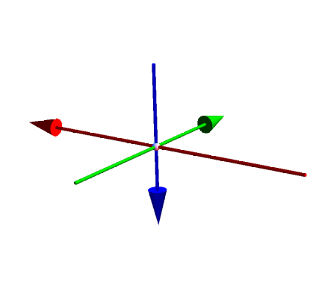
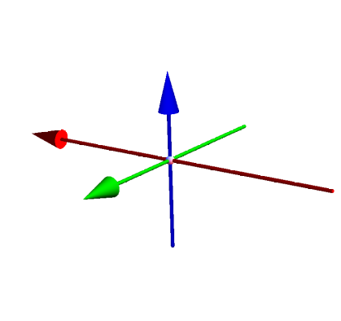
Method 1: PCA
How to orient the PCA axes?
  Observing the right-hand rule
  There are 2 possible orientation assignments in 2D, and 4 in 3D
1st eigenvector
2nd eigenvector
3rd eigenvector

Slide 28
Method 1: PCA
Computing rotation R
  Fix the orientation of the target axes.
  For each orientation assignment of the source axes, compute R
  Pick the R with smallest rotation angle (by checking the trace of R)
Smaller rotation
Larger rotation

Slide 29
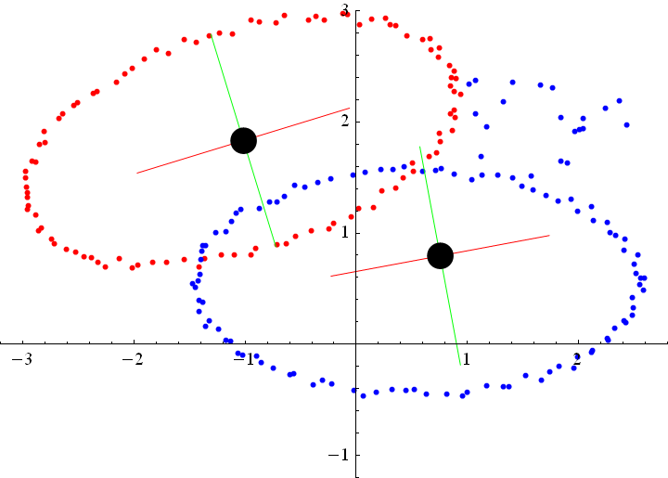
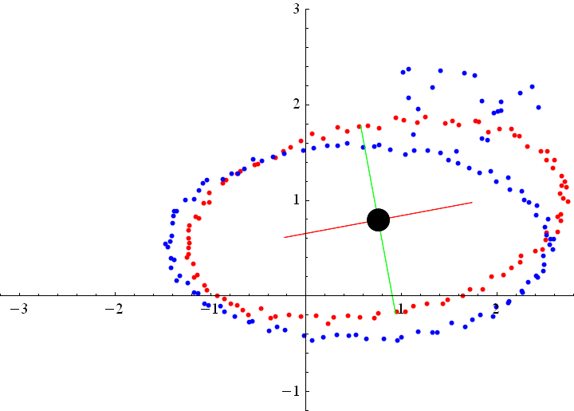
Method 1: PCA
Limitations
  Centroid and axes are affected by noise
Noise
Axes are affected
PCA result

Slide 30
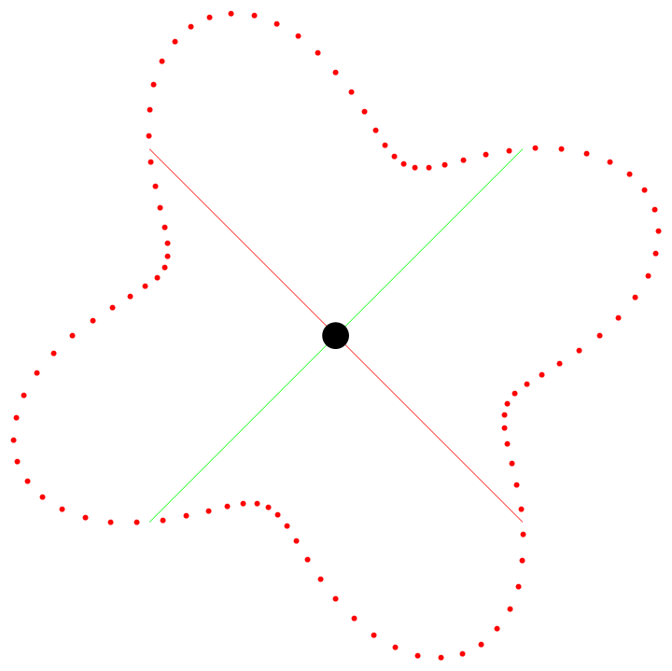
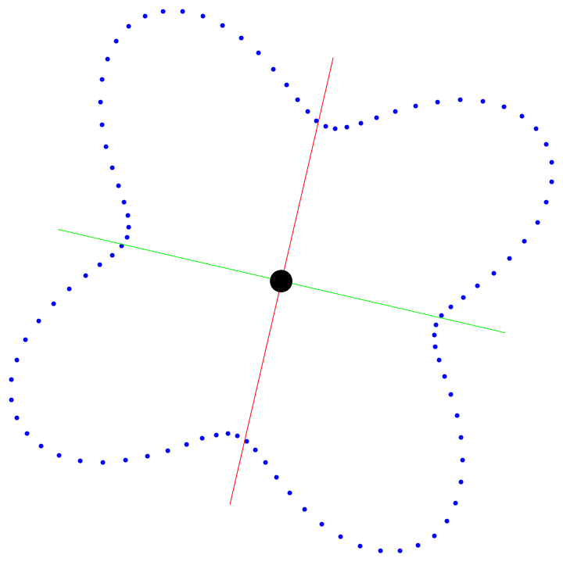
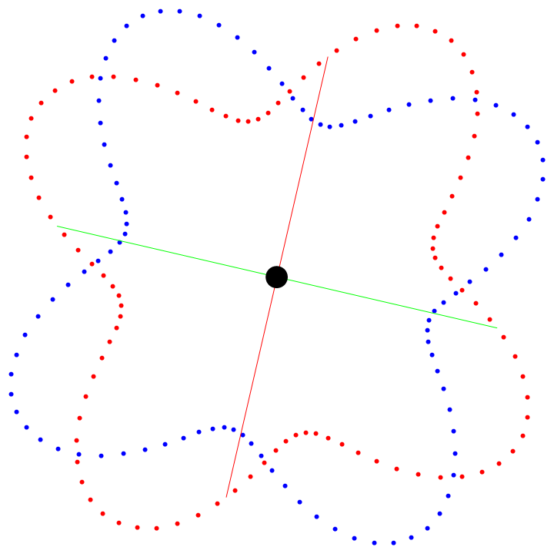
Method 1: PCA
Limitations
  Axes can be unreliable for circular objects
    Eigenvalues become similar, and eigenvectors become unstable
Rotation by a small angle
PCA result

Slide 31
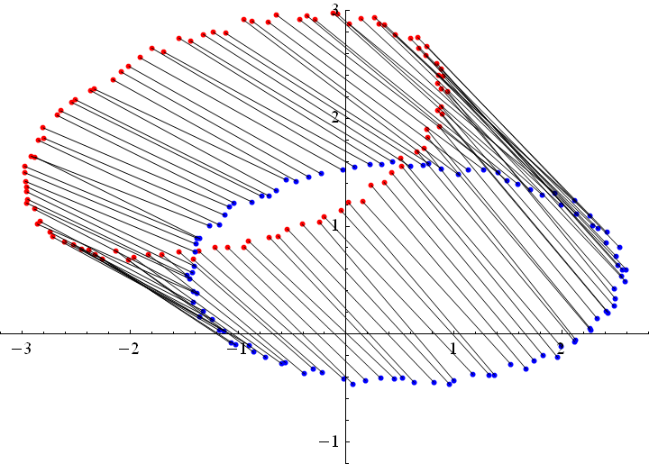

Method 2: SVD
Optimal alignment between corresponding points
  Assuming that for each source point, we know where the corresponding target point is

Slide 32
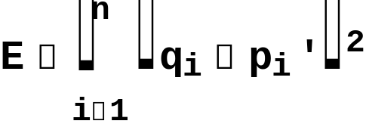
Method 2: SVD
Formulating the problem
  Source points p₁,…,p_{n} with centroid location c_{S}
  Target points q₁,…,q_{n} with centroid location c_{T}
    q_{i} is the corresponding point of p_{i}
  After centroid alignment and rotation by some R, a transformed source point is located at:
  We wish to find the R that minimizes sum of pair-wise distances:

Slide 33


Method 2: SVD
An equivalent formulation
  Let P be a matrix whose i-th column is vector p_{i} – c_{S}
  Let Q be a matrix whose i-th column is vector q_{i} – c_{T}
  Consider the cross-covariance matrix:
  Find the orthonormal matrix R that maximizes the trace:

Slide 34


Method 2: SVD
Solving the minimization problem
  Singular value decomposition (SVD) of an m by m matrix M:
    U,V are m by m orthonormal matrices (i.e., rotations)
    W is a diagonal m by m matrix with non-negative entries
  The orthonormal matrix (rotation) is the R that maximizes the trace
  SVD is available in Mathematica and many Java/C++ libraries

Slide 35
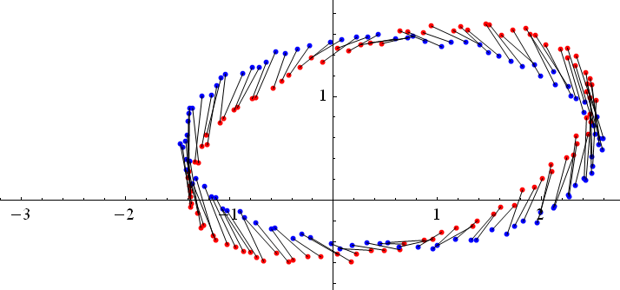
Method 2: SVD
SVD-based alignment: summary
  Forming the cross-covariance matrix
  Computing SVD
  The rotation matrix is
  Translate and rotate the source:
Translate
Rotate

Slide 36
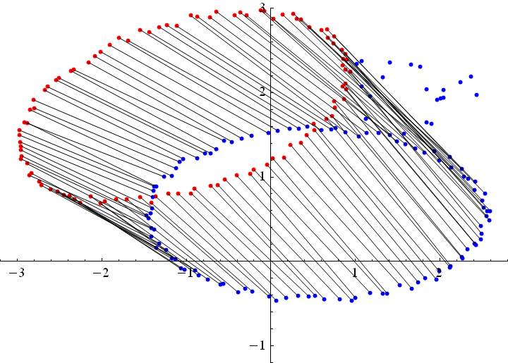
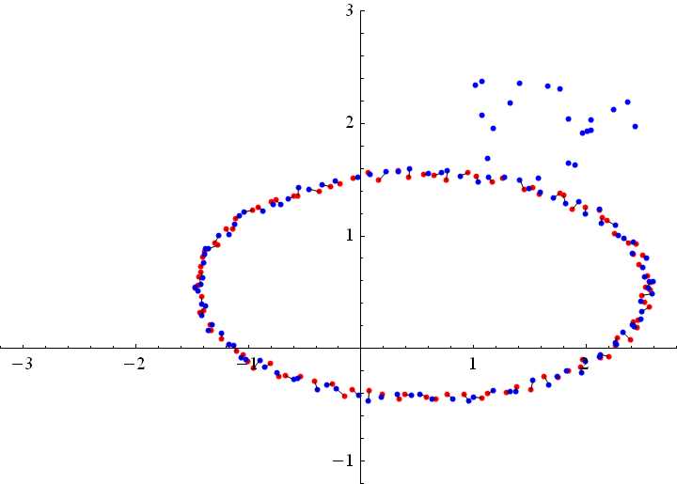
Method 2: SVD
Advantage over PCA: more stable
  As long as the correspondences are correct

Slide 37
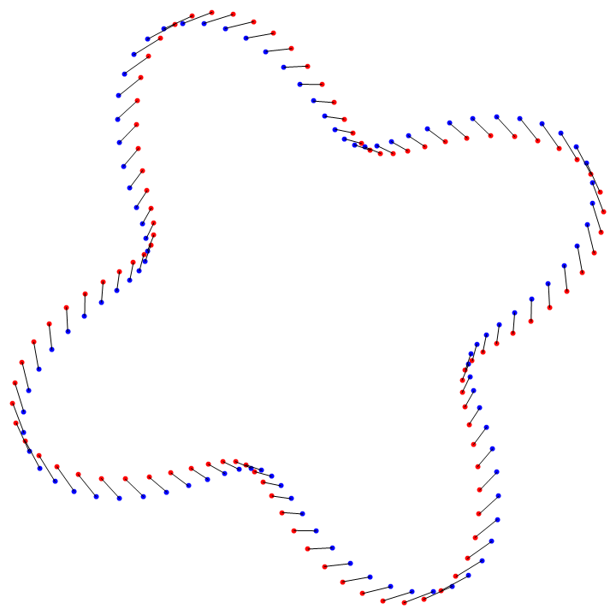

Method 2: SVD
Advantage over PCA: more stable
  As long as the correspondences are correct

Slide 38
Method 2: SVD
Limitation: requires accurate correspondences
  Which are usually not available

Slide 39
Method 3: ICP
The idea
  Use PCA alignment to obtain initial guess of correspondences
  Iteratively improve the correspondences after repeated SVD
Iterative closest point (ICP)
  1. Transform the source by PCA-based alignment
  2. For each transformed source point, assign the closest target point as its corresponding point. Align source and target by SVD.
    Not all target points need to be used
  3. Repeat step (2) until a termination criteria is met.

Slide 40
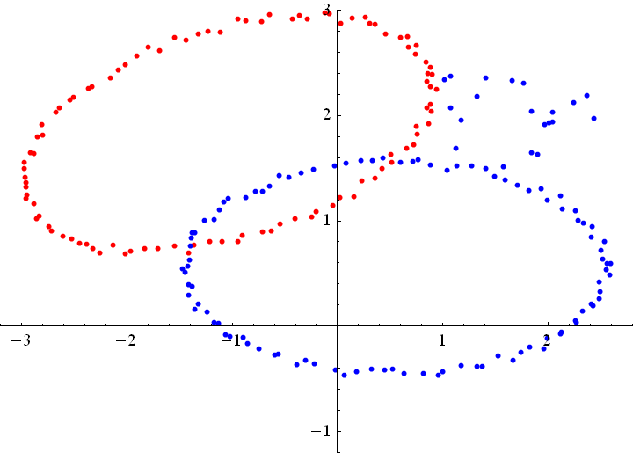
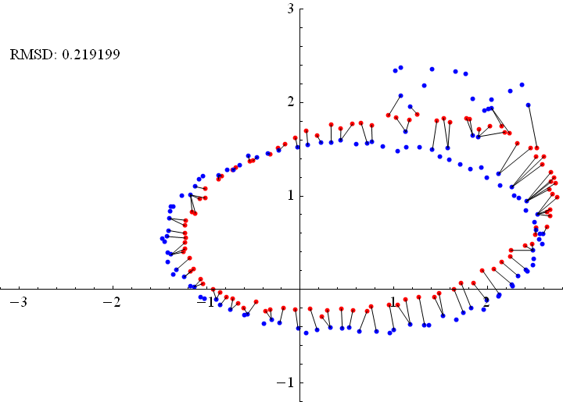
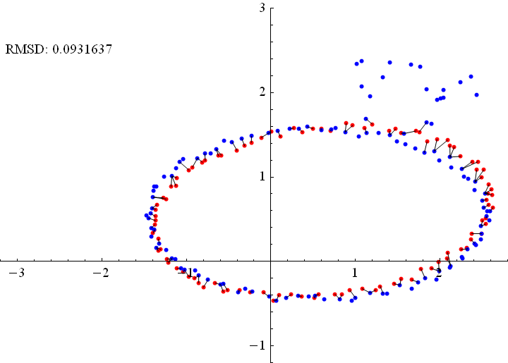
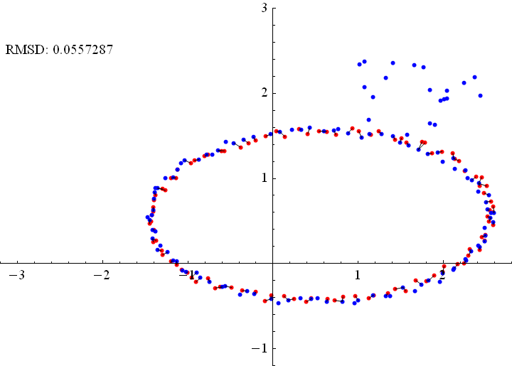
ICP Algorithm
After PCA
After 1 iter
After 10 iter

Slide 41
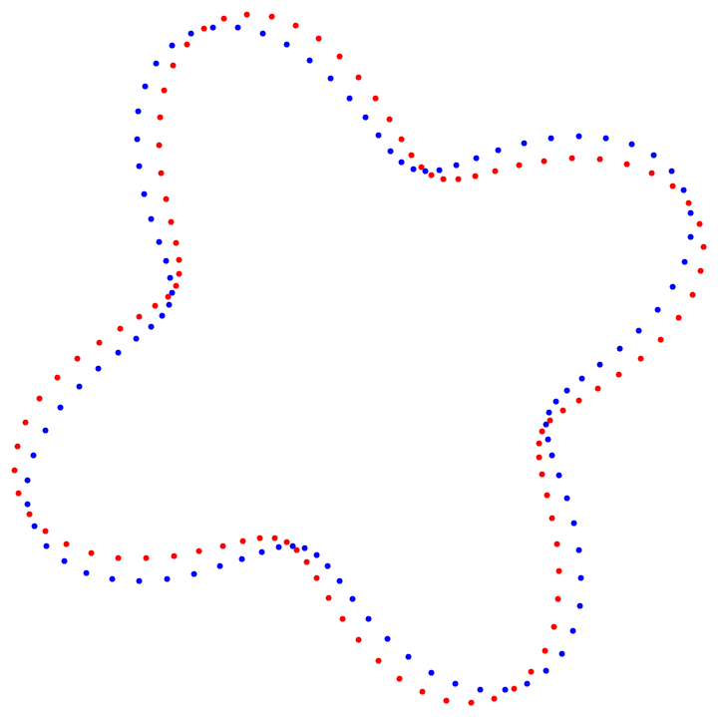
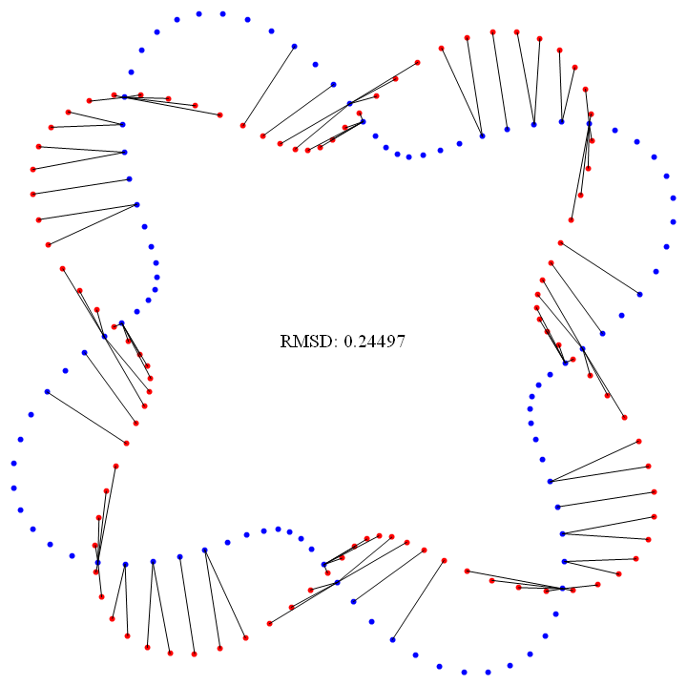
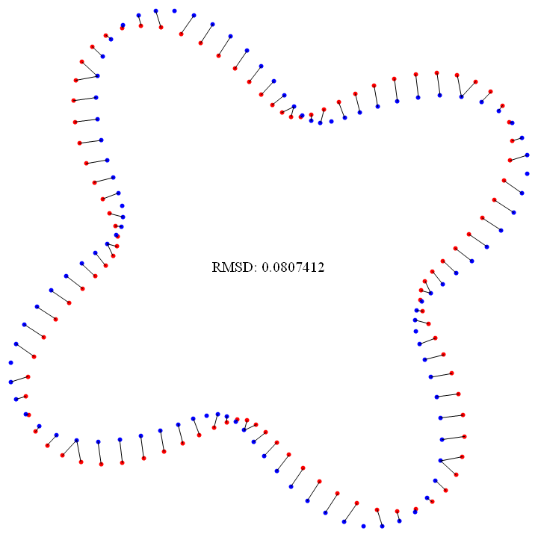

ICP Algorithm
After PCA
After 1 iter
After 10 iter

Slide 42

ICP Algorithm
Termination criteria
  A user-given maximum iteration is reached
  The improvement of fitting is small
    Root Mean Squared Distance (RMSD):
      Captures average deviation in all corresponding pairs
    Stops the iteration if the difference in RMSD before and after each iteration falls beneath a user-given threshold

Slide 43



More Examples
After PCA
After ICP

Slide 44






More Examples
After PCA
After ICP

