Slide 1
Economics of Power Generation
Terms
Factors
Load curve
Load duration curve
Connected load
Maximum demand
Average load
Demand factor
Load factor
Diversity factor
Plant capacity factor
Plant use factor

Slide 2
Load Curve: The curve showing the variation of load on the power station with respect to (w.r.t) time is known as load curve

Slide 3
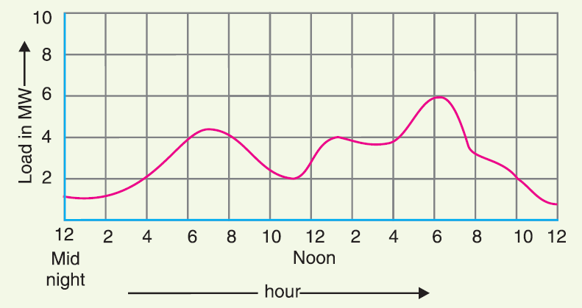

Slide 4
Importance. The daily load curves have attained a great importance in generation as they supply the following information readily :
(i) The daily load curve shows the variations of load on the power station during different hours of the day.
(ii) The area under the daily load curve gives the number of units generated in the day.
Units generated/day = Area (in kWh) under daily load curve.
(iii) The highest point on the daily load curve represents the maximum demand on the station on
that day.

Slide 5
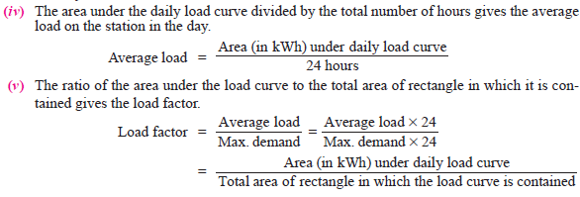

Slide 6
(vi) The load curve helps in selecting* the size and number of generating units.
(vii) The load curve helps in preparing the operation schedule** of the station.

Slide 7
Load Duration Curve: When the load elements of a load curve are arranged in the order of descending magnitudes, the curve thus obtained is called a load duration curve.

Slide 8
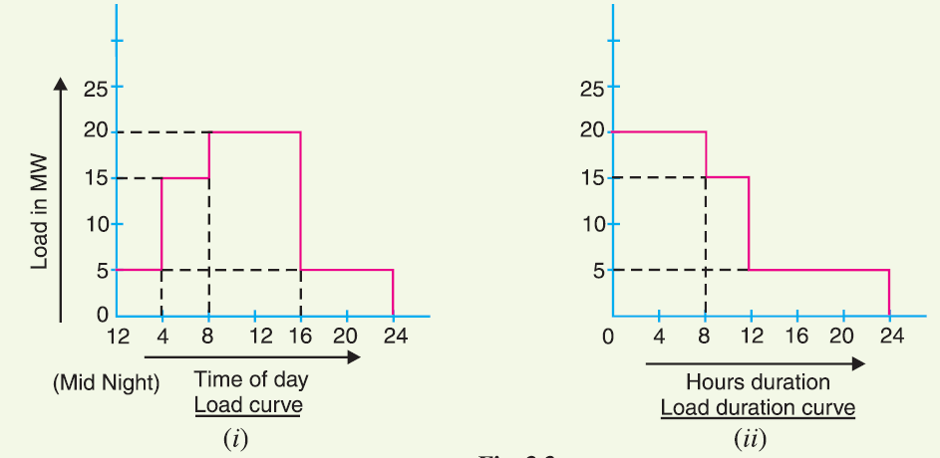

Slide 9
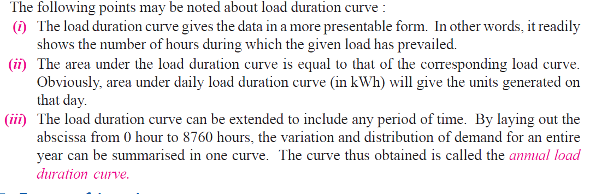

Slide 10
Terms and factors used in Economics of power plants

Slide 11
(i) Connected load. It is the sum of continuous ratings of all the equipments connected to supply system.

Slide 12
A power station supplies load to thousands of consumers. Each consumer has certain equipment installed in his premises. The sum of the continuous ratings of all the equipments in the consumer’s premises is the “connected load” of the consumer.

Slide 13
For instance, if a consumer has connections of five 100-watt lamps and a power point of 500 watts, then connected load of the consumer is 5 × 100 + 500= 1000 watts. The sum of the connected loads of all the consumers is the connected load to the power station.

Slide 14
(ii) Maximum demand : It is the greatest demand of load on the power station during a given period.

Slide 16
The load on the power station varies from time to time. The maximum of all the demands that have occurred during a given period (say a day) is the maximum demand. Thus referring back to the load curve of , the maximum demand on the power station during the day is 6 MW and it occurs at 6 P.M.

Slide 17
Maximum demand is generally less than the connected load because all the consumers do not switch on their connected load to the system at a time. The knowledge of maximum demand is very important as it helps in determining the installed capacity of the station. The station must be capable of meeting the maximum demand

Slide 18
(iii) Demand factor. It is the ratio of maximum demand on the power station to its connected load

Slide 19
i.e.,
Demand factor = (Maximum demand / Connected load)
The value of demand factor is usually less than 1. It is expected because maximum demand on the power station is generally less than the connected load. If the maximum demand on the power station is 80 MW and the connected load is 100 MW, then demand factor = 80/100 = 0·8. The knowledge of demand factor is vital in determining the capacity of the plant equipment

Slide 20
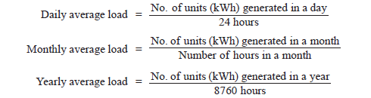
(iv) Average load. The average of loads occurring on the power station in a given period (day or month or year) is known as average load or average demand.

Slide 21
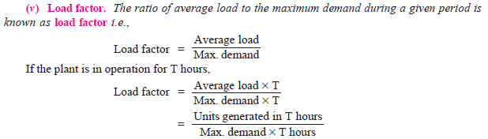

Slide 22
The load factor may be daily load factor, monthly load factor or annual load factor if the time period considered is a day or month or year. Load factor is always less than 1 because average load is smaller than the maximum demand. The load factor plays key role in determining the overall cost per unit generated. Higher the load factor of the power station, lesser* will be the cost per unit
generated.

Slide 23


Slide 24
A power station supplies load to various types of consumers whose maximum demands generally do not occur at the same time. Therefore, the maximum demand on the power station is always less than the sum of individual maximum demands of the consumers. Obviously, diversity† factor will always be greater than 1. The greater the diversity factor, the lesser‡ is the cost of generation of power.

Slide 25
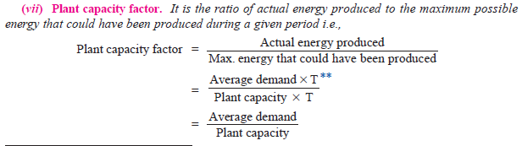


Slide 26
The plant capacity factor is an indication of the reserve capacity of the plant. A power station is so designed that it has some reserve capacity for meeting the increased load demand in future. Therefore, the installed capacity of the plant is always somewhat greater than the maximum demand on the plant.
Reserve capacity = Plant capacity − Max. demand

Slide 27
It is interesting to note that difference between load factor and plant capacity factor is an indication of reserve capacity. If the maximum demand on the plant is equal to the plant capacity, then load factor and plant capacity factor will have the same value. In such a case, the plant will have no reserve capacity.

Slide 28
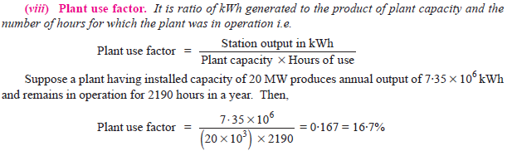

Slide 29
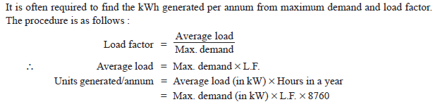

Slide 31


Slide 33
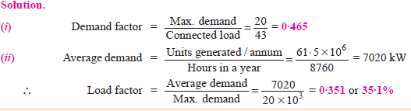

Slide 35
