Slide 1
Personal Finance Tracker
(Group-19)
Aniruddha Bywar & Atul Singh

Slide 2
Introduction & Objective
Tracking personal finances is vital for informed budgeting and decision-making. Fragmented tools and manual methods often hinder visibility and control, leading to missed opportunities and financial missteps.
This system offers a user-friendly, single-user platform to manage personal accounts, set budgets, categorize transactions, and gain insights—without relying on third-party integrations. It ensures simplicity, privacy, and actionable financial clarity.ide theme, or if you're adding narration alongside it.

Slide 3
Problem Statement
Managing personal finances is often fragmented and error-prone due to:
Absence of a centralized system: Users juggle multiple tools and methods, reducing financial visibility.
Manual tracking limitations: Reliance on spreadsheets leads to data inconsistencies and human error.
Lack of real-time insights: Without timely updates, users struggle to monitor budgets and expenses effectively

Slide 4
Proposed Solution
How about when??
A secure, accessible platform for personal financial management.
Web-based System: Centralized tool to manage accounts, budgets, and transactions from anywhere.
Responsive Design: Seamless experience across desktops, tablets, and smartphones.
Data Security: Password-encrypted storage ensures confidentiality and user control.

Slide 5



Technology Stack
Frontend: React.js · HTML5 · CSS3 · JavaScript
Responsive, modular UI for seamless interaction across devices
Backend: Spring Boot · Java 17+
Secure, scalable RESTful services with high performance
Database: MySQL 8+
Structured storage supporting complex queries and relationships

Slide 6
System Architecture
Presentation Layer - React UI
Interactive dashboard for tracking income, expenses, budgets, and financial goals
Responsive views for account summaries, transaction history, and visual analytics
Business Layer - Spring boot & REST API
Implements core services: user authentication, budget forecasting, and transaction categorization
RESTful endpoints for CRUD operations on accounts, categories, budgets, and logs
Validates inputs and enforces business rules before data persistence
Data Layer – MySQL Database
Normalized schema for efficient querying and referential integrity
Tables for Users, Accounts, Transactions, Budgets, Categories, and Logs
Supports auditability and historical tracking via time-stamped entries

Slide 7
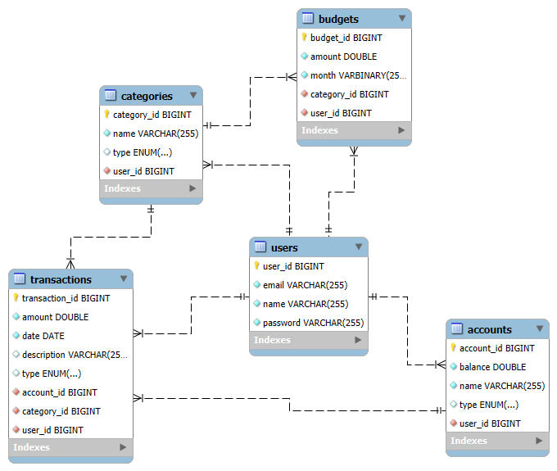

Slide 8
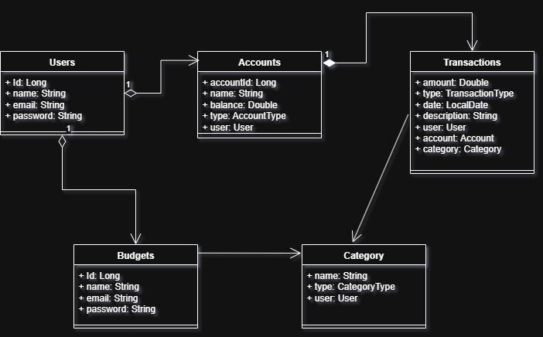
Class Diagram

Slide 9
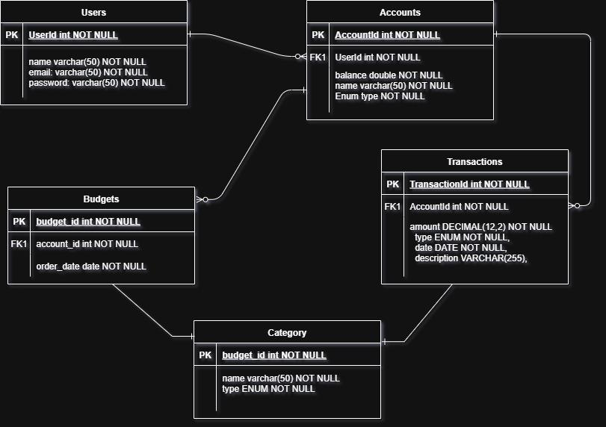
ER Diagram

Slide 10
Functionality & Features
The Personal Finance Manager system initiates with secure authentication to validate user identity, followed by account management functionalities enabling CRUD operations on financial accounts.
Users can then configure budgets by setting category-based expenditure limits, after which transactions—both income and expenses—are recorded with categorical and account-level tagging. Advanced filtering and reporting tools support financial analysis.
Lastly, the system facilitates category management through predefined and user-defined classifications, enhancing personalization and usability throughout the financial tracking workflow.

Slide 11
Conclusion & Future Scope
The Personal Finance Manager system successfully integrates core functionalities essential for individual financial oversight, including secure authentication, modular account and transaction management, budget tracking, and customizable categorization. Its structured architecture and intuitive interface promote usability, data integrity, and analytical clarity, making it a robust tool for personal finance administration.
Banking API integration for automated transaction syncing
Mobile app development for enhanced accessibility
AI-driven insights for budget recommendations
Shared accounts for collaborative financial planning
Advanced data visualizations for improved analysis

Slide 12
Thank you for your attention

