Slide 1
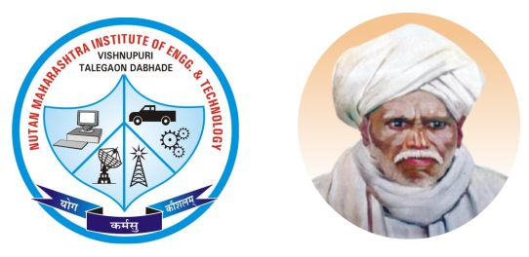

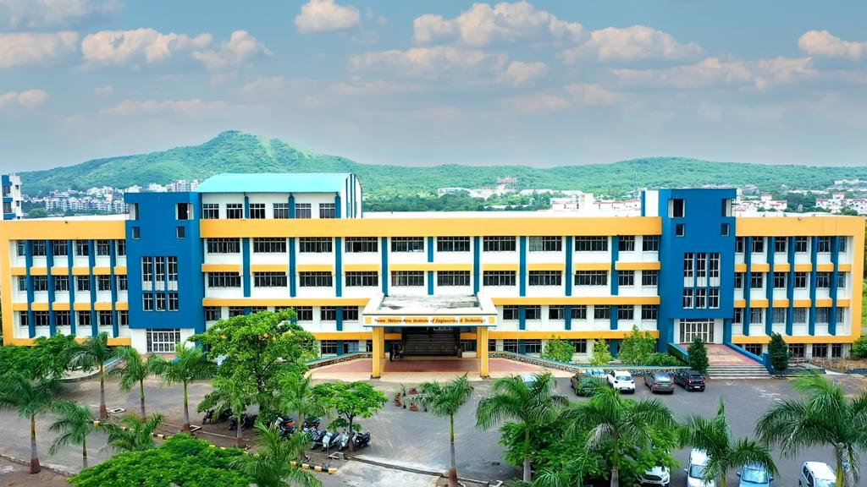

NUTAN MAHARASHTRA INSTITUTE OF ENGINEERING & TECHNOLOGY, PUNE
Nutan Maharashtra Vidya Prasarak Mandal's
Seminar and Technical Communication
Review
Department of Computer Engineering
https://www.nmiet.edu.in/index.php

Slide 2

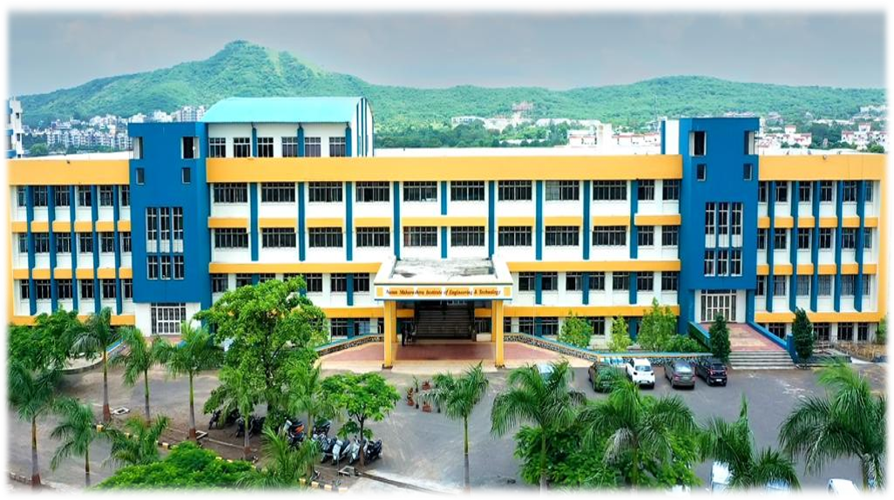
Nutan Maharashtra Vidya Prasarak Mandal's
NUTAN MAHARASHTRA INSTITUTE OF ENGINEERING & TECHNOLOGY, PUNE
Topic name
Deepfake Technology
Presented By
RollNo:TEB127 Name: Aniruddha Kalubarme
Under the Guidance of
Prof. Rupali Kaldoke Mam
Department of Computer Engineering
https://www.nmiet.edu.in

Slide 3
Nutan Maharashtra Vidya Prasarak Mandal's
NUTAN MAHARASHTRA INSTITUTE OF ENGINEERING & TECHNOLOGY, PUNE
Contents
1.Motivation
2.Introduction
3.Literature Survey
4.Objectives
5.Architecture/Flow Diagram
6.Methodology Used
7.Expected outcome
8.Conclusion
9.Future Scope
10.References
Department of Computer Engineering
https://www.nmiet.edu.in

Slide 4
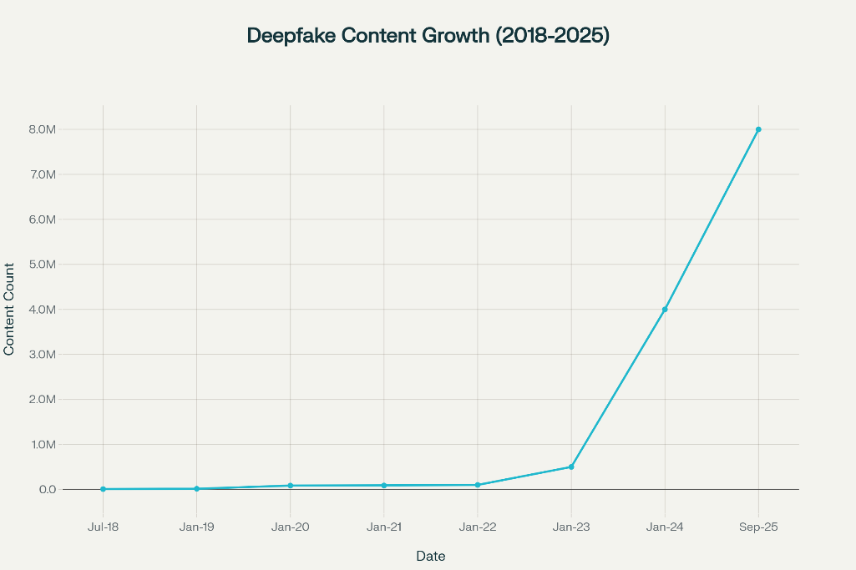
Nutan Maharashtra Vidya Prasarak Mandal's
NUTAN MAHARASHTRA INSTITUTE OF ENGINEERING & TECHNOLOGY, PUNE
Motivation
Deepfakes are fake videos and voices made using AI.
They can spread lies, cause harm, and cheat people.
We need good ways to find and
stop them.
Department of Computer Engineering
https://www.nmiet.edu.in

Slide 5
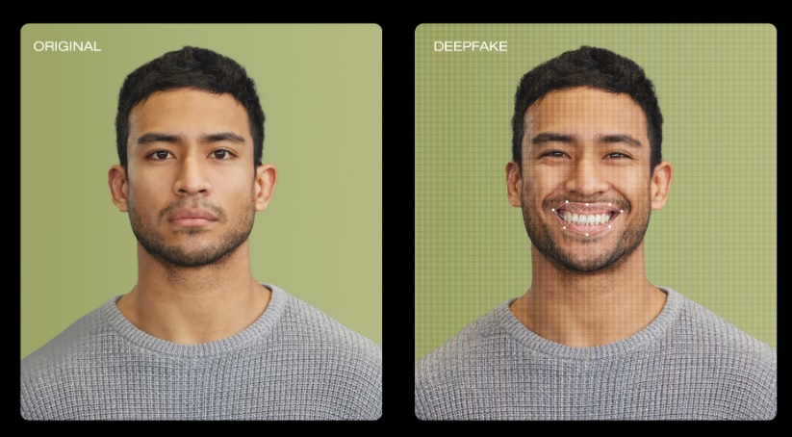
Nutan Maharashtra Vidya Prasarak Mandal's
NUTAN MAHARASHTRA INSTITUTE OF ENGINEERING & TECHNOLOGY, PUNE
Introduction
Deepfakes are fake images, videos, or audio made by computers.
They look and sound real, but are not genuine.
Many people can be fooled by deepfakes.
Detecting them is becoming very important.
Department of Computer Engineering
https://www.nmiet.edu.in

Slide 6
Nutan Maharashtra Vidya Prasarak Mandal's
NUTAN MAHARASHTRA INSTITUTE OF ENGINEERING & TECHNOLOGY, PUNE
Literature Survey
Title | Author & Year | Methodology | Advantages | Gaps / Drawbacks
Visual Deepfake Detection: Review | Ahmed et al., 2024–25 | Systematic review by feature domain (spatial, temporal, freq., spatio-temporal) | Up-to-date, structured synthesis, covers tools & datasets | Poor real-world generalization, dataset dependence, no unified benchmark
DFFMD: Deepfake Face Mask Dataset | Alnaim et al., 2023 | Masked-face dataset + Inception ResNet v2–based detector | High accuracy (≈99.8%), first on masked deepfakes | Limited dataset diversity, weak generalization
Deepfake Generation & Detection | Patel et al., 2023 | Multimodal survey (image/video/audio) + case study (IBMM) | Broad coverage, links generation & detection | High computation, dataset scarcity, low real-world accuracy
Department of Computer Engineering
https://www.nmiet.edu.in

Slide 7
Nutan Maharashtra Vidya Prasarak Mandal's
NUTAN MAHARASHTRA INSTITUTE OF ENGINEERING & TECHNOLOGY, PUNE
Objectives
Entertainment -Deepfakes can be used to create realistic special effects
in movies, TV Shows, and video games..
Education -Deepfakes can be used to create realistic simulations for
training purposes, such as medical procedures or military exercises..
Social media content -Deepfakes can be used to create humorous or
satirical videos for social media platforms.
Department of Computer Engineering
https://www.nmiet.edu.in

Slide 8
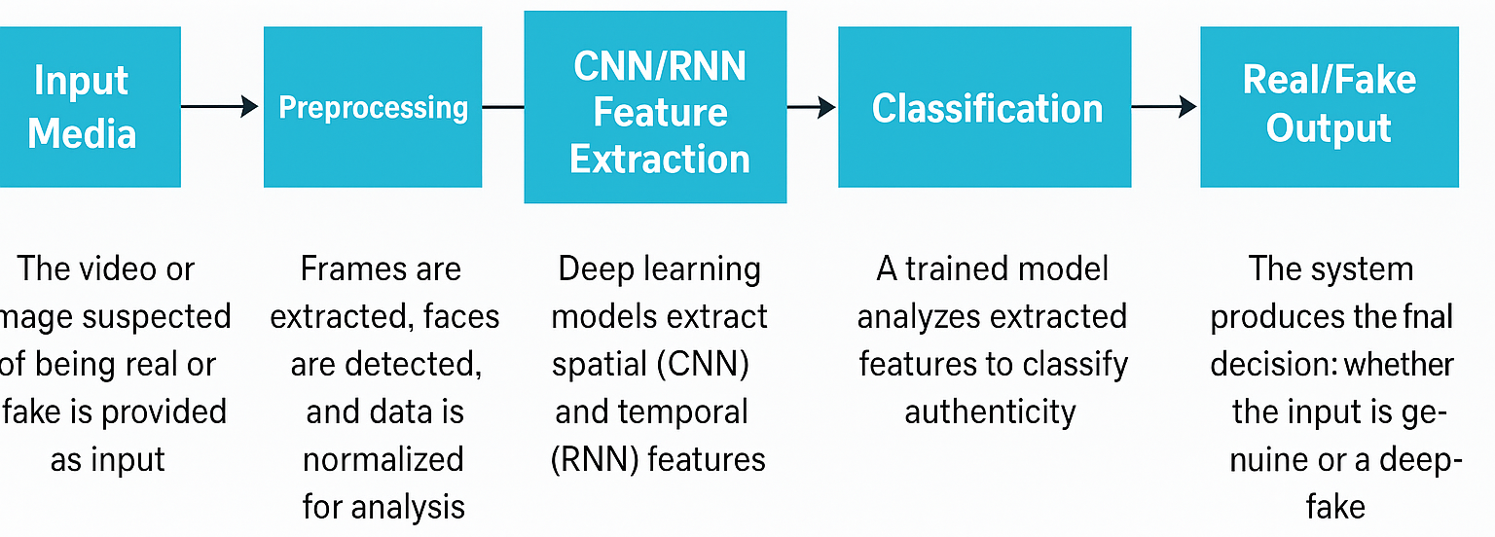
Nutan Maharashtra Vidya Prasarak Mandal's
NUTAN MAHARASHTRA INSTITUTE OF ENGINEERING & TECHNOLOGY, PUNE
Architecture / Flow Diagram
CNNs (Convolutional Neural Networks): process images or grid-like data
RNNs (Recurrent Neural Networks): process audio or video frames
Department of Computer Engineering
https://www.nmiet.edu.in

Slide 9
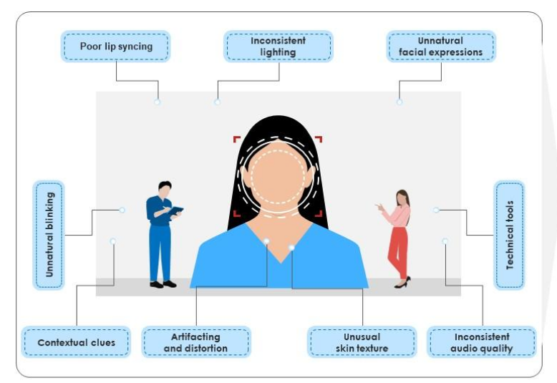
Nutan Maharashtra Vidya Prasarak Mandal's
NUTAN MAHARASHTRA INSTITUTE OF ENGINEERING & TECHNOLOGY, PUNE
Methodology Used
Collected and reviewed recent research papers.
Compared different deepfake tools
and detection methods.
Tested detection models on public
datasets like DFDC and Celeb-DF.
Department of Computer Engineering
https://www.nmiet.edu.in

Slide 10
Nutan Maharashtra Vidya Prasarak Mandal's
NUTAN MAHARASHTRA INSTITUTE OF ENGINEERING & TECHNOLOGY, PUNE
Expected Outcome
Awareness – Participants will gain a clear understanding of how deepfake technology works, its applications, and associated risks.
Identification Skills – Ability to recognize signs of manipulated media such as poor lip-syncing unusual facial expressions, and inconsistent audio/video quality.
Technical Understanding – Knowledge of detection methods using AI/ML models (CNNs, RNNs) and preprocessing techniques.
Department of Computer Engineering
https://www.nmiet.edu.in

Slide 11
Nutan Maharashtra Vidya Prasarak Mandal's
NUTAN MAHARASHTRA INSTITUTE OF ENGINEERING & TECHNOLOGY, PUNE
Conclusion
Deepfakes will keep getting better and harder to spot.
We need smart and quick ways to catch them.
Both generation and detection will improve and challenge
each other.
Department of Computer Engineering
https://www.nmiet.edu.in

Slide 12
Nutan Maharashtra Vidya Prasarak Mandal's
NUTAN MAHARASHTRA INSTITUTE OF ENGINEERING & TECHNOLOGY, PUNE
Future Scope
Build stronger, faster detection tools.
Make detection work for all types of deepfakes.
Create clearer, larger datasets.
Teach people about deepfake risks.
Department of Computer Engineering
https://www.nmiet.edu.in

Slide 13
Nutan Maharashtra Vidya Prasarak Mandal's
NUTAN MAHARASHTRA INSTITUTE OF ENGINEERING & TECHNOLOGY, PUNE
References
Patel et al., "Deepfake Generation and Detection: Case Study and
Challenges", IEEE Access, 2023
Department of Computer Engineering
https://www.nmiet.edu.in

