Slide 1
Problem Statement and Understanding
Spam Detector is used to detect unwanted, malicious and virus infected texts and helps to separate them from the nonspam texts. It uses a binary type of classification containing the labels such as ‘ham’ (nonspam) and spam. Application of this can be seen in Google Mail (GMAIL) where it segregates the spam emails in order to prevent them from getting into the user’s inbox.
The files contain one message per line. Each line is composed by two columns: v1 contains the label (ham or spam) and v2 contains the raw text. A collection of 5573 rows SMS spam messages was manually extracted from the Grumbletext Web site. This is a UK forum in which cell phone users make public claims about SMS spam messages, most of them without reporting the very spam message received. The identification of the text of spam messages in the claims is a very hard and time-consuming task, and it involved carefully scanning hundreds of web pages. A subset of 3,375 SMS randomly chosen ham messages of the NUS SMS Corpus (NSC), which is a dataset of about 10,000 legitimate messages collected for research at the Department of Computer Science at the National University of Singapore. The messages largely originate from Singaporeans and mostly from students attending the University. These messages were collected from volunteers who were made aware that their contributions were going to be made publicly available.

Slide 2
EDA Steps
Data structuring
Analysing the data
Cleaning and processing the data
Writing down findings and observations
Using different models to train the data
Selecting best fitted model for predictions
Hyper tuning the selected model
Predicting outcome for test data

Slide 3
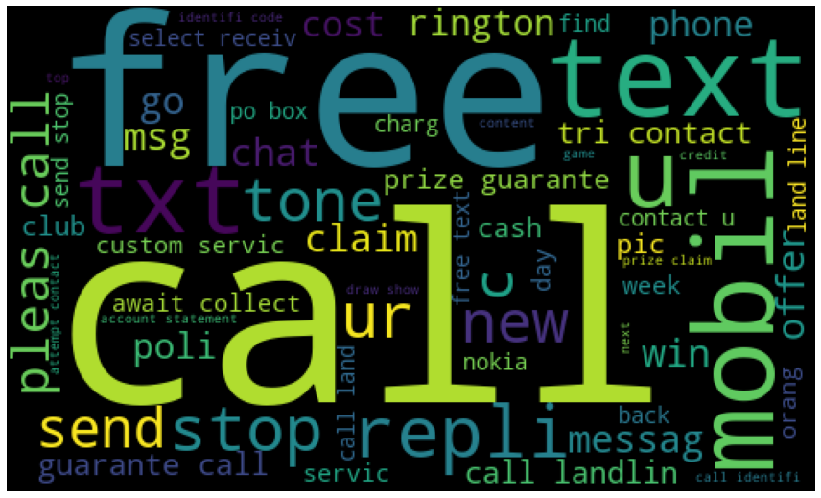
Visualizations
WordCloud: -
Observations:
Free, Call, Please, Text, txt are some words which are occuring for most number of time

Slide 4
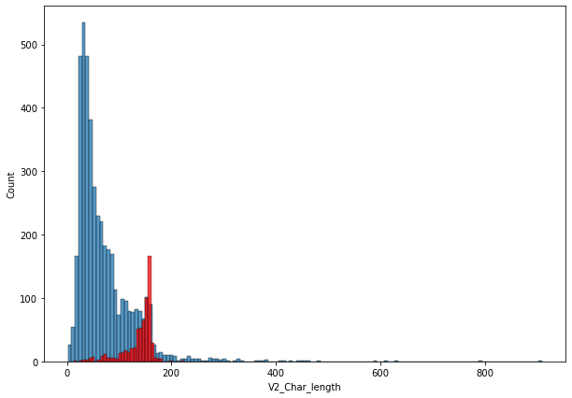
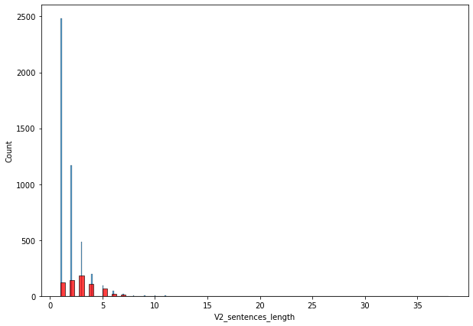
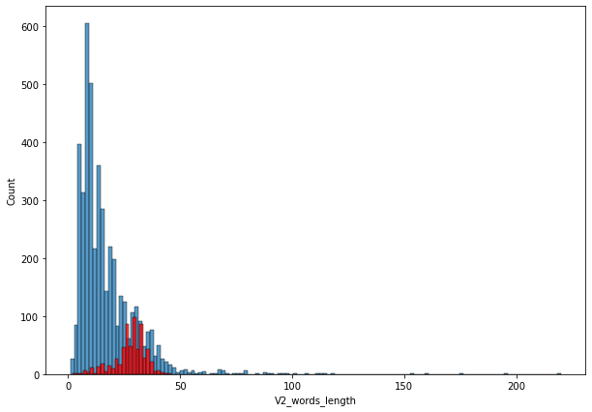
Visualizations
2. Histogram: -
Observations:
Spam mails and messages contain a greater number of sentences that ham mails and messages.
Spam mails and messages contain a greater number of words that ham mails and messages.
Spam mails and messages contain a greater number of characters that ham mails and messages.

Slide 5
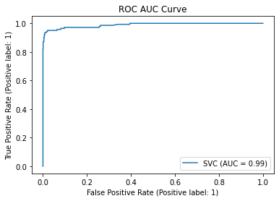
Visualizations
3. ROC AUC Curve: -
Observations:
AUC Score is 99% which is pretty good

Slide 6
Steps and Assumptions
Clean and organized the data.
Checked the data type of each column.
Changed the Object data type to Integer.
Checked whether the data has any Null Values.
Checked whether the data is categorical data or continuous data.
Encoded remaining Object data type columns to integer using encoder technique.
Checked the co-relation of features with label i.e v1.
Checked the Distribution of data.

Slide 7
Model Dashboard
Identification of possible problem
The data was not structured and organized hence cleaned the data using various data cleaning and pre-processing techniques.
Have run several EDAs to understand the data.
The data is not balanced since spam comments are less that the ham comments hence have changed the evaluation methods, instead of focusing on accuracy I focused on precision score.
Used vectorization to build the model.
Testing of Identified Approaches
These are the algorithms which have been used to train and test data.
RandomForestClassifier
LogisticRegression
GradientBoostingClassifier
DecisionTreeClassifier
KNeighborsClassifier
Support Vector Classifier
GaussianNB
MultinomialNB
BernoulliNB

Slide 8
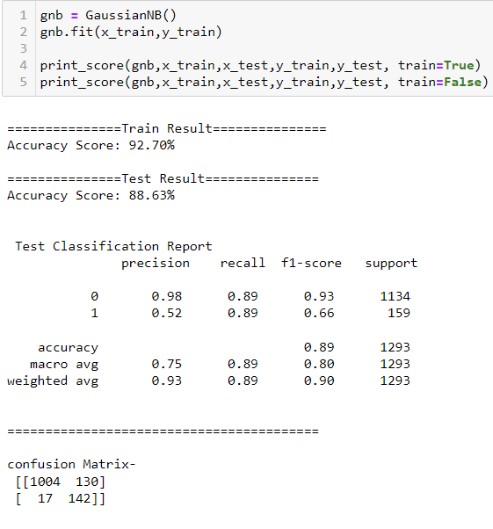
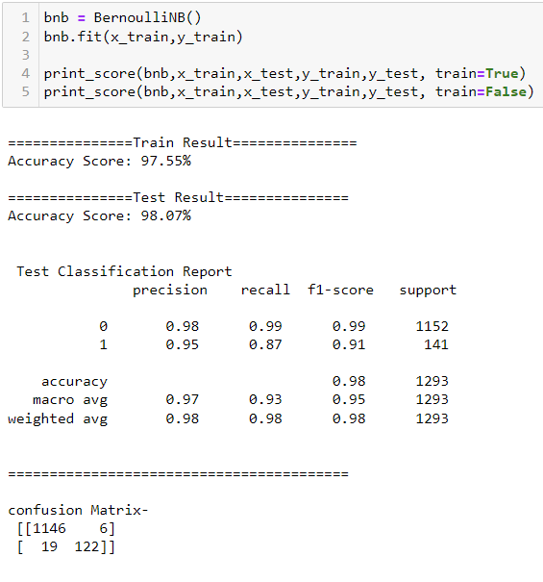
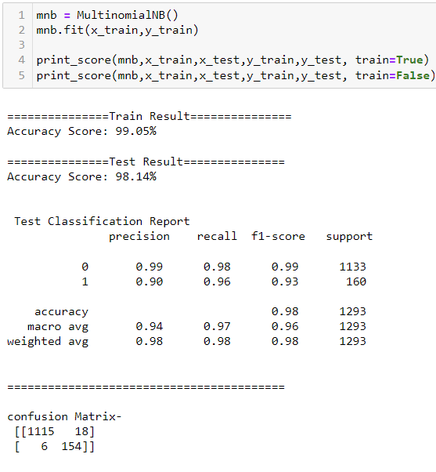
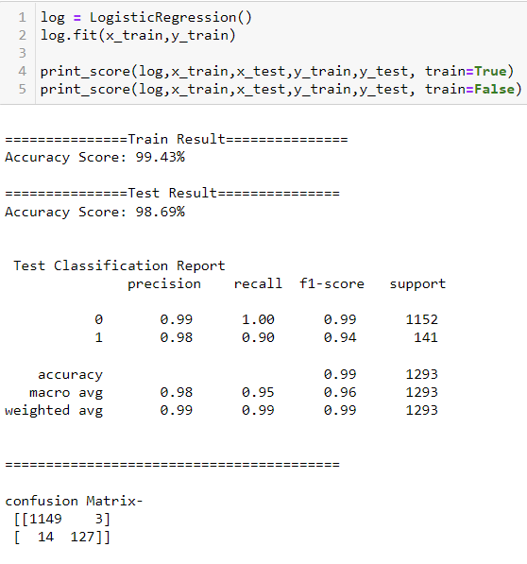
Model Dashboard
1. GaussianNB: -
2. MultinomialNB: -
3. BernoulliNB: -
4. LogisticRegression: -

Slide 9
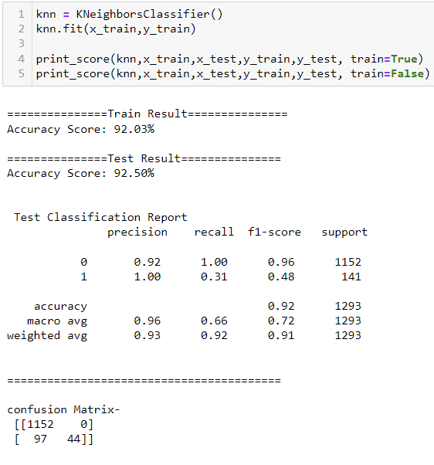
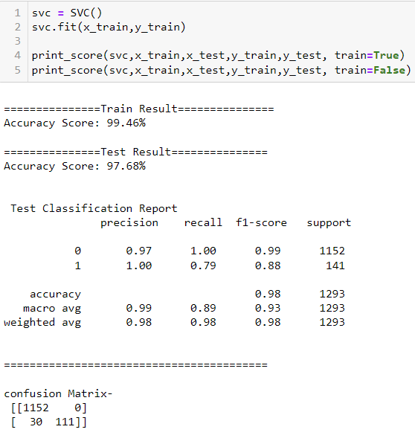
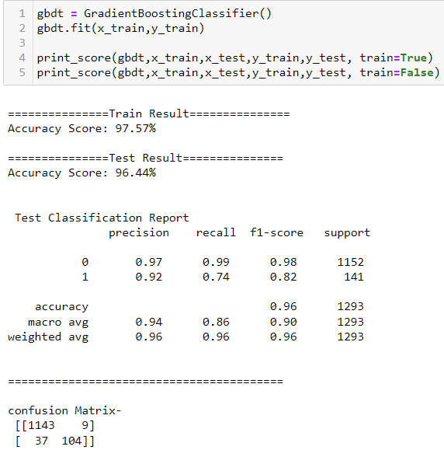
Model Dashboard
5. KNeighborsClassifier: -
6. GradientBoostingClassifier: -
7. SupportVectorClassifier: -

Slide 10
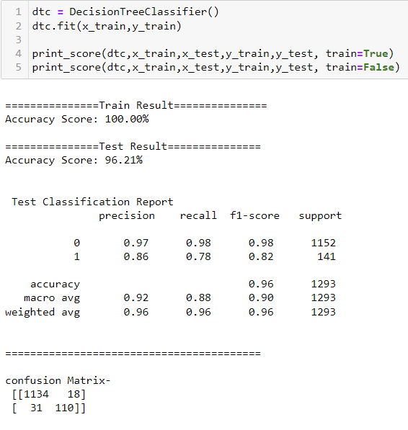
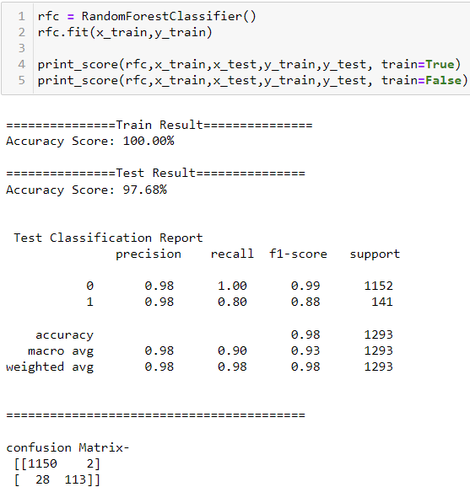
Model Dashboard
8. DecisionTreeClassifier: -
9. RandomForestClassifier: -

Slide 11
Conclusion
Interpretation of the Results
Below is the table that shows the final result of the various models.
Model_Name | Accuracy | Precision_Score | Confusion_Matrix_FP
SupportVectorClassifier | 97.68 | 1 | 0
KNeighborsClassifier | 92.5 | 1 | 0
RandomForestClassifier | 97.68 | 0.98 | 2
LogisticRegression | 98.69 | 0.98 | 3
BernoulliNB | 98.07 | 0.95 | 6
GradientBoostingClassifier | 96.44 | 0.92 | 9
MultinomialNB | 98.14 | 0.9 | 18
DecisionTreeClassifier | 96.21 | 0.86 | 18
GaussianNB | 88.63 | 0.52 | 130

Slide 12
Conclusion
Learning Outcomes of the Study in respect of Data Science
Data Cleaning helps to convert unorganized and unstructured data into structured data which will be used to make findings.
Data visualization helps understand and analyse the data.
Model building helps to predict outcomes, in this case SupportVectorClassifier model fits perfect for this dataset.
There are many unwanted characters in the messages and mails which need more pre-processing.

Slide 13
Finalized Model
Key Findings and Conclusions of the Model
Selecting SupportVectorClassifier model since the Accuracy score i.e., 99.46% and test scores i.e., 97.68% are greater and close to each other.
recall and f1-score are also high for SupportVectorClassifier model.
Precision score is 1 for this model means there are no false positives in the test result which states that our model is working really good.

