Slide 1
E-retail factors for customer activation and retention: A case study from Indian e-commerce customers
Problem Statement
Customer satisfaction has emerged as one of the most important factors that guarantee the success of online store; it has been posited as a key stimulant of purchase, repurchase intentions and customer loyalty. A comprehensive review of the literature, theories and models have been carried out to propose the models for customer activation and customer retention. Five major factors that contributed to the success of an e-commerce store have been identified as: service quality, system quality, information quality, trust and net benefit. The research furthermore investigated the factors that influence the online customers repeat purchase intention. The combination of both utilitarian value and hedonistic values are needed to affect the repeat purchase intention (loyalty) positively. The data is collected from the Indian online shoppers. Results indicate the e-retail success factors, which are very much critical for customer satisfaction

Slide 2
Understanding Problem Statement
As discussed in the problem statement, we need to understand and analyze five qualities (service quality, system quality, information quality, trust and net benefit) that creates customer utility and desire to buy products from a specific online retailer. To analyze these qualities first we need to calculate utilitarian value and hedonistic values which can be used to calculate customer retention points. This analysis can bring several aspects on customer satisfaction and new customer integration.

Slide 3
Exploratory Data Analysis
Needs to check the Data type, whether the data is Object or Int.
Needs to check whether the data has Null values or not.
Needs to bifurcate categorical data and continuous data separately.
Needs to handle those data which has URL.

Slide 4
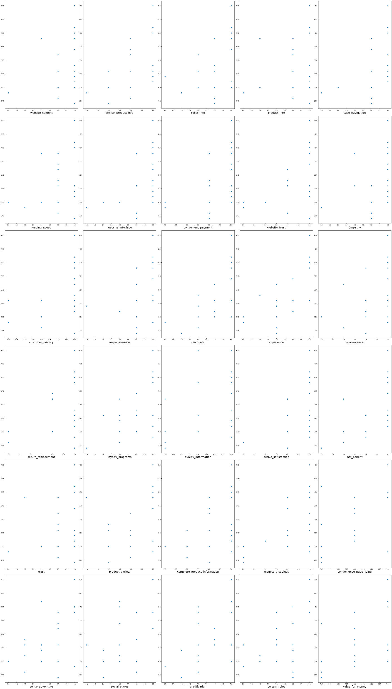
Visualization
Scatter Plot
This graph shows the data plotting of selected features with Label i.e Customer retention points.
product_info, trust and return_replacement has less co-relation with customer_retention_points.
similar_product_info, website_interface, convenient_payment, website_trust, customer_privacy, discounts, experience, monetary_savings, social_status, gratification and certain_roles has a great correlation with label.

Slide 5
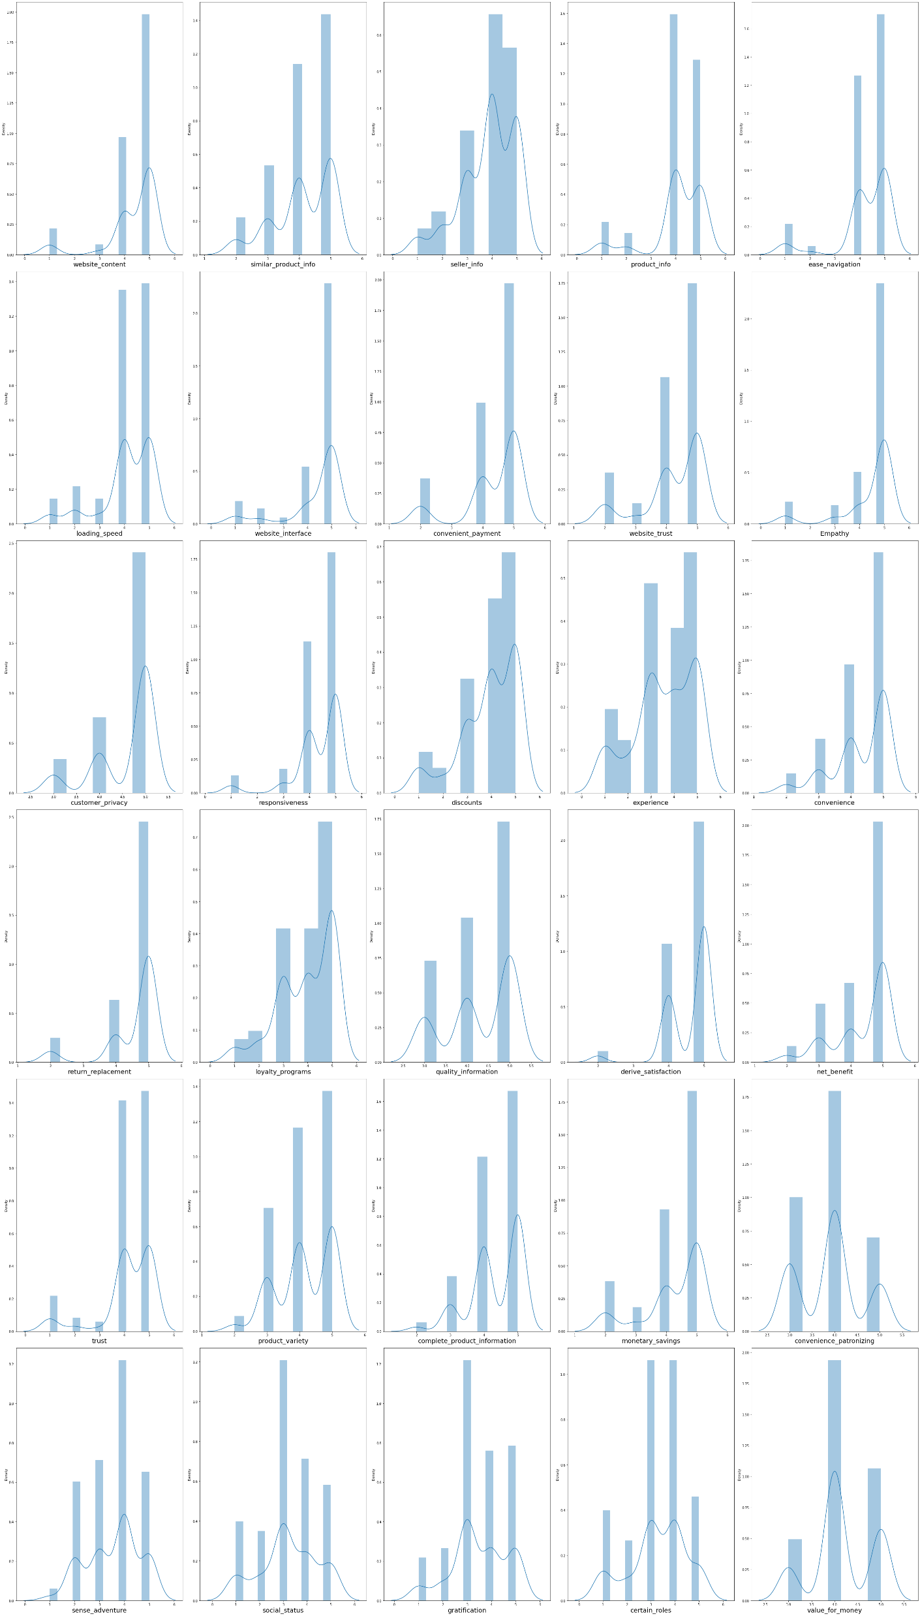
Visualization
Distribution Plot
This graph shows the data distribution of selected features.
Each column is a categorical column hence we can not consider the skewness in the data however have shown this to make analysis out of it.
Experience, quality_information, product_variety, convenience_patronizing, sense_adventure, social_status, gratification, certain_roles and value_for_money column has less skewness in the data.
website_content, ease_navigation, website_interface, Empathy, responsiveness and return_replacement column has highest skewness in the data.

Slide 6
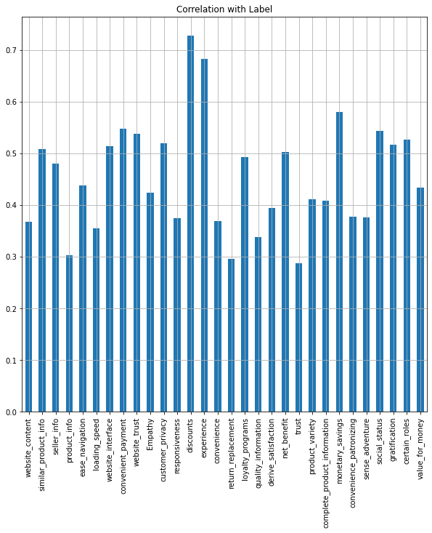
Visualization
Bar Plot
This graph shows the correlation of selected features with Label i.e Customer retention points.
Discount and experience has the highest co-relation with Customer retention points.
Product_info, return_replacement and trust column has the lowest co-relation with label.

Slide 7
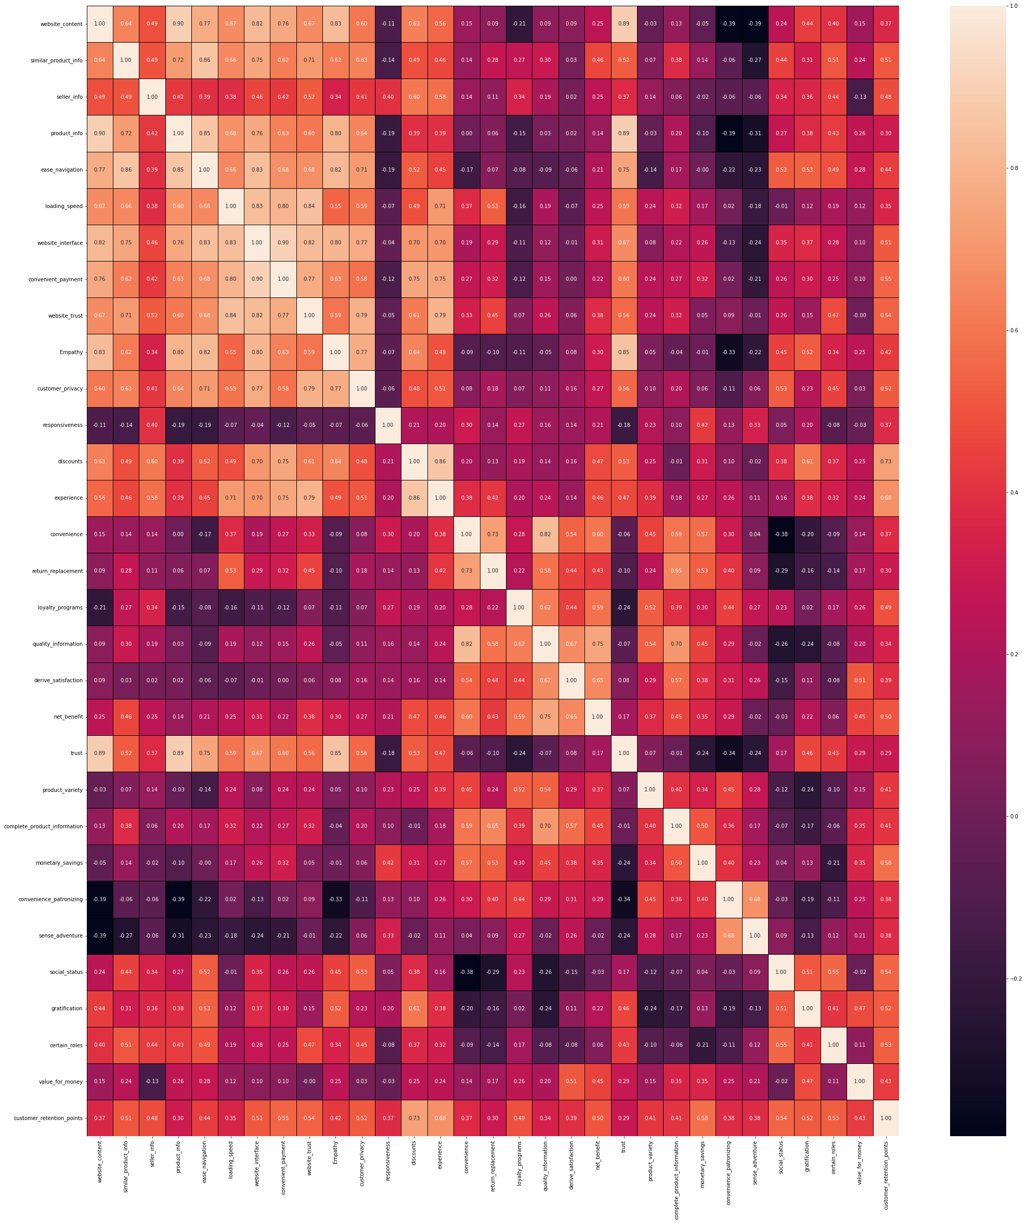
Visualization
Heatmap
This graph shows the multicollinearity of selected features.
Website_content and product_info have multicollinearity problem.
Website_interface and convenient_payment have multicollinearity problem.

Slide 8
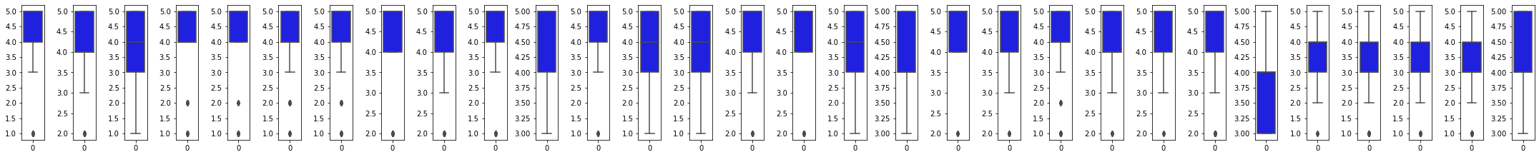
Visualization
Boxplot
This graph shows outliers in the data.
These all are the categorical data hence we can not remove outliers from the data however have shown this graph for the analysis.
website_content, similar_product_info, product_info, ease_navigation, loading_speed, website_interface, convenient_payment, website_trust, Empathy, responsiveness, convenience, return_replacement, derive_satisfaction, net_benefit, trust, product_variety, complete_product_information, monetary_savings, sense_adventure, social_status, gratification and certain_roles has outliers.

