Slide 1
FAKE IMAGE DETECTION
Submitted by:
Jaya vardhan - ME20B1008
Aniruddh – ME20B1003
Kevin – ME20B1014

Slide 2
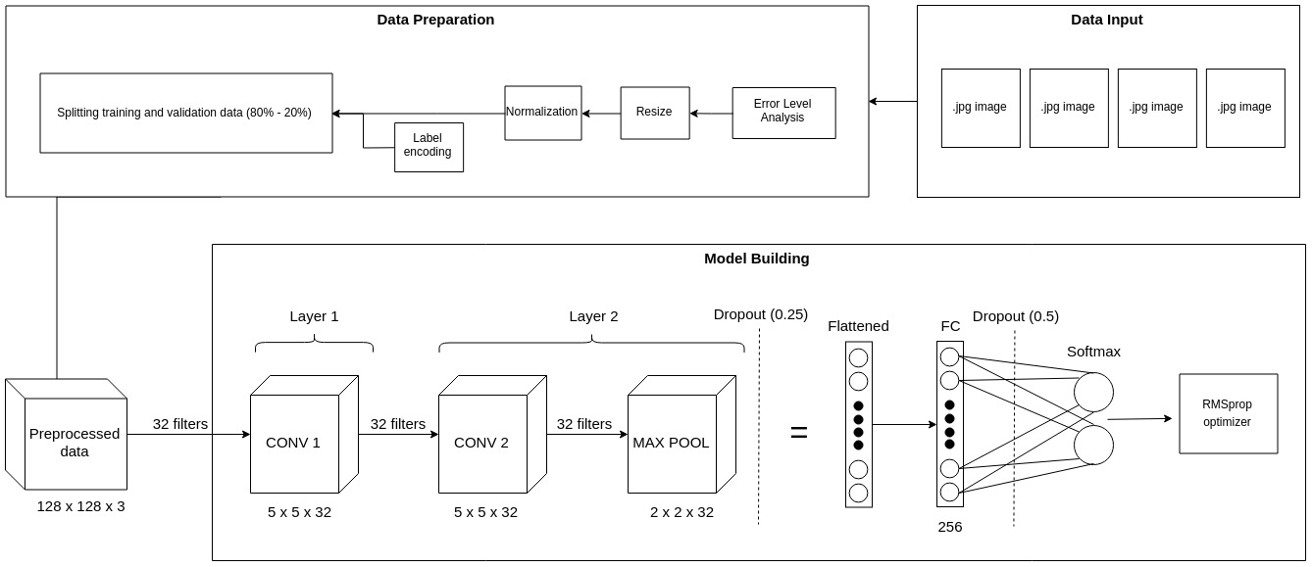
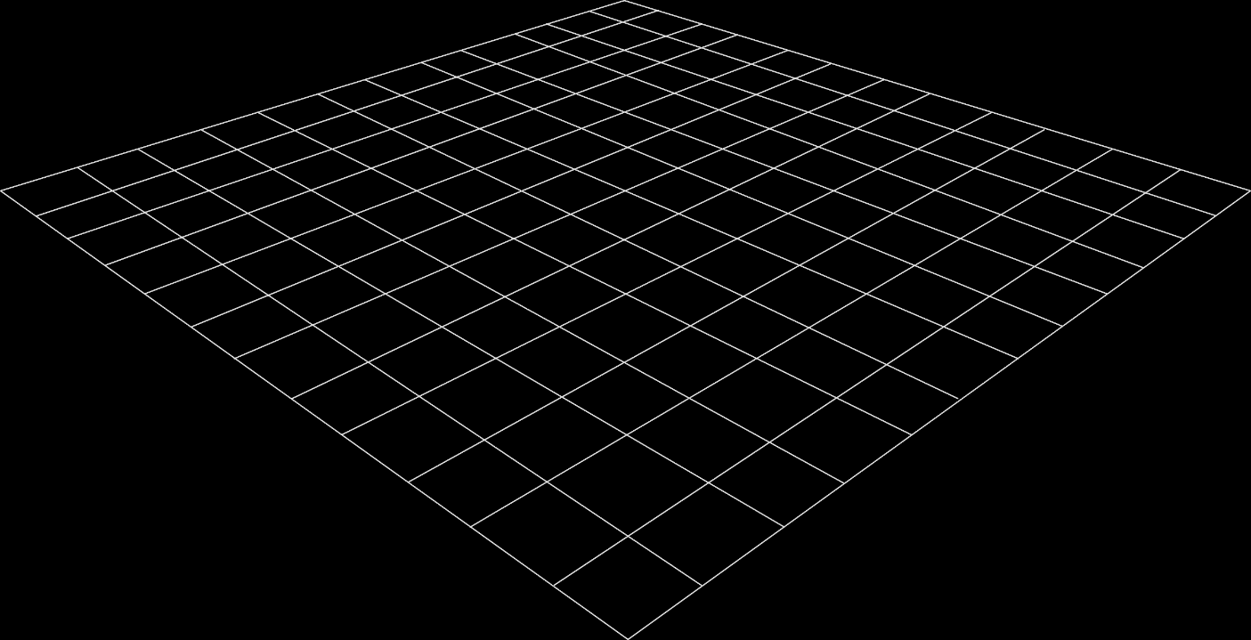
Fake Image Detection with ELA and CNN (OVERVIEW)
2D Slides
3D Models
Slides are a static portrait.
3D helps foster conceptual understanding and visual and spatial thinking.
Audience is passive and cannot interact.
Animated 3D models display objects within space in ways text and images cannot.

Slide 3
LIBRARIES AND MODULES USED
pandas and numpy are used for data processing and manipulation.
matplotlib.pyplot and matplotlib.image are used for data visualization.
seaborn is used for setting the style of the plots.
%matplotlib inline is a magic command that enables inline plotting in Jupyter notebooks.
np.random.seed(2) sets the random seed for reproducibility.
train_test_split and confusion_matrix are used for splitting the data into training and testing sets and evaluating the performance of the model.
itertools is used for creating iterable objects.
to_categorical is used for converting the class labels to one-hot encoded vectors.
Sequential is used for creating a sequential model.
Dense, Dropout, Flatten, Conv2D, and MaxPool2D are used for defining the layers of the CNN model.
RMSprop and Adam are used for defining the optimizer for the model.
ImageDataGenerator is used for data augmentation.
ReduceLROnPlateau and EarlyStopping are used for callbacks during training to adjust the learning rate and stop training early based on certain conditions.
sns.set sets the style, context, and color palette for the plots.

Slide 4

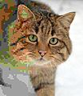
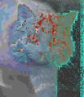
ERROR LEVEL ANALYSIS (ELA)
Error level analysis (ELA) is a technique used to determine the extent to which digital images have been altered. In this code, the ‘convert_to_ela_image’ function uses ELA to create a new image that highlights areas of the original image that have undergone compression or other forms of manipulation.
The ELA image is created by subtracting a resaved version of the original image from the original image itself. The resulting image highlights the areas of the original image that have undergone changes in pixel values due to the compression or manipulation process. By normalizing and enhancing the pixel values of the ELA image, the areas of change become more visible, allowing for easier identification of image manipulation.
A composite image, where the different parts have different JPEG compression levels
The same image with a uniform 90% quality JPEG compression
The difference between the two images shows a variation of the JPEG compression artifacts

Slide 5
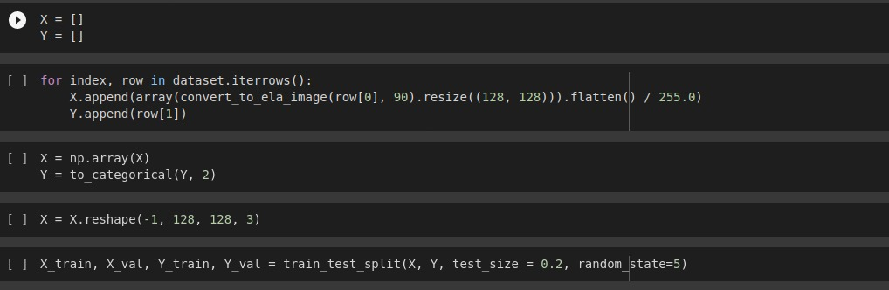
STEPS IN DATA PREPERATION
1. Read dataset and conversion to ELA
2. Resize
3. Normalization
4. Train Test split

Slide 6
CONVOLUTIONAL NEURAL NETWORK (CNN) BUILDING
The CNN used in the above code is a simple sequential CNN with two Convolutional layers, one MaxPooling layer, and two Dense layers. The architecture of the CNN is as follows:
Input layer: A Conv2D layer with 32 filters of size 5x5, using the ReLU activation function, and taking an input shape of (128, 128, 3) where 3 is the number of channels for RGB images.
Hidden layer: Another Conv2D layer with 32 filters of size 5x5, using the ReLU activation function.
MaxPooling layer: A MaxPooling2D layer with a pool size of 2x2.
Dropout layer: A Dropout layer with a rate of 0.25, which randomly sets input units to 0 during training to prevent overfitting
Flatten layer: A Flatten layer that flattens the output from the previous layer into a 1D vector.

Slide 7
Dense layer: A Dense layer with 256 neurons and the ReLU activation function.
Another Dropout layer: A Dropout layer with a rate of 0.5.
Output layer: A Dense layer with 2 neurons and the sigmoid activation function, which is used to classify the input images into one of two classes: real or fake.
The first two Conv2D layers learn features from the input images, and the Dense layers perform the classification. The MaxPooling and Dropout layers help to prevent overfitting and improve generalization.

Slide 8
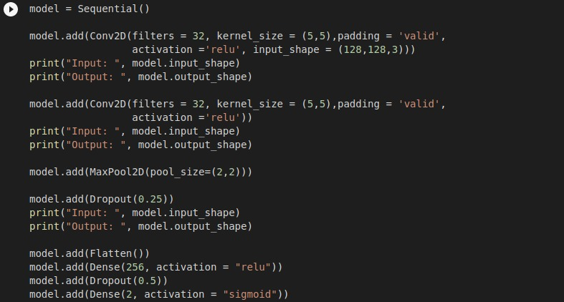

Slide 9
ACTIVATION FUNCTIONS
Sigmoid Activation function
The sigmoid function is defined as follows:
sigmoid(x) = 1 / (1 + e^(-x))
In this particular case, the sigmoid activation function is used to produce a probability distribution over the two classes (fake or real) in the output layer of the neural network. The output values of the sigmoid function can be interpreted as the likelihood of the input image being classified into each of the two classes, where a value close to 0 indicates a high likelihood of being classified as the first class (e.g., fake) and a value close to 1 indicates a high likelihood of being classified as the second class (e.g., real).
In the code, the ReLU activation function is used to introduce non-linearity into the model, allowing it to learn complex patterns and relationships within the input data. It is applied to the output of the convolutional and dense layers, which allows the model to learn different feature representations at each layer. This can help in speeding up the training process of the model, as it reduces the occurrence of the vanishing gradient problem and allows the model to learn faster

Slide 10
RMSprop optimizer
The RMSprop optimizer is a type of stochastic gradient descent optimization algorithm that is designed to converge faster and adapt to the changing weights in the neural network. The main idea behind the RMSprop optimizer is to scale the learning rate of each weight by dividing it by the root mean square (RMS) of the past gradients for that weight. This is done to prevent oscillations in the weight updates and to keep the gradients in a similar range. It is mainly used in the above code for training the deep learning model.
In the above code, the RMSprop optimizer is initialized with a learning rate of 0.0005, a rho value of 0.9, an epsilon value of 1e-08, and a decay of 0.0. These values are used to calculate the updated weights in the neural network during the backpropagation process. The optimizer is then compiled with a binary cross-entropy loss function and the accuracy metric.

Slide 11
LIMITATIONS
Limited Training Data: CNN requires a large amount of data to train effectively. However, fake images are usually generated in small quantities and are difficult to obtain. Therefore, the limited training data can result in a lower accuracy rate for detecting fake images.
Adversarial Examples: Adversarial examples are images that are intentionally designed to fool machine learning algorithms. Attackers can use these examples to bypass the fake image detection system and create convincing fake images that are difficult to detect.
Limited Detection Capability: ELA algorithm is not effective in detecting sophisticated image manipulations such as DeepFake, which involves the use of artificial intelligence to generate realistic fake images. It is mainly useful in detecting simple image manipulations such as image resizing or compression.
Computational Complexity: CNN requires significant computational resources to train and run. The process of training the CNN model and detecting fake images can be time-consuming and expensive, which may limit its applicability in certain contexts.

Slide 12
False Positives: The CNN and ELA algorithms are not perfect and can produce false positives, identifying genuine images as fake. This can be particularly problematic in situations where a high degree of accuracy is required, such as in legal or forensic applications.
Limited Interpretability: Neural networks like CNN are complex and opaque, meaning it can be difficult to understand how they arrive at their decision to classify an image as fake or genuine. This can be a problem for users who require interpretability and transparency in their decision-making processes.

Slide 13
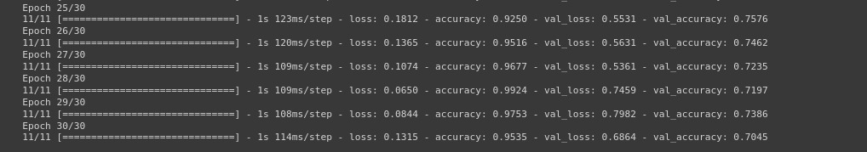
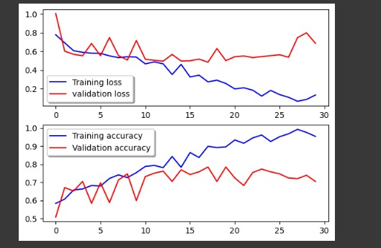
ACCURACY AND RESULTS

Slide 14
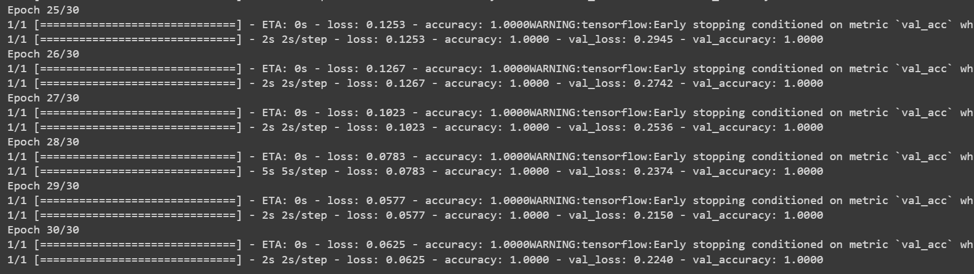
COMPARISON

Slide 15
MORDEN ALGORITHMS FOR FAKE IMAGE DETECTION
DeepFake Detection: This algorithm uses deep learning techniques such as Generative Adversarial Networks (GANs) and Convolutional Neural Networks (CNNs) to detect fake images. It trains a model on a large dataset of real and fake images to learn the differences between them and can detect even highly realistic DeepFake images.
Image Metadata Analysis: This algorithm examines the metadata of an image, such as the camera make and model, location, and creation date, to determine its authenticity. It can identify discrepancies in the metadata that indicate an image has been manipulated or created using a fake source.
Reverse Image Search: This algorithm uses a reverse image search engine to compare an image to a database of known real and fake images. If the image matches a known fake image, it is flagged as fake.

Slide 16
Noise Analysis: This algorithm analyzes the noise patterns in an image to identify any inconsistencies that may indicate manipulation. It compares the noise patterns in different regions of the image to identify discrepancies and flag images that have been manipulated.
Face Manipulation Detection: This algorithm uses facial recognition technology to detect inconsistencies in facial features, such as eye placement, skin tone, and hair. It can identify images where the face has been manipulated or replaced and flag them as fake.

Slide 17
This concludes our presentation Thank You

