Slide 1
Title-Analysis of Customer Service Data for an E-commerce Company Nile.

Slide 2
1. Business Understanding-
Nile is an e-commerce company and operates online, selling products. Customer service in these companies resolves issues like delivery problems, product defects, refunds, and order tracking through communication channels.
2. Data Understanding-
Categorical Variables
Mode of communication used by customer (Channel)
Reason behind the complaint
Response time
Call center location
City, State, Month, Year
Continuous Variables
Customer Sentiment
CSAT score
Call duration in minutes

Slide 3
3. Data Preparation-
Following operations were undertaken to transform the raw data into clean data for scalable analysis.
Extraction of year, month, and date from date_time column.
Assigning value to customer sentiment, as it was measured on interval scale.
Handling the missing values (Check for fill).
Custom grouping to classify states into three distinct categories.
Duplicates handling, sorting, and trimming the dataset.
4. Development of Interactive Dashboard-

Slide 4
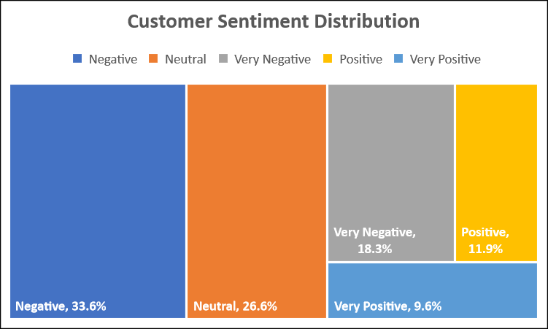
Objective 1- Customer Sentiment Analysis
Customer Sentiment Analysis
Mean | 2.61
Standard Error | 0.01
Median | 2.00
Mode | 2.00
Standard Deviation | 1.19
Sample Variance | 1.42
Kurtosis | -0.59
Skewness | 0.48
Range | 4.00
Minimum | 1.00
Maximum | 5.00
Sum | 85976.00
Count | 32941.00
Ranking used to convert text data to numeric data-
1 | Very Negative
2 | Negative
3 | Neutral
4 | Positive
5 | Very Positive
The mean value for customer sentiment variable is below 3. Hence, the customers are said to remained unsatisfactory for the given time period.

Slide 5
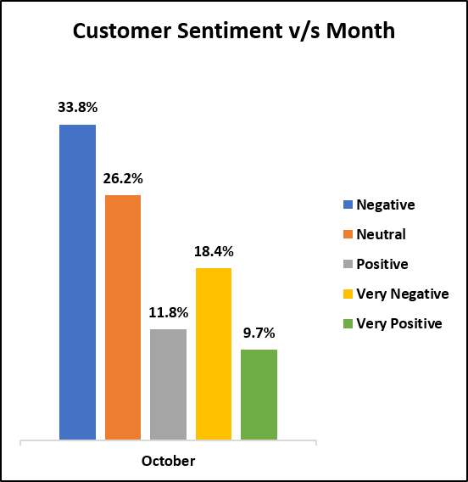
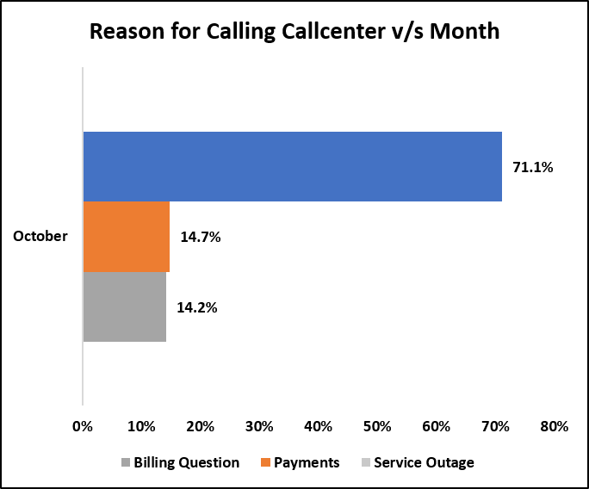
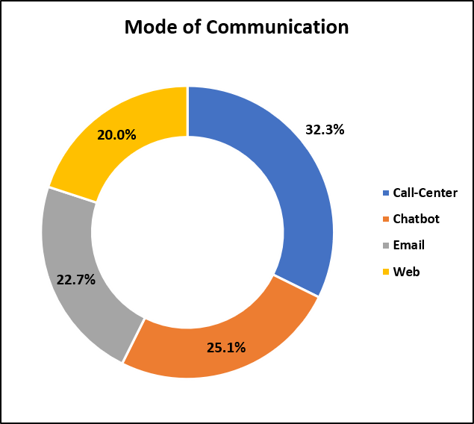
Objective 2- Root Cause Analysis
In 2020, the October month registered maximum no of complaints (63.9%).
Most of the Customers complain regarding the billing issue.
Communication mode used by customers (Chatbot, Email, Web)- 67.7%
Communication mode used by customers (Call Center)- 32.7%
Billing question is the main reason for contacting the call center and customers preferred digital/online communication to convey their problem.

Slide 6
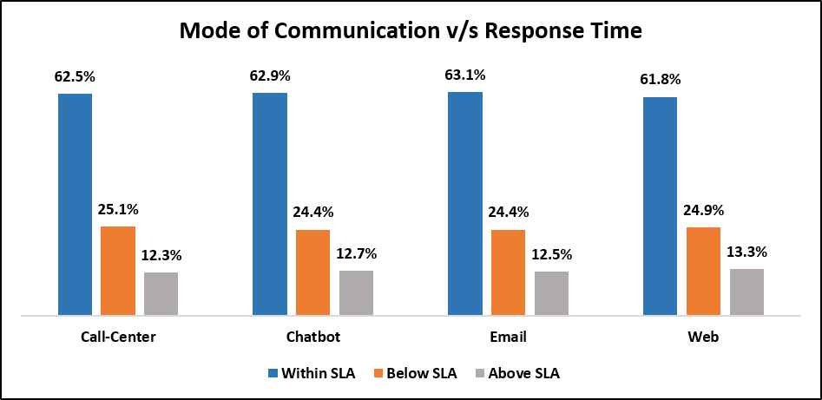

Objective 3 - Service Response Time Analysis
Irrespective of mode of communication and call center location, the response time percentage for below SLA remained (25%) and within SLA remained (62%).
Hence Company need to work on improving response time, i.e. promptly provide service to the customer request.
No service centre is lagging behind in terms of performance and customer service delivery.

Slide 7
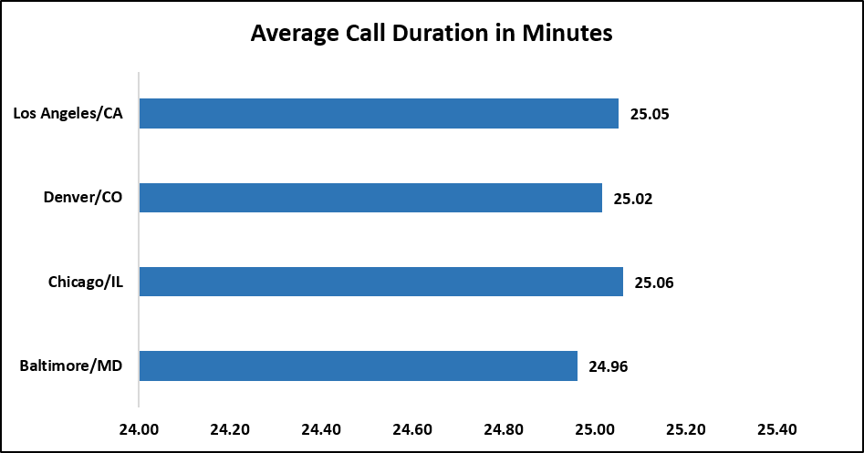
However, despite having (62%) response well within stipulated time and (12%) above SLA, customers are still showing negative sentiments.
The observed average call duration= 25 Mins (high).
Given that the average call duration and the distribution of negative and very negative customer sentiments are consistently similar across all call centers, we can infer a correlation between longer call durations and negative customer sentiment levels.
Call_Center | Negative | Neutral | Positive | Very Negative | Very Positive | Grand Total
Baltimore/MD | 33.2% | 27.2% | 11.6% | 18.8% | 9.2% | 100.0%
Chicago/IL | 34.0% | 25.6% | 11.7% | 19.3% | 9.4% | 100.0%
Denver/CO | 33.3% | 26.8% | 12.0% | 17.9% | 10.0% | 100.0%
Los Angeles/CA | 33.8% | 26.4% | 12.3% | 17.6% | 9.9% | 100.0%
Grand Total | 33.6% | 26.6% | 11.9% | 18.3% | 9.6% | 100.0%
Hence, the time duration service executives taking to comprehend client issues, even after being communicated through various digital channels, can be considered as an important factor contributing to negative sentiment creation.

Slide 8
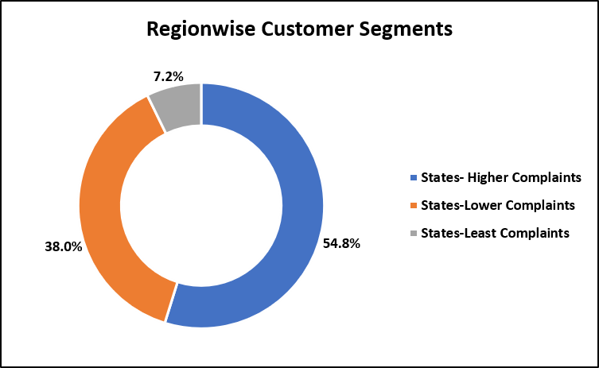
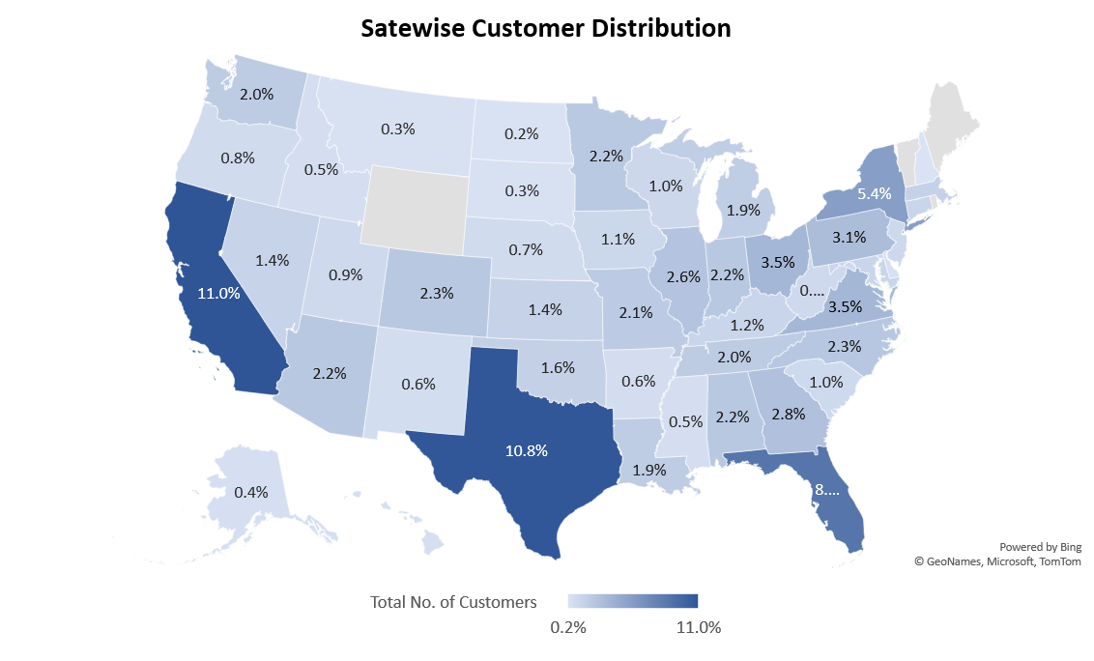
Objective 4 - Customer Segmentation
Customer Segmentation-
1). Region
2). Sentiment
3). Mode of channel
Total customers are segmented based on region. Three distinct regions are created where higher, lower, and least number of complaints being generated.
States with high customers
California | 11.0%
Texas | 10.8%
Florida | 8.6%
New York | 5.4%
Virginia | 3.5%
Cities with high customers
Sacramento | 1.04%
Los Angeles | 1.00%
San Diego | 0.78%
San Francisco | 0.77%
Fresno | 0.64%

Slide 9
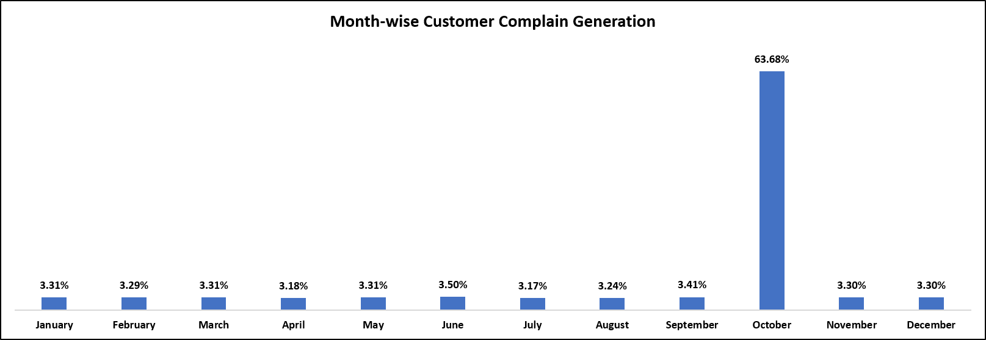
Objective 5 – Trends and Patterns Identification
In the October month, maximum complains were registered.
As we have understood that, the customers are complaining regarding the billing question, there must be some problem or efficiency was likely to be occurred in billing generation & maintenance system (SAP).

Slide 10
Recommendation to Nile’s -
1. Find out why service executives taking so much of time, while understanding/redressing client query?
Proper training program.
Technology intervention (To address the billing related problems faced by customer).
Dedicated team to solve billing issues.
2. Reduce the existing response time for within SLA and below SLA time. Map the SLA time for competitors and devise a strategy accordingly. (What competitors are doing?/How they are handling customer problems?).
3. As (67.7%) customers are preferring online/digital communication, ask the service executives to be more proactive. (Create standard operating procedure to reduce service time & service failure, while resolving issues recorded through Chatbot, Email, and Web mode).
4. Make digital/online communication mode more interactive (Animations & Coupons).

Slide 11
