Slide 1
Title-Analysis of Fincorp Lending Data to Evaluate the Lending Process/Fraud Detection and Improve it's Market Offerings.

Slide 2
Objective(1)-Perform basic data cleaning, standardize data formats using Power Query, calculate total loans, average interest rates, basic loan statistics using DAX
A. Most of the business is coming from the education loan segment, followed by business segment.
B. Firm is accepting loan applications across the region, age_group, and profession of the applicant.
C. As close to 50.0% of the loan applications have a history of (loan default+timely non payment of loans), and close to 66.0% of the loan applicants were not able to pay their last loan EMIs, application scrutiny needs to be made rigorously.
D. Around 33.3% of borrowers are living in own house, these applications can be considered on a priority basis for fast loan disbursal. (Strong collateral availability)
E. The firm is a short term financial lender, and average time frame ofr the loan repayment remains 3 years.
F. The credit score of the applicant remained at 573.0, which is a concern for the firm. Hence, applicants with low credit score should be given more time for approval.
G. A total of 1,00,000 loan applications are processed by the firm over 6 years of time, making it a very high application processor.
H. As the duration of loan repayment is very low, disbursement 8.0 Billion of loans, likely to represent speedy operationability of the firm.

Slide 3
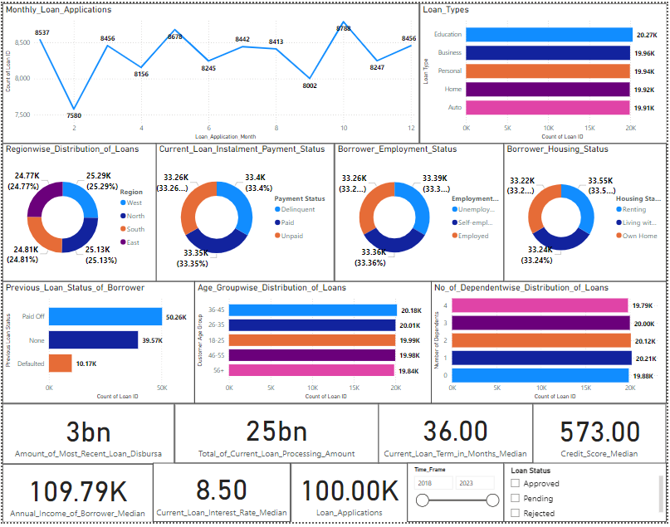

Slide 4
Objective(2)-Tailor loan products effectively and identify profitable customer segments.
Identification of Profitable Customer Segments-
A. Loan_Type-
Education_loan (20.5%) and Home_loan(20.5%)
B. Employment_Status-
Employed_borrowers
C. Age_Group-
35-60 Years(20.4%) and 18-25 Years(20.2%)
D. Region-
West
E. Housing_Status/Collateral_Availability-
Living with parents (33.4%)
Living in rental property (33.3%)
The Total Expected Profit Generation by the Firm over The Forecast Period Remained at 2.98 Billion From Approved Loans.
Loan Product Should be Designed by considering the requirements of these profitable segments.

Slide 5
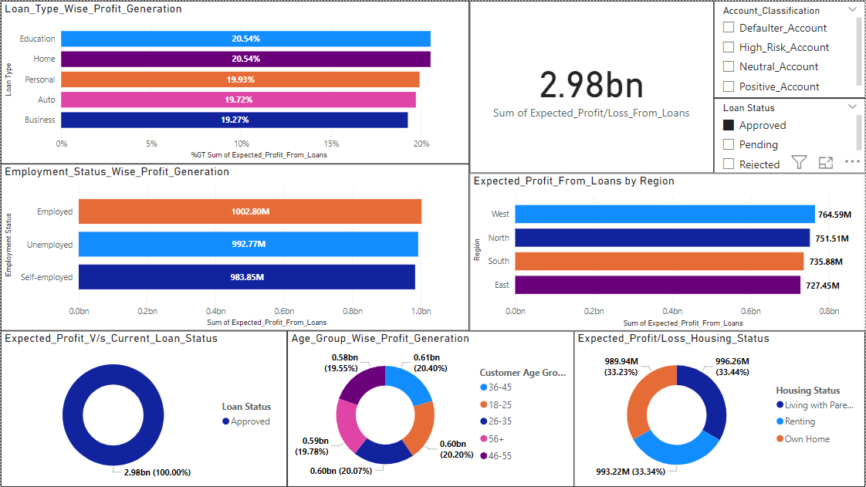

Slide 6
Objective-(3)-Categorize customers based on loan application; visualize the segments with complex charts.
Customer Segmentation Based on Loan Application-
A. Loan_Duration_Preference-
1-Year Duration
5-Year Duration
B. Customer_Age_Group-
36-45 Years
26-35 Years
C. Credit_Score-
Credit_Score>600 (45.0%)- Classified as borrowers with best credit score.
Credit_Score>400 (45.0%)- Classified as borrowers with bad credit score.
D. Previous_Loan_Status-
Paid_off-(50.2%)
None-(39.6%)
E. No_of_Dependents-
Maximum applicants have number of dependents lying between 1-2
F.Housing_Status_of_Applicant (Collaterals)-
Applicants living in rental property-(33.5%)

Slide 7
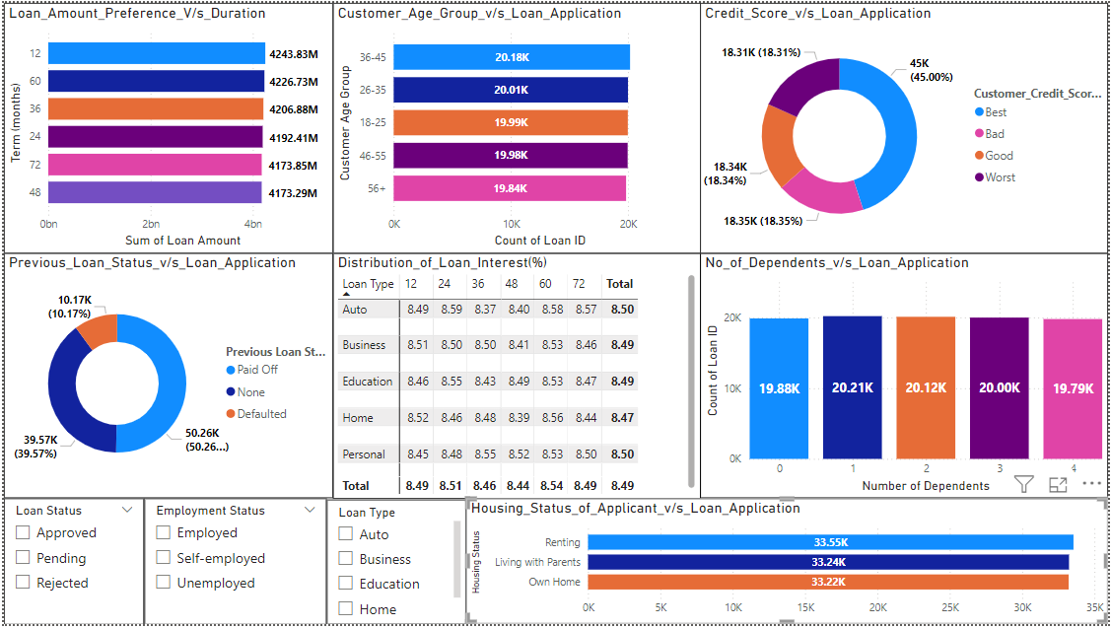

Slide 8
Objective (4)- Time-Series Analysis, Forecasting, and Trend Identification for Loan Applications across the Loan Types
Yearly_Loan_Approval_Trend-
There is a consistent proportion of around (34::33::33-Loan_pending::Loan_approval::Loan_rejection) over the timeline. Hence, the loan approval rate is very high in terms of total applications received.
B. The loan application, loan approval, and loan pending follows the sinusoidal pattern, thereby the firm is likely to follow the same pattern over the next 5 years.
C. But for the loan rejections, the pattern is expected follow a zero gradient line graph/stagnancy.
D. The financial firm has been giving around 33.0% approval to the loans each year, out of which only 33.8% of the borrowers are consistent in terms of the monthly installment payment.
E. Additionally, for the loan pending and rejection, similar observations can be taken out. Hence, there is a need to inculcate SoPs in the loan approval process.
F. I. In the Fourth quarter of each year, loan applications received by firm increases thereby loan approvals increases rapidly as compare to other quarters.

Slide 9
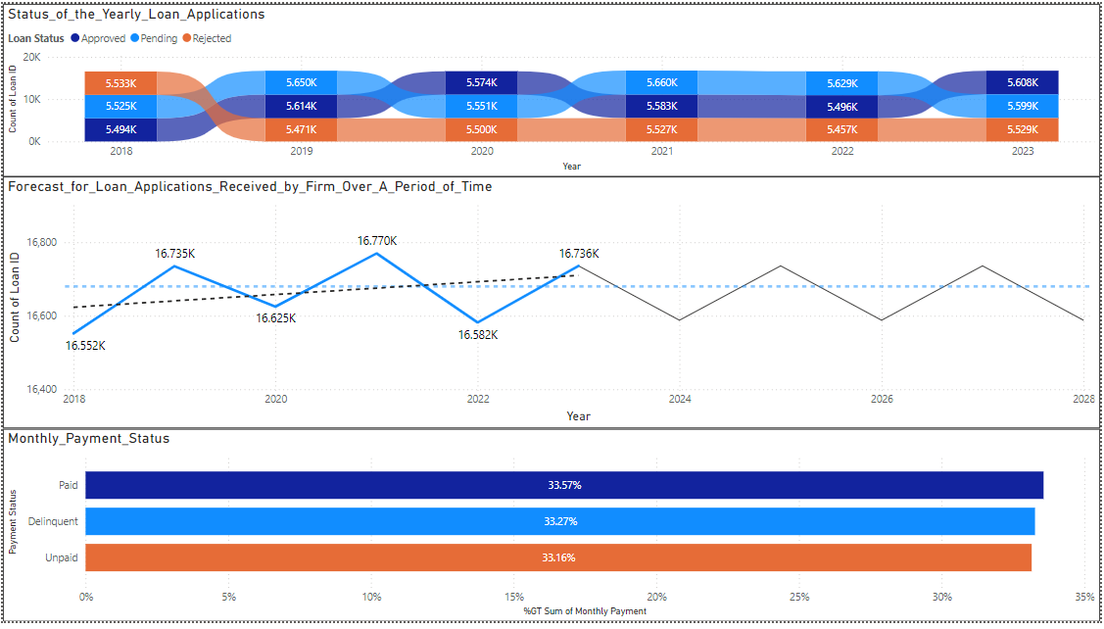

Slide 10
Objective (5)-Understanding the NPAs and Fraud Detection
On an average the firm approved 4 loans to a single borrower, which is likely to create a high NPA situation over the long term.
There are a total of 6,729 borrowers who received approximately 2 loan approvals with credit_score classified as bad (<400) and worst(<200), thereby creating a high risk scenario.
Furthermore, out of the above 6,729 borrowers 4,471 borrowers are considered as defaulters, that have either defaulted the previous loans and never settled the loan amount. The firm gave around 6,099 loans to these 4,471 borrows making it very high risk business.
In addition to that, this high risk 4,471 borrows are distributed uniformly across the age categories and loan types.
The average monthly income of these 4,471 borrowers remained as 9,0150.0 Rs and the monthly installment they require to pay for all the loans combined remains at 9,120.0 Rs Due to which, the monthly outstanding loan installment amount remained at -664.8 Rs. on an average. This indicates a likeliness of fraud in the firm.
With such scenario, the chance of these 4,471 borrowers with 6,099 loan account is likely to become NPAs.
Finally, out of the given 6,099 loans a total of 4,082 loan accounts are expected to become NPAs and 3,295 borrowers holding these loan accounts have not paid monthly installment.
As such high discrepancy at loan approval stage is not acceptable in financial sector, there is a need to scrutinize the loan approval process of 3,295 borrowers to understand the extent of fraud.

Slide 11
