Slide 1
Name-Aniruddha M. Khedkar Graded Project on EDA(Python) Title- Exploratory Data Analysis to Evaluate and Optimize Bank Telemarketing Campaign for Revenue Enhancement.

Slide 2
Business Understanding-
The bank seeks to boost revenue through a cost-effective telemarketing campaign targeting term deposits for existing customers. Term deposits are fixed-rate investments that strengthen long-term customer relationships.
Steps Followed to Conduct the EDA-
Data Cleaning/Handling Inconsistencies in Attributes.
Assigning Proper Datatype.
Missing Value Handling (Imputation).
Check the Normality/Statistical Distribution of Attributes.
Handling Outliers.
Duplicate Removal.
Data Analysis.
Reporting.
Identification of Patterns and Provide Insights to Improve the Positive Response Rate for the Opening of Term-deposit Account.
Tool_used_for_Analysis-Python (Jupyter Notebook)

Slide 3
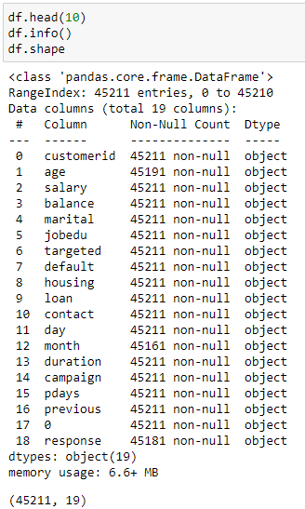
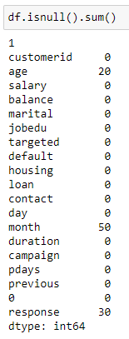
Objective-1 (Understanding the Dataset)
jobedu attribute
It has 2 attributes (Strip)
month attribute
It contains month & year (Strip)
duration attribute
It has both units (Converted into min)
0 attribute
Need to assign column name to attribute
All attributes
In string format (Assign data type)
Shape of dataset
(45211-Rows and 19-Column)

Slide 4
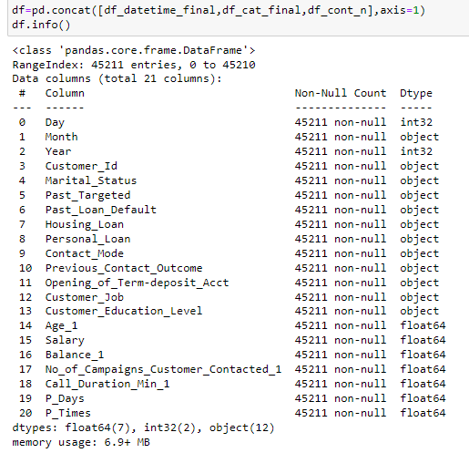
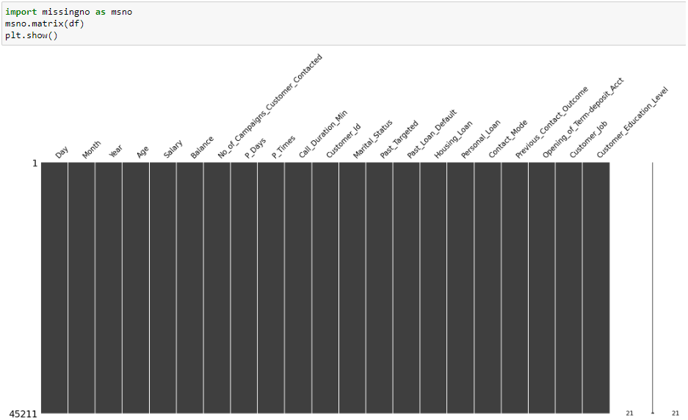
Final Dataframe after handling the missing values, outliers, and duplicates is given as below- (Suffix_1-indicates variables where outlier handling was carried out)
Categorical Variables-12
Continuous Variables-7
Datetime Variables-3
Depending on the type of variable descriptive statistical parameters are computed.

Slide 5
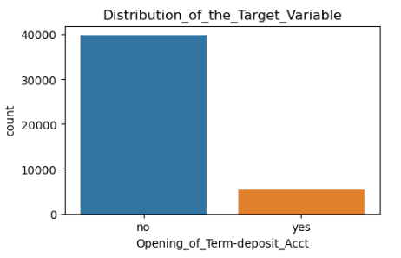
Objective-2 (Descriptive Statistics)
Attributes | count | mean | median | mode | std | min | 25% | 50% | 75% | max | Skewness | Kurtosis
Age_1 | 45211.0 | 40.86 | 39.0 | 32.0 | 10.38 | 18.0 | 33.00 | 39.0 | 48.00 | 70.00 | 0.52 | -0.41
Salary | 45211.0 | 57006.17 | 60,000.0 | 20,000.0 | 32085.72 | 0.0 | 20000.00 | 60000.0 | 70000.00 | 120000.00 | 0.14 | -1.01
Balance_1 | 45211.0 | 933.71 | 448.0 | 3462.0 | 1176.77 | -1962.0 | 72.00 | 448.0 | 1428.00 | 3462.00 | 1.10 | 0.01
No_of_Campaigns_Customer_Contacted_1 | 45211.0 | 2.39 | 2.0 | 1.0 | 1.60 | 1.0 | 1.00 | 2.0 | 3.00 | 6.00 | 1.10 | 0.07
Call_Duration_Min_1 | 45211.0 | 3.92 | 3.0 | 10.72 | 2.95 | 0.0 | 1.72 | 3.0 | 5.32 | 10.72 | 1.04 | 0.11
P_Days | 45211.0 | 40.20 | -1.0 | -1.0 | 100.13 | -1.0 | -1.00 | -1.0 | -1.00 | 871.00 | 2.62 | 6.94
P_Times | 45211.0 | 0.58 | 0.0 | 0.0 | 2.30 | 0.0 | 0.00 | 0.0 | 0.00 | 275.00 | 41.85 | 4506.86
Distribution_of_Target_Variable- [Opening_of_Term_Deposit_Account]
count | 45211
Unique | 2
top | No
freq | 39,924
dtype | Object
Conclusions
There might be a problem with communication channel used by the bank. (Mode is high & Median is very low, indicating that for most of the calls, proper communication is happening and for others it’s not happening properly.)
As the response for the Opening_of_Term_Deposit_Account attribute is negative, the campaign may be considered as ineffective.

Slide 6
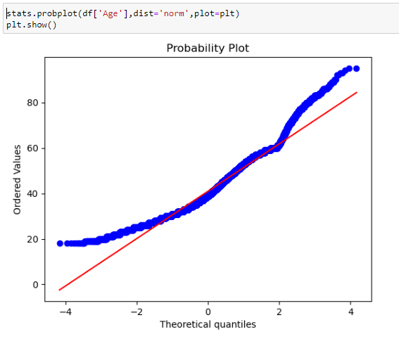
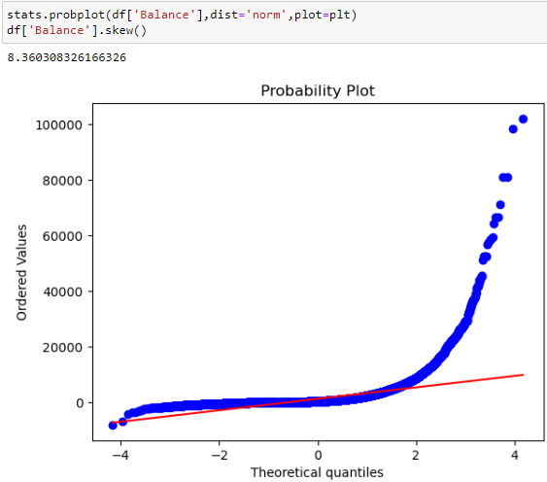
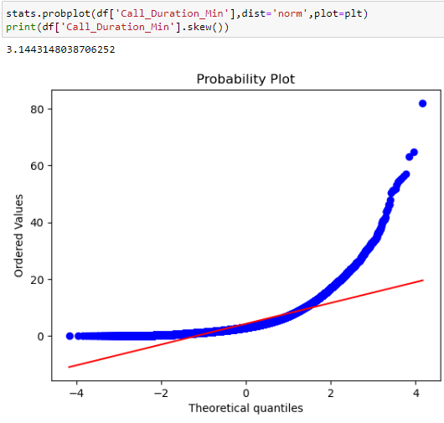
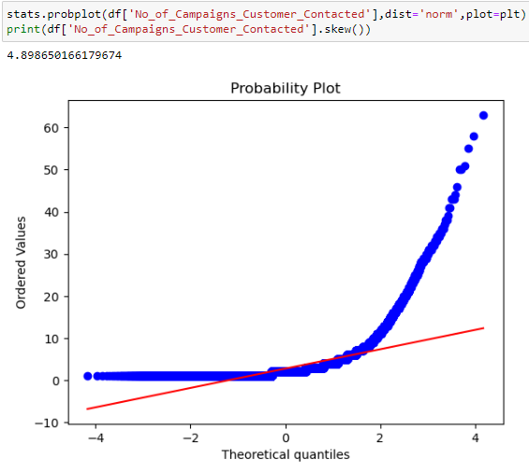
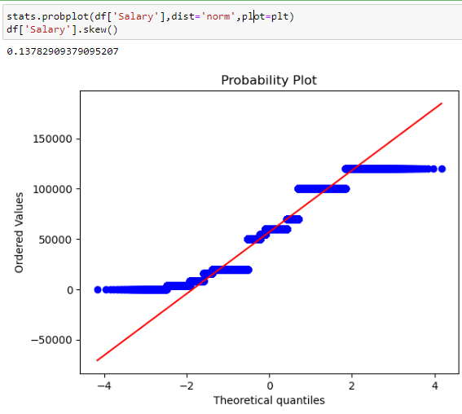
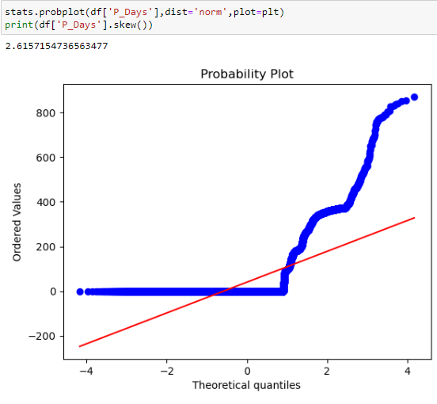
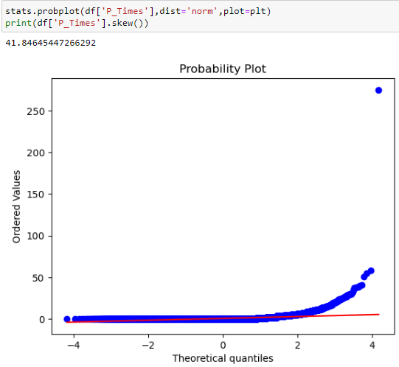
Objective-3 (Univariate Analysis)[For_Continuous_Variables]
Age
Balance
Call_Duration_Min
No_of_Campaigns_Customer_Contacted
Attributes following Normal Distribution-
Age
Balance
Call_Duration_Min
No_of_Campaigns_Customer_Contacted
Salary
P_Days
P_Times

Slide 7
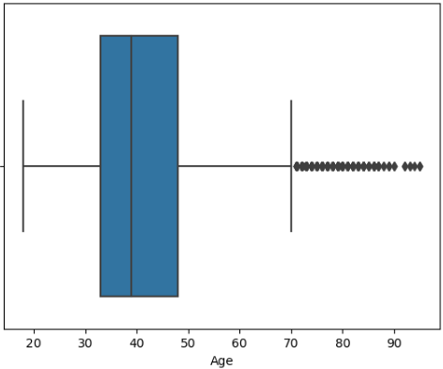
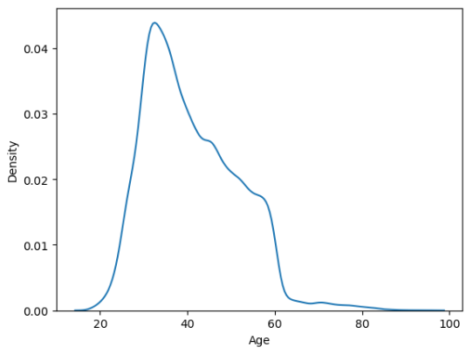
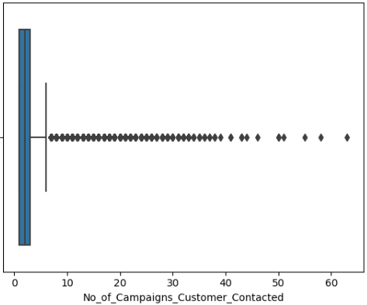
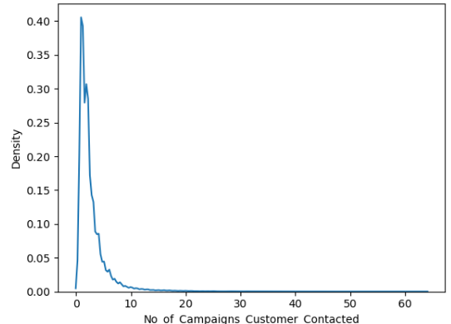
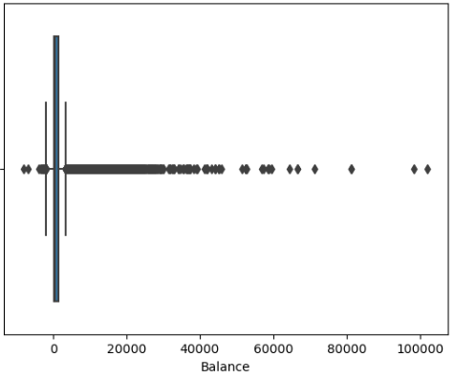
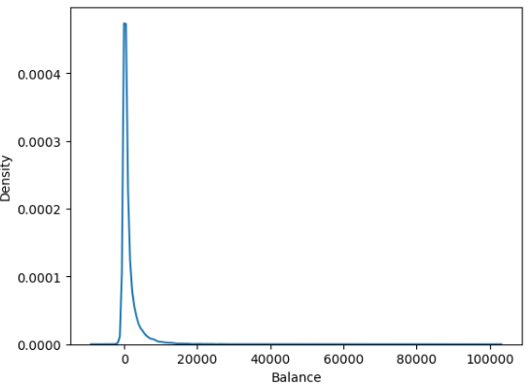
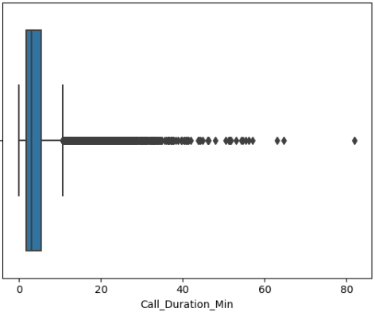
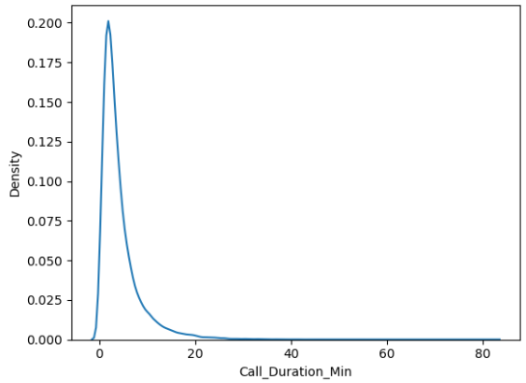
Objective-3 (Univariate Analysis)
Age
No_of_Campaigns_Customer_Contacted
Balance
Call_Duration_Min

Slide 8
Objective-4 (Bivariate Analysis) [For_Categorical_Variables]
Contact_Mode | Opening_of_Term-deposit_Acct
 | no | yes
cellular | 24918 | 4367
telephone | 2516 | 390
unknown | 12490 | 530
Past_Loan_Default | Housing_Loan | Personal_Loan | Opening_of_Term-deposit_Acct
 |  |  | no | yes
no | no | no | 13873 | 3119
 |  | yes | 2498 | 211
 | yes | no | 18814 | 1647
 |  | yes | 3976 | 258
yes | no | no | 197 | 15
 |  | yes | 160 | 8
 | yes | no | 280 | 22
 |  | yes | 126 | 7
Customer_Job | Opening_of_Term-deposit_Acct
 | no | yes
admin. | 4541 | 630
blue-collar | 9024 | 708
entrepreneur | 1364 | 123
housemaid | 1131 | 109
management | 8157 | 1301
retired | 1748 | 516
self-employed | 1393 | 186
services | 3785 | 369
student | 669 | 269
technician | 6757 | 840
unemployed | 1101 | 202
unknown | 254 | 34
Past_Targeted | Previous_Contact_Outcome | Opening_of_Term-deposit_Acct
 |  | no | yes
no | failure | 735 | 163
 | other | 268 | 69
 | success | 135 | 274
 | unknown | 5648 | 828
yes | failure | 3548 | 455
 | other | 1265 | 238
 | success | 398 | 704
 | unknown | 27927 | 2556
Customer_Education_Level | Opening_of_Term-deposit_Acct
 | no | yes
primary | 6260 | 591
secondary | 20753 | 2449
tertiary | 11306 | 1995
unknown | 1605 | 252

Slide 9
Objective-4 (Bivariate Analysis) [For_Continuous_Variables]
Attribute | Opening_of_Term-deposit_Acct
 | no | yes
Call_Duration_Min_1 | 2.73 | 7.10
Age_1 | 39.0 | 38.0
Balance_1 | 417.0 | 733.3
No_of_Campaigns_Customer_Contacted_1 | 2 | 2
Customer contacted through cellular contact mode resulted in more term account openings
Targetted customers with no past loan default showed positive response towards telemarketing campaign
Customers who have high balance, opened accounts as compared with lower balance customers.
The average call duration time for account opening decision remained significantly different, hence there is a relationship between call duration and conversion.
Clients with management job type, technician, blue-collar, and admin workers opened more term accounts.
Potential customers with secondary education level opened more accounts.
There is no significant difference in the age of the cutomers showing positive or negative response to the account opening
No of campaigns by which customers are contacted does not showcased any relationship with term-deposit account opening.

Slide 10
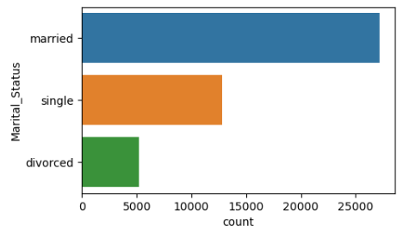
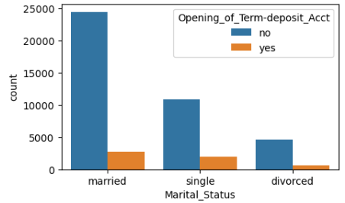
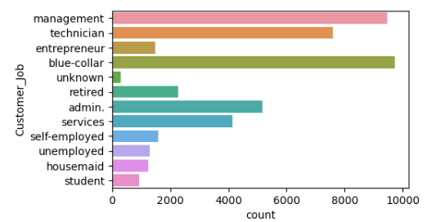
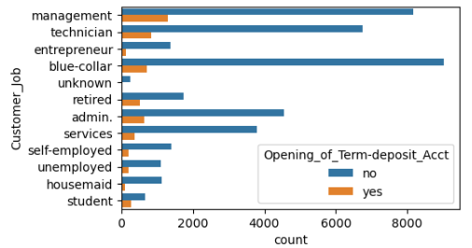
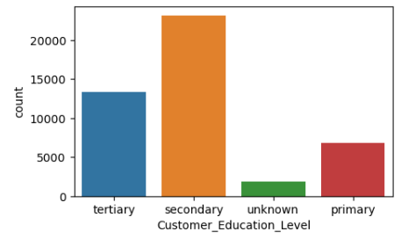
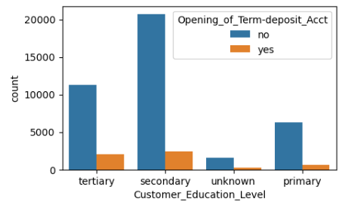
Objective-5 (Categorial Variable Analysis)
Marital_Status is not a significant factor impacting the term-deposit account opening decision.
Customer_Job with subcategories [Management, blue-collar, admin, technician, and services] are imp.
Customer_Education_Level is an important attribute impacting the response. (Tertiary education should also be given more preference).

Slide 11
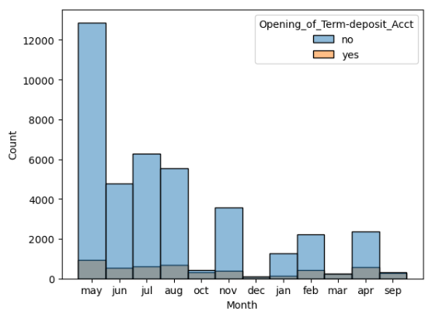
Objective-6 (Temporal Analysis)
Month | Opening_of_Term-deposit_Acct
 | no | yes
may | 12867 | 930
jul | 6262 | 626
aug | 5552 | 688
jun | 4791 | 544
nov | 3565 | 403
apr | 2354 | 577
feb | 2207 | 439
jan | 1260 | 142
oct | 415 | 323
sep | 308 | 268
mar | 229 | 247
dec | 114 | 100
Day | Opening_of_Term-deposit_Acct
 | no | yes
20 | 11066 | 3409
21 | 1762 | 118
19 | 1577 | 73
28 | 1554 | 59
29 | 1544 | 45
1. Campaign is run heavily in the May, June, July, and August month. But the conversion rate during the same month is very low, indicating ineffectiveness of the campaign.
2. In the October, December, March, and September, campaign have not run so heavily. Still these month showcased the higher term-deposit opening.
5. Middle dates of month generally offers good response, as the customers might have generated sufficient balance after paying the monthly dues.

Slide 12
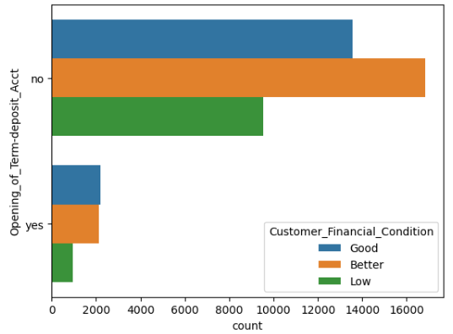
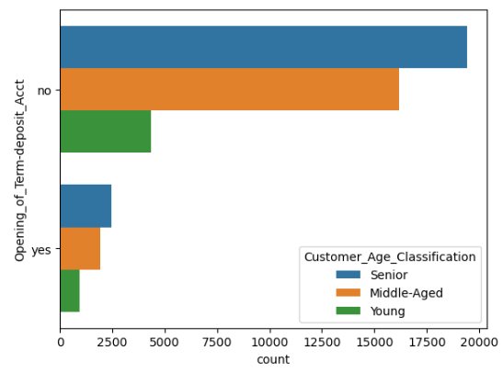
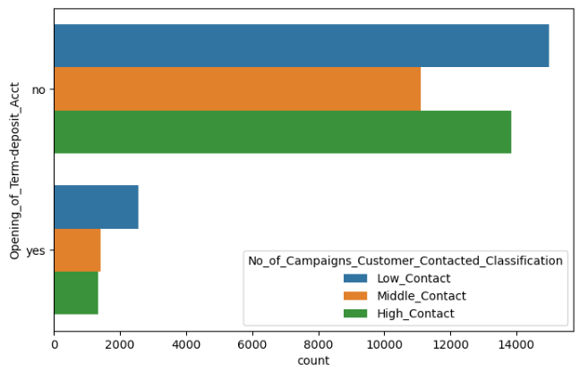
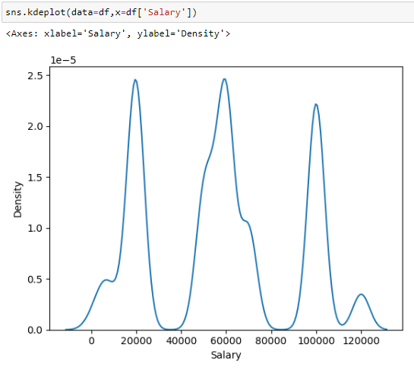
Objective-7 (Feature Engineering)
Customer_Age_Classification-
Young= Age_1<30
Middle-Aged= Age_1<40
Senior= Age_1>40
No_of_Campaigns_Contacted_Classification-
Low_Contact= No_of_Campaigns_Contacted _1<2
Middle_Contact= No_of_Campaigns_Contacted _1<3
High_Contact= No_of_Campaigns_Contacted _1>3
Customer_Financial_Condition-
1. Low= Salary<40000 & Balance_1<1500
2. Better= Salary<80000 & Balance_1<2500
3. Good= Salary>80,000 & Balance_1>2500
Distribution_of_Salary_Variable

Slide 13
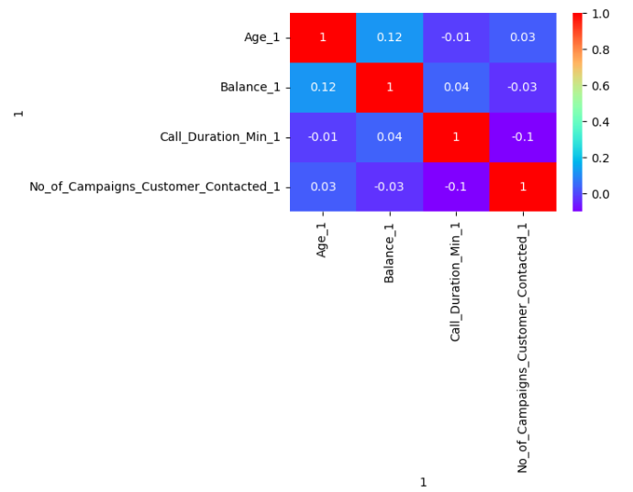
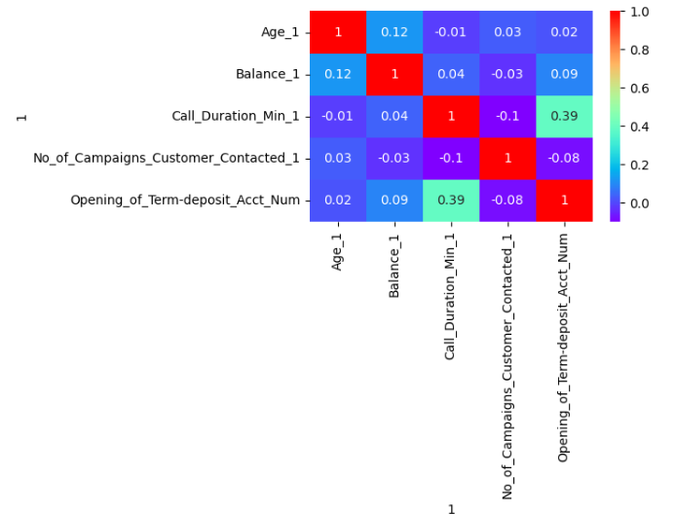
Objective-8 (Correlation Analysis)
Heat_Map_to_Evaluate_Multicollinearity
Heat_Map_to_Evaluate_Correlation_between_Independent_Variables_and_Target_variable
As the Pearson's correlation coefficient for the Age, balance, call duration attributes, and No_of_Campaigns_Customer_Contacted remained less than 0.1, there is no relationship between them.
Hence, there is no presence of multicollinearity between the independent variables.
The Pearson's correlation coefficient for the dependent targer variable [Opening_of_Term-deposit_Acct_Num] and independent varaiable [Call Duration_1] is 0.4.
Hence, there exists a positive moderate relationship between these two variables.

Slide 14
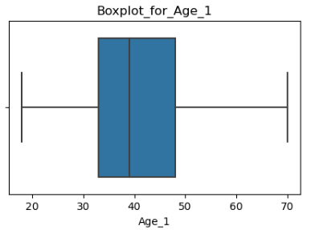
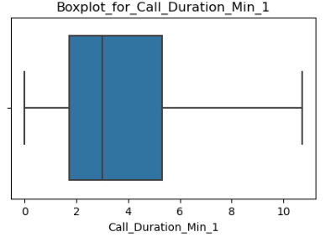
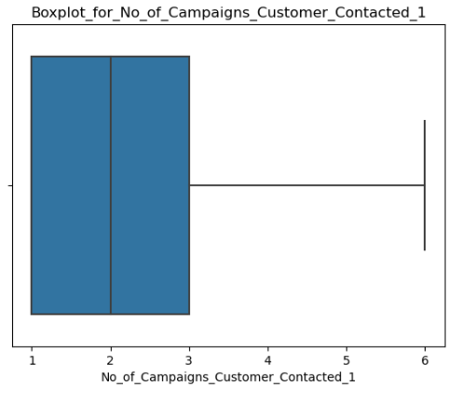
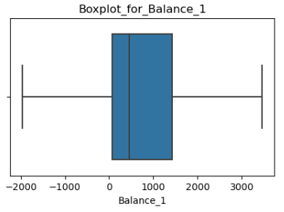
Objective-9 (Outlier Detection and Handling) [IQR Method[~10% of total data]]
Age_Variable
Call_Duration_Variable
No_of_Campaigns_Customer_Contacted_Variable
Balance_Variable

Slide 15
Findings-
1. Problem with Customer Targeting-
This campaign is offering/targeting its product to the customers with diversified economical & social background, and demographics. This has led to the problem of one fit for all.
2. Communication problem-
Call_Duration_Min_1[(Median<<<<Mode)] & Call_Duration_Min_1 is directly proportional to the positive response from customers.
This indicates that, for some of the calls the call duration is very less, indicating problem with the communicator/communication channel.
3. Improper understanding of high prospect customer segment by campaigner-
The campaigner might not be aware about the customers that are expected to open the term-deposit account easily, before the start of campaign. For example- Financial condition of the potential customer, their occupation which are more likely to open the term-deposit account.
Recommendations-
1. Ask the marketing team to finetune the customer segment they are intending to target and provide same to the team responsible for running the campaign. [To improve the targeting]
2. Improve the communication channel (Digital channels & Employee training)
3. Remapping the product’s market relevance, as for some of the ideal potential customers the offered product is not catering their new needs. [To map potential change occurred in customers’ requirements]

