Slide 1
Title-SQL Data Analysis & Visualization With Power BI for FDA.

Slide 2
Business Understanding-
The U.S. Food and Drug Administration (FDA) is a federal agency responsible for safeguarding public health in the United States (Drugs, Forms, Approvals, Market Status)
SQL-
Create Informative Report Pertaining to Approvals, Market Status of Various Types of Drugs
Schema Creation
Table & Data Addition
ER Diagram in SQL (Understanding PK & FK)
Query Writing (Data Retrieval)
Chart Preparation & Dashboard Creation (Power BI)-

Slide 3
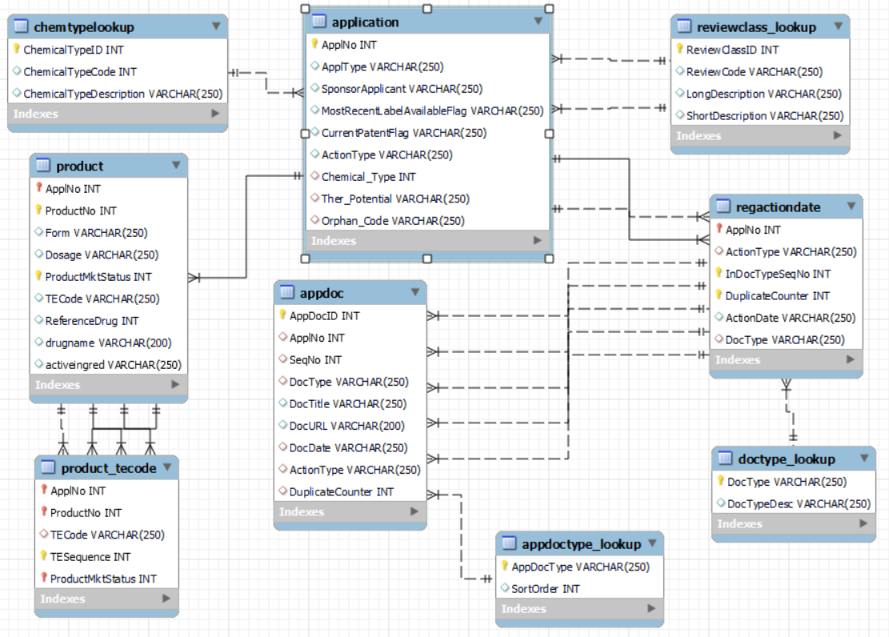
ER-Diagram

Slide 4
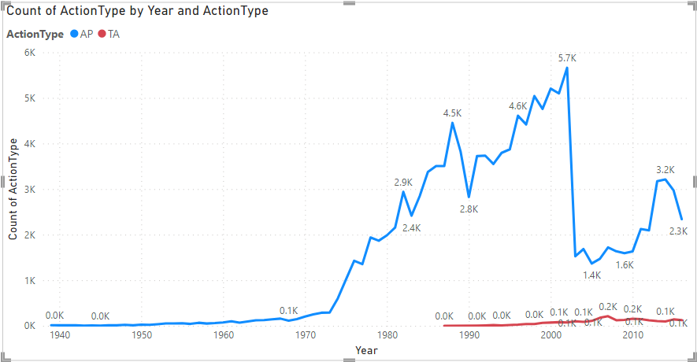
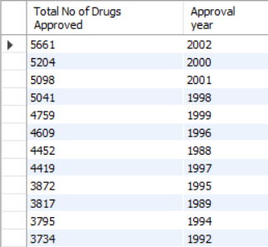
Objective 1-Visualize the yearly approval trends of drugs. Highlight any significant patterns and/or fluctuations, if any.
Year- 2002,2000,2001
Maximum no of Drugs Approved

Slide 5
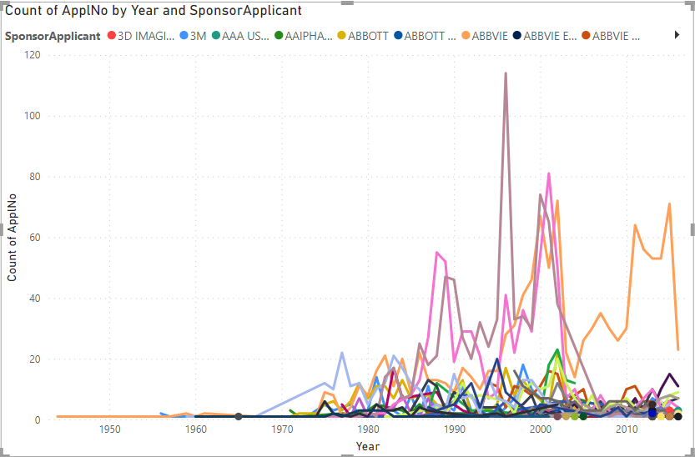
Objective 2- Explore approval trends over the years based on different sponsors. Uncover patterns and changes in approval rates among sponsors.
From the 1980 onwards, the number of applicant/Sponsor has been continuously growing.
The highest surge can be observed between mid 1990’s and 2010’s.

Slide 6
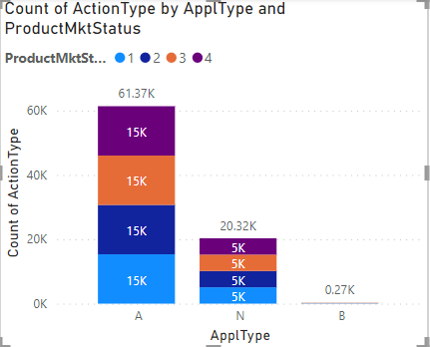
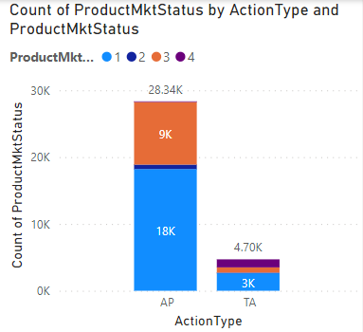
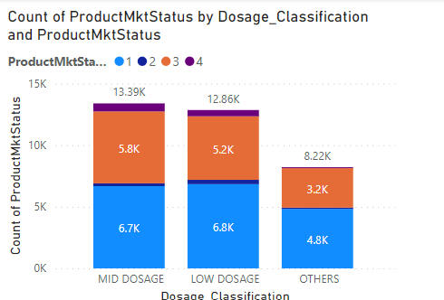
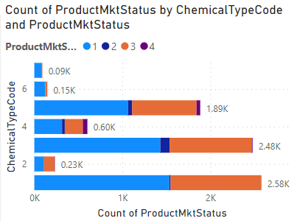
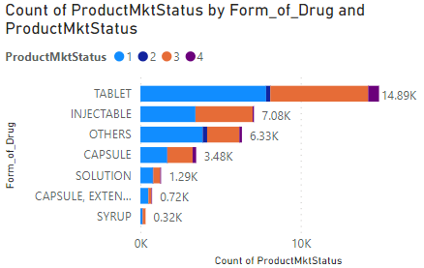
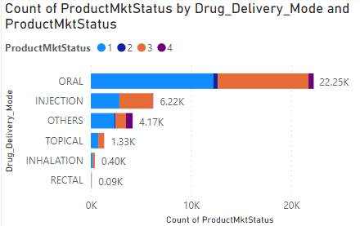
Objective 3 - Visualize the segmentation of products based on MarketingStatus.
Application_Type: (A): Abbreviated New Drug Application (ANDA) Followed by New Drug Application (NDA)
Product_Market_Status : (1-3-2-4) [Marketed-Pending-Withdrawn-Premarket]
Chemical_Type_Code: 1,3,4,5 AND Form_of_Drug: Tablet AND Mode_of_Drug_delivery: Oral

Slide 7
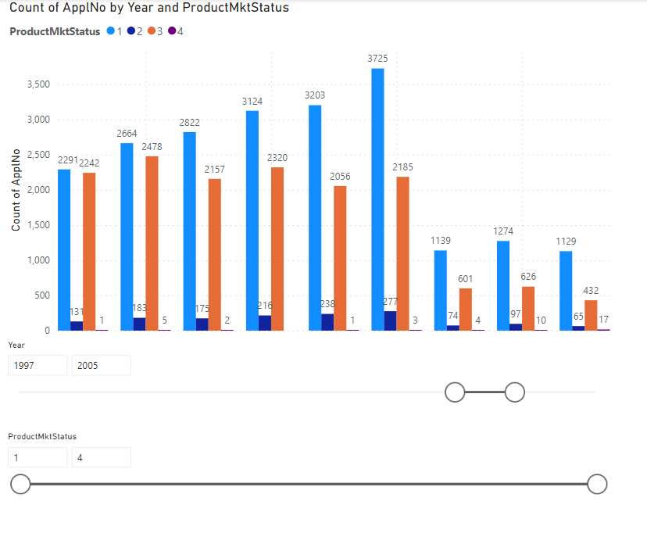
Objective 4 - Show the total number of applications for each MarketingStatus. Enable users to filter by years and MarketingStatus for detailed analysis.
MarketingStatus-1 (Marketed) observed highest no of count across the years.
There is a drastic reduction in total no of MarketingStatus, as the total no of applications for approval seen drop over the same years.

Slide 8
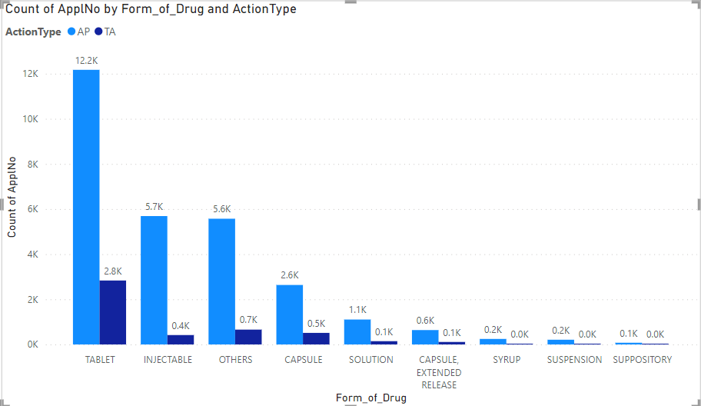
Objective 5 - Analyze the grouping of drugs by dosage form. Visualize the distribution of approvals across different forms. Identify the most successful dosage form.
Tablet is most successful dosage form in terms of approval.

Slide 9
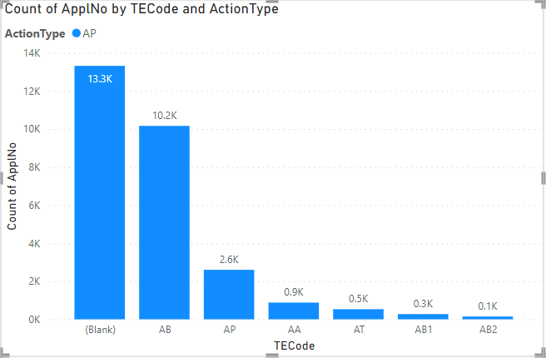
Objective 6 – Visualize drug approvals based on therapeutic classes. Identify classes with the highest number of approvals.
AB, AP, and AA are the classes thar received highest no of approvals, over the time frame

Slide 10
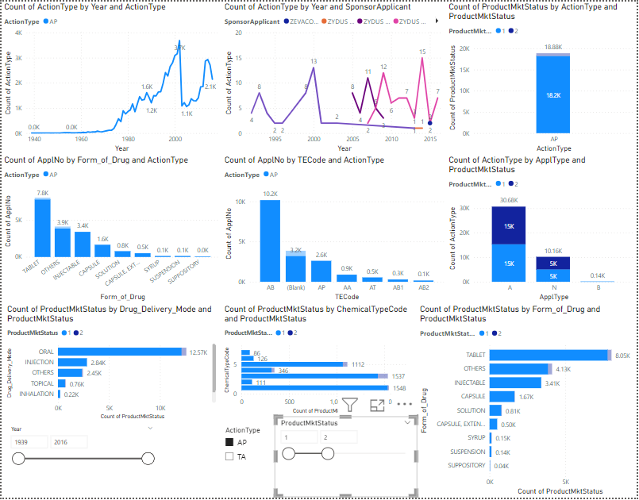
Dashboard For FDA Data

Slide 11
Conclusion-
Total no of applications from drug sponsors for drugs and their rate of approval from FDA end is also increasing, till 2002.
Post 2002, there is a sudden decrease in the total no of applications and approvals from FDA end.
After Mid 1985’s there can be seen a rise in drug approval application, for specific therapeutic area.
More no of applicants can be seen applying to receive drug approvals.
Low & Mid Dosage are likely to get approvals from FDA
AB, AP, and the AA are the therapeutic classes which had received highest no of approvals.
Table-Form of drug and Oral-Type of dosage, had received highest approvals.
Most of the products were in the state of being marketed or in the state of pending.

