Slide 1
Name-Aniruddha M. Khedkar Graded Project on Power BI Title-Analysis of Airbnb Data To Understand Customer Satisfaction.

Slide 2
Business Understanding-
Online Marketplace Specializing in Short-term Accommodations & Experiences
Data Understanding & Preparation-
Duplicate Removal and Error/Null Value Handling
Trim, Clean, and Data Type.
Replace, DAX (If), Measure.
Insights into user experiences and satisfaction levels
Chart Preparation & Dashboard Creation-

Slide 3
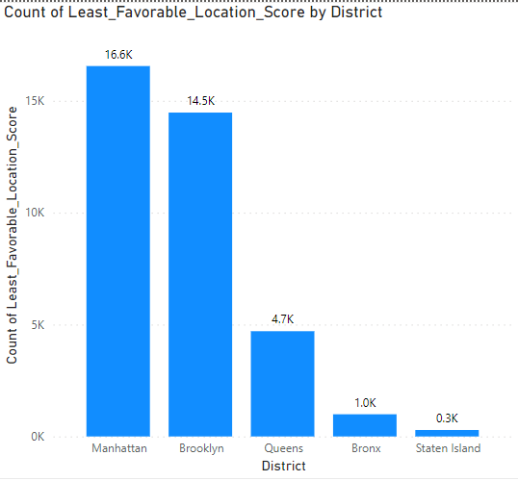
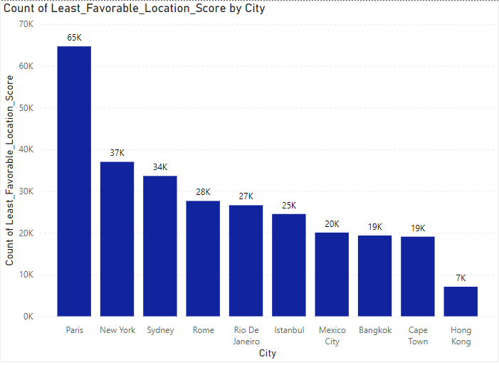
Objective 1-Assessing District Location Scores
District- Manhattan
City-Paris

Slide 4
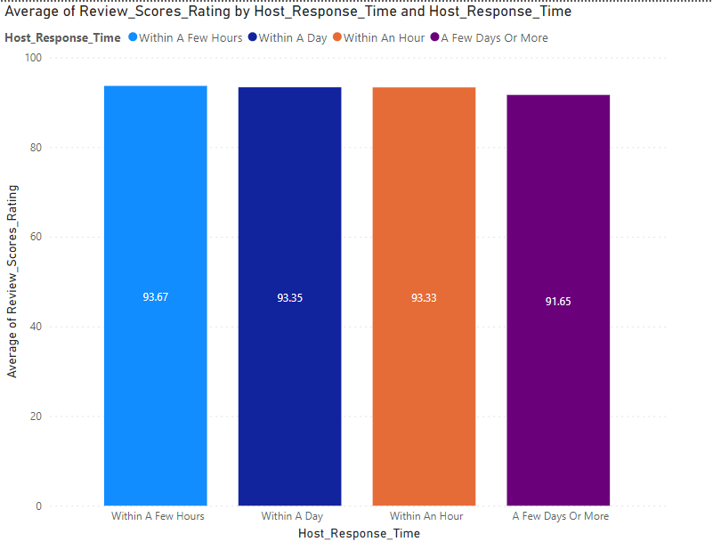
Objective 2- Examining Host Response Time Impact
Listings’ overall rating remains same irrespective of time taken by the host to respond.
Within a few hours response is impacting more as compare to other 3 categories.

Slide 5
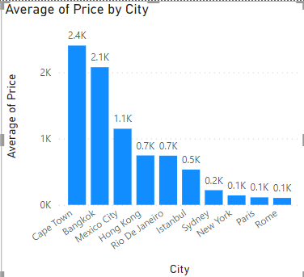
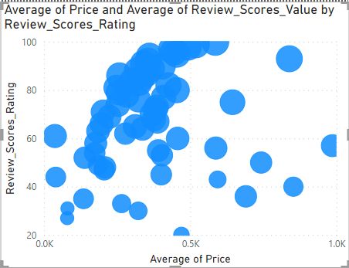
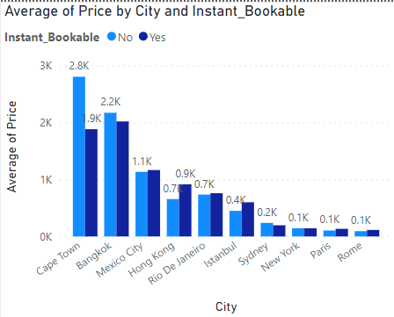
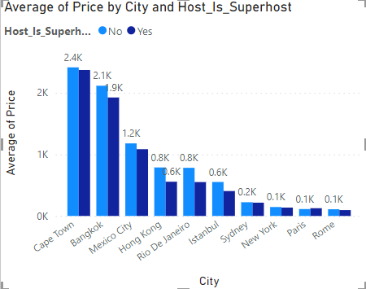
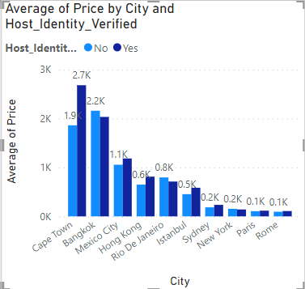
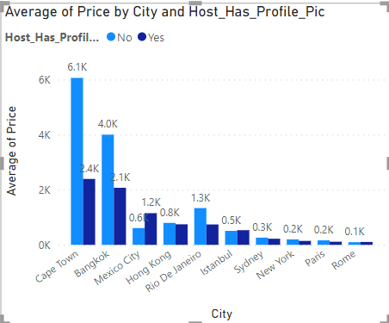
Objective 3 - Visualizing Airbnb Listing Prices
Host identity, Listings’ instant bookableness, Listings’ overall rating are important factors

Slide 6
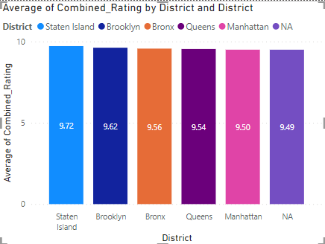
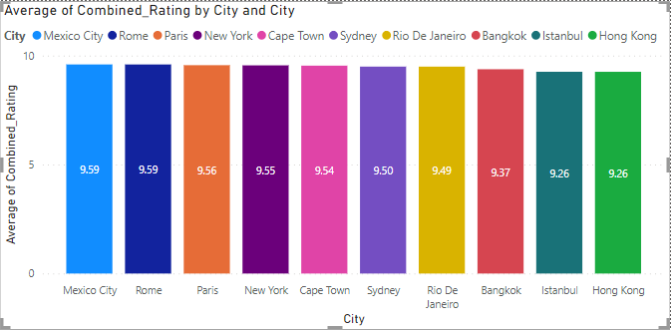
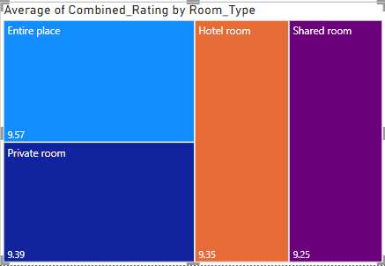
Objective 4 - Analyzing Composite Scores
For district and city level, check-in experience and communication by host remains close to each other.
For room type also the combined rating given by guests remained same over the given time frame.

Slide 7
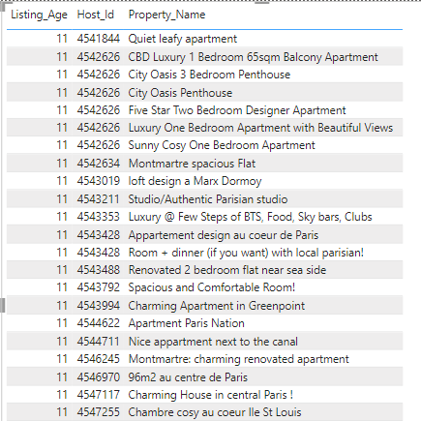
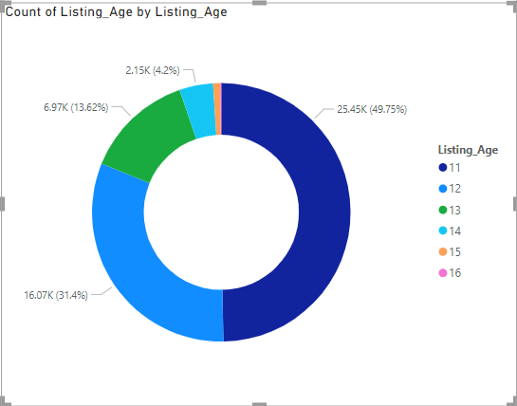

Objective 5 - Calculating Listing Age and Host Tenure
There are a total of 51,330 listed properties with more than 10 years of age.

Slide 8
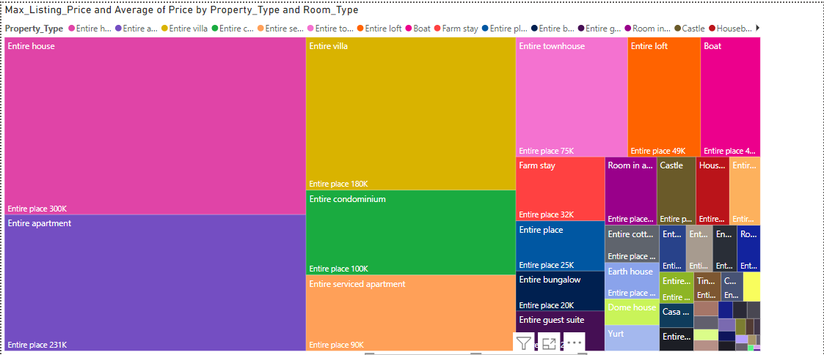
Objective 6 – Property Type Price Analysis
This tree map represents the average prices for the properties associated with the highest prices for different rooms and property types.

Slide 9
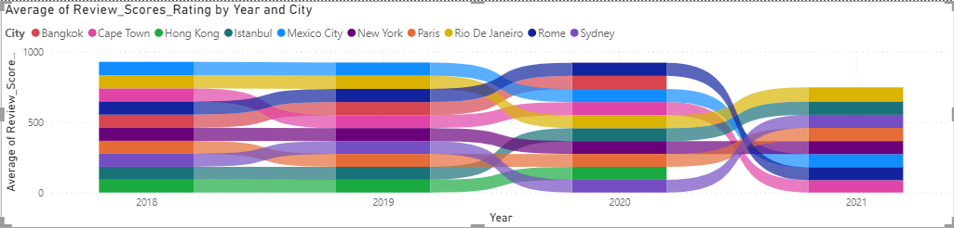
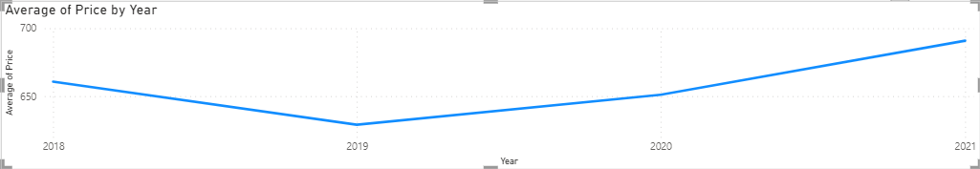
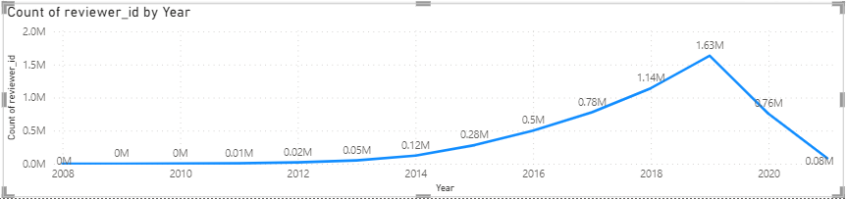
Objective 7 – Property Type Price Analysis
In the year 2019, there is a sudden change in listing price across the property types and onboarding of customers witnessed significant increase.
Listings’ overall rating had remained consistent till 2019, but post 2019, it changed significantly.

Slide 10
Recommendation to Airbnb -
For least favorable locations, take more detailed review from customers and hosts.
Prompt response by hosts while accepting the guest request, impacted the listings’ overall rating. Hence, Airbnb should communicate this findings to hosts, as if their ratings improved they can charge premium price.
Customers can pay higher amount for stay if host identity, listings’ instant bookableness, listings’ overall rating are properly maintained. Hence, company should focus on improving visibility of these factors through its digital structure or platforms to potential customers.
Check-in level, cleanliness, and host communication are adequately being maintained, hence company can leverage these factors to uniquely position itself in the market. (Positioning)
18.4% (51,330) properties are listed from more than 10 years, so a deep study should be carried out to further improve serviceability and profitability of these properties.
As the customer onboarding had been increasing post 2018, company should crease new segment and tap the unmet needs of the new customers (Market development & penetration).

Slide 11
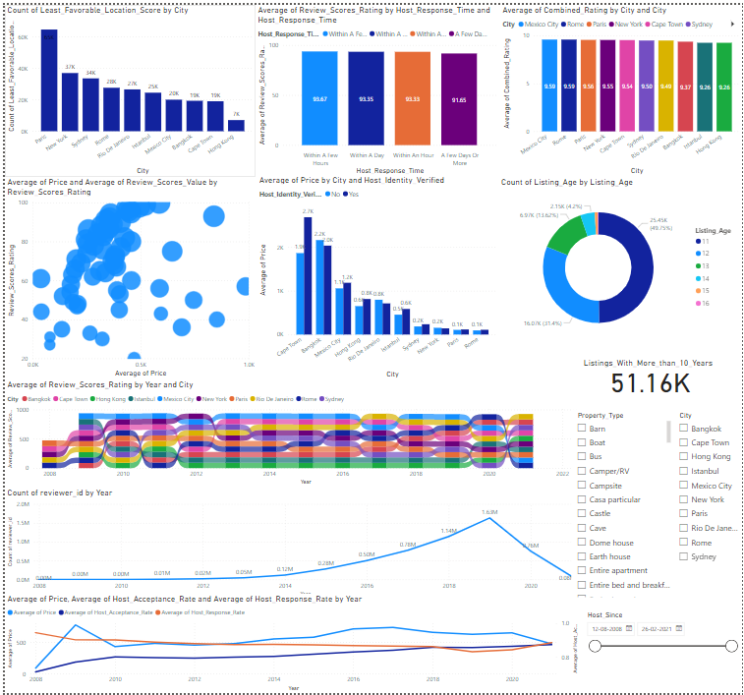
Dashboard For Airbnb

