Slide 1
Analyzing Online Advertising Performance: Insights from Company X's Campaigns (April - June 2020) - A Data-Driven Approach to Measuring and Optimizing Advertising Effectiveness Presented by: N Aniruddhan Date: 18th July 2024

Slide 2
agenda
Introduction 3
Dataset Overview 4
Key Metrics 5
Visual Aids 6
Final Call 23

Slide 3

Introduction: This presentation provides an in-depth analysis of the online advertising performance of Company X over the period from April 1, 2020, to June 30, 2020. Using detailed campaign data, we will explore key metrics such as user engagement, ad displays, costs, clicks, revenue, and post-click conversions to uncover trends, measure effectiveness, and identify opportunities for optimization. All financial figures are presented in US dollars.

Slide 4

Dataset Overview Description of the dataset Time period covered: April 1, 2020 - June 30, 2020 Currency: US Dollar Metrics included in the dataset

Slide 5
Key Metrics
Key Metrics
Day: Date of the advertising campaign
Campaign: Targeted user groups
User Engagement: Engagement level of targeted users
Banner: Size of the ad
Placement: Publisher space (websites or apps)
Displays: Number of ads served
Cost: Placement cost of the ads
Clicks: Number of ad clicks
Revenue: Amount paid by Company X for clicks
Post-Click Conversions: On-site transactions within 30 days post-click
Post-Click Sales Amount: Value of post-click transactions

Slide 6
Visuals and Insights
ENHANCING YOUR UNDERSTANDING

Slide 7
Common Insights for testing the data
User Engagement Insights
Analysis of user engagement metrics
Trends and patterns in user engagement
Comparison between different campaigns
User Engagement Insights
Analysis of user engagement metrics
Trends and patterns in user engagement
Comparison between different campaigns
Post-Click Performance
Analysis of post-click conversions and sales amount
Conversion rate and average sales amount per conversion
Time-lag analysis of conversions post-click

Slide 8
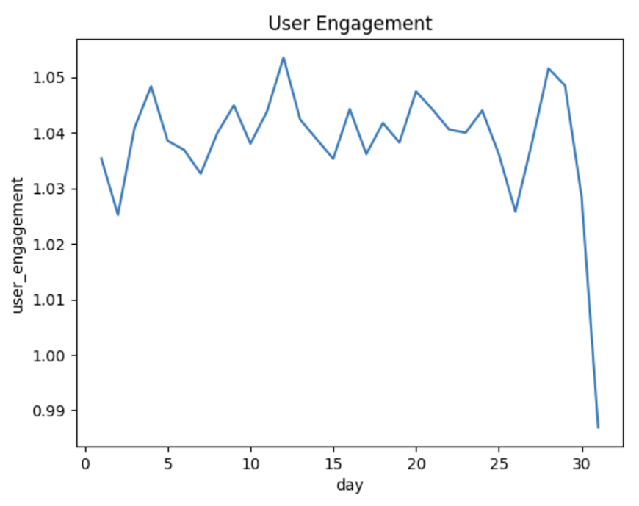
User Engagement
We could see the trendlines of user engagement being almost similar and maintaining same trend for the months of April and May around value of 1, while in june although the trend is continued the same throughout all days of the month, the value i shifted and concentrated around 1.1

Slide 9
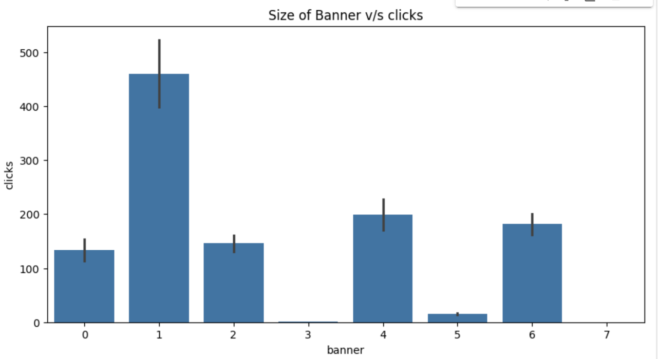
Size of the ad (banner) impact the number of clicks generated
Insight:
Banner size one impacted the most, while banner size 3 had contributed to the least impact of clicks generated

Slide 10
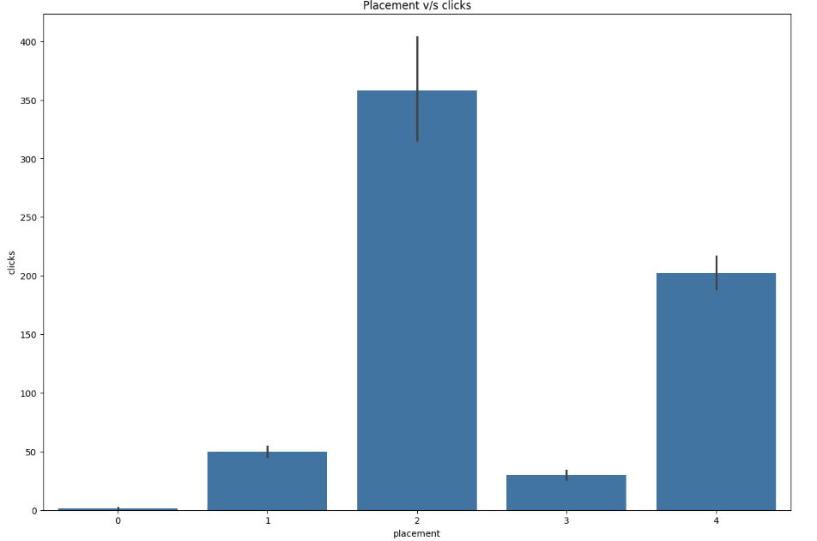
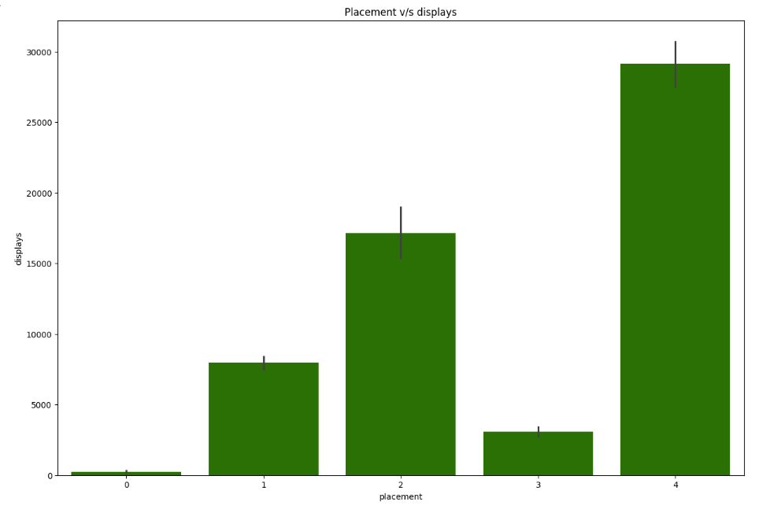
Publisher spaces (placements) yielded the highest number of displays and clicks
Placement type 4 highest yield in terms of display
While Placement type 2 highest yield in terms of clicks

Slide 11

Correlation between the cost of serving ads and the revenue generated from clicks
On testing the correlation code, we sense a positive correlation for, Cost has a correlation score of 0.76 with revenue generated.

Slide 12
Average revenue generated per click
Highest Value:
Value: 0.121284
Index: 18
Lowest Value:
Value: 0.101218
Index: 31

Slide 13
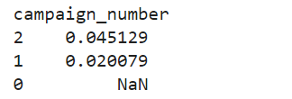
Campaigns had the highest post-click conversion rates
Campaign Number 2 is highest, followed by Campaign Number 1.

Slide 14
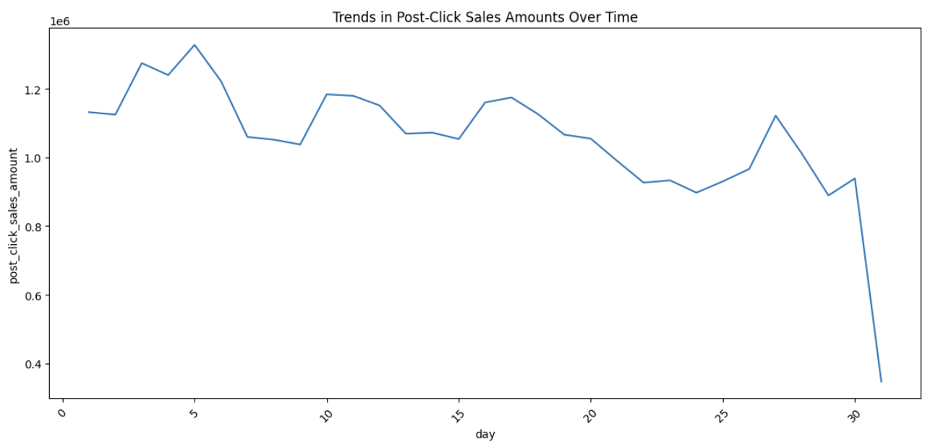
Trends or patterns in post-click sales amounts
Steady Decline of Post-click sales over the time!

Slide 15
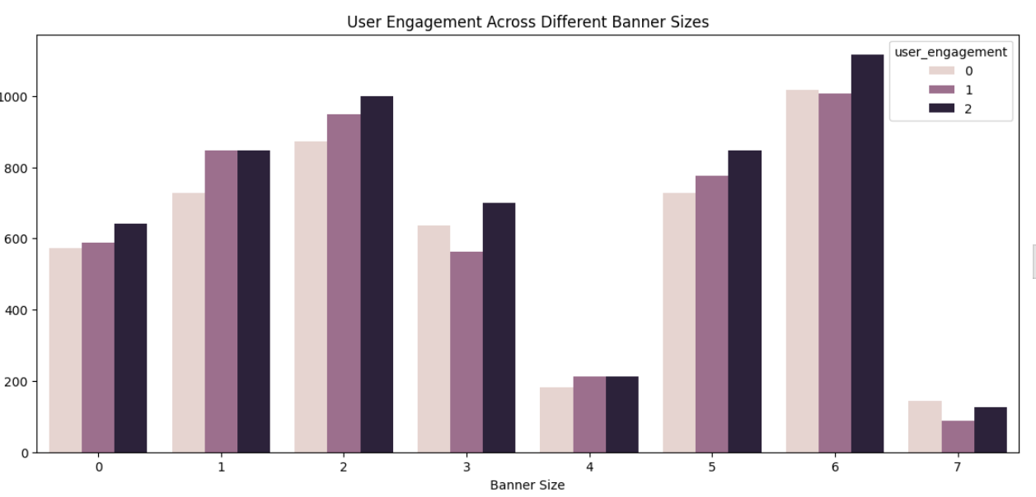
Level of user engagement vary across different banner sizes
Banner Size 6 has highest engagement among different banner sizes.

Slide 16
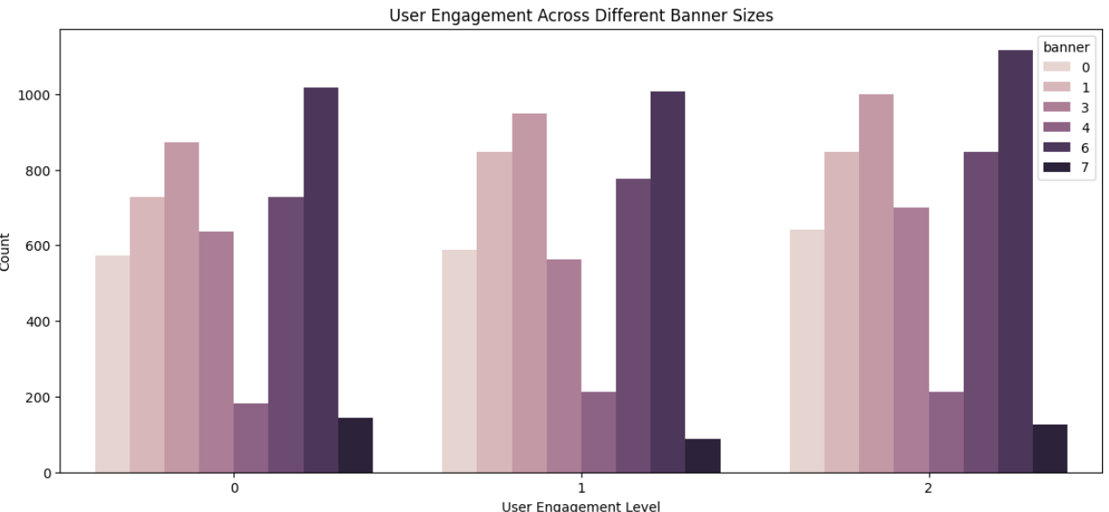
Level of user engagement vary across different banner sizes
Banner Size 6 has highest engagement among different banner sizes.

Slide 17
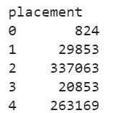
Placement types result in the highest post-click conversion
Placement 4 has the highest sum among 5.

Slide 18
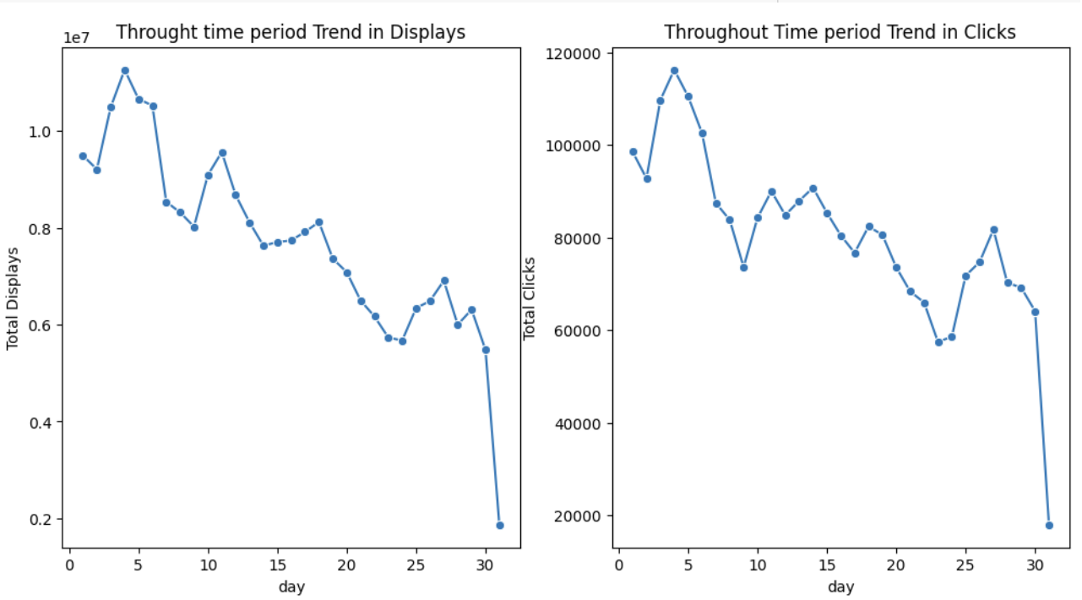
seasonal patterns or fluctuations in displays and clicks throughout the campaign period
Trend of displays and cliks are declining but not steadily, however there was some fluctuations.

Slide 19
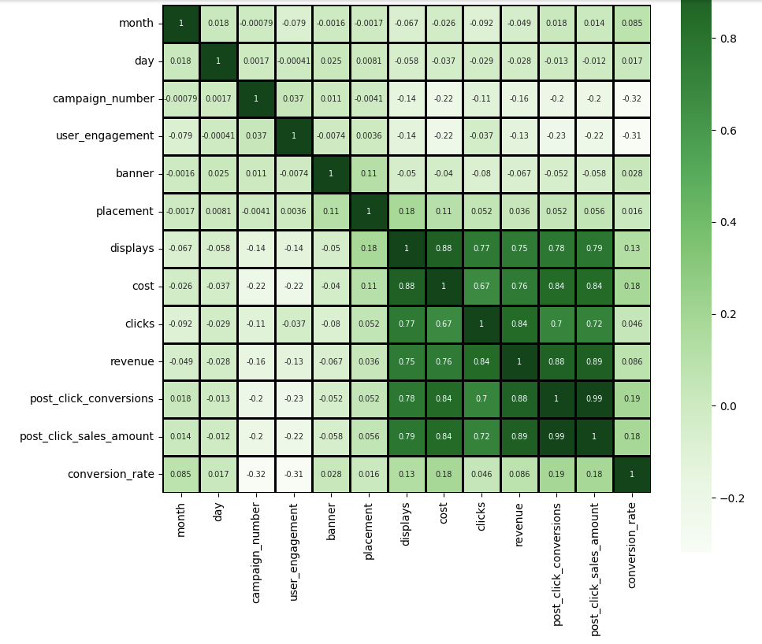
correlation between user engagement levels and the revenue
There is a negative correlation between user engagement levels and the revenue.

Slide 20
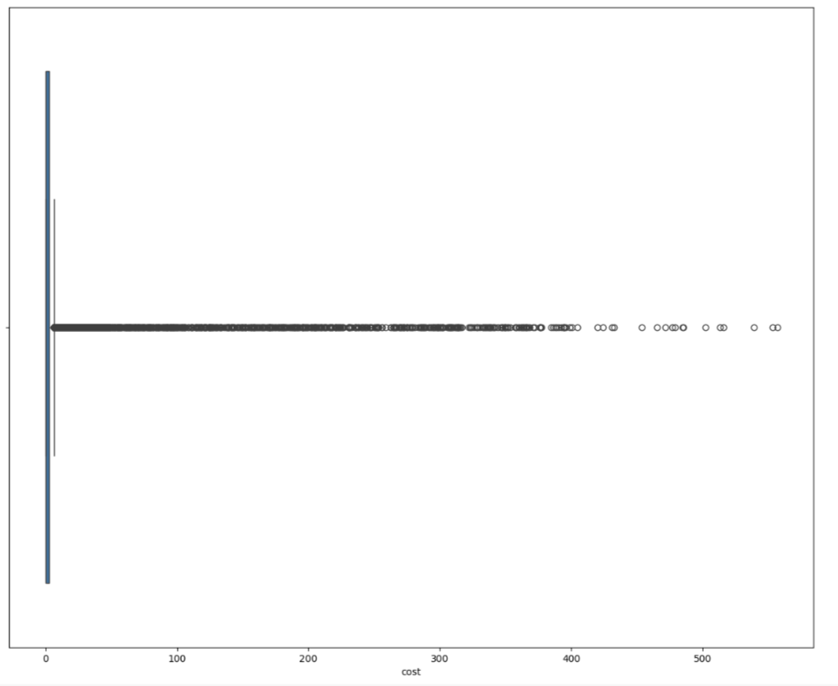
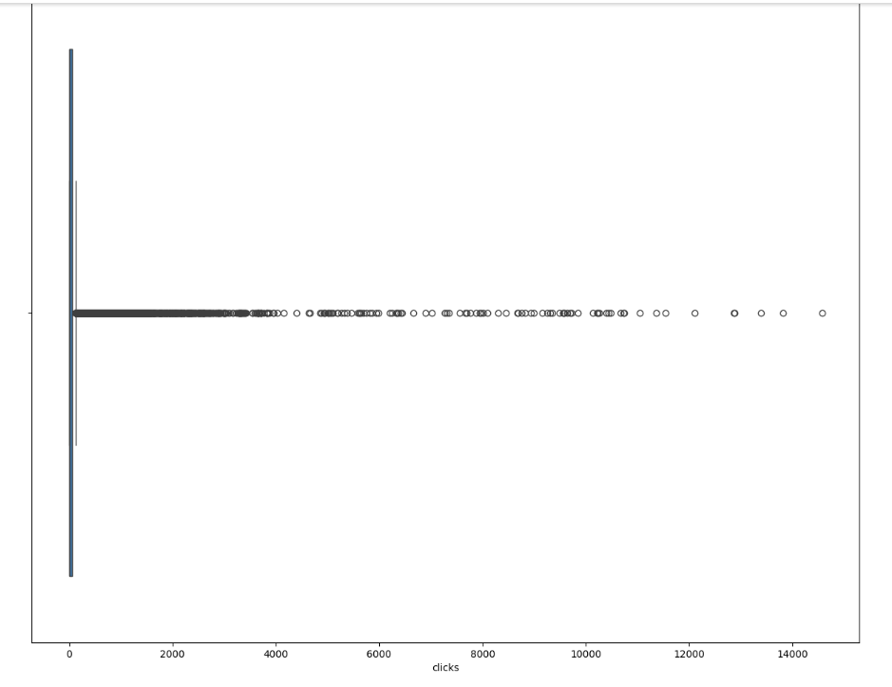
Outliers in terms of cost, clicks, or revenue
Yes, there are some outliers, but they are neither big outliers, nor outliers by massive margin . They are almost closer to median and close to each other.

Slide 21
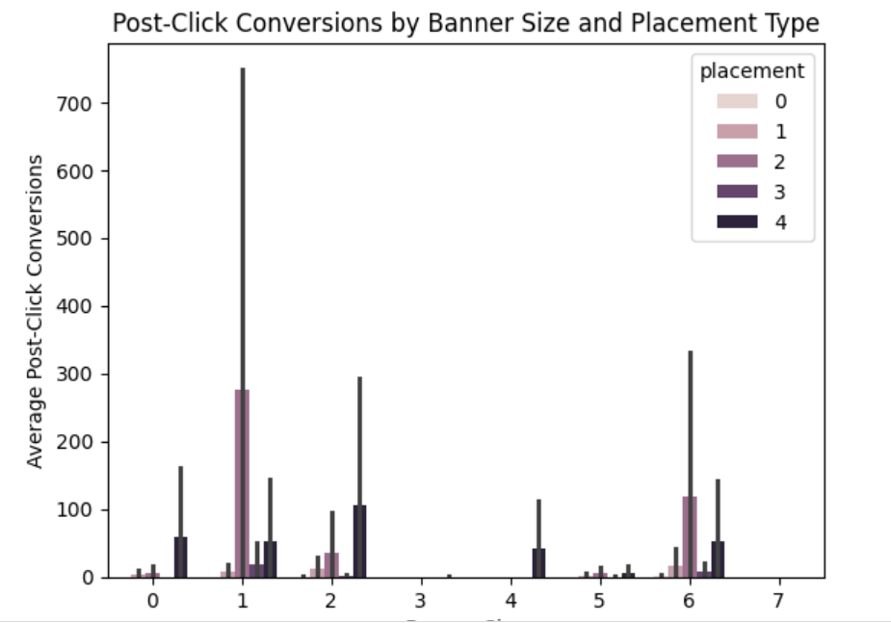
effectiveness of campaigns vary based on the size of the ad and placement type
Distribution of campaign number across banner size and post click conversion. Campaign 1, Placement 1 achieves highest post click conversions

Slide 22
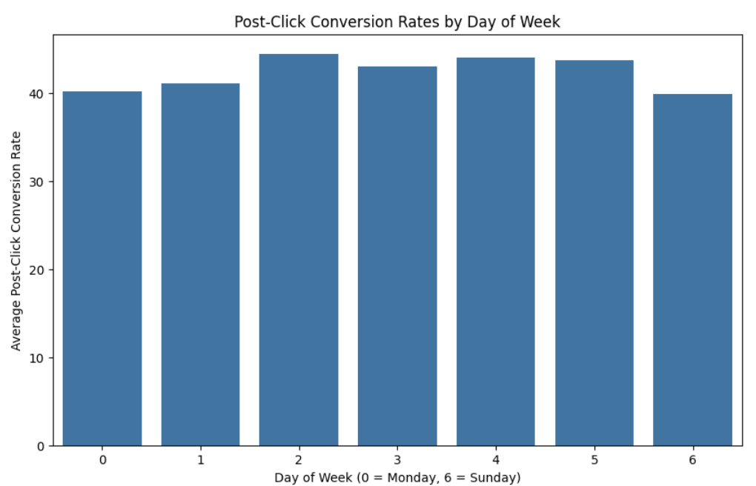
trends or patterns in post-click conversion rates based on the day of the week
Post click conversion rates are highest for Tuesdays (2) and almost on par with each other, even though Sundays and Saturdays being the lowest but not by big margins.

Slide 23
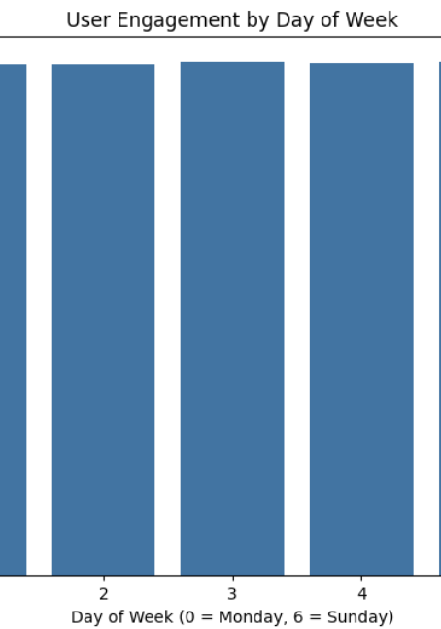
Average User Engagement
The User Engagement Levels put evenly for all days of the week.. From Saturday till next Saturday, across whole week user engagement levels are perfectly similar with minimal/ decimal level change of values.

Slide 24
Final tips & takeaways
Strategic recommendations based on the analysis :
Increase focus on high-performing campaigns and similar target groups.
Optimize ad placements and banners for better user engagement.
Allocate budget towards periods with historically high engagement and conversions.
Further investigate underperforming campaigns to identify specific issues.

Slide 25
Conclusion
Recap of the key points discussed:
Importance of continuous performance analysis
Insights into campaign effectiveness
Strategic actions to optimize future campaigns

Slide 26
THANK YOU!!
N Aniruddhan
VIT Chennai

