Slide 1
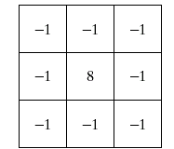
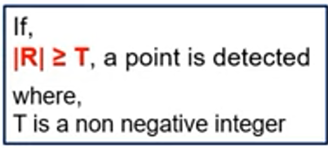
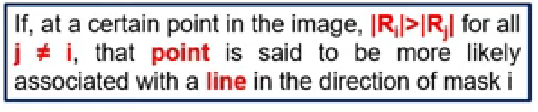
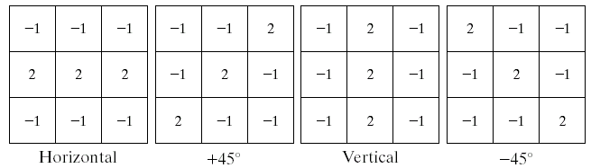
Point detection
Can be achieved by using the mask below. Points are detected at those pixels in the subsequent filtered image that are above a set threshold
Line Detection
The masks below will extract lines that are one pixel thick and running in a particular direction

Slide 2
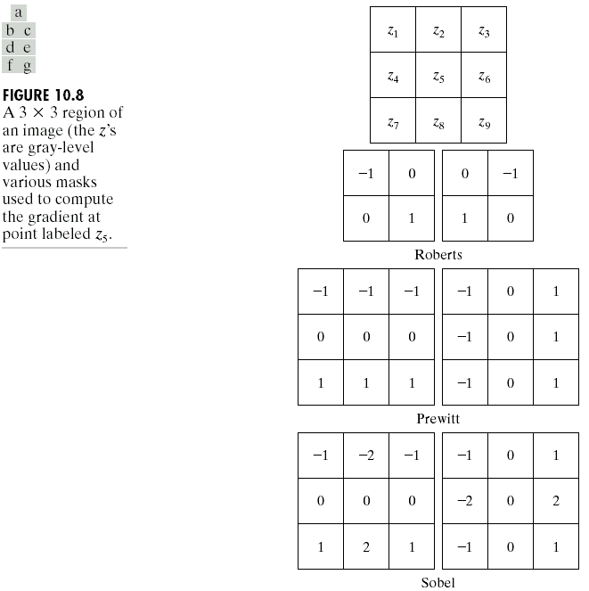
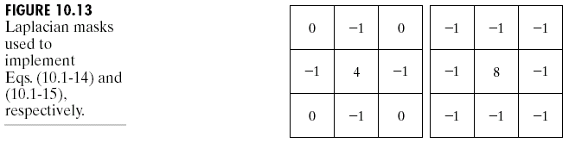

Edge Detection
An edge is a set of connected pixels that lie on the boundary between two regions
We have already spoken about how derivatives are used to find discontinuities
1st derivative tells us where an edge is
2nd derivative can be used to show edge direction
Given a 3*3 region of an image the following edge
detection filters can be used
Laplacian Edge Detection
We encountered the 2nd-order derivative based Laplacian filter already
The Laplacian is typically not used by itself as it is too sensitive to noise
Laplacian (for edge detection) is combined with a smoothing Gaussian filter (for noise removal )

Slide 3
Basic Global Thresholding
Based on the histogram of an image
Partition the image histogram using a single global threshold
The success of this technique very strongly depends on how well the histogram can be partitioned
The basic global threshold, T, is calculated as follows:
Select an initial estimate for T (typically the average grey level in the image)
Segment the image using T to produce two groups of pixels: G₁ consisting of pixels with grey levels >T and G₂ consisting pixels with grey levels ≤ T
Compute the average grey levels of pixels in G₁ to give μ₁ and G₂ to give μ₂
Compute a new threshold value:
Repeat steps 2 – 4 until the difference in T in successive iterations is less than a predefined limit T∞
Example-
Let T=(5+3+9+2+1+7+8+4+2)/9 = 4.55 = 5
Segmenting the image using T we would get G1={9,7,8} and G2={5,3,2,1,4,2}
µ1 = (9+7+8)/3 = 8 and µ2 = (5+3+2+1+4+2)/6 = 3 so T= (8+3)/2 = 5
5 3 9
6 2 7
8 4 2

Slide 4
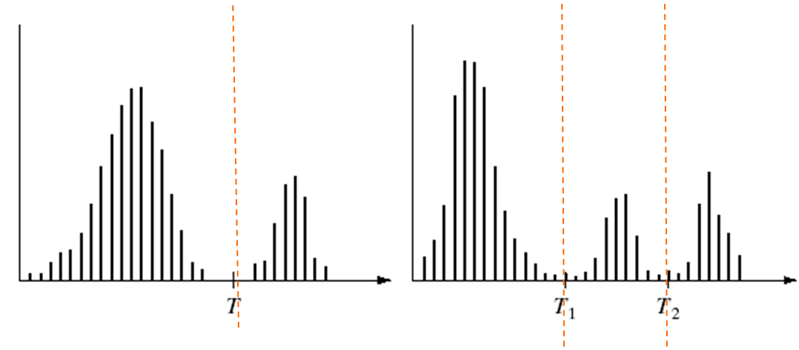
Problems With Single Value Thresholding
Single value thresholding only works for bimodal histograms
Images with other kinds of histograms need more than a single threshold
Basic Adaptive Thresholding
An approach to handling situations in which single value thresholding will not work is to divide an image into sub images and threshold these individually
Since the threshold for each pixel depends on its location within an image this technique is said to adaptive

Slide 5
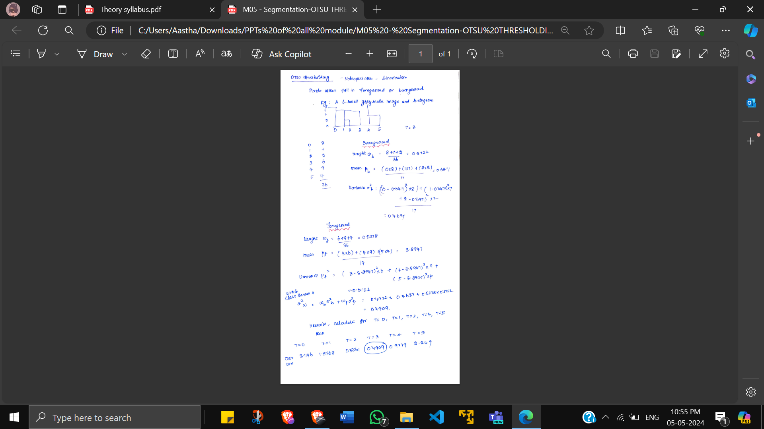
Otsu Thresholding
If value <= T then background
If value > T then foregorund

Slide 6
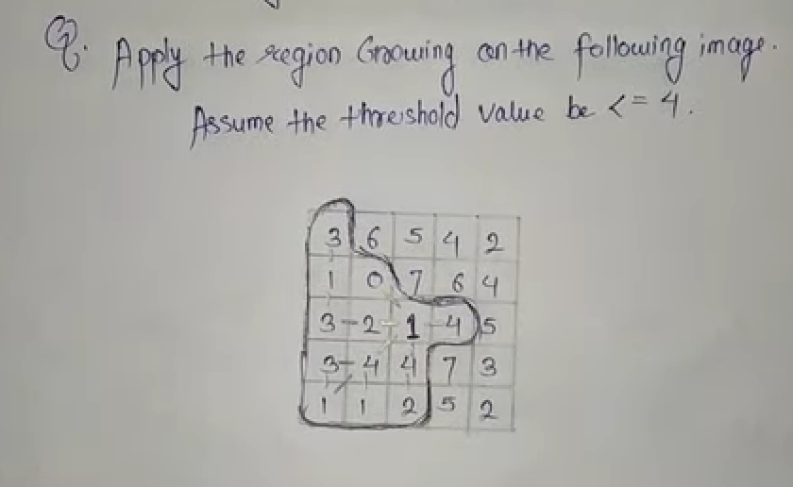
Region Splitting and Merging
https://youtu.be/V5VTJEKRcVs?si=Onzp3ikQXn0K4vEU

Slide 7
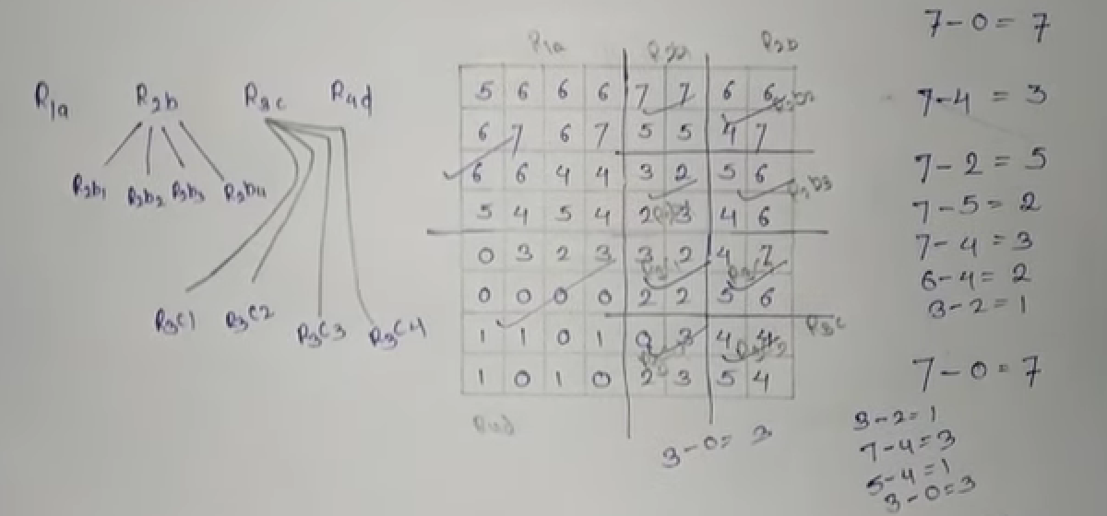
Q. Apply region splitting on the following img assuming threshold <=4

Slide 8
Hough Transform
Hough transform is a process that converts xy-plane to ab-plane (parameter space). Considering b = -ax_{i} + y_{i} in ab-plane:
A point (x_{i} , y_{i}) in the image space is mapped to many points {(a, b)} in the parameter space which are on line.
(x_{j}, y_{j}) is mapped to many points {(a, b)} in the parameter space which are on line: b=-ax_{j}+y_{j}.
These two points are collinear if b = -ax_{i} + y_{i} and b=-ax_{j}+y_{j} in the parameter space intersect at (a’, b’).

Slide 9
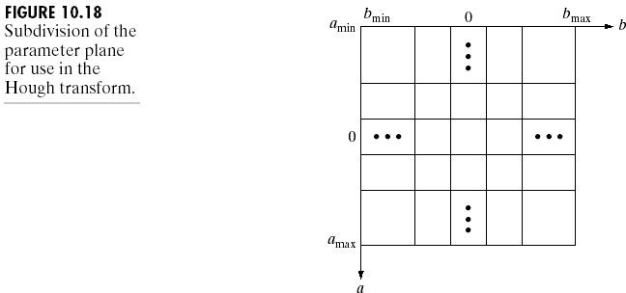
The Procedures of Hough Transform
Step 1:
Subdivide ab-plane to accumulator cells. Let A(i, j) be the cell at (i, j) where a_{min}≤a_{i} ≤ a_{max}, b_{min} ≤b_{j} ≤b_{max} and A(i, j)=0.
Step 2:
For every (x_{k}, y_{k}), find b=-x_{k}a_{p}+y_{k} for each allowed p.
Step 3:
Round off b to the nearest allowed value b_{q}. Let A(p,q)=A(p,q)+1.

Slide 10
Performance and Limitation
Performance
With n image points and K accumulator cells, there are nK computation involved.
Limitation
The slope approaches infinitely as the line approaches the vertival.
Solution:
Rewrite the normal representation of a line to
x_{i} cosθ + y_{i} sinθ = ρ

Slide 11
Rewriting a line as x cosθ + y sinθ = ρ
This implementation is identical to the method using slope-intercept representation.
Instead of straight lines, the loci are sinusoidal curves in ρθ -plane. □

Slide 12
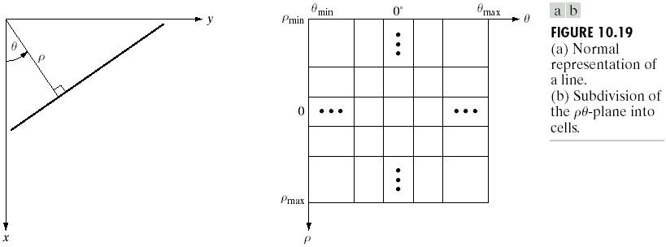
Rewriting a line as x cosθ + y sinθ = ρ
-90
90

Slide 13
Edge-Linking Using Hough Transform
Compute the gradient of an image and threshold it to obtain a binary image.
Specify subdivisions in the ρθ -plane.
Examine the counts of the accumulator cells for high pixel concentrations.
Examine the relationship (for continuity) between pixels in a chosen cell.□

Slide 14
Edge Linking and Boundary Detection
Set of pixels from edge detecting algorithms, seldom define a boundary completely because of noise, breaks in the boundary etc.
Therefore, Edge detecting algorithms are usually followed by linking and other detection procedures, designed to assemble edge pixels into meaningful boundaries

Slide 15
Two Methods
Local Processing (Local edge linker)
Global Processing (Global edge linker)
Local Processing
Two principal properties for establishing similarity of edge pixels:
Strength of the response of the gradient operator used to produce the edge pixel
Direction of the gradient vector.

Slide 16
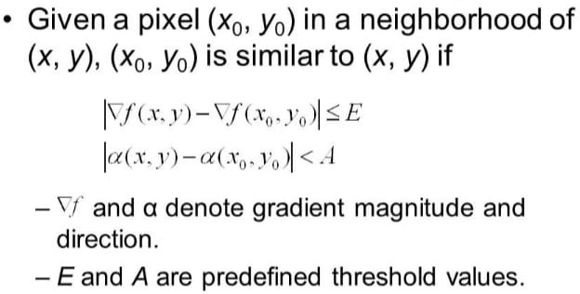
Local Processing
Analyzing the characteristics of edge pixels in a small neighborhood.
Gradient magnitude.
Gradient direction.

Slide 17
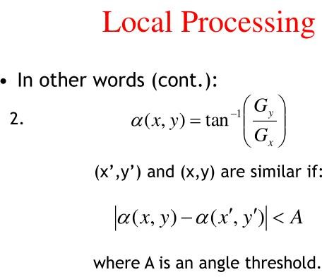

Slide 18
Global processing: Hough transform
Now consider global relationships between pixels.
Suppose that, for n points in an image, we want to find all subsets of these points that lie on straight lines

Slide 19
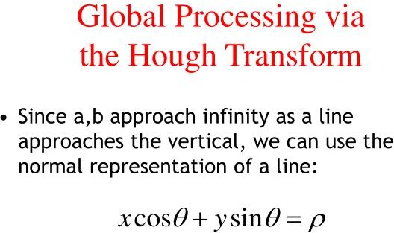

Slide 20
Boundary
Detection is a vital part of extracting
information encoded in images, allowing for the computation of quantities of interest including density, velocity, pressure, etc.
□ Boundary detection is closely related to, but not identical with, edge detection. Edge detection is a classical problem in computer vision which aims at finding brightness discontinuities. Edge detection is usually viewed as a low-level process of feature extraction that works under the assumption of ideal edge models (such as step and ridge edges).

Slide 21
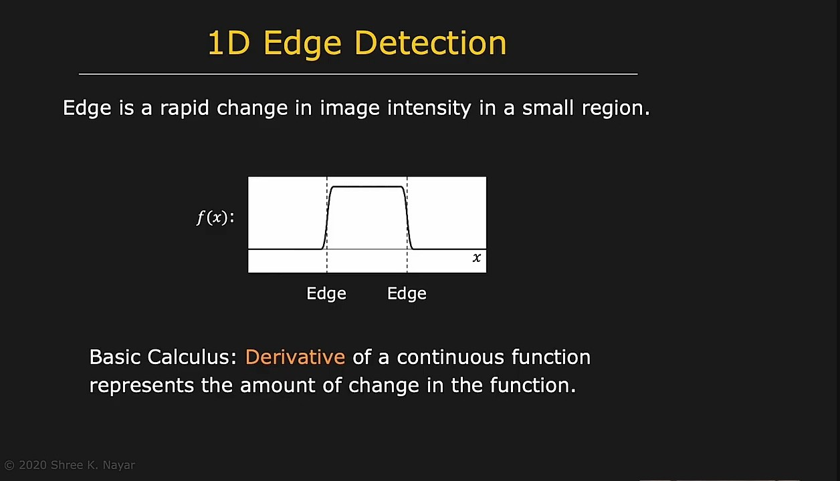

Slide 22
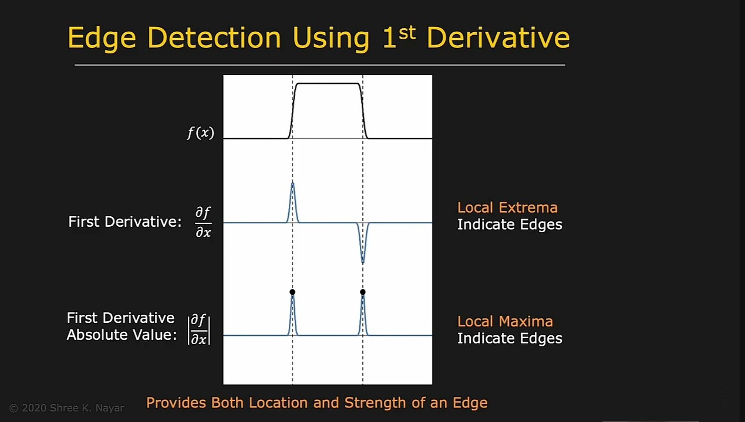

Slide 23
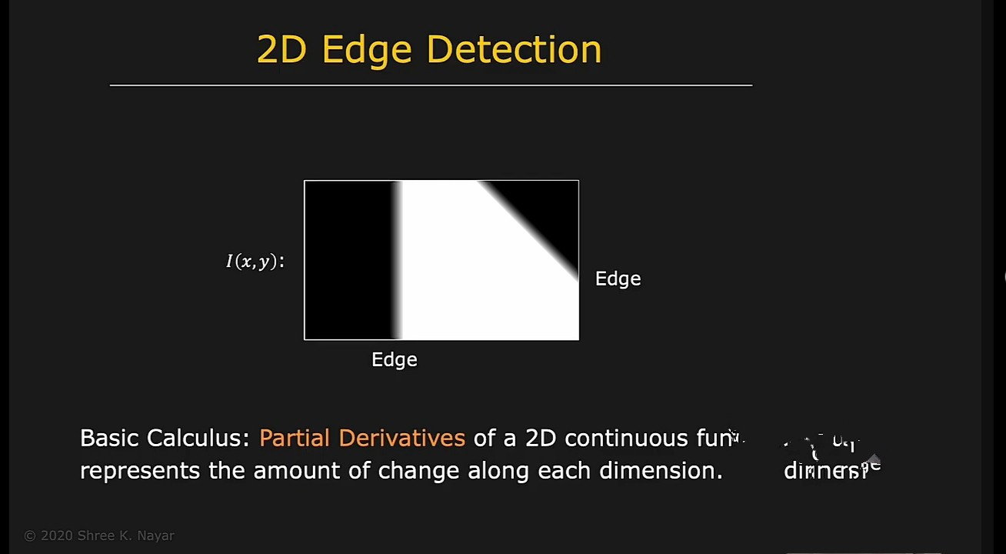

Slide 24
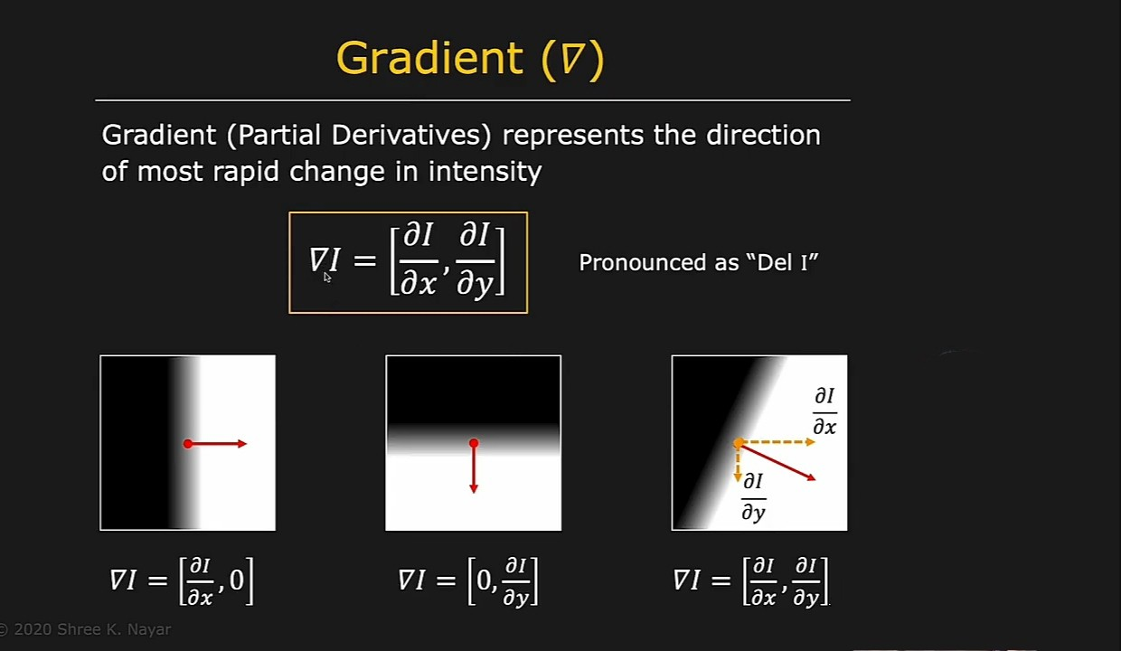

Slide 25
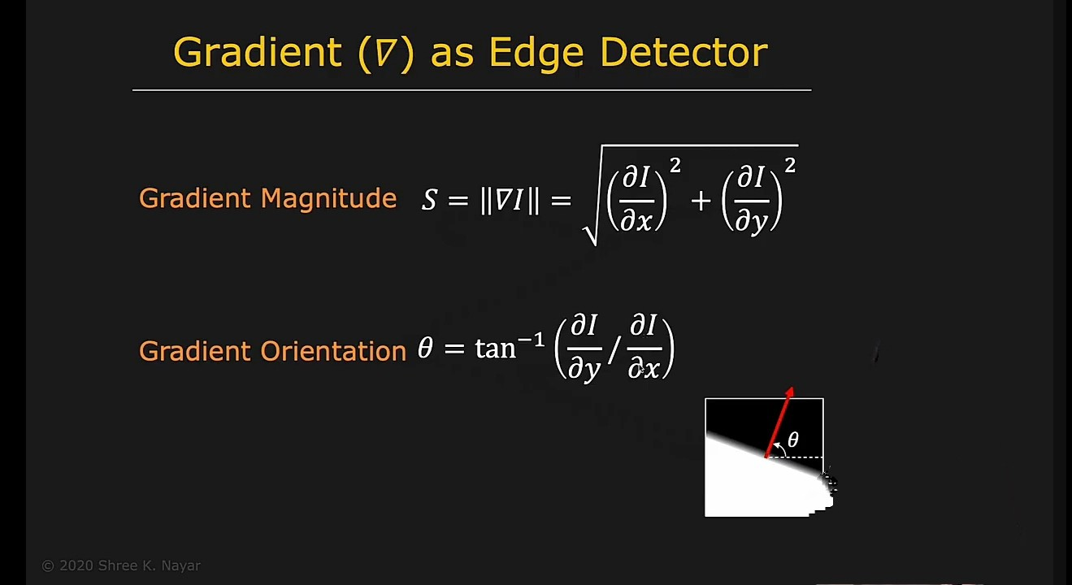

Slide 26
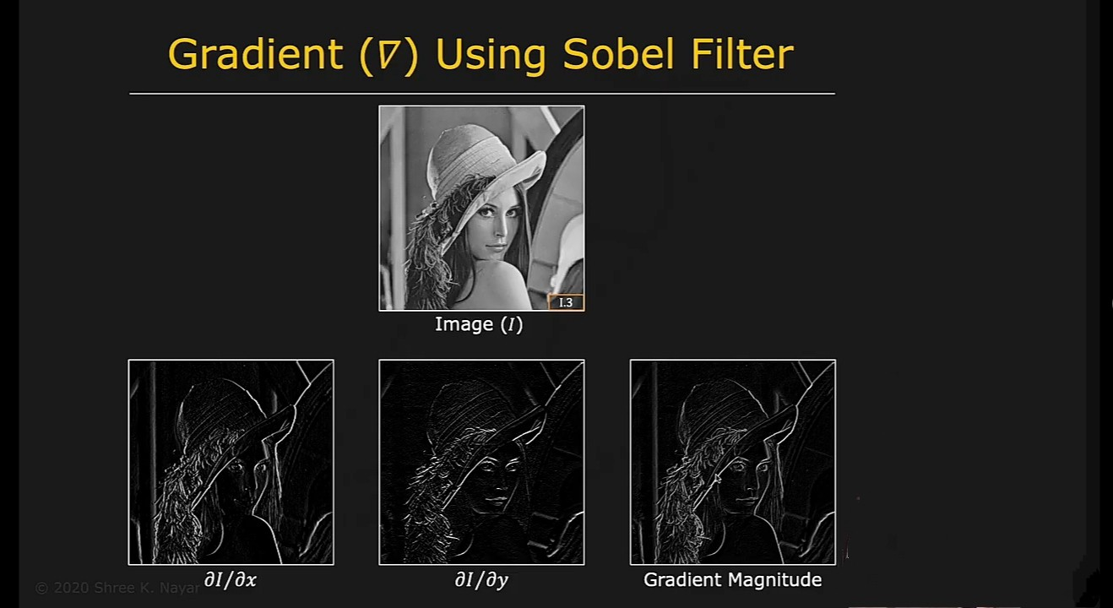

Slide 27
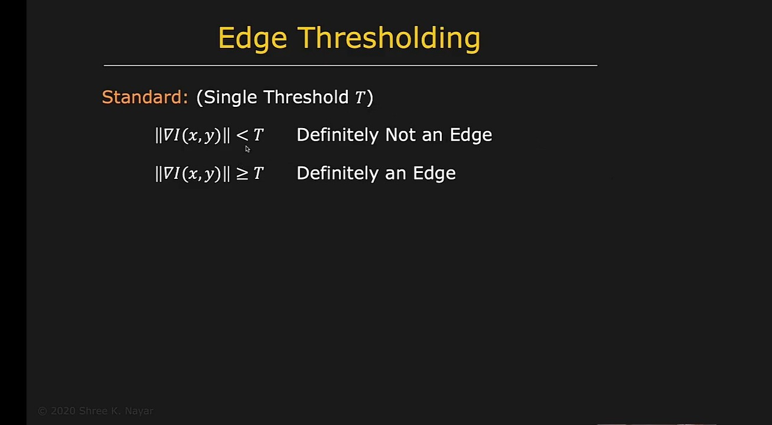

Slide 28
Global Processing - Hough Transform
Hough transformation is a features extraction method for detecting simple shapes such as circle, lines etc. in an image.
Hough transformation takes the images created by edge detection operations but most of the time edge map is disconnected.
Therefore Hough transformation is used to connect the disjoined edge points.

Slide 29


Poin
Line
Line
Point

Slide 30
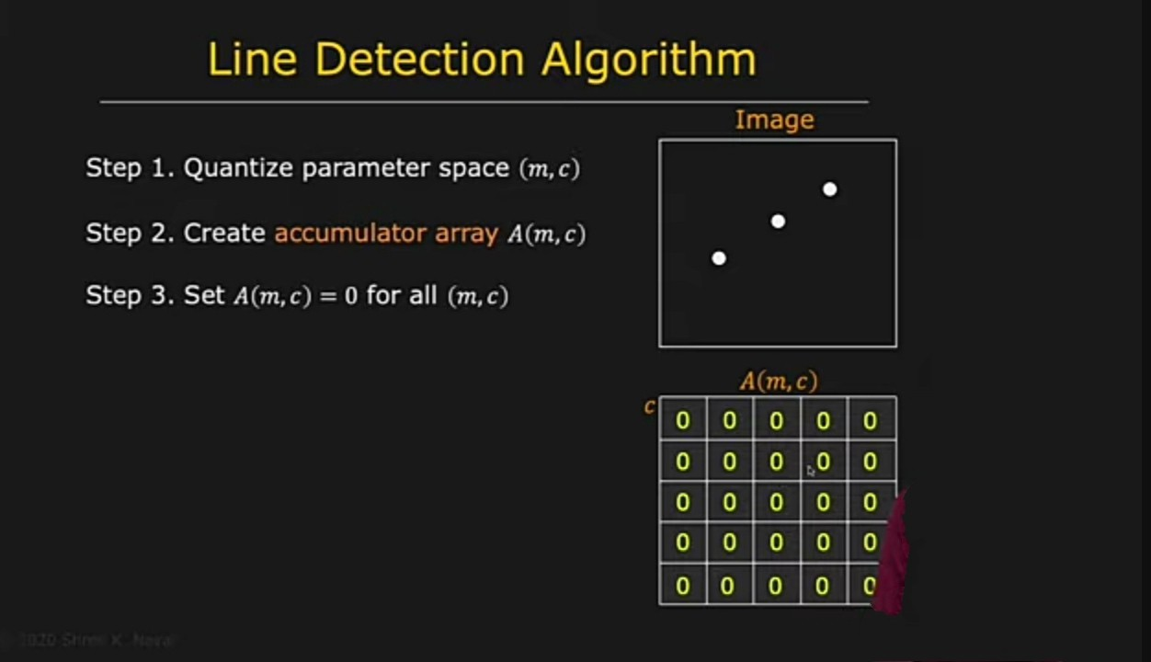

Slide 31





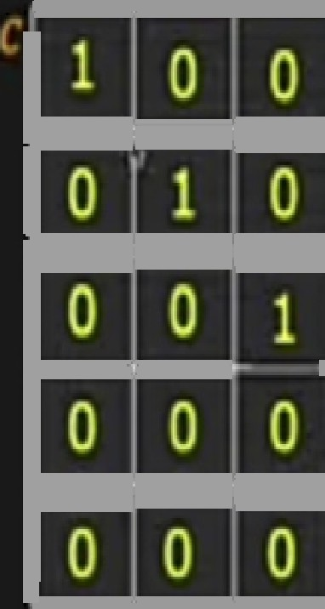
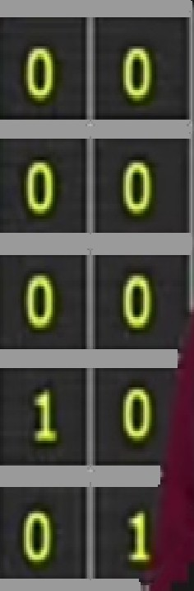





Line Oetection Algorithm
Inia9e
Step
quantize panmeter space (n,r)
Step
Create accumulatotrrray J(m,r)
st°
P
Set I(n,r) = 0 for all țm,c)
Step 4, For each edge point íx;,y,),
»
on the line:

Slide 32
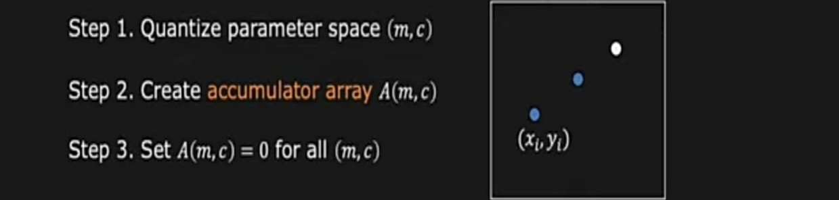
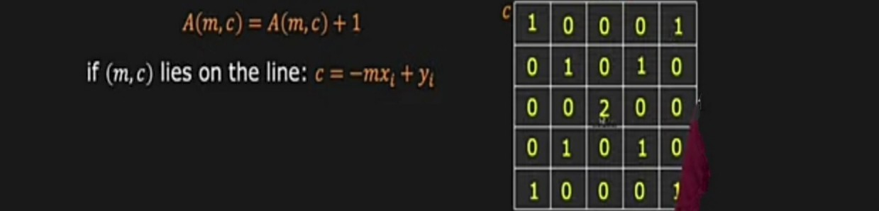
nage
Step 4. For each edge point
„\, ,

Slide 33
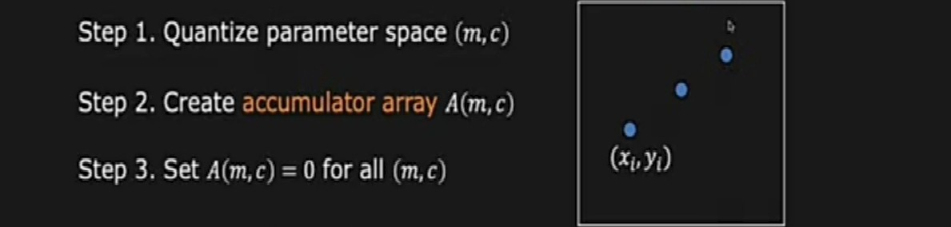
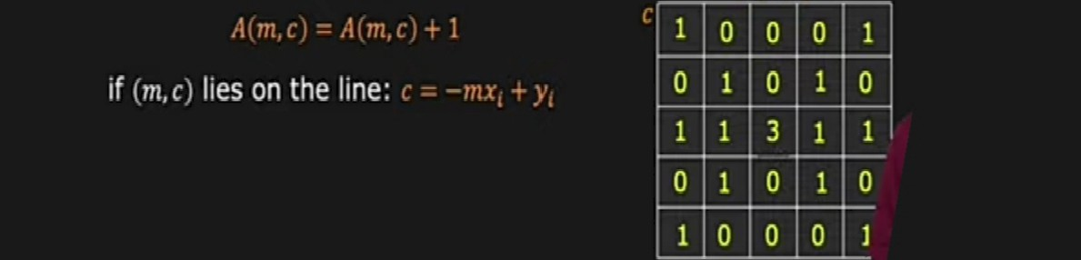
aoe
Step 4. For each edge point (x y ,

Slide 34
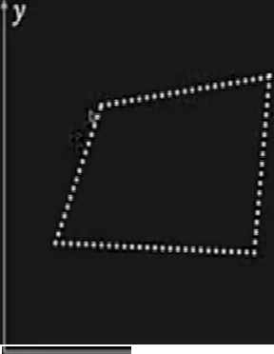
image Space
Parameter Space

Slide 35

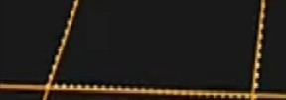
Image Space
Parameter Space

Slide 36
ss c.
Slope of the line — s s =
Large Accumulator
More Pemop and Computation
Orientation 8 is finite: 0 8 < r
Distance p is finite

Slide 37
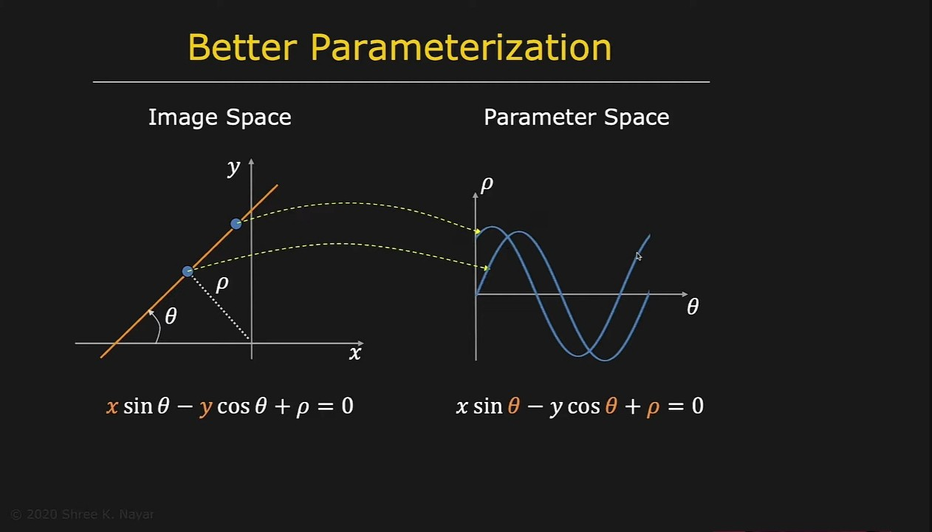

Slide 38



Better Parameterization
Image Space
Parameter Space

