Slide 1
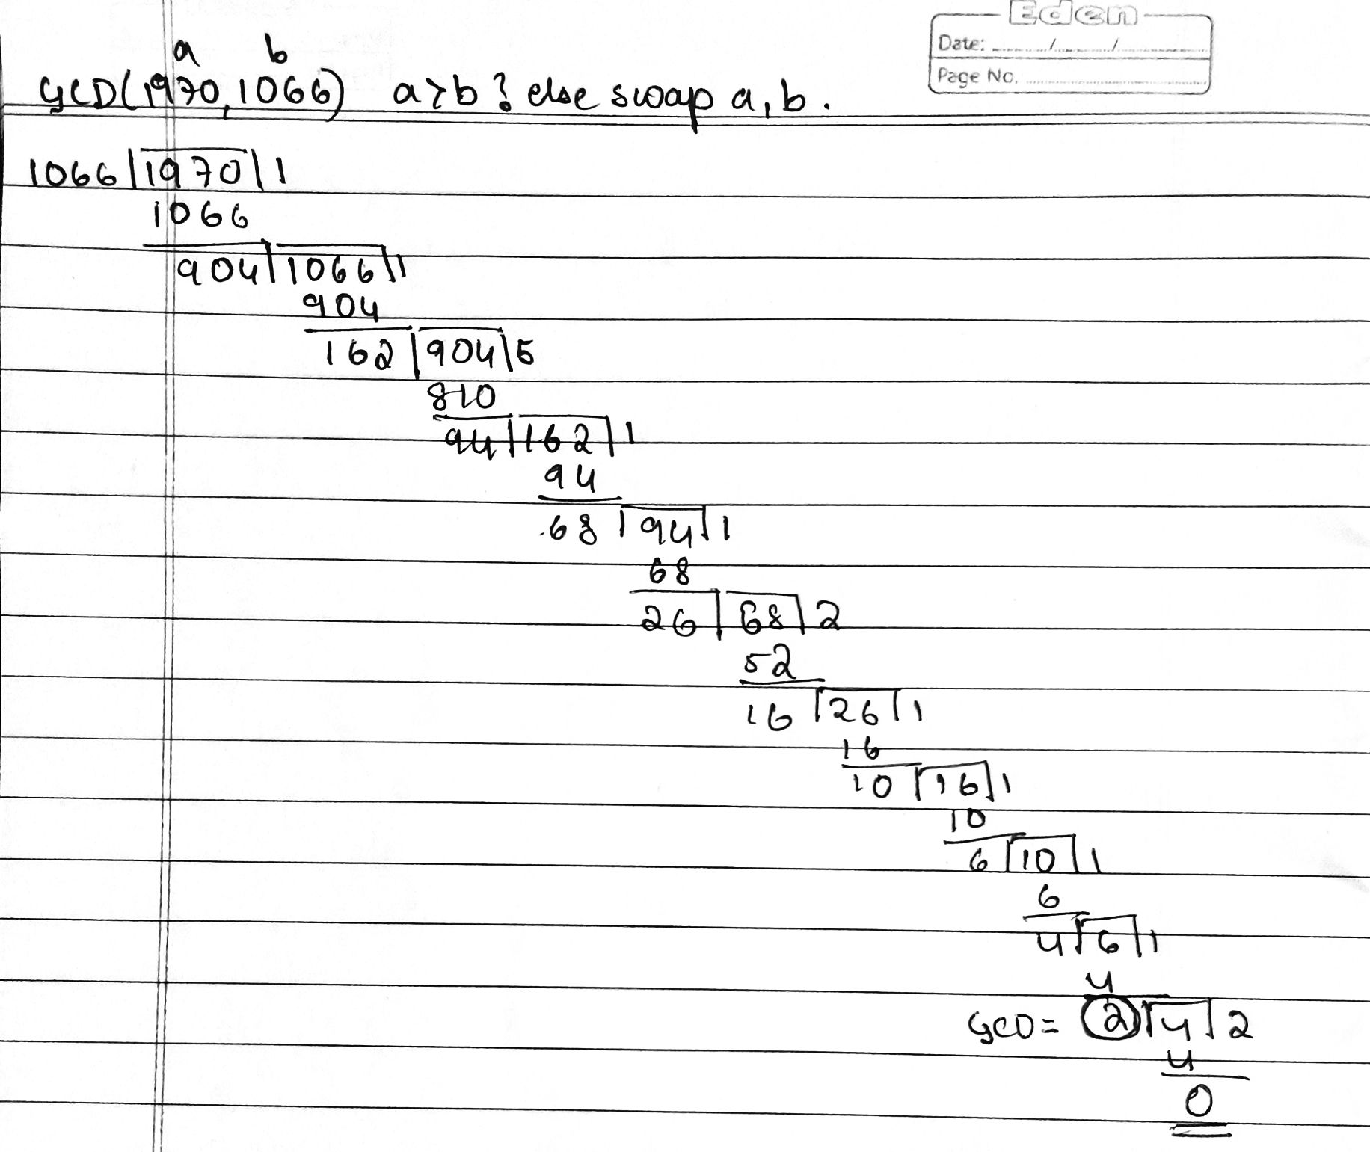
Greatest Common Divisor (GCD)
GCD (a,b) of a and b is the largest integer that divides evenly into both a and b. E.g., GCD(60,24) = 12
E.g., GCD(8,15) = 1 Therefore, 8 & 15 are relatively prime becuz they have no common factors (except 1)
Euclidean Algorithm : GCD(a,b) = GCD(b, a mod b)
Example: GCD(1970,1066)

Slide 2
Extended Euclidean Algorithm
calculates not only GCD but x & y where ax + by = gcd(a, b)
if GCD(a,b)=1 these values are inverses
Eg: Find x and y values of 5 mod 3
First check if a>b else swap. Here, a=5 > b=3
Check if GCD(a,b)=1. here GCD(5,3)=1 relatively prime
Start with S1=1, S2=0,T1 = 0, T1=1 in first row
S=S1 – S2 * Q and T=T1 – T2 * Q
When R = 0 , stop
x = S2 = -1 and y = T2 = 2
q | a | b | r | s1 | s2 | s3 | t1 | t2 | t3
1 | 5 | 3 | 2 | 1 | 0 | 1 | 0 | 1 | -1
1 | 3 | 2 | 1 | 0 | 1 | -1 | 1 | -1 | 2
2 | 2 | 1 | 0 | 1 | -1 | 3 | -1 | 2 | -5
GCD(5, 3) = 1, s = -1, t = 2 Therefore, |s × a + t × b| = |-1 × 5 + 2 × 3| = |-5 + 6| = |1| = 1

Slide 3
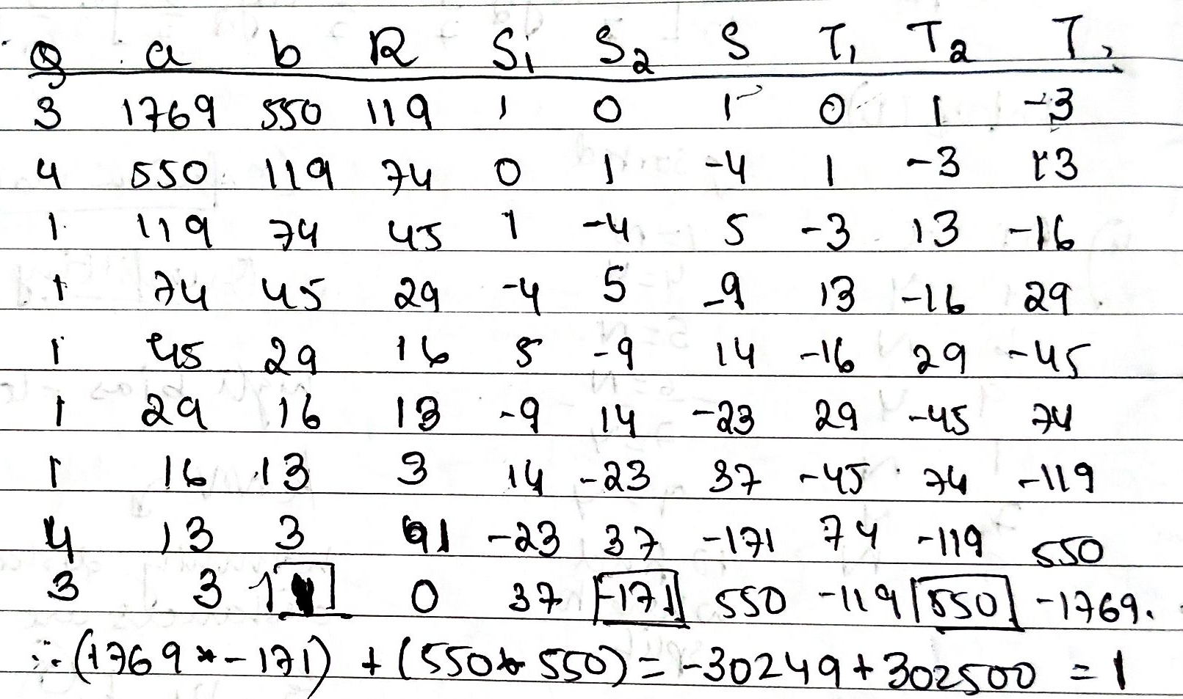
Practice Problems
Using Extended Euclidean Algorithm, Compute the following: 550 mod 1769

Slide 4
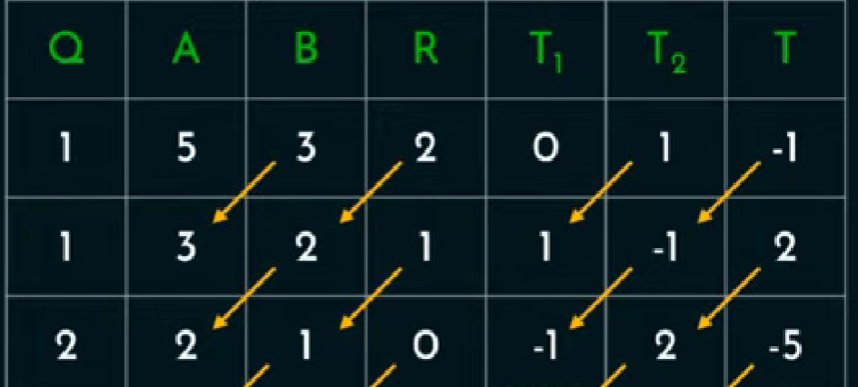

Find multiplicative inverse of (3 mod 5) using EEA
First check if a>b else swap. Here, a=5 > b=3
Check if GCD(a,b)=1. here GCD(5,3)=1 relatively prime
Start with T1 = 0 and T1=1 in first row
T=T1 – T2 * Q
When R = 0 , stop
How to check?
2*3 mod 5 = 1
Finding mod of –ve number: -n mod k = k – (n mod k)
Eg: -3 mod 12 = 12 – (3 mod 12) = 12 – 3 = 9 [3<12, but don’t swap a,b]
Eg: -25 mod 3 = 3 – (25 mod 3) = 3 – 1 = 2 [swap only while GCD]

Slide 5
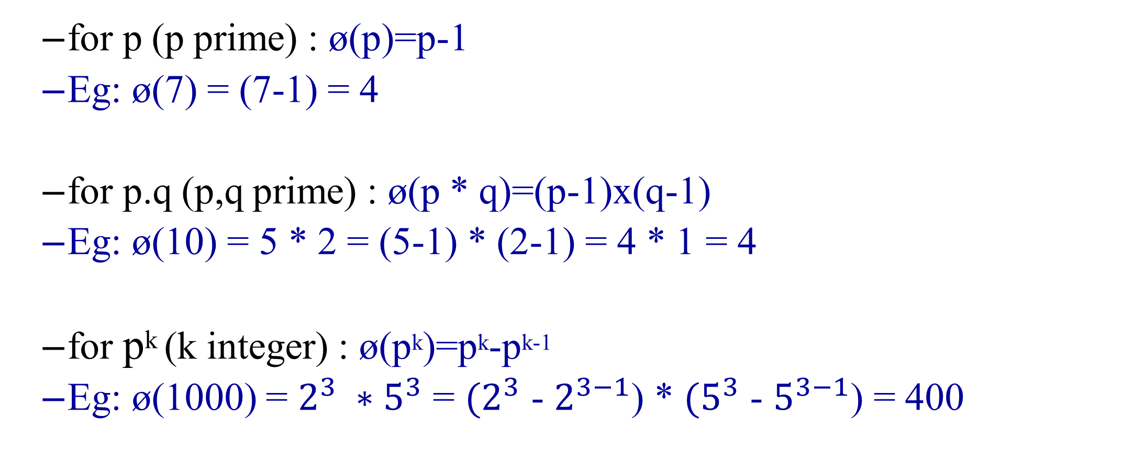
Euler Totient Function ø(n)
for p (p prime) : ø(p)=p-1
Eg: ø(7) = (7-1) = 4
for p.q (p,q prime) : ø(p * q)=(p-1)x(q-1)
Eg: ø(10) = 5 * 2 = (5-1) * (2-1) = 4 * 1 = 4
for p^{k} (k integer) : ø(p^{k})=p^{k}-p^{k-1}
Eg: ø(1000) = $2^{3} ∗5^{3}$ = ${(2}^{3}$ - $2^{3−1}$) * ${(5}^{3}$ - $5^{3−1}$) = 400
Euler’s Theorem
a^{ø(n)} ≡1 (mod n) for any a,n where gcd(a,n)=1
a^{ø(n)+1} ≡ a (mod n)

Slide 6
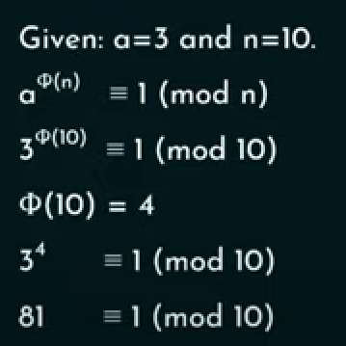
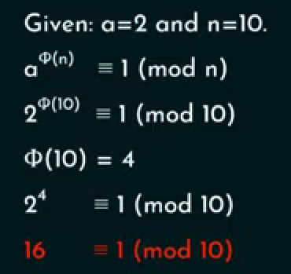
Prove that Euler’s theorem holds true for a = 3 and n = 10
Prove that Euler’s theorem does not holds true for a = 2 and n = 10
Hence, Euler’s theorem holds true for a = 3 and n = 10
Prove that Euler’s theorem does not hold true for a = 2 and n = 10

Slide 7

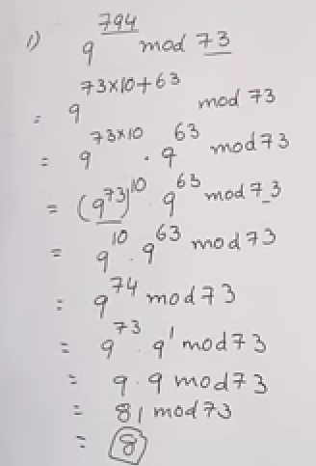
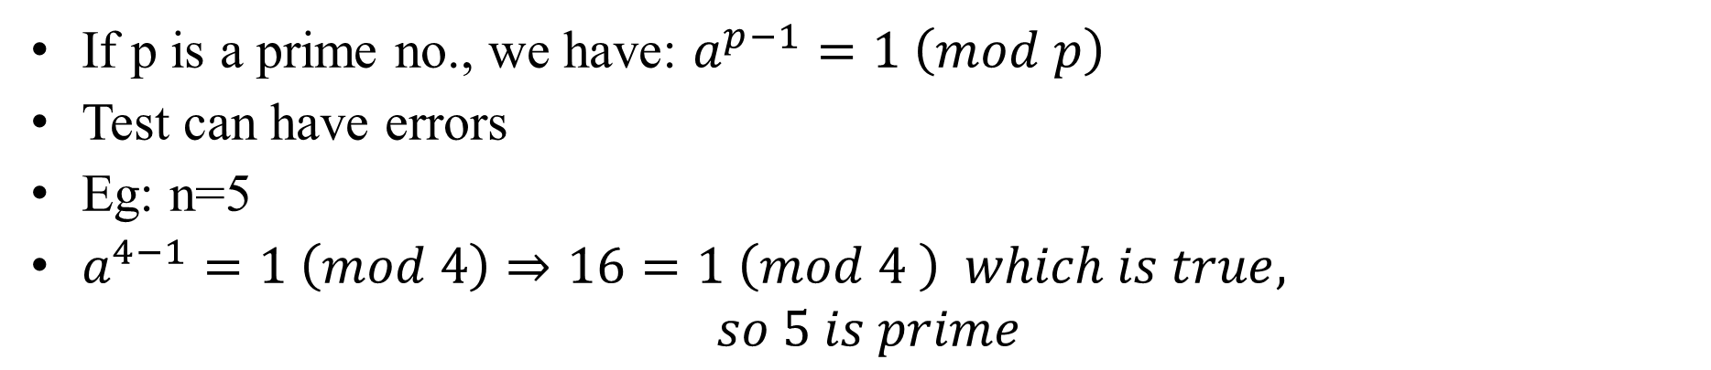
Fermat’s Theorem
a^{p-1} ≡ 1 (mod p) where p is prime and gcd(a,p)=1
a^{p} ≡ a (mod p)
Eg: Does Fermat’s Theorem hold true for p=5 and a=2?
16 mod 5 = 1
Threfore Fermat’s theorem holds true for p=5 and a=2
https://youtu.be/J6al-Vq9Ea8?si=GCmxCpEqtjBg7SEb
Using Fermat’s Theorem, find 3²⁰¹ mod 11.
3²⁰¹ mod 11
= 3^{10*20 + 1} mod 11
= 3^{10*20} * 3¹ mod 11
= 1²⁰ * 3¹ mod 11
= 3 mod 11
= 3
Primality Testing (using Fermat’s Theorem)
If p is a prime no., we have: $a^{p−1}=1 \left(mod p\right)$
Test can have errors
Eg: n=5
$a^{4−1}=1 \left(mod 4\right)⇒16=1 \left(mod 4 \right) which is true,$
$$so 5 is prime$$

Slide 8
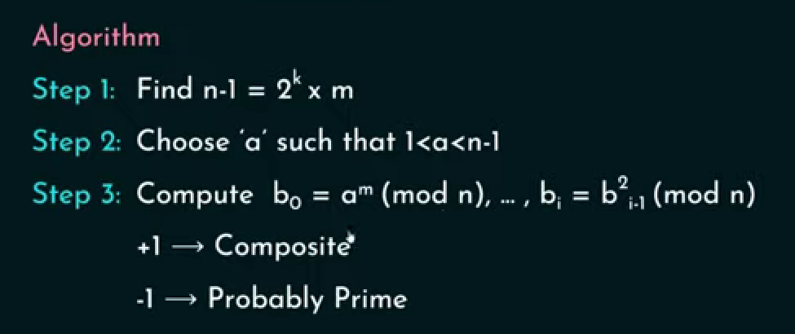
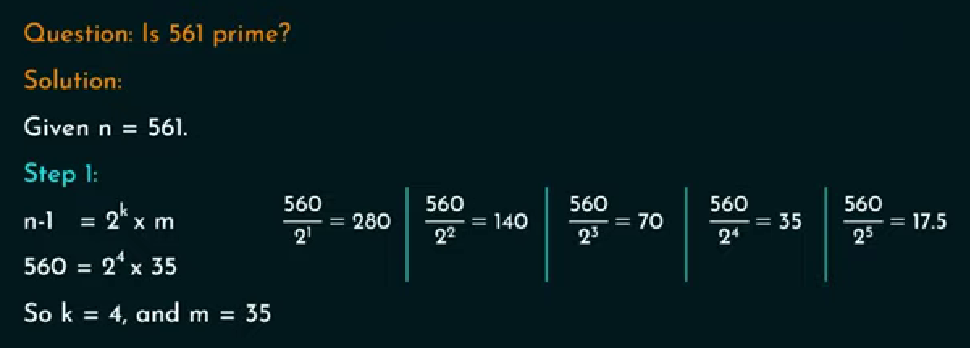





Miller Rabin Algorithm
Non integer value

Slide 9
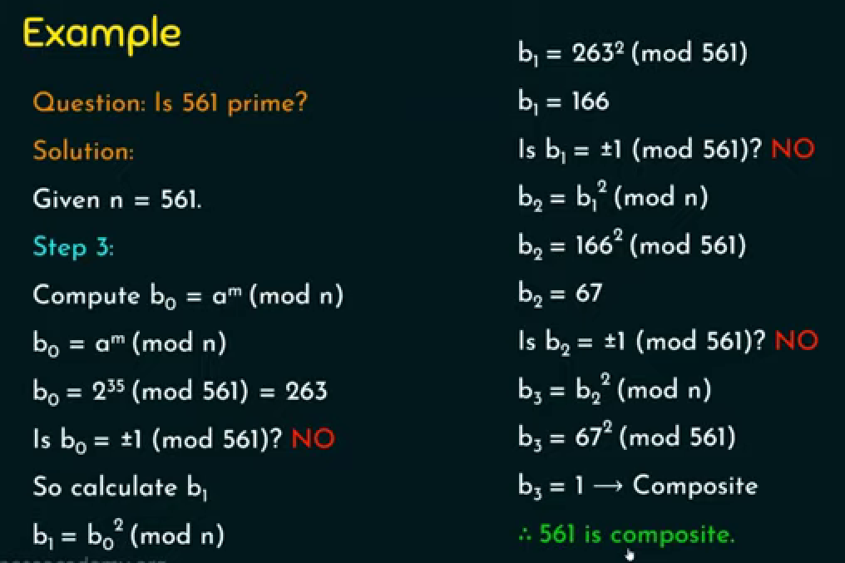


Slide 10
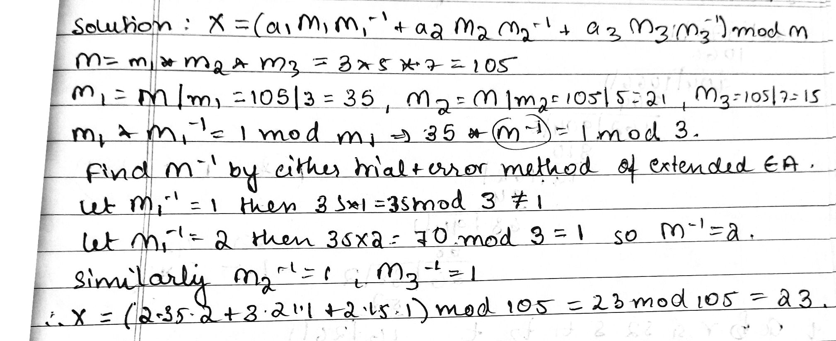


Chinese Remainder Theorem
x≡2(mod 3)
x≡3(mod 5)
x≡2(mod 7)
1) Use the CRT to find x for the following equations:

Slide 11

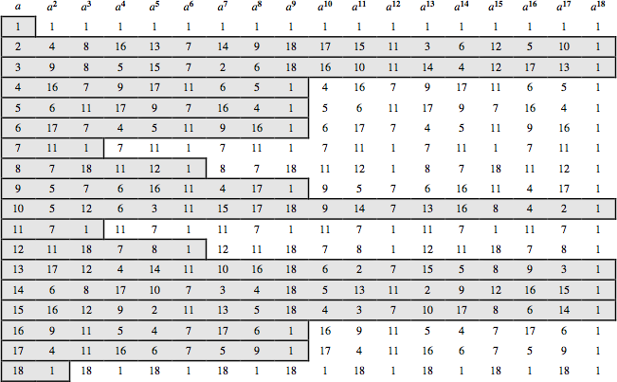

Powers mod 19
2 mod 13= 2
2^2 mod 13 = 4
2^3 mod 13 = 8 and so on..
If a row contains distinct non repeating values, it is called primitive root
For the prime number 19, its primitive roots are 2, 3, 10, 13, 14, and 15.

Slide 12
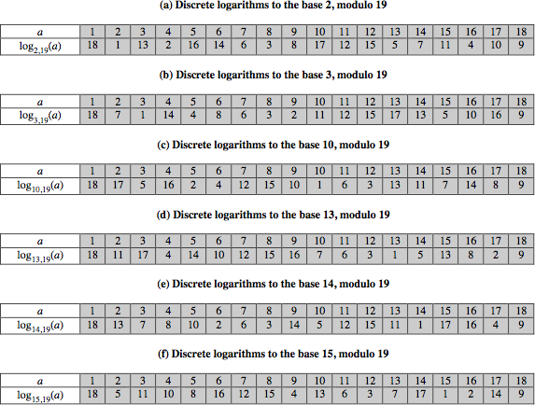
Discrete Logarithms mod 19

