Slide 1

RSA Encryption and Decryption
each user generates a public/private key pair by:
selecting two large primes at random: p, q
computing their system modulus n=p.q and ø(n)=(p-1)(q-1)
selecting at random the encryption key e
where 1<e<ø(n), gcd(e,ø(n))=1
solve following equation to find decryption key d
e.d=1 mod ø(n) and 0≤d≤n
publish their public encryption key: PU={e,n}
keep secret private decryption key: PR={d,n}
Encryption: C = P^{e} mod n
Decryption: P = C^{d} mod n
Select primes: p=17 & q=11
Calculate
Calculate
Select e: gcd(e,160)=1; choose e=7
Determine d: de=1 mod 160 and d < 160
Value is d=23 since 23 x 7=161= 10 x 160 + 1
Publish public key PU={7,187}
Keep secret private key PR={23,187}
Consider plaintext (P)=8
Encryption: C = P^{e} mod n = $8^{7}$ mod 187 = 134
Decryption: P = C^{d} mod n = ${134}^{23}$ mod 187 = 8
n = pq =17 x 11=187 ø(n)=(p–1)(q-1)=16x10=160

Slide 2
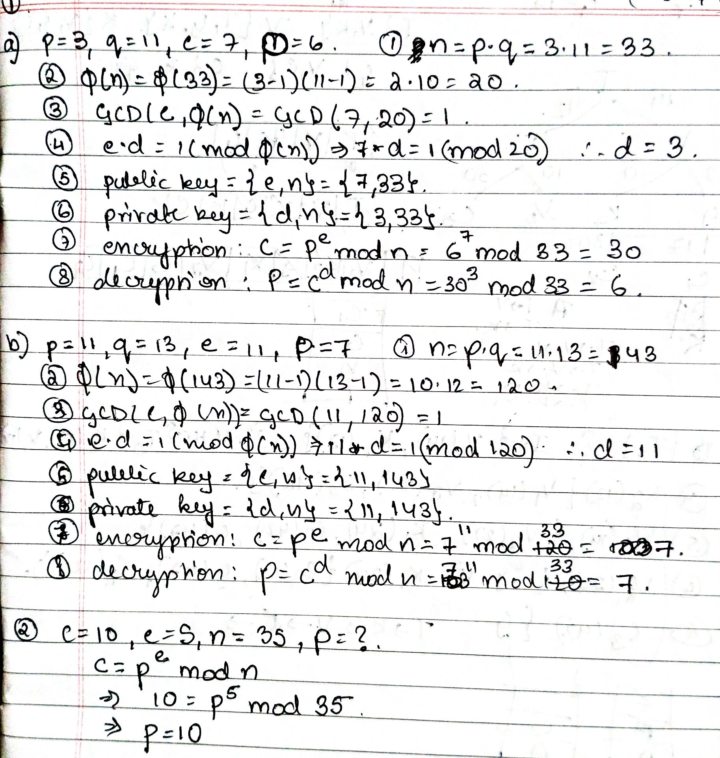
Practice Problems
1) Perform encryption and decryption using the RSA algorithm:
a) p=3; q=11; e=7; M=6
b) p=11; q=13; e=11; M=7
In a public-key system using RSA, you intercept the ciphertext C=10 sent to a user whose public key is e=5, n=35. What is the plaintext M?

Slide 3

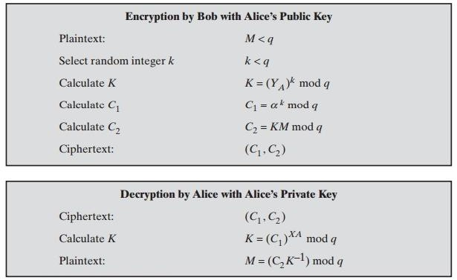
ElGamal Message Exchange … Contd.

Slide 4
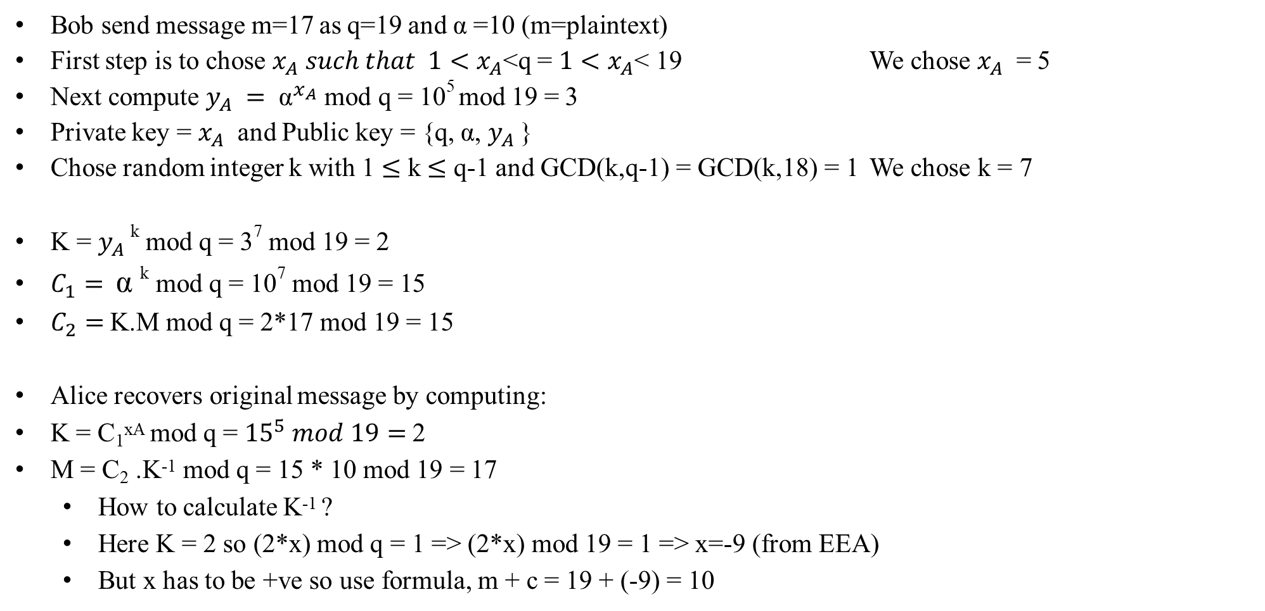
ElGamal Example
Bob send message m=17 as q=19 and α =10 (m=plaintext)
First step is to chose $x_{A} such that 1<x_{A}$<q = $1<x_{A}$< 19 We chose $x_{A}$ = 5
Next compute $y_{A} = {\text{α}}^{x_{A}}$ mod q = 10⁵ mod 19 = 3
Private key = $x_{A}$ and Public key = {q, α, $y_{A}$}
Chose random integer k with 1 $≤$ k $≤$ q-1 and GCD(k,q-1) = GCD(k,18) = 1 We chose k = 7
K = $y_{A}$^{k} mod q = 3⁷ mod 19 = 2
$C_{1}=$ α ^{k} mod q = 10⁷ mod 19 = 15
$C_{2}=$K.M mod q = 2*17 mod 19 = 15
Alice recovers original message by computing:
K = C₁^{xA} mod q = ${15}^{5} mod 19=$2
M = C₂ .K⁻¹ mod q = 15 * 10 mod 19 = 17
How to calculate K⁻¹ ?
Here K = 2 so (2*x) mod q = 1 => (2*x) mod 19 = 1 => x=-9 (from EEA)
But x has to be +ve so use formula, m + c = 19 + (-9) = 10

Slide 5
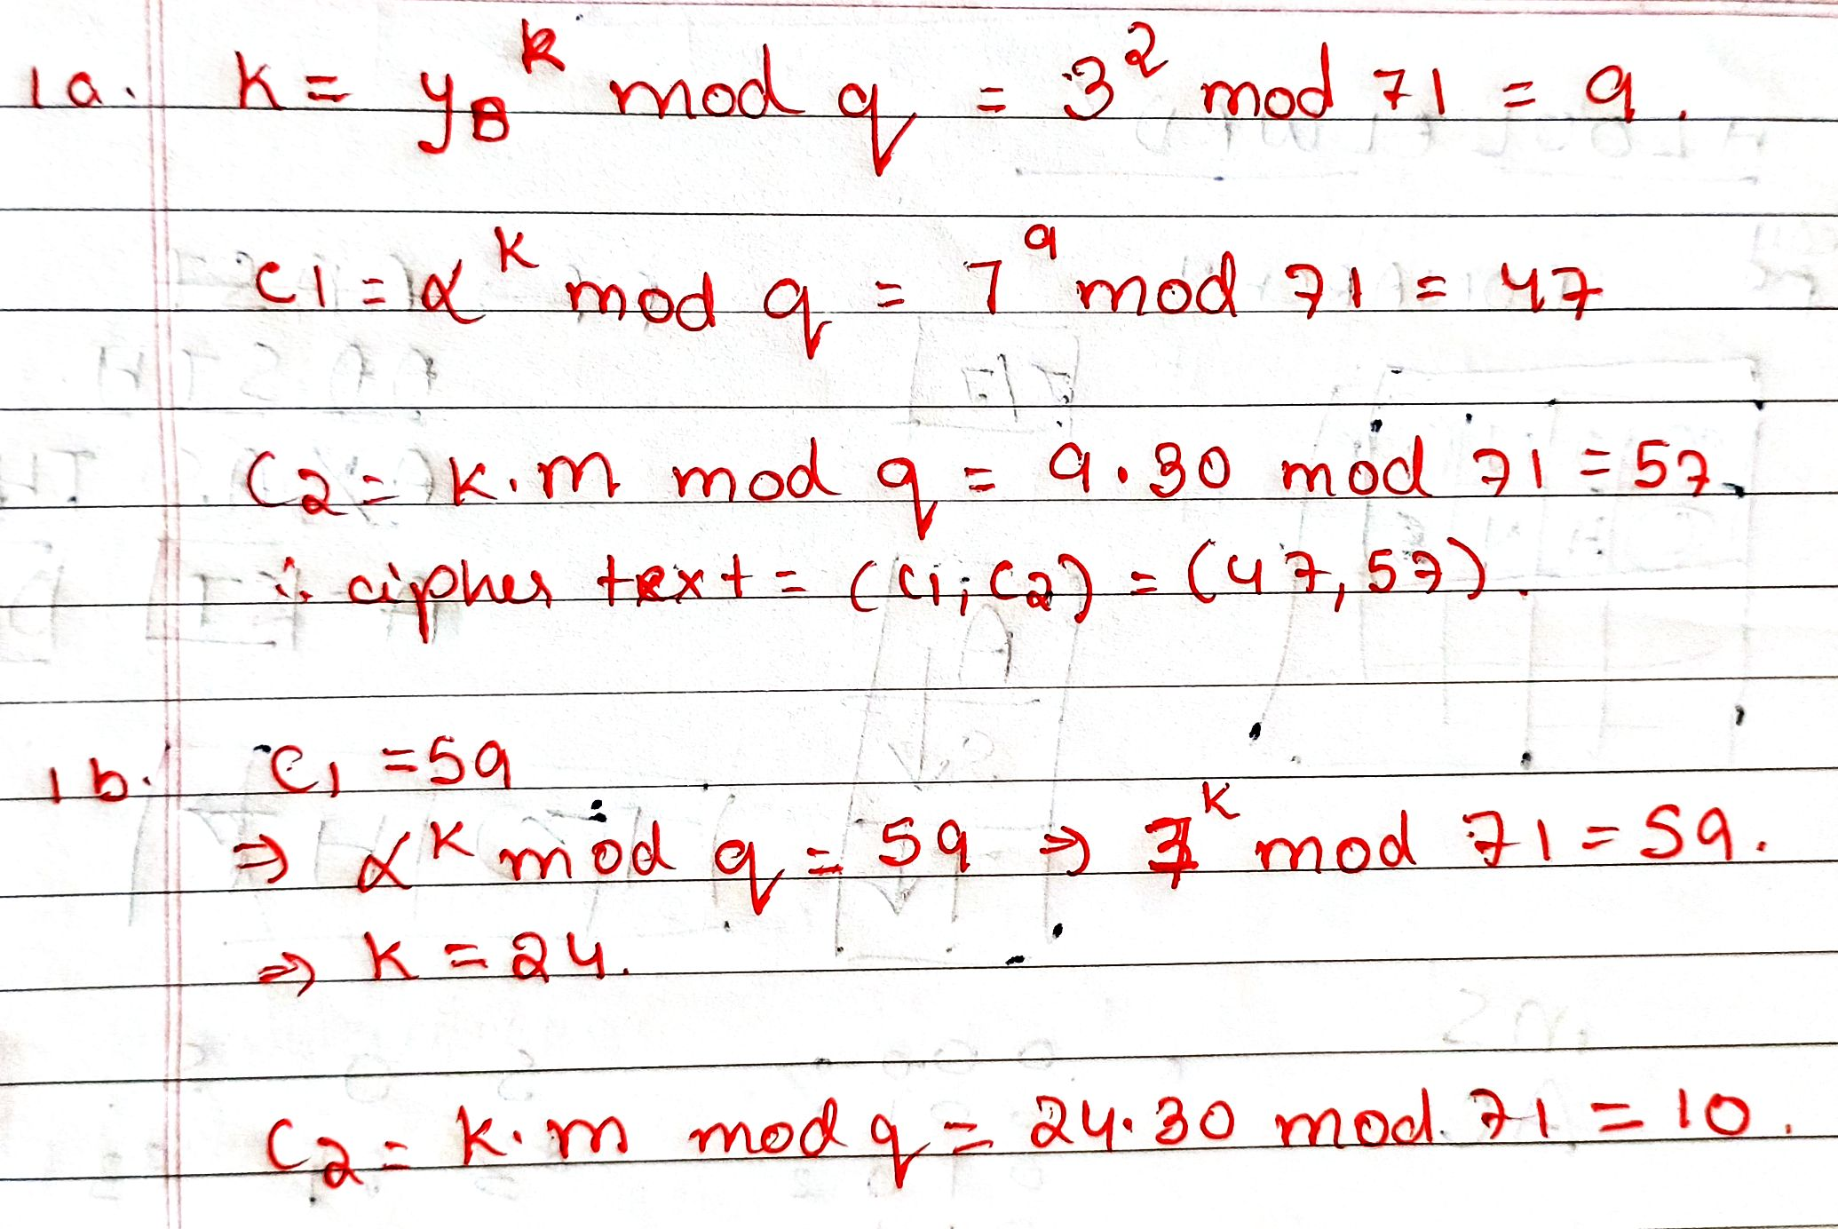
Practice Problems
Suppose Alice and Bob use an ElGamal scheme with a common prime q=71 and a primitive root α=7.
If Bob has public key YB=3 and Alice chose the random integer k=2, what is the ciphertext of M=30?
If Alice now chooses a different value of k so that the encoding of M=30 is C=(59, C2), what is the integer C2?

Slide 6
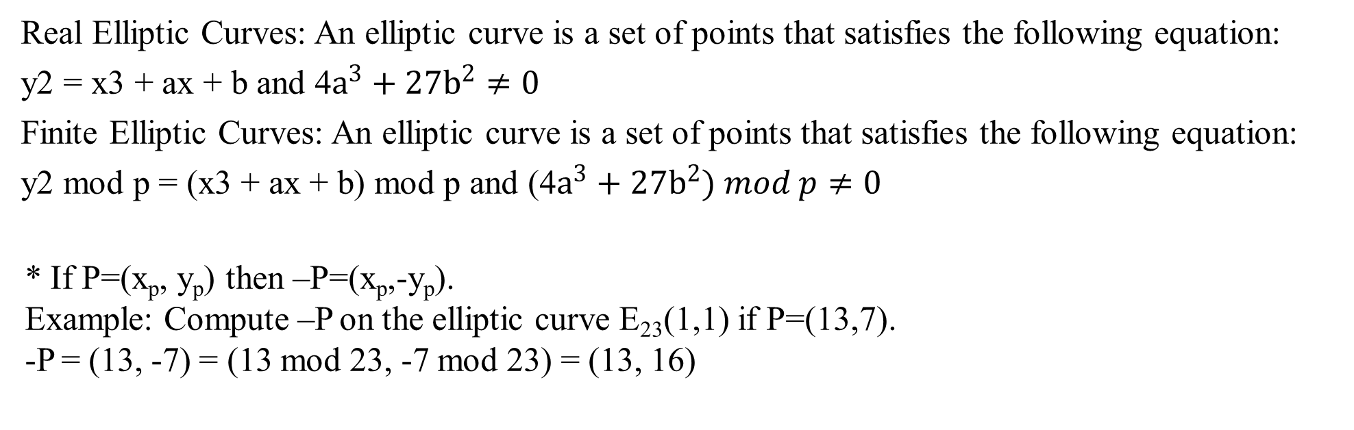
Elliptic Curve Cryptography (ECC)
Majority of public-key cryptography use either integer or polynomial arithmetic with very large numbers/polynomials imposing a significant load in storing and processing keys and messages. Elliptic curve offers the same security with smaller bit sizes.
Applications: small devices with limited storage and computational power like Wireless communication devices & smart cards
Real Elliptic Curves: An elliptic curve is a set of points that satisfies the following equation:
y2 = x3 + ax + b and 4$a^{3}+{27b}^{2}≠0$
Finite Elliptic Curves: An elliptic curve is a set of points that satisfies the following equation:
y2 mod p = (x3 + ax + b) mod p and (4$a^{3}+{27b}^{2}) mod p≠0$
* If P=(x_{p}, y_{p}) then –P=(x_{p},-y_{p}).
Example: Compute –P on the elliptic curve E₂₃(1,1) if P=(13,7).
-P = (13, -7) = (13 mod 23, -7 mod 23) = (13, 16)
https://youtu.be/EWouocApQYk?si=-1Tvqc4rkr-l28Tg

Slide 7
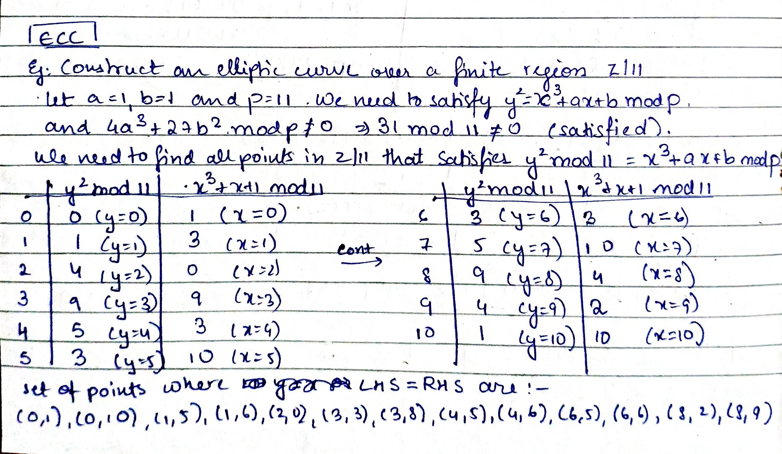

Slide 8
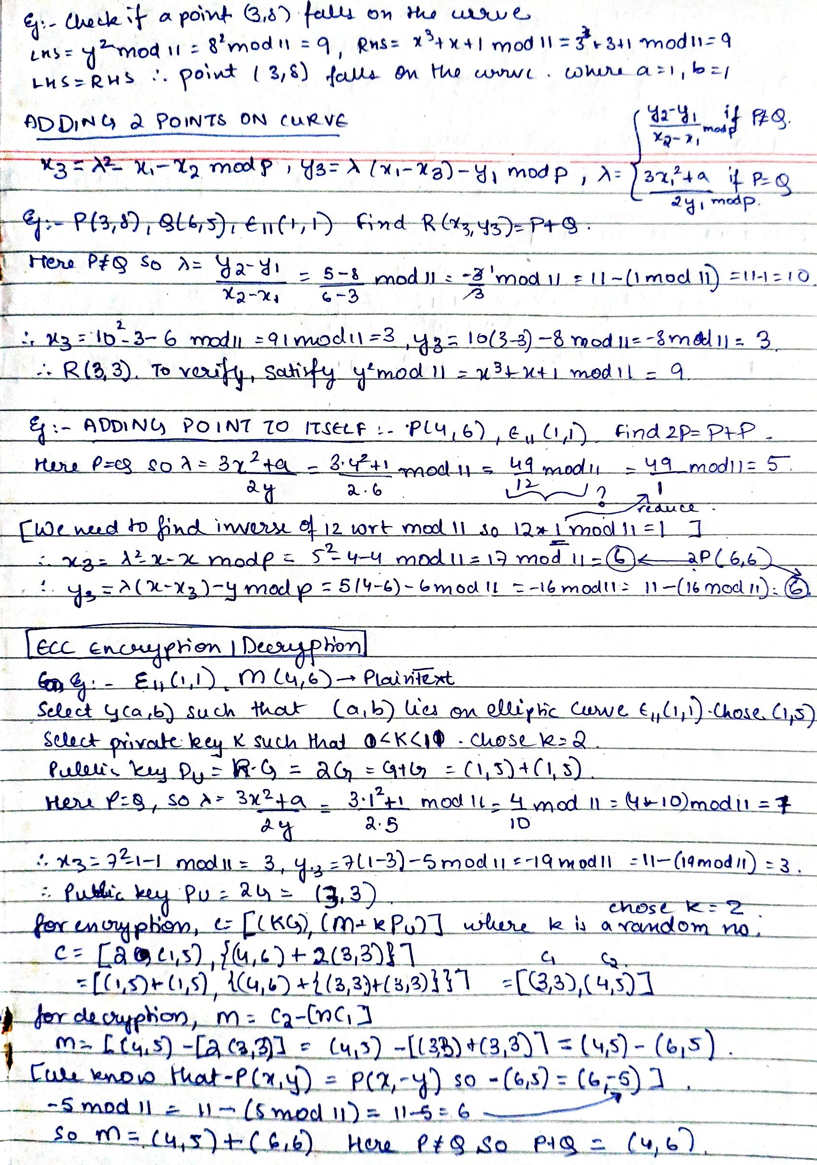

Slide 10
Practice Questions
Consider the elliptic curve E₇(2,1); that is the curve is defined by y²=x³+2x+1 with a modulus of p=7. Determine all the points in E₇(2,1).
What are the negatives of the following elliptic curve points over Z₁₇? a) P=(5,8) b) Q=(3,0) c) R=(0,6)
For E₁₁(1,7), consider the point G=(3,2). Compute the multiple of G from 2G through 13G.
Assume a secure communication happens between User A and B using elliptic curve cryptosystem. The cryptosystem parameters are E₁₁(1, 6) and G=(2,7). B’s private key is n_{B}=3.
Find B’s public key P_{B}.
A wishes to encrypt the message P_{m}=(10, 9) and chooses a random value k=3. Determine the ciphertext C_{m}.
Show the calculation by which B recovers P_{m} from C_{m}.
21 February 2024
BCSE309L-M3-L4

Slide 11
Diffie-Hellman
users Alice & Bob who wish to swap keys:
agree on prime q=353 and α=3
select random secret keys:
– A chooses x_{A}=97, B chooses x_{B}=233
compute respective public keys:
– y =3⁹⁷ mod 353 = 40
(Alice) (Bob)
A
– y_{B}=3 mod 353 = 248
233
compute shared session key as:
– K = y ^{xA} mod 353 = 248⁹⁷ = 160
(Alice) (Bob)
AB B_{xB}
– K_{AB}= y_{A}
233
mod 353 = 40 = 160
20 March 2024
BCSE309L-M3-L5

Slide 12
Diffie-Hellman – Multiparty Computation
Steps
The parties agree on the algorithm parameters p and g.
The parties generate their private keys, named a, b, and c.
Alice computes gª mod p and sends it to Bob.
Bob computes (gª)^{b} mod p = g^{ab} mod p and sends it to Carol.
Carol computes (g^{ab})^{c} mod p = g^{abc} mod p and uses it as her secret.
Bob computes g^{b} mod p and sends it to Carol.
Carol computes (g^{b})^{c} mod p = g^{bc} mod p and sends it to Alice.
Alice computes (g^{bc})ª mod p = g^{bca} mod p = g^{abc} mod p and uses it as her secret.
Carol computes g^{c} mod p and sends it to Alice.
Alice computes (g^{c})ª mod p = g^{ca} mod p and sends it to Bob.
Bob computes (g^{ca})^{b} mod p = g^{cab} mod p = g^{abc} mod p and uses it as his secret.

Slide 13
Practice Problems
Alice and Bob use the Diffie-Hellman key exchange technique with a common prime q=353 and a primitive root α=3.
If Alice has a private key X_{A}=97, find her public key Y_{A}.
If Bob has a private key X_{B}=233, find his public key Y_{B}.
What is the shared secret key between Alice and Bob?
Alice and Bob use the Diffie-Hellman key exchange technique with a common prime q=23 and a primitive root α=5.
If Bob has a public key Y_{B}=10, what is Bob’s private Y_{B}?
If Alice has a public key Y_{A}=8, what is the shared key K with Bob?
Show that 5 is a primitive root of 23.
20 March 2024
BCSE309L-M3-L5

Slide 14
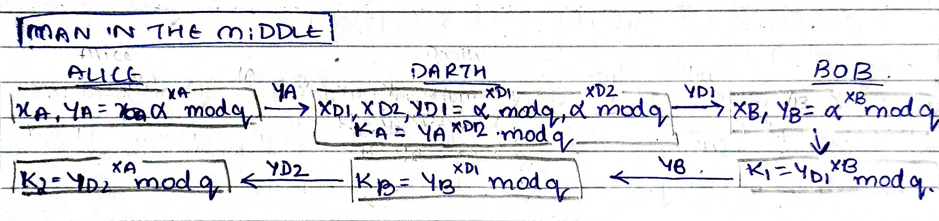
Man-in-the-Middle Attack.
https://youtu.be/ev2Cbu23m-Q?si=SnV4iT_YaafzF7LR
20 March 2024
BCSE309L-M3-L5

