Slide 1

Hash Functions
condenses arbitrary message to fixed size h = H(M)
hash used to detect changes to message
Requirements:
Preimage resistant (One-way property) Given h(M), difficult to find M’ s.t. h(M’)=h(M)
Second preimage resistant (Weak collision resistant) Given M, difficult to find M’ s.t. h(M’)=h(M), M’≠M
Collision resistant (Strong collision resistance) Difficult to find any pair (M, M’) with M’≠ M s.t. h(M) = h(M’)
Applications: Message Integrity Check (MIC) – send hash of message, Message Authentication Code (MAC)- send keyed hash of message, Digital Signature – encrypt hash with private signed key, Pseudorandom Function (PRF)- generate session keys, Pseudorandom Number Generator (PRNG), Password & Signature Verification, Verifying File and Message Integrity
Encryption is 2 way and requires a key while hashing is 1 way and does not require a key.

Slide 2
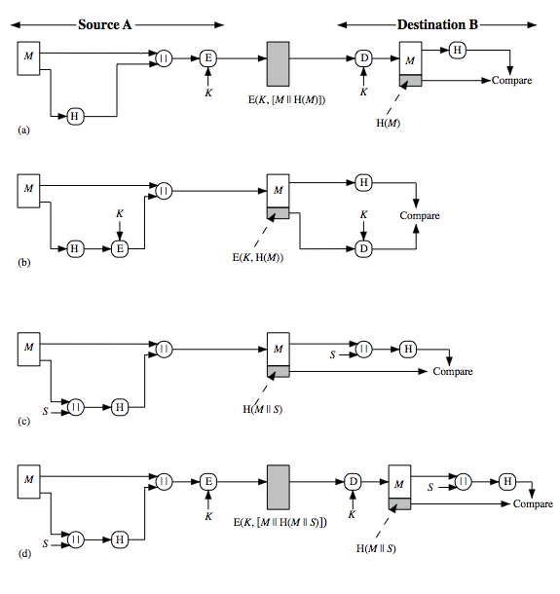
Hash Functions and Message Authentication
a. The message plus concatenated hash code is encrypted using secret key. Only A and B share the secret key, which implies the message must have come from A and has not been altered.
b. Only the hash code is encrypted, using secret key. This reduces the processing burden for those applications not requiring confidentiality.
c. The two communicating parties share a common secret value S. M and S is concatenated and then hashed. Resulting value is appended to M again. Because B possesses S, it can re-compute the hash value to verify. Because the secret value itself is not sent, an opponent (attacker) cannot modify an intercepted message and cannot generate a false message.
d. Confidentiality can be added to the approach of method (c) by encrypting the entire message plus the hash code.
Notes:
2
Message authentication is a mechanism or service used to verify the integrity of a message, by assuring that the data received are exactly as sent. Stallings Figure 11.2 illustrates a variety of ways in which a hash code can be used to provide message authentication, as follows:
The message plus concatenated hash code is encrypted using symmetric encryption. Since only A and B share the secret key, the message must have come from A and has not been altered. The hash code provides the structure or redundancy required to achieve authentication.
Only the hash code is encrypted, using symmetric encryption. This reduces the processing burden for those applications not requiring confidentiality.
Shows the use of a hash function but no encryption for message authentication. The technique assumes that the two communicating parties share a common secret value S. A computes the hash value over the concatenation of M and S and appends the resulting hash value to M. Because B possesses S, it can recompute the hash value to verify. Because the secret value itself is not sent, an opponent cannot modify an intercepted message and cannot generate a false message.
Confidentiality can be added to the approach of (c) by encrypting the entire message plus the hash code.
When confidentiality is not required, method (b) has an advantage over methods (a) and (d), which encrypts the entire message, in that less computation is required.

Slide 3
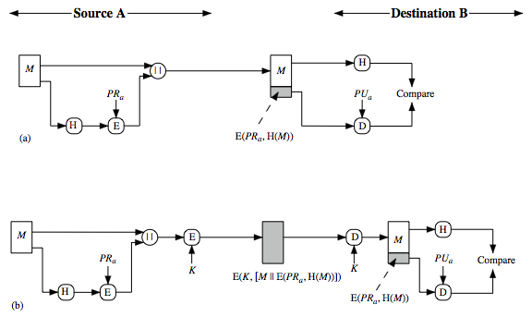
Hash Functions and Digital Signatures
Digital Signatures
▪ A digital signature is a mathematical scheme for verifying the authenticity of digital messages or documents
▪ The hash value of a message is encrypted with a user's private key→ Signing
▪ Anyone who knows the user's public key can verify the integrity of the message that is associated with the digital signature→ Verification
The hash code is encrypted, using public-key encryption with the sender's private key.
The message plus the private-key-encrypted hash code can be encrypted using a symmetric secret key.

Slide 4
Birthday Attacks
Tries to find two different input messages that produce the same hash value. This is called a collision. If an attacker can find a collision, they can trick a system into thinking that two different messages are the same.
Process:
given user prepared to sign a valid message x
opponent generates 2m/2 variations x’ of valid message x and 2m/2 variations y’ of a fraudulent message y
two sets of messages are compared to find pair with same hash (probability > 0.5 by birthday paradox)
have user sign the valid message, then substitute the forgery which will have a valid signature
How to Prevent Birthday Attack?
Use a hash function with a larger output size − The larger the output size, the less likely it is that two different input messages will produce the same output.
Use a different cryptographic technique − Use other cryptographic techniques that is not vulnerable to birthday attacks. Eg: MACs and digital signatures
Use multiple hash functions − Using multiple hash functions in parallel can make it much more difficult for an attacker to find a collision.

Slide 5
SHA-512
Step 1: Append padding bits
The message is padded so that the length is congruent to 896 mod 1024 (even if the message is already of the desired length). Each block should be 1024 bits.
The padding consists of of a single 1 bit followed by the necessary number of 0 bits.
Step 2: Append length
A block of 128 bits is appended to the message.
It contains the length of the original message in bits (before the padding).
The outcome of the first two steps yields a message that is an integer multiple of 1024 bits in length.
Step 3: Initialize hash buffer
8 buffers each of size 64 bits; Buffers – (a, b, c, d, e, f, g, h)
Hexadecimal format
Step 4: Process the message in 1024-bit (128-word) blocks, which forms the heart of the algorithm –
80 rounds

Slide 6
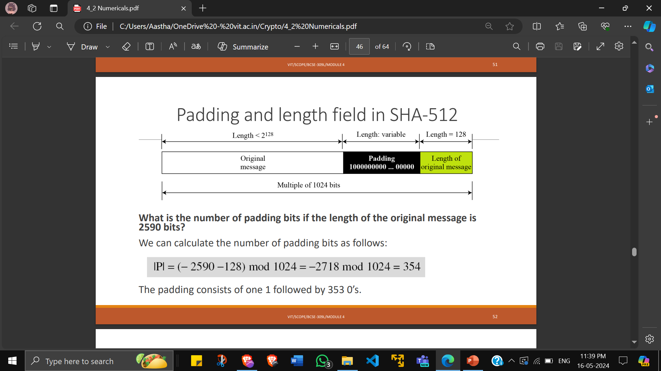

Slide 7
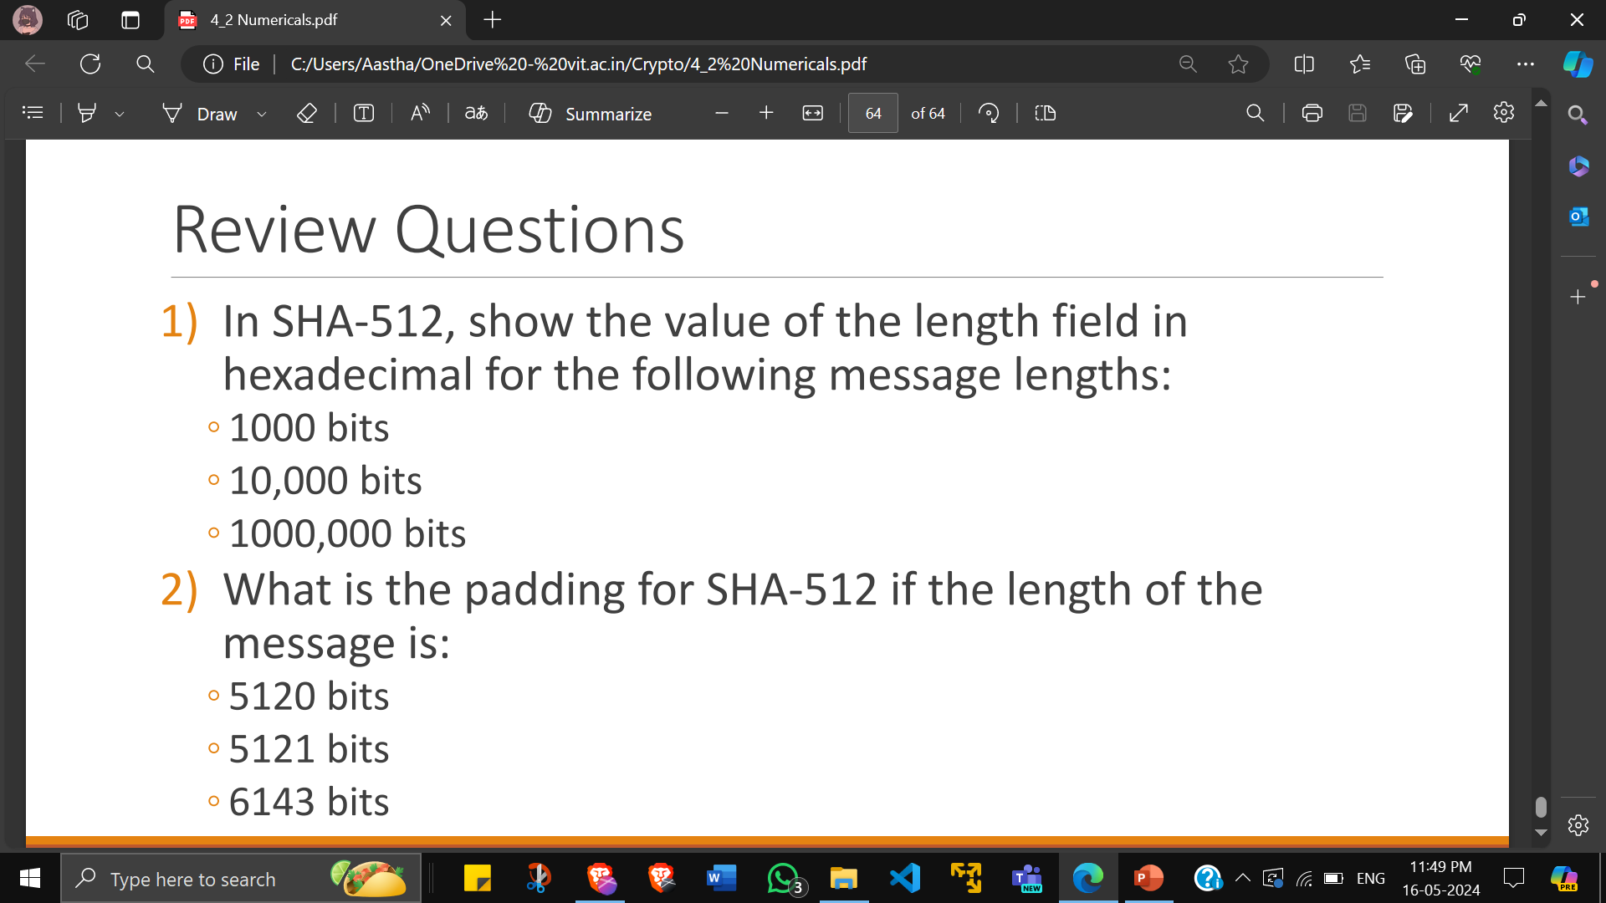

Slide 8
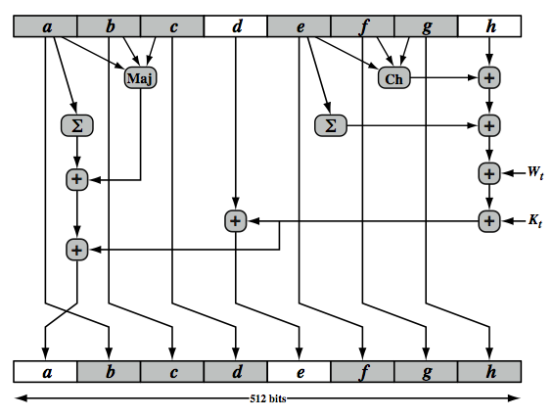
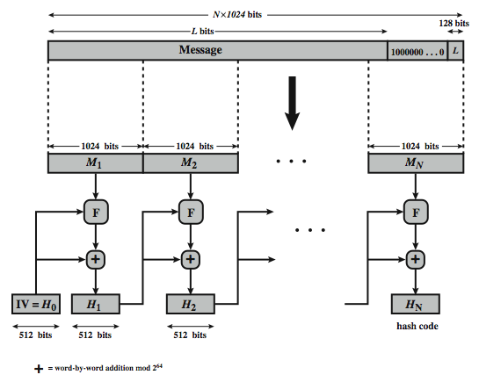
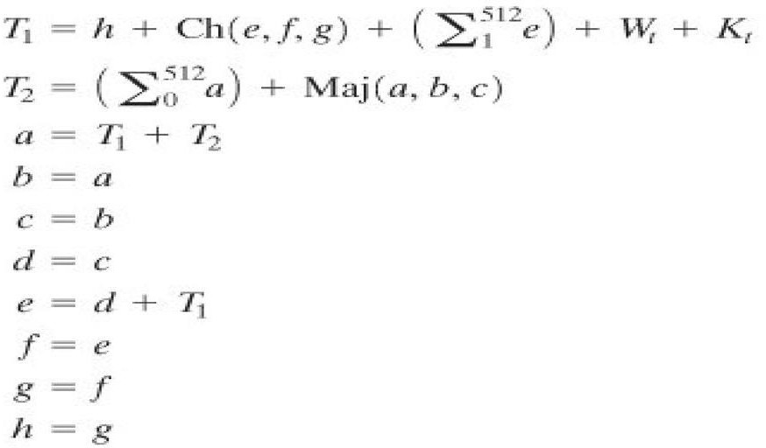
SHA-512 Compression/Round Function
updating a 512-bit buffer using a 64-bit value Wt derived from the current message block
Ch(e,f,g) = (e AND f) XOR (NOT e AND g)
Maj(a,b,c) = (a AND b) XOR (a AND c) XOR (b AND c)
∑(a) = ROTR(a,28) XOR ROTR(a,34) XOR ROTR(a,39)
∑(e) = ROTR(e,14) XOR ROTR(e,18) XOR ROTR(e,41)
+ = addition modulo 2^64

Slide 9
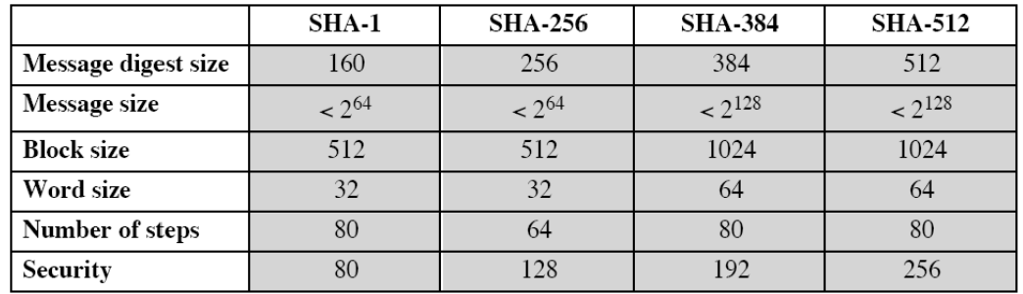
SHA verses MD5
brute force attack is harder in SHA (160 vs 128 bits for MD5)
SHA is not vulnerable to any known attacks (compared to MD4/5)
SHA is slower than MD5 (80 vs 64 steps)
SHA is optimised for big end CPU's (vs MD5 which is optimised for little endian CPU’s)

Slide 10
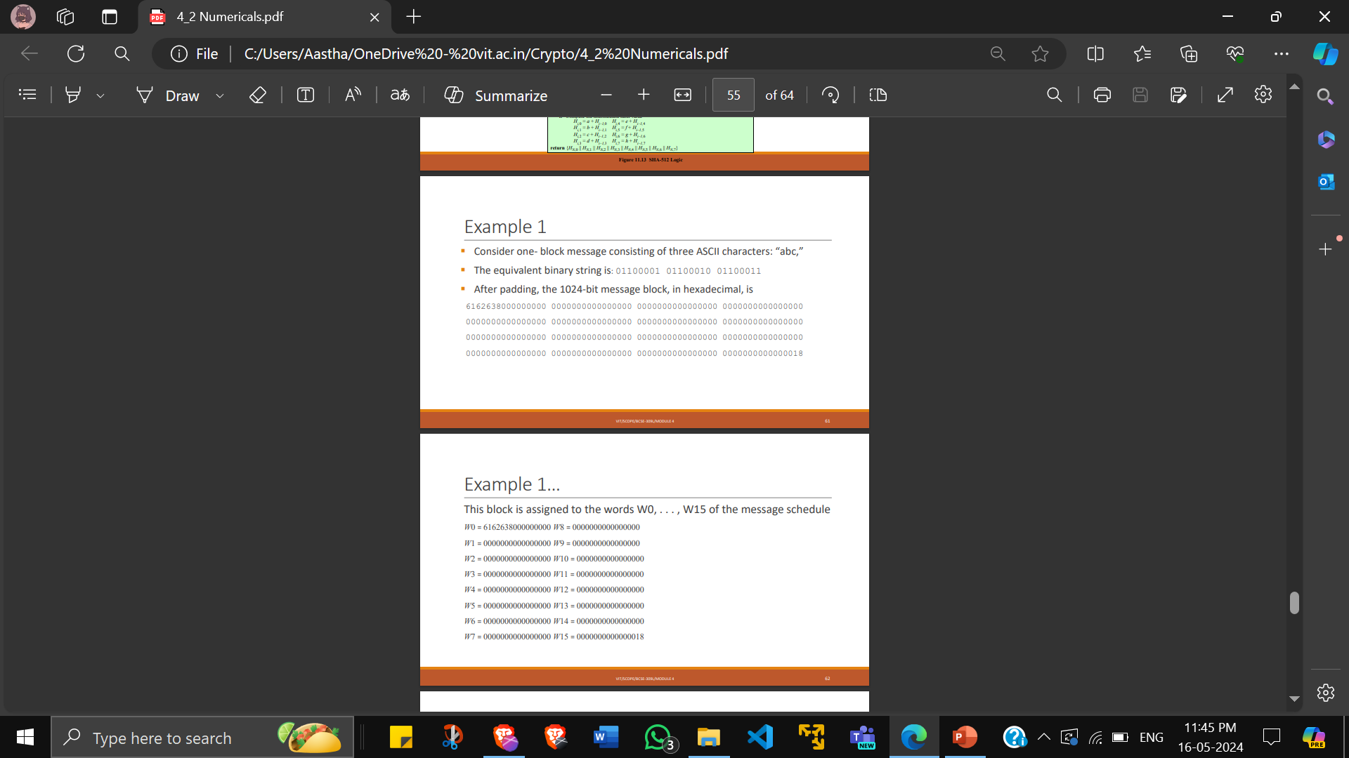

Slide 11
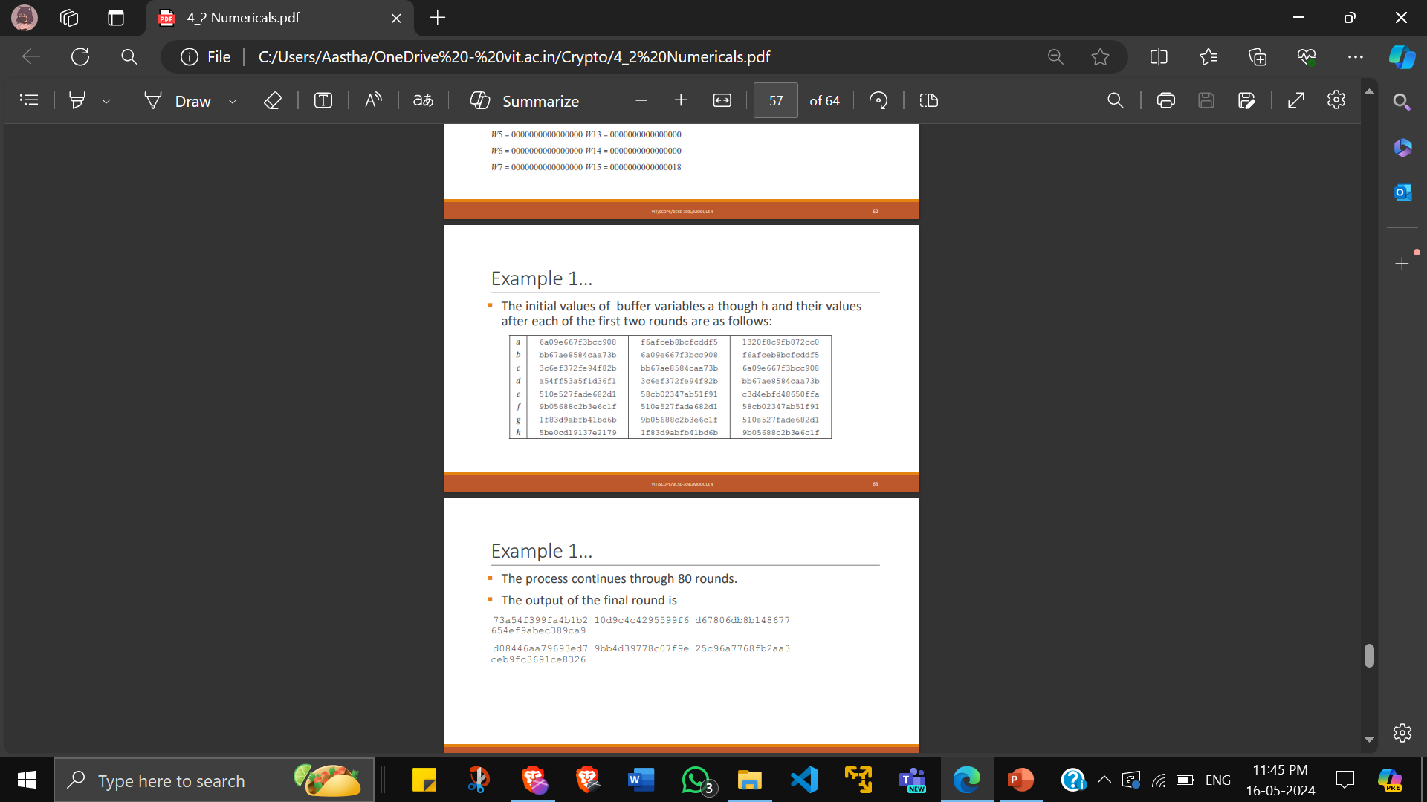

Slide 12
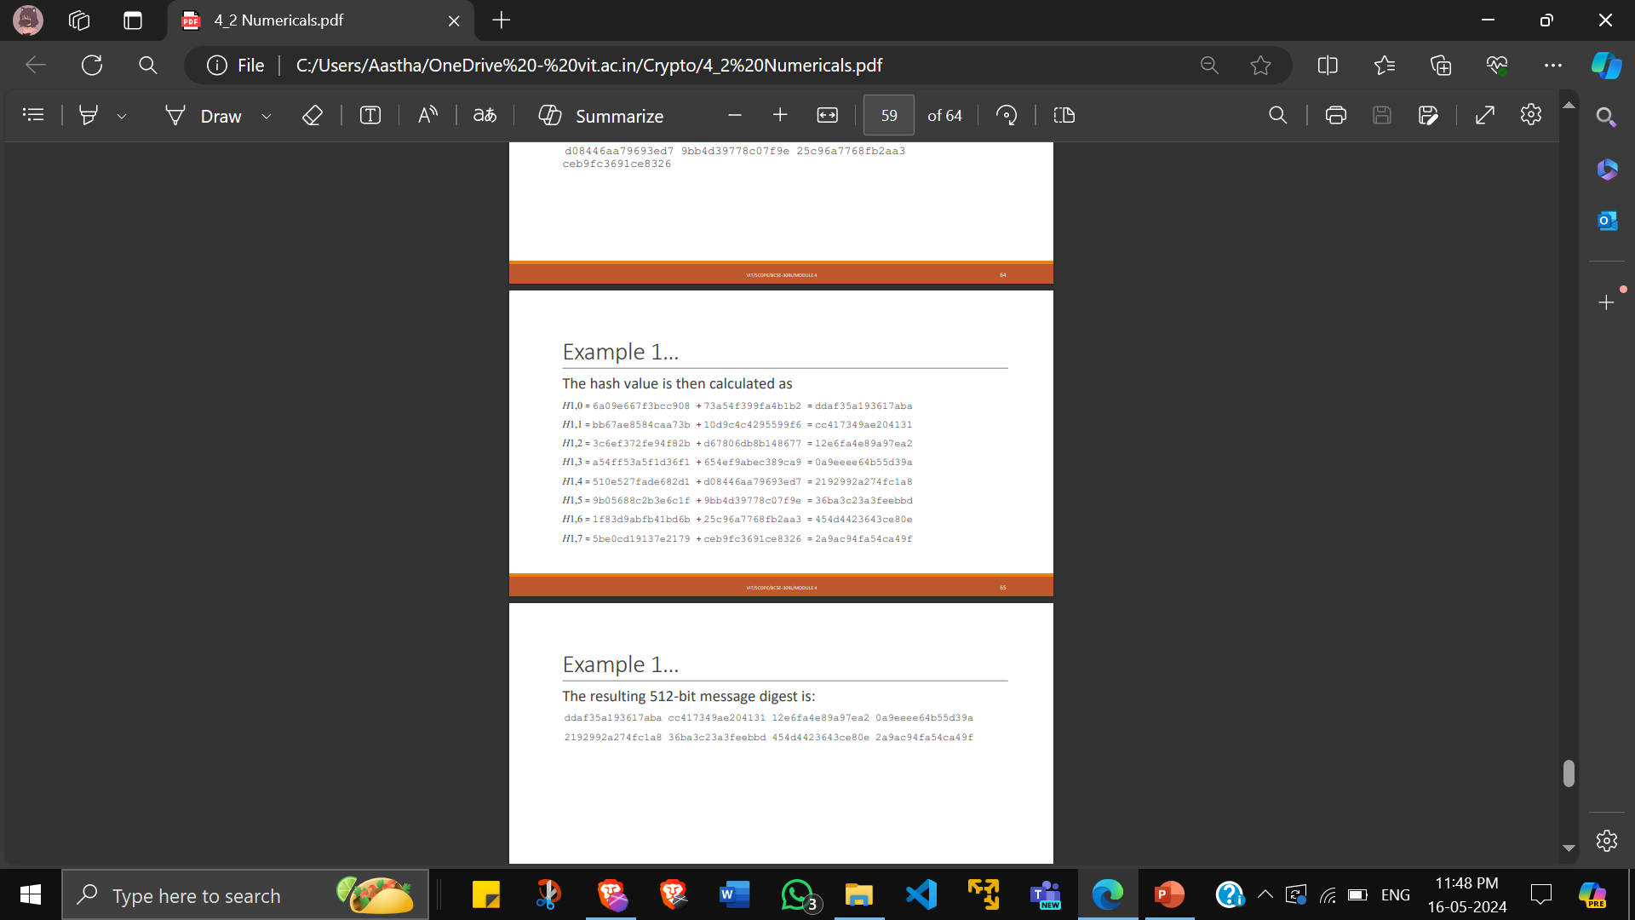

Slide 13
MD5
MD5 is a cryptographic hash function algorithm that takes the message as input of any length and changes it into a fixed-length message of 16 bytes.
Step1: Append padding bits
The input message is padded so that its length (in bits) equals 448 mod 512. A single 1 bit is appended to the message, and then 0 bits are appended as needed.
Step 2: Append length
A 64-bit representation of the length of the message is appended to the result of step 1
The resulting message (after padding with bits and with b) has a length that is an exact multiple of 512 bits as (512 * n – 64) + 64 = 512 * n
The input message will have a length that is an exact multiple of 16 words or 32- bit words

Slide 14
Step 3: Initialize MD buffer
A four-word buffer (A, B, C, D) each of 32 bit is used. These registers are initialized to the following values in hexadecimal, low- order bytes first:
word A: 01 23 45 67
word B: 89 ab cd ef
word C: fe dc ba 98
word D: 76 54 32 10
Step 4: Process message in 16-word blocks
Here, a total of 64 operations are performed in 4 rounds each having 16 operations.
We apply a different function on each round i.e. for the 1st round we apply the F function,
for the 2nd G function, 3rd for the H function, and 4th for the I function.
Four functions will be defined such that each function takes an input of three 32-bit words and produces a 32-bit word output
F(B, C, D) = (B∧C)∨(¬B∧D)
G(B, C, D) = (B∧D)∨(C∧¬D)
H(B, C, D) =B⊕C⊕D
I(B, C, D) = C⊕(B∨¬D)

Slide 15
“They are deterministic” is written in binary as:
01010100 01101000 01100101 01111001 00100000 01100001 01110010 01100101 00100000 01100100 01100101 01110100 01100101 01110010 01101101 01101001 01101110 01101001 01110011 01110100 01101001 01100011
This means that the input totals 176 bits
The next step in MD5 is to add padding. Inputs in MD5 are broken up into 512-bit blocks, with padding added to fill up the rest of the space in the block. 448 – 176 = 272
Therefore the padding for this block will include a one, then an extra 271 zeros. The reason we only need to pad it up to 448 bits (instead of 512) is because the final 64 bits (512 – 64 = 448) are reserved to display the message’s length in binary.
In this case, the number 176 is 10110000 in binary.
Once the padding scheme is complete, we end up with the following 512-bit string:
01010100 01101000 01100101 01111001 00100000 01100001 01110010 01100101 00100000 01100100 01100101 01110100 01100101 01110010 01101101 01101001 01101110 01101001 01110011 01110100 01101001 01100011 10000000 00000000 00000000 00000000 00000000 00000000 00000000 00000000 00000000 00000000 00000000 00000000 00000000 00000000 00000000 00000000 00000000 00000000 00000000 00000000 00000000 00000000 00000000 00000000 00000000 00000000 00000000 00000000 00000000 00000000 00000000 00000000 00000000 00000000 00000000 00000000 00000000 00000000 00000000 00000000 00000000 10110000
our 512-bit M needs to be split into sixteen 32-bit “words”. Each of these words is assigned its own number, ranging from M0 to M15. In our example, these 16 words are:
M₀ – 01010100 01101000 01100101 01111001 M₁ – 00100000 01100001 01110010 01100101 …
M₁₄ – 00000000 00000000 00000000 00000000 M₁₅ – 00000000 00000000 00000000 10110000

Slide 16
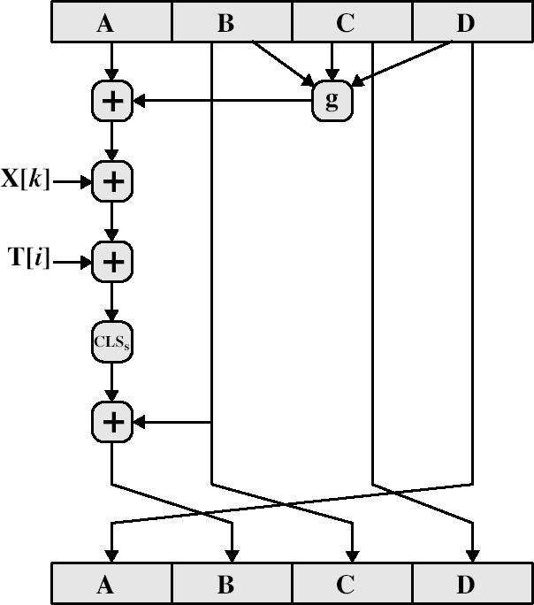
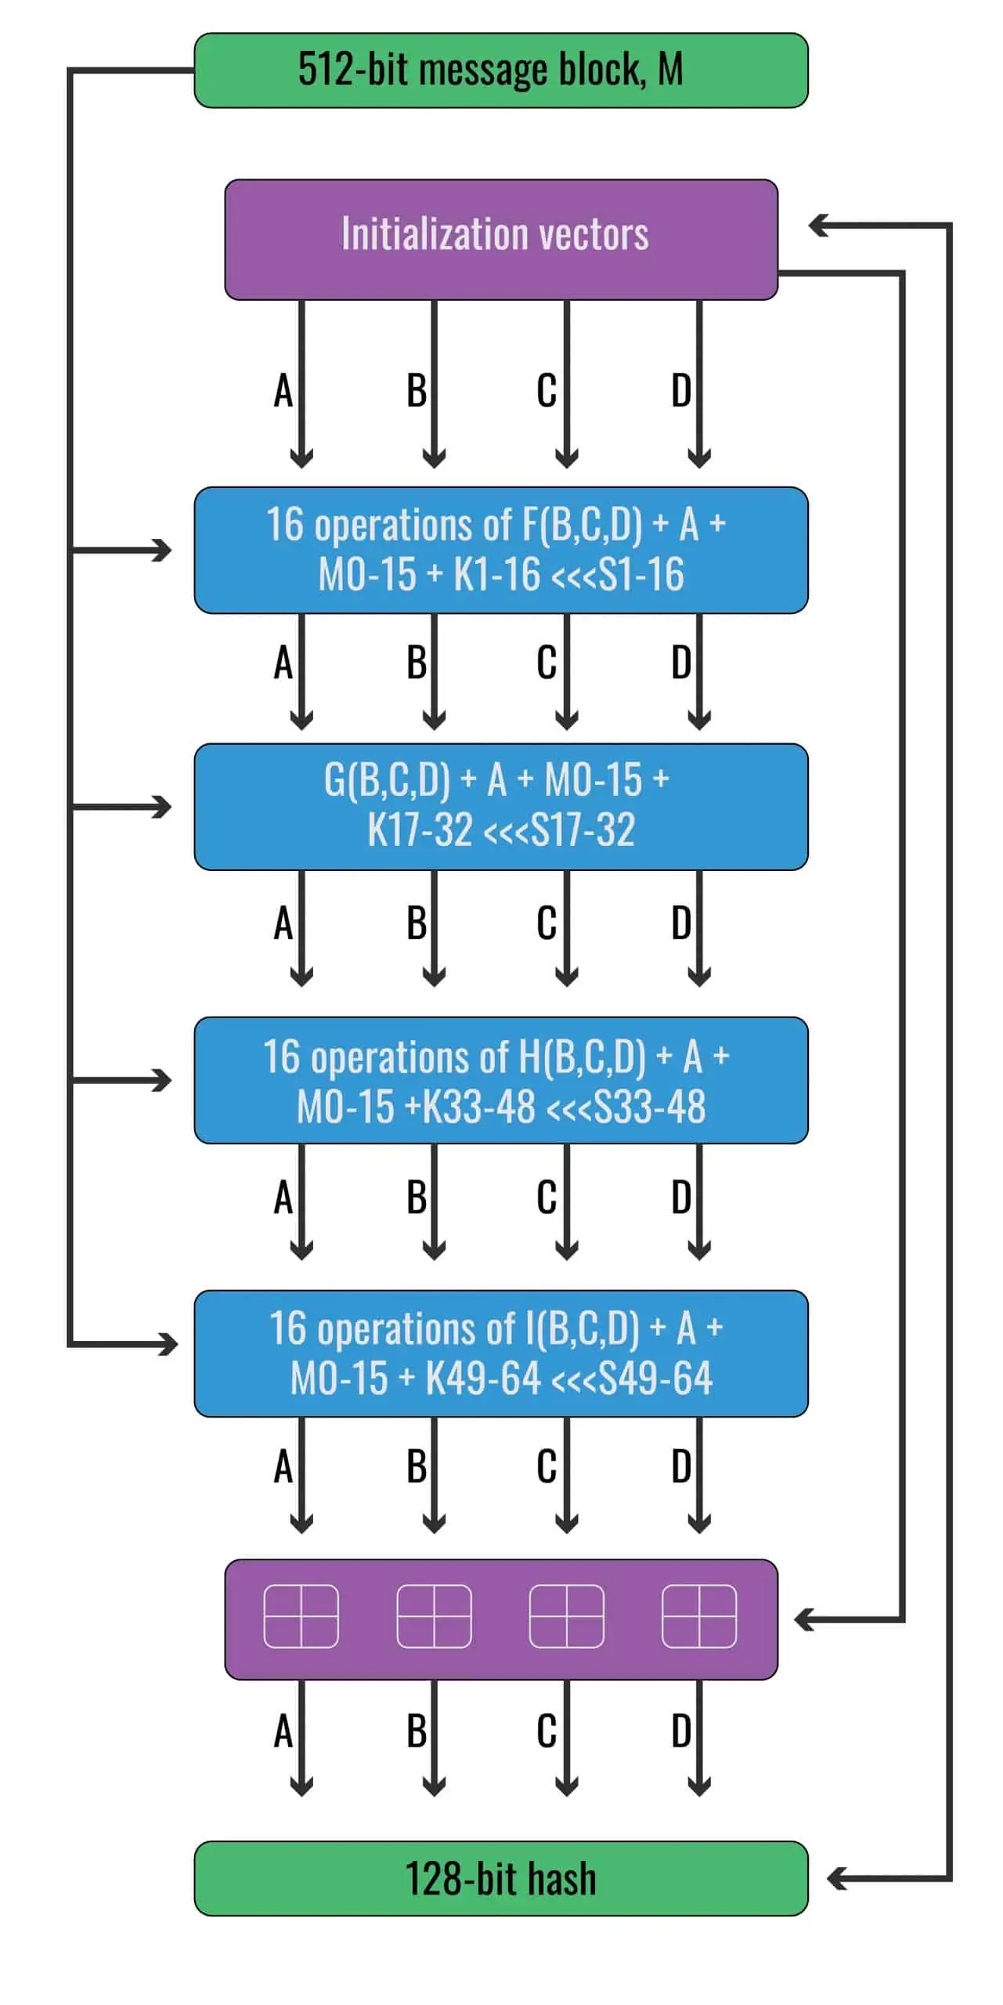
4 March 2024
BCSE309L-M4-L3

Slide 17
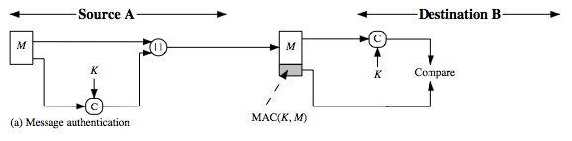
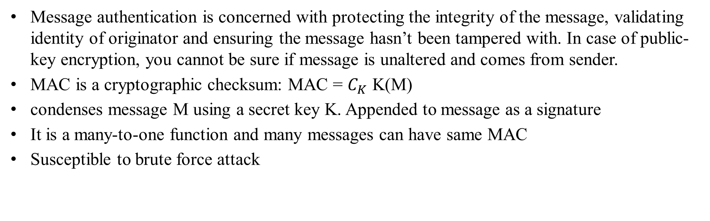
Message Authentication Code (MAC)
Message authentication is concerned with protecting the integrity of the message, validating identity of originator and ensuring the message hasn’t been tampered with. In case of public-key encryption, you cannot be sure if message is unaltered and comes from sender.
MAC is a cryptographic checksum: MAC = $C_{K}$ K(M)
condenses message M using a secret key K. Appended to message as a signature
It is a many-to-one function and many messages can have same MAC
Susceptible to brute force attack
MAC vs Digital Signature:
MAC is generated by a secret key algo. Schemes – keyed hash (HMAC), Block cipher (CBC-MAC)
Digital Signature is generated by a public key and a hash function. Schemes – RSA,DSA

Slide 18
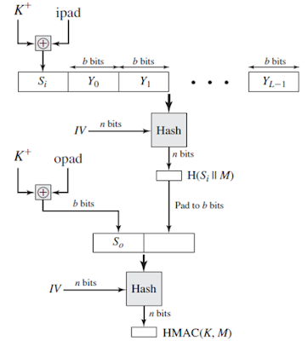
HASH Message Authentication Code (HMAC)
Combination of MAC, hash function and secret key. Algorithm:
Make the length of K+ equal to b (K = secret key)
K+ XOR ipad (00110110) = Si (input signature)
Append Si with original message M
The selected message-digest algorithm (e.g. MD5,SHA-l, etc.) is applied to the output of step 3
K+ XOR opad (01011100) = So (input signature)
Append the message digest calculated in step 4 to the end of So.
The selected message-digest algorithm (e.g., MD5, SHA-I, etc.) is applied to the output of step 6
Pros: HMAC is faster because they use hash functions rather than public key. HMACs are much smaller than digital signatures but provide comparably higher security. HMACs use symmetric key(same copy) while Signatures use asymmetric (two different keys).
Cons: HMAC cannot be used if the number of receivers is greater than one. If multiple parties share the same symmetric key, how does a receiver know that the message was sent by the sender? HMAC can be cracked using brute force or birthday attack since it uses shared key.

