Slide 1
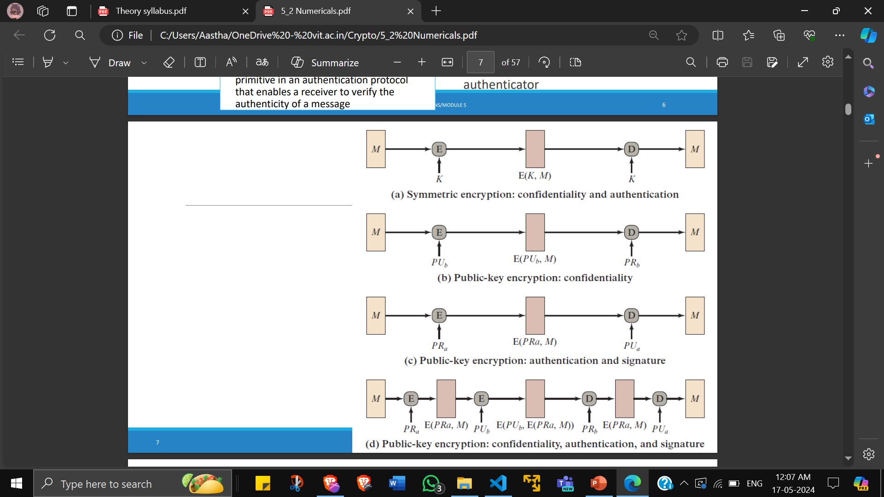

Slide 2

RSA Encryption and Decryption
each user generates a public/private key pair by:
selecting two large primes at random: p, q
computing their system modulus n=p.q and ø(n)=(p-1)(q-1)
selecting at random the encryption key e
where 1<e<ø(n), gcd(e,ø(n))=1
solve following equation to find decryption key d
e.d=1 mod ø(n) and 0≤d≤n
publish their public encryption key: PU={e,n}
keep secret private decryption key: PR={d,n}
Encryption: C = P^{e} mod n
Decryption: P = C^{d} mod n
Select primes: p=17 & q=11
Calculate
Calculate
Select e: gcd(e,160)=1; choose e=7
Determine d: de=1 mod 160 and d < 160
Value is d=23 since 23 x 7=161= 10 x 160 + 1
Publish public key PU={7,187}
Keep secret private key PR={23,187}
Consider plaintext (P)=8
Encryption: C = P^{e} mod ø(n) = $8^{7}$ mod 160 = 32
Decryption: P = C^{d} mod ø(n) = ${32}^{23}$ mod 160 = 8
n = pq =17 x 11=187 ø(n)=(p–1)(q-1)=16x10=160

Slide 3
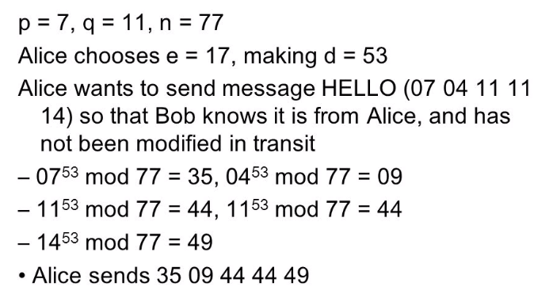
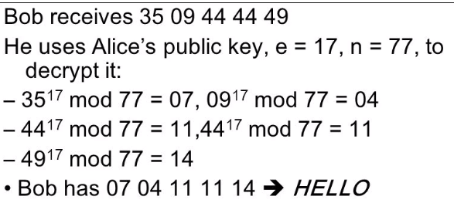

Slide 4

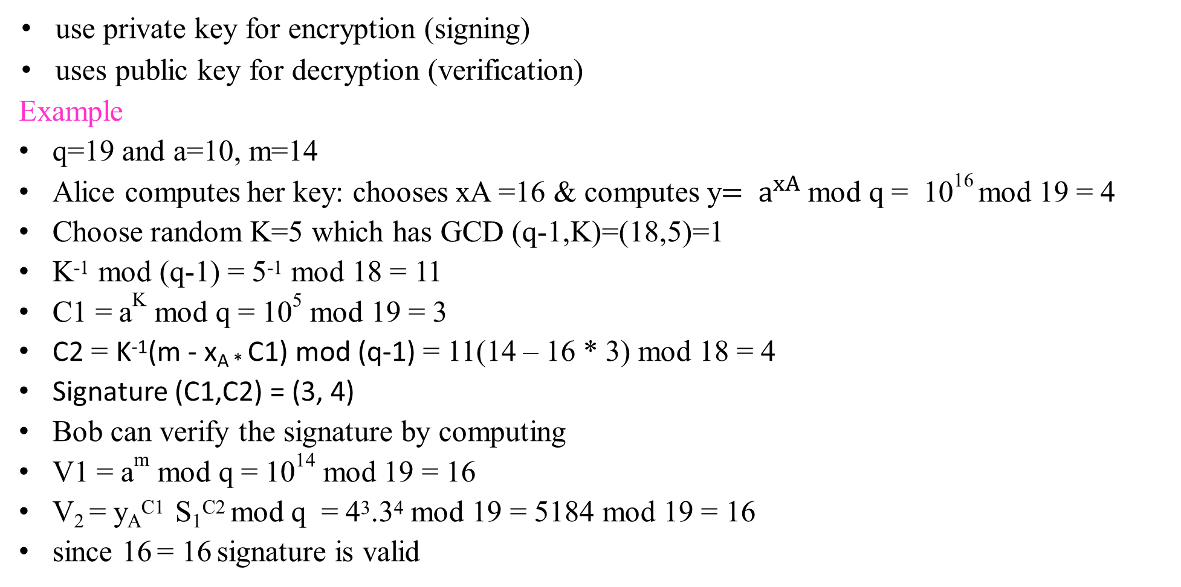
ElGamal Digital Signature
use private key for encryption (signing)
uses public key for decryption (verification)
Example
q=19 and a=10, m=14
Alice computes her key: chooses xA =16 & computes y$= a^{xA}$ mod q = 10¹⁶ mod 19 = 4
Choose random K=5 which has GCD (q-1,K)=(18,5)=1
K⁻¹ mod (q-1) = 5⁻¹ mod 18 = 11
C1 = a^{K} mod q = 10⁵ mod 19 = 3
C2 = K⁻¹(m - x_{A *} C1) mod (q-1) = 11(14 – 16 * 3) mod 18 = 4
Signature (C1,C2) = (3, 4)
Bob can verify the signature by computing
V1 = a^{m} mod q = 10¹⁴ mod 19 = 16
V₂ = y_{A}^{C1} S₁^{C2} mod q = 4³.3⁴ mod 19 = 5184 mod 19 = 16
since 16 = 16 signature is valid

Slide 5
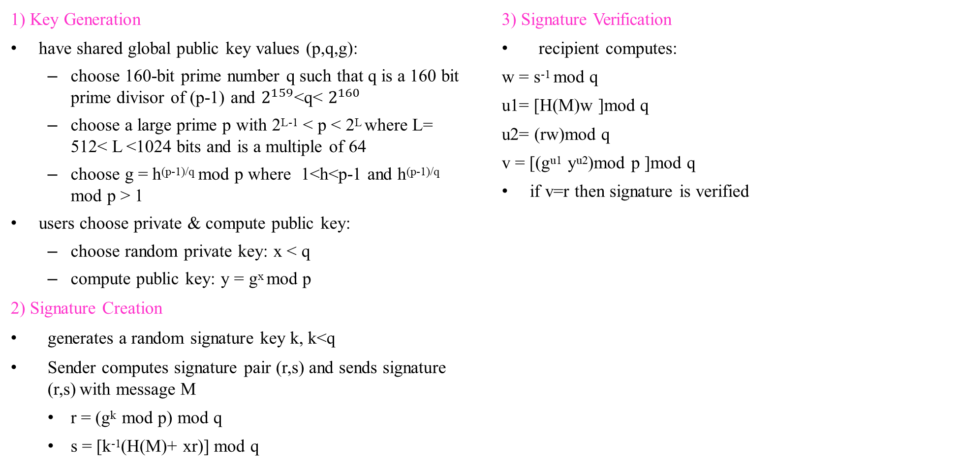
Digital Signature Algorithm (DSA)
1) Key Generation
have shared global public key values (p,q,g):
choose 160-bit prime number q such that q is a 160 bit prime divisor of (p-1) and $2^{159}$<q< $2^{160}$
choose a large prime p with 2^{L-1} < p < 2^{L} where L= 512< L <1024 bits and is a multiple of 64
choose g = h^{(p-1)/q} mod p where 1<h<p-1 and h^{(p-1)/q} mod p > 1
users choose private & compute public key:
choose random private key: x < q
compute public key: y = g^{x} mod p
2) Signature Creation
generates a random signature key k, k<q
Sender computes signature pair (r,s) and sends signature (r,s) with message M
r = (g^{k} mod p) mod q
s = [k⁻¹(H(M)+ xr)] mod q
3) Signature Verification
recipient computes:
w = s⁻¹ mod q
u1= [H(M)w ]mod q
u2= (rw)mod q
v = [(g^{u1} y^{u2})mod p ]mod q
if v=r then signature is verified
creates a 320 bit signature
smaller and faster than RSA

Slide 6
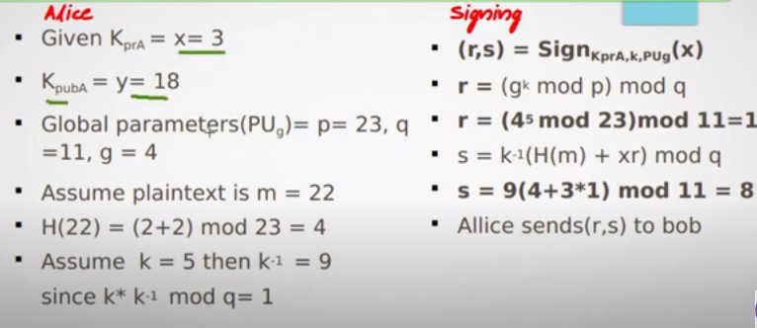
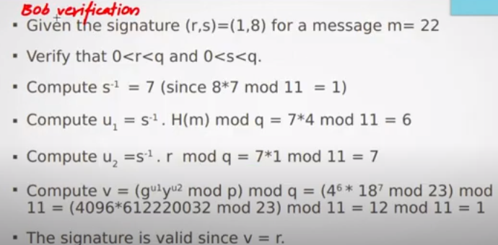

Slide 7
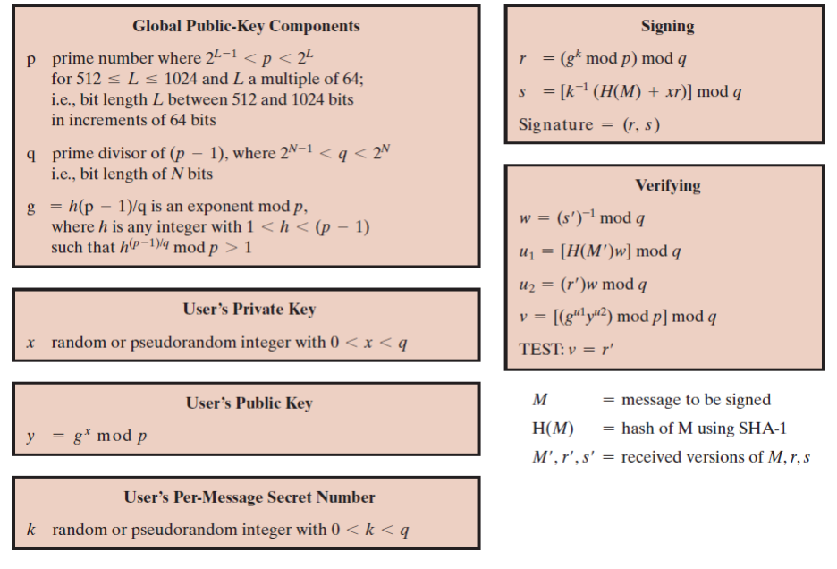

Slide 8
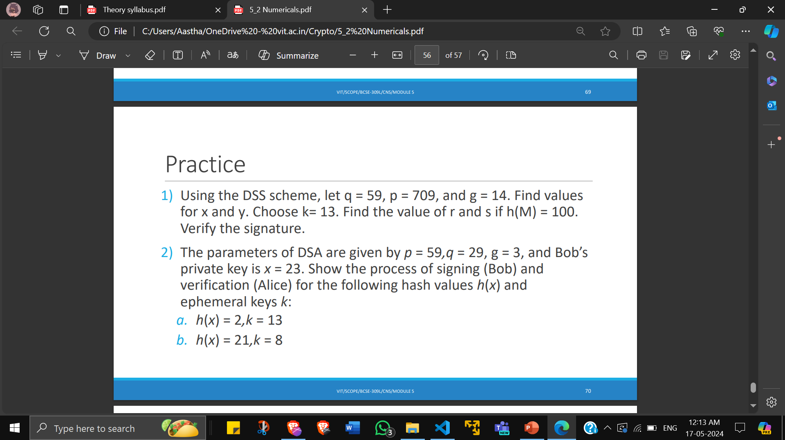

Slide 9
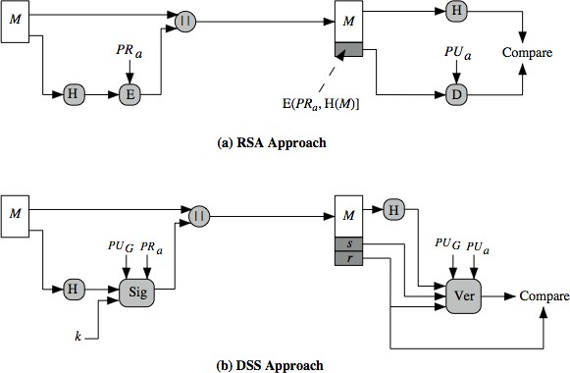
DSS vs RSA
In the RSA approach, the message to be signed is input to a hash function that produces a secure hash code of fixed length. This hash code is then encrypted using the sender's private key to form the signature. Both the message and the signature are then transmitted. The recipient takes the message and produces a hash code. The recipient also decrypts the signature using the sender's public key. If the calculated hash code matches the decrypted signature, the signature is accepted as valid. Because only the sender knows the private key, only the sender could have produced a valid signature.
In the DSS approach, the hash code is provided as input to a signature function along with a random number k generated for this particular signature. The signature function also depends on the sender's private key (PR _{a}) and a global public key (PU_{G}). The result is a signature consisting of two components, labeled s and r. At the receiving end, the hash code of the incoming message is generated. This plus the signature is input to a verification function. The verification function also depends on the global public key as well as the sender's public key (PU_{a}), which is paired with the sender's private key. The output of the verification function is a value that is equal to the signature component r if the signature is valid. The signature function is such that only the sender, with knowledge of the private key, could have produced the valid signature.

Slide 10
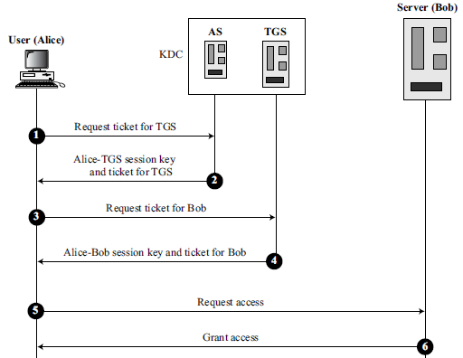
Kerberos
provides centralised private-key third-party authentication in a distributed network without needing to trust all workstations. Rather all trust a central authentication server.
Authentication Server (AS): AS grants each user identity and a password. AS has a database with these identities and the corresponding passwords. The AS verifies the user, issues a session key to be used between Alice and the TGS.
Ticket Granting server (TGS): The ticket-granting server (TGS) issues a ticket for the real server (Bob). It also provides the session key between Alice and Bob. In this way, though Alice verifies her ID just once with the AS, she can contact the TGS multiple times to obtain tickets for different real servers.

Slide 11
X.509 Authentication Service
Bob wants people to know his public key but does not want it to be compromised. To prevent the certificate itself from being forged, the CA signs the certificate with its private key. Now Bob can upload the signed certificate. Anyone who wants Bob’s public key downloads the signed certificate and uses the center’s public key to extract Bob’s public key.
A certificate has the following fields:
Version number. version of X.509 of the certificate.
Serial number. number assigned to each certificate.
Signature algorithm ID. algorithm used to sign the certificate.
Issuer name.
Validity Period.
Subject name. entity to which the public key
Subject public key. owner’s public key
Issuer unique identifier. This optional field allows two issuers to have the same issuer field value, if the issuer unique identifiers are different.
Subject unique identifier. allows two different subjects to have the same subject field value, if the subject unique identifiers are different.
Extensions. allows issuers to add more private information
Signature. This field is made of three sections. The first section contains all other fields in the certificate. The second section contains the digest of the first section encrypted with the CA’s public key. The third section contains the algorithm identifier used to create the second section.

Slide 12
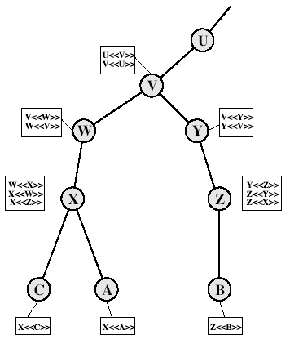




Obtaining a Certificate
CA Hierarchy
If both users share a common CA then they are assumed to know its public key otherwise CA's must form a hierarchy
Each CA has certificates for clients (forward) and parent (backward). Each client trusts parents certificates
Certificate Extensions
supports info about subject issuer keys and policies
support alternative names, in alternative formats for certificate subject and/or issuer
allow constraints on use of certificates by other CA’s with path constraints
notation CA<<A>> denotes certificate for A signed by CA
Track chains of certificates:
A acquires B certificate using chain: X<<W>>W<<V>>V<<Y>>Y<<Z>>Z<<B>>
B acquires A certificate using chain: Z<<Y>>Y<<V>>V<<W>>W<<X>>X<<A>>
BCSE309L-M5-L2

Slide 13
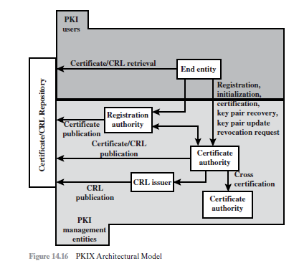
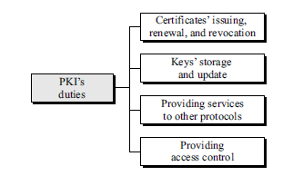
Public Key Infrastructure (PKI)
End entity: end users, devices (e.g., servers, routers), which consume/support PKI-related services.
Certification authority (CA)
Registration authority (RA): can assume a number of administrative functions from the CA.
CRL issuer: publish CRLs.
Repository: method of storing certificates and CRLs so that they can be retrieved by end entities.

Slide 14
PKIX Functions
Registration: This is the process whereby a user first makes itself known to a CA
Initialization: installation of key materials
Certification: CA issues a certificate for a user’s public key and posts that certificate in a repository.
Key pair recovery
Key pair update
Cross certification: A cross-certificate is a certificate issued by one CA to another CA that contains a CA signature key used for issuing certificates.
BCSE309L-M5-L2

