Slide 1

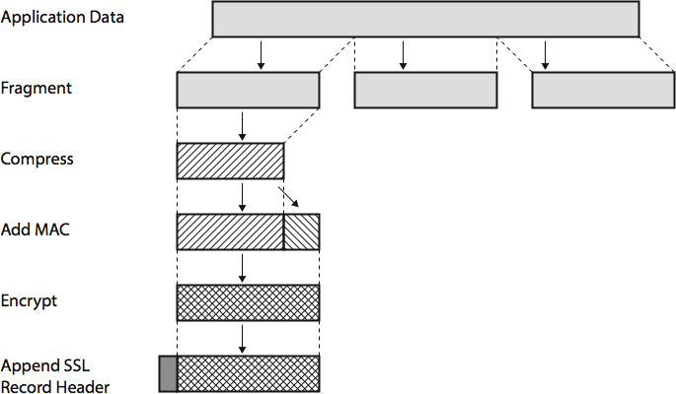
SSL Record Protocol Operation

Slide 2
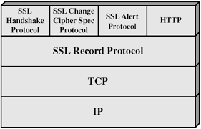
Secure Socket Layer (SSL)
SSL Handshake Protocol
Authenticate server and client key exchange
SSL Change Cipher Spec Protocol
causes pending state to become current
hence updating the cipher suite in use
SSL Alert Protocol
conveys SSL-related alerts to peer entity
specific alert: fatal, warning
HTTPS
combination of HTTP & SSL/TLS to secure communications between browser & server
TLS - Used to encrypt messages using HMAC and SHA/MD5 hence guaranteeing confidentiality of data
TCP
reliable delivery service for data packets on the internet.
TCP breaks down data into packets, ensures they arrive in order, and requests retransmission if any are lost.
IP
It assigns unique numerical addresses (IP addresses) to devices on the internet.
IP packets route data across networks based on these addresses.

Slide 3
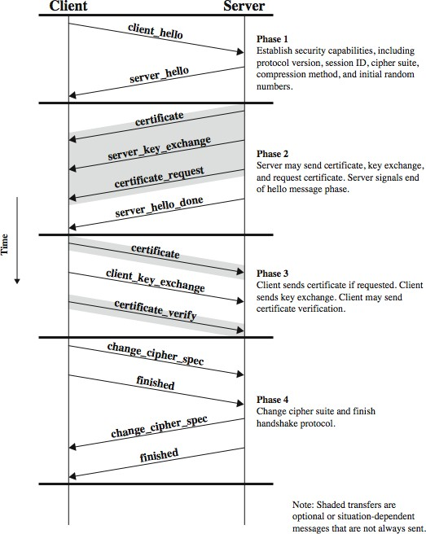
SSL Handshake Protocol … Contd.

Slide 4
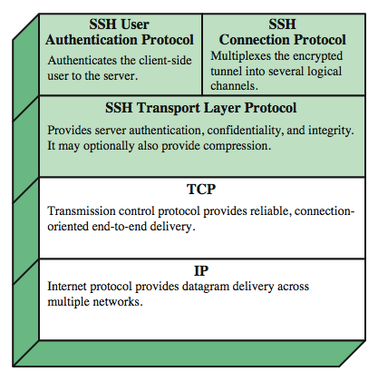
Secure Shell (SSH)
protocol for secure network communications
designed to be simple & inexpensive
SSH provided secure remote login facility
Port Forwarding
convert insecure TCP connection into a secure SSH connection
SSH Transport Layer Protocol establishes a TCP connection between SSH client & server
client traffic redirected to local SSH, travels via tunnel, then remote SSH delivers to server

Slide 5

Introduction to IP Security
General IP Security mechanisms provides authentication, confidentiality, key management
Benefits of IPSec
In a firewall/router provides strong security to all traffic crossing the perimeter
Is below transport layer, hence transparent to end users
Access control
Connectionless integrity
Data origin authentication

Slide 6
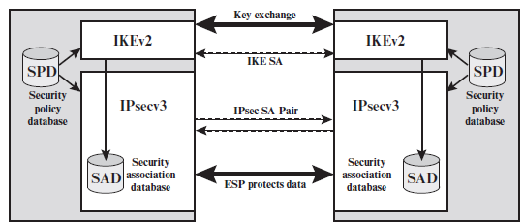
IP Security Policy
IPsec policy is determined primarily by the interaction of two databases, the security association database (SAD) and the security policy database (SPD).
IPSec Architecture

Slide 7
Security Association Database
Security Parameter Index
A 32-bit value selected by the receiving end of an SA to uniquely identify the SA.
In an SAD entry for an outbound SA, the SPI is used to construct the packet’s header.
In an SAD entry for an inbound SA, the SPI is used to map traffic to the appropriate SA.
Sequence Number Counter
A 32-bit value used to generate the Sequence Number field in headers.
Sequence Counter Overflow
A flag indicating overflow and prevent further transmission of packets on this SA.
Anti-Replay Window
Used to determine whether an inbound packet is a replay.
AH Information
Authentication algorithm, keys, key lifetimes, and related parameters being used with AH.

Slide 8
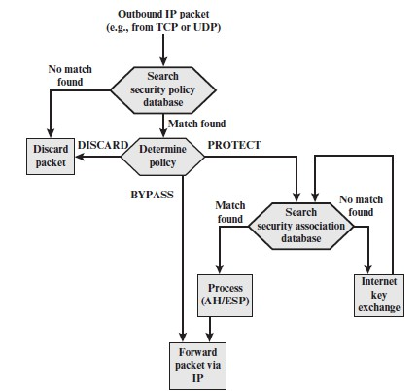
IP Traffic Processing
Outbound Traffic
IPsec searches the SPD for a match to this packet.
If no match is found, then the packet is discarded and an error message is generated. If a match is found, further processing is determined by the first matching entry in the SPD.
If the policy for this packet is DISCARD, then the packet is discarded.
If the policy is BYPASS, then there is no further IPsec processing; the packet is forwarded to the network for transmission.
If the policy is PROTECT, then a search is made of the SAD for a matching entry. If no entry is found, a new entry is made in the SA.
The matching entry in the SAD determines the processing for this packet. The packet is then forwarded to the network for transmission.

Slide 9
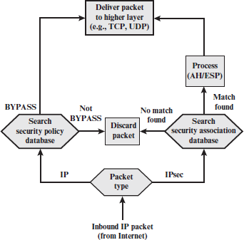
IP Traffic Processing … Contd.
Inbound Traffic
IPsec determines whether this is an unsecured IP packet or one that has ESP or AH headers/trailers, by examining the IP Protocol field (IPv4) or Next Header field (IPv6).
If the packet is unsecured, IPsec searches the SPD for a match to this packet. If the first matching entry has a policy of BYPASS, the packet body is delivered to the next higher layer, such as TCP.
If the first matching entry has a policy of PROTECT or DISCARD, or if there is no matching entry, the packet is discarded.
For a secured packet, IPsec searches the SAD. If no match is found, the packet is discarded. Otherwise, IPsec applies the appropriate ESP or AH processing. Then, the packet body is delivered to the next higher layer, such as TCP.

Slide 10
Encapsulating Security Payload (ESP)
provides message content confidentiality, data connectionless integrity, an anti-replay service, confidentiality
origin authentication, limited traffic flow
services depend on options selected when establish Security Association (SA), net location
can use a variety of encryption & authentication algorithms

Slide 11
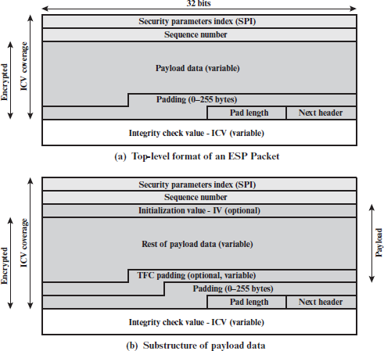
ESP Packet Format
Security Parameters Index (32 bits): Identifies a security association.
Sequence Number (32 bits): A monotonically increasing counter value; this provides an anti-replay function.
Payload Data (variable): This is a transport-level segment (transport
mode) or IP packet (tunnel mode) that is protected by encryption.
Padding (0–255 bytes): Expanding plaintext.
Pad Length (8 bits): Indicates the number of pad bytes immediately
preceding this field.
Next Header (8 bits): Identifies the type of data contained in the payload data field by identifying the first header in that payload (e.g., an extension header in IPv6, or an upper-layer protocol such as TCP).
Integrity Check Value (variable): A variable-length field (must be an integral number of 32-bit words) that contains the Integrity Check Value computed over the ESP packet minus the Authentication Data field.

Slide 12
ESP Packet Format … Contd.
When any combined mode algorithm is employed, the algorithm itself is expected to return both decrypted plaintext and a pass/fail indication for the integrity check.
For combined mode algorithms, the ICV that would normally appear at the end of the ESP packet (when integrity is selected) may be omitted.
When the ICV is omitted and integrity is selected, it is the responsibility of the combined mode algorithm to encode within the Payload Data an ICV-equivalent means of verifying the integrity of the packet.
Two additional fields may be present in the payload.
An initialization value (IV), or nonce, is present if this is required by the encryption or authenticated encryption algorithm used for ESP.
If tunnel mode is being used, then the IPsec implementation may add traffic flow confidentiality (TFC) padding after the Payload Data and before the Padding field, as explained subsequently.

Slide 13
Encryption & Authentication
ESP can encrypt payload data, padding, pad length, and next header fields
if needed have IV at start of payload data
ESP can have optional ICV for integrity
is computed after encryption is performed
Padding
ESP uses padding
to expand plaintext to required length
to align pad length and next header fields
to provide partial traffic flow confidentiality

Slide 14
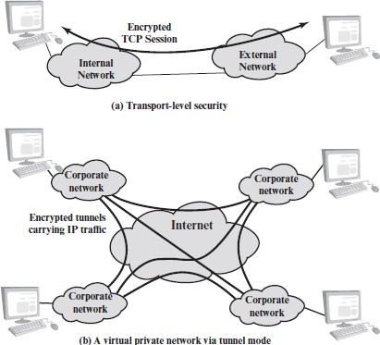
Transport and Tunnel Modes
In Figure (a), encryption (and optionally authentication) is
provided directly between two hosts.
Figure (b) shows how tunnel mode operation can be used to set up a virtual private network.
An organization has four private networks interconnected across the Internet.
Hosts on the internal networks use the Internet for the transport of data but do not interact with other Internet- based hosts.
By terminating the tunnels at the security gateway to each internal network, the configuration allows the hosts to avoid implementing the security capability.

Slide 15
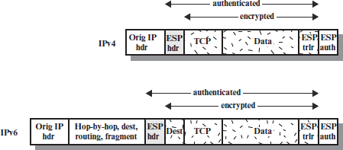
Transport and Tunnel Modes … Contd.
At the source, the block of data consisting of the ESP trailer plus the entire transport-layer segment is encrypted and the plaintext of this block is replaced if this option is selected.
The packet is then routed to the destination.
Each intermediate router needs to examine and process the IP header plus any plaintext IP extension headers but does not need to examine the ciphertext.
The destination node examines and processes the IP header plus any plaintext IP extension headers.
On the basis of the SPI in the ESP header, the destination node decrypts the remainder of the packet to recover the plaintext transport-layer segment.
Transport mode operation provides confidentiality for any application that uses it, thus avoiding the need to implement confidentiality in every individual application.
One drawback to this mode is that it is possible to do traffic analysis on the transmitted packets.
Transport Mode ESP

Slide 16
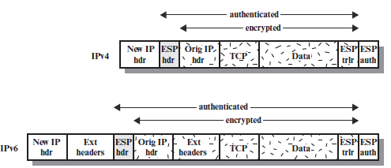
Transport and Tunnel Modes … Contd.
Tunnel mode ESP is used to encrypt an entire IP packet.
For this mode, the ESP header is prefixed to the packet and then the packet plus the ESP trailer is encrypted.
This method can be used to counter traffic analysis.
Because the IP header contains the destination address and possibly source routing directives and hop-by-hop option information, it is not possible simply to transmit the encrypted IP packet prefixed by the ESP header.
Intermediate routers would be unable to process such a packet.
It is necessary to encapsulate the entire block (ESP header plus ciphertext plus Authentication Data) with a new IP header that will contain sufficient information for routing but not for traffic analysis.
Tunnel Mode ESP

Slide 17
Transport and Tunnel Modes … Contd.
Consider a case in which an external host wishes to communicate with a host on an internal network protected by a
firewall, and in which ESP is implemented in the external host and the firewalls.
The following steps occur for transfer of a transport-layer segment from the external host to the internal host:
The source prepares an inner IP packet with a destination address of the target internal host.
This packet is prefixed by an ESP header; then the packet and ESP trailer are encrypted and Authentication Data
may be added.
The resulting block is encapsulated with a new IP header (base header plus optional extensions such as routing and hop-by-hop options for IPv6) whose destination address is the firewall; this forms the outer IP packet.
The outer packet is routed to the destination firewall.
Each intermediate router needs to examine and process the outer IP header plus any outer IP extension headers but does not need to examine the ciphertext.
The destination firewall examines and processes the outer IP header plus any outer IP extension headers.
Then, on the basis of the SPI in the ESP header, the destination node decrypts the remainder of the packet to recover the plaintext inner IP packet.
This packet is then transmitted in the internal network.
The inner packet is routed through zero or more routers in the internal network to the destination host.

