Slide 1
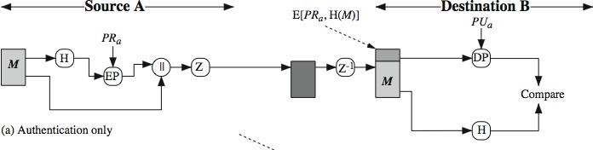
PGP Operation - Authentication
* Most commonly AES with a 128-bit key is used, with the cipher block chaining (CBC) mode.
sender creates message
make SHA-256 hash of message
the message digest is encrypted with RSA using the sender’s private key, and the result is appended to the message.
receiver uses RSA with the sender’s public key to decrypt the message
It compares with the decrypted hash code. If the two match, the message is accepted as authentic.

Slide 2
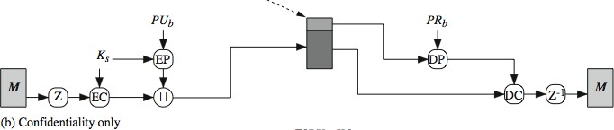
PGP Operation - Confidentiality
encrypts message with 128 bit session key
attaches session key encrypted with RSA using the recipient’s public key and is attached to the message.
The receiver uses RSA with its private key to decrypt and recover the session key.
The session key is used to decrypt the message.

Slide 3

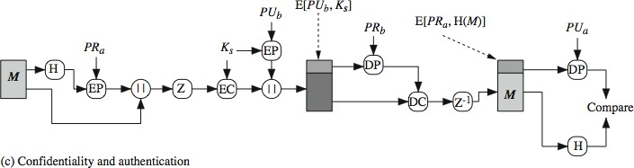
PGP Operation – Confidentiality & Authentication
can use both services on same message
create signature & attach to message
encrypt both message & signature
attach RSA/ElGamal encrypted session key

Slide 4
PGP Key Rings
public-key ring contains all the public-keys of other PGP users known to this user, indexed by key ID
private-key ring contains the public/private key pair(s) for this user, indexed by key ID & encrypted keyed from a hashed passphrase. Security of private keys thus depends on the pass-phrase security
PGP Key Management
in PGP every user is its own Certificate Authority - can sign keys for users they know directly
can trust keys others have signed if have a chain of signatures to them
users can also revoke their keys

Slide 5
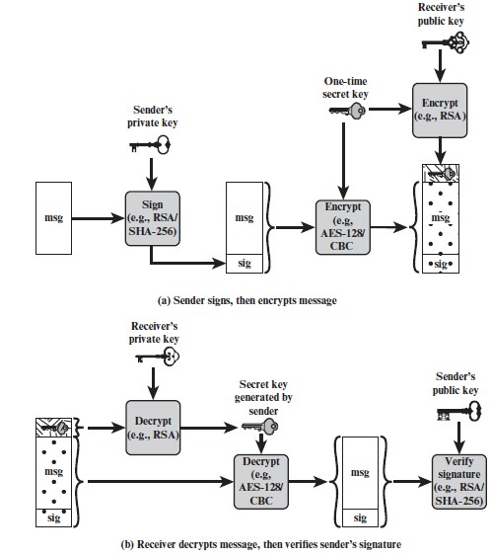
Secure/Multipurpose Internet Mail Extension (S/MIME)
S/MIME provides four message-related services:
authentication, confidentiality, compression, and email compatibility
Compression
Compression of binary encoded encrypted data is discouraged, since it will not yield significant compression. Base64 encrypted data better.
If a lossy compression algorithm is used with signing, need to compress first, then sign.
Email Compatibility
Many electronic mail systems only permit the use of blocks consisting of ASCII text.
To accommodate this restriction, S/MIME converts the raw 8-bit binary stream to a stream of ASCII characters, a process referred to as 7-bit encoding via Base64 conversion.

Slide 6
Messages
Message Content Types
Data: Inner MIME-encoded message content, which may then be encapsulated in a SignedData, EnvelopedData, or CompressedData content type.
SignedData: Used to apply a digital signature to a message.
EnvelopedData: Consists of encrypted content of any type and encrypted content encryption keys for one or more recipients.
CompressedData: Used to apply data compression to a message.
SECURING A MIME ENTITY S/MIME secures a MIME entity with a signature, encryption, or both.
ENVELOPED DATA An application/pkcs7-mime subtype is used for one of four categories of S/MIME processing, each with a unique s/mime-type parameter.
SIGNED DATA The signedData s/mime-type can be used with one or more signers.
CLEAR SIGNING Clear signing is achieved using the multipart content type with a signed subtype.
REGISTRATION REQUEST Typically, an application or user will apply to a certification authority for a public-key certificate.
CERTIFICATES-ONLY MESSAGE A message containing only certificates or a certificate.

Slide 7

Certificate Processing … Contd.
An S/MIME user has several key management functions to perform.
Key generation
Each key pair MUST be generated from nondeterministic random input and should be long.
Registration
A user’s public key must be registered with a certification authority to receive an X.509 public key certificate.
Certificate storage and retrieval
A user requires access to a local list of certificates to verify incoming signatures and to encrypt outgoing messages.
RFC 2634 defines four enhanced security services for S/MIME:
Signed receipts
Returning a signed receipt provides proof of delivery to the originator of a message.
Security labels
A security label is a set of security information regarding the sensitivity of the content.
Signing certificates
This service is used to securely bind a sender’s certificate to their signature through a signing certificate attribute

Slide 8
Pros and Cons of S/MIME
Advantages
High availability
It is utilized in commercial or industrial settings.
It ensures the message's validity and security.
The digital signature protects the email by using email spoofing.
Disadvantages
All users are unable to benefit from S/MIME due to the enforced certificate need
because some users simply desire encryption.
All email clients do not support S/MIME signatures.

Slide 9
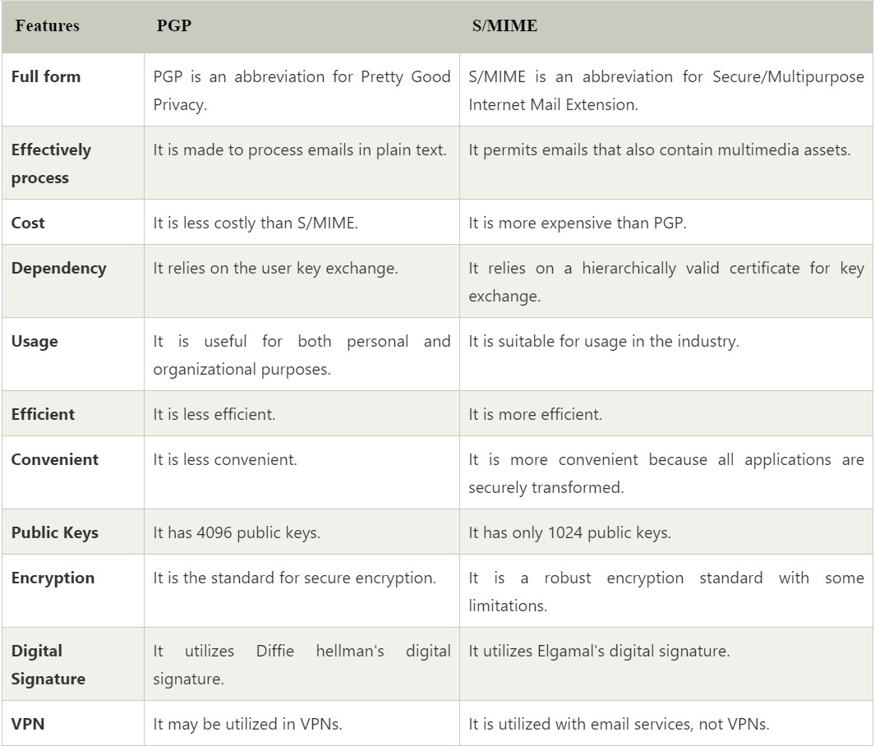

Slide 10
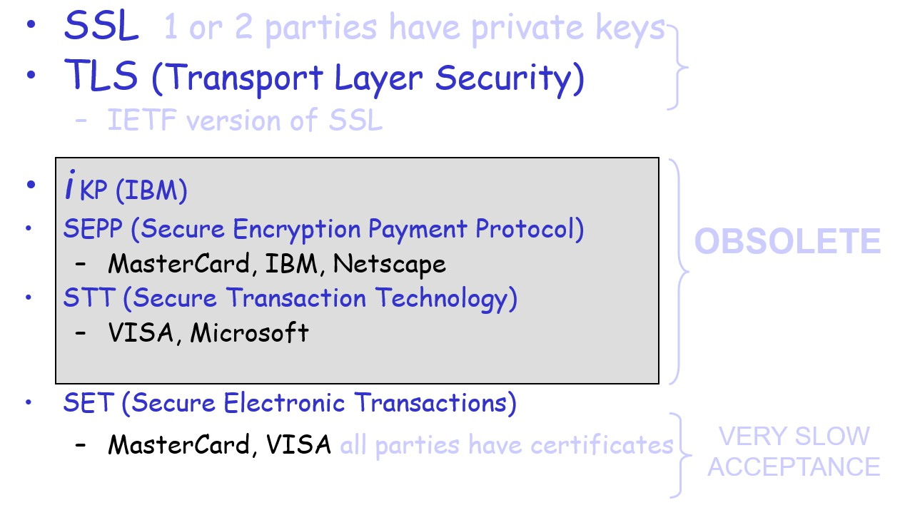
Credit Card Protocols
OBSOLETE
VERY SLOW
ACCEPTANCE

Slide 11
Secure Electronic Transaction (SET)
Designed to protect credit card transactions
Confidentiality: all messages encrypted (DES)
Trust: all parties must have digital certificates
Integrity of data: RSA digital signatures with SHA hash codes
Cardholder account authentication: X.509v3 digital certificates with RSA signatures
Merchant authentication: X.509v3 digital certificates with RSA signatures
Privacy: separation of order and payment information using dual signatures
SET Business Requirements
Provide confidentiality of payment and ordering information
Ensure the integrity of all transmitted data
Provide authentication that a cardholder is a legitimate user
Provide authentication that a merchant can accept credit card transactions
Facilitate and encourage interoperability among software and network providers

Slide 12
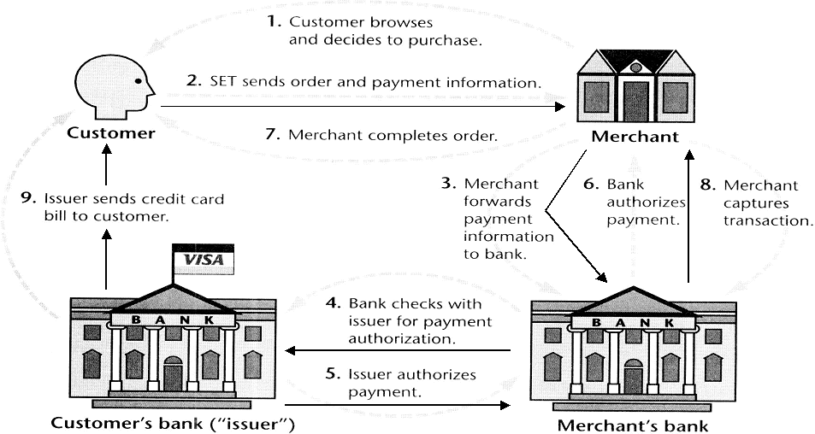
SET Transactions (important)

Slide 13
Dual Signatures
Concept: Link Two Messages Intended for Two Different Receivers:
Order Information (OI): Customer to Merchant
Payment Information (PI): Customer to Bank
Goal: Limit Information to A “Need-to-Know” Basis:
Merchant does not need credit card number.
Bank does not need details of customer order.
Afford the customer extra protection in terms of privacy by keeping these items separate.

Slide 14
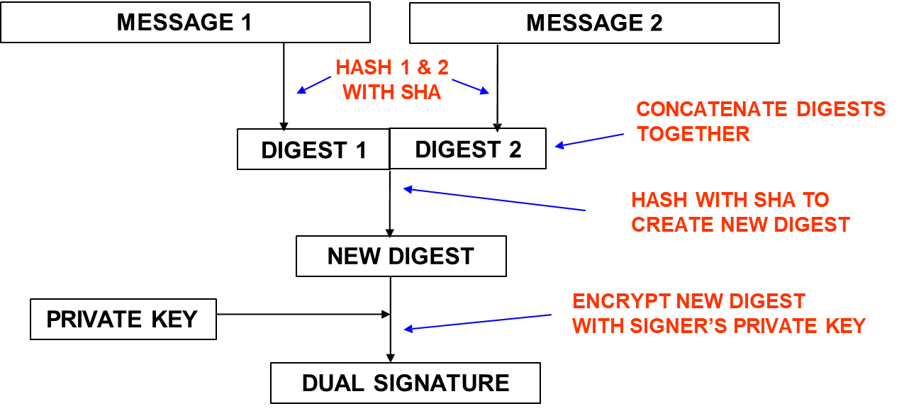
Dual Signature Operation
The operation for dual signature is as follows:
Take the hash (SHA-1) of the payment and order information.
These two hash values are concatenated [H(PI) || H(OI)] and then the result is hashed.
Customer encrypts the final hash with a private key creating the dual signature.
DS = E_{KRC} [ H(H(PI) || H(OI)) ]

Slide 15
DS Verification by Merchant
The merchant has the public key of the customer obtained from the customer’s certificate.
Now, the merchant can compute two values: H(PIMD || H(OI)) - > D_{KUC}[DS] Should be equal!
DS Verification by Bank
The bank is in possession of DS, PI, the message digest for OI (OIMD), and the customer’s public key, then the bank can compute the following: H(H(PI) || OIMD) -> D_{KUC} [ DS ]
What did we accomplish?
The merchant has received OI and verified the signature.
The bank has received PI and verified the signature.
The customer has linked the OI and PI and can prove the linkage.

Slide 16
SET Supported Transactions
card holder registration
merchant registration
purchase request
payment authorization
payment capture
certificate query
purchase inquiry
purchase notification
sale transaction
authorization reversal
capture reversal
credit reversal

Slide 17
Intruders
classes of intruders:
Masquerader →An individual who is not authorized to use the computer and who penetrates a system’s access controls to exploit a legitimate user’s account
Misfeasor →A legitimate user who accesses data, programs, or resources for which such access is not
authorized, or who is authorized for such access but misuses his or her privileges
Clandestine user →An individual who seizes supervisory control of the system and uses this control to evade auditing and access controls or to suppress audit collection
Intrusion Detection vs. Extrusion Detection
Intrusion detection is mostly concerned about the identification of incoming attacks
Extrusion detection systems try to prevent attacks from being launched in the first place

Slide 18
Hackers
motivated by thrill of access and status
IDS / IPS / VPNs can help counter
identify potentially vulnerable services
brute force (guess) passwords
install remote administration tool
wait for admin to log on and capture password

Slide 19
Criminal Enterprise
organized groups of hackers now a threat (corporation / government / loosely affiliated gangs)
typically young
often target credit cards on e-commerce server and have specific targets
once penetrated act quickly and get out
IDS / IPS help but less effective
act quickly and precisely to make their activities harder to detect
use trojan horses (hidden software) to leave back doors for re-entry
use sniffers to capture passwords
make few or no mistakes

Slide 20
Insider Attacks
among most difficult to detect and prevent
employees have access & systems knowledge
may be motivated by revenge / entitlement
IDS / IPS may help but also need least privilege, monitor logs, strong authentication, termination process to block access & mirror data
create network accounts for themselves and their friends
access accounts and applications they wouldn't normally use for their daily jobs
e-mail former and prospective employers
visit web sites that cater to disgruntled employees, such as f'dcompany.com
perform large downloads and file copying
access the network during off hours

Slide 21
Password Guessing
attacker knows a login (from email/web page etc) then attempts to guess password for it
success depends on password chosen by user
Password Capture
watching over shoulder as password is entered and using valid login/password thus impersonating user
using a trojan horse program to collect
monitoring an insecure network login
extracting recorded info after successful login (web history/cache, last number dialed etc)

Slide 22
Approaches to Intrusion Detection
statistical anomaly detection
attempts to define normal/expected behavior
Needs to store info in the form of history
threshold
profile based
rule-based detection
attempts to define proper behavior
Doesn’t need to store info in the form of history
anomaly
penetration identification

Slide 23
Statistical Anomaly Detection
threshold detection
count occurrences of specific event over time
if exceed reasonable value assume intrusion
ineffective detector
profile based
characterize past behavior of users
detect significant deviations from this
profile usually multi-parameter

Slide 24
Rule-Based Intrusion Detection
rule-based anomaly detection
analyze historical audit records to identify usage patterns & auto-generate rules for them
then observe current behavior & match against rules to see if conforms
like statistical anomaly detection does not require prior knowledge of security flaws
rule-based penetration identification
rules identifying known penetration, weakness patterns, or suspicious behavior
compare audit records or states against rules
rules are generated by experts who interview & codify knowledge of security admins

Slide 25
Honeypots
Decoy systems filled with fabricated information to lure attackers away from accessing critical systems
are instrumented to collect detailed information on attackers activities

Slide 26
Firewall Limitations
cannot protect from attacks bypassing it
eg sneaker net, utility modems, trusted organisations, trusted services (eg SSL/SSH)
cannot protect against internal threats
eg disgruntled employee
cannot protect against transfer of all virus infected programs or files
because of huge range of O/S & file types

Slide 27
Attacks on Packet Filters
IP address spoofing
fake source address to be trusted
add filters on router to block
Source routing attacks
attacker sets a route other than default
block source routed packets
Tiny fragment attacks
split header info over several tiny packets
either discard or reassemble before check

Slide 28
Types of Firewalls
1. Packet-Filtering Firewalls (Static Inspection):
Think of it as a simple traffic cop.
Analyzes individual data packets based on pre-defined rules.
Focuses on:
Source and destination IP addresses (who's sending and receiving)
Protocol type (TCP, UDP, etc.) - what kind of communication is happening
Port numbers (specific services on a device) - what application or service is being used
Advantages:
Easy to configure and manage
Efficient for basic traffic control
Disadvantages:
Limited control: Can't differentiate between legitimate and malicious applications using the same protocol and port.
Not suitable for complex network environments
2. Stateful Inspection Firewalls (Dynamic Inspection):
Offers more control compared to packet-filtering.
Maintains state information about ongoing network connections.
Analyzes:
Individual packets
The context of the connection they belong to (e.g., is it a request or a response?)
Benefits:
Allows or blocks packets based on the established connection stage (e.g., only allowing responses after a request is initiated).
Can identify suspicious traffic patterns that might indicate attacks.
Drawbacks:
More complex to configure than packet-filtering firewalls
Requires more processing power

Slide 29
3. Application-Level Gateways (Proxy Firewalls):
Dives deeper, inspecting the actual content of data packets.
Acts as an intermediary for network traffic.
Capabilities:
Grant or deny access based on application type or specific functionalities within an application.
Filter malicious content within application data (e.g., blocking malware in email attachments).
Downsides:
Can impact performance due to in-depth analysis
Requires more complex configuration
4. Circuit-Level Gateways (NOT a common firewall type):
Focuses on managing connections rather than packet inspection. (Not as widely used in modern firewalls)
Establishes and monitors the "circuit" between two communicating devices.
Functionality:
Ensures that packets involved in a connection are working correctly.
Once a connection is established, the firewall might not actively monitor the data transfer within that connection.
Considerations:
Simpler and less resource-intensive than other types
Potential security risk if malicious content slips through after the initial connection is established

