Slide 1
What is the Learning Problem?
Learning = Improve over task T, with respect to performance measure P, based on experience E (Task T, Performance P, Experience E)
Email classification
Task T: assign a mail to its content category (spam, not_spam)
Performance measure P: Accuracy, Precision, Recall
Training experience E: Example pre-classified mails
Loan approval
Task T: Predict whether a loan should be approved or not.
Performance measure P: accuracy.
Training experience E (Data) : Loan application data

Slide 2
Handwritten recognition
Task T: recognizing and classifying handwritten words within images
Performance measure P: percentage of words correctly classified (accuracy)
Training experience E: a database of handwritten words with given classifications
Text classification
Task T: assign a document to its content category
Performance measure P: Precision and Recall
Training experience E : Example pre-classified documents
Robot driving
Task T: driving on using vision sensors
Performance measure P : average distance traveled before an error
Training experience E : a sequence of images and steering commands recorded while observing a human driver

Slide 3
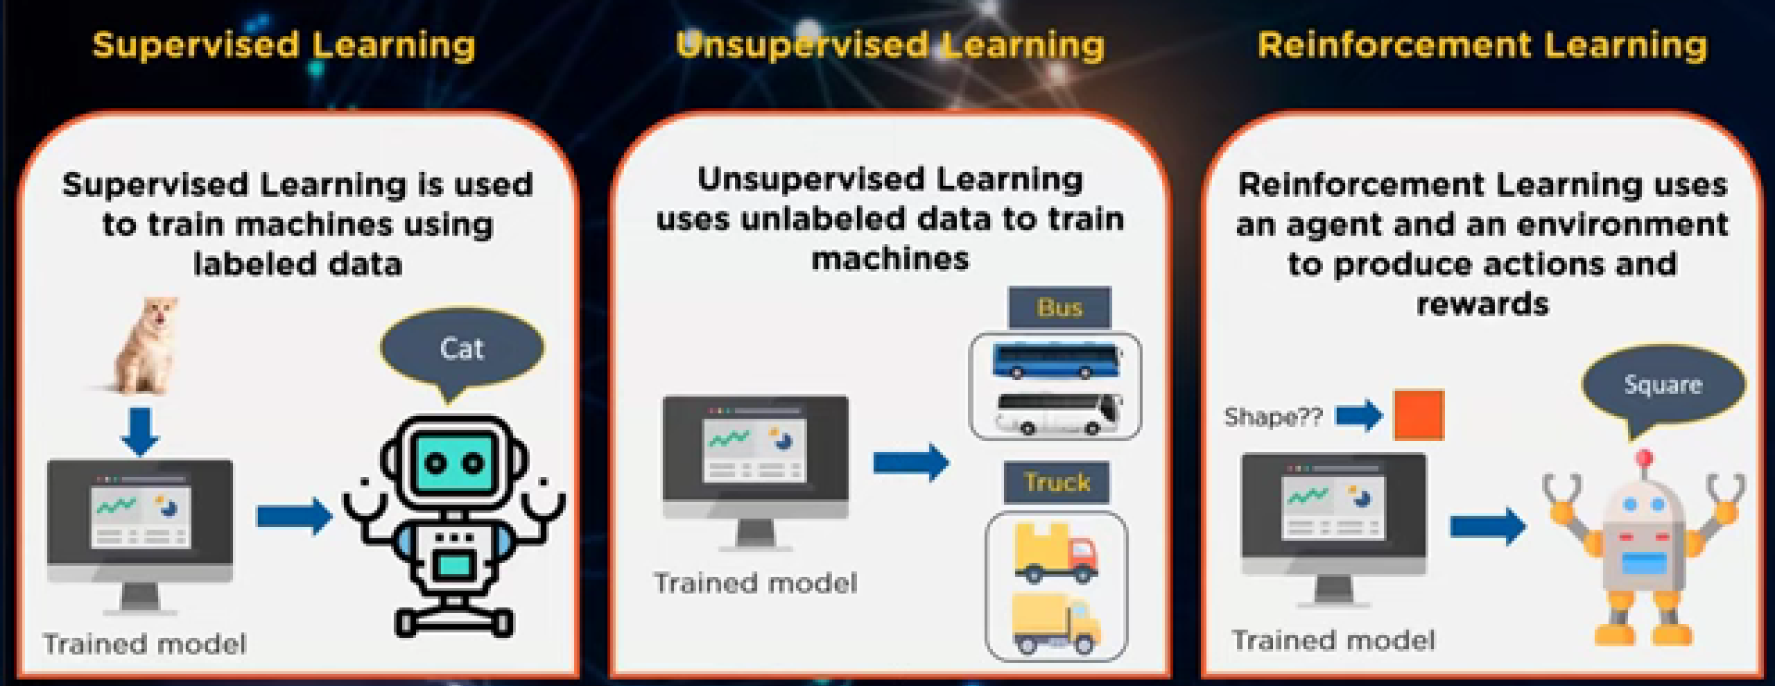
Labeled data = output already known to you. The model just needs to map the labeled inputs to the known outputs
The model learns from the data, identifies patterns in the input and returns corresponding output
There might be diff paths to reach the end state and the robot is trained to find the best path via reward system. AKA it follows trial and error method to find the desired sol.
Classification and Regression Cluster and Association Reward based

Slide 4
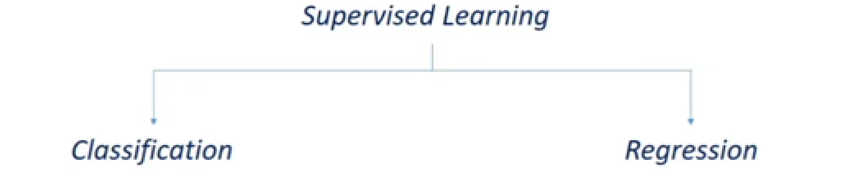
Supervised learning
Unsupervised learning
Examples of unsupervised learning:
Weather prediction
Sales forecast
Stock price analysis
Examples of unsupervised learning:
Computing clusters
Market segmentation
Data analysis
Genomics – grping ppl by genetic similarity
target variables are discrete. | target variables are continuous.
Problems like Spam Email Classification, Disease prediction | Problems like House Price Prediction, Rainfall Prediction

Slide 5
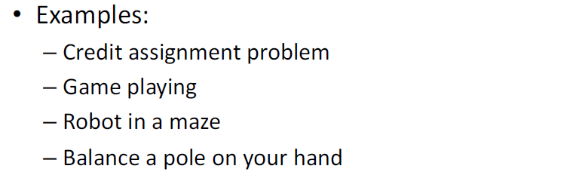

Reinforcement Learning
Reinforcement learning is learning which maps situations to actions—The learner is not told which actions to take, but instead must discover which actions yield the most reward by trying them.
There is no fixed training dataset, rather a goal or set of goals that an agent is required to achieve.

Slide 6
Which method of ML will use for the given problems?
Spam Email Detection: Supervised Learning - Classification
Grade History of Students: Supervised Learning - Regression
Product Recommendation: Unsupervised learning
Suggestion of Friends in Facebook: Unsupervised Learning
Sales Report Generation: Unsupervised Learning
Predict Next Year's Sale Based on History Data: Supervised Learning – regression
Updating Facebook User Profiles: Reinforcement Learning

Slide 7
Suppose you are a business analyst of an online food ordering system.
How will you identify customers for advertising new products?
Customer Segmentation using Unsupervised learning (clustering)
How will you know whether a customer buys a product or not?
Supervised Learning : Classification (class1: Buys_yes , class2: Buys_no)
(Age, Income, Credit_card, employed, Buys)
C. How will you determine the sales (in Rupees) of certain products?
Supervised Learning : Regression
(Advertisement, product_rating, Sales)

Slide 8
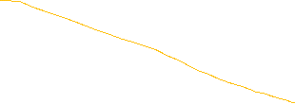

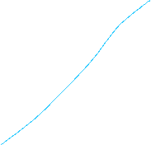
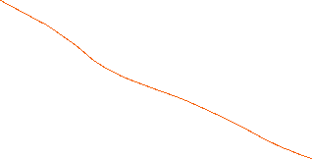
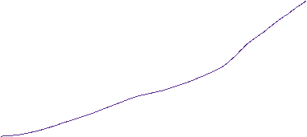
Match the following
A. Face Recognition | P. Reinforcement Learning
B. Malware detection | Q. Regression
C. Group similar gene profiles | R. Classification
D. Gaming | S. Unsupervised learning
E. Predicting the remaining useful time of batteries | T. Anomaly detection

