Slide 1
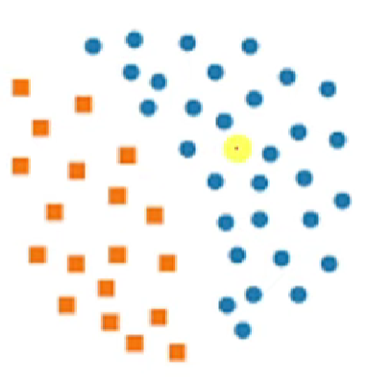
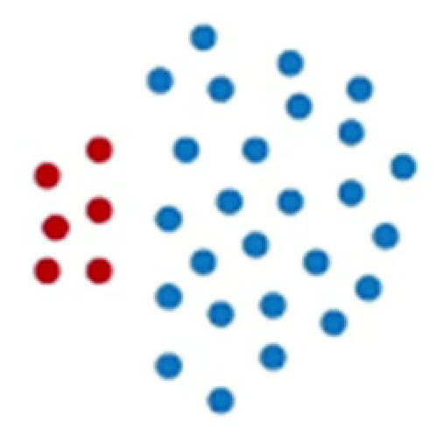
BALANCED DATASET:
Low difference bw +ve and –ve classes
IMBALANCED DATASET:
High difference bw +ve and –ve classes
Problems with imbalanced datasets: Many classifiers are designed to optimize error/accuracy. This tends to bias performance towards the majority class leading to high difference bw +ve and –ve classes.

Slide 2
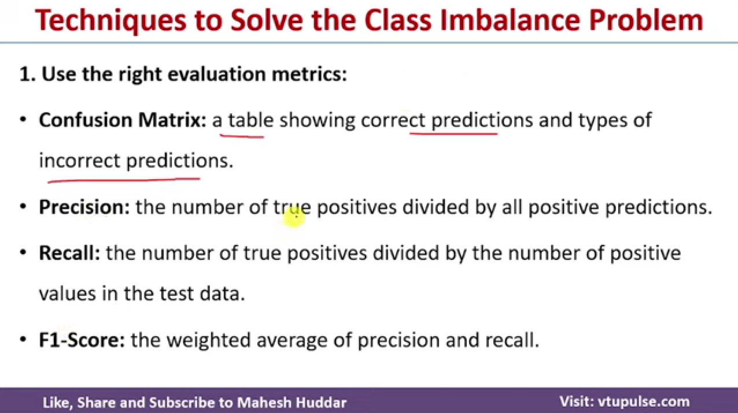
Rather than just focusing on accuracy % and hence biasing towards majority class use the following metrics

Slide 3
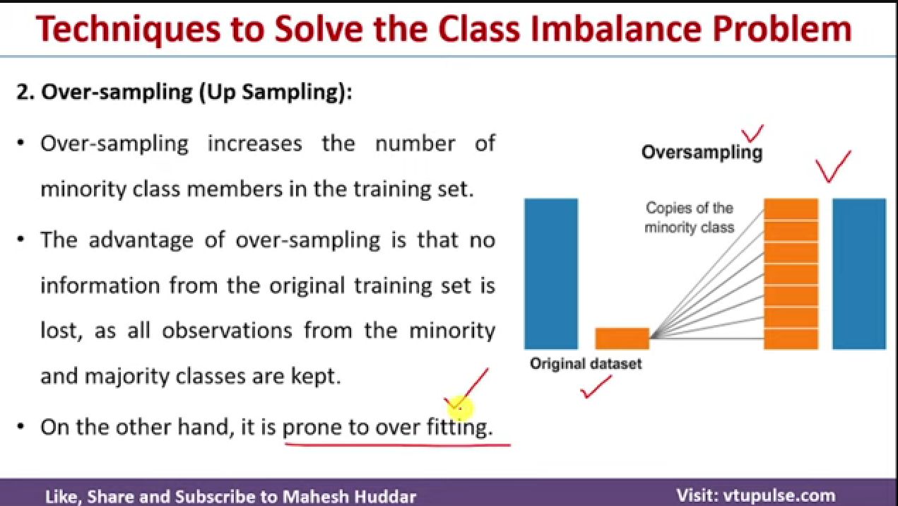

Slide 4
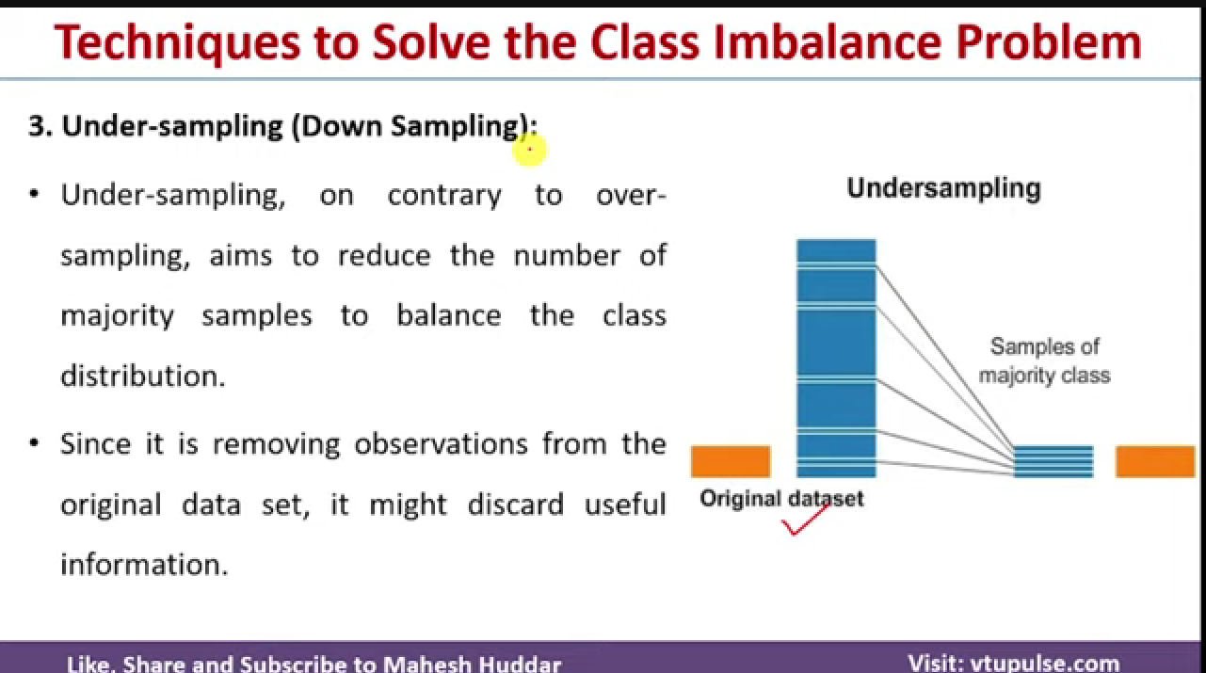

Slide 5
Subsampling
Ensembling Methods: Decision Trees
99.997%
not-phishing
calculate the “score” for each feature if we used it to split the data
pick the feature with the highest score, partition the data based on that data value and call recursively
50%
not-phishing
labeled data
50%
phishing
Pros:
Easy to implement
Training becomes much more efficient (smaller training set)
For some domains, can work very well
Cons:
Throwing away a lot of data/information
0.003%
phishing
Create a new training data set by:
including all k “positive” examples
randomly picking k “negative” examples

Slide 6
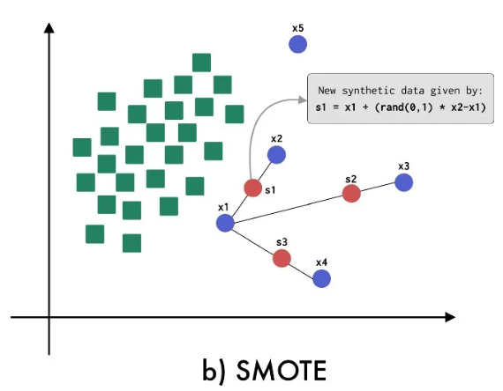
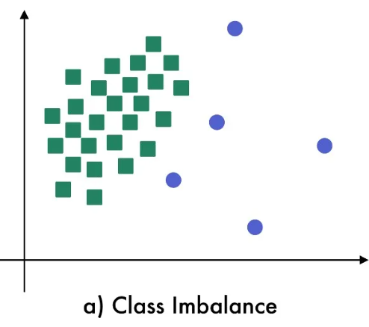
SMOTE stands for Synthetic Minority Oversampling Technique. It is an oversampling technique that is used to create synthetic data for minority classes. It smoothens the decision boundary which was previously overfitted.
A minority class is selected.
KNN is applied to the minority class.
Lines are drawn from one sample of the minority class to its K nearest neighbor.
Random values are selected at any point on those lines. These values are considered new data for the minority class.

Slide 7
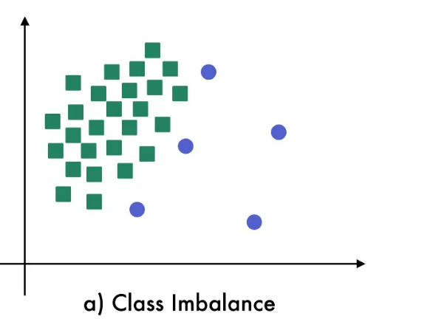
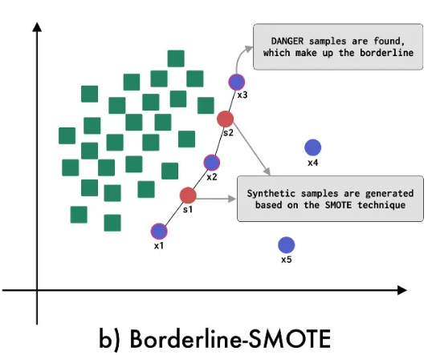
Borderline SMOTE
Synthetic data is generated only from the border separating minority class from other classes.

Slide 8
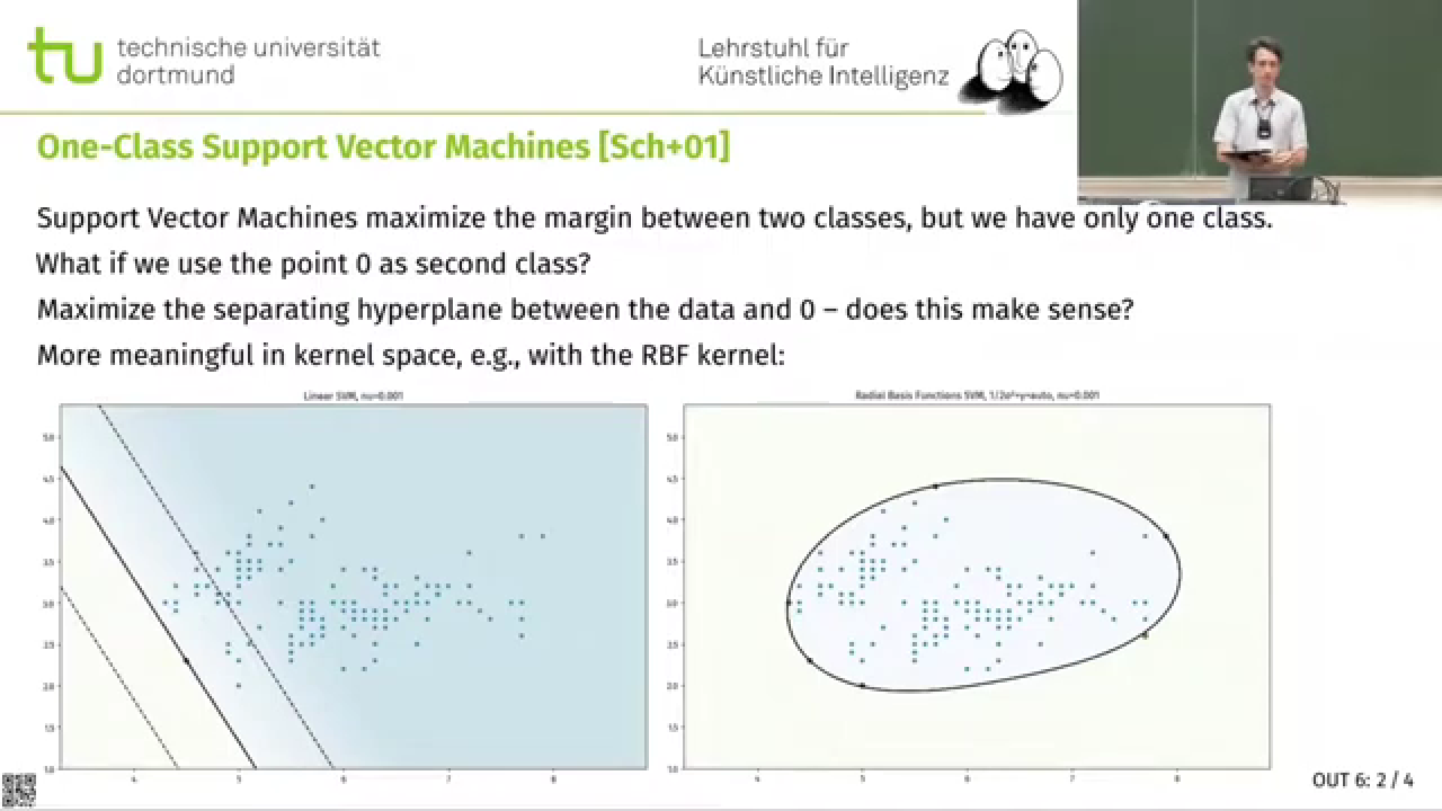

Slide 9
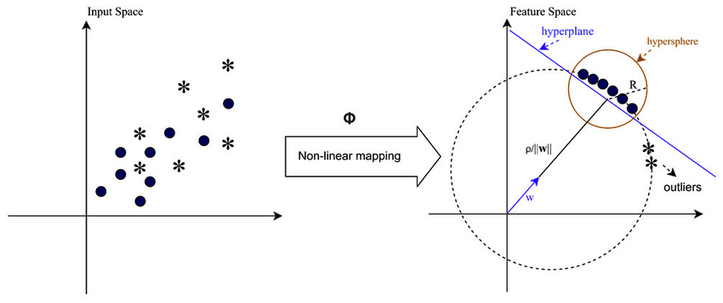
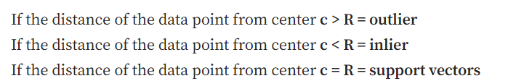
One class SVM
Aims to differentiate samples of one particular class by learning from single class samples during training
One-Class SVM is similar to traditional SVM but instead of using a hyperplane to separate two classes of instances, it uses a hypersphere to encompass all of the instances of the same class.
Steps in OCSVM:
Project all the data points to a higher dimensional space
Separate all the data points from the origin in the feature space using hyper-plane
Unlike traditional svm where we use soft margin for smoothness, we use a parameter that fixes fraction of outliers in the data
maximise the distance between the hyper-plane and the origin
The points lying below the hyper-plane and closer to origin are outliers

Slide 10
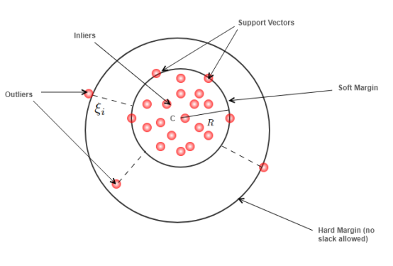
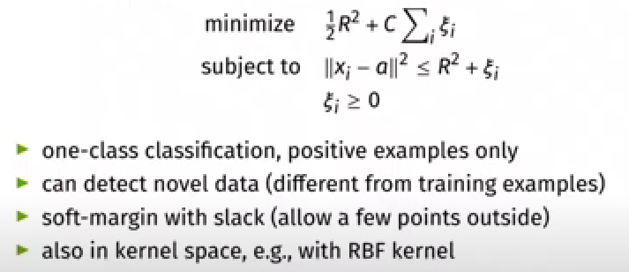
Minimize the radius, R, of the above hyper-sphere. Here we are considering soft margin, where some slackness is allowed.
Applications
Outlier Detection: Detecting outliers from training data is an essential step of cleaning data before training a Machine Learning Model
AD in Acoustic Signals: One of the major applications of AD is to detect anomalies in industrial machinery using the Acoustic Signals generated by parts of machinery.
Novelty Detection and many others.

