Slide 1
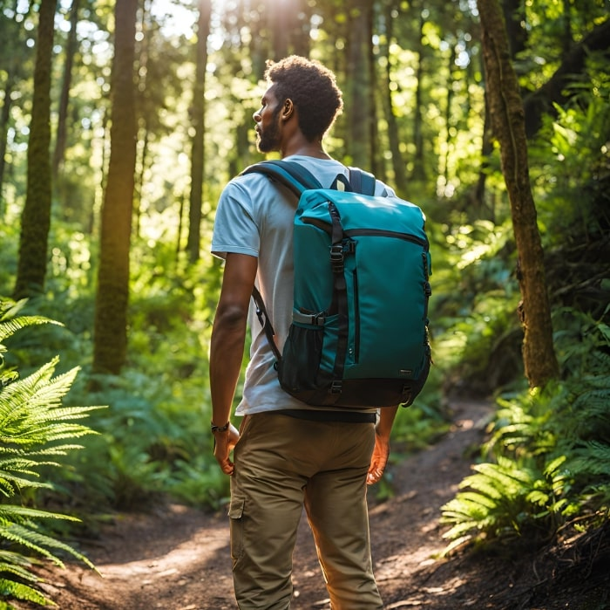
Investor Pitch for RevoPack
RevoPack: The Next Revolution in Backpacks
"Adjustable Size for Maximum Versatility"

Slide 2
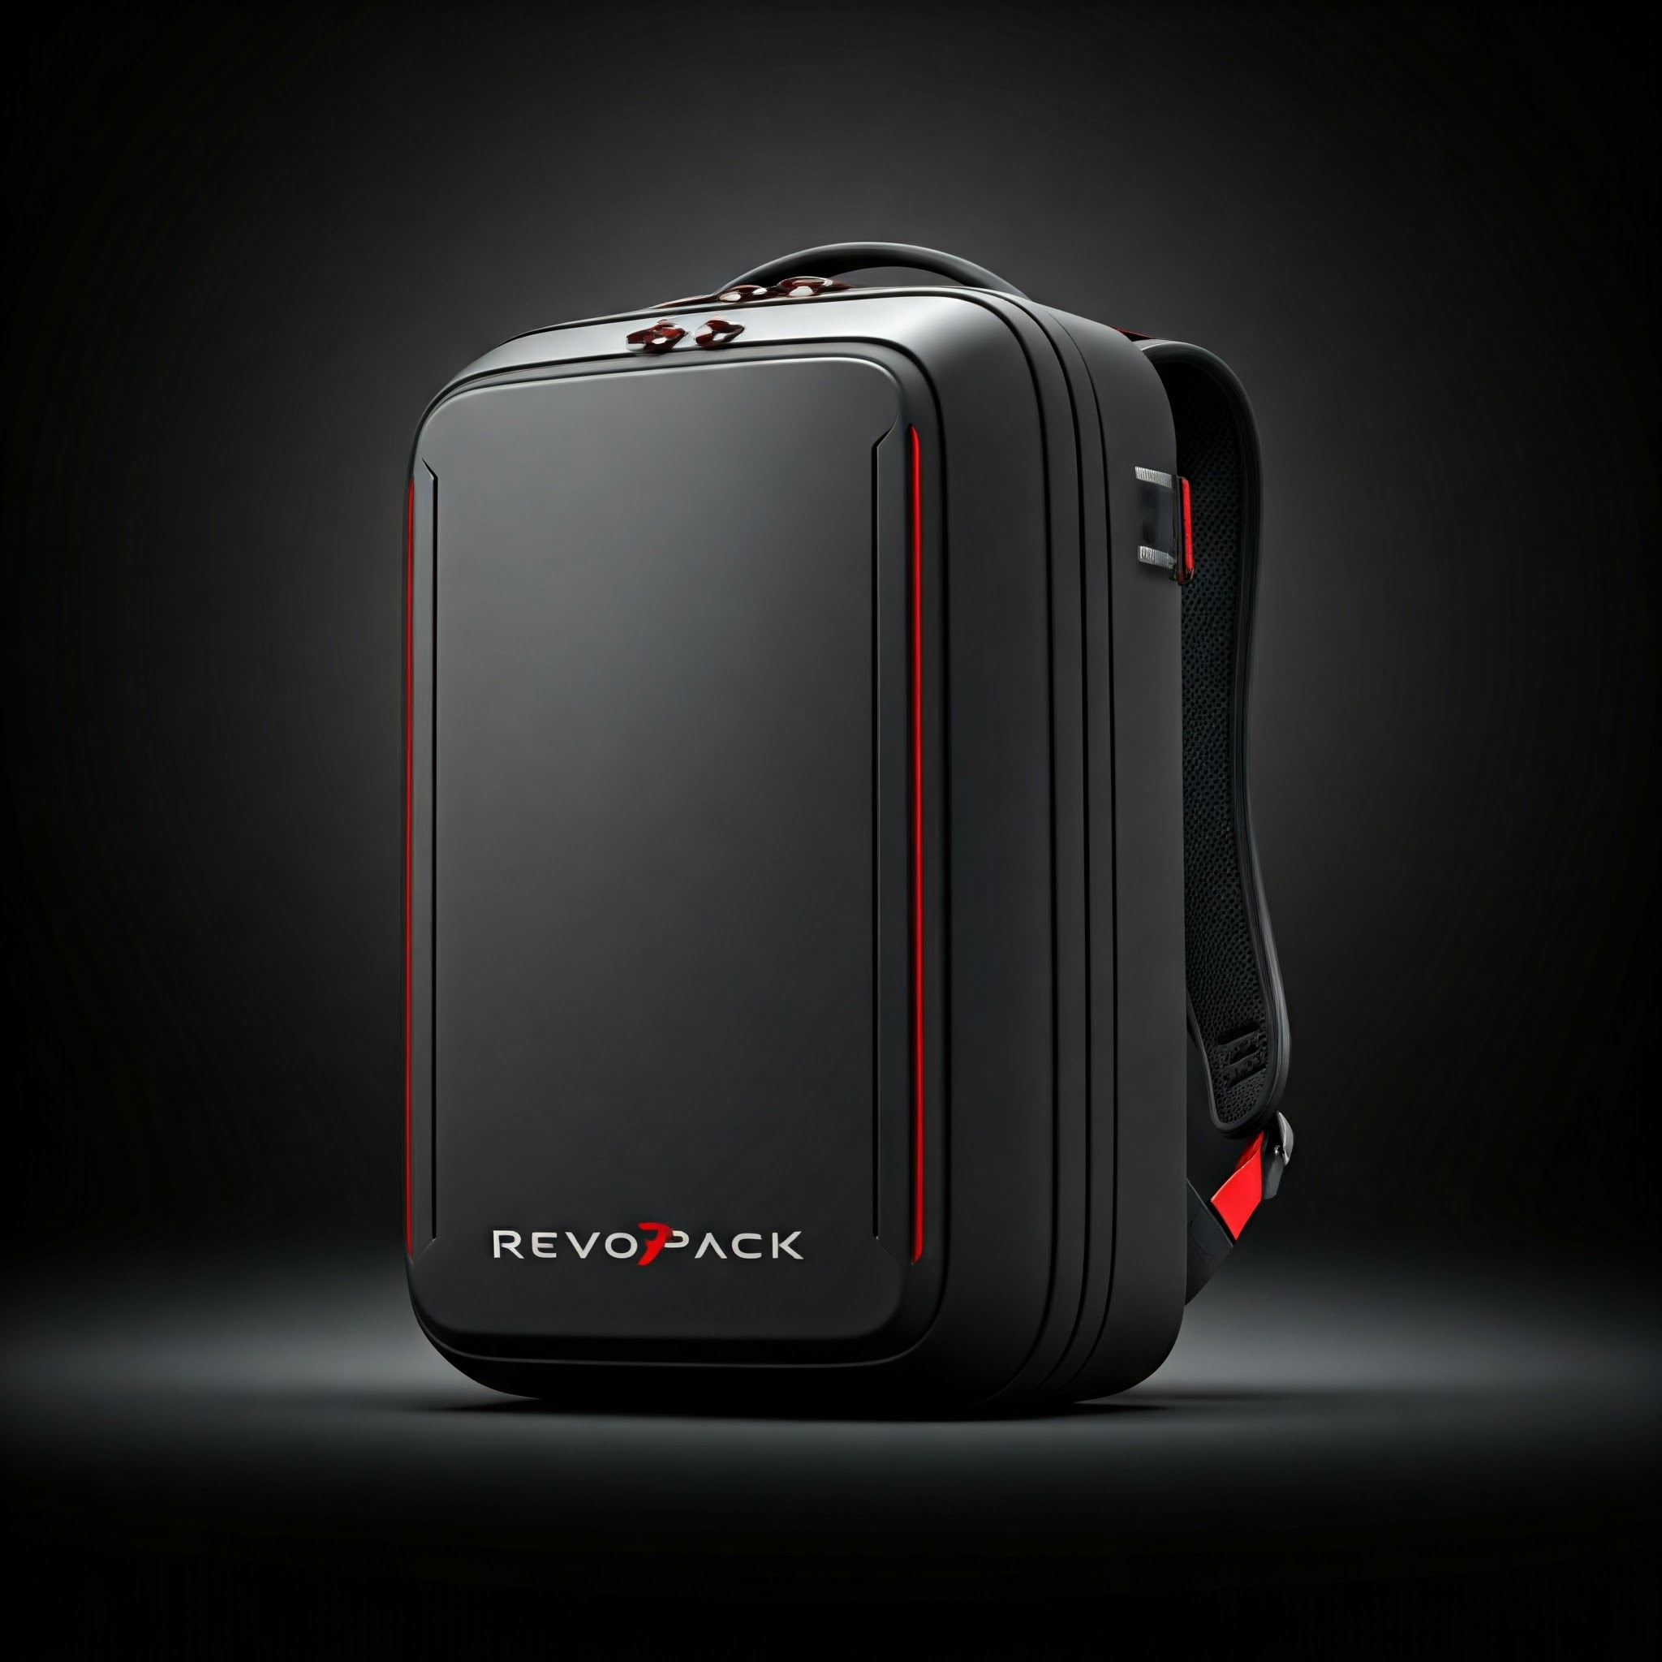
Introducing RevoPack
Welcome to the future of backpacks.
RevoPack is more than just a bag; it’s a revolutionary product designed to adapt to your dynamic lifestyle.
With its adjustable size feature, RevoPack is built to provide ultimate convenience, style, and sustainability.
Join us as we redefine what a backpack can be.

Slide 3
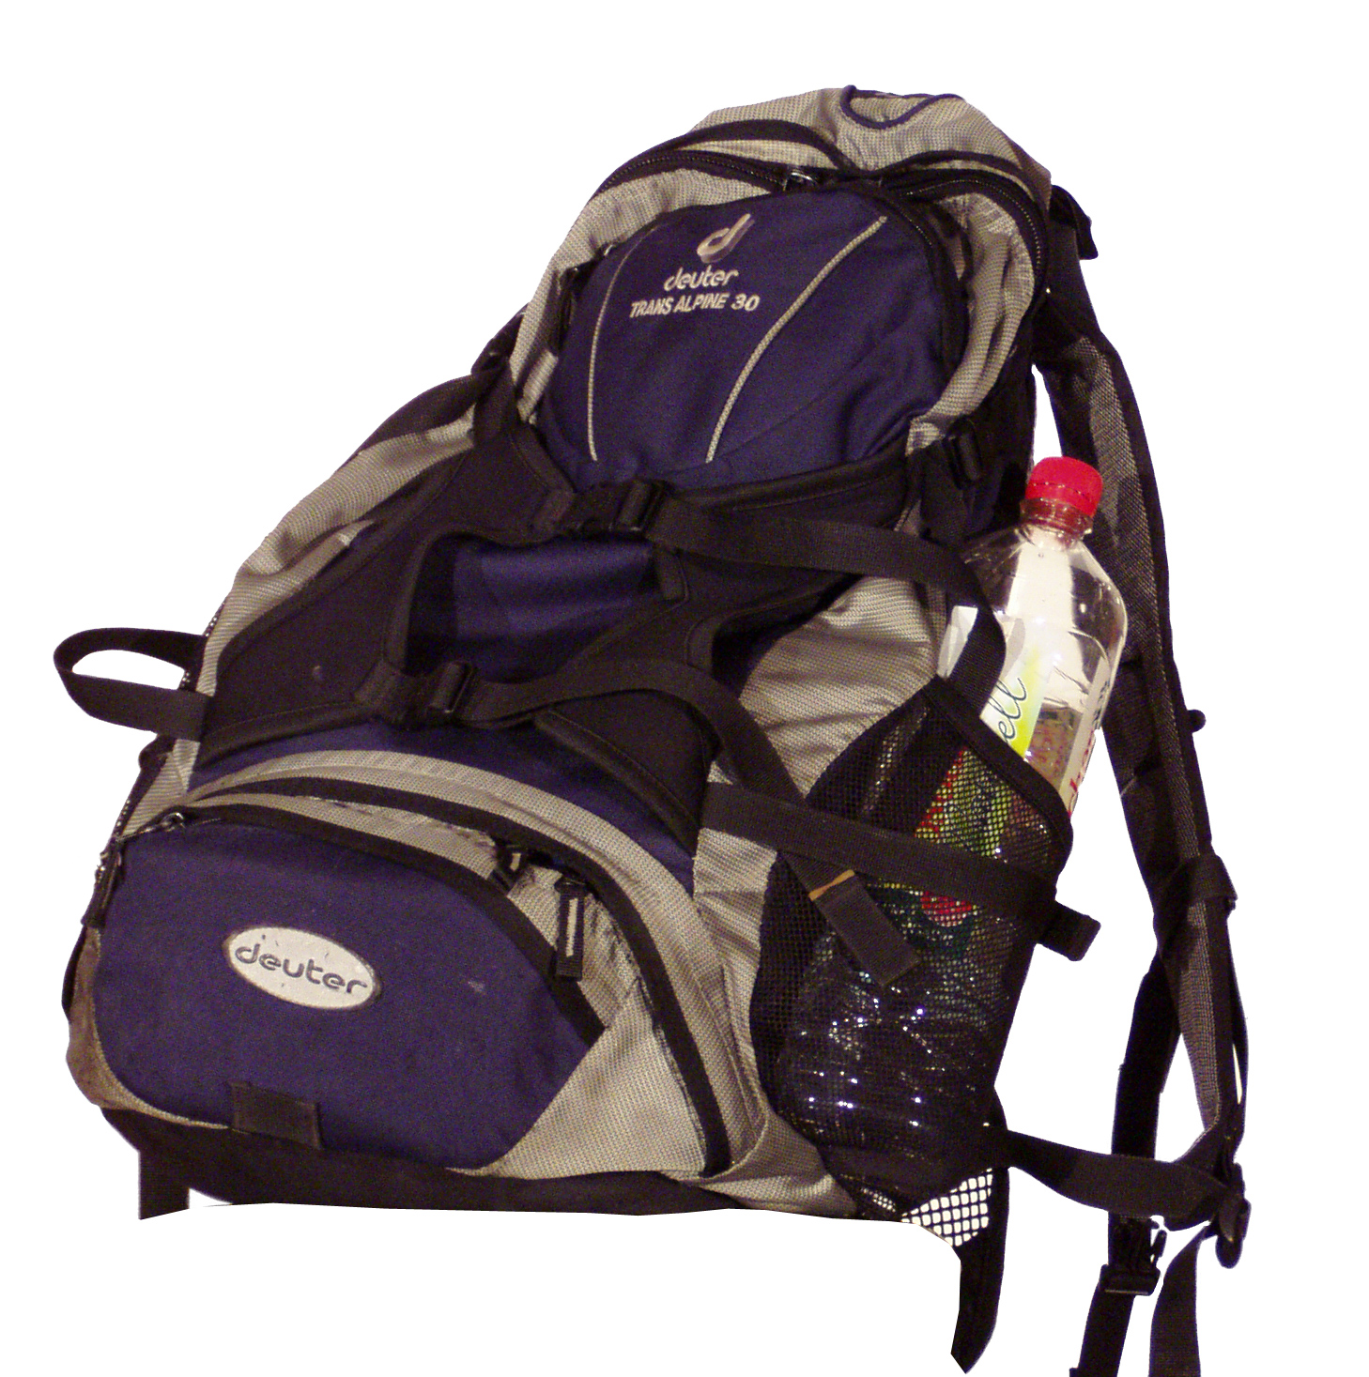
The Problem
Modern backpacks lack versatility in size, leading to inefficient use of space.
Consumers often need multiple backpacks for different purposes.
This results in unnecessary expense, inconvenience, and environmental waste.
This Photo by Unknown Author is licensed under CC BY-SA

Slide 4
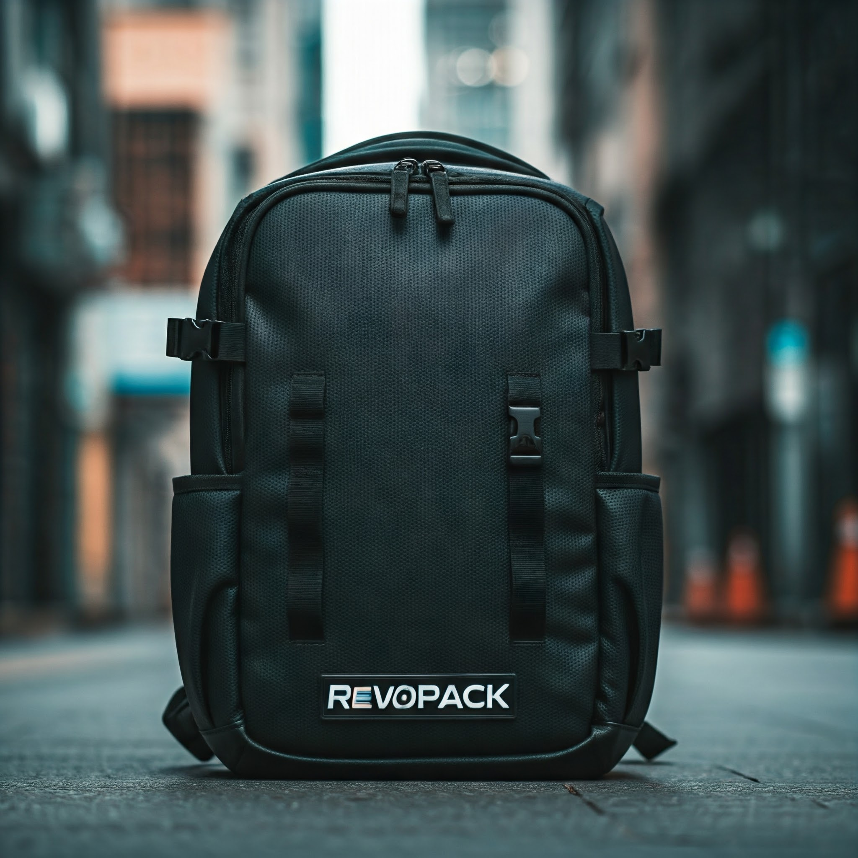
The Solution
RevoPack: One Backpack, Infinite Possibilities
Adjustable size feature that adapts to your needs.
Compact and lightweight for everyday use, expandable for travel or heavy-duty use.
Durable materials and modern design.

Slide 5
Market Opportunity
Growing demand for versatile and sustainable products.
Target audience: Students, professionals, travelers, and outdoor enthusiasts.
Emerging trends: Urbanization and remote work increasing demand for multi-functional bags.
Sustainability focus: Consumers are willing to pay a premium for eco-friendly products.
Large untapped markets in developing regions with rising disposable incomes.

Slide 6
Competitive Advantage
Unique adjustable size feature sets us apart.
Combination of style, comfort, and functionality unmatched in the market.
Affordable pricing without compromising quality.

Slide 7
Business Model
How We Make Money
Direct-to-consumer via our website.
Strategic partnerships with retailers and online platforms.
Revenue streams: Product sales, accessories, and subscription for premium features.

Slide 8
Market Strategy
Launching RevoPack
Phase 1: Pre-launch campaign on social media and crowdfunding platforms.
Phase 2: Product launch with online and offline marketing.
Phase 3: Expand distribution through retail partnerships.

Slide 9
Financial Projections
Projected Growth
Year 1: Revenue of ₹5 crore with 20% profit margin.
Year 2: Revenue of ₹8 crore with steady growth.
Year 3: Break-even achieved and profitability increases to ₹12 crore.

Slide 10
Funding Requirements
What We Need?
Total funding required: ₹2 crore.
Funds will be used for:
Manufacturing: ₹80 lakh
Marketing: ₹60 lakh
Research & Development: ₹40 lakh
Operations: ₹20 lakh

Slide 11
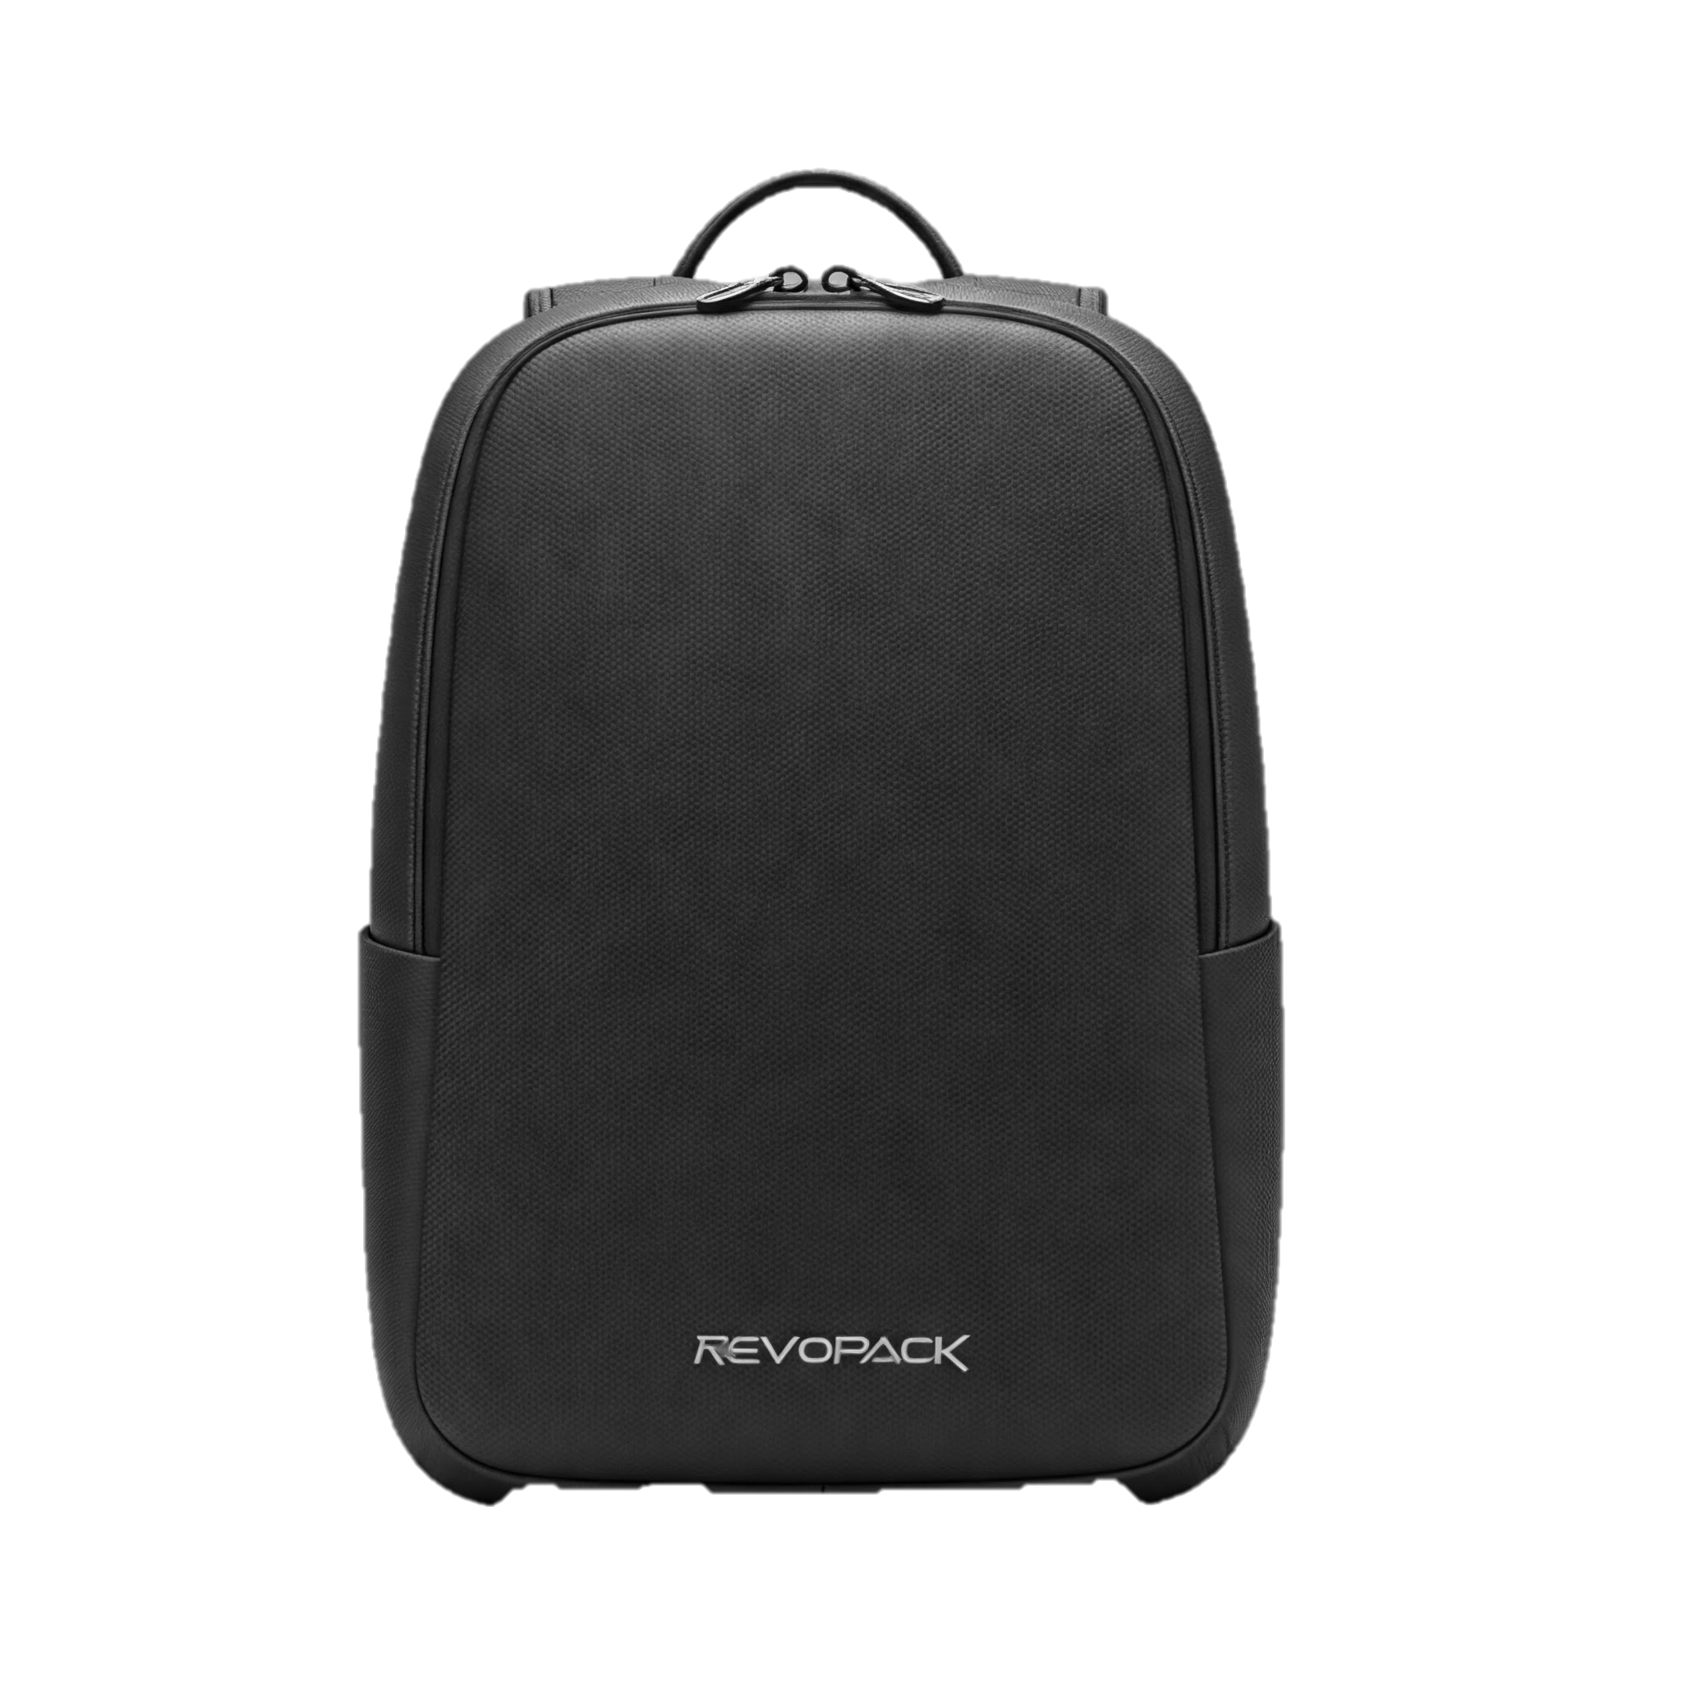
Call to Action
Join Us in Revolutionizing Backpacks
Be part of this game-changing journey.
Invest in RevoPack and make an impact.
Contact us: [revopack@gmail.com] | [+91xxxxxxxxx] | [www.RevoPack.com]

Slide 12
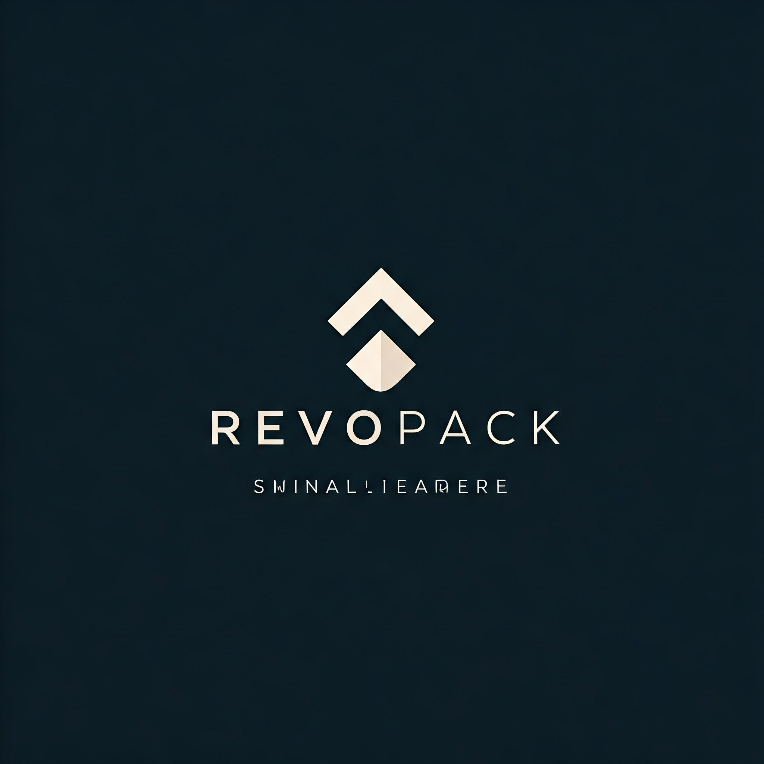
"Thank You!“
Questions? We’re here to answer.
Let’s create something extraordinary together.

